Slide 1
The sun’s effect on climate Lesson 2A
Why Are Places Closer to Earth’s Equator Hotter than Places Farther Away from the Equator?

Slide 2
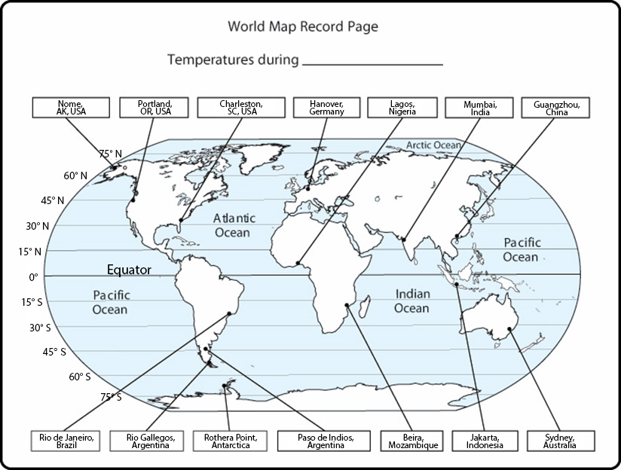
Review: Temperature Patterns
What have we learned so far about temperature patterns from our maps and data?

Slide 3
Review: Key Science Ideas
Temperature patterns on Earth vary according to latitude and time of year.
Temperatures are generally warmer closer to the equator, at lower latitudes, and cooler toward the poles, at higher latitudes.
Temperatures aren’t the same in January or July in the Northern and Southern Hemispheres.

Slide 4
Lesson Focus Question
Why are places closer to Earth’s equator hotter than places farther away from the equator?

Slide 5
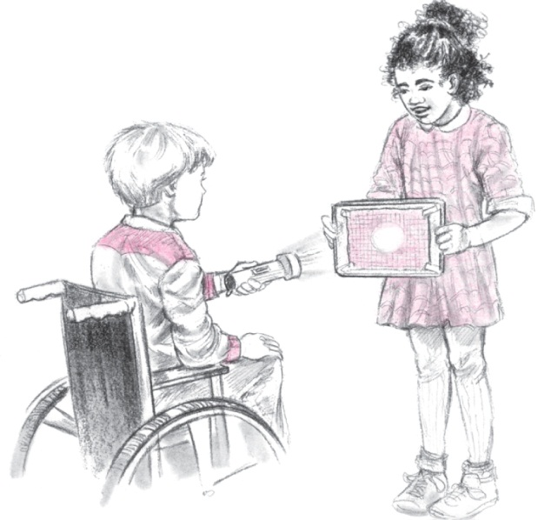
Investigating Angles of Light Energy
Today we’ll investigate what happens when sunlight strikes Earth’s surface at different angles.
For this activity, we’ll use trays, flashlights, and graph paper.

Slide 6
Your Predictions
What do you predict will happen when you shine a flashlight directly at the tray?
If you tilt the tray, do you think the image that the light projects on the graph paper will change in any way?
Sentence starter: I predict the image on the graph paper [will/won’t] change because _____________.

Slide 7
Angles of Light Energy
Follow the directions for part 1 on handout 2.1 (Angles of Light Energy). Then discuss the questions at the end of that part.
Follow the directions for part 2, making sure to count the number of squares on each graph-paper cutout.
Question to think about: Does the data give you any ideas about whether the amount of energy from a light source is different when it strikes a surface at an angle?

Slide 8
Angles of Light Energy
On the class data chart, record the number of lighted squares you counted on each cutout.
Number of Lighted Squares
Light Hits the Tray Straight On | Light Hits the Tray at an Angle
Notes:
This two-column chart—Number of Lighted Squares—should be prepared ahead of time. (See the overview page in the lesson plan.) You might also have students tape their cutouts to the chart to create a visual image that complements the numerical data.

Slide 9
Your Observations
When you held the tray in the two positions, did the amount of light energy coming from the flashlight change or stay the same?
Turn and Talk: Did something else about the light energy change when the tray was tilted? If so, what?
Make sure to include evidence from our data chart in your response.

Slide 10
Imagine This!
You’re standing on your graph-paper cutouts with sunlight shining on them. The sunlight is hitting the small circle straight on, and it’s hitting the large circle at an angle.
Do you think you’d feel hotter standing on the small circle or the large circle? Why?
Which circle wouldn’t feel as hot to stand on? Why?
Do you think light energy is more concentrated when it shines directly on a surface or at an angle? What is your evidence?

Slide 11
Today’s Focus Question
Why are places closer to Earth’s equator hotter than places farther away from the equator?
Let’s gather more information to help us answer this question!

Slide 12
Angles of Light Energy: A New Model
This time we’ll use a model with a flashlight representing the Sun and an inflatable globe representing Earth.
What do you predict will happen when you shine the flashlight on the globe?
Where do you think the light will shine more directly (more straight on)?
Where will the light shine less directly (at a less direct angle)?

Slide 13
Your Observations
What did you observe when you shined the flashlight on different parts of the globe?
What images did the light project on the surface of the globe?
Where was the light more concentrated?
Where was the light more spread out?

Slide 14
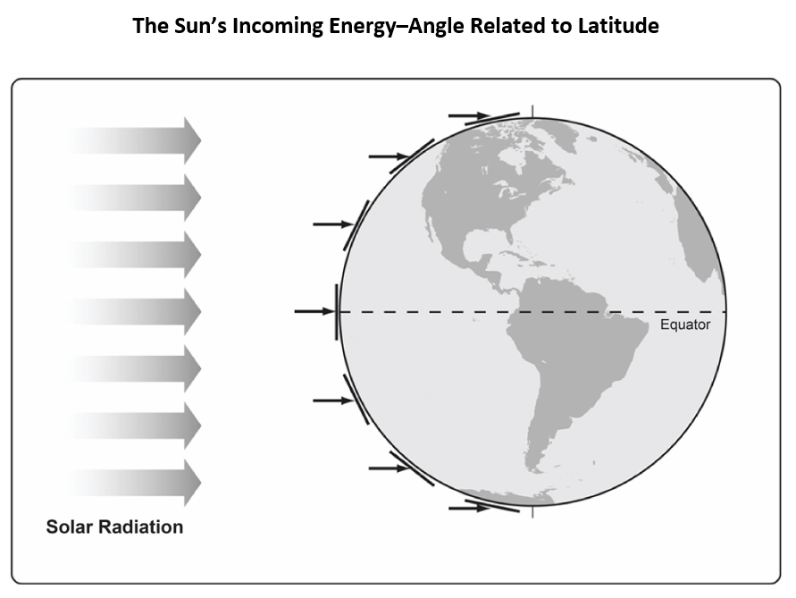
Another Model of Solar Radiation
What do you notice about the angle at which the Sun’s energy (solar radiation) strikes Earth?

Slide 15
Let’s Summarize!
Key science idea: Because Earth is a sphere, sunlight strikes the curved surface more directly at the equator and less directly above and below the equator.
How does our tray-and-flashlight model illustrate this idea? Hint: Think about concentrated light energy and angles.

Slide 16
Lesson Focus Question
Why are places closer to Earth's equator hotter than places farther away from the equator?
Write a possible answer to our focus question in your science notebook. Include evidence from today’s investigations in your response.
Hint: Think about the angle of sunlight!

Slide 17
Next Time
Today we learned one reason why it’s hotter near the equator than it is farther away.
Closer to the equator, sunlight hits Earth more directly, so the light energy (solar radiation) is more concentrated and intense.
Closer to the poles, sunlight hits Earth at a less direct angle, so the solar radiation is more spread out or less intense.
Tomorrow we’ll use another content representation to gather more information.

