Slide 1
The sun’s effect on climate Lesson 5a
Why Do Some Places at the Same Latitude Have Different Temperature Patterns?

Slide 2
Our Unit Central Question
Why are some places on Earth hotter than others at different times of the year?
Think about science ideas from past lessons that help explain temperature differences around the world at different times of the year.
In your small groups, discuss the best ideas you’ve come up with so far for answering this question. Be ready to share your ideas and evidence with the class.

Slide 3
Lesson Focus Question
Why do some places at the same latitude have different temperature patterns?

Slide 4
Latitude and Temperature Patterns
What are some other factors that might explain why some places at the same latitude have different temperature patterns?
Talk about this question in your small group and write down your ideas in your science notebook. Be prepared to share with the class.

Slide 5
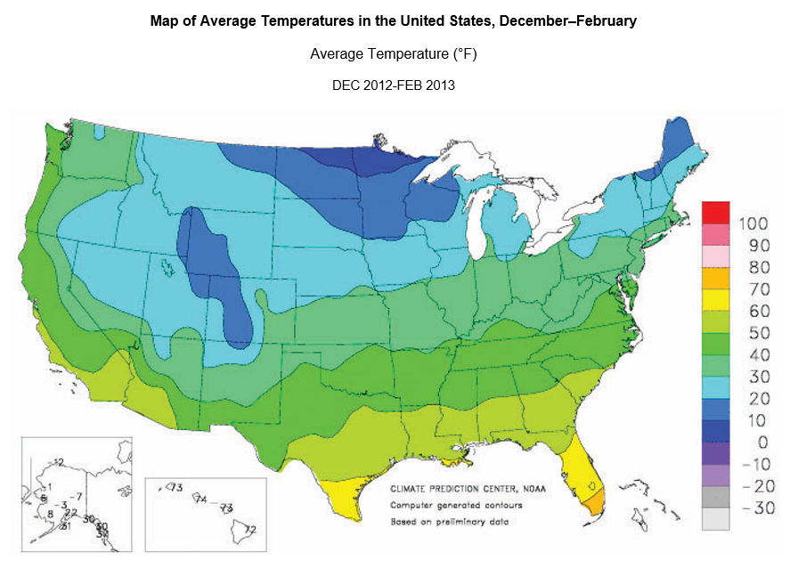
Identifying Different Temperature Patterns at the Same Latitude

Slide 6
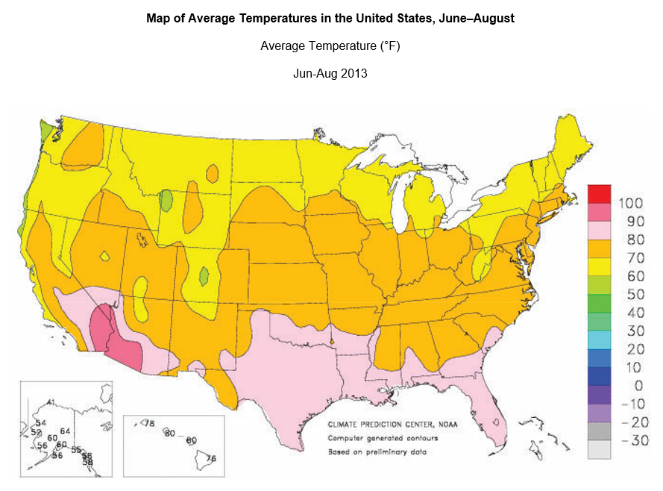
Identifying Different Temperature Patterns at the Same Latitude

Slide 7
Identifying Different Temperature Patterns at the Same Latitude
Work with a partner to identify areas on each map where temperature patterns might be different from other areas at the same latitude.
Do these different patterns show up in both the winter and the summer?
Record these locations in your science notebook and be prepared to explain your decision.

Slide 8
Investigating Temperature Patterns
Following the directions on handout 5.2, create a line graph using data from the data table. (See page 2 of the handout for detailed instructions on making a line graph.)
Discuss the handout questions in your group:
What temperature patterns do you notice?
What similarities and differences do you observe when you compare the temperatures of these cities?

Slide 9
Investigating Temperature Patterns
What temperature patterns did your group observe in the line-graph data for the three cities?

Slide 10
Let’s Summarize!
Today’s focus question: Why do some places at the same latitude have different temperature patterns?
Think about the temperature patterns we identified in the line-graph data and write a possible answer to this question in your science notebook.

Slide 11
Next Time
Today we learned that some places at the same latitude can have different temperature patterns. But why?
In the next lesson, we’ll use a new content representation to help us figure this out.

