Slide 1
The sun’s effect on climate Lesson 5b
Why Do Some Places at the Same Latitude Have Different Temperature Patterns?

Slide 2
Last Time
In the last lesson, we investigated temperature patterns for three cities at the same latitude.
Then based on your line-graph data, you proposed an answer to the focus question, Why do some places at the same latitude have different temperature patterns?
What ideas did you come up with? Make sure to include observations and evidence from your line graphs (handout 5.2).

Slide 3
Lesson Focus Question
Today we’ll continue investigating the focus question from last time: Why do some places at the same latitude have different temperature patterns?

Slide 4
Review: Temperature Data for Three Cities
Examine your line-graph data and the temperature patterns you observed and recorded for the three cities on handout 5.2.
What temperature patterns would you expect to see in all three cities since they’re located at about the same latitude? Why?

Slide 5
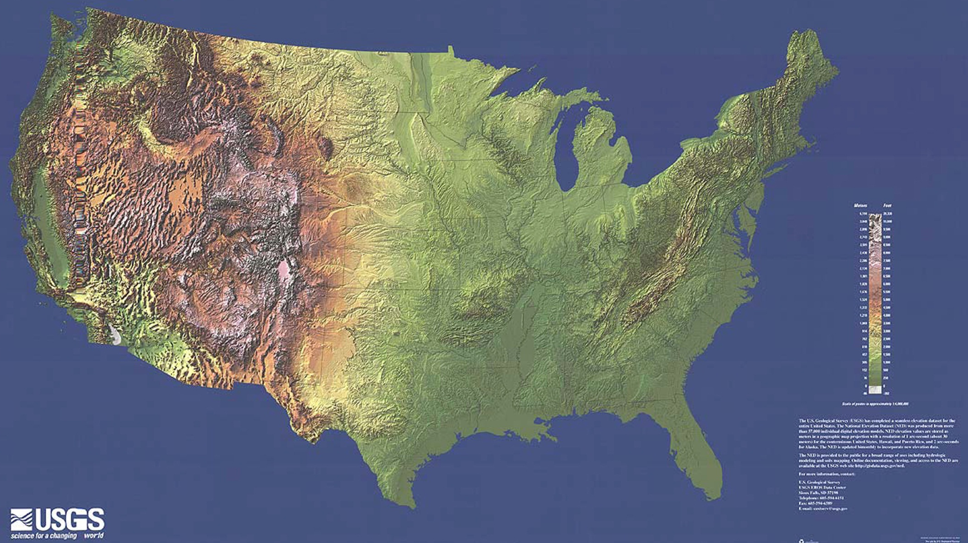
A Physical Map of the United States

Slide 6
Investigating Differences in Temperature Patterns
What do you observe about the location of each city on the map?
What geographical or physical features do you notice that might account for the different temperature patterns of these cities?

Slide 7
Investigating Differences in Temperature Patterns
Here’s what we’ve observed so far:
San Francisco is close to the Pacific Ocean.
Colorado Springs is near the Rocky Mountains.
St. Louis is in the center of the United States and isn’t near the mountains or an ocean.
How do you think the location of each city might influence temperature patterns?

Slide 8
Key Science Ideas
Not all places at the same latitude have the same average temperatures.
Latitude, while important, isn’t the only factor that determines the temperatures at a specific location on Earth.
Other factors that influence climate and temperature patterns are elevation (how high a location is above sea level) and being near a large body of water like an ocean.

Slide 9
Key Science Ideas
These science ideas help explain different temperature patterns around the world:
Earth’s tilt and the angle of sunlight cause solar radiation to hit certain places more directly and other places less directly.
Latitudes closer to the poles generally have cooler temperatures than latitudes closer to the equator.
As Earth orbits the Sun, the most direct angles of sunlight reach different parts of Earth at different times of the year. This causes opposite seasons in the Northern and Southern Hemispheres.

Slide 10
Today’s Focus Question
Why do some places at the same latitude have different temperature patterns?
Discuss this question in your small group. Then write your best answer in your science notebook.
Be ready to share your ideas with the class.

Slide 11
Let’s Summarize!
Our unit central question: Why are some places on Earth hotter than others at different times of the year?
Discuss this question in your small group and come up with your best answer.
In your response, include key science ideas from all of the lessons.
Be prepared to share your group’s answer with the class.

Slide 12
Next Time
How do oceans or other large bodies of water affect temperatures in nearby locations?
We’ll explore this next time!

