Slide 1




RESPeCT PD pROGRAM
Day 1
RESPeCT Summer Institute
Notes:
5 min
a. Greet participants as they enter the room.
b. Help them find their notebooks and table tents.

Slide 2
Before We Dig In: Essentials
On-time session starts and endings
Sign-in sheets
Restrooms
Sustenance (lunch and snack breaks)
Questions or special needs?
Notes:
20 min for slides 2–14 presentation (averaging approximately 1 min per slide)
a. Give everyone a big welcome to the RESPeCT PD program!
b. Fill participants in on the essential details listed on the slide.

Slide 3
What Is RESPeCT?
Reinvigorating Elementary Science through a Partnership with California Teachers
A partnership built for long-term success!
A professional development program
A leadership development program
A research study
Notes:
Approximately 1 min
a. Emphasize: The RESPeCT project began with three main components:
A professional development program
A leadership development program
A research study
b. The district now sustains RESPeCT as a professional development program.

Slide 4

The RESPeCT Partnership
PUSD
CPP
PUSD:
Pomona Unified School District
CPP:
California State Polytechnic University, Pomona
Photo courtesy of Pixabay.com
BSCS
BSCS:
Biological Sciences Curriculum Study
Notes:
Approximately 1 min
a. The original RESPeCT partners included the following:
Cal Poly: science, science education, and mathematics faculty, as well as the Center for Excellence in Mathematics and Science Teaching (CEMaST)
PUSD: district central administrators, principals, teacher specialists, and teachers
BSCS: an additional partner located in Colorado that provides expertise on science curriculum development, science teacher professional development, and research on science teaching and learning.
Note: Established in 1958, BSCS stands for Biological Sciences Curriculum Study, but the organization now deals with all sciences, not just biology.
Students: Emphasize that students are at the center of this partnership. Their learning is what the project is all about.

Slide 5
The RESPeCT PD Program
  Builds on the successful Science Teachers Learning from Lesson Analysis (STeLLA) program
  Has a significant impact on student learning as demonstrated in two rigorous studies
  Teaches videocase-based lesson analysis
  Facilitates science-content deepening
Notes:
Approximately 1 min
a. Let participants know they’ll be learning more about the RESPeCT PD program and STeLLA teaching strategies as they experience firsthand what it means to perform videocase-based lesson analysis.

Slide 6
The RESPeCT PD Program
Extends the STeLLA approach by
  Addressing grade-level standards in Next Generation Science Standards (NGSS)
  Incorporating Common Core English language arts (ELA) and math standards
  Addressing more explicitly the needs of English language learners (ELLs)
  Addressing all grade levels, K–6
Notes:
Approximately 1 min
a. Read the information on the slide.
b. Emphasize the importance of these additions to the STeLLA approach. By integrating Common Core English language arts (ELA) and math standards into the science curriculum, the RESPeCT PD program enables teachers to invest more time in teaching science. The teaching strategies developed in the RESPeCT PD program are also valuable tools in other subject areas.

Slide 7
Goals of the RESPeCT PD Program
Deepen teachers’ science-content knowledge and knowledge of effective science teaching.
Develop teachers’ analytical skills to improve lesson-plan development and the teaching of science.
Support teachers in the practical use of new knowledge and analytical skills in their classrooms.
Improve students’ science learning.
Achieve sustainability by eventually reaching all
K–6 teachers.
Notes:
Approximately 1 min
a. The bottom line: improving students’ science learning—a goal that has been reached in two previous research studies of this approach.

Slide 8
Summer Institute Study-Group Leaders
Grade [Insert grade level here]
[Insert leader names here]
[Insert leader names here]
Notes:
Approximately 1 min
a. Modify this slide to include the grade level of your study group and the names of the Teacher Leaders who will be facilitating the study-group sessions.
b. Formally introduce yourselves to the group.

Slide 9

The Key
Each of us is key to the success of the
RESPeCT PD program!
Notes:
Approximately 1 min
a. Many people are involved in organizing, planning, and leading this program, but the teacher-participants are the key to its success.

Slide 10
Summer Institute Schedule
Notes:
Note: This is a transition slide.

Slide 11
Summer Institute: A Typical Daily Schedule
8:00 Getting started
8:30 Video-based lesson analysis
10:00 BREAK
10:10 Lesson analysis continued
12:00 LUNCH
12:45 Content deepening
2:00 BREAK
2:10 Content deepening continued
3:00 Wrap-up: homework, summary, reflections
3:30 Adjourn
Notes:
Approximately 1 min
a. A typical daily schedule includes the following:
Time spent on videocase lesson analysis
Time focused on content deepening
Short homework assignments
A morning and an afternoon break, with a 45-minute lunch break

Slide 12
Summer Institute at a Glance
Week 1: Content Area 1 (Genetics)
  Student Thinking Lens—strategies to make student thinking visible
  Analysis of video teaching in content area 1
  Analysis of lesson plans to be taught second semester
  Content deepening in content area 1
Week 2: Content Area 2 (The Sun’s Effect on Climate)
  Science Content Storyline Lens—strategies to create coherence
  Analysis of video teaching in content area 2
  Analysis of lesson plans to be taught in the fall
  Content deepening in content area 2
Notes:
Approximately 1 min
a. During the Summer Institute, each grade level will focus on two content areas, with one week devoted to each area. Participants will deepen their science-content knowledge, study lesson plans in each content area, and analyze videocases of teachers presenting this content.

Slide 13
School-Year Schedule
Fall [Insert year here]
Teach the first lesson set.
Meet three times as a study group (4 hours each).
Meet an additional time to review the second lesson-set plans (2 hours).
Winter/Spring [Insert year here]
Teach the second lesson set.
Meet three times as a study group (4 hours each).
Note: The study group will determine meeting dates and times.
Notes:
Approximately 1 min
a. “The Summer Institute is just the beginning! During the school year, you’ll continue meeting with your grade-level study group.”

Slide 14
Your RESPeCT PD Program Materials
Your science notebook
STeLLA strategies booklet
RESPeCT PD program binder
RESPeCT lesson plans binder
Materials kit (1 per topic)
Notes:
Approximately 1 min
a. Transition slide: “In a moment we’ll break up into grade-level study groups and dig into the RESPeCT PD program! But first let’s review this list of materials you’ll receive in your designated meeting rooms.”

Slide 15
Transition to Grade-Level Study Groups
Any questions before we break up into our grade-level study groups?
Notes:
5 min
a. “Any questions before we head to our grade-level study groups?”
b. Send-off: “Have a great day and be sure to let us know if there is anything we can do to support you in getting the most out of this experience!”

Slide 16
Notebook Setup
Write your name on the front cover of the notebook.
Leave two or three pages for the table of contents. (You’ll add to the TOC each day throughout the program.)
Number your pages. (Front and back pages should be numbered separately.)
Use sticky tabs to divide your notebook into two main sections: Lesson Analysis and Content Deepening. (Each section will comprise about half the notebook.)
Keep a chronological record of your activity in each section. Add a title for each entry and enter in your TOC to easily locate.
Customize and decorate your notebook any way you wish.
Notes:
8 min
a. Welcome participants to the study group and introduce yourself as they arrive.
b. Help participants find their table tents and materials so they can get settled.
c. Direct them to the instructions for setting up their notebooks (Setting Up Your Summer Institute Notebook in the pretabs section of their PD program binders) and get them started working on this task. Interact informally with them and allow them to chitchat as they work.

Slide 17
Getting Started: Introductions
Quick-write exercise:
  Describe your experience learning science in school.
  What do you hope to learn through RESPeCT in the coming year?
Share your responses with a partner.
Introduce each other to the group.
Notes:
15 min
a. Individuals (3 min): Have participants write their responses to the questions on the slide in their notebooks. Emphasize that this is an independent writing exercise.
b. Pairs (3 min): Have participants pair up and share their responses to the questions. Encourage them to learn other things about their partners as well (e.g., school, years of teaching, favorite subjects to teach, hobbies).
Note: If the group has an odd number of participants, pair up with one of them.
c. Whole group (9 min): Have each participant introduce her or his partner, highlighting what that partner hopes to learn from the RESPeCT PD program. Model the first pair of introductions to demonstrate that they should be brief.
Note: If you weren’t able to pair up with someone, simply introduce yourself.
Monitor the time: Introductions should be longer than a sentence, but not the length of a full essay!

Slide 18
RESPeCT PD Program Goals
Business-as-Usual PD
Not closely linked to day-to-day classroom teaching
Rarely see other teachers practice
Learning about content separate from learning about teaching
RESPeCT PD Program
Learn science content in the context of analyzing teaching and student learning.
Engage with one another
in a collaborative analysis of content-specific videocases
of other teachers.
Learn science content in the context of analyzing teaching and student learning.
Notes:
2 min
a. Talk through this slide, emphasizing how RESPeCT PD is different from many other professional development opportunities.

Slide 19
RESPeCT PD Program Goals: Lesson Analysis PD
Business-as-Usual PD
Focus on what to do tomorrow and “cool” activities
Development not sustained over time
Effectiveness measured in terms of teachers’ enjoyment
RESPeCT Lesson Analysis PD
Learn how to select and carry out science activities based on analysis of science content and student thinking and learning.
Be supported in using new teaching knowledge throughout the year.
Measure effectiveness in terms of teacher and student learning.
Notes:
1 min
a. Highlight the goals of RESPeCT lesson analysis PD and how it differs from other professional development opportunities.

Slide 20
Norms for Working Together: The Basics
Purpose: Build trust and develop a productive study group for all participants.
The Basics
Arrive prepared and on time; stay for the duration; return from breaks on time.
Remain attentive, thoughtful, and respectful; engage and be present.
Eliminate interruptions (turn off cell phones, email, and other electronic devices; avoid sidebar conversations).
Make room for everyone to participate (monitor your floor time).
Notes:
3 min
a. “To do this kind of work together, we need to develop a strong study group where everyone feels safe sharing their ideas, questions, confusion, successes, and stumbles. Having a set of agreed-upon norms will help us build such a learning community.”
b. Read over these basic norms.
c. “What do you think? Are there any changes or additions you’d like to suggest?”

Slide 21
Norms for Working Together: The Heart
Purpose: Build trust and develop a productive study group for all participants.
The Heart of RESPeCT Lesson Analysis and Content
Deepening
Keep the goal in mind: analysis of teaching to improve student learning.
Share your ideas, uncertainties, confusion, disagreements, questions, and good humor. All points of view are welcome.
Expect and ask questions to deepen everyone’s learning; be constructively challenging.
Listen carefully; seek to understand other participants’ points of view.
Notes:
5 min
a. “This set of norms moves beyond the basics and targets the heart of RESPeCT PD program goals.”
b. Read the list.
c. “Is anything unclear? Do you have any changes or additions you’d like to suggest? Do you have any concerns about these norms?”
d. Direct participants to handout 1.1 (Norms for Working Together) and pass out the half-page copy of the norms for them to paste on the inside front cover of their notebooks.
e. Ask participants if they’re willing to live with these norms today; then tell them they’ll have an opportunity to revise them tomorrow.

Slide 22
Agenda for Day 1
Focus questions and ideas about effective science teaching
The case for the Science Content Storyline Lens (SCSL)
The case for the Student Thinking Lens (STL)
Content deepening: genetics
Lunch
Content deepening (continued)
STL strategies: elicit, probe, and challenge questions
Summary, homework, and reflections
Notes:
Less than 1 min
a. Talk through the agenda for the day.

Slide 23
Today’s Focus Questions
Lesson Analysis
Content Deepening
What are the STeLLA lenses and teaching strategies, and what is the evidence that they will make a difference in your science teaching?
How can we represent trait-variation patterns among individuals of a species?
What are some of the causes of trait variation and inheritance patterns?
Notes:
1 min
a. “Each day we’re going to have at least one lesson analysis focus question and one content deepening focus question. These are today’s focus questions.”
b. Read the focus questions on the slide.

Slide 24
Ideas about Effective Science Teaching
What is your image of effective science teaching?
  What does it look like in action?
  What are key features of good science teaching?
Notes:
15 min
a. “Before we explore these questions, let’s create a list of ideas about effective science teaching.”
b. Individuals (3 min): “Take a few minutes to think and write about the questions on the slide.”
c. Whole group (10 min): Go around the group (round-robin) asking everyone to contribute an idea. Write the ideas on a chart paper and title the chart “Effective Science Teaching.”
d. “Throughout the sessions, we’ll revisit this list to add new ideas, clarify our thinking, and make other modifications.”

Slide 25

Lesson Analysis Focus Question
What are the STeLLA lenses and teaching strategies, and what is the evidence that they will make a difference in your science teaching?
Student
Thinking Lens
Science
Content
Storyline Lens
Notes:
2 min
a. “This PD program will focus on two lenses as analytical tools to guide our learning: the Student Thinking Lens and the Science Content Storyline Lens.”
b. “Today we’re going to examine why these two lenses were chosen for our focus.”
c. “Let’s begin with the Science Content Storyline Lens.”

Slide 26
TIMSS Video-Study Questions
What does science teaching look like in different countries?
What can we learn from looking at science-teaching practice in higher-achieving countries?
Notes:
2 min
a. “A large video study of science teaching in different countries revealed the importance of the Science Content Storyline Lens.”
b. “The TIMSS video study explored the research questions on this slide.”
Background info:
TIMSS stands for Trends in Mathematics and Science Study.
TIMSS is known for its achievement studies comparing student performance in math and science internationally.

Slide 27
TIMSS Video-Study Comparisons
The study compared science teaching in the United States with science teaching in these higher-achieving countries:
Australia
Czech Republic
Japan
Notes:
2 min
a. “Australia, the Czech Republic, and Japan are higher-achieving countries in science compared to the United States.”
b. “In these countries, 100 eighth-grade lessons were randomly video recorded. The goal was to describe typical science teaching in each country.”

Slide 28
TIMSS Video-Study Results
Although each higher-achieving country had its own approach, they all had strategies for engaging students with core science concepts and ideas.
In US lessons, content played a less central role, and sometimes no role at all. Instead, lessons engaged students in carrying out a variety of activities.
Notes:
2 min
a. “The TIMSS video study showed these results.”

Slide 29
TIMSS Video-Study Results
Although each higher-achieving country had its own approach, they all had strategies for engaging students with core science concepts and ideas.
In US lessons, content played a less central role, and sometimes no role at all. Instead, lessons engaged students in carrying out a variety of activities.
Notes:
2 min
a. Call attention to the text highlighted in red to emphasize the difference between US science lessons and science lessons in higher-achieving countries.

Slide 30
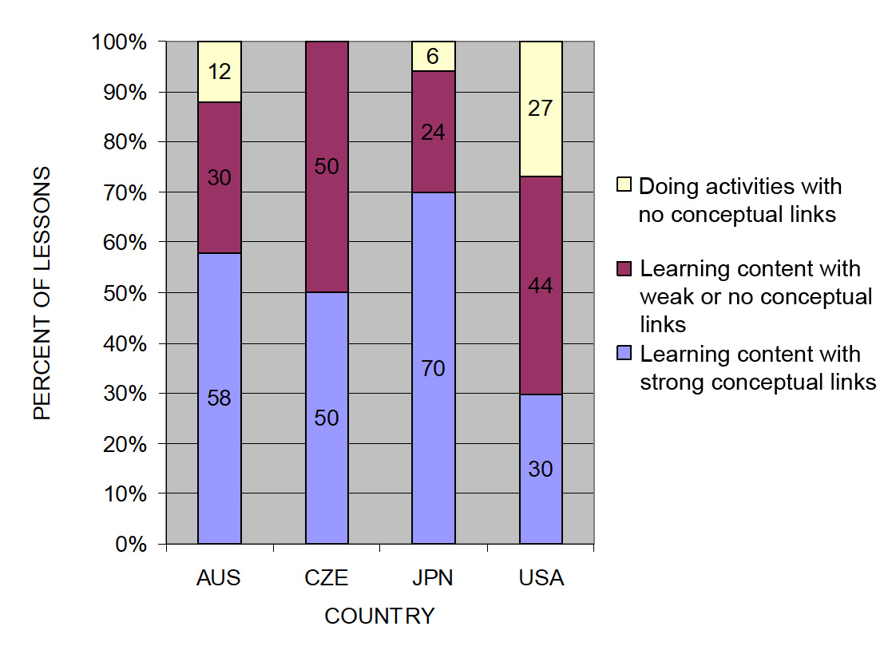
TIMSS: Conceptual Links
Source: TIMSS study
Notes:
3 min
a. Ask: “What do you notice from this graph? What do you make of this data?”
b. Emphasize: “In the US, more than a quarter of the lessons had no science content; whereas in the other countries, the majority of the randomly selected lessons (or typical lessons) had content with strong conceptual links.”
c. Example of a lesson with no science content: “What’s a science lesson with no content? In this research, a lesson with at least one complete statement of a science idea was scored as ‘learning content.’ Lessons with ‘no content’ had only topic-level mentions of science concepts. For example, one teacher started a lesson by telling students to take out their rockets and get to work. They had directions to follow, but the teacher’s only focus in his interactions with students was on how to build the rockets. At the end of the lesson, he told students to clean up and then dismissed them. This is a lesson with no science content!”
Other key ideas to highlight:
Each higher-achieving country engaged students with core science concepts and ideas (more consistently than the US).
All the higher-achieving countries linked ideas and activities (more consistently than the US).
In US lessons, the focus was on performing activities with less attention to content and even less attention to linking activities and science ideas.

Slide 31
What Makes a Difference?
Watch two video clips of 8th-grade science:
  A US classroom
  A Japanese classroom
What did you notice about these two classrooms?
In which classroom are students more likely to learn? Why do you think so?
Link to TIMSS US video clip: 1.1_TIMSS_US_lesson3_c1
Link to TIMSS Japan video clip: 1.2_TIMSS_Japan_lesson_c1_1
Notes:
20 min
a. Direct participants to the transcripts for Video Clips 1.1 and 1.2 (handouts 1.2 and 1.3) before showing each clip.
b. Show US classroom video: Ask participants to focus on what is going on with the science content and storyline.
c. Discuss: “What did you notice?”
Key ideas to emphasize and link back to the results include the following:
The teacher focuses on the activity and the procedure needed to complete the activity.
The teacher and students place no real focus on important science ideas.
There’s only a topic-level mention of science ideas (“pulleys,” “effort distance,” “resistance force”).
d. Show Japanese classroom video: Ask participants to focus on what is going on with the science content.
e. Discuss: “What did you notice?”
Key ideas to emphasize and link back to the results include the following:
Content ideas are made clear to students (focus question, pairs talk) before doing any activity.
Students are asked to talk about science ideas, not just procedures.
The lesson purpose is made clear to students.
f. Ending discussion: “In which classroom are students more likely to learn science concepts? Why?”
Note: Participants may be critical of both classrooms because student thinking isn’t made visible. This is true, but bring their focus back to the science content and storyline. They should see a clear distinction between the science content storylines in the Japanese and US lessons. Students in the Japanese classroom are more likely to learn because science-content ideas are made visible, and students are engaged in thinking about these ideas, not just science activities.

Slide 32
The TIMSS Findings Show …
Each higher-achieving country engaged students with core science concepts and ideas.
All the higher-achieving countries linked ideas and activities.
In US lessons, the focus was on performing activities with less attention to content and even less attention to linking activities and science ideas.
Notes:
1 min
a. Use this slide and the next to summarize key ideas from the TIMSS video study.

Slide 33
What Can We Learn from the Research?
A coherent science content storyline can …
make science ideas more prominent in science lessons,
  strengthen connections among science-content ideas,
  strengthen connections between science-content ideas and activities, and
improve lesson coherence by shaping science lessons as stories that make sense to students.
For more insights, see TIMSS Educational Leadership article, “What Science Teaching Looks Like: An International Perspective” (handout 1.4 in binder).
Notes:
1 min
a. After reading this slide, share with participants that the Science Content Storyline Lens addresses the need uncovered in the TIMSS video study: to strengthen the links between science ideas and lesson activities.
b. Encourage participants to read handout 1.4 (TIMSS Educational Leadership article) for further insight.

Slide 34
Discussion Questions
What new features can we add to our earlier description of effective science teaching?
Are there any ideas we should add to our list, modify, or delete?
Notes:
5 min
a. “What features on our list of ideas about effective science teaching are consistent with the TIMSS video-study findings?”
b. “Are there any ideas you’d like to add to our list, delete, or modify?”
Note: Use a different color to add/delete/modify ideas. Encourage participants to keep an open mind about changing their ideas. Provide opportunities for them to reflect on any changes and the reasons for those changes.
c. Transition: “During week 2 of the Summer Institute, we’ll focus on strategies for creating a strong, coherent science content storyline. This week, we’ll focus on the Student Thinking Lens. Right now, let’s consider the reasons for focusing on the Student Thinking Lens.”

Slide 35
Lesson Analysis Focus Question
What are the STeLLA lenses and teaching strategies, and what is the evidence that they will make a difference in your science teaching?
Student
Thinking
Lens
Science
Content
Storyline
Lens
Notes:
Less than 1 min
a. “At this point, we’ll transition from a focus on the Science Content Storyline Lens (SCSL) to the Student Thinking Lens (STL).”
b. “We’ll be focusing on the Student Thinking Lens the rest of the day and throughout this week.”

Slide 36
Research on How Students Learn
Respond in your notebooks to the following question:
    Imagine that a seed is planted in the ground and grows into a tree. Where does most of the matter come from that makes up the wood and leaves of the tree?
We won’t share our responses with the whole group.
Notes:
3 min
a. Individuals: Have participants answer the question on the slide in their science notebooks.
Background for PD leaders: Participants will likely have the same misconceptions revealed in the video, but they may not yet be comfortable sharing their confusion. At this point, don’t ask them to share their ideas with the group. It will be interesting to see if some of them voluntarily share their “wrong” ideas after they see the video.

Slide 37
Minds of Our Own
Minds of Our Own is a video that visually summarizes a large body of research on student learning in science classrooms.
As you watch, think about the following questions:
How do Harvard graduates answer the question about the mass of a tree? Is their response the same as or different from yours?
Does this give you any new ideas about effective science teaching?
Link to Minds of Our Own video clip.
Notes:
10 min
a. Read the information and instructions on the slide.
b. Watch the Minds of Our Own Lessons From Thin Air video. Total viewing time is approximately 10 minutes. (https://www.learner.org/series/minds-of-our-own/2-lessons-from-thin-air/?jwsource=cl)
MIT/Harvard interview—start at segment 3:30 and end at 5:40.
John preinterview, class, and post interview—start at segment 7:50 and end at 16:45.
Note: If time is short, stop after Phil Sadler. If you have enough time, you can show the entire segment from 3:30 to 16:45.

Slide 38
Discussion Questions
What did you notice in the Minds of Our Own video?
What does research on learning say to us about effective science teaching?
What new features can we add to our description of effective science teaching?
Notes:
15 min
a. There’s a lot to talk about in this video! Here are some additional questions you might pose:
Did John’s ideas about photosynthesis change through instruction?
What did the teacher say about his instruction?
What did the experts say?
How do the Harvard students’ responses compare with your own? What ideas does this give you about your own science learning experiences?
Key idea to emphasize: Research shows that we not only need to engage students in more thinking and sensemaking, but we also need to listen to their ideas—especially when they’re wrong—and use them to guide our instruction.
b. Modify the chart of ideas about effective science teaching as participants share features from the research.

Slide 39
What Can We Learn from the Research?
A Student Thinking Lens can …
reveal, support, and challenge student thinking throughout instruction;
provide opportunities for students to analyze and interpret data, as well as construct arguments and explanations;
engage students in making connections between ideas and activities; and
provide structures to teach students how to communicate in scientific ways.
For more insights, see “Synthesis of Research from How Students Learn: Science in the Classroom” (handout 1.5 in binder).
Notes:
2 min
“This slide nicely summarizes some of the ways we get students thinking and make their thinking visible.”
Note: Encourage participants to read handout 1.5 (“Synthesis of Research from How Students Learn: Science in the Classroom”) for further insight.
b. Transition: “Today we’ll start learning some particular strategies for making student thinking more prominent in science lessons.”
Background for PD leaders: The STeLLA conceptual framework addresses the need uncovered in this and other studies on how people learn and, more specifically, how students learn science:
If students’ initial knowledge is not engaged, they may fail to grasp the new concepts and information that are taught and may distort the new information to make it fit their prior experience.
This idea of learning with understanding has two parts: (1) factual knowledge must be placed in a conceptual framework (a big idea or a set of big ideas) organized in ways that enable students to use and apply that knowledge to make predictions, solve problems, explain new situations, and so forth; and (2) multiple representations that are rich in science ideas and details give concepts meaning.
This idea helps students monitor their developing understandings, engaging them in reflecting on their learning experiences, their changing ideas, and their remaining questions and musings.

Slide 40

genetics
SCIENCE CONTENT DEEPENING Grade 6
Notes:
Less than 1 min
a. “Now let’s begin our content deepening work on genetics.”
Note: Throughout this content deepening phase, refer as needed to Genetics Learning Goals for Students and Teachers, the Genetics Content Background Document, and Common Student Ideas about Variation and Inheritance of Traits.

Slide 41
Genetics Unit Central Question
Why are individuals of a species different from one another?
Notes:
Less than 1 min
a. Introduce participants to the unit central question that students will answer in the Genetics lesson sequence.
b. “Today we’ll explore the key science ideas that will help us answer this question.”
c. “Write this question in your notebooks and draw a double-lined box around it.”
Note: Copying the unit central question into their notebooks will reinforce an important practice participants should follow with their students.

Slide 42
Content Deepening Focus Questions
How can we represent trait-variation patterns among individuals of a species?
What are some of the causes of trait variation and inheritance patterns?
Notes:
Less than 1 min
a. Read the focus questions on the slide.
b. “Let’s see if we can figure out the answer to the first focus question.”

Slide 43
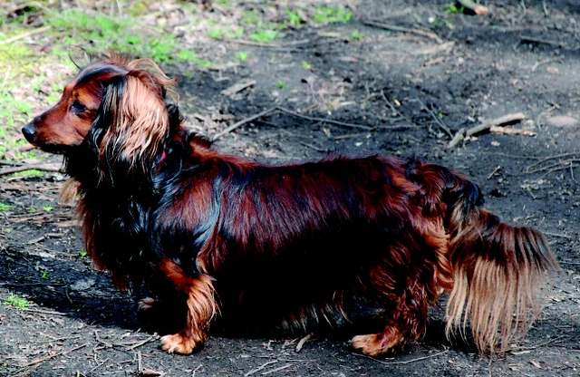
What Is a Trait?
Photo courtesy of Pixabay.com
As you look at this dachshund, what traits do you see? What are some traits that aren’t visible?
Work with a partner to come up with a definition of a trait. Write this definition in your notebook.
Read the section about traits in your content background document and revise your definition.
Notes:
8 min
a. “What are some of this dachshund’s visible traits?”
b. “What are some traits that aren’t visible?”
c. As participants share their observations, summarize them on chart paper.
d. After participants list five or six traits, have them pair up to develop a working definition of a trait and write their ideas in their notebooks.
e. Invite participants to share their definitions with the group. Ask probe questions to clarify their thinking.
f. After 1 or 2 minutes of sharing, have participants locate the Genetics Content Background Document in their lesson plans binders and read the section on traits. Then have them revise their definitions based on this information.
g. “As the reading pointed out, traits aren’t just physical features; they can also be molecular pathways, like DNA; chemical pathways; or developmental pathways, or even behaviors.”

Slide 44
Celebrate Variation!
Work with a partner to identify about 15 or 20 individual plants of the same species and a trait you would like to measure. Examples of traits you could measure:
  The length of the longest stem on 10 rosemary plants
  The length of the biggest leaf on 15 rose stems
  The height of the flower on 20 dandelions
  The length of 20 different pea pods
Measure this trait for every individual in your sample population. Then record the data on the Plant Species Measurement table in your handout.
Notes:
15 min
a. “To find trait-variation patterns among individuals of a species, we need to work like scientists. This means collecting data on a specific trait from a sample population and then recording the data on a table. That’s what we’re going to do next.”
b. Walk participants through the steps on the slide; then distribute handout 1.6 (Celebrate Variation!). Have participants record their data on the Plant Species Measurements table in their handouts.
Option to save time: To save time, instead of having participants collect their data outside, bring in samples of the same kind of fruit, vegetable, or plant (e.g., 20 bananas, 20 carrots, 20 green beans) for participants to measure.

Slide 45
Create a Histogram
Determine the range in your sample by finding the difference between the largest and smallest measurement.
Divide the resulting range into 4 to 6 intervals.
Count the number of measurements that fall into each interval and record this data on the frequency distribution table in your handout (page 2).
Use the data in your frequency distribution table to create a histogram (bar graph) on your handout that illustrates the results. (See the sample histogram on page 1.)
Notes:
15 min
a. “Now that you and your partner have collected and recorded your data, let’s go over the steps for creating a histogram.”
b. Walk participants through the steps on the slide. Then display the sample frequency distribution table and histogram on the next two slides.
Note: As pairs work on their histograms, be available to answer questions and give direction as needed.
c. After participants have created their histograms, ask them to copy them onto chart paper and then display all the histograms for participants to see.

Slide 46
Sample Frequency Distribution Table
Length Range | Number of Individuals in That Range
6–10 mm | 2
11–15 mm | 6
16–20 mm | 10
21–25 mm | 4
26–30 mm | 3
31–35 mm | 1
Notes:
Less than 1 min
a. Show participants the sample frequency distribution table and note that it also appears in their handouts.

Slide 47
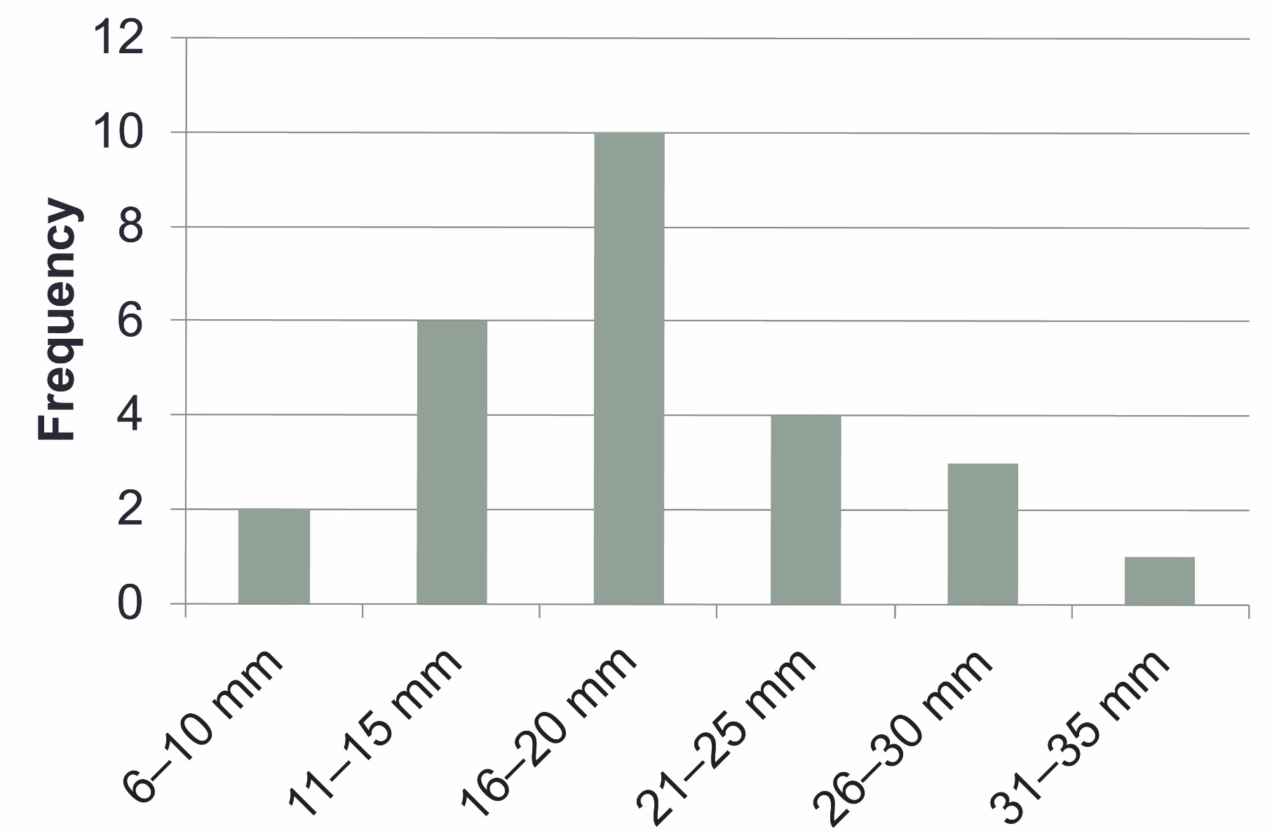
Sample Histogram
Notes:
Less than 1 min
a. Show participants this sample histogram and note that it also appears in their handouts. Highlight the information that should appear on the x- and y-axes.

Slide 48
Interpreting the Results
Sketch a copy of your histogram in your science notebook or on your worksheet.
Draw lines pointing out what you see in the data and use short phrases to describe your observations.
Then draw lines and use short phrases describing what you think the results mean.
Answer the questions on page 3 of your handout independently.
Notes:
15 min
a. Have participants complete the first three steps on the slide. Then have a brief group discussion about their observations and explanations.
b. During this discussion, keep participants focused on what they see in the data (observations of patterns) and what they think the results mean (inferences). Use probe questions to clarify their thinking as needed.
c. Highlight that a common trait-variation pattern is a bell-shaped curve that scientists call continuous variation. Later in the session, participants will contrast this trait-variation pattern with another pattern.
d. “Now I’d like you to answer the questions on page 3 of your handouts, using what you already know about traits. Work on this task independently.”

Slide 49
Our Ideas and Questions about Inheritance
Let’s list our ideas and questions about trait inheritance on two charts:
Our Current Ideas about Inheritance
Our Questions about Inheritance
We’ll review and update these ideas and questions periodically.
Notes:
5 min
a. “Let’s list our ideas and questions about trait inheritance on two charts so we can review and update them periodically.”
b. “What do you think accounts for the differences in traits among individuals of the same species? Which types of traits are inherited, and what role might the environment play in some of the differences among individuals?”
Note: The same charting strategy is used throughout the Genetics unit.
c. Keep this discussion brief, since participants will revisit their initial ideas in another activity during the second half of the content deepening phase.

Slide 50
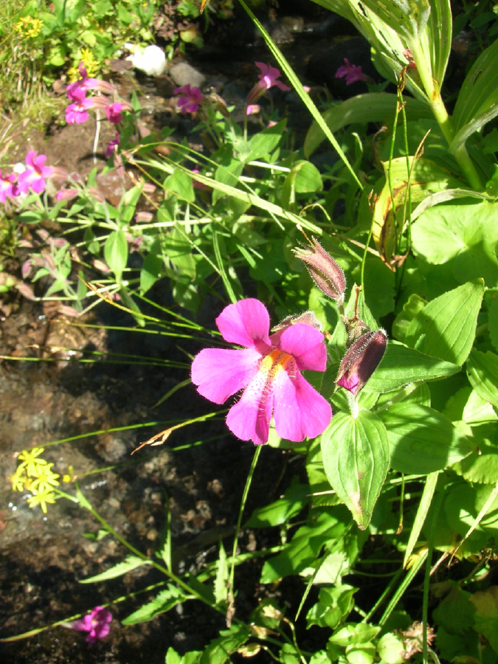
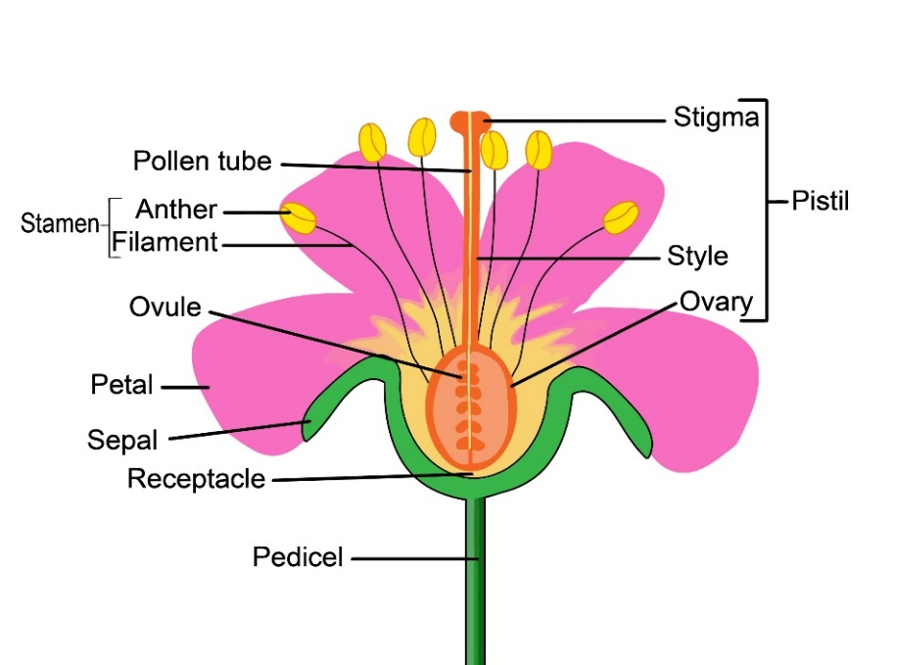
Trait Data on Monkey Flowers
Monkey- flower traits:
Pistil length
Stamen length
Flower color
(amount of
purple
pigment)
Photo courtesy of Will Taylor, Wikimedia Commons
Photo courtesy of Stock.Adobe.com
Notes:
Less than 1 min
a. “Now let’s put your new skills to use analyzing more trait data and identifying patterns. As before, you’ll use the data to create a histogram showing the pattern of trait variation. Some of you will examine data on monkey-flower traits, and others will examine data on dachshund traits.”
Note: You may need to show participants where the pistil and stamen are on the slide images. Tell them that the monkey flowers can have purple or white flowers.

Slide 51
Trait Data on Dachshunds
Dachshund traits:
Hair length
Body length
Height
Photo courtesy of Pixabay.com
Notes:
3 min
a. Distribute handout 1.8 (Data on Traits) and review the instructions. Then assign each participant a trait to analyze. Make sure to assign all six traits (three monkey-flower traits and three dachshund traits).

Slide 52
Exploring Patterns of Trait Variation
Examine your assigned data set and complete the frequency distribution table on the handout.
Using this data, create a histogram on graph paper.
Then copy your histogram onto chart paper and post it where everyone can see it.
Group discussion: What trait-variation patterns do you see in these histograms? Hint: There are two major patterns.
Notes:
15 min
a. Have participants examine their assigned data set and complete the frequency distribution table on the handout.
b. Once participants have filled in their frequency tables, have them create a histogram for their assigned trait on graph paper and copy it onto chart paper with grids. Then ask participants to post their charts where they will be visible.
c. “What trait-variation patterns do you see in these histograms?”
d. During this discussion, draw out the observation that some traits show a continuous-variation pattern (a bell-shaped curve), but other traits show two hump patterns with little data in between.
e. “Most traits show a continuous-variation or bell-shaped pattern, but analyzing inheritance patterns is more complicated than this. Other traits have only two common forms—like purple or white monkey flowers. These simple inheritance patterns are easier to understand and provide us with a basis for analyzing and understanding more complex patterns. The goal of 6th-grade genetics content is to understand the simpler patterns of trait inheritance that have just two common forms.”

Slide 53
Reflect: Content Deepening Focus Question 1
How can we represent trait-variation patterns among individuals of a species?
Notes:
2 min
a. Ask participants to reflect on the first content deepening focus question and write their best answers in their science notebooks.
b. “Now let’s break for lunch before we begin the second part of our content deepening work.”

Slide 54
Unit Central Question
Why are individuals of a species
different from one another?
What progress have we made so far in answering this question?
Notes:
3 min
a. “Let’s revisit our unit central question for a moment. What progress we have made so far in answering this question?”
b. Ask for one or two ideas from the group.

Slide 55
Content Deepening: Focus Question 2
What are some of the causes of trait variation and inheritance patterns?
Notes:
Less than 1 min
a. Introduce the focus question for the afternoon session and remind participants that they began formulating an answer to this question in part 1 of the content deepening phase.

Slide 56
Causes of Trait Variation
Strongly Passed from Parents to Children (Simple) | Strongly Passed from Parents to Children (Complicated)
Somewhat Passed from Parents to Children; Somewhat Influenced by the Environment | Mostly Caused by the Environment
Notes:
5 min
a. “Are you ready for a challenge? In this activity, you’ll work with a partner to decide the causes of trait variations. First, let’s break up into pairs, and then I’ll give each pair a set of category cards showing four possible causes of variations within a trait.”
b. Divide the group into pairs and give each pair a set of four category cards representing the causes of trait variations.
c. “As you can see on the slide, two of the categories have to do with traits that parents pass to their offspring, one involves both genetic and environmental causes, and one category involves primarily environmental causes.”

Slide 57
Trait Cards
Intelligence | Obesity
Ear “Floppiness” | Leg Length
Trustworthiness | Ability to Recognize a Command Like “Sit”
Body Length | Hair Length
Notes:
1 min
a. Next, give each pair a set of trait cards and review the list of traits.

Slide 58
Matching Traits and Causes of Variation
Work with a partner to assign each of the eight traits to one of the four causes of trait variation.
Record your decisions in your science notebook and include the reasons for your choices.
Include any evidence from the histogram data we explored earlier if it helped you make a decision.
Notes:
20 min
a. “Work with your partner assigning each of the eight traits to one of the four causes. When you’ve finished sorting your cards, record the reasons for your choices in your notebooks. Make sure to include any evidence from the histogram data we recorded earlier if it helped you make a decision.”
Note: The main purpose of this activity is to understand how participants view inheritance patterns and trait variations among individuals and what causes them.
b. After participants complete this card-sorting challenge, tally the results and discuss participants’ decisions and reasoning.
c. During the group discussion, ask participants whether they want to add to or modify the charts that list their ideas and questions about inheritance.
d. After the discussion, briefly share the following causes of variation attributed to the traits in this activity based on current ideas among scientists:
Intelligence: Somewhat passed from parents to children; somewhat influenced by the environment
Ear “floppiness”: Strongly passed from parents to children (simple)
Trustworthiness: Somewhat passed from parents to children; somewhat influenced by the environment
Body length: Strongly passed from parents to children (complicated)
Obesity: Somewhat passed from parents to children; somewhat influenced by the environment
Leg length: Strongly passed from parents to children (complicated)
Ability to recognize a command like “sit”: Mostly caused by the environment
Hair length: Strongly passed from parents to children (simple)

Slide 59
Genetics Lessons
Turn to lesson 1a in your lesson plans binder and read the following:
The unit central question and lesson focus question on the overview page
Setup for the activity in the detailed plan
Reflect on how today’s content deepening work relates to what students do in the lesson. Write your observations in your science notebook.
Notes:
4 min
a. Ask participants to complete the tasks outlined on the slide.

Slide 60
Testing Our Ideas about Inheritance
How could we test our ideas about how traits are passed from parents to their offspring?
One possible way is to observe whether offspring exhibit the same traits as their parents.
Let’s investigate!
Notes:
Less than 1 min
a. “How could we test some of our ideas about how traits are passed from parents to offspring? One way is to observe whether offspring exhibit the same traits as their parents.”

Slide 61
Leg Length in Dogs
Notes:
1 min
a. “For example, what do you think would happen if a group of dogs with long legs mated with a group of dogs with short legs? This graph shows the leg lengths of the parents.”

Slide 62
Leg Length in Dogs: The Results
Notes:
1 min
a. “In this case, the offspring exhibit a blending of the parents’ traits in a bell-curve or continuous variation pattern. This is a common pattern when many genes are involved in causing trait variations. Even though the bell-curve is the most common trait-inheritance pattern in organisms, understanding what causes this pattern is more complicated.”

Slide 63
Continuous Trait Variation
Many traits, like leg length in dogs, are continuous, resulting in a blended inheritance pattern.
To help us make sense of complex patterns like this, let’s consider a simpler example …
Notes:
Less than 1 min
a. Remind participants that the goal of 6th-grade genetics content is to understand the simpler patterns of trait inheritance in which a trait has only two common forms.
b. “It’s easier to understand trait-inheritance patterns involving only two common forms, such as white flowers and purple flowers. Learning to explain these simpler patterns will help us make sense of more complex patterns later in the session.”

Slide 64


Two Dachshunds Traits
Male
Female
Photo courtesy of © Isselee | Dreamstime.com
Photo courtesy of © Oxilixo | Dreamstime.com
Notes:
Less than 1 min
a. Introduce the two dachshund hair-length traits: long haired and short haired.

Slide 65
Dachshund Puppies: Your Predictions
When these long-haired and short-haired dachshunds mate, what do you think their puppies will look like?
Will they have long hair like the dad, short hair like the mom, or a blending of both traits?
Write your predictions in your notebook and make sure to include your reasoning.
Notes:
2 min
a. “When these long-haired and short-haired dachshunds mate, what will their puppies look like? What hair length do you think they’ll have? Write your predictions in your science notebooks and make sure to include your reasoning.”

Slide 66



The Results
Photo courtesy of Pixabay.com
Photo courtesy of Pixabay.com
Photo courtesy of Pixabay.com
Notes:
Less than 1 min
a. “Here are the offspring of the long- and short-haired dachshund parents. Does it surprise you that all of the puppies have short hair like their mom?”

Slide 67
What Happened with the Puppies?
What did you predict about the puppies’ hair length?
How do you explain what actually happened? Why do you think all of the puppies have short hair?
What do you think happened to the long-hair trait?
Notes:
3 min
a. Ask participants to think about the questions on the slide for a moment and then discuss their predictions and reasoning with a partner.

Slide 68
Our Ideas and Questions about Inheritance
Our Current Ideas about Inheritance
Our Questions about Inheritance
Notes:
10 min
a. “Let’s revisit the ideas and questions we recorded earlier on our charts. Based on the dachshund results, do you have any new ideas or questions you’d like to add to either chart? What about any changes?”
b. Direct participants to locate the resource document Common Student Ideas about Variation and Inheritance of Traits in their PD program binders. Ask them to scan the student ideas and see if any of them match the current ideas about inheritance on the chart. Also reflect on common student ideas that have already been addressed, such as “Genes control only an individual’s visible traits (like hair color, skin color, fur color), not the traits that aren’t visible (like blood type, personality traits, and whether an individual will get cancer or other diseases).”

Slide 69
Three Inheritance Claims
Juan’s claim: Since all the puppies have short hair, they must have inherited instructions for hair length from only one parent.
Celia’s claim: The puppies inherited information for hair length from both parents. But the instructions for short hair covered up the instructions for long hair.
Michael’s claim: The puppies got instructions for hair length from each parent, so they should have medium-length hair—a blend of short hair and long hair.
Notes:
3 min
a. “Let’s examine the claims of three fictional students that explain how the hair-length trait was passed from the dachshund parents to their offspring.”

Slide 70
Which Claims Does the Evidence Support?
Did you agree or disagree with Juan, Celia, and Michael?
Which claim(s) did you accept?
Which claim(s) did you reject?
Make sure to give reasons and evidence for your answers!
Notes:
7 min
a. “Which of the three students’ claims does the evidence support? Which do you agree with, and which do you think should be rejected? Make sure to give reasons and evidence for your decisions.”
b. Ask probe and challenge questions to help participants recognize that the evidence doesn’t support Michael’s claim because the puppies don’t have medium-length hair. The evidence does, however, fit both Juan’s and Celia’s claims.

Slide 71

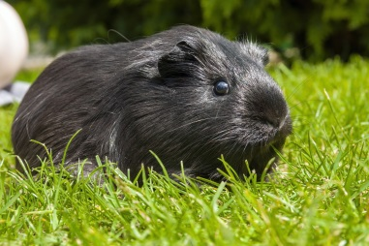
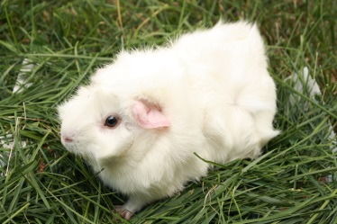
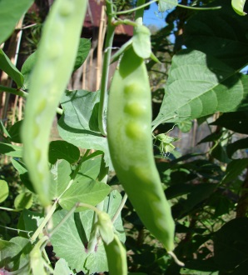
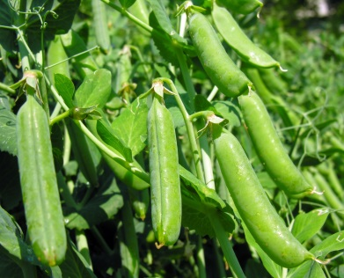
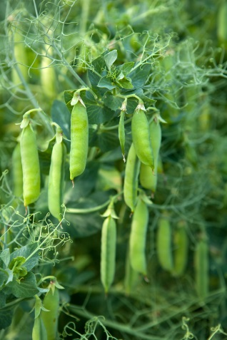
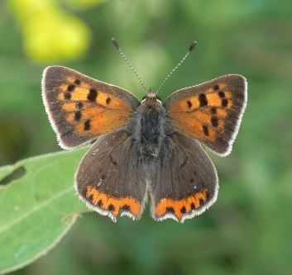
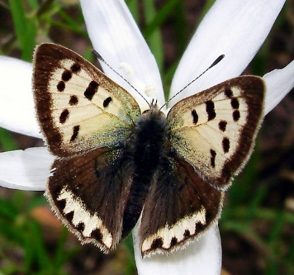
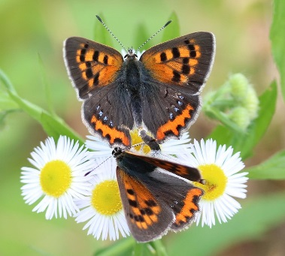
Different Traits of Parents and Offspring
Photograph by Farinoza
Photograph by Belizar
Photograph by Blueelephant
Photograph by Forest & Kim Starr
Photograph by Slogger
Photograph by Gordana Sermek
Photograph by Quartl, Wikimedia Commons
Photograph by Tanya Mass
Photograph by Alpsdake, Wikimedia Commons
Notes:
8 min
a. “What do you notice about the parents and offspring on this slide?”
b. Participants should recognize that in each case, the parents exhibit two forms of the same trait. The offspring, however, exhibit only one form of the trait. So the pattern that participants observed with the dachshunds is found in other species as well.
Note: The trait that varies in the pea plants is pod shape. The parents have pods that are either inflated (puffy) or flat. All the offspring have inflated pods.
c. After the discussion, point out that participants just completed the activities their students will work on in Genetics lesson 1b. Have participants look over the lesson plan, and challenge them to identify key science ideas about inheritance in the dachshund activity.
d. “Offspring may have the same trait as one parent, but not the other. For these traits, offspring don’t show a blend of their parents’ traits.”

Slide 72
Reflect: Content Deepening Focus
Question 2
What are some of the causes of trait variation and inheritance patterns?
Notes:
5 min
a. To wrap up the content deepening work, ask participants to answer the focus question in their notebooks, summarizing what they’ve learned so far about trait variation and inheritance patterns.
b. “In the next session, we’ll continue our investigation of the dachshund traits.”

Slide 73
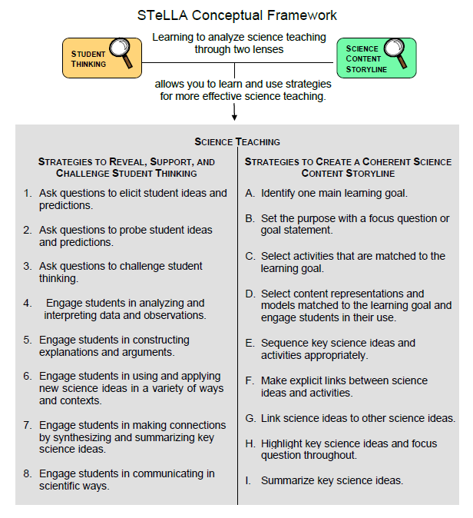
Lesson Analysis Focus Question
What are the STeLLA lenses and teaching strategies, and what is the evidence that they will make a difference in your science teaching?
Notes:
1 min
a. Read the focus question on the slide.
b. “This visual on this slide tells us a little about the first part of our focus question: What are the STeLLA lenses and teaching strategies? As you can see, there are eight specific science teaching strategies to support the Student Thinking Lens.”
c. Acknowledge: “I know you have existing frameworks (ideas and language) regarding teaching and learning, and I expect you’ll continuously draw from them during the Summer Institute.”

Slide 74
Lesson Analysis Focus Question
What are the STeLLA lenses and teaching strategies, and what is the evidence that they will make a difference in your science teaching?
Notes:
1 min
a. “Today we’ll begin learning about three of the Student Thinking Lens teaching strategies.”
b. Read the strategies highlighted on the slide.
c. “These three types of questions will help reveal, support, and challenge student thinking.”
d. Emphasize: “Even though we’re studying the strategies this summer, you’ll better understand them as you start trying them out in your teaching next fall.”

Slide 75
Strategies 1, 2, and 3: Questions That Elicit, Probe, and Challenge Student Thinking
Student Thinking Lens: Strategies to reveal, support, and challenge student thinking.
  Strategy 1: Ask questions to elicit student ideas and predictions.
  Strategy 2: Ask questions to probe student ideas and predictions.
  Strategy 3: Ask questions to challenge student thinking.
Read and fill in the purpose and key features of each strategy on your Z-fold summary chart. Then share your charts with a partner.
Notes:
20 min
a. Orient participants to the STeLLA strategies booklet. Forecast that you’ll come back to this resource repeatedly to ensure consistent use of ideas, meaning, and language that match the STeLLA conceptual framework.
b. Individuals: Have participants read about all three strategies and write on their blank STL Z-fold summary charts the purpose(s) and key features of each strategy. State that in the future, they’ll do this kind of reading and writing as homework.
c. Pairs: Have participants pair up and share their Z-fold summary charts. Encourage them to provide evidence from the readings to support their ideas and ask each other questions consistent with the norms for working together, such as “Where did you find that?” or “I interpreted that differently.”

Slide 76
Elicit Questions
What are the purpose and key features of questions that elicit student ideas and predictions?
  Which question from the examples in the strategies booklet do you think would elicit the highest number of different student responses in your classroom? Why do you think so? (Cite ideas from the strategies booklet.)
Notes:
5 min
a. As a group, discuss the purpose and key features of questions that elicit student ideas and predictions. Write these features on chart paper and hang the chart where it can be referenced later.
b. Sample chart:
Key Ideas about Elicit Questions
Purpose: To reveal student’ ideas, predictions, misconceptions, and experiences before they learn about the content.
Key features:
Asked anytime, but often at the beginning of a lesson
Phrased in everyday language that students can understand even before studying the related content
Addressed to multiple students (usually the whole class)
Reveals a variety of student ideas
Useful to teachers in adapting instruction
Useful to students so they see that others have different ideas
Can be a prediction
Can set up a discrepant event

Slide 77
Probe and Challenge Questions
Probe Questions
What are the purpose and key features of questions that probe student ideas and predictions?
Challenge Questions
What are the purpose and key features of questions that challenge student thinking?
  Remember to cite ideas from the strategies booklet!
Notes:
13 min
a. Small groups (5 min): Split participants into two groups—one group for probe questions, and one group for challenge questions. Have each group create a chart of the purpose and key features of the assigned strategy from the STeLLA strategies booklet (not from experience).
b. Whole group (8 min): Share the charts with the entire group. Encourage participants to add to, delete from, and modify them as needed to ensure they’re accurate and match the language in the strategies booklet.

Slide 78
Elicit versus Probe Questions
  What are some key differences between questions that elicit and questions that probe student ideas and predictions?
Notes:
5 min
a. Turn and Talk: “Discuss this question with your elbow partner.”
b. Whole-group share-out. Have participants share their ideas with the group.
Key ideas about elicit questions versus probe questions:
Elicit questions are addressed to the whole class; probe questions are addressed to individual students.
Elicit questions are used before students have studied a concept; probe questions can be asked at any time.
Elicit questions start a discussion; probe questions follow up on something a student has already said.

Slide 79
Elicit/Probe Questions versus Challenge Questions
  What are some key differences between questions that elicit and probe student ideas and predictions and questions that challenge student thinking?
Notes:
5 min
a. Turn and Talk: “Discuss this question with your elbow partner.”
b. Whole-group share out. Have participants share their ideas with the group.
Key ideas about elicit/probe questions versus challenge questions:
Elicit and probe questions focus on understanding students’ existing ideas rather than trying to change students’ thinking.
In contrast, challenge questions are designed to push students’ thinking toward more-scientific understandings and support them in changing their thinking.

Slide 80
The RESPeCT Lesson Plans Binder
What comes before the lessons?
  Scope and sequence
  Learning goals
  California NGSS
  Student pretest/posttest
  Features analysis chart
  Working with English language learners (ELLs) in science
Overview of lesson format and structure:
  Lesson overview
  Lesson outline
  Detailed lesson plan
Notes:
5 min
a. Foreshadow: “In a moment, we’ll review the details of a homework assignment related to the lesson plans you’ll be teaching in the upcoming school year.”
b. “But before we look at the assignment, let’s review the organization and contents of the lesson plans binder.”
c. Use the slide to guide participants through the binder contents.

Slide 81
Let’s Summarize Today’s Work!
We thought about what constitutes effective science teaching.
We examined the rationale for the Science Content Storyline Lens and analyzed the US and Japanese video clips from the TIMSS video study.
We examined the rationale for the Student Thinking Lens and watched the video of the Harvard and MIT graduates and John and his teacher.
We deepened our understandings of trait variation and inheritance patterns.
We read and talked about the purposes and key features of elicit, probe, and challenge questions.
Notes:
5 min
a. Remind participants of the various activities they’ve been involved in today.
b. Foreshadow: Let participants know that you’re going to ask them to reflect on what they’ve learned from these activities.

Slide 82
How Did Today’s Work Help You Think about Our Focus Questions?
What are the STeLLA lenses and teaching strategies, and what is the evidence that they will make a difference in your science teaching?
How can we represent trait-variation patterns among individuals of a species?
What are some of the causes of trait variation and inheritance patterns?
Notes:
10 min
Note: If time is short, you may want to skip the Turn and Talk or the entire slide.
a. Turn and Talk: “Discuss these questions with an elbow partner.”
b. Whole-group share-out: Invite participants to share their ideas with the group.

Slide 83
Extended Homework
Locate handout 1.9 (Extended Homework: RESPeCT Lesson Plan Analysis) in your PD program binder.
Between now and Friday, read the scope and sequence for the set of lessons and your assigned lesson plan in the lesson plans
binder.
Be prepared to share your findings about
your assigned lesson plan in a study-group conversation on Friday.
Notes:
5 min
a. Assign each participant one of the lessons in the Genetics lesson-plan sequence. There are six 2-part lessons in this content area. Each teacher should take responsibility for one 2-part lesson. That is, Teacher 1 will study lessons 1a and 1b; Teacher 2 will study lessons 2a and 2b; and so forth.
b. If the study group is small, figure out who will be assigned an extra lesson (or when you, as the PD leader, will cover any extra lessons).
c. If the study group is large, assign lessons to more than one teacher later in the sequence.
d. Go over the homework sheet (handout 1.9) with participants. If time allows, have them read the assignment sheet before discussing.

Slide 84
Reflections on Today’s Session
Complete the Daily Reflections sheet.
What were your first reactions to the STeLLA claim that it’s important to plan and analyze science teaching through the Student Thinking Lens and the Science Content Storyline Lens? What was convincing or not so convincing for you and why?
What questions do you have about trait-variation patterns among individuals of a species?
Provide feedback about today’s session and the program so far (likes, dislikes, questions, concerns, suggestions).
Notes:
5 min
a. Review the questions on the Daily Reflections sheet (handout 1.10).
b. Ask participants to think about these questions and write down their reflections.

