Slide 1
RESPeCT PD pROGRAM
Day 3
RESPeCT Summer Institute
Notes:
5 min
a. Take care of any housekeeping issues.

Slide 2
Agenda for Day 3
Day-2 reflections
Focus questions
Purposes and key features of STL strategies 4 and 5
Lesson analysis: STL strategies 4 and 5
Lunch
Content deepening: genetics
Summary, homework, and reflections
Notes:
2 min
a. Talk through the agenda for the day.

Slide 3
Trends in Reflections
Lesson Analysis | Science Content Learning
Notes:
5 min
a. Invite participants to look at your feedback on their reflections from day 2 and offer reactions, comments, or follow-up questions.
b. Optional: Give participants an opportunity to refine the norms for working together.

Slide 4
Today’s Focus Questions
Lesson Analysis
Content Deepening
How can analyzing data and constructing explanations help students move forward toward deeper understandings of science ideas?
How can we represent DNA, genes, and chromosomes to make sense of trait-variation patterns?
Notes:
2 min
a. Introduce the focus questions that will guide today’s session.
b. “The words moving forward are in bold on the slide because that’s our theme for today and the rest of the week. Yesterday we practiced asking elicit and probe questions, which are great for revealing student ideas. But what do we do with those ideas once we’ve elicited them? How do we support students in moving forward toward deeper understandings of science ideas?”

Slide 5
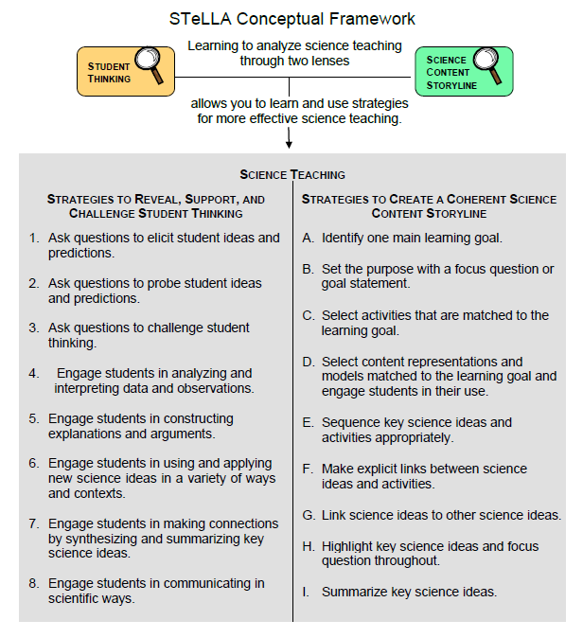
Notes:
1 min
a. Point out the strategies highlighted on the slide.
b. “We’ll continue working on understanding and using the Student Thinking Lens questioning strategies, but today we’ll focus on two closely related activity strategies. Strategy 4 engages students in analyzing and interpreting data and observations, and strategy 5 engages students in constructing explanations and arguments.”

Slide 6
The Student Thinking Lens: Moving Student Thinking Forward
How can we advance students’ science learning without just telling them about science ideas and expecting them to memorize the concepts?
By using STeLLA strategies 4–8 to engage students in making sense of the world around them.
Notes:
10 min
a. Initially, reveal only the question on the slide.
b. Have participants think about the question for a minute; then open up a brief conversation about it.
c. Ask the following questions to stimulate discussion if participants are struggling:
What was your experience as a science student in school or college?
How were you expected to learn science ideas? What learning methods were used?
Did you ever have the opportunity in science classes to make sense of the experiments you performed (instead of just recording the correct answers in a lab report)?
Did science teachers ever support your learning in ways that went beyond merely having you take lecture notes, read from a textbook, or record the correct answers in lab reports?
d. After discussing the questions, reveal the second part of the slide and emphasize the following points:
“Strategies 4 and 5 (as well as 6, 7, and 8) are designed to move student thinking forward by engaging students in sensemaking as they observe data. Rather than just spoon-feeding students science content to read or memorize, these activities lead them toward deeper understandings of science ideas as they construct meaning from evidence.”
“Telling students about science ideas is important, but teachers tend to tell students too much. Instead of doing the hard cognitive work for them, we need to create more opportunities for students to do the thinking and sensemaking themselves so they can truly understand the science concepts. So don’t be in such a hurry to tell students the right answers. Slow down and give them a chance to think!”

Slide 7
The Student Thinking Lens: Moving Student Thinking Forward
Strategies That Reveal Student Thinking | Strategies That Move Student Thinking Forward
1. Elicit questions
2. Probe questions
3. Challenge questions | 3. Challenge questions
4. Analysis and interpretation of data | 4. Analysis and interpretation of data
5. Construction of explanations | 5. Construction of explanations
6. Use and application of new ideas | 6. Use and application of new ideas
7. Synthesis and summarizing | 7. Synthesis and summarizing
8. Scientific communication | 8. Scientific communication
Notes:
5 min
a. Have participants look at the slide representation of the Student Thinking Lens strategies.
b. Ask: “What patterns do you notice?”
Key ideas:
Elicit and probe questions are designed only to reveal student thinking, not to challenge it.
The rest of the strategies reveal and challenge student thinking.

Slide 8
The Student Thinking Lens: From Questions to Activities
Look at the Summary of STeLLA Student Thinking Lens Strategies in the strategies booklet.
What distinguishes strategies 1–3 from the rest of the Student Thinking Lens strategies?
Notes:
5 min
a. Individuals: Have participants briefly examine the summary chart of STL strategies in the STeLLA strategies booklet (Summary of STeLLA Student Thinking Lens Strategies).
Note: Direct participants to the correct page in the strategies booklet or have them consult the table of contents.
b. Whole group: “How are the first three strategies different from the rest?”
Key ideas:
Strategies 1–3 are questions; the rest are activities.
Probe and challenge questions can and should be asked during all types of activities.

Slide 9
STL Strategies 4 and 5: Purposes and Key Features
Strategy 4
What are the purpose and key features?
Strategy 5
What are the purpose and key features?
Notes:
30 min
a. Small groups (12 min): Divide participants into two groups and assign one strategy to each group. Have one group create a poster charting the purpose and key features of strategy 4, and have the other group chart the purpose and key features of strategy 5. Each group should be prepared to answer the discussion question for the assigned strategy.
b. Whole-group share-out (18 min): Have groups report the purpose and key features of each strategy.
Key ideas:
Strategy 4 involves activities that engage students in organizing their data and/or observations and looking for patterns and meaning in them. They aren’t just “doing” activities or describing their observations.
Strategy 5 engages students in learning how to use logical thinking, evidence, and science ideas to construct explanations of scientific data or phenomena they have observed. It also engages them in critiquing various proposed explanations through scientific argumentation.
Remind participants that these strategies are closely related and will overlap in some activities. However, each has a specific purpose and unique attributes.

Slide 10
Relationships between Strategies 4 and 5
Discuss the question assigned to your group and be ready to share your ideas:
Group 1: How is analyzing/interpreting different from describing observations?
Group 2: How are strategy 4 and strategy 5 different? How are they related?
Group 3: How are scientific explanation and scientific argumentation related? How are they different? How are arguments in science different from arguments in everyday situations?
To support your responses, use the STeLLA strategies booklet and Quick Reference Tools for Strategies 4 and 5 (handout 3.1).
Notes:
15 min
a. Small groups (5 min): Divide participants into three small groups or pairs. Assign each group one question to discuss and tell participants to be ready to share their ideas with the entire group.
b. Emphasize: Participants should use the STeLLA strategies booklet and Quick Reference Tools for Strategies 4 and 5 (PD handout 3.1) to support their responses.
c. Whole-group share-out (10 min):
“What did you come up with for the first question?”
Key ideas for question 1: Analysis and interpretation involve moving beyond simply describing observations to doing something with the data, including (but not limited to) making comparisons, identifying relationships, and organizing data in ways that will reveal patterns (such as using charts, diagrams, and graphs).
“What did you come up with for the second question?”
Key ideas for question 2: Strategy 4 lays the groundwork for strategy 5. Before we can build a scientific explanation for a specific phenomenon, we need to make some observations, analyze the data to reveal patterns, and organize the data to gather the necessary evidence to support construction of a scientific explanation. A scientific explanation includes a claim that answers the question being studied, evidence that supports the claim, and reasoning that links the claim to the evidence and to science ideas.
“What did you come up with for the third question?”
Key ideas for question 3: A scientific explanation includes a claim that answers the question being studied, evidence that supports the claim, and reasoning that links the claim to the evidence and to science ideas. Scientific argument involves assessing the strength and quality of the evidence and reasoning in different scientific explanations for the same observations and determining which proposed explanation has the best supporting evidence, science ideas, and reasoning.

Slide 11
Practice Identifying Strategies 4 and 5
Examine student statements made during a science-class activity. Decide whether each statement represents the following:
An observation
An analysis or interpretation of the observations (e.g., describing a pattern) (strategy 4)
An attempt to construct an explanation that has a claim, evidence, and/or reasoning that uses science ideas (strategy 5)
An attempt to construct an argument (strategy 5)
Refer to Practice Identifying Strategies 4 and 5 (handout 3.2).
Notes:
15 min
a. “Before we view classroom video clips to identify and analyze strategies 4 and 5, we’re going to practice identifying observations, analyses, interpretations, explanations, and arguments from a handout of student statements. Learning to distinguish which strategy students are using in these examples will help us when we review the classroom videos, where the strategies aren’t always as clear cut.”
b. Refer participants to handout 3.2 in their PD program binders (Practice Identifying Strategies 4 and 5).
c. Pairs: Have participants work in pairs to analyze student statements in the handout.
d. Whole group: As participants discuss and clarify their analyses of the student statements, encourage them to refer frequently to the STeLLA strategies booklet and the Quick Reference Tools handout (PD handout 3.1).
Note: For examples of ideal participant responses, see PD Leader Master: Practice Identifying Strategies 4 and 5.

Slide 12
Lesson Analysis Focus Question
How can analyzing data and constructing explanations help students move forward toward deeper understandings of science ideas?
Notes:
Less than 1 min
a. Review the focus question that will guide today’s lesson analysis work.

Slide 13
Lesson Analysis: Review Lesson Context
Video Clip 1
Review the lesson context at the top of the transcript for video clip 1 (handout 3.3 in your PD program binder).
Notes:
2 min
a. “Now let’s see if we can recognize students analyzing and interpreting data in a classroom video clip.”
b. Review the lesson context at the top of the transcript for video clip 1 (handout 3.3 in PD binder), making sure participants understand both the content and activity in focus.

Slide 14
Lesson Analysis: Identify Strategy 4
Video Clip 1
Identify instances where the teacher or the students are engaged in analyzing and interpreting data and observations by
clarifying key observations,
identifying a pattern in the observations,
identifying what needs to be explained,
organizing data/observations, and/or
trying to make sense of the observations (analyzing, interpreting).
Discuss: How are these actions implemented in the video?
Link to video clip 1: 3.1_stella_GEN_kawamura_L3_c2
Notes:
25 min
a. “As we watch the video clip, we’ll identify actions that illustrate strategy 4. Be on the lookout for instances where the teacher or the students do something listed on the slide. That’s what we’ll discuss first.”
b. Show the video clip.
c. Individuals: “Think about the strategy 4 actions listed on the slide.”
d. Whole group: “Discuss the question on the slide. Make sure to support your claims with evidence from the video transcript.”
Observations:
In this video clip, students realize that one pair of their classmates didn’t get the same results as the others. They think critically about the representation they used to demonstrate alleles passing from one generation to another, and they try to make sense of the outlier data point.

Slide 15
Lesson Analysis: Analyze Strategy 4 and Reflect
Video Clip 1
Analyze
What student thinking is revealed in the video clip by engaging students in analysis and interpretation?
Were any opportunities missed for engaging students in analyzing and interpreting data and observations?
Reflect
What did you learn about strategy 4 from analyzing this video clip?
Did the analysis process focus your attention on aspects you might not have noticed before? If yes, what is one example?
Notes:
25 min
a. Individuals: “For the first analysis question on the slide, study the transcript for video clip 1 and come up with a claim, evidence, and reasoning to support your claim. For the second analysis question, consider alternative moves the teacher could have made as you identify missed opportunities.”
b. Whole group: After participants have shared their analyses, ask, “Were there any missed opportunities for engaging students in analyzing and interpreting data?”
c. Reflect: Discuss the reflection questions on the slide, making sure participants share specifically what they learned about strategy 4.
Possible claim: Most students understand that this simulation of parents passing genes to offspring resulted in the traits expressed in the offspring. They also sufficiently understand the roles of dominant and recessive alleles and therefore are able to identify that the production of one brown-billed ducko in the simulation didn’t match their understandings of the inheritance process.
Evidence: The evidence for this claim begins at video segment 0:01:37.6, when one student says, “That … shouldn’t have happened.” Again at segment 0:03:42.7, the teacher mentions that several students think the brown-billed duck shouldn’t have happened and asks them to explain their thinking. The teacher missed an opportunity to push students to clarify their thinking about inheritance in this simulation when they explain one possible reason the brown-billed ducko appeared: student error. The teacher could have pressed for other students to explain how the inheritance process helped them know this data point wasn’t correct.

Slide 16
Strategy 5 Practice: Explanation and Argumentation
Analyze the genetics sample transcript in the strategies booklet to find evidence of students engaged in constructing explanations and arguments by
making a claim that answers the investigation question,
making a claim and supporting it with evidence,
making a claim and supporting it with science ideas,
using logical reasoning to explain why the evidence supports a claim, and/or
making an argument.
Notes:
10 min
a. “Strategy 5 is the focus of the next video clip, although you may also see evidence of strategy 4 being used.”
b. Have participants analyze the second transcript example (under “About Genetics” in the strategy 5 chapter) in the STeLLA strategies booklet and look for evidence of students engaging in constructing explanations and arguments.
Note: This is an important activity, but it can be cut if time is short.
c. “Before we view another classroom video, let’s practice analyzing one of the examples of strategy 5 in the STeLLA strategies booklet. Read the sample transcript in the “About Genetics” section and see if you can find any evidence of the teacher engaging students in constructing explanations and arguments. Refer to the action list on the slide for guidance.”
d. Individual work time (5 min).
e. Whole-group share-out: Have participants share evidence from the transcript of students engaging in strategy 5, noting the specific action illustrated from the list on the slide.
Observations:
In this sample transcript, students are comparing data from the offspring of long- and short-haired dachshunds with three possible explanations. None of the proposed claims have evidentiary support, so students must use logic and reasoning to see which claim about how traits are passed from parents to offspring best fits their observations. Students aren’t making a claim in this example, so the first three options on the slide aren’t visible; however, they are using logical reasoning to explain why the evidence supports one of the claims. Student 3 makes a counterargument that rules out explanation 2.
This particular activity in the lesson sequence is intended to help students develop explanations and arguments by articulating why one claim is better than others. It’s a stepping-stone that supports students in generating good explanations and arguments (with evidence) later in the lesson sequence.

Slide 17
Lesson Analysis: Review Lesson Context
Video Clip 2
Review the lesson context at the top of the transcript for video clip 2 (handout 3.4 in your PD program binder).
Notes:
Less than 1 min
a. “Now we’re going to look at another video clip and focus on identifying strategy 5: Engage students in constructing explanations and arguments.”
b. Read the context of the lesson at the top of the transcript for video clip 2 (handout 3.4 in the PD program binder).

Slide 18
Lesson Analysis: Identify Strategy 5
Video Clip 2
Identify instances in the video clip where students are constructing explanations or arguments by
stating an explanation or claim,
using evidence from observations to support or develop the explanation/claim,
using science ideas to support or develop the explanation/claim,
using logical reasoning to develop the explanation/claim, and/or
engaging in argumentation (agreeing, disagreeing).
Discuss: How are these actions implemented in the video?
Link to video clip 2: 3.2_stella_GEN_kawamura_L2.2_c6
Notes:
25 min
a. “As you watch the video clip, identify instances where students are engaged in constructing explanations and arguments (strategy 5). You might notice examples of strategy 4 (analyzing and interpreting data), but focus on identifying strategy 5. Also notice the kinds of questions the teacher asks (elicit, probe, or challenge).”
b. Before showing the video clip, read the list of actions on the slide.
c. Individuals: “Think about the strategy 5 actions listed on the slide.”
d. Whole group: “Discuss the question on the slide. Make sure to support your claims with evidence from the video transcript.”
e. Emphasize: “Strategy 5 is designed to help move student thinking forward toward deeper understandings of science ideas, so we should see challenge questions as well as probe questions in the video clip.”
Observations:
In this video clip, the teacher asks students to make a general statement about the trait patterns they observe from one generation to the next and to support that general statement with evidence from two class activities. In identifying that all the generations showed the same pattern, students are engaged in data analysis. And in developing a general statement, they’re interpreting that data. As they support their general statement with evidence from their observations, they’re constructing arguments to support their claims. Notice that the teacher doesn’t use probe questions in this clip but instead uses two distinct challenge questions: At video segment 0:00:38.9 (video clip 2b in transcript), she presses students to use evidence from previous activities, and at segment 0:04:09.5, she encourages them to incorporate new vocabulary into their explanations.

Slide 19
Lesson Analysis: Analyze Strategy 5 and Reflect
Video Clip 2
Analyze
What student thinking is revealed by engaging students in constructing explanations of genetics?
Were there any missed opportunities to support students in constructing explanations and arguments?
Reflect
What did you learn about strategy 5 from analyzing this video clip?
Did the analysis process focus your attention on aspects you might not have noticed before? If yes, what is one example?
Notes:
25 min
a. Individuals: “For the first analysis question on the slide, study the video transcript and come up with a claim, evidence, and reasoning to support your claim. For the second analysis question, consider alternative moves the teacher could have made as you identify any missed opportunities.”
b. Whole group: After participants have shared their analyses, ask, “Were there any missed opportunities for engaging students in constructing explanations and arguments?”
c. Reflect: Discuss the reflection questions on the slide, making sure participants share specifically what they learned about strategy 5.
Observations:
In this video clip, students are doing a good job incorporating their observations, bringing up the different kinds of organisms they worked with (dachshunds, cows, frogs), and even including evidence from their own lives as they talk about the traits they inherited from their parents. Although at first they have a hard time understanding how to connect a claim with evidence, the teacher has one student share her explanation to model this connection (video segments 0:02:17.8 and 0:02:17.8–0:02:52.3).

Slide 20
Reflect: Key Ideas about Lesson Analysis
Lesson analysis slows down classroom events so we can focus on specific student thinking.
Making a claim based on evidence challenges us to listen carefully to what students are saying and understanding. When we make quick assessments, we might think they understand things they’re actually still struggling with.
Even though events happen fast in classroom teaching, we can get better at listening to students and making on-the-spot assessments of their understandings and confusion!
Notes:
2 min
a. “Let’s reflect on some key ideas you can take away from your lesson analysis experiences. These ideas may not reflect your personal experiences with lesson analysis so far, but hopefully you’ll see their value in the lesson analysis process over time.”
b. Read the key ideas on the slide.
c. Ask participants for their reactions to these ideas.

Slide 21
Summarizing Strategies 4 and 5
Create a word picture (a concept map, a thinking map, or other visual) to show how analysis and interpretation (strategy 4) are related to explanation and argumentation (strategy 5). Label any connecting arrows. Suggested words to use:
Analyze and interpret
Argument
Data
Evidence
Explanation
Logical thinking
Organize
Observe/observations
Patterns
Reasoning
Science ideas
Notes:
15 min
Note: Skip this activity if time is short.
a. Individuals: To summarize strategies 4 and 5, have participants work independently to create visuals that show how analysis and interpretation, (strategy 4) are related to explanation and argumentation (strategy 5).
b. Pairs: “Share and compare your visuals with a partner.”
c. Whole group: “What questions did this activity raise for you?”

Slide 22
Reflect: Lesson Analysis Focus Question
How can analyzing data and constructing explanations help students move forward toward deeper understandings of science ideas?
Notes:
5 min
a. Review today’s lesson analysis focus question.
b. Think-Pair-Share: “Think for a moment about this focus question and how you might convince parents or colleagues that analyzing data and constructing explanations moves student thinking forward toward deeper understandings of science ideas. Then share your ideas with an elbow partner.”

Slide 23
genetics
SCIENCE CONTENT DEEPENING Grade 6
Notes:
Less than 1 min
Note: Refer to the Genetics Content Background Document and the Common Student Ideas about Variation and Inheritance of Traits as needed throughout this phase.
a. “Now let’s dig into today’s content deepening work.”

Slide 24
Unit Central Question
Why are individuals of a species different from one another?
Notes:
Less than 1 min
a. Remind participants of the unit central question that students will answer in the Genetics lesson sequence.
b. “Today we’ll gather more information to help us answer this question. We’ll also use what we already know about the movement of chromosomes and genes to better explain trait variations and inheritance patterns.”

Slide 25
Content Deepening Focus Question
How can we represent DNA, genes, and chromosomes to make sense of trait-variation patterns?
Notes:
Less than 1 min
a. “Our focus question for today’s content deepening work should look familiar. We’ll continue investigating this question from yesterday’s session.”

Slide 26
Review: Key Science Ideas
Genes are a set of instructions for a trait.
Alleles are different forms of a gene that provide instructions for variations of a trait.
In sexually reproducing organisms, individuals have two copies of a each gene.
Offspring get one allele for a trait from each parent.
Some traits are dominant, and some are recessive.
Notes:
5 min
a. Read through the key science ideas on the slide.
b. “Do you have questions about any of these key science ideas?”

Slide 27
The Dance of Chromosomes
Read the essay Understanding Inheritance: Results from Studies of Cells (handout 3.1 in lesson plans binder)
Work with a partner to complete the Genes and Chromosomes worksheet (handout 3.5 in PD program binder).
Group discussion: How can we support students as they work with these complex science ideas?
Notes:
25 min
a. Ask participants to locate Genetics lesson handout 3.1 (Understanding Inheritance: Results from Studies of Cells) in their lesson plans binders and handout 3.5 (Genes and Chromosomes) in their PD program binders.
b. Have participants complete the first task on the slide independently and then work with a partner to complete the Genes and Chromosomes worksheet.
c. “When you teach this lesson, it would be helpful to have a set of sample answers prepared in advance for this worksheet.”
d. After pairs complete the worksheet, have a group discussion about the best ways to support students as they wrestle with these complex science ideas. Highlight the sample marked-up essay (handout 3.3 in the lesson plans binder) to support student reading activities.

Slide 28
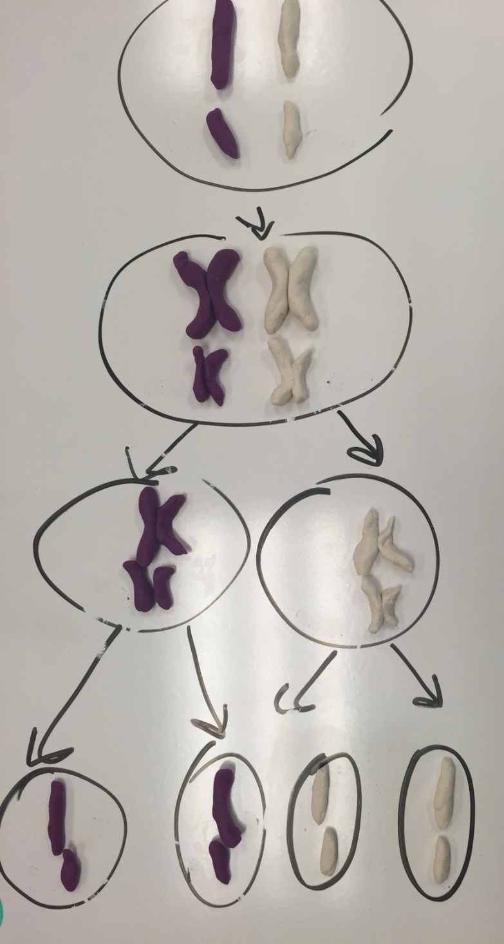
A Model of Meiosis
Photo courtesy of Paul Beardsley
Notes:
5 min
a. Walk participants through the content representation on the slide.
b. “This is a model of meiosis for a species that has two different chromosomes and two copies of each chromosome. The purple chromosomes came from the dad, and the white chromosomes came from the mom. Meiosis is the process of making sex cells. In meiosis, a single cell divides into four daughter cells, each of which has one copy of each chromosome.”

Slide 29
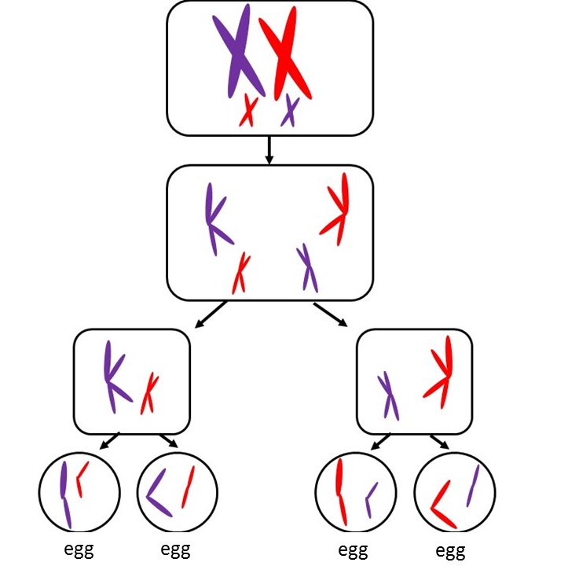
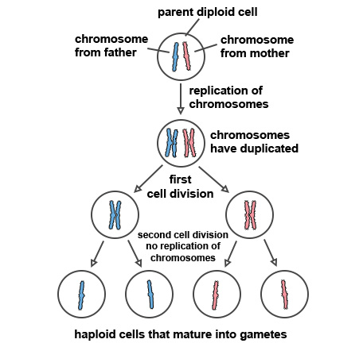
The Process of Meiosis
Courtesy of Cal Poly Pomona
Notes:
7 min
a. Ask participants to compare the two content representations on the slide. They should observe that in the diagram on the right, the organism has a total of only one pair of chromosomes, whereas in the other diagram, the organism has two pairs of chromosomes. The image on the right also shows the chromosomes being duplicated initially, which is essential for the process to work.
b. “What do the blue and red colors represent in these diagrams?” [Answer: Whether the chromosome came from the mother or the father.]
c. “How many copies of each chromosome will be present in each of the sex cells?” [Answer: One copy.]
d. “A human body cell has 46 chromosomes. How many would there be in an egg or sperm cell?” [Answer: Each cell would have 23 chromosomes.]
e. “Where would we find alleles?” [Answer: Along DNA strands in the chromosomes.]
f. Emphasize that alleles represent very small portions of the chromosomes that are shown.
g. “Next, we’ll use a simulation from one of the Genetics lessons to help us understand how the movement of genes and chromosomes relates to inheritance patterns.”

Slide 30
Creating a Model of Meiosis
Task: In groups of three, develop a model of meiosis simulating how a plant that’s heterozygous for purple flower color can make pollen.
Materials for each group: playdough, whiteboard, coin, small allele cards labeled “P “ and “p”
Assumptions:
The plant has two different chromosomes.
There are two copies of each chromosome.
The gene for flower color is on the second chromosome.
Notes:
10 min
a. Divide participants into groups of three for this activity.
b. To remind participants of the steps in meiosis, you may want to display the previous slide throughout this simulation.
Note: For a brief review of the difference between heterozygous and homozygous offspring, see section 7 (Key Terms) in the content background document.
c. Review the instructions on the slide and highlight the three assumptions participants will begin with. Make sure participants have the supplies they need and understand what to do.
d. Circulate among the groups as they work on the simulation and ask the following questions:
“How are you demonstrating which allele is which?”
“Why do plants go through meiosis?”
“What role does chance play in this process?”

Slide 31
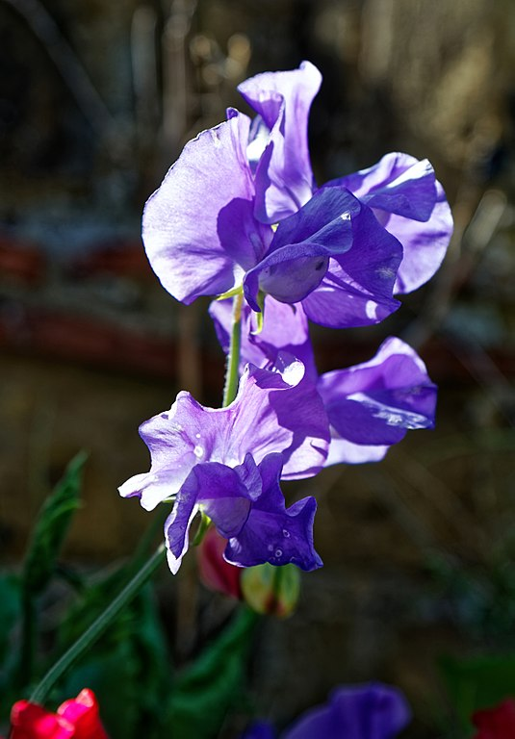
Creating a Model of Meiosis
Group task: Simulate what happens when two heterozygous plants are crossed. Flip a coin to demonstrate the possible allele combinations.
What are the possible outcomes?
Photo courtesy of Acabashi, Wikimedia Commons
Notes:
10 min
a. As groups develop their model of meiosis, have them flip a coin to select the alleles represented in each of the parents’ sex cells. This will highlight the role of chance in the possible allele combinations.
b. Groups should notice that the possible genotypes (or allele combinations) for the offspring are PP, Pp, and pp. The phenotypes (traits exhibited) are purple flowers (PP or Pp) or white flowers (pp).

Slide 32
Interpreting the Results
Part of Model | Is Like … | Part of Nature | Because … | Reason
The letter P | is like … |  | because …
 | is like … | the recessive allele | because …
 | is like … | a chromosome | because …
Coin flipping | is like … |  | because …
 | is like … |  | because …
Notes:
4 min
a. Walk the group through this table to help participants interpret their models.

Slide 33
Reflect: Content Deepening Focus Question
How can we represent DNA, genes, and chromosomes to make sense of trait-variation patterns?
What have we learned from the meiosis simulation that might help us answer this question?
Notes:
2 min
a. “Before we take a short break, let’s review our focus question for this content deepening work.”
b “What have we learned from the meiosis simulation that might help us answer this question?”

Slide 34
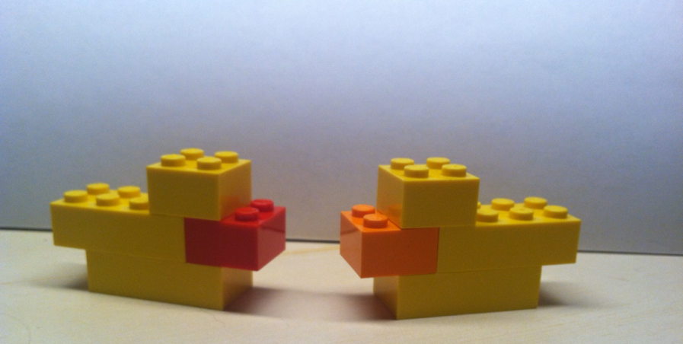
Bill Color in Duckos
How are alleles passed from parents to offspring?
Let’s find out by tracing the bill-color trait in organisms called duckos!
Photo courtesy of BSCS
Notes:
2 min
a. “Next, we’re going to simulate how alleles are passed from parents to offspring by tracing the bill-color trait in fictional organisms called duckos.”
b. Build a model ducko from the Legos in the lesson materials kit so participants can see how simple these organisms are to make.

Slide 35
Teaching Practice: Ducko Simulation 1
Pair up and decide who will be Teacher A and Teacher B. Then read the activity instructions for lesson 4a in your lesson plans binders.
Teacher A: Teach the simulation activity and respond to your partner’s questions.
Teacher B: Write down questions students might ask and how you would respond if you were the teacher. Ask your partner these questions during the simulation.
Link to video clip: 3.3_Lisa_Defoort_GEN_L1
Notes:
15 min
a. Have participants pair up for this activity and decide who will be Teacher A and Teacher B. Review the roles of each teacher on the slide.
b. Ask participants to read the activity instructions for lesson 4a in their lesson plans binders. Make sure they have the supplies they need before they begin the simulation.
c. If there’s time following this activity, consider showing the video clip of Lisa DeFoort teaching the simulation (video segments 30:21–39:10). Afterward, ask participants to summarize what students seemed to understand and not understand about the science ideas in the simulation.

Slide 36
Teaching Practice: Ducko Simulation 2
Switch teaching roles for the second simulation.
Locate handout 4.5 (Making Generation 2 Duckos) in your lesson plans binder and read the worksheet instructions. Then read the teacher instructions for lesson 4b in your lesson plans binder. Make sure you have the necessary supplies.
To increase the sample size for this activity, you’ll build 10 Generation 2 duckos instead of two.
After the simulation, we’ll compile the results, create a bar graph, and compute the ratio of red- billed to orange-billed duckos.
Notes:
20 min
a. Ask participants to locate handout 4.5 (Making Generation 2 Duckos) in their lesson plans binders and read through the activity instructions. Then have them read the teacher instructions for lesson 4b in their lesson plans binders. Note that for this simulation, pairs should switch teaching roles (Teacher A and B).
b. In this activity, students build only two baby duckos for Generation 2, but to increase the sample size, have pairs build 10 offspring.
c. After pairs have finished the simulation, compile the results from all the pairs and make a bar graph showing the number of red-billed and orange-billed duckos. Compute the ratio of red-billed to orange-billed offspring to see whether it comes close to 3:1.
d. “Why do you think we’re more likely to see a 3:1 ratio with a larger sample size?”

Slide 37
Generation 1 Duckos:
Parents’ Alleles
Mom has a red bill. Dad has an orange bill.
MOM’s Alleles DAD’s Alleles
B B b b
Possible Alleles for Offspring
Bb
Bb
Bb
Bb
Each offspring in Generation 1 has a ________ bill.
Notes:
7 min
Note: The slide animations for this activity come from lesson 5a.
a. “Next, we’ll use a series of slide animations from lesson 5 to explain the ducko results.”
b. First display only the top portion of the slide showing one allele (B or b) in each parent’s sex cells.
c. “The capital B in this diagram represents the dominant allele, and the lowercase b represents the recessive allele. The letter b was selected to represent bill color, but scientists use any letter or symbol that makes sense.”
d. “Remember, the way the parents’ sex cells come together is entirely random. Any egg could combine with any sperm when offspring are made, so let’s see what might happen with the ducko parents’ cells.”
e. Click through the slide animation to reveal how each egg could combine with either sperm. Emphasize that no matter which sex cells combine, all the offspring have the same allele combination: Bb.
f. “So what color bill do all the first-generation duckos have? Why do you think there were no orange-billed duckos in Generation 1? Talk about this with a partner and see if you can come up with an explanation for this result.”
g. “Next, we’ll see what happens with the second generation of duckos.”

Slide 38
Generation 2 Duckos:
Parents’ Alleles
Mom has a red bill. Dad has a red bill.
MOM’s Alleles DAD’s Alleles
B b B b
Possible Alleles for Offspring
BB
Bb
bB
bb
Red Bill
Red Bill
Red Bill
Orange Bill
What bill color do you think each offspring will have?
Notes:
5 min
a. First display only the top portion of the slide. Point out that both parents have one dominant allele and one recessive allele.
b. “Why do you think each of the parents has a dominant allele and a recessive allele?”
Note: Participants should recognize that the parents (the Generation 1 offspring) received a dominant and a recessive allele from their parents.
c. “Now let’s see the possible allele combinations for the Generation 2 duckos. Remember, the parents’ sex cells join together randomly, so any sperm could combine with any eggs.”
d. Reveal each possible allele combination on the slide animation one at a time. When the animation shows an arrow pointing from one allele to another, ask participants to describe which two alleles the offspring would have. Then advance the animation to confirm the answer.

Slide 39
Mom has a red bill. Punnett Dad has a red bill. MOM’s Alleles Squares DAD’s Alleles
B b B b
Mom’s Alleles
B b
Possible Alleles for Offspring:
BB = 1 Bb = 2 bb = 1
B
BB
Bb
Possible Traits for Offspring:
BB = Red = 1
Bb = Red = 2
bb = Orange = 1
Punnett Square
Dad’s Alleles
3
b
Bb
bb
Notes:
10 min
a. Walk participants through this simulation from lesson 5a. Reveal the top portion of the slide first and review the Generation 1 parents’ alleles. Then advance the animation to demonstrate how a Punnett square works.
b. “The Punnett square on this slide is another way to represent the possible allele combinations for the Generation 2 ducko offspring. The mom’s alleles appear at the top of the square, and the dad’s alleles appear along the left side. To show the different allele combinations for the offspring, an allele at the top of the square is combined with an allele on the side of the square and recorded in the appropriate box.”
c. Click through the slide animation to demonstrate filling in the Punnett square for Generation 2 duckos.
d. “How would you describe the different alleles the Generation 2 offspring received from their parents?”
“How many of the four offspring inherited two dominant alleles from their parents?”
“How many inherited both a dominant allele and a recessive allele?”
“How many inherited two recessive alleles?”
e. Advance the slide animation to reveal the possible allele combinations for the offspring (BB, Bb, and bb) and the number of offspring that inherited each combination.
f. “Based on these allele combinations which bill color do you think each of these offspring will have? Think about this for a moment and then share your answers with a partner to see if you agree.”
g. After participants have shared their predictions, reveal the possible bill-color traits of the Generation 2 offspring and how many duckos exhibit each bill color.

Slide 40
Practice with Punnett Squares
Locate handout 3.6 (Exploring Trait Patterns in Offspring) in your PD program binder.
Work with a partner to complete the worksheet.
Notes:
10 min
a. Have participants locate handout 3.6 (Exploring Trait Patterns in Offspring) in their PD program binders. This handout is from Genetics lesson 5b.
b. Ask participants to work with a partner to complete the worksheet.

Slide 41
Reflect: Content Deepening Focus Question
How can we represent DNA, genes, and chromosomes to make sense of trait-variation patterns?
Notes:
2 min
a. Review the focus question on the slide.
b. “Reflect on the content deepening work we completed today and then answer this question in your science notebooks.”

Slide 42
Summary: Moving Student Thinking Forward
How can we advance student thinking without simply telling students about science ideas and asking them to memorize the concepts?
Refer to our Effective Science Teaching chart from day 1. Which of these ideas do you want to highlight based on the strategies we’ve explored so far? Anything you want to add or modify?
Notes:
5 min
a. Have participants share ideas about the first question on the slide. Then ask, “What are some things we’ve discussed today that address this question?”
b. Refer participants to the Effective Science Teaching chart from day 1 and discuss the remaining questions on the slide. Modify the chart as participants share their ideas.

Slide 43
Summary: Today’s Focus Questions
Lesson Analysis
Content Deepening
How can analyzing data and constructing explanations help students move forward toward deeper understandings of science ideas?
How can we represent DNA, genes, and chromosomes to make sense of trait-variation patterns?
Notes:
5 min
a. Review today’s focus questions.
b. Discuss: “The STeLLA strategies booklet claims that strategies 4 and 5 are ways of moving student thinking forward. How would you support or challenge that claim? In other words, are you convinced that letting students analyze data and construct explanations will help them move forward toward deeper understandings of science ideas?”
c. Ask: “What key ideas do you now have about how to address our content deepening focus question?”

Slide 44
Homework
Review strategy 6 in the STeLLA strategies booklet and complete the STL Z-fold summary chart for this strategy: Engage students in using and applying new science ideas in a variety of ways and contexts.
Be prepared to share your assigned lesson plan review.
Notes:
1 min
a. “Tomorrow we’ll focus on another strategy to help move student thinking forward toward deeper understandings of science ideas.”
b. Review the homework assignment and have participants copy it into their science notebooks.

Slide 45
Reflections on Today’s Session
Complete the Daily Reflections sheet (handout 3.7).
What new idea or insight did you have today related to strategy 4 (analyzing and interpreting data and observations) and strategy 5 (constructing explanations and arguments)?
What ideas do strategies 4 and 5 give you about things to try or change in your science teaching?
Answer one of these questions: (1) What important science idea are you taking away from our content deepening work today? Remember to state the idea in a complete sentence. (2) What question do you have about trait variation and inheritance (i.e., something you’re unclear or wonder about)?
Notes:
4 min
a. Have participants reflect on today’s session and answer the questions on the Daily Reflections sheet (handout 3.7 in PD program binder).
Note: To support this task, encourage participants to refer to the STeLLA strategies booklet, the charts they created for STL strategies 4 and 5, the Effective Science Teaching chart, and their STL Z-fold summary charts.

Slide 46
Norms for Working Together: The Basics
Purpose: Build trust and develop a productive study group for all participants.
The Basics
Arrive prepared and on time; stay for the duration; return from breaks on time.
Remain attentive, thoughtful, and respectful; engage and be present.
Eliminate interruptions (turn off cell phones, email, and other electronic devices; avoid sidebar conversations).
Make room for everyone to participate (monitor your floor time).
Notes:
Hidden slide—available for use as needed.

Slide 47
Norms for Working Together: The Heart
Purpose: Build trust and develop a productive study group for all participants.
The Heart of RESPeCT Lesson Analysis and Content Deepening
Keep the goal in mind: analysis of teaching to improve student learning.
Share your ideas, uncertainties, confusion, disagreements, questions, and good humor. All points of view are welcome.
Expect and ask questions to deepen everyone’s learning; be constructively challenging.
Listen carefully; seek to understand other participants’ points of view.
Notes:
Hidden slide—available for use as needed.

