Slide 1
RESPeCT PD pROGRAM
Day 5
RESPeCT Summer Institute
Notes:
5 min
a. Take care of any housekeeping issues.

Slide 2
Agenda for Day 5
Day-4 reflections
Focus questions
Review of strategy 6: use and apply
What Is the Science Content Storyline Lens (SCSL)?
Introducing SCSL strategy A
Lesson analysis: SCSL strategy A
Lunch
Content deepening: the Sun’s effect on climate
Summary, homework, and reflections
Notes:
2 min
a. Talk through the agenda for the day.

Slide 3
Trends in Reflections
Lesson Analysis | Science Content Learning
Notes:
5 min
a. Give participants time to review your feedback on their reflections from day 4 and offer reactions, comments, or follow-up questions.

Slide 4
Norms for Working Together: The Basics
Purpose: Build trust and develop a productive study group for all participants.
The Basics
Arrive prepared and on time; stay for the duration; return from breaks on time.
Remain attentive, thoughtful, and respectful; engage and be present.
Eliminate interruptions (turn off cell phones, email, and other electronic devices; avoid sidebar conversations).
Make room for everyone to participate (monitor your floor time).
Notes:
5 min
a. Review the norms as a group.
b. Ask: “Any comments or suggested changes? How are we doing with applying these norms?”

Slide 5
Norms for Working Together: The Heart
Purpose: Build trust and develop a productive study group for all participants.
The Heart of RESPeCT Lesson Analysis and Content Deepening
Keep the goal in mind: analysis of teaching to improve student learning.
Share your ideas, uncertainties, confusion, disagreements, questions, and good humor. All points of view are welcome.
Expect and ask questions to deepen everyone’s learning; be constructively challenging.
Listen carefully; seek to understand other participants’ points of view.
Notes:
5 min
a. Review these norms as a group.
b. Ask: “Any comments or suggested changes? Which of these norms do you think we could get better at applying individually and as a group?”
c. Remind participants: “These norms will become increasingly important during the Summer Institute and throughout the academic year as we analyze one another’s classroom videos and learn together.”

Slide 6
Notes:
2 min
a. Transition: This slide marks the transition from the STL strategies to the Science Content Storyline Lens strategies.
b. “Throughout the PD program, we’ll continue learning about the Student Thinking Lens (STL) strategies, but today we’ll transition to the Science Content Storyline Lens strategies.”
c. Highlight the SCSL strategies on the slide.

Slide 7
Focus for the Week
Content area 2: the Sun’s effect on climate (SEC)
Science Content Storyline Lens
Strategies A, B, C, D, F, G, H, and I
Video-based lesson analysis (SEC lessons)
SEC lesson plans review (last day)
Academic-year schedule (last day)
Video recording
Study-group sessions
Notes:
1 min
a. “This week we’ll focus on a new content area: the Sun’s effect on climate. We’ll also examine the Science Content Storyline Lens strategies and the SEC lessons you’ll be teaching in the fall, analyze video clips of those lessons, and deepen your science-content knowledge related to the lesson plans.”
b. “On the last day of the RESPeCT PD program, we’ll review the lesson plans and the schedule for the academic year.”
c. “You may notice that we skip strategy E: Sequence key science ideas and activities appropriately. This strategy will be addressed during the school year as you teach the STeLLA lesson plans and analyze how they’re sequenced within each lesson and across lessons.”

Slide 8
Today’s Focus Questions
What is the Science Content Storyline Lens (SCSL)?
Why is one main learning goal essential for science content storyline coherence?
What temperature patterns can you find on Earth at different latitudes?
What temperature patterns can you find on Earth at different times of the year?
Notes:
1 min
a. Introduce the focus questions that will guide today’s work.

Slide 9
Check Your Understanding of Strategy 6
Jot down your responses to this multiple-choice quiz:
Use-and-apply tasks are used [before/during/after] new science ideas are introduced.
For difficult content ideas, students might need to practice applying new ideas in [one/two/many] different contexts.
[True/false]: Use-and-apply questions or activities are used primarily for student assessment at the end of a unit.
It’s appropriate for teachers to ask [elicit/probe/challenge] questions during a use-and-apply activity.
Teachers should [never/judiciously/always] tell students about science ideas they are missing or stating inaccurately.
Notes:
7 min
Note: Display this slide only if it wasn’t used on day 4.
a. “To check your understanding of STL strategy 6, jot down your responses to this multiple-choice quiz in your science notebooks.”
b. Have participants discuss their answers either in pairs or as a group. (If time is short, just read the answers aloud.)
Answer key:
1. After
2. Many
3. False
4. Challenge (and probe)
5. Judiciously (defined as “good or discriminating judgment; wise, sensible, or well advised”)

Slide 10
Use and Apply Your Content Deepening Knowledge
Scenario: Several members of your extended family have very crooked teeth. You’d like to figure out whether this is a genetic trait or environmental factors (like thumb sucking) are the cause.
Use and apply what you learned about genetics last week to solve this mystery. Jot down your explanation in bullet points and make sure to use science ideas to support your answer.
Share your ideas with a partner and note any questions that arise.
Notes:
8 min
a. Think-Pair-Share (3 min): “Think about the scenario on the slide. Use an apply what you learned about genetics last week to figure out why several members of your extended family have very crooked teeth. Jot down your explanation in bullet points in your notebooks, making sure to use science ideas to support your answer. Then share your ideas with an elbow partner and note any questions that arise.”
b. Whole-group share-out (4 min): “What ideas did you have for solving this use-and-apply scenario?”
Ideal responses:
“If a trait is genetic, it will show up in a specific pattern among my relatives.”
“I’d create a chart showing who in my family has crooked and straight teeth, and then I’d track this through as many generations as possible.”
“Based on a guess that crooked teeth might be a dominant or recessive trait, I’d show two recessive alleles for each person who has that trait. For those who exhibit what might be a dominant trait, I’d indicate the possibility that they might have two dominant alleles or one dominant and one recessive allele.”
“I’d use these allele markers to figure out whether the pattern in visible traits makes sense (or is even possible). If it doesn’t make sense, I’d reverse my guess about dominant and recessive traits and redesignate the possible alleles of each individual.”
“If neither the dominant or recessive scenarios generate a pattern of inheritance that makes sense, I’d consider how other environmental influences might have come into play for the various individuals in my family.”

Slide 11
Planning Science Lessons: Quick Write
What is generally your thinking process when you plan your science lessons?
Be prepared to share your ideas with the group.
Notes:
6 min
Note: This activity is a lead-in for thinking about specific SCSL strategies. When planning science lessons, are participants thinking primarily about (1) SCSL issues, such as learning goals, (2) student misconceptions (an STL issue), which is a great start but doesn’t include SCSL strategies, or (3) activities and/or classroom management and timing issues?
a. Individuals: Direct participants to take 2–3 minutes to write down the key things they think about when planning science lessons.
b. Whole group: Ask participants to share their reflections with the group.
c. Tell participants: “The Science Content Storyline Lens strategies should provide some new or additional ways of thinking about planning your science lessons.”

Slide 12
Lesson Analysis: Focus Question 1
What is the Science Content Storyline Lens (SCSL)?
What is a science content storyline, and why is it important?
What is challenging about developing a science content storyline?
Notes:
7 min
a. Small groups: Direct half the group to focus on the first bulleted question on the slide, and the other half to focus on the second. Allow groups 2 minutes to think about their assigned questions as they review “Introduction to the Science Content Storyline Lens” in the STeLLA strategies booklet.
b. Whole group: Have each group share their ideas and responses for these questions.
c. As you listen to participants, make sure that what they’re saying is consistent with the strategies booklet. If you aren’t sure they’re interpreting the text accurately, ask them to identify the specific text they are drawing from.

Slide 13
The TIMSS Video Study Findings and the Science Content Storyline Lens
Source: TIMSS study
Notes:
2 min
a. Emphasize the research basis for the Science Content Storyline Lens and its importance. Remind participants that the data on the slide was presented on day 1 of the PD program.
b. Ask: “What does this graph reveal about US science lessons compared with higher-achieving countries?”
Ideal response: According to the study, US science lessons didn’t do as well linking science ideas to lesson activities; in fact, many lessons were activity focused and included significantly fewer science ideas compared to other countries.
c. Summarize: Point to strategies F and G on the STeLLA strategies poster: Make explicit links between science ideas and activities (strategy F) and link science ideas to other science ideas (strategy G). These strategies and the idea of a Science Content Storyline Lens grew out of the TIMSS research findings.
d. “Today we’ll begin our study of the Science Content Storyline Lens, with a focus on strategy A: Identify one main learning goal.”

Slide 14
Lesson Analysis: Focus Question 2
Why is one main learning goal essential for science content storyline coherence?
Notes:
1 min
a. Read the focus question on the slide.

Slide 15
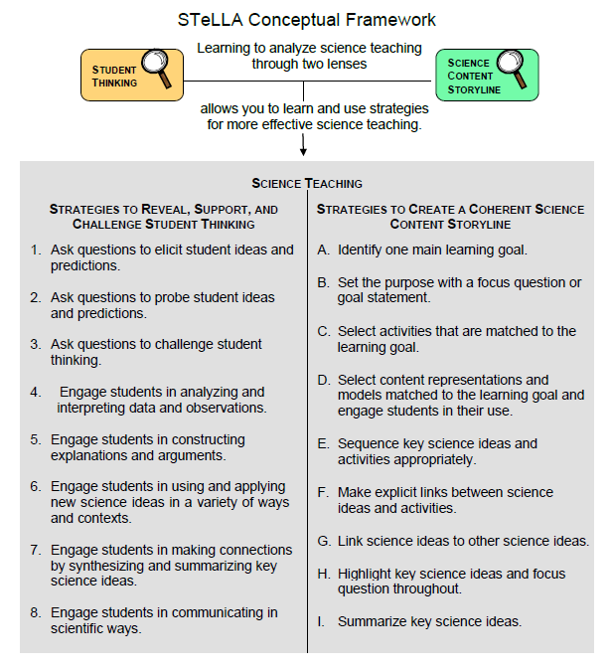
Notes:
1 min
a. “Now let’s dig into SCSL strategy A!”
b. “As you can see, strategy A is the first of nine Science Content Storyline Lens strategies. It appears first because it’s the foundation on which all the other SCSL strategies are built. This will become clearer as we delve into the other strategies and see how important it is that each of them is matched to the lesson’s main learning goal.”

Slide 16
Purpose and Key Features of Strategy A
Review your SCSL Z-fold summary chart and share with a partner the purpose and key features of strategy A: Identify one main learning goal.
Remember to cite passages from the STeLLA strategies booklet.
Be prepared to share with the group.
Notes:
25 min
a. Pairs: “Share with a partner what you wrote on your Science Content Storyline Lens Z-fold summary chart about the purpose and key features of strategy A.”
b. Whole group: Have one or two participant volunteers lead the group in creating a chart that describes the purpose and key features of strategy A.
c. Transition: “Next, we’ll review the difference between a science idea and the main learning goal of a lesson. Then you’ll practice identifying and clarifying this distinction.”

Slide 17
A Main Learning Goal Is …
A big science idea that you want students to learn
A big idea that shows the relationship among science ideas
The focus of the lesson (or series of lessons)
Stated in a complete sentence (for planning purposes)
Stated by the teacher, a student, a text, or a multimedia resource
A support for teacher planning
Notes:
1 min
a. “This slide lists some key ideas about the definition of a main learning goal.”
b. Read through the ideas.
c. Emphasize: “Notice the parenthetical reference to ‘lessons’ in the third bullet point. Each lesson should have only one main learning goal, but you might need two or more lessons to help students accomplish a difficult goal. So it’s often necessary to spend more than one lesson on a specific learning goal.”

Slide 18
A Main Learning Goal Is NOT …
A topic or phrase
An activity
A question
A performance task or objective
A supporting detail, definition, or fact
A student misconception or idea that isn’t scientifically accurate
Notes:
1 min
a. Review what is not considered a main learning goal.

Slide 19
Definitions: One Main Learning Goal and Science Ideas
Read these sections in the STeLLA strategies booklet: (1) STeLLA Strategy A: Identify One Main Learning Goal, and (2) Student Ideas and Science Ideas Defined.
Based on these readings, what are the differences between a main learning goal and a science idea?
Notes:
10 min
a. Have participants locate these two readings in the strategies booklet: (1) STeLLA Strategy A: Identify One Main Learning Goal, and (2) Student Ideas and Science Ideas Defined.
b. “After you read these sections in the strategies booklet, we’ll discuss the differences between a science idea and a main learning goal.”
c. Individuals (3 min): Give participants time to read the specified sections in the strategies booklet.
d. Whole group (7 min): Discuss the question on the slide.
e. Emphasize: “While you might incorporate several science ideas that support the main learning goal of a lesson, be careful not to plan an ‘all about’ lesson with too many different science ideas that will likely come across to students as a bunch of disconnected facts to be memorized.”

Slide 20
Practice Identifying Student Ideas and Science Ideas
Identify any student ideas and science ideas in this list:
The North Pole and South Pole are the coldest places on Earth because they’re farthest from the Sun.
Earth orbits the Sun in an elliptical (oval) path, so sometimes it’s farther from the Sun.
The angle of sunlight striking certain places on Earth varies at different times of the day and year.
Earth’s tilted axis
The Northern and Southern Hemispheres are warmest at opposite times of the year.
Why are places closer to Earth’s equator hotter than places farther away from the equator?
Notes:
5 min
a. “Next, we’ll practice identifying student ideas and science ideas just to make sure you understand the way we’re defining these terms.”
Note: As needed, refer participants to the section in the strategies booklet where student ideas are defined (Student Ideas and Science Ideas Defined).
b. Individuals: “First, identify examples of science ideas on the slide. If you need help, refer to the document in your lesson plans binders titled Common Student Ideas about the Sun’s Effect on Climate and Seasons. Then identify examples of student ideas on the slide.”
c. Whole group: Discuss participants’ responses and the correct answers (see answer key).
Answer key:
Science ideas: 3, 5
Student ideas: 1, 2
Neither: 4, 6

Slide 21
Practice Identifying Student Ideas and Science Ideas in a Class Discussion
Identify one student idea and one science idea in this class discussion:
T: Why do you think it’s summertime in the Southern Hemisphere when it’s wintertime in the Northern Hemisphere?
S1: Earth’s tilt.
S2: I disagree. It’s Earth’s orbit.
S3: Earth is farther from the Sun in the winter.
T: Whose wintertime—the Northern or Southern Hemisphere’s?
S3: Oh, I guess that doesn’t make sense. If distance from the Sun causes seasons, both hemispheres would have winter and summer at the same time.
Food for thought: To avoid problems, why not require students to speak in complete sentences during science discussions?
Notes:
5 min
a. “It’s a little trickier to recognize student ideas and science ideas in class discussions because students sometimes give only one- or two-word answers to teacher questions. But if you link the teacher’s question with the student’s response, you can sometimes find a science idea or a student idea.”
Note: In the RESPeCT PD program, we encourage students to speak in complete sentences as much as possible.
b. “Let’s practice linking the teacher’s question with student responses in the sample discussion on the slide.”
c. Pairs: “Work with a partner to see if you can identify one student idea and one science idea in this discussion.”
d. Whole-group share-out: Have participants share the ideas they identified in the sample discussion Then review the answers (see answer key).
e. Emphasize: “Here’s some food for thought: To make student thinking more visible, why not require students to speak in complete sentences during classroom discussions about science ideas?”
Answer key:
Student ideas/misconceptions:
Since it’s the combination of Earth’s orbit and tilt that causes opposite seasons, both S1 and S2 have only part of the science idea, so these would be considered “student ideas; incomplete understanding.”
At first, S3 expresses another student idea—that the distance from Earth to the Sun is different during different seasons. S3 realizes this is an error based on the teacher’s probe question and states a science idea (but not the answer to the original question): “If distance from the Sun causes seasons, both hemispheres would have winter and summer at the same time.”
Correct and complete science idea:
It’s warmer in the Southern Hemisphere when it’s cooler in the Northern Hemisphere because the tilt of Earth and its orbit around the Sun cause the most direct (straight-on or concentrated) sunlight to shift from the Northern Hemisphere to the Southern Hemisphere at different times of the year.

Slide 22
Science Ideas That Support the Main Learning Goal
Main learning goal: Earth’s consistent tilt and yearly orbit around the Sun produce opposite seasons in the Northern and Southern Hemispheres.
Supporting ideas:
Earth revolves around the Sun in a nearly circular orbit, so the distance between them is the same year-round.
Earth’s axis tilts consistently at 23.5 degrees and always points toward the North Star.
Sunlight striking Earth’s surface at a more direct angle (almost 90º) results in more concentrated solar radiation and greater heating.
During Earth’s orbit, the part leaning toward the Sun or closest to a 90-degree angle experiences the greatest heating.
Spring and fall occur when Earth’s hemispheres are leaning neither toward nor away from the Sun along Earth’s orbit.
Notes:
6 min
a. Display only the main learning goal on the slide.
b. Pairs: “Work with a partner to come up with two or three science ideas that might support the development of this main learning goal. Use the SEC content background document and the Common Student Ideas chart as resources.”
c. Whole group: Have pairs share the supporting science ideas they came up with.
d. Next, reveal the list of possible supporting science ideas one by one on the slide and compare them with participants’ ideas.
e. Highlight: “Some of these supporting science ideas could also be a lesson’s main learning goal.”

Slide 23
Practice Identifying Main Learning Goals
Small groups or pairs: Use the criteria in Analysis Guide A (handout 5.1 in binder) to analyze a list of candidate main learning goals related to the Sun’s effect on climate (handout 5.2: Practice Identifying One Main Learning Goal).
Select candidates from the list that you think are good main learning goals for the focus of the lesson and record the reasons for your choices on handout 5.2.
Whole group: Discuss and justify your selections.
Notes:
10 min
a. Direct participants to locate handout 5.1 (Analysis Guide A: Identifying One Main Learning Goal) and handout 5.2 (Practice Identifying One Main Learning Goal) in their PD program binders.
b. Small groups/pairs: Have participants form small groups or pairs and use the criteria from Analysis Guide A to analyze the list of possible learning goals on handout 5.2.
c. Direct participants to write yes or no on the handout to indicate whether the statement is or is not a good candidate for a lesson’s main learning goal. Then have them state the reason for each assessment using criteria from the analysis guide.
d. Whole-group share-out: Have participants share and discuss their selections.
e. Be sure to highlight what distinguishes a main learning goal from supporting science ideas, topics, phrases, activities, or questions.
f. Also use this discussion to clarify science content.
Content note: One question that might emerge is the shape of Earth’s orbit around the Sun. Refer to the content background document (page 3, middle paragraph) to clarify this concept. Participants may not yet have an idea about the impact of Earth’s spherical shape and the changing angles of the Sun on climate. Let them know they’ll be exploring this in more depth during the content deepening work this week.
Note: For answers, see PD Leader Master: Practice Identifying One Main Learning Goal (Answer Key).

Slide 24
Lesson Analysis: Strategy A
Next we’ll watch a sequence of three video clips from a single lesson about the Sun’s effect on climate.
Analysis question for all three clips: Does this lesson have one main learning goal?
Follow-up questions:
If yes, what is it?
If no, what do you think is happening in the lesson?
Notes:
1 min
a. Make sure participants understand that they will be viewing a sequence of three video clips from the same lesson on the Sun’s effect on climate.
b. “For all three clips, we’ll answer the analysis question, Does this lesson have one main learning goal?”
c. “If the answer is yes, what is the learning goal? If no, why do you think that’s the case? What do you think is happening in the lesson?”

Slide 25
Lesson Analysis: Review Lesson Context, Video Clip 1
Read the lesson context on the video transcript (handout 5.3 in PD program binder).
As you watch the clip, keep the analysis question in mind: Does this lesson have one main learning goal?
If yes, what is it?
If no, what do you think is happening in the lesson?
Link to video clip 1: 5.1_stella_SEC_evans_L6_c1
Notes:
5 min
a. Have participants read the lesson context at the top of the video transcript (handout 5.3 in PD program binder). (Less than 1 min)
b. Read the information on the slide. (Less than 1 min)
c. Show the video clip. (4 min)

Slide 26
Lesson Analysis: Analyze the Video, Video Clip 1
Study the video transcript and write down any science ideas the students and/or the teacher put on the table.
Pair up and compare the science ideas you identified. Then discuss the analysis question: Does this lesson have one main learning goal?
If yes, what is it?
If no, what do you think is happening in the lesson?
As a group, discuss what the main learning goal might be. Support your answers using your analysis of the science ideas you identified.
Notes:
25 min
a. Before participants analyze the video transcript, remind them of these key points: (1 min)
A science idea is a full-sentence idea that students could take away as something they learned during the lesson.
Science ideas are sometimes identified by linking the teacher’s question with the student’s response.
b. Individuals (8 min): “Study the video transcript and write in your notebooks any science ideas you identify in the discussion.”
c. Pairs (5 min): “Pair up and compare the science ideas you identified. Then discuss the questions on the slide.”
d. Whole-group share-out (11 min): Have participants share what they think might be the main learning goal of this lesson, using their analyses of the science ideas they identified.
e. List the possible learning goals on chart paper.
f. Let participants know they’ll revisit this list of possible main learning goals for the lesson after they watch the remaining video clips.
Observations:
The unit central question is “Why are some places on Earth hotter than others at different times of the year?” The focus question for this lesson is “How does being near the ocean or at a higher elevation affect air temperature?”
The following ideas emerge about the simulation:
The heat lamp represents the Sun (video segment 0:00:12.1).
Students will test the impact that heating has on soil and water and relate this to temperature patterns in San Francisco, Colorado Springs, and St. Louis, Missouri (segments 0:00:20.7 and 0:00:37.5).
When the heat lamp is off, it represents winter (segment 0:00:31.4).
When the heat lamp is on, it represents summer (segment 0:00:36:8).
The teacher prompts students to recall other ideas they learned about in previous lessons:
The curve of Earth’s surface affects climate at different locations (segment 0:00:59.3).
The distance between Earth and the Sun stays constant throughout the year at 93 million miles (segments 0:01:11.8–0:01:18.5).
Earth’s tilt is essentially constant at 23.5 degrees (segments 0:01:21.1–0:01:42.1).
Possible main learning goal:
In addition to the factors that cause uneven heating on Earth, such as the curve of Earth’s surface, Earth’s tilt and orbit, and latitude, another factor that impacts an area’s climate is proximity to a large body of water.

Slide 27
Lesson Analysis: Review Lesson Context, Video Clip 2
Read the lesson context on the video transcript (handout 5.4 in PD binder).
As you watch the clip, keep the analysis question in mind: Does this lesson have one main learning goal?
If yes, what is it?
If no, what do you think is happening in the lesson?
Link to video clip 2: 5.2_stella_SEC_evans_L6_c2
Notes:
5 min
a. Have participants read the lesson context at the top of the video transcript (handout 5.4 in PD binder). (Less than 1 min)
b. Review the instructions on the slide. (Less than 1 min)
c. Show the video clip. (4 min)

Slide 28
Lesson Analysis: Analyze the Video, Video Clip 2
Study the video transcript and write down any student ideas and science ideas you identify.
Pair up and compare the student ideas and science ideas you identified. Then discuss this question: Are these ideas consistent with the possible main learning goal you identified for video clip 1?
As a group, discuss the possible main learning goal for this lesson. Make sure to support your answers using your analysis of the science ideas you identified.
Notes:
25 min
Note: This video clip includes two segments. For the sake of time, show only the first segment, stopping the video at 1:18.
a. Review the definitions of a science idea and a student idea. Remind participants that students can express correct science ideas and inaccurate student ideas at the same time. (1 min)
b. Individuals (8 min): “Study the video transcript and write in your notebooks any student ideas and science ideas you identify.”
c. Pairs (5 min): “Pair up and compare the student ideas and science ideas you identified. Then discuss the question on the slide.”
d. Whole-group share-out (11 min): Have participants share out what they think might be the main learning goal of this lesson, using their analyses of the science ideas they identified to support their suggestions.
e. List the possible learning goals on chart paper.
f. Let participants know they’ll revisit this list of possible main learning goals for the lesson after they watch one more video clip.
Observations:
The clip begins with a student stating that water cools down slower and heats up faster—an idea not supported by the data (video segment 0:00:01.4).
The teacher asks students to link the simulation results to real cities like San Francisco (segment 0:00:19.7).
Referring specifically to the data, a student points out that the soil heats up faster (segment 0:00:54.4).
Again referring to the data, students show that water heats up more slowly than soil (segments 0:01:04.3–0:01:39.9).
At segment 0:02:21.6, the teacher again asks students to link the data they collected in the simulation to the actual temperature readings (plotted on graphs in lesson 5) of three US cities (San Francisco, Colorado Springs, and St. Louis); however, he doesn’t stick around to hear whether students are making the connections.
The discussion is entirely focused on different rates of heating for water and soil. At this point, it’s unclear whether students are connecting the simulation results to differential heating in three US cities, but the discussion is consistent with the main learning goal identified in the first clip.

Slide 29
Lesson Analysis: Review Lesson Context, Video Clip 3
Read the lesson context on the video transcript (handout 5.5 in PD binder).
As you watch the clip, keep the analysis question in mind: Does this lesson have one main learning goal?
If yes, what is it?
If no, what do you think is happening in the lesson?
Link to video clip 3: 5.3_stella_SEC_evans_L6_c3
Notes:
5 min
a. Have participants read the lesson context at the top of the video transcript (handout 5.5 in PD binder). (Less than 1 min)
b. Review the instructions on the slide. (Less than 1 min)
c. Show the video clip. (4 min)

Slide 30
Lesson Analysis: Analyze the Video, Video Clip 3
Study the video transcript and write down any student ideas and science ideas you identify.
Pair up and compare the student ideas and science ideas you identified. Then discuss this question: Are these ideas consistent with the possible main learning goal you identified for clips 1 and 2?
As a group, discuss the possible main learning goal for this lesson. Make sure to support your answers using your analysis of the science ideas you identified.
Notes:
24 min
a. Individuals (8 min): “Study the video transcript and write in your notebooks any student ideas and science ideas you identify.”
b. Pairs (5 min): “Pair up and compare the student ideas and science ideas you identified on the transcript. Then discuss the question on the slide.”
c. Whole-group share-out (11 min): Have participants share what they think might be the main learning goal of this lesson, using their analyses of the science ideas they identified to support their suggestions.
d. List the science ideas and possible learning goals on chart paper.
e. Ask: “Did the three video clips develop coherence across the lesson or include too many ideas that didn’t support the main learning goal?”
Observations:
In this whole-group lesson summary, the teacher asks students if they’ve answered the day’s focus question regarding the impact of proximity to water and elevation on the average temperature of cities at the same latitude.
Referring to their data from the simulation, students claim that water retains heat, thus keeping it hot or warm throughout the year (video segment 0:00:17.2), and the soil temperature fluctuated greatly (segment 0:00:28.1).
Students didn’t specifically relate the soil and water data to the three US cities.
Students also refer to St. Louis as being really flat (no mountains) but don’t relate any ideas about how elevation might impact a location’s temperature. It’s unclear whether they understood the connection between elevation and temperature.
Whereas the stated focus question indicates that there is a dual focus in this lesson on proximity to water and elevation as factors causing temperature variation, from the clips we viewed and the lesson summary, it appears that the main learning goal was mostly about proximity to water. This is consistent with what was identified in clips 1 and 2. Participants may notice that the students don’t make a clear connection in the three clips between their data and the three US cities.

Slide 31
One Main Learning Goal?
Based on your analysis of the three video clips, does this lesson have one main learning goal? What do you think it is?
Use the criteria questions in Analysis Guide A to analyze the main learning goal identified in these clips.
Are there any supporting science ideas that don’t closely match the main learning goal?
Notes:
15 min
a. Whole group: Discuss the first question on the slide and reach a consensus on the main learning goal for the lesson.
Ideal response: Earth’s daily spin (rotation), yearly orbit (revolution), and tilt contribute to changes in temperature that relate to differences in an area’s overall climate and daily changes in weather.
b. Pairs: Have participants work in pairs to answer the criteria questions in Analysis Guide A for this agreed-upon main learning goal. Also have them identify any supporting science ideas that don’t closely match the main learning goal.
c. Whole group: Discuss participants’ responses to the questions in Analysis Guide A and the final question on the slide.
Observations:
There does appear to be one main learning goal in this lesson: Water holds heat energy and doesn’t fluctuate as much as soil; therefore, locations closer to large bodies of water would have a more stable temperature with less fluctuation between winter and summer. The fact that the focus question refers to the impact of elevation on a location’s temperature patterns seems to distract from the main learning goal. Students don’t have much to say about elevation’s influence on temperature other than observing in the lesson summary that St. Louis is flat.

Slide 32
Examine the Sun’s Effect on Climate: Lesson 1
Locate the scope and sequence chart for the SEC lessons (lesson plans binder, pretab section).
Examine the main learning goals for lessons 1a and 1b. Then read the supporting science ideas in the Science Content Storyline column.
What two patterns do students identify in these lessons?
Keep these patterns in mind as the storyline develops in the lesson sequence.
Notes:
5 min
Note: This slide is optional if time is running short. It’s designed to help participants see how the lesson plans are written to highlight the main learning goal and science ideas that support the main learning goal.
a. Have participants examine the main learning goals for lessons 1a and 1b in the scope and sequence chart of their lesson plans binder. Then have them review the supporting science ideas in the Science Content Storyline column.
b. Ask: “What two patterns do students identify in these lessons?”
c. Encourage participants to keep the identified patterns in mind throughout the lesson sequence.

Slide 33
The SUN’S EFFECT ON CLIMATE
SCIENCE CONTENT DEEPENING Grade 6
Notes:
Less than 1 min
a. “Now let’s begin our investigation of the Sun’s effect on climate.”
Note: Throughout this content deepening phase, refer as needed to the Sun’s Effect on Climate Content Background Document and Common Student Ideas about the Sun’s Effect on Climate and Seasons.

Slide 34
The
Sun’s
Effect on
Climate
Content
Deepening
Developed by
Dr. Jeff Marshall
Geological Sciences
Cal Poly Pomona
Used by permission
Photo courtesy of NASA
Notes:
Less than 1 min
a. “Today’s content deepening work will focus on science ideas about the Sun’s effect on climate from SEC lesson 1.”

Slide 35
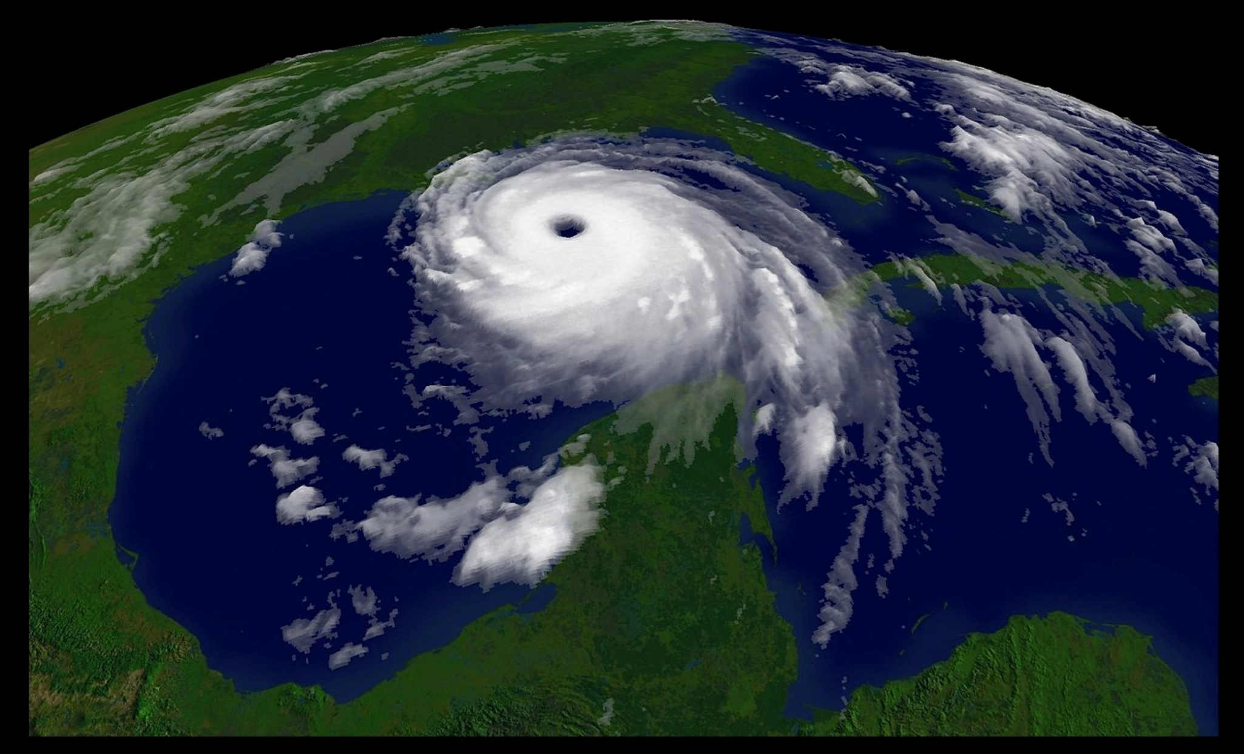
Weather versus Climate
Courtesy of NOAA/Wikimedia Commons
What is WEATHER? What is CLIMATE?
Notes:
20 min
a. Introduce the two questions on the slide.
b. Individuals: Ask participants to think about these questions and jot down brief answers in their science notebooks.
c. As participants are working, create a two-column chart on chart paper to document participants’ responses to these questions. Label one column “Weather” and the other column “Climate.”
d. Whole group: In a round-robin discussion, call on participants to share their responses to the questions.
e. Record participants’ responses on the chart you created. List key words rather than entire sentences.
f. After everyone has shared their responses, briefly highlight some of the key ideas that characterize weather and climate.
g. Ask participants these questions:
Why is it important for students to understand the difference between weather and climate?
What are the key similarities between these terms? What are the key differences?

Slide 36
Weather or Climate?
Can you recognize the difference between weather and climate? Let’s find out!
First, we’ll watch five short video clips.
After each clip, you’ll turn to your elbow partner and briefly discuss whether the clip was an example of weather or climate.
Then we’ll vote as a group: Was this video clip an example of weather or climate?
Later, we’ll watch two more clips that cover key science ideas related to this activity.
Notes:
2 min
a. Go over the instructions on the slide.
b. “Next we’ll watch a sequence of five short video clips showing different scenarios. After each clip, you’ll turn to an elbow partner and discuss whether the scenario was an example of weather or climate. Then we’ll vote on the scenario as a group, and I’ll track the results on chart paper.”
c. “Later we’ll watch two more clips that cover key science ideas related to this activity.”

Slide 37
Weather and Climate Video Clips
Climax, Kansas Supercells https://www.youtube.com/watch?v=Y4EK2r9JJ1k
TV weather forecast https://www.youtube.com/watch?v=zsdQE275PvA
LA Is on Storm Watch https://www.youtube.com/watch?v=z_pTv-qvRI0
El Niño Explained https://www.youtube.com/watch?v=yCsMmajLYG4
Drilling for Ice https://www.youtube.com/watch?v=fuT8Appwak8
Earth: Climate and Weather https://www.youtube.com/watch?v=zz_CRzcIT-Q
Weather versus Climate Change https://www.youtube.com/watch?v=cBdxDFpDp_k
Notes:
1 min
a. Briefly review the list of seven video clips participants will be watching. The first five clips present weather-versus-climate scenarios, and the last two cover key science ideas related to this activity.
Note: To facilitate preloading the video clips, all seven web links are displayed on this slide. Links are also included on slides 38–42 and 49–50. Loading these videos into a web browser before starting this segment will make it easier and more efficient to switch back and forth between this PowerPoint presentation and each of the Internet videos. (See overview page for advance preparation instructions.)
Videos credits and total time:
Climax, Kansas Supercells (Stephen Locke, 2:57 min); https://www.youtube.com/watch?v=Y4EK2r9JJ1k
TV weather forecast (Jackie Johnson, CBS2 News, 2:37 min); https://www.youtube.com/watch?v=zsdQE275PvA
LA Is on Storm Watch (Jimmy Kimmel Live, 3:03 min); https://www.youtube.com/watch?v=z_pTv-qvRI0
El Niño Explained (Climatedogs, 1:19 min); https://www.youtube.com/watch?v=yCsMmajLYG4
Drilling for Ice (Horizon, BBC, 3:21 min); https://www.youtube.com/watch?v=fuT8Appwak8
Earth: Climate and Weather (National Geographic, 3:22 min) https://www.youtube.com/watch?v=zz_CRzcIT-Q
Weather versus Climate Change (Neil deGrasse Tyson, National Geographic, Cosmos, A Spacetime Odyssey, 2:09 min) https://www.youtube.com/watch?v=cBdxDFpDp_k

Slide 38
Scenario 1: Midwest Thunderstorm
Photo courtesy of Pixabay.com
Link to video clip: Climax, Kansas Supercells
Notes:
6 min
Note: For slides 38–42, introduce the video scenario and then switch to the web browser to show the video. Afterward, switch back to the PowerPoint slide.
a. Review the steps for analyzing each scenario: (1) Watch the video clip, (2) pair up and discuss whether the scenario depicts weather or climate (or both), and (3) vote as a group on the final decision.
b. Introduce scenario 1, “Midwest Thunderstorm”; then switch to the web browser and show the video clip.
c. Turn and Talk: After showing the clip, switch back to this PowerPoint slide and ask participants to discuss their observations with an elbow partner.
d. Whole group: Following the Turn and Talk, have the entire group vote on whether the scenario was an example of weather or climate. Record the results on chart paper.
Note: Don’t discuss voting results at this point. There will be a group discussion after all five videos have been viewed.

Slide 39
Scenario 2: TV Weather Report
Photo courtesy of Pixabay.com
Link to video clip: Jackie Johnson, CBS2 News
Notes:
6 min
a. Introduce scenario 2, “TV Weather Report”; then switch to the web browser and show the video clip.
b. Turn and Talk: After showing the clip, switch back to this PowerPoint slide and ask participants to discuss their observations with their elbow partners.
c. Whole group: Following the Turn and Talk, have the group vote on whether the scenario was an example of weather or climate. Record the results on chart paper.

Slide 40
Scenario 3: LA Is on Storm Watch!
Photo courtesy of Pixabay.com
Link to video clip: Jimmy Kimmel Live!
Notes:
6 min
a. Introduce scenario 3, “LA Is on Storm Watch!”; then switch to the web browser and show the video clip.
b. Turn and Talk: After showing the clip, switch back to this PowerPoint slide and ask participants to discuss their observations with their elbow partners.
c. Whole group: Following the Turn and Talk, have the group vote on whether the scenario was an example of weather or climate. Record the results on chart paper.

Slide 41
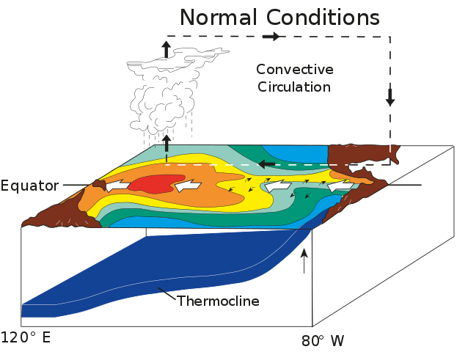
Scenario 4: El Niño Explained
Courtesy of Fred the Oyster, Wikimedia Commons
Link to video clip: Climatedogs, El Nino
Notes:
5 min
a. Introduce scenario 4, “El Niño Explained”; then switch to the web browser and show the video clip.
b. Turn and Talk: After showing the clip, switch back to this PowerPoint slide and ask participants to discuss their observations with their elbow partners.
c. Whole group: Following the Turn and Talk, have the group vote on whether the scenario was an example of weather or climate. Record the results on chart paper.

Slide 42
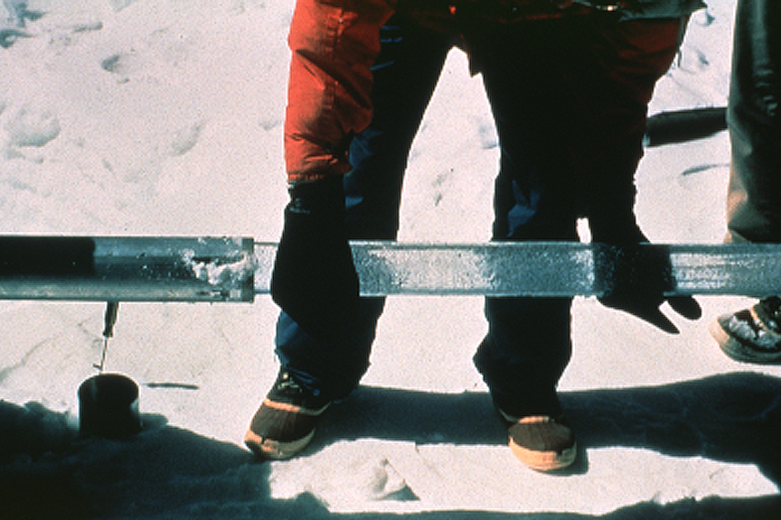
Scenario 5: Ice-Core Research
Courtesy of Lonnie Thompson, Wikimedia Commons
Link to video clip: Drilling for Ice
Notes:
6 min
a. Introduce scenario 5, “Ice-Core Research”; then switch to the web browser and show the video clip.
b. Turn and Talk: After showing the clip, switch back to this PowerPoint slide and ask participants to discuss their observations with their elbow partners.
c. Whole group: Following the Turn and Talk, have the group vote on whether the scenario was an example of weather or climate. Record the results on chart paper.

Slide 43
The Results: Weather or Climate?
Courtesy of NOAA/Wikimedia Commons
What is WEATHER? What is CLIMATE?
Notes:
7 min
a. Whole-group discussion: Discuss the voting results as a group.
Did everyone reach a consensus on all five weather-versus-climate scenarios?
Were some scenarios more challenging to evaluate than others? Why?
What criteria did participants use to make their decisions?
What are the defining characteristics of weather? What are the defining characteristics of climate?
b. Refer participants to the key ideas you charted earlier on weather and climate.
c. Did any of the video scenarios include elements of both weather and climate? Which ones?

Slide 44
Defining Weather and Climate
WEATHER:
Short-term, temporary atmospheric conditions
at a particular location (e.g., temperature, pressure,
precipitation, wind speed, and direction).
CLIMATE:
Long-term, average atmospheric conditions across
a large region or the whole world (e.g., average
temperature and moisture conditions described as
arid, humid, tropical, polar).
Courtesy of NOAA/Wikimedia Commons
What is WEATHER? What is CLIMATE?
Notes:
6 min
a. Read the definitions of weather and climate on the slide.
b. Direct participants to write these definitions in their science notebooks.
c. Ask: “Do these definitions match the criteria we developed from the video scenarios?”
d. Invite a few participants to share their thoughts.

Slide 45
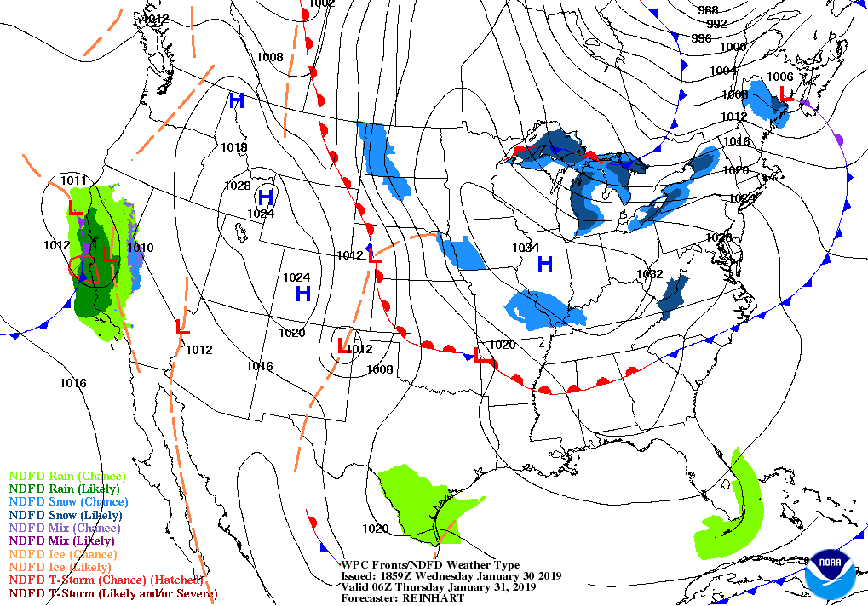
US Weather Map
Courtesy of NOAA/National Weather Service
Weather = Local, short-term, temporary conditions
Notes:
2 min
a. “Next we’ll examine three content representations and two more video clips that summarize the difference between weather and climate.”
b. “This weather map of the United States shows weather conditions at 6:00 a.m. on a Thursday. On the map, we can see temperatures, weather fronts, and high- or low-pressure cells in many locations across the country. Since these atmospheric conditions are short term and temporary, they meet our definition of weather.”

Slide 46
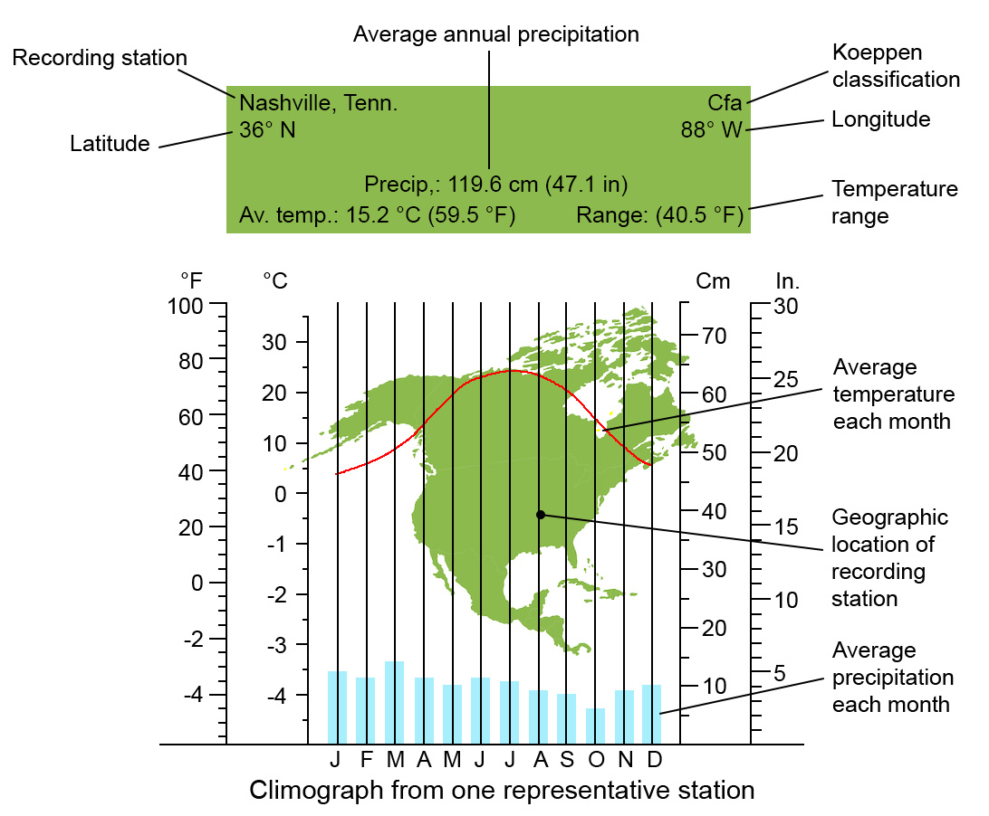
Average Monthly Weather Data
Nashville, Tennessee, Weather Station
Notes:
2 min
a. “This slide shows average monthly weather data from a weather station in Nashville, Tennessee. The data include average temperatures and rainfall totals over a 12-month period.”
b. “When short-term, regional weather data are compiled and averaged over longer periods of time, this meets our definition of climate.”
c. Point out the Köppen classification for this weather station at the top right-hand corner of the slide. (Cfa refers to a humid subtropical climate.) The Köppen climate classification is a system that describes different types of regional climates. So short-term, local weather patterns can help define long-term, regional climate.

Slide 47
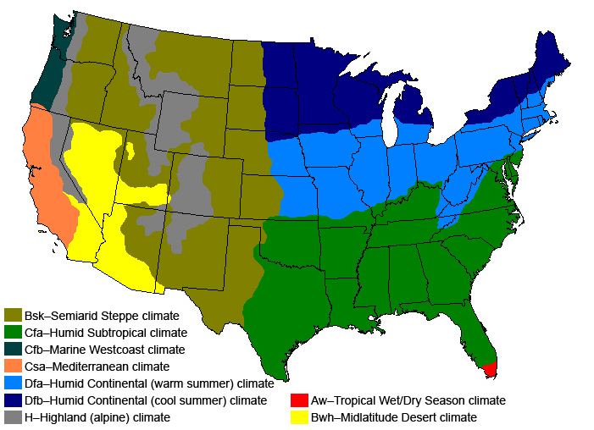
US Climate–Zone Map
Courtesy of Strongbad1982/ Wikimedia Commons
Climate = Regional, long-term, average weather conditions
Notes:
2 min
a. “This map shows the climate zones of the continental United States. The color key in the bottom left-hand corner classifies the different climate zones based on the Köppen classification system.”
b. “A climate-zone map like this one shows the types of regional climates based mostly on average temperatures and precipitation data from hundreds of weather stations across each region. These long-term, average atmospheric conditions across large regions of the United States meet our definition of climate.”

Slide 48
Climate and Weather
Photo courtesy of Pixabay.com
Link to video clip: Climate and Weather
Notes:
7 min
a. “Next, we’ll watch two more video clips that cover key science ideas related to our investigation.”
b. Introduce the National Geographic video Climate and Weather: “This National Geographic video presents a nice synopsis of the difference between weather and climate.”
c. Switch to the web browser and show the video clip.
d. After showing the clip, switch back to this PowerPoint slide.
e. Whole-group discussion: “What aspects of this video stood out to you? In what ways were the definitions of weather and climate in the video similar to or different from our definitions?”
f. Invite a few participants to share their observations.

Slide 49
Weather versus Climate Change
Photo courtesy of Pixabay.com
Link to video clip: Weather versus Climate Change
Notes:
7 min
a. Introduce the National Geographic video Weather versus Climate Change, hosted by astrophysicist Neil deGrasse Tyson.
b. Explain that this video offers another unique look at the difference between weather and climate.
c. Switch to the web browser and show the video clip.
d. After showing the clip, switch back to this PowerPoint slide.
e. Whole-group discussion: “What aspects of this video stood out to you? In what ways were the definitions of weather and climate in the video similar to or different from our definitions?”
f. Invite a few participants to share their observations.

Slide 50
Unit Central Question
Why are some places on Earth hotter than others at different times of the year?
Notes:
2 min
a. Read the unit central question on the slide and emphasize that students will think about this question throughout the SEC lesson series.
Note: If time allows, have participants review the overview page of SEC lesson 1a in their lesson plans binders to orient themselves to the lesson plan.
b. “The science ideas we’ll explore during our content deepening work this week will help us answer this question.”
c. Have participants write the unit central question in their science notebooks and draw a double-lined box around it.

Slide 51
The Sun’s Effect on Climate
Lesson 1a
Photo courtesy of NASA
Notes:
Less than 1 min
a. “Next, we’ll explore key science ideas about the Sun’s effect on climate from SEC lesson 1a.”

Slide 52
Content Deepening: Focus Question 1
What temperature patterns can you find on Earth at different latitudes?
Notes:
Less than 1 min
a. Read the focus question on the slide.
b. “This focus question will guide student learning throughout lesson 1a.”
c. Have participants write this question in their science notebooks and draw a box around it. Make sure they leave space below the question to write a response later.

Slide 53
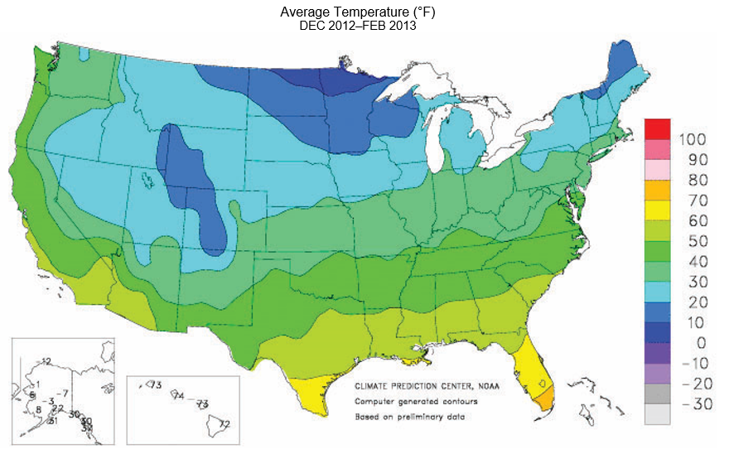
Investigating Temperature Patterns: Part 1
Notes:
Less than 1 min
a. “This map shows average US temperatures from December 2012 through February 2013.”
b. Direct participants to locate handout 1.1 (Map of Average Temperatures in the United States, December–February) in their lesson plans binders.
c. “For this investigation, you and an elbow partner will work together analyzing this map and answering a series of questions about the patterns you observe.”

Slide 54
Investigating Temperature Patterns: Part 1
Examine the map of average US temperatures from December 2012 through February 2013.
What overall temperature patterns do you see?
How do temperatures vary from north to south?
How do temperatures vary from east to west?
What other patterns do you notice?
Note: Answer as concisely and specifically as you can. Use compass directions (e.g., “north” rather than “up” or “top”) and refer to the color scale.
Notes:
6 min
a. Read the instructions and questions on the slide.
b. Pairs: “Discuss these questions with an elbow partner and answer them as concisely and specifically as possible. Be prepared to share your observations and responses with the group.”
c. Whole group: Invite a few pairs to share their observations and answers to the questions. Probe and challenge the responses and elicit differing points of view.

Slide 55
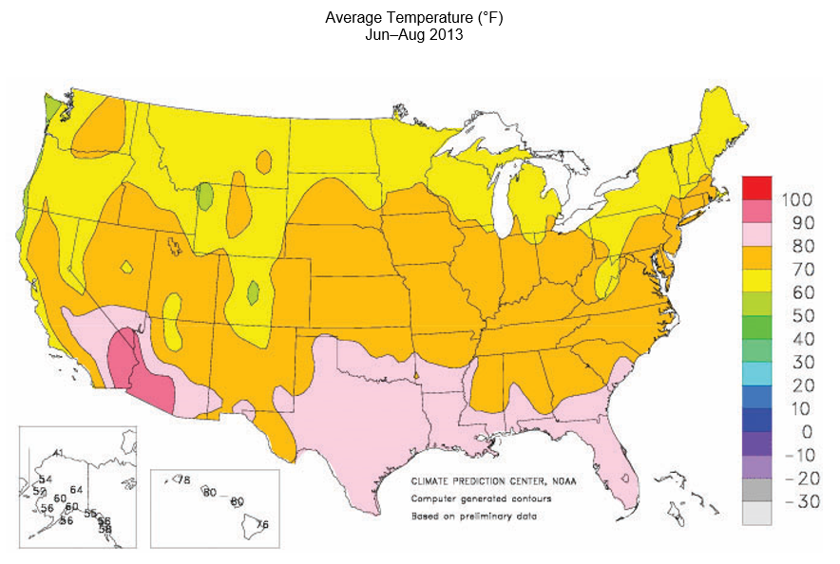
Investigating Temperature Patterns: Part 2
Notes:
Less than 1 min
a. “This map shows average US temperatures from June through August 2013.”
b. Have participants locate handout 5.1 (Map of Average Temperatures in the United States, June–August) in their lesson plans binders.
c. “For this investigation, you and your elbow partner will compare this map with the first temperature map and answer a series of questions about the patterns you observe.”

Slide 56
Investigating Temperature Patterns: Part 2
Now look at both US temperature maps and compare the patterns you observed for winter and summer.
How do the temperature patterns change from winter to summer?
What general patterns remain the same?
What patterns are different?
Remember to answer as concisely and specifically as possible!
Notes:
6 min
a. Read the instructions and questions on the slide.
b. Pairs: “Discuss these questions with your elbow partners and answer them as concisely and specifically as possible. Be prepared to share your observations and responses with the group.”
c. Whole group: Invite a few pairs to share their observations and answers to the questions. Probe and challenge the responses and elicit differing points of view.

Slide 57
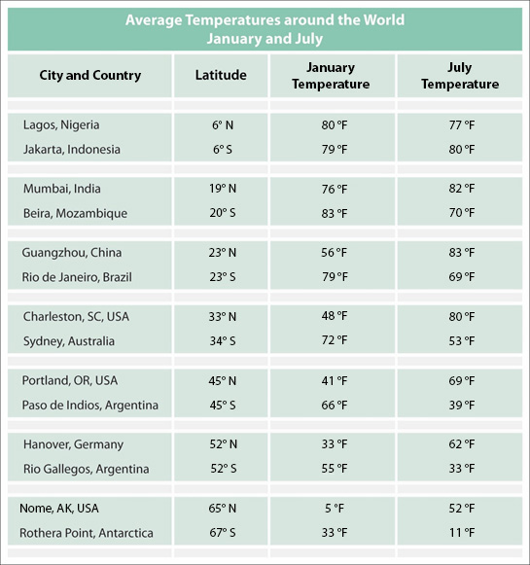
Investigating Temperature Patterns around the World
Notes:
2 min
a. “Next we’ll investigate temperature patterns around the world.”
b. Draw participants’ attention to the data table on the slide and direct them to handout 1.2 (Average Temperatures around the World: January and July) in their lesson plans binders.
c. “This table shows average temperatures for 14 cities around the world. These cities are listed in the left-hand column, and their latitudes are listed in the second column. Each city is paired with a city located at a similar latitude in the opposite hemisphere.”
d. “For example, the first pair of cities—Lagos, Nigeria, and Jakarta, Indonesia—are located at 6 degrees north of the equator and 6 degrees south of the equator, respectively.”
e. “The third and fourth columns on the table show average temperatures for these cities in January and July.”
f. “For this investigation, you and your elbow partner will plot the temperature data for these cities on a world map.”

Slide 58
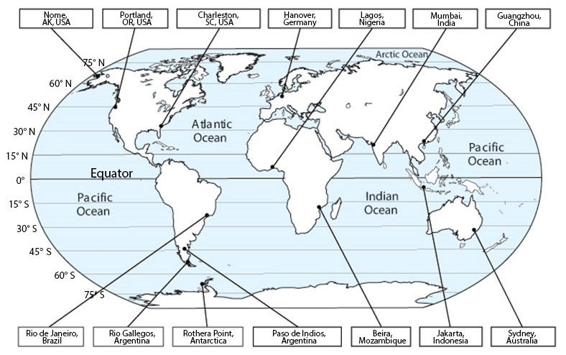
Investigating Temperature Patterns around the World
Notes:
2 min
a. “This world map shows the locations of the 14 cities from the data table. It also shows the equator and latitude lines in the Northern and Southern Hemispheres.”
b. Distribute the premarked copy of handout 5.6 (World Map Record Page) showing the July temperature data from the table on handout 1.2 (Average Temperatures in the United States: January and July). Then direct participants to locate the blank copy of this handout in their PD program binders.

Slide 59
Investigating Temperature Patterns around the World
Work with your elbow partner to find the average January temperature for each city on the data table and record it on the world map. (The July map has already been completed for you.)
Write the temperature next to the dot for the corresponding city, not next to the city name!
Compare the two maps for January and July.
What temperature patterns do you notice? How do the temperatures change from January to July?
Notes:
6 min
a. “The map showing average July temperatures for each city has already been completed for you, but you and your partner will need to record the January temperatures for each city on the blank map.”
b. Review the instructions and questions on the slide.
c. Pairs: Direct pairs to record the January temperature data for each city on the corresponding map.
d. “After you finish your maps, discuss your observations and work together to answer the questions on the slide. Be prepared to share your observations and responses with the group.”
e. Whole group: Invite a few pairs to share their observations and answers to the questions. Probe and challenge the responses and elicit differing points of view.

Slide 60
The Sun’s Effect on Climate
Lesson 1b
Photo courtesy of NASA
Notes:
Less than 1 min
a. “Now let’s explore ideas about the Sun’s effect on climate from lesson 1b.”

Slide 61
Content Deepening: Focus Question 2
What temperature patterns can you find on Earth at different times of the year?
Notes:
1 min
a. Read the focus question on the slide.
b. Emphasize that this focus question will guide student learning throughout lesson 1b.
c. Have participants write this question in their science notebooks and draw a box around it. Make sure they leave space below the question to write a response later.

Slide 62
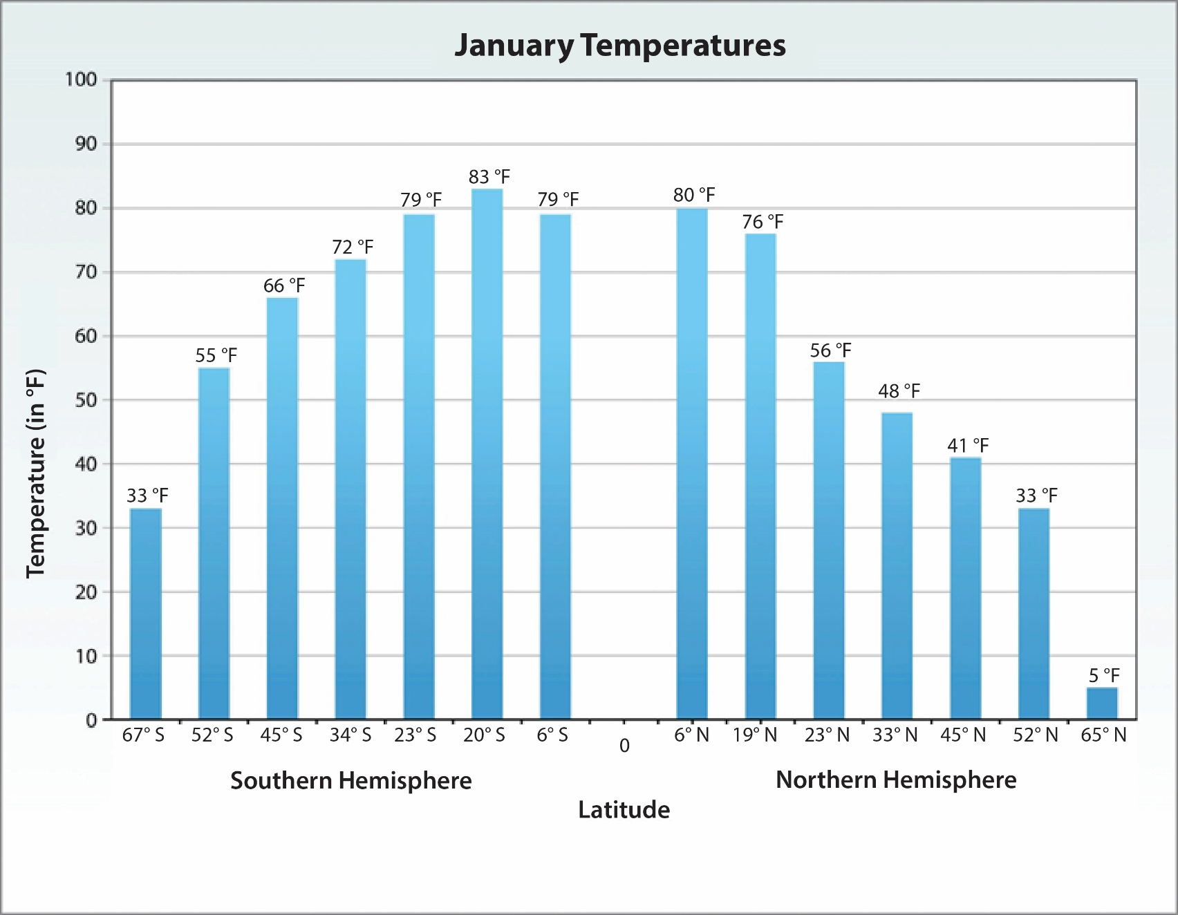
Investigating Temperature Patterns around the World
Notes:
1 min
a. “This bar graph shows average temperatures around the world during the month of January. Temperatures in degrees Fahrenheit are recorded on the y-axis, and latitude north or south of the equator is recorded on the x-axis. The equator is in the middle of the graph at 0 degrees, the Northern Hemisphere is on the right, and the Southern Hemisphere is on the left.”

Slide 63
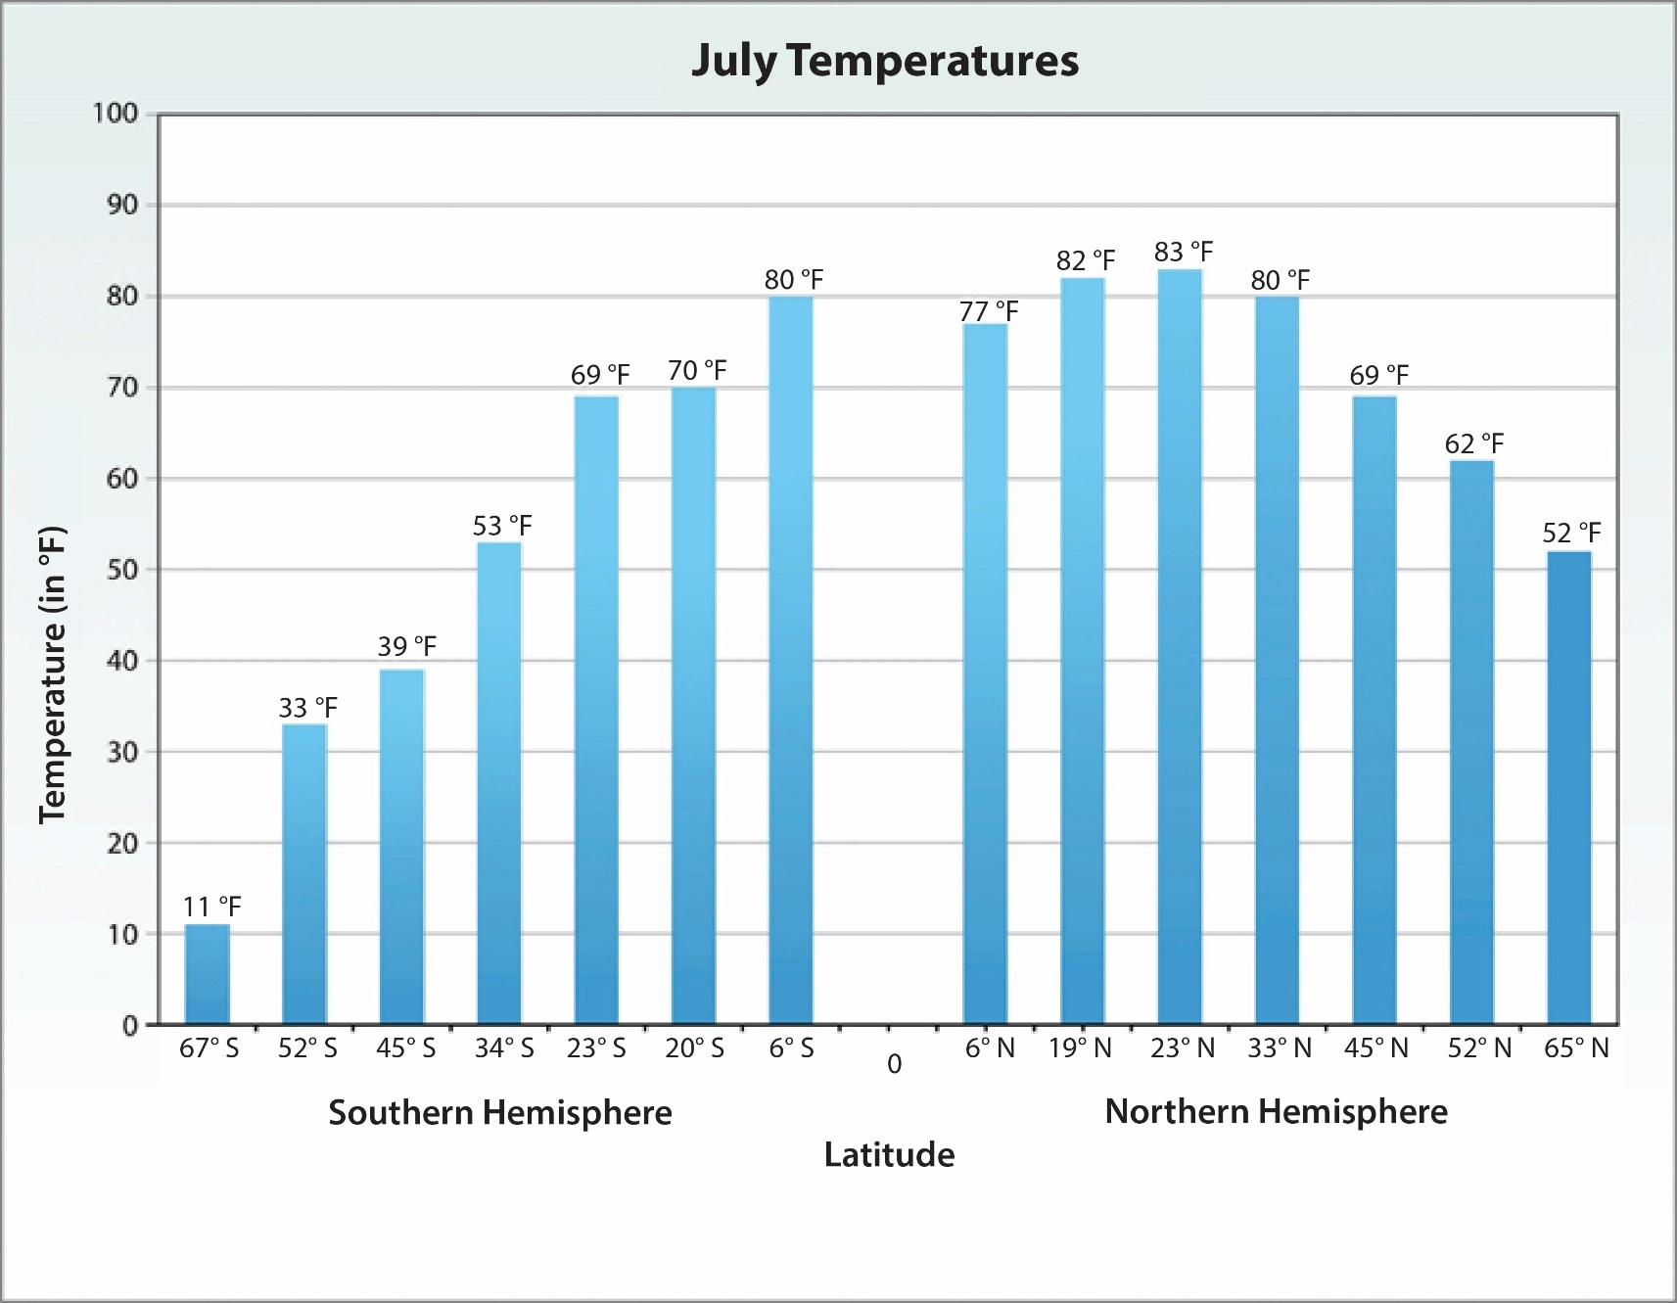
Investigating Temperature Patterns around the World
Notes:
1 min
a. “This bar graph shows average temperatures around the world for the month of July.”
b. “You’ll find these two bar graphs in your SEC lesson handouts, one for January temperatures and another for July temperatures.”
c. Have participants locate handouts 1.4 (Bar Graph of January Temperatures) and 1.5 (Bar Graph of July Temperatures) in their lesson plans binders.
d. “In this investigation, you and your elbow partner will compare the two bar graphs and answer a series of questions about the patterns you observe.”

Slide 64
Investigating Temperature Patterns around the World
Pairs: Compare the average temperatures by latitude on the January and July bar graphs (see handouts 1.4 and 1.5). Then discuss these questions:
Where is the equator on the bar graphs? Which direction is north? Which direction is south?
How do the bar graphs relate to the previous temperature maps you worked with?
What temperature patterns do you notice on the January and July bar graphs?
How do the temperature patterns change from January to July? Why is this change happening?
Notes:
6 min
a. Read the instructions and questions on the slide.
b. Before pairs begin the activity, toggle back and forth between the two previous slides several times. Tell participants that if they look carefully at the bar graphs, they’ll see the temperature variations between January and July.
c. Pairs: Return to this slide and direct pairs to compare the bar graphs on their handouts and then discuss the questions on the slide.
d. Whole group: Invite a few pairs to share their observations and answers to the questions. Probe and challenge participants about the responses and elicit differing points of view.

Slide 65
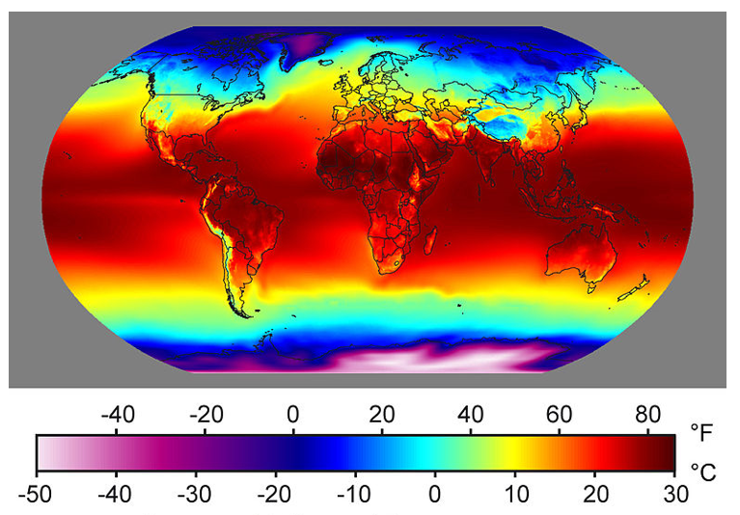
Investigating Temperature Patterns around the World
Courtesy of Kiddle.co
Notes:
1 min
a. “This map shows average annual temperatures around the world for an entire year.”
b. Have participants locate handout 1.6 (Map of Average Yearly Temperatures on Earth) in their lesson plans binders.
c. “Once again, you and your partner will examine this map and answer a series of questions about the patterns you observe.”

Slide 66
Investigating Temperature Patterns around the World
Pairs: Examine this map of average annual temperatures around the world (see handout 1.6) and discuss these questions:
What overall temperature patterns do you see?
How do average annual temperatures vary from north to south? From east to west?
Where are the warmest temperatures? Where are the coldest temperatures?
What do you think is the main reason for displaying the temperature patterns on this map?
Notes:
6 min
a. Read the instructions and questions on the slide.
b. Pairs: “Examine this map of average annual world temperatures on your handouts and discuss your observations with your elbow partner. Then work together to answer the questions on the slide. Be prepared to share your ideas with the group.”
c. Whole group: Invite a few pairs to share their observations and answers to the questions. Probe and challenge the responses and elicit differing points of view.

Slide 67
Reflect: Content Deepening Focus Questions
What temperature patterns can you find on Earth at different latitudes?
What temperature patterns can you find on Earth at different times of the year?
Reminder: These focus questions from SEC lessons 1a and 1b appear in the scope and sequence and on the lesson overview page in your lesson plans binders.
Notes:
6 min
a. Review the focus questions on the slide.
b. Remind participants that these focus questions from SEC lessons 1a and 1b appear in the scope and sequence and on the overview page for each lesson in their lesson plans binders.
c. Individuals: Have participants answer these questions in their science notebooks.
d. Whole group: Ask a few participants to share their answers in complete-sentence statements, using evidence from the investigations they’ve just completed to support their conclusions.
e. As participants share their answers, write down key ideas on chart paper. Direct others to listen carefully to the responses and think about whether they agree, disagree, have something to add from the investigations, or have a question.

Slide 68
Key Science Ideas
What temperature patterns can you find on Earth at different latitudes?
Average temperatures are warmer near the equator and colder near the poles (in both hemispheres).
With some exceptions, average temperatures north and south of the equator are comparable at similar latitudes around the world.
What temperature patterns can you find on Earth at different times of the year?
In July, average temperatures are warmer in the Northern Hemisphere and colder in the Southern Hemisphere. In January, average temperatures are colder in the Northern Hemisphere and warmer in the Southern Hemisphere.
Notes:
5 min
a. Highlight the key science ideas on the slide that answer the content deepening focus questions. Emphasize that today’s investigations and the evidence they gathered helped shape these responses.
b. Whole-group discussion: “Does everyone agree with the answers to these focus questions? Would you like to add or revise anything?”
c. Ask participants to copy the answers to the focus questions into their science notebooks.

Slide 69
Today’s Focus Questions
What is the Science Content Storyline Lens (SCSL)?
Why is one main learning goal essential for science content storyline coherence?
What temperature patterns can you find on Earth at different latitudes?
What temperature patterns can you find on Earth at different times of the year?
Notes:
1 min
a. Review the focus questions addressed during today’s session.

Slide 70
Summary: Today’s Lesson Analysis Work
Reflect on today’s session:
STL strategy 6: use and apply
The Science Content Storyline Lens (SCSL)
Science ideas and student ideas
SCSL strategy A: Identify one main learning goal
Based on our work today, do you have any suggestions for modifying our image of effective science teaching?
Notes:
3 min
a. Individual think time (1 min): Ask participants to reflect on the work they accomplished during today’s lesson analysis and think about the question on the slide.
b. Whole-group share-out (2 min): Invite participants to share their ideas for modifying the image of effective science teaching based on today’s work. Revise the chart as needed.

Slide 71
Summary: Today’s Content Deepening Work
Name one main learning goal for today’s content deepening work.
OR
Name one supporting science idea you learned today about the Sun’s effect on climate.
OR
Name one common student idea (misconception) about the Sun’s effect on climate.
Notes:
3 min
a. Individual think time (1 min): Present the options on the slide and give participants 1 minute to come up with a statement that summarizes today’s content deepening work in one of these areas.
b. Whole-group round-robin (2 min): Go quickly around the room and have each participant share one summarizing statement. Push for complete sentences!

Slide 72
Homework
Read in the STeLLA strategies booklet:
SCSL strategy B: Set the purpose with a focus question or goal statement
SCSL strategy C: Select activities that are matched to the learning goal
SCSL strategy I: Summarize key science ideas
STL strategy 7: Engage students in making connections by synthesizing and summarizing key science ideas
Fill in the appropriate columns on your SCSL Z-fold summary charts.
Notes:
3 min
a. Review the homework assignment on the slide and have participants write it in their notebooks.
b. Make sure participants are clear about the reading and writing tasks.

Slide 73
Extended Homework
Locate handout 5.7 (Extended Homework) in your PD program binder.
Between now and Friday, read the scope and sequence for the SEC lesson plans and your assigned two-part lesson (parts A and B).
Be prepared to share your findings in a study-group conversation on our last day.
Notes:
3 min
a. Go over the information on this slide.
b. Have participants review the Extended Homework assignment sheet (handout 5.7), which provides further details about the assignment.
c. Remind participants that like the extended homework on the Genetics lessons they were assigned during week 1, participants are responsible for reading parts A and B of their assigned lesson plan.
d. Assign a two-part lesson to each participant.
e. Ask if there are any questions about the assignment.
f. Emphasize: The group share-out on the last day of the PD program (day 8) should focus on the assignment-sheet questions (section 2). Participants won’t have time to share all the details of each lesson plan.

Slide 74
Reflections on Today’s Session
Reflect on lesson analysis: In what way(s) did our lesson analysis work and/or our study of SCSL strategy A (one main learning goal) stretch your thinking? Give an example to support your response.
Reflect on content deepening: Describe how our content deepening work today helped you clarify a science-content idea.
Feedback: Provide feedback about today’s session and the program so far (likes, dislikes, questions, concerns, suggestions).
Notes:
7 min
a. Allow at least 5 minutes for participants to think about today’s session and write their reflections and feedback on the Daily Reflections sheet (handout 5.8 in PD program binder).

