Slide 1
RESPeCT PD pROGRAM
Day 6
RESPeCT Summer Institute
Notes:
5 min
a. Take care of any housekeeping issues.

Slide 2
Agenda for Day 6
Day-5 reflections
Review: Science content storyline
Today’s focus questions
Lesson analysis: STeLLA strategies B, I, and 7
Content deepening: The Sun’s effect on climate
Lunch
Content deepening (continued)
Lesson analysis: SCSL strategy C
Summary, homework, and reflections
Notes:
5 min
a. Go over the agenda for the day.

Slide 3
Trends in Reflections
Lesson Analysis | Science Content Learning
Notes:
7 min
a. Give participants time to review your feedback on their reflections from day 5 and offer reactions, comments, or follow-up questions.

Slide 4
Review: Science Content Storyline
In your notebooks, jot down …
things you remember from yesterday’s session,
ideas that seem important to you, and
question you have.
Be prepared to share one idea and question with the group.
3
2
1
Notes:
10 min
a. Point out the three tasks on the slide. Allow 4–5 minutes for participants to write their responses in their science notebooks.
b. Have each participant share one idea about the science content storyline that she or he thinks is really important.
c. Then ask participants to share their questions. If you can answer them quickly, go ahead and do so. If a question needs a more detailed response, write it down and schedule a time to address it.

Slide 5
Today’s Focus Questions
How can we begin and end a lesson to help students develop a coherent science content storyline?
How can selecting appropriate science activities help students develop a coherent science content storyline?
Why are places closer to Earth’s equator hotter than places farther away from the equator?
Why is it summer in the United States (the Northern Hemisphere) when it’s winter in Argentina (the Southern Hemisphere)?
Why is it warmer in the summer than in the winter?
Notes:
2 min
a. Introduce today’s focus questions.

Slide 6
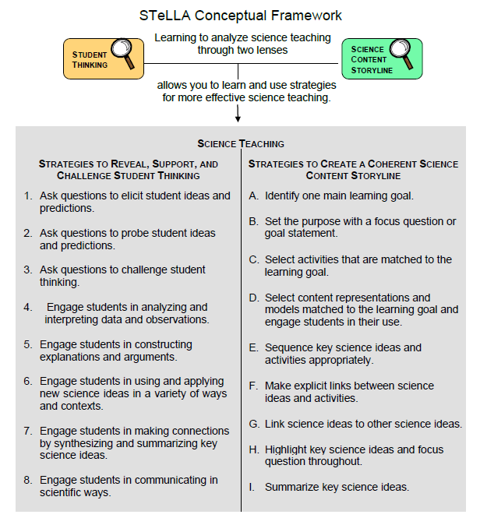
Notes:
1 min
a. “Today we’ll be looking at four new STeLLA strategies. Three of them are Science Content Storyline Lens strategies, and one is a Student Thinking Lens strategy. Throughout the session, think about how these strategies are different from one another and how they are closely linked to each other.”

Slide 7
Lesson Analysis: Focus Question 1
How can we begin and end a lesson to help students develop a coherent science content storyline?
Notes:
Less than 1 min
a. “Now let’s dig into our first focus question.”

Slide 8
Strategies B, I, and 7: Purposes and Key Features
Group 1: What are the purpose and key features of strategy B?
Why is a focus question or goal statement important for science content storyline coherence?
Group 2: What are the purpose and key features of strategy I?
Why is summarizing key science ideas important for science content storyline coherence?
Group 3: What are the purpose and key features of strategy 7?
How does strategy 7 compare with strategy I?
All groups: Make sure to cite ideas from the STeLLA strategies booklet in your answers.
Notes:
25 min
a. Pairs (3 min): Direct participants to retrieve their Z-fold summary charts and share with a partner what they learned from their homework assignment about STeLLA strategies B, I, and 7.
b. Small groups (12 min): Divide participants into three small groups and have them make posters that capture the purposes and key features of the three strategies.
Note: Challenge participants to imagine themselves in a Teacher Leader role. Ask them, “How would you explain these strategies to the teachers you’re leading?”
c. Whole group (10 min): Have small groups share their posters in a whole-group share-out.
Key ideas:
Make sure participants understand that a focus question is designed to do more than just get students interested in the lesson. It gets them thinking about a phenomenon or something else they’ve never thought about before. It also reveals important things about the knowledge and experiences they’re bringing to the lesson, it conceptually situates the learning, and it’s referred to throughout the lesson.
STeLLA strategies B, I, and 7 are like bookends that mark the beginning and end of a lesson. The science ideas used in the summary should match the focus question from the beginning of the lesson, and both the focus question and the summary should match the lesson’s main learning goal.

Slide 9
Discussion Questions: Strategy B
What is the difference between focus questions and goal statements?
Which do you think would be more useful in engaging student interest and making their thinking visible—focus questions or goal statements?
Notes:
7 min
a. Whole group: Discuss the questions on the slide as a group.
Key ideas:
A focus question is designed to be answered using the lesson’s main learning goal and supporting science ideas. A goal statement describes the main science idea to be learned.
Focus questions are always used in RESPeCT lesson plans because they are useful in engaging student interest, making their thinking visible, and eliciting initial ideas at the beginning of a lesson. When posed at the end of a lesson, focus questions challenge students to use new ideas developed during the lesson.

Slide 10
Discussion Questions: Strategies I and 7
What are various ways a lesson or unit can be synthesized and/or summarized?
How are strategies I and 7 similar and different?
SCSL strategy I: Summarize key science ideas.
STL strategy 7: Engage students in making connections by synthesizing and summarizing key science ideas.
Notes:
7 min
a. Whole group: Discuss the first question on the slide. Participants can refer to the information on strategy 7 in the STeLLA strategies booklet to identify a variety of ways in which key science ideas in a lesson can be synthesized.
b. Emphasize: “Toward the end of a unit, an entire lesson may be devoted to strategy 7, which engages students in synthesizing and summarizing science ideas across several lessons.”
c. Discuss the second question on the slide.
Key ideas:
In strategy I, the teacher creates a summary of key science ideas in the lesson. Strategy 7, however, engages students in synthesizing and summarizing key science ideas in the lesson. When students themselves perform this work, it makes their thinking visible, engages them in active sensemaking, and reveals to the teacher any misunderstandings or gaps in knowledge. Using both strategies brings coherence to a science lesson and is a powerful way to end it.
In strategy 7, summarizing involves making connections between key science ideas, which helps students synthesize the main learning goal or big idea in a lesson.
Summaries should focus on key science ideas, not activities; that is, focusing on “what we learned” versus “what we did.”
For a variety of reasons, a lesson sometimes ends before the main learning goal has been fully developed. However, summarizing work should still take place. For example, the teacher might say, “Our focus question today was How do plants get their food? What have we found out so far?” After students respond, the teacher could reply, “Yes, so far we’ve discovered that water and soil aren’t food for plants. But we still haven’t figured out what is food for plants. We’ll continue working on this question next time.”

Slide 11
Video-based Lesson Analysis
Next we’ll analyze a video clip from the beginning and end of a lesson on the Sun’s effect on climate.
Notes:
Less than 1 min
a. Transition: This slide marks the transition to video-based lesson analysis.

Slide 12
Lesson Analysis: Strategy B
In Analysis Guides B and I (handout 6.1), review the four criteria for strategy B: Setting the purpose.
Read the lesson context at the top of the video transcript (handout 6.2).
Watch the first video clip, keeping in mind the criteria for strategy B.
Analyze the transcript using the analysis guide.
How well does the beginning of this lesson match the criteria for strategy B?
Share and compare your analyses.
Link to video clip 1: 6.1-6.2_stella_SEC_crom_L2_c1-c2
Notes:
20 min
a. Have participants locate Analysis Guides B and I (handout 6.1 in PD program binder) and spend 1 or 2 minutes reading the criteria for strategy B: Setting the purpose.
b. Ask: “Do you have any questions about these criteria?”
c. Emphasize: “Keep the criteria for strategy B in mind as you watch the first clip from the beginning of a lesson about the Sun’s effect on climate.”
d. Individuals: Give participants a couple of minutes to read and think about the lesson context at the top of the video transcript (handout 6.2).
e. This video has two clips (1 and 2). At this point, show only the first clip (47.1 seconds).
f. Whole group: “How well does the beginning of this lesson match the criteria for strategy B?
Note: During the discussion, be on the lookout for opportunities to clarify science-content ideas.
Observations:
The teacher reviews the focus question in language students can understand and highlights the idea of identifying patterns. It seems to be an appropriate opening for the lesson, and students should be able to anticipate the implied main learning goal: There are observable temperature patterns at different latitudes and times of the year.

Slide 13
Lesson Analysis: Strategy I
In Analysis Guides B and I (handout 6.1), review the six criteria for strategy I: Summarizing key science ideas.
Review the lesson context at the top of the video transcript (handout 6.2).
Watch the second video clip, keeping in mind the criteria for strategy I.
Analyze the transcript using the analysis guide.
How well does the end of this lesson match the criteria for strategy I?
Share and compare your analyses.
Link to video clip 2: 6.1-6.2_stella_SEC_crom_L2_c1-c2
Notes:
20 min
a. Allow participants 1 or 2 minutes to read the six criteria in the analysis guide for strategy I: Summarizing key science ideas.
b. Ask: “Do you have any questions about these criteria?”
c. Emphasize: “Keep the criteria for strategy I in mind as you watch the next clip from the end of the same SEC lesson.”
d. Individuals: Give participants a couple of minutes to review the lesson context at the top of the video transcript (handout 6.2).
e. Show the second video clip.
Note: This clip begins at segment 00:00:56.4.
f. Whole group: “How well does the end of this lesson match the criteria for strategy I? How well does the summary statement match the beginning of the lesson?”
Note: During the discussion, be on the lookout for opportunities to clarify science-content ideas.
Observations:
At the beginning of the second video clip, students articulate patterns they identified in the data: “It’s warmer in July than January” in the Northern Hemisphere, and “it’s warmer in January than July” in the Southern Hemisphere (video segments 00:01:20.7–00:02:06.0).
At segment 00:02:34.7, rather than articulating the pattern, the student poses the question, “Why do you think the temperatures are higher closer to the equator?” and responds, “Because the equator is warmer” (segment 00:02:40.5). Then echoing what Madison said, the teacher adds an idea: “The Sun’s rays [hit the] ‘middle of the Earth’” (segment 00:03:32.4). (That addition didn’t really clarify anything for me!)
Finally the teacher prompts students to summarize the second pattern: Temperatures are warmer closer to the equator and cooler farther away from the equator (segments 00:04:23.7–00:04:57.5).
The summary might have been better had the teacher focused simply on clearly identifying the two patterns in the data rather than asking whether temperatures are the same north or south in relation to temperatures at the equator (segment 00:04:57.5). I wonder whether students thought they should know about temperature variations. I wonder whether students thought they should know at the end of the lesson why the equator is hotter. At this point, the question had no good answer and distracted from clearly identifying the two patterns students would be explaining in the remaining lessons in the sequence.

Slide 14
The SEC Lesson Plans: Reading and Analysis
Examine the main learning goal, the lesson focus question, and the lesson summary for your assigned SEC lesson plan (parts A and B).
Answer these questions in your notebooks, keeping in mind the analysis-guide criteria for strategies B and I:
What do you notice?
What do you wonder about?
Notes:
10 min
Note: This slide can be abridged or skipped if time is running short.
a. Read the instructions on the slide and assign a two-part lesson plan (parts A and B) to each participant.
b. Ask participants if they have any questions about the assignment.
c. Individual reading-and-analysis time (5 min): “Answers the slide questions in your notebooks, keeping in mind the analysis-guide criteria.”
d. Whole-group discussion (5 min): Briefly discuss participants’ observations and questions for their assigned lesson plans.
Note: Participants should see a close match between the main learning goal, the lesson focus question, and the summary. However, also welcome critiques and suggestions for improvement. Just make sure critiques are based on good understandings of the strategies involved.

Slide 15
The SUN’S EFFECT ON CLIMATE
SCIENCE CONTENT DEEPENING Grade 6
Notes:
Less than 1 min
a. Transition: This slide marks the transition to the content deepening work.

Slide 16
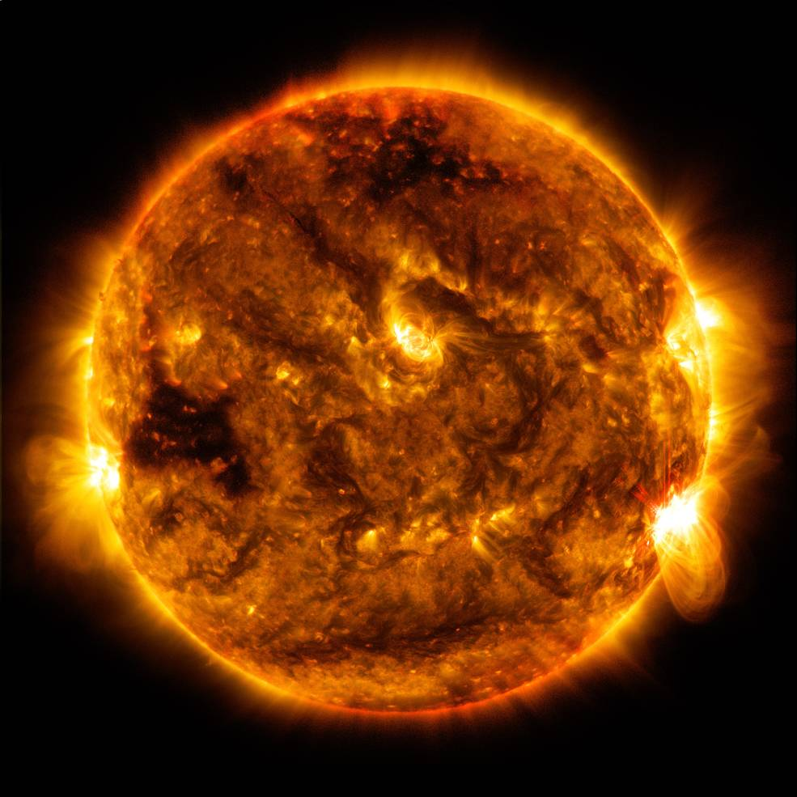
The
Sun’s
Effect on
Climate
Content
Deepening
Developed by
Dr. Jeff Marshall
Geological Sciences
Cal Poly Pomona
Used by permission
Photo courtesy of NASA
Notes:
Less than 1 min
a. “Our content deepening work today will focus on science ideas about the Sun’s effect on climate from SEC lessons 2 through 4.”
Note: Throughout this content deepening phase, refer as needed to the Sun’s Effect on Climate Content Background Document and Common Student Ideas about the Sun’s Effect on Climate and Seasons.

Slide 17
Unit Central Question
Why are some places on Earth hotter than others at different times of the year?
Notes:
Less than 1 min
a. Review the unit central question on the slide.

Slide 18
The Sun’s Effect on Climate
Lesson 2a
Photo courtesy of NASA
Notes:
Less than 1 min
a. “Next, we’ll explore key science ideas about the Sun’s effect on climate from SEC lesson 2a.”

Slide 19
Content Deepening: Focus Question 1
Why are places closer to Earth’s equator hotter than places farther away from the equator?
Notes:
Less than 1 min
a. Read the focus question on the slide.
b. Emphasize that this focus question will guide student learning throughout SEC lessons 2a and 2b.
c. Have participants write the question in their science notebooks and draw a box around it. Make sure they leave space below the question to write a response later.

Slide 20
Investigation 1: Angles of Light Energy
Notes:
1 min
a. “For this investigation, you’ll work with a partner to explore variations in the intensity of light striking a surface at different angles.”
b. Have participants look over their supplies for this activity. Each pair should have a flashlight, a plastic tray, two sheets of graph paper, and a pencil.

Slide 21
Investigation 1: Angles of Light Energy
The task: Investigate what happens when you shine a flashlight on a flat tray at different angles.
Test two scenarios:
What happens when you hold the tray perpendicular to the light beam (“straight on”)?
What happens when you tilt the tray away from the light beam (at an angle)?
Instructions:
Before each scenario, tape a sheet of graph paper to the tray.
Move ONLY the tray! Keep the light beam parallel (horizontal) to the floor. Maintain the same distance between the flashlight and the tray at all times.
Using a pencil, trace the circular pattern of light (the brightest area) shining on the graph paper (for both scenarios).
Notes:
10 min
a. Read the instructions on the slide and emphasize the importance of following them carefully.
b. “Work with your partner to complete the tasks on the slide.”
c. Make sure participants tape a sheet of graph paper to the top surface of the tray before they begin each scenario.

Slide 22
Investigation 1: Angles of Light Energy
Count the total number of squares within the circular light pattern you traced on each sheet of graph paper.
In which scenario was the circle smaller? In which scenario was the circle larger?
Imagine that the flashlight represents sunlight hitting Earth’s surface. In which circle of light would it feel warmer—the small circle or the large circle? Why? Be prepared to share your answer and reasoning.
Notes:
10 min
a. Read the instructions and questions on the slide.
b. Pairs: “Work with your partner to complete the task on the slide. Then discuss your observations and answer the questions as concisely as possible in your science notebooks. Be prepared to share your ideas with the group.”
c. Whole group: Invite a few pairs to share their observations and answers to the questions. Probe and challenge participants’ responses and elicit differing points of view.

Slide 23
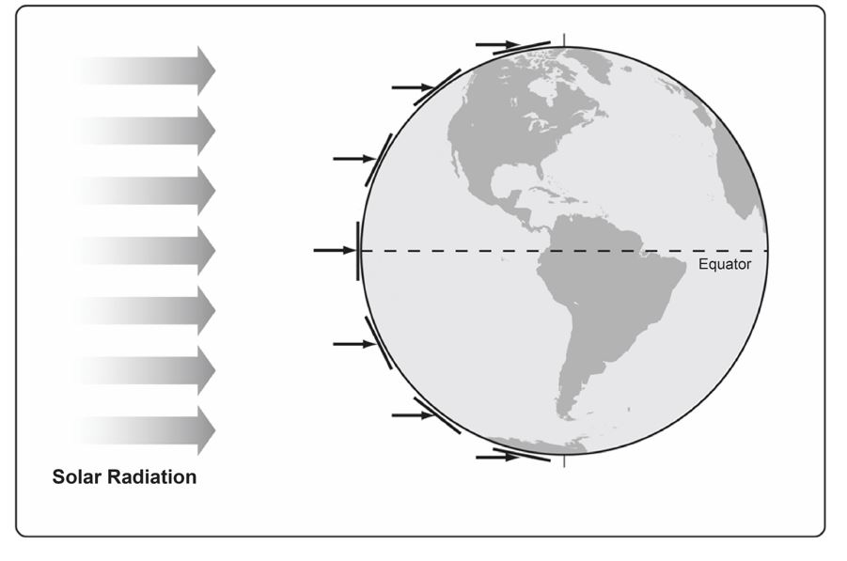
Investigation 1: Angles of Light Energy
Notes:
Less than 1 min
a. “This diagram shows parallel ray’s of sunlight approaching Earth’s surface.”
b. Have participants locate handout 2.2 (The Sun’s Incoming Energy—Angle Related to Latitude) in their lesson plans binders and refer to it throughout the investigation.

Slide 24
Investigation 1: Angles of Light Energy
Instructions:
Examine the diagram showing parallel “rays” of sunlight approaching Earth. Note the relationship between these rays and the straight “tangent” lines at different points on Earth’s curved surface.
Using the flashlight, tray, and inflatable globe, work with your partner to simulate sunlight striking Earth at each of these points. Remember: Keep the light beam in a horizontal position and maintain the same distance between the flashlight and tray.
Question: How does this model help explain the temperature patterns observed in lessons 1a and 1b?
Notes:
10 min
a. Read the instructions and question on the slide.
b. Pairs: “Work with your elbow partner to complete these tasks and answer the question as concisely as possible in your notebooks. Make sure to follow the instructions carefully.”
Note: Participants may refer to data and handouts from the previous session if they need to refresh their memories.
c. Whole group: Invite a few pairs to share their observations and answers to the question. Probe and challenge participants’ responses and elicit differing points of view.

Slide 25
The Sun’s Effect on Climate
Lesson 2b
Photo courtesy of NASA
Notes:
Less than 1 min
a. “Now let’s explore ideas about the Sun’s effect on climate from SEC lesson 2b.”

Slide 26
Content Deepening: Focus Question 1
Why are places closer to Earth’s equator hotter than places farther away from the equator?
Notes:
Less than 1 min
a. Review the focus question on the slide.
b. “We’ll continue thinking about this question during the next investigation.”
c. Remind participants that this focus question will guide student learning throughout lesson 2b.

Slide 27
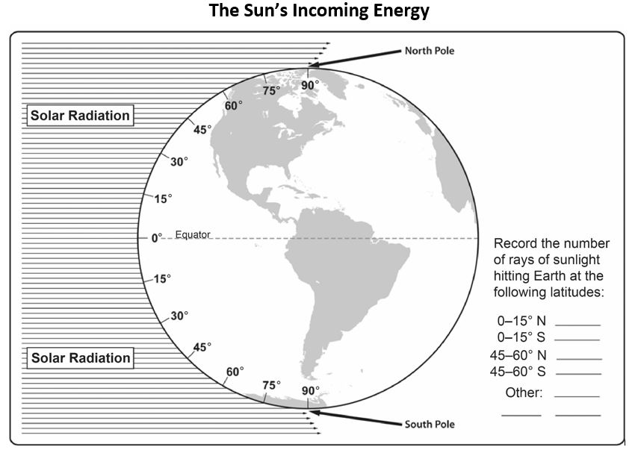
Investigation 2: Counting Sun Rays
Notes:
1 min
a. “The diagram on this slide is similar to the previous one. But in this investigation, you and your partner will explore how the amount of solar radiation hitting Earth varies based on latitude.”
b. Have participants locate handout 6.3 (The Sun’s Incoming Energy) in their PD program binders and let them know they’ll complete it during the investigation.

Slide 28
Investigation 2: Counting Sun Rays
In this diagram, the incoming rays of sunlight appear as narrow, densely spaced parallel lines.
Work with your partner to count the number of lines that strike Earth’s surface between the following latitudes and record the results on handout 6.3:
0–15º N
0–15º S
Questions:
What happens to the number of lines as we move farther away from the equator north and south?
How does this diagram relate to the tray-and-flashlight model?
45–60º N
45–60º S
Notes:
10 min
a. Read the instructions and questions on the slide and remind participants to follow the instructions carefully.
b. Pairs: “Work with your partner to complete these tasks and answer the questions as concisely as possible in your notebooks. Be prepared to share your observations and ideas with the group.”
c. Whole group: Invite a few pairs to share their observations and answers to the questions. Probe and challenge participants’ responses and elicit differing points of view.

Slide 29
Reflect: Content Deepening Focus Question 1
Why are places closer to Earth’s equator hotter than places farther away from the equator?
Notes:
7 min
a. Revisit the first content deepening focus question.
b. Remind participants that this focus question from SEC lessons 2a and 2b appears in the scope and sequence and on the overview page for each lesson in their lesson plans binders.
c. Individuals: Have participants answer the focus question in their science notebooks.
d. Whole group: Ask a few participants to share their answers to this question with complete-sentence statements, using evidence from the investigations they just completed.
e. As participants share their responses, record key ideas on chart paper. Direct others to listen carefully to the responses and be prepared to agree, disagree, or add ideas from the investigations.

Slide 30
Key Science Ideas
Rays of sunlight (solar radiation) approach Earth along parallel, straight-line paths and hit the curved surface at varying angles in different locations.
When sunlight strikes Earth’s surface more directly (straight on), heat energy is concentrated over a smaller area. When sunlight hits the surface less directly (at an angle), heat energy is spread out over a larger area.
Locations closer to the equator (with more-direct sunlight) are hotter than places closer to the poles (with less-direct sunlight).
The angle of sunlight hitting Earth’s surface, NOT the distance from Earth to the Sun, determines global temperature patterns. The Earth-Sun distance is 10,000 times greater than Earth’s diameter, so the distance between the Sun and any point on Earth’s surface is essentially the same and has no effect on temperature patterns.
Notes:
7 min
a. Highlight the key science ideas on the slide that answer the first content deepening focus question.
b. Emphasize that participants’ observations from the investigations and the evidence they gathered helped to shape the answer to this question.
c. Whole group: “Does everyone agree that these key ideas answer our focus question? Would you like to add or revise anything?”
d. Ask participants to write these key ideas under the focus question in their science notebooks.

Slide 31
The Sun’s Effect on Climate
Lesson 3a
Photo courtesy of NASA
Notes:
Less than 1 min
a. “Our next investigation is from SEC lesson 3a.”

Slide 32
Content Deepening: Focus Question 2
Why is it summer in the United States (the Northern Hemisphere) when it’s winter in Argentina (the Southern Hemisphere)?
Notes:
Less than 1 min
a. Read the focus question on the slide.
b. Have participants write the question in their science notebooks and draw a box around it. Make sure they leave space below the question to write a response later.
c. Emphasize that this focus question will guide student learning throughout SEC lessons 3a and 3b.

Slide 33
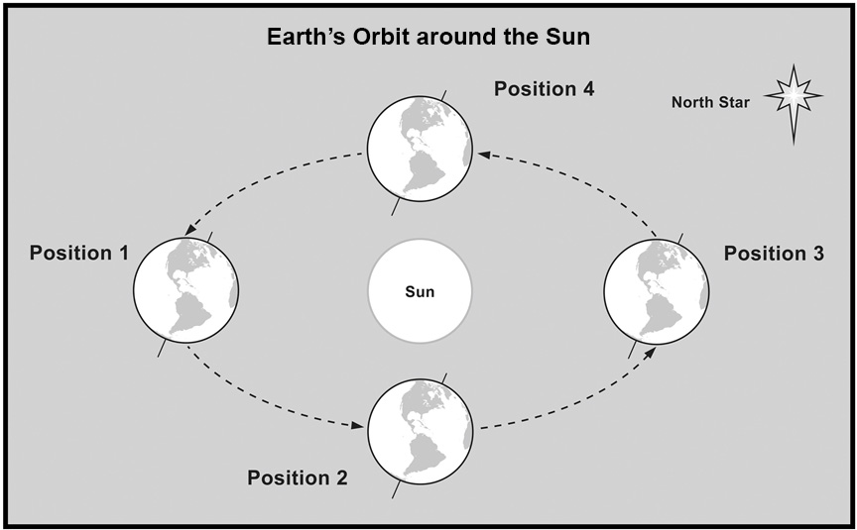
Investigation 3: Earth’s Orbit around the Sun
Notes:
2 min
a. “This slide shows a diagram of Earth’s orbit around the Sun. In each orbital position, one of Earth’s hemispheres is tilted toward the Sun, and one hemisphere is tilted away from the Sun.”
b. Have participants locate handout 3.1 (Earth’s Orbit around the Sun) in their lesson plans binders and refer to it throughout the investigation.
c. “In the next investigation, you and your partner will build a model to simulate Earth’s orbit around the Sun.”
d. Have participants look over the supplies they’ll need to build their Earth-Sun model: a lightbulb setup, a Hula Hoop, a Styrofoam ball, a wooden stick, a rubber band, two pushpins, and a stand to hold the model steady at a 23.5-degree angle.

Slide 34
Investigation 3: Earth’s Orbit around the Sun
What do these materials represent?
Lightbulb
Styrofoam ball
Rubber band
Hula Hoop
Wooden stick
Notes:
2 min
Discuss the question on the slide.

Slide 35
Investigation 3: Earth’s Orbit around the Sun
Instructions:
Turn on the light setup and place it in the middle of the Hula Hoop on the table.
Place the rubber band around the middle of the Styrofoam ball.
Insert the wooden stick through the center of the ball and place the ball on the wooden stand to approximate Earth’s tilt.
Place the light setup on a stack of books so it’s in the same horizontal plane as the ball.
Position the Styrofoam ball (in the stand) next to the Hula Hoop and move it around the lightbulb to simulate Earth’s yearly orbit around the Sun.
Notes:
10 min
a. Read the instructions on the slide and remind participants to follow them carefully as they assemble their models.
Note: While participants are working on their models, circulate around the room to answer questions and provide help as needed.

Slide 36
Investigation 3: Earth’s Orbit around the Sun
Insert pushpins in each hemisphere of the model to show where the United States and Argentina are located.
Place your Earth-Sun model in position 1 to represent summer in the United States (Northern Hemisphere).
Why does this position represent summer in this hemisphere? What happens as the light hits this hemisphere? What happens in the other hemisphere?
Place your model in position 3 to represent summer in Argentina (Southern Hemisphere) and answer the same questions.
Compare positions 1 and 3 in Earth’s orbital pattern. Where are they located relative to each other?
Notes:
10 min
a. Read the instructions and questions on the slide and remind participants to follow the instructions carefully.
b. Pairs: “Work with your partner to complete each task on the slide, discuss your observations, and answer the questions as concisely as possible in your notebooks. Be prepared to share your ideas with the group.”
c. Whole group: Invite a few pairs to share their observations and answers to the questions. Probe and challenge participants’ responses and elicit differing points of view.

Slide 37
The Sun’s Effect on Climate
Lesson 3b
Photo courtesy of NASA
Notes:
Less than 1 min
a. “Now we’ll explore ideas about the Sun’s effect on climate from SEC lesson 3b.”

Slide 38
Content Deepening: Focus Question 2
Why is it summer in the United States (the Northern Hemisphere) when it’s winter in Argentina (the Southern Hemisphere)?
Notes:
Less than 1 min
a. Review the focus question on the slide.
b. “We’ll continue thinking about this focus question during the next investigation.”
c. Remind participants that this focus question will guide student learning throughout lesson 3b.

Slide 39
Investigation 4: Earth’s Tilt and Seasons
Notes:
1 min
a. “In this investigation, we’ll continue exploring Earth’s orbit around the Sun and the relationship between Earth’s tilt and seasons.”
b. Let participants know they’ll need their Earth-Sun model and handout 3.1 for this investigation as well.

Slide 40
Investigation 4: Earth’s Tilt and Seasons
Another important component of our Earth-Sun model is the North Star (Polaris). During Earth’s yearly orbit around the Sun, Earth’s axis always points toward this star. So the Northern Hemisphere tilts toward the Sun (position 1) part of the year, and the Southern Hemisphere tilts toward the Sun (position 3) the other part of the year.
Using the handout diagram and the North Star on the wall as a guide, move your Earth-Sun model around the Hula Hoop to simulate Earth’s orbit. Stop at each of the four orbital positions and answer these questions:
What is happening to the light in this position?
What season is each hemisphere experiencing in this position?
Notes:
10 min
a. Read the instructions and questions on the slide. Remind participants to follow the instructions carefully.
b. Draw participants’ attention to the image of the North Star on the wall and emphasize its importance in Earth’s orbit around the Sun.
c. Pairs: “Work with your partner to complete the tasks on the slide. Then discuss your observations and answer the questions as concisely as possible in your notebooks. Be prepared to share your ideas with the group.”
d. Whole group: Invite a few pairs to share their observations and answers to the questions. Probe and challenge participants’ responses and elicit differing points of view.

Slide 41
Reflect: Content Deepening Focus Question 2
Why is it summer in the United States (the Northern Hemisphere) when it’s winter in Argentina (the Southern Hemisphere)?
Notes:
7 min
a. Revisit the second content deepening focus question.
b. Remind participants that this focus question from SEC lessons 2a and 2b appears in the scope and sequence and on the overview page for each lesson in their lesson plans binders.
c. Individuals: Have participants answer the focus question in their science notebooks.
d. Whole group: Ask a few participants to share their answers to this question with complete-sentence statements, using evidence from the investigations they just completed.
e. As participants share their responses, record key ideas on chart paper. Direct others to listen carefully to the responses and be prepared to agree, disagree, or add ideas from the investigations.

Slide 42
Key Science Ideas
Earth’s axis always points toward the North Star (Polaris) during Earth’s yearly orbit around the Sun. So the Northern Hemisphere tilts toward the Sun (position 1) part of the year, and the Southern Hemisphere tilts toward the Sun (position 3) the other part of the year.
The hemisphere tilting toward the Sun experiences more-direct sunlight, longer days, and warmer temperatures (summer), while the opposite hemisphere experiences less-direct sunlight, shorter days, and colder temperatures (winter).
Spring and fall occur when the hemispheres are tilting neither toward nor away from the Sun (positions 2 and 4 of Earth’s orbit).
Notes:
7 min
a. Highlight the key science ideas on the slide that answer the second content deepening focus question. Emphasize that participants’ observations from the investigations and the evidence they gathered helped to shape the answer to this question.
b. Whole group: “Does everyone agree that these key ideas answer our focus question? Would you like to add or revise anything?”
c. Ask participants to write these key ideas under the focus question in their science notebooks.

Slide 43
The Sun’s Effect on Climate
Lesson 4a
Photo courtesy of NASA
Notes:
Less than 1 min
a. “Our next investigation is from SEC lesson 4a.”

Slide 44
Content Deepening: Focus Question 3
Why is it warmer in the summer than in the winter?
Notes:
Less than 1 min
a. Read the focus question on the slide.
b. Have participants write the question in their science notebooks and draw a box around it. Make sure they leave space below the question to write a response later.
b. Emphasize that this focus question will guide student learning throughout SEC lessons 4a and 4b.

Slide 45
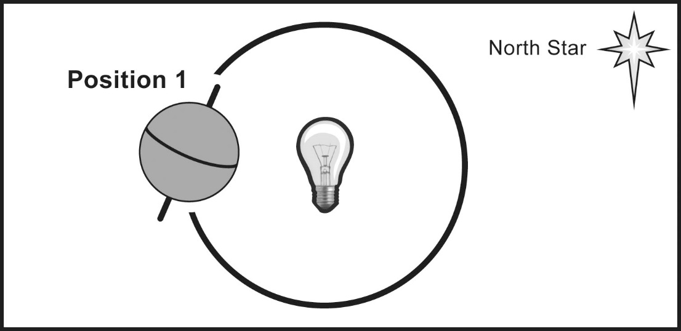
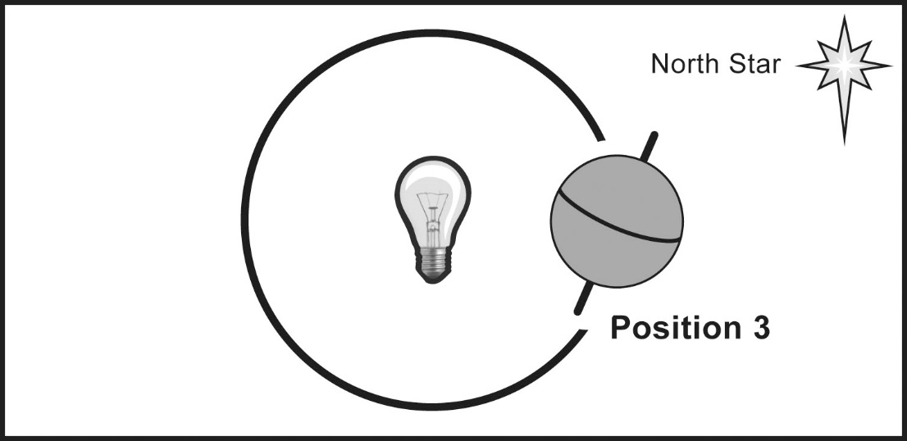
Investigation 5: Winter versus Summer
Notes:
1 min
a. “In this investigation, you and your partner will focus on Earth’s orbit around the Sun in positions 1 and 3 and explore how the angle of sunlight hitting Earth in these positions affects seasons at different latitudes.”

Slide 46
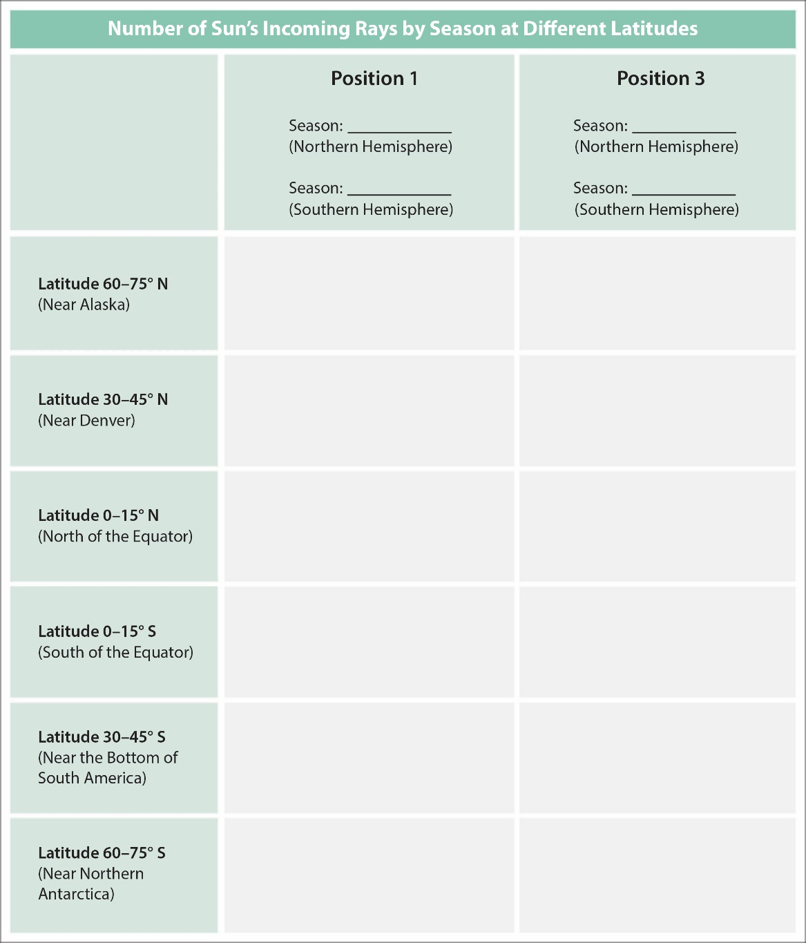
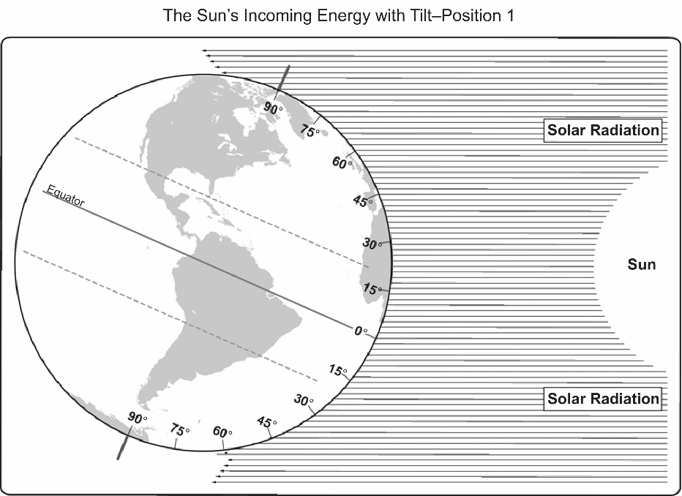
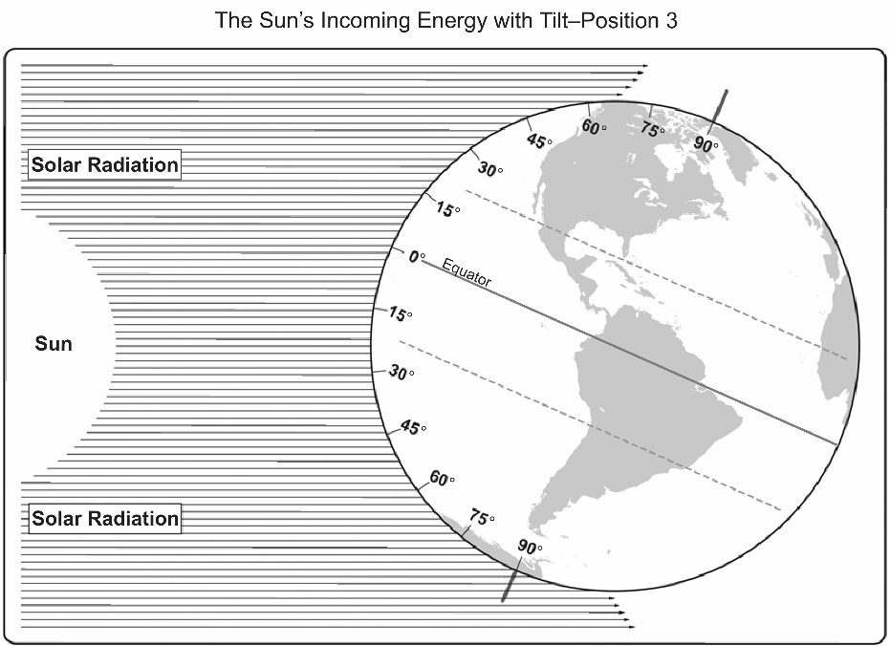
Investigation 5: Winter versus Summer
Notes:
1 min
a. “The diagrams of Earth on this slide are similar to the diagram you used earlier to count the number of Sun rays striking Earth’s surface. The only difference is that these diagrams show Earth tilted on its axis in positions 1 and 3.”
b. “In this investigation, you and your partner will count the lines of incoming rays of sunlight at various latitudes on the diagrams and then record the information on a data table.”
c. Have participants locate SEC lesson handouts 4.2 (The Sun’s Incoming Energy with Tilt—Position 1) and 4.3 (The Sun’s Incoming Energy with Tilt—Position 3) in their lesson plans binders, and handout 6.4 (Data Table—Number of Sun’s Incoming Rays by Season at Different Latitudes) in their PD program binders.

Slide 47
Investigation 5: Winter versus Summer
Work with your partner to count the incoming rays of sunlight on each diagram at the latitudes indicated on the data table (handout 6.4).
First, count the number of lines at the specified latitudes on the diagram showing Earth in position 1 (handout 4.2) and record this data in the corresponding column on the data table.
Then count the number of lines at the specified latitudes on the diagram showing Earth in position 3 (handout 4.3) and record this data in the corresponding column on the data table.
Question: How does this numerical data confirm your observations from the Earth-Sun-model investigations?
Notes:
6 min
a. Read the instructions and question on the slide. Remind participants to follow the instructions carefully.
Note: Participants may refer to their resources from the previous investigation to refresh their memories as needed.
b. Pairs: “Work with your partner to complete the tasks on the slide, discuss your observations, and then answer the question. Be prepared to share your observations and ideas with the group.”
c. Whole group: Invite a few pairs to share their observations and answers to the question. Ask probe and challenge questions and elicit differing points of view.

Slide 48
The Sun’s Effect on Climate
Lesson 4b
Photo courtesy of NASA
Notes:
Less than 1 min
a. “Finally we’ll explore ideas about the Sun’s effect on climate from SEC lesson 4b.”

Slide 49
Content Deepening: Focus Question 3
Why is it warmer in the summer than in the winter?
Notes:
Less than 1 min
a. Review the focus question on the slide.
b. “We’ll continue thinking about this question during this investigation.
c. Remind participants that this focus question will guide student learning throughout lesson 4b.

Slide 50
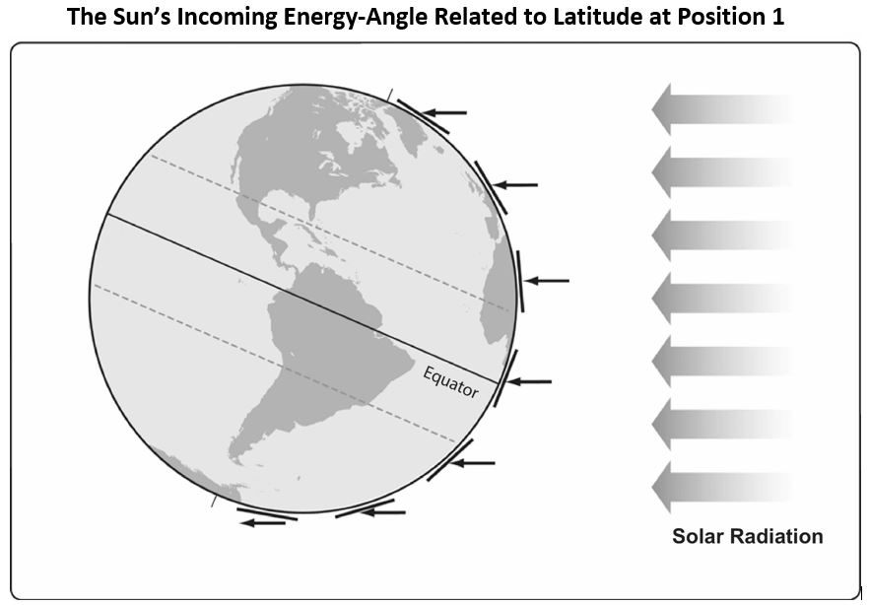
Investigation 6: Winter versus Summer
Notes:
1 min
a. “The diagram of Earth on this slide is similar to the one from lesson 2a, except that Earth is tilted on its axis in orbital position 1, with the Northern Hemisphere leaning toward the Sun.”
b. Remind participants that the thick arrows represent the incoming rays of sunlight, and the thin lines striking Earth’s curved surface at different latitudes are called tangent lines.
c. Also point out the two dashed lines that run parallel to the equator around Earth’s circumference, one in the Northern Hemisphere and one in the Southern Hemisphere. These lines represent the Tropic of Cancer and the Tropic of Capricorn.
d. Have participants locate handout 4.5 (The Sun’s Incoming Energy—Angle Related to Latitude at Position 1) in their lesson plans binders and refer to it throughout the investigation.

Slide 51
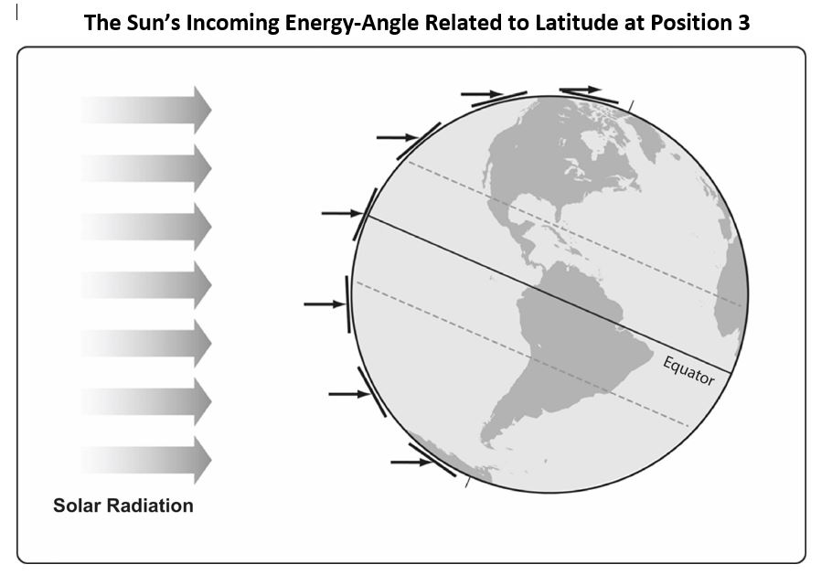
Investigation 6: Winter versus Summer
Notes:
1 min
a. “This diagram shows Earth in orbital position 3, with the Southern Hemisphere leaning toward the Sun. It also shows the arrows representing solar radiation and the dotted lines representing the Tropics of Cancer and Capricorn.”
b. Have participants locate handout 4.6 (The Sun’s Incoming Energy—Angle Related to Latitude at Position 3) in their lesson plans binders and refer to it throughout the investigation.

Slide 52
Investigation 6: Winter versus Summer
Compare the two diagrams of a tilted Earth in orbital positions 1 and 3 (handouts 4.5 and 4.6).
Discuss with your partner the significance of the two dotted lines that run parallel to the equator (the Tropic of Cancer and the Tropic of Capricorn).
Hint: Look at the positions of these dotted lines relative to the arrows and tangent lines on the diagrams. Keep in mind the orbital positions of Earth in each diagram.
Be prepared to share your observations and ideas with the group.
Notes:
6 min
a. Read the instructions on the slide and remind participants to follow them carefully.
b. Pairs: “Work with your partner to complete the tasks on the slide. Then discuss your observations and the significance of the two dashed lines that run parallel to the equator on each diagram of Earth. Be prepared to share your observations and ideas with the group.”
c. Whole group: Invite a few pairs to share their observations and ideas. Ask probe and challenge questions and elicit differing points of view.

Slide 53
Reflect: Content Deepening Focus Question 3
Why is it warmer in the summer than in the winter?
Notes:
6 min
a. Revisit the third content deepening focus question.
b. Remind participants that this focus question from SEC lessons 4a and 4b appears in the scope and sequence and on the overview page for each lesson in their lesson plans binders.
c. Individuals: Have participants answer the focus question in their science notebooks.
d. Whole group: Ask a few participants to share their answers to this question with complete-sentence statements, using evidence from the investigations they just completed.
e. As participants share their responses, record key ideas on chart paper. Remind others to listen carefully to the responses and be prepared to agree, disagree, or add ideas from the investigations.

Slide 54
Key Science Ideas
When one hemisphere of Earth tilts toward the Sun, the incoming sunlight strikes Earth’s surface at a more-direct angle. This concentrates solar radiation (heat energy) over a smaller surface area, resulting in warmer temperatures (summer).
A secondary effect of Earth tilting toward the Sun is longer days, which means more hours of sunlight.
The combination of sunlight striking Earth at a more-direct angle (the most important factor) and longer daylight hours (a secondary effect) results in warmer temperatures in the summer.
Notes:
6 min
a. Highlight the key science ideas on the slide that answer the third content deepening focus question. Emphasize that participants’ observations from the investigations and the evidence they gathered helped to shape the answer to this question.
b. Whole group: “Does everyone agree that these key ideas answer our focus question? Would you like to add or revise anything?”
c. Ask participants to write these key ideas under the focus question in their science notebooks.

Slide 55
Lesson Analysis: Focus Question 2
How can selecting appropriate science activities help students develop a coherent science content storyline?
Notes:
1 min
a. Read the focus question on the slide.
b. “To help us answer this focus question, we’re going to explore STeLLA strategy C: Select activities that are matched to the learning goal.”

Slide 56
Strategy C: Purpose and Key Features
According to the strategies booklet, what are the purpose and key features of strategy C: Select activities that are matched to the learning goal?
Notes:
25 min
a. Ask participants to locate the section on strategy C in the STeLLA strategies booklet.
b. Have one participant lead the group in creating a chart that summarizes the purpose and key features of strategy C: Select activities that are matched to the learning goal.
c. Ask: “What does the strategies booklet say about science activities that are fun and engaging for students?
Ideal responses:
Activities should be selected because they can support students in understanding the main learning goal, not because they’re fun or easy to do.
Avoid activities that are only topically related (e.g., something about plants); instead, activities should focus on a specific science idea that is closely linked to the main learning goal (e.g., Plants get their food by making it out of carbon dioxide, water, and light energy).
Activities should not just be interesting supplements to the science content storyline; they should help develop it.
d. Follow-up: “Think back on science-lab activities in high school or college. Did these activities play a key role in helping you better understand the science concepts presented in textbooks or lectures? Or were they more like add-on activities that were only loosely related to the science concepts being taught?”

Slide 57
Lesson Analysis Question
Main Learning goal: While the curved surface of Earth, its consistent tilt, and its orbital path around the Sun are the main factors that produce climate variations at different latitudes, other factors, such as elevation and proximity to large bodies of water, influence climate as well.
Focus question: Why do some places at the same latitude have different temperature patterns?
Activity: Students plot the average monthly temperatures of three US cities located at about the same latitude and examine regional geography to identify factors that may influence temperature patterns in each city.
Analysis question: Is the activity well matched to the main learning goal?
Notes:
2 min
a. For this lesson analysis, participants will view a set of four video clips from one SEC lesson.
b. Review the main learning goal, focus question, and activity on the slide. Then introduce the analysis question: Is the activity well matched to the main learning goal?

Slide 58
Lesson Analysis: Strategy C
Write this main learning goal at the top of Analysis Guide C (handout 6.5):
Factors other than latitude, such as elevation and proximity to large bodies of water, influence climate.
For this analysis, we’ll watch four video clips from the same SEC lesson.
Before each clip: Read the lesson context at the top of the corresponding video transcript.
After each clip: Complete part 1 of the analysis guide.
Links to Evans video clips: 6.3_stella_SEC_evans_L5_c1; 6.4_stella_SEC_evans_L5_c2; 6.5_stella_SEC_evans_L5_c3; 6.6_stella_SEC_evans_L5_c4
Notes:
60 min
Note: Refer to the SEC content background document as needed throughout this lesson analysis.
a. Have participants locate Analysis Guide C (handout 6.5) in their PD binders and write the main learning goal for the selected SEC lesson at the top. Then orient them to part 1 of the analysis guide.
b. Before each video clip: Have participants read the lesson context at the top of the corresponding video transcript (handout 6.6 for clip 3, handout 6.7 for clip 4, handout 6.8 for clip 5, and handout 6.9 for clip 6).
c. Show each video clip.
d. After each clip (individuals or pairs): Allow time for participants to review the analysis guide, write down science ideas revealed in the activity, and assess how well matched these ideas are to the main learning goal.
Observations:
Video Clip 6.3: The teacher introduces the focus question, Why do some places at the same latitude have different temperature patterns? This question implies the main learning goal but doesn’t introduce any science ideas.
Video Clip 6.4: In small groups, students are looking for temperature patterns in the United States in the summer and winter. They’re also reviewing ideas they learned in previous lessons about why these patterns exist. Students bring up the science idea that the Sun’s rays hit Earth most directly at the equator, so places in the US that are closer to the equator will be hotter (video segments 0:00:18.8–0:01:14.2 and 0:01:34.7–0:02:36.6), and places farther away from the equator will be colder.
At this point, students don’t mention other possible factors that cause temperature variations, nor do they even acknowledge that the maps show temperature variations at the same latitude. The only factors they focus on are latitude and the angle of sunlight striking Earth at specific latitudes.
Video Clip 6.5: The teacher notes that during the class discussion, students observed that the Rocky Mountains might play a role in influencing temperature patterns at a given latitude because a dip in one of the color bands on the map indicates cooler temperatures in both the summer and winter right where the Rocky Mountains are located. However, it isn’t clearly stated that temperatures aren’t the same in locations at similar latitudes or that factors like proximity to mountains might play a role in these temperature variations.
Video Clip 6.6: As students are creating graphs of monthly temperatures for three US cities, the teacher points out that students could use this data to find the average temperature over the year for each city, as well as the minimum and maximum temperatures, and the mode and then compare them across the three cities. However, there is no indication how this mathematical analysis might help them understand factors influencing climate in these three locations. These additional mathematical calculations seem to distract from the lesson focus.

Slide 59
Lesson Analysis: Strategy C
Discuss these questions with a partner:
Were the activities well matched to the learning goal? Provide evidence to support your response.
Suggest ways to improve the match between the activities and the main learning goal (part 2, Analysis Guide C).
Be prepared to share your ideas in a group discussion.
Notes:
10 min
a. Pairs: “Discuss the questions on the slide and be ready to share your ideas with the group.”
b. Whole group: Discuss how well the activities in the video clips matched the main learning goal, and ask participants to offer suggestions for improving the match.
Observations:
The activity itself was well matched to the learning goal. The graphing activity presented a clear pattern in the data, indicating that the three selected cities have quite different patterns of temperatures and setting the stage for figuring out why these patterns exist. Juxtaposing the topographic map with the temperature patterns might prompt students to think about other factors that influence temperature patterns, such as elevation and proximity to a large body of water.

Slide 60
Lesson Analysis: Strategy C
Study the video transcripts again and gather evidence to answer these questions:
What kept students focused on the main learning goal?
What distracted students from the learning goal?
Notes:
5 min
a. Read the questions on the slide.
b. Individuals: Direct participants to look for evidence in the video transcripts that will help them answer these questions.
c. Whole group: Ask one or two participants to share their ideas and evidence in response to the questions.
Observations:
Video Clip 6.3: Introducing the focus question in this clip helped students understand why they’re doing the graphing.
Video Clip 6.4: Quite a bit of review about the intensity of sunlight in this clip didn’t specifically relate to the lesson focus. Perhaps the teacher should have emphasized the temperature variations at particular latitudes in his conversations with small groups in this portion of the lesson to keep students focused on the main learning goal.
Video Clip 6.5: In this clip, the teacher highlights the temperature anomalies at the same latitude; however, this introduction to the graphing activity could have been strengthened with a direct reference to the focus question.
Video Clip 6.6: In this clip, the teacher discusses alternative calculations that could be made from the data points students are graphing, but these calculations wouldn’t help answer the focus question. The teacher diverts the focus from the main learning goal by suggesting that other calculations might have furthered the storyline of the lesson.

Slide 61
Practice: Strategy C
Main learning goal: Water holds heat energy better than land, so areas farther away from large bodies of water will have greater temperature variations throughout the year than areas near large bodies of water.
Candidate activities:
Students plot and compare temperatures of San Francisco, California; the Galapagos Islands; and Tasmania.
Students plot and compare temperatures of Chicago, Illinois; Athens, Greece; and Shanghai, China.
Using a hair dryer to simulate wind, students blow air over a bowl of water and measure any changes in water temperature over 5 minutes.
Questions:
How well does the activity match the main learning goal?
How might the activity be changed to better match the main learning goal?
Notes:
7 min
Note: This activity may be skipped if time is running short.
a. Individuals (2–3 min): “Think about how well the activities on the handout are matched to the main learning goal. Be prepared to give a rationale for your choices.”
b. Whole group: Invite participants to share their ideas and reasoning with the group.
Ideal responses:
Activity 1: This activity isn’t matched to the main learning goal because the three cities are all close to large bodies of water. None of them experience large temperature swings throughout the year (although San Francisco and Tasmania have greater temperature swings than the Galapagos Islands, because the Galapagos are located at the equator and experience minimal temperature variations related to seasons).
Activity 2: This activity isn’t matched to the main learning goal not only because all three cities are near a large body of water but also because there are a number of additional confounding variables that make temperature comparisons difficult. Chicago is situated at a more northerly latitude, and Shanghai is closer to the equator than the other two cities. Chicago is at the center of a continent near a large lake, whereas Athens is on a peninsula in the Mediterranean Sea. Shanghai sits along the east coast of a large land mass, where the prevailing winds are offshore rather than onshore, which has less of an impact on temperatures than onshore winds in a West Coast city like San Francisco.
Activity 3: This activity isn’t matched to the main learning goal. The direction of the prevailing winds blowing toward or away from a location on land does impact temperature, as does the temperature of the prevailing currents (such as a strong, warm or cold ocean current). However, blowing heated air over a bowl of water and measuring changes in water temperature isn’t an effective way to simulate temperature variations on land.

Slide 62
Today’s Focus Questions
How can we begin and end a lesson to help students develop a coherent science content storyline?
How can selecting appropriate science activities help students develop a coherent science content storyline?
Why are places closer to Earth’s equator hotter than places farther away from the equator?
Why is it summer in the United States (the Northern Hemisphere) when it’s winter in Argentina (the Southern Hemisphere)?
Why is it warmer in the summer than in the winter?
Notes:
Less than 1 min
a. Remind participants of today’s focus questions.

Slide 63
Summarize Today’s Work
Hold up three fingers when you have all of these in mind:
One idea you’re taking away about strategy C: Select activities that are matched to the learning goal
One idea you’re taking away about strategies B, I, and 7:
Set the purpose with a focus question or goal statement (strategy B)
Summarize key science ideas (strategy I)
Engage students in making connections by synthesizing and summarizing key science ideas (strategy 7)
One science idea about the Sun’s effect on climate that you’re taking away from today’s content deepening work.
Notes:
7 min
a. Individuals: Read the instructions on the slide and give participants enough time to come up with three ideas to summarize today’s work.
b. Whole group: In a round-robin, invite participants to share a key idea for each category on the slide. (Allow participants to pass if they wish.)

Slide 64
Homework
In the STeLLA strategies booklet, read about SCSL strategy D:
Select content representations and models matched to the learning goal and engage students in their use.
Fill in the appropriate column on your SCSL Z-fold summary chart.
Notes:
Less than 1 min
a. Go over the homework assignment and have participants write it in their notebooks.
b. Make sure participants understand each part of the assignment.

Slide 65
Reflections on Today’s Session
How are STeLLA strategies B, I, 7, and C related to one another?
What new insights or questions have emerged about the Sun’s effect on climate?
Only two more days are left of our time together at the Summer Institute. What burning questions do you think should be answered before the end of the week?
Notes:
7 min
a. Allow participants at least 5 minutes to think about today’s session and write their reflections and feedback on the Daily Reflections sheet (handout 6.10 in PD program binder).

