Slide 1




RESPeCT PD pROGRAM
Day 7
RESPeCT Summer Institute
Notes:
5 min
a. Take care of any housekeeping issues.

Slide 2
Agenda for Day 7
Day-6 reflections
Focus questions
Introducing SCSL strategy D
Sample analysis of content representations
Lesson analysis: SCSL strategy D
Lunch
Content deepening: the Sun’s effect on climate
Summary, homework, and reflections
Notes:
5 min
a. Talk through the agenda for the day.

Slide 3
Trends in Reflections
Lesson Analysis | Science Content Learning
Notes:
5 min
a. Give participants time to review your feedback on their reflections from day 6 and offer reactions, comments, or follow-up questions.

Slide 4
Norms for Working Together: The Basics
Purpose: Build trust and develop a productive study group for all participants.
The Basics
Arrive prepared and on time; stay for the duration; return from breaks on time.
Remain attentive, thoughtful, and respectful; engage and be present.
Eliminate interruptions (turn off cell phones, email, and other electronic devices; avoid sidebar conversations).
Make room for everyone to participate (monitor your floor time).
Notes:
2 min
a. Review the norms and ask participants to think about areas where they could improve individually or as a group.
b. “How do you think we’re doing individually and as a group applying these norms? Do you have any comments or suggestions about areas where we could improve?”

Slide 5
Norms for Working Together: The Heart
Purpose: Build trust and develop a productive study group for all participants.
The Heart of RESPeCT Lesson Analysis and Content
Deepening
Keep the goal in mind: analysis of teaching to improve student learning.
Share your ideas, uncertainties, confusion, disagreements, questions, and good humor. All points of view are welcome.
Expect and ask questions to deepen everyone’s learning; be constructively challenging.
Listen carefully; seek to understand other participants’ points of view.
Notes:
5 min
a. Review the norms that are at the heart of the RESPeCT program and ask participants to think about areas where they could improve individually or as a group.
b. Emphasize: “We’re doing quite well with our norms, but as we approach the fall, I hope to see our interactions evolving so that you feel comfortable interacting less through your PD leaders as the ‘teachers’ and direct more of your questions and comments to one another, challenging each other, piggybacking on each other’s ideas, and listening carefully to one another so that everyone is contributing to the kind of productive analysis that will help us figure out ways to strengthen our students’ science learning.”
c. Offer an opportunity for participants to comment on how the group is doing with these norms. Ask, “Are there any areas where we could improve? Any suggested changes?”

Slide 6
Today’s Focus Questions
How do you know when a content representation is appropriate and matched to the main learning goal?
How can we engage students in using content representations and models in meaningful ways?
Why do some places at the same latitude have different temperature patterns?
How does being near the ocean or another large body of water affect air temperature?
How does being near the ocean or at a higher elevation affect air temperature?
How can we use what we’ve learned about the Sun’s effect on climate to answer the unit central question, Why are some places on Earth hotter than others at different times of the year?
Notes:
1 min
a. Introduce the focus questions on the slide.

Slide 7
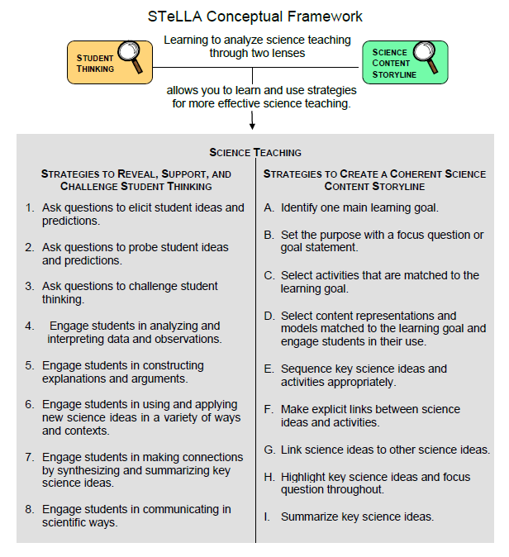
Notes:
2 min
a. “We’ll be focusing on STeLLA strategy D today. Notice that this SCSL strategy has two parts. The first part—select content representations and models matched to the learning goal—sounds similar to strategy C—select activities that are matched to the learning goal. The second part focuses on engaging students in the use of content representations. This ensures that students aren’t just looking at diagrams or models but are actively engaging with them.”

Slide 8
Lesson Analysis: Focus Question 1
How do you know when a content representation is appropriate and matched
to the main learning goal?
Notes:
Less than 1 min
a. “Now let’s explore the first part of strategy D and our first focus question.”
b. Read the focus question on the slide.

Slide 9
SCSL Strategy D: Purpose and Key Features
  What are the purpose and key features of this strategy?
  Cite ideas and examples from the STeLLA strategies booklet and your SCSL Z-fold summary chart.
Notes:
25 min
a. Small groups (13 min): Divide participants into two groups and have each group make a chart identifying the purpose and key features of strategy D described in their SCSL Z-fold summary charts and the STeLLA strategies booklet.
b. Whole group (12 min): Have groups report out. Then ask, “What differences do you notice between the two charts?”
Key ideas:
Content representations can help students envision things that are too big or too small for them to see firsthand in the classroom, or processes that take place too quickly or slowly for them to perceive.
Content representations give students access to different ways of making sense of key science ideas.
If content representations or models are closely matched to the main learning goal, they can be especially useful in helping students see how the science content storyline fits together.
There are many different types of content representations (analogies, metaphors, and visual representations, such as diagrams, charts, graphs, concept maps, models, and role-plays).
Content representations can reveal and challenge student thinking if students are involved in creating, modifying, and analyzing the representations (instead of just listening to the teacher explain them).

Slide 10
Strategy D: Discussion Questions
  How is this strategy similar to or different from selecting activities matched to the learning goal (strategy C)?
  How might good content representations be especially helpful for English language learners?
Notes:
10 min
a. Whole group: Discuss the questions on the slide.
Key ideas:
Slide question 1: Both strategy C and strategy D emphasize that all activities must be matched to the main learning goal. Strategy D, however, emphasizes a very important kind of activity: content representations. It also emphasizes that teachers should actively engage students in creating, modifying, and using content representations.
Slide question 2: Good content representations can benefit all students, but they especially benefit ELL students because they present science ideas in pictures, images, and other visual formats in addition to words.

Slide 11
Analysis Guide for Strategy D
Read Analysis Guide D (handout 7.1 in your PD program binder).
Keep this question in mind: What do you notice about how this guide is organized?
Notes:
6 min
a. Have participants locate Analysis Guide D in their PD program binders (handout 7.1).
b. Individuals : “As you read the analysis guide, keep in mind the discussion question on the slide.”
c. Whole group: Discuss the question on the slide.
Key ideas:
The analysis guide focuses on the main learning goal by having participants write that down first.
The guide is divided into three parts. Part 1 focuses on how well matched the content representation is to the main learning goal. Part 2 focuses on how well engaged students are in using the content representation.
The guide ends with identifying ways to improve the content representation and its use in a lesson (part 3).

Slide 12
Content Representation 1: Tray-and-Globe Model
Read the main learning goal and description of the content representation in Analysis Guide D1 (page 1 of handout 7.1).
Notes:
2 min
a. Set the context: “Now we’re going to analyze a content representation to see how well it’s matched to the stated learning goal.”
b. Have participants read the main learning goal and description of the content representation in Analysis Guide D1 (page 1 of handout 7.1).

Slide 13
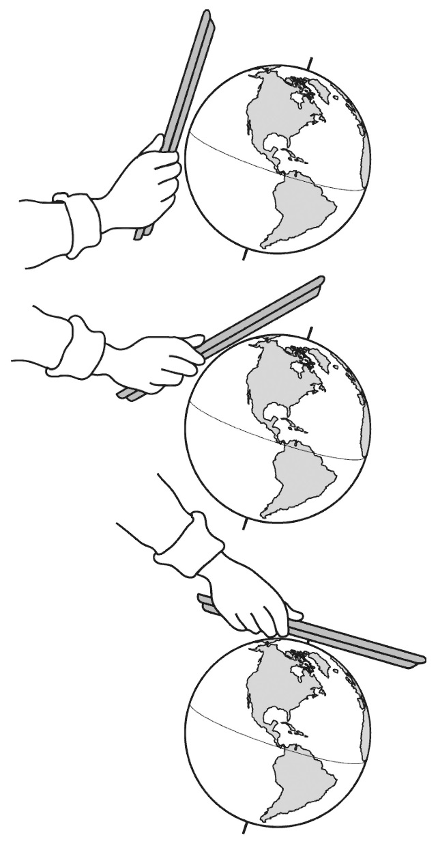
Content Representation 1: Tray-and-Globe Model
Notes:
8 min
a. Individuals: Have participants work independently on part 1 of Analysis Guide D1.
Note: Encourage participants to refer as needed to handout 7.2 (Tray-and-Globe Example) in their PD binders.
b. Pairs: “Now pair up and discuss your answers to the analysis questions.”
c. Emphasize that the content representation participants are analyzing is not just the image but the entire activity, which involves measuring the surface area that falls within the circle of light striking the tray straight on or at an angle.

Slide 14
Does Content Representation 1 Match the Main Learning Goal?
How did you answer these questions from part 1 of the analysis guide?
Is the content representation scientifically accurate?
Is it closely matched to the main learning goal?
Does it present science ideas to students in comprehensible ways?
Does it reinforce/introduce any misconceptions?
Does it address common misconceptions?
Does it contain distracting details?
Notes:
10 min
a. Whole group: Discuss participants’ responses to the questions in part 1 of Analysis Guide D1.
b. Ask: “How might this content representation be improved? Would you use it with your students?”
Observations:
This content representation is scientifically accurate in depicting the intensity of sunlight striking Earth (the tray) at a single latitude, but since Earth’s surface is curved and the tray is flat, the model is flawed. You almost need to move the tray at the tangent of the globe to visualize the changing intensity of light (rather than at several static points around the globe).
This content representation can be misleading in the following ways:
The flashlight beam often casts a faint light around the edges of the circle, which can lead students to mistakenly conclude that sunlight is fainter farther from the equator because it’s at the “edge” of the light rays. Higher-quality flashlights do a better job of shining light more uniformly throughout the circle, including around the edges. Related misconceptions are that sunlight strikes Earth only at the equator or makes a circle of light in much the same way a flashlight pointed directly at the equator creates a circle of light that spreads out as it moves toward the poles. Students think that the poles don’t get as much light as the equator because they’re farther from where the circle of sunlight strikes the surface.
Students falsely equate the tilted tray with Earth’s tilted axis and miss the point that variations in light intensity resulting in warmer temperatures at the equator and cooler temperatures at the poles are related not to Earth’s tilt but to the angle at which sunlight strikes Earth’s curved surface.
The scale of the objects in this content representation and the distances between Earth and the Sun are misleading. The Sun isn’t close to Earth, nor does it shine on just one spot. It’s actually very far away from Earth and shines not only on Earth but on other celestial bodies.
Take-home message: Trying to address all six criteria in the analysis guide is a balancing act or trade-off. To make complex science ideas meaningful and comprehensible to students, the content representation needs to be simplified, but simplifications can sometimes be misleading in terms of scientific accuracy. The important thing is for teachers to be aware of such problems so they can be addressed.

Slide 15
Content Representation 2: The Sun’s Incoming Energy
Read the main learning goal and description of the content representation in Analysis Guide D2 (page 2 of handout 7.1).
Use your experience with this content representation to complete part 1 of the analysis guide.
Notes:
5 min
a. Set the context for analyzing another content representation.
b. Have participants turn to Analysis Guide D2 (page 2 of handout 7.1) and read the main learning goal and description of the content representation.

Slide 16
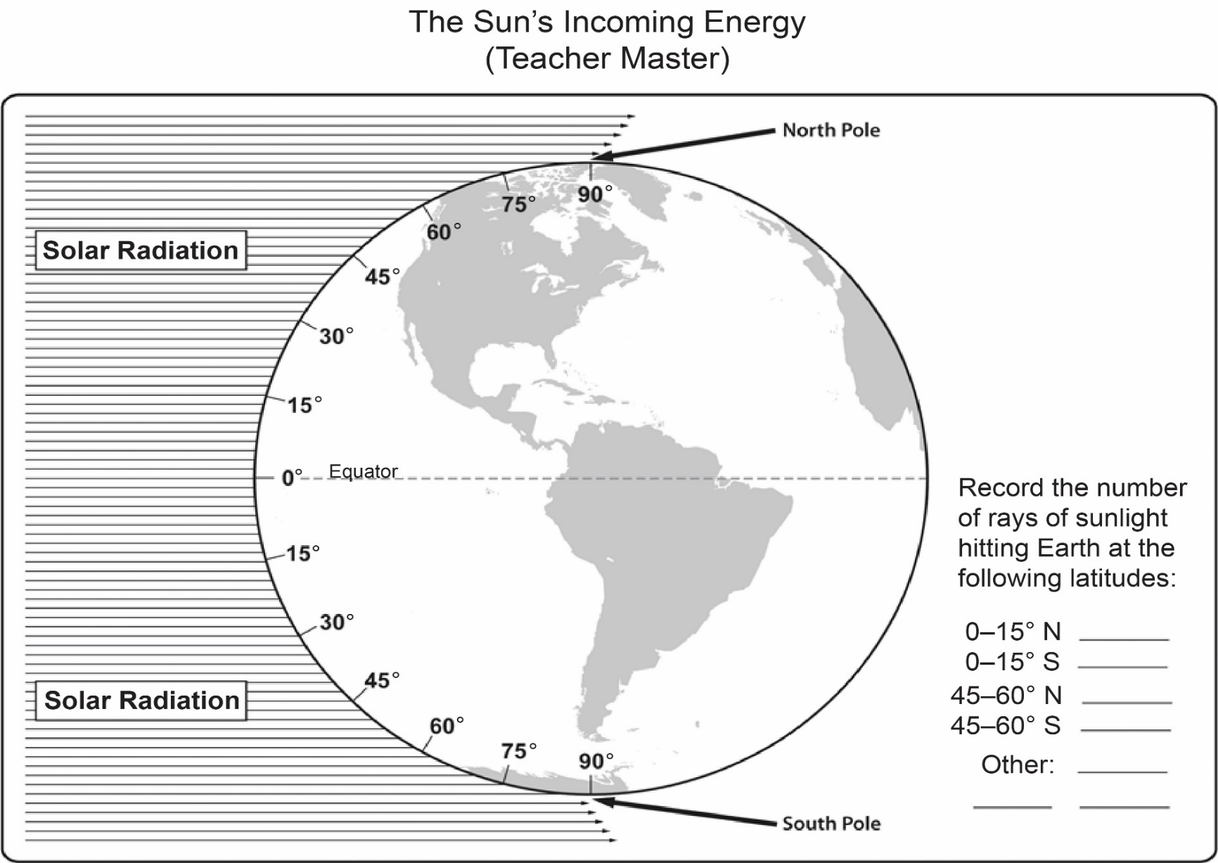
Content Representation 2: The Sun’s Incoming Energy
The Sun’s Incoming Energy
Notes:
7 min
a. Individuals: Have participants work independently on part 1 of Analysis Guide D2. Let them know they can find this slide diagram in their lesson plans binders (handout 2.3, The Sun’s Incoming Energy).
Note: If time is short, just do partner work.
b. Pairs: “Now pair up and discuss your answers to the analysis questions.”

Slide 17
Does Content Representation 2 Match the Main Learning Goal?
How did you answer these questions from part 1 of the analysis guide?
Is the content representation scientifically accurate?
Is it closely matched to the main learning goal?
Does it present science ideas to students in comprehensible ways?
Does it reinforce/introduce any misconceptions?
Does it address common misconceptions?
Does it contain distracting details?
Notes:
10 min
a. Whole group: Discuss participants’ responses to the questions in part 1 of Analysis Guide D2.
b. Ask: “How might this content representation be improved? Would you use it with your students?”
Observations:
This content representation is a different way of depicting how light that strikes Earth’s curved surface at an angle spreads out and is less intense. Students can count more lines per latitude interval closer to the equator and fewer lines per latitude interval near the poles. The representation is scientifically accurate for the most part; however, Earth’s position on the diagram gives the impression that the equator receives the most-direct rays of sunlight. The fact is, the Sun’s rays strike the equator directly (straight on) only twice a year: during the spring and autumn equinoxes. Earth’s tilt and orbit around the Sun (which students learn about in later lessons) cause the focal point of most-direct sunlight to shift between 23.5° south latitude (during the winter solstice) and 23.5° north latitude (during the summer solstice).
One misconception this content representation introduces and/or reinforces is that the Sun’s rays are literal lines of light, which is inaccurate. The Sun’s rays don’t actually form literal lines. The lines simply represent the general movement of the Sun’s rays as they travel through Earth’s atmosphere.
Take-home message: Trying to address all six criteria in the analysis guide is a balancing act or trade-off. To make complex science ideas meaningful and comprehensible to students, the content representation needs to simplified, but simplifications can sometimes be misleading in terms of scientific accuracy. The important thing is for teachers to be aware of such problems so they can be addressed.

Slide 18
Content Representation 3: Two-Flashlights-and-Globe Model
Read the main learning goal and description of the content representation in Analysis Guide D3 (page 3 of handout 7.1).
Notes:
5 min
Note: If time is running short, this content representation can be skipped.
a. Have participants turn to Analysis Guide D3 (page 3 of handout 7.1) and read the main learning goal and description of the content representation.
b. Emphasize that in this simulation, students point one of the flashlight beams directly at the equator, and the other toward one of the poles.

Slide 19
Content Representation 3: Two-Flashlights-and-Globe Model
Notes:
7 min
a. Individuals: Have participants work independently on part 1 of Analysis Guide D3.
Note: If time is short, just do partner work.
b. Pairs: “Now pair up and discuss your answers to the analysis questions.”

Slide 20
Does Content Representation 3 Match the Main Learning Goal?
How did you answer these questions from part 1 of the analysis guide?
Is the content representation scientifically accurate?
Is it closely matched to the main learning goal?
Does it present science ideas to students in comprehensible ways?
Does it reinforce/introduce any misconceptions?
Does it address common misconceptions?
Does it contain distracting details?
Notes:
10 min
a. Whole group: Discuss participants’ responses to the questions in part 1 of Analysis Guide D3.
b. Ask: “How might this content representation be improved? Would you use it with your students?”
Observations:
This content representation helps students visualize how light spreads out at higher (and lower) latitudes. It also helps them connect the flat-tray representation to a curved Earth. The representation is closely matched to the main learning goal, but the two lights can lead to student misconceptions. Some students may think there are two Suns or that the lights represent the Sun and the Moon. This content representation also poorly depicts the scale of the objects and the distance between Earth and the Sun.
Take-home message: Trying to address all six criteria in the analysis guide is a balancing act or trade-off. To make complex science ideas meaningful and comprehensible to students, the content representation needs to be simplified, but simplifications can sometimes be misleading in terms of scientific accuracy. The important thing is for teachers to be aware of such problems so they can be addressed.

Slide 21
Lesson Analysis: Focus Question 2
How can we engage students in using content representations and models in meaningful ways?
Notes:
Less than 1 min
a. Transition slide: “Next we’ll watch three video clips of strategy D in use during an SEC lesson on Earth’s orbit around the Sun. In addition to completing part 1 of Analysis Guide D4, we’ll focus on parts 2 and 3: How well engaged are students in using the content representation? And what suggestions do you have for improving the content representation and its use with students?”
b. “In these video clips, three different teachers engage their students in using a Hula Hoop, a Styrofoam ball, and a lightbulb setup to simulate Earth’s orbit around the Sun. These lessons were taught using slightly different lesson plans, but the science ideas are found in lessons 3 and 4 of our current RESPeCT lesson series.”

Slide 22
Lesson Analysis 1: Strategy D (Earth-Sun Model)
Read the context for the first video clip at the top of the transcript (handout 7.3).
Read the main learning goal and description of the content representation at the top of Analysis Guide D4.
Watch the video clip, keeping in mind the criteria for strategy D (part 1 of the analysis guide).
Work with a partner to complete part 1 of the analysis guide.
Share your responses with the group.
Link to Video Clip 7.1: 7.1_stella_SEC_kawamura_c1–c3
Notes:
20 min
a. Orient participants to Analysis Guide D4 and the transcript for video clip 1 (handout 7.3 in PD binder).
b. Have participants read the main learning goal and description of the content representation at the top of the analysis guide.
Note: The teacher in this clip is reviewing the main learning goal from previous lessons.
c. Show the video clip.
d. Pairs: Have participants pair up and complete part 1 of the analysis guide.
e. Whole group: Discuss participants’ responses to the questions in part 1 of the guide.
Observations:
Students are engaged in comparing the content representation with their understandings of what the positions and movements of Earth and the Sun really involve. The teacher challenges students to describe what’s good and not so good about the content representation. They also discuss similarities and differences between the model and the actual Earth-Sun system. The following student ideas (misconceptions) are made visible during this discussion:
Earth’s orbit around the Sun is more like an oval than a circle.
The Sun isn’t in the center of Earth’s orbit but is skewed to one side.
The distance between the Sun and Earth vary over the course of the year, causing seasonal temperature changes and differences in the size of shadows based on the position of the Sun.
While student thinking is revealed during this discussion, it also provides a sensemaking opportunity. When the teacher asks a student to draw on the board his concept of the Earth-Sun system and explain his thinking, she raises a key question: “Whose summer did you represent?” (video segment 0:03:35.4). The student’s attempts to talk his way around the inconsistencies in his thinking allow other students to consider the proposed model in greater depth and present ideas and evidence for why it’s wrong.
Rather than summarizing what she thinks this final student was trying to express, the teacher could have asked probe questions to make his thinking visible.

Slide 23
Lesson Analysis 1: Strategy D (Earth-Sun Model)
Part 2
Are students engaged in modifying or creating the content representation?
Are students engaged in analyzing the meaning of the content representation?
Are students engaged in critiquing the content representation?
Part 3
What did you learn from watching the video clip that might suggest ways to improve the content representation?
Notes:
15 min
a. “Now we’re going to turn our attention to part 2 of strategy D, which engages students in using content representations. We’ll also consider ways the content representation could be improved.”
b. Individuals: “Study the video transcript again and think about parts 2 and 3 of Analysis Guide D4. Be ready to share evidence that supports your conclusions.”
c. Pairs: “Compare your conclusions about student engagement with the content representation.”
d. Whole group: Review participants’ responses to parts 2 and 3 of the analysis guide. Challenge participants to support their answers with evidence from the video transcript.
e. If it didn’t already come up in the discussion, ask participants, “How might the teacher have engaged these students in analyzing or critiquing the representation?”

Slide 24
Lesson Analysis 2: Strategy D (Earth-Sun Model)
Read the context for the second video clip at the top of the transcript (handout 7.4).
Review the main learning goal and description of the content representation at the top of Analysis Guide D5.
Watch the video clip, keeping in mind the criteria for part 2 of the analysis guide and looking for ways the content representation might be improved (part 3).
Pairs: Complete parts 2 and 3 of the analysis guide.
Link to Video Clip 7.2: 7.2_stella_SEC_hannigan_L6_c6
Notes:
20 min
a. Orient participants to Analysis Guide D5 and the transcript for the second video clip (handout 7.4 in PD binder).
b. Have participants read the main learning goal and description of the content representation at the top of the analysis guide. Emphasize that they’ll focus only on parts 2 and 3 of the guide for this clip.
c. “For this analysis, we’re going to look at a new classroom video and examine how students are (or are not) engaged in using the content representation.”
d. Show the video clip.
e. Pairs: Have participants pair up and complete parts 2 and 3 of the analysis guide.

Slide 25
Lesson Analysis 2: Strategy D (Earth-Sun Model)
Part 2
Are students engaged in modifying or creating the content representation?
Are students engaged in analyzing the meaning of the content representation?
Are students engaged in critiquing the content representation?
Part 3
What did you learn from watching the video clip that might suggest ways to improve the content representation?
Notes:
10 min
a. Whole group: Discuss participants’ responses to parts 2 and 3 of Analysis Guide D5. Challenge participants to support their answers with evidence from the video transcript.
b. If it didn’t already come up in the discussion, ask participants, “How might the teacher have engaged these students in analyzing or critiquing the representation?”
Observations:
As in the first clip from Ms. Kawamura’s class, students in Ms. Hannigan’s class have been struggling with the idea that Earth’s orbit is a circle, not an oval. They’re convinced that Earth is closer to the Sun at certain points in its orbital path, so Ms. Hannigan relates their current content representation (the round Hula Hoop) to the diagrams commonly seen in textbooks that might lead to this misconception.
The discussion in this clip should focus on how engaging students in using the content representation helped them analyze and critique it and specifically addressed a common student misconception. Ms. Hannigan helps students make sense of Earth’s circular orbit by explaining the flaws in two-dimensional representations that reinforce the misconception that Earth’s orbit is elliptical. While the teacher doesn’t address the main learning goal directly, she does address a persistent misconception related to the learning goal and thus gives students a reason to reject their previous understandings of Earth’s orbit and adopt a more-scientific understanding.

Slide 26
Lesson Analysis 3: Strategy D (Earth-Sun Model)
Read the context for the final video clip at the top of the transcript (handout 7.5).
Read the main learning goal and description of the content representation at the top of Analysis Guide D6.
Watch the video clip, keeping in mind the criteria for strategy D (part 1 of the analysis guide).
Work with a partner to complete part 1 of the analysis guide.
Share your responses with the group.
Link to Video Clip 7.3: 7.3_stella_SEC_belcastro_c1
Notes:
15 min
a. Orient participants to Analysis Guide D6 and the transcript for the final video clip (handout 7.5 in PD binder).
b. Have participants read the main learning goal and description of the content representation at the top of the analysis guide.
c. Show the video clip.
d. Pairs: Have participants pair up and complete part 1 of the analysis guide.
e. Whole group: Discuss participants’ responses to the questions in part 1 of the guide.
Observations:
For a full 20 seconds before asking any questions or making any comments, the teacher simply listens to students trying to make sense of the model.
The teacher then uses both probe and challenge questions to help students clarify their understandings of the relationship between Earth’s movements, areas that receive the most-direct sunlight, and seasonal changes. She often encourages students to pause during their simulation of Earth’s orbit around the Sun in different positions and really think (and talk) through how they’re making sense of the model in relation to temperature patterns and seasonal changes in the Northern and Southern Hemispheres.
Students talk about “more sunlight” and “not as much sunlight” without making a clear connection to the ideas from lesson 2 about the angle of sunlight striking Earth’s curved surface. One student refers to “more direct light” (video segment 0:02:16.9) but doesn’t articulate exactly what that means. Another student refers to a “circle of light” shining on the Styrofoam ball (segment 0:02:24.6). This makes me wonder whether students are associating “more light” or “less light” with where the circle shines on the globe (and conversely, where there is no light, such as near the North Pole during the long, sunless days of winter). If their focus is more on the circle of light, students may not be thinking about the angle of sunlight at different times of the year at all.
The “circle of light” reference raises interesting analysis questions about the misconceptions this content representation reinforces. Modifications to the content representation and alternative teaching moves might challenge students to interpret the content representation in more-scientific ways.

Slide 27
Lesson Analysis 3: Strategy D (Earth-Sun Model)
Part 2
Are students engaged in modifying or creating the content representation?
Are students engaged in analyzing the meaning of the content representation?
Are students engaged in critiquing the content representation?
Part 3
What did you learn from watching the video clip that might suggest ways to improve the content representation?
Notes:
10 min
a. “Now let’s focus on parts 2 and 3 of strategy D.”
b. Individuals: “Study the video transcript again and think about parts 2 and 3 of Analysis Guide D6. Be ready to share evidence that supports your conclusions.”
c. Pairs: “Compare your conclusions about student engagement with the content representation in the video clip.”
d. Whole group: Review participants’ responses to parts 2 and 3 of the analysis guide. Challenge participants to support their answers with evidence from the video transcript.
e. If it didn’t already come up in the discussion, ask participants, “How might the teacher have engaged these students in analyzing or critiquing the representation?”

Slide 28
Strategy D: Synthesize and Summarize
What new ideas do you have about these aspects of today’s lesson analysis work?
How to select content representations
How to engage students in using content representations
Did our content-representation work give you any new insights about why the Northern and Southern Hemispheres have opposite seasons?
Notes:
10 min
a. Individuals (5 min): Have participants work on the slide questions. Encourage them to use their resources (e.g., the strategies booklet, their Z-fold summary charts, the content background document, notes they’ve taken).
b. Whole group (5 min): Have participants share their new ideas for each question in a round-robin format, if time allows. Otherwise, have a couple of volunteers share their ideas for each question.

Slide 29

The SUN’S EFFECT ON CLIMATE
SCIENCE CONTENT DEEPENING Grade 6
Notes:
Less than 1 min
a. Transition: This slide marks the transition to the content deepening phase of the session.

Slide 30
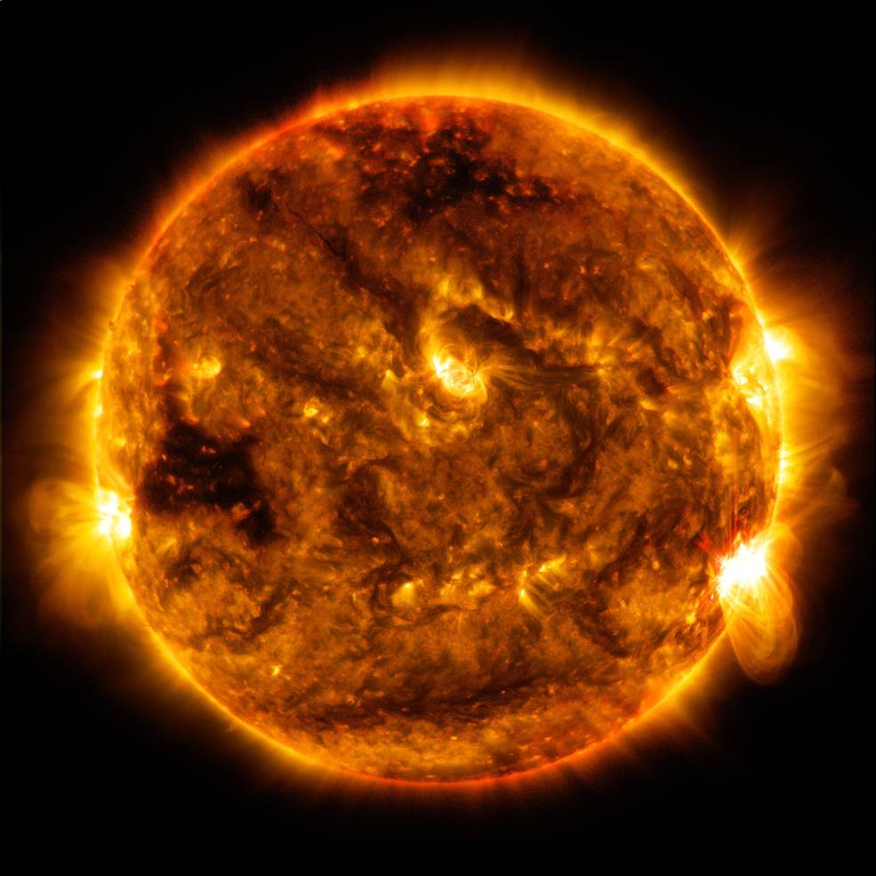
The
Sun’s
Effect on
Climate
Content
Deepening
Developed by
Dr. Jeff Marshall
Geological Sciences
Cal Poly Pomona
Used by permission
Photo courtesy of NASA
Notes:
Less than 1 min
a. “Today our content deepening work will focus on science ideas about the Sun’s effect on climate from SEC lessons 5 through 7.”
Note: Throughout this content deepening phase, refer as needed to the Sun’s Effect on Climate Content Background Document and Common Student Ideas about the Sun’s Effect on Climate and Seasons.

Slide 31
Unit Central Question
  Why are some places on Earth hotter than others at different times of the year?
Notes:
Less than 1 min
a. Review the unit central question on the slide.

Slide 32
The Sun’s Effect on Climate
Lesson 5a
Photo courtesy of NASA
Notes:
Less than 1 min
a. “Next, we’ll explore ideas about the Sun’s effect on climate from SEC lesson 5a.”

Slide 33
Content Deepening: Focus Question 1
  Why do some places at the same latitude have different temperature patterns?
Notes:
Less than 1 min
a. Read the focus question on the slide.
b. Emphasize that this focus question will guide student learning throughout SEC lessons 5a and 5b.
c. Ask participants to write the question in their science notebooks and draw a box around it. Make sure they leave space below the question to write a response later.

Slide 34
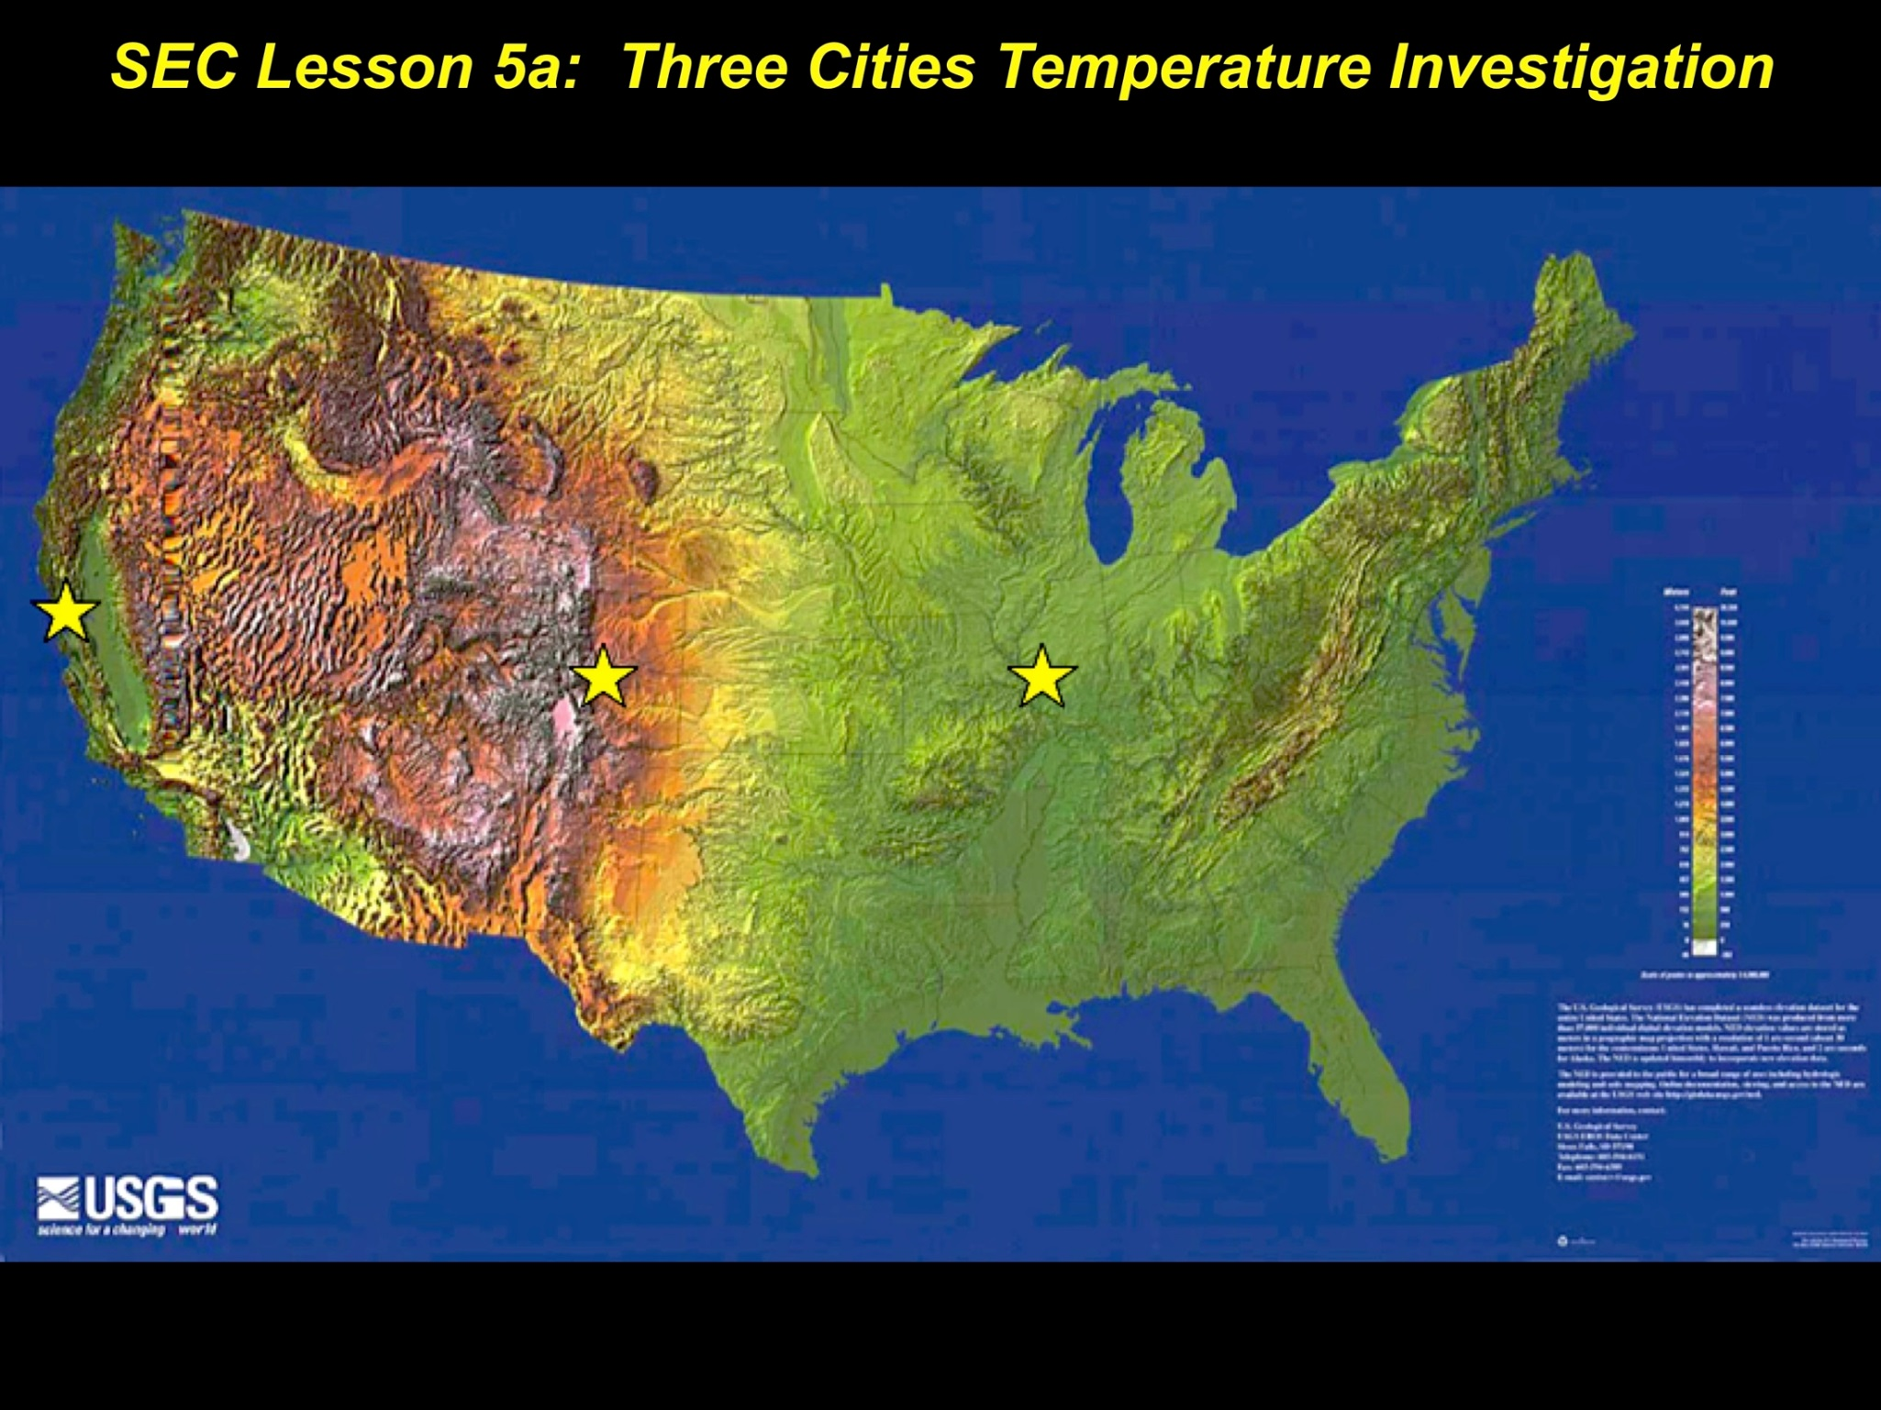
Investigation 1: Temperature Trends in Three US Cities
Photo courtesy of USGS
Notes:
Less than 1 min
a. “The map on this slide shows the location of three US cities that are at approximately the same latitude: San Francisco, California; Colorado Springs, Colorado; and St. Louis, Missouri.”
b. Have participants locate handout 5.3 in their lesson plans binders and refer to it throughout the investigation.

Slide 35
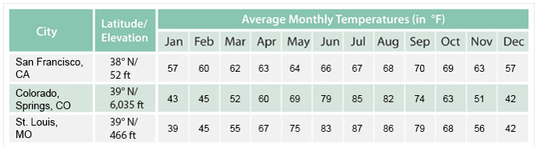

Investigation 1: Temperature Trends in Three US Cities
DATA TABLE
Notes:
Less than 1 min
a. “The data table on this slide lists average monthly temperatures for 12 months in each of the three US cities. The first column shows the names of the cities, the second column notes their latitude and elevation above sea level, and the remaining columns show the average monthly temperatures.”
b. Have participants locate handout 7.6 (Investigating Temperatures at the Same Latitude) in their PD program binders and explain that they’ll work with an elbow partner to graph the temperature data on this handout. Make sure participants have three different-colored pencils for graphing their data.

Slide 36
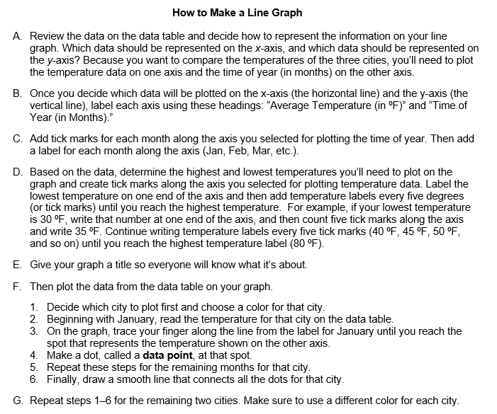
Investigation 1: Temperature Trends in Three US Cities
Notes:
Less than 1 min
a. “This slide lists step-by-step instructions for creating a line graph showing the temperature data for the three cities.”
b. A copy of these instructions appears on the back of handout 7.6. Make sure to follow them carefully as you work on your graphs.”

Slide 37
Investigation 1: Temperature Trends in Three US Cities
Work with your partner to investigate temperature patterns in three US cities at about the same latitude:
San Francisco, Colorado Springs, and St. Louis.
Examine the data table (handout 7.6) and the map (handout 5.3). Then plot the temperature data for
each city on your own line graph.
Note: Choose an appropriate scale to make sure the data for all three cities fits on the graph. (See graph instructions on handout 7.6.)
After completing your graphs, compare the temperature patterns for each city and answer the questions on the handout.
Notes:
12 min
a. Read the instructions on the slide and highlight the note. Emphasize the importance of following the instructions carefully.
b. Pairs: “Work with your partner to investigate temperature patterns in San Francisco, Colorado Springs, and St. Louis. Using the map and the data table on handout 7.6, plot the temperatures for each city on your own line graph. After completing your graphs, compare the temperature patterns for each city. Then discuss your observations and answer the questions on the handout as concisely as possible. Be prepared to share your ideas with the group.”
c. Whole group: Invite a few pairs to share their observations and answers to the questions. Probe and challenge participants’ responses and elicit differing points of view.

Slide 38
The Sun’s Effect on Climate
Lesson 5b
Photo courtesy of NASA
Notes:
Less than 1 min
a. “Now let’s explore ideas about the Sun’s effect on climate from SEC lesson 5b.”

Slide 39
Content Deepening: Focus Question 1
  Why do some places at the same latitude have different temperature patterns?
Notes:
Less than 1 min
a. Review the focus question on the slide.
b. “We’ll continue thinking about this question during the next investigation.”
c. Remind participants that this focus question will guide student learning throughout lesson 5b.

Slide 40

Investigation 2: Temperature Trends in Three US Cities
Photo courtesy of USGS
Notes:
Less than 1 min
a. “For this investigation, you and your partner will continue working with this map and the line graphs you created showing the monthly temperature trends for the three US cities.”

Slide 41
Investigation 2: Temperature Trends in Three US Cities
Examine your line graph for the three US cities
and revisit the similarities and differences in temperature patterns between the cities.
Study the map showing the locations of these cities (handout 5.3) and look at the elevation data for each city on the data table (handout 7.6).
Discuss your observations with your partner and develop several working hypotheses to explain the temperature trends for each city. Be ready to share your ideas with the group.
Notes:
7 min
a. Read the instructions on the slide and remind participants to follow them carefully.
b. Individuals: “Examine your line graph, the map showing the location of each city, and the elevation data for each city on your data table.”
c. Pairs: “Discuss your observations with your partner and work together to develop several hypotheses to explain the temperature trends for each city. Be prepared to share your ideas with the group.”
d. Whole group: Invite a few pairs to share their observations and hypotheses. Ask probe and challenge questions and elicit differing points of view.

Slide 42
Reflect: Content Deepening Focus Question 1
  Why do some places at the same latitude have different temperature patterns?
Notes:
5 min
a. Revisit the first content deepening focus question.
b. Remind participants that this focus question from SEC lessons 5a and 5b appears in the scope and sequence and on the overview page for each lesson in their lesson plans binders.
c. Individuals: Have participants answer the focus question in their science notebooks.
d. Whole group: Ask a few participants to share their answers to this question with complete-sentence statements, using evidence from the investigations they just completed.
e. As participants share their responses, record key ideas on chart paper. Direct others to listen carefully to the responses and be prepared to agree, disagree, or add ideas from the investigations.

Slide 43

Key Science Ideas
Latitude and the angle at which sunlight strikes Earth’s surface are the main factors that determine average annual temperatures around the world.
But other factors, such as elevation and proximity to large bodies of water, influence regional temperature patterns of locations at approximately the same latitude.
Locations at higher elevations tend to be cooler overall than locations at lower elevations. Locations near large bodies of water tend to heat up and cool down more slowly than inland locations far away from oceans or large lakes.
Notes:
5 min
a. Highlight the key science ideas on the slide that answer the first content deepening focus question. Emphasize that participants’ observations from the investigations and the evidence they gathered helped to shape the answer to this question.
b. Whole group: “Does everyone agree that these key ideas answer our focus question? Would you like to add or revise anything?”
c. Ask participants to write these key ideas under the focus question in their science notebooks.

Slide 44
The Sun’s Effect on Climate
Lesson 6a
Photo courtesy of NASA
Notes:
Less than 1 min
a. “Our next investigation is from SEC lesson 6a.”

Slide 45
Content Deepening: Focus Question 2
  How does being near the ocean or another large body of water affect air temperature?
Notes:
Less than 1 min
a. Read the focus question on the slide.
b. Emphasize that this focus question will guide student learning throughout lesson 6a.
c. Ask participants to write the question in their science notebooks and draw a box around it. Make sure they leave space below the question to write a response later.

Slide 46
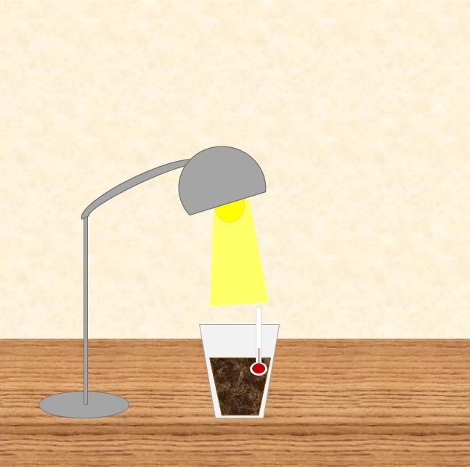
Investigation 3: Heating and Cooling Rates
Photo courtesy of Cal Poly Pomona
Notes:
1 min
a. “For this activity, we’ll work together as a group to investigate temperature patterns in soil and water samples when they’re heated and then are allowed to cool.”
b. Have participants locate handout 7.7 (Uneven Heating) in their PD program binders and direct their attention to the list of supplies they’ll need.
c. Have participants check their supplies against the list on the handout. They should have a heat lamp; two plastic cups, one filled two thirds with fresh water, and one filled two thirds with soil; two thermometers; masking tape; a watch with a second hand; and two colored pencils for each participant.

Slide 47
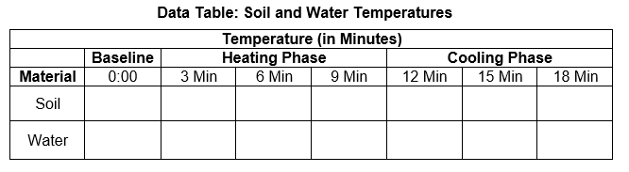
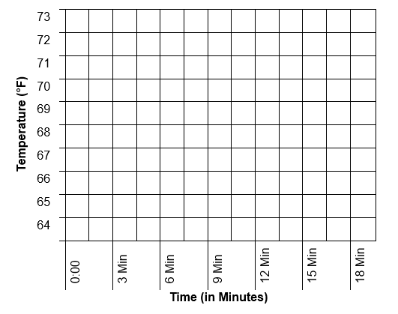
Investigation 3: Heating and Cooling Rates
Notes:
1 min
a. “In this investigation, we’ll measure the temperatures of water and soil samples at 3-minute intervals and record them on a data table like the one on this slide. First, we’ll take a baseline temperature before turning on the heat lamp. Then we’ll take readings every 3 minutes and record the temperatures in the corresponding columns on the data table. At 9 minutes, we’ll measure and record the temperatures and then turn off the heat lamp. As the soil and water samples cool, we’ll continue measuring and recording temperatures every 3 minutes. After the experiment is over, you’ll plot the data on graph paper.”
b. Direct participants to the instructions, data table, and graph in part 1 of handout 7.7.

Slide 48
Investigation 3: Heating and Cooling Rates
Purpose: To investigate heating and cooling rates of soil and water
Carefully follow the setup instructions on handout 6.2.
First, record baseline temperatures for each sample on your data tables (handout 7.7). Then turn on the heat lamp and record temperatures every 3 minutes during the heating phase.
After the 9-minute reading, turn off the heat lamp and record temperatures every 3 minutes as the samples cool.
After recording the temperature data, plot the data for each sample on the graph (handout 7.7).
Notes:
20 min
a. Have participants locate handout 6.2 (Lab Instructions for Uneven-Heating Demonstration) in their lesson plans binders.
b. Go over the instructions on the handout for setting up the experiment. Emphasize the importance of following the directions carefully.
Note: Rather than asking volunteers to track the time for this investigation, it may be more efficient to track it yourself (using a wall clock with a second hand, a stopwatch, or the clock on your cell phone). However, you may want to ask for one or more volunteers to take the temperature readings.
c. Before turning on the heat lamp, make sure participants record the baseline temperature of the soil and water samples on their data tables.
d. After turning on the heat lamp, take temperature readings every 3 minutes. After the 9-minute reading, turn off the heat lamp and take three more readings at 12, 15, and 18 minutes.
e. After participants have recorded all the temperature readings on their data tables, have them plot the data on the graph in handout 7.7 (page 2).

Slide 49
Investigation 3: Heating and Cooling Rates
What patterns do you observe when you compare the soil and water temperatures during the heating phase? What about during the cooling phase?
Which material (soil or water) heats up and cools down more quickly? Which material changes temperature more gradually?
How does water temperature or soil temperature relate to air temperature?
How do these observations relate to the three-cities investigations you conducted?
Notes:
6 min
a. Read the questions on the slide.
b. Pairs: “Discuss your observations with your partner and answer these questions as concisely as possible. Be prepared to share your ideas with the group.”
c. Whole group: Invite a few pairs to share their observations and answers to the questions. Ask probe and challenge questions and elicit differing points of view.

Slide 50
The Sun’s Effect on Climate
Lesson 6b
Photo courtesy of NASA
Notes:
Less than 1 min
a. “Now we’ll explore ideas about the Sun’s effect on climate from SEC lesson 6b.”

Slide 51
Content Deepening: Focus Question 3
  How does being near the ocean or at a higher elevation affect air temperature?
Notes:
Less than 1 min
a. Read the focus question on the slide.
b. Emphasize that this focus question will guide student learning throughout SEC lesson 6b.
c. Ask participants to write the question in their science notebooks and draw a box around it. Make sure they leave space below the question to write a response later.

Slide 52
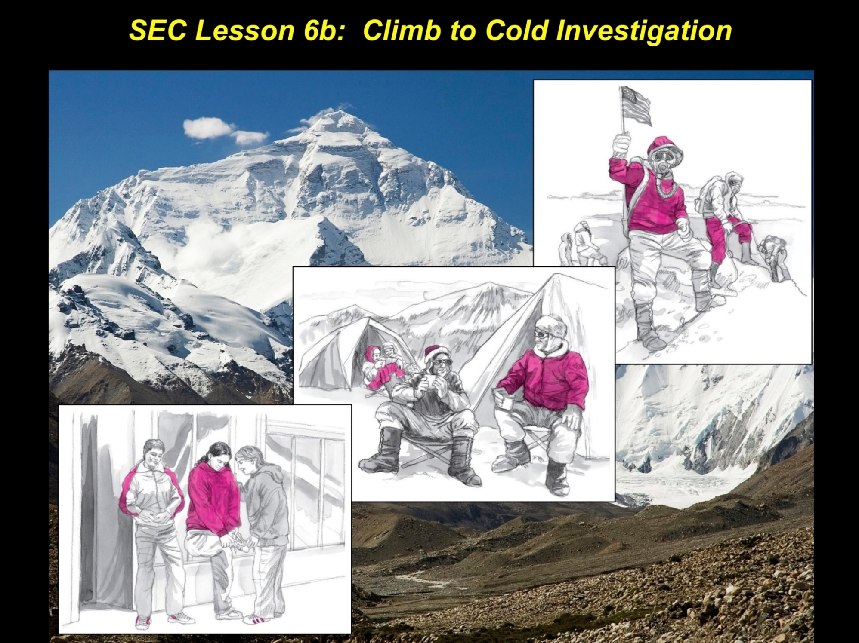
Investigation 4: Climb to Cold
Inset images courtesy of BSCS; photo public domain
Notes:
Less than 1 min
a. “In the next investigation, you and your partner will explore how elevation affects air temperature. Some of the illustrations on this slide are from the story you’ll be reading about an expedition to Mount Everest.”
b. Have participants locate handout 6.3 (Climb to Cold) in their lesson plans binders.

Slide 53
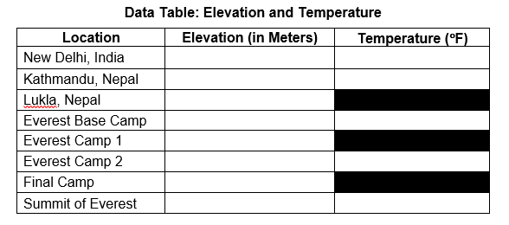
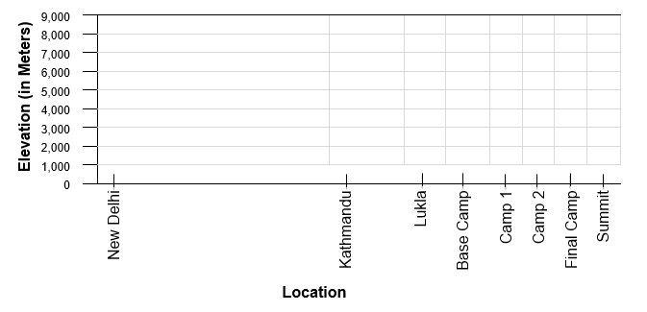
Investigation 4: Climb to Cold
Notes:
Less than 1 min
a. “This slide shows the data table and graph you’ll use for this investigation.”
b. Direct participants to the data table and graph in part 2 of handout 7.7. Make sure each participant has three colored pencils (different colors) for making the graph.

Slide 54
Investigation 4: Climb to Cold
Read the story “Climb to Cold” (handout 6.3).
Whenever you see a STOP sign in the story, record the elevation and temperature (if noted) for the specified location on the data table (part 2 of handout 7.7).
After recording the elevation for each location, plot the data points on the elevation graph (handout 7.7). Place a dot on the graph at the correct elevation for each location; then write the temperature (if any) next to the data point.
Follow the directions on the handouts carefully!
Notes:
10 min
a. Read the instructions and questions on the slide and remind participants to follow the handout instructions carefully.
b. “Read the story about the expedition to Mount Everest. At every stop sign you encounter in the story, record the elevation and temperature data on your data tables. Keep in mind that some locations won’t have temperature data.”
c. “After completing the data table, plot the elevation data points for each location on the elevation graph in your handouts and write any temperature readings next to the data point.”

Slide 55
Investigation 4: Climb to Cold
What temperature patterns did you observe as the climbers traveled to the summit of Mount Everest?
Why might the climbers have had to wear oxygen masks as they approached the summit?
How do you think air density relates to air temperature?
How does this story relate to the three-cities investigation?
Notes:
6 min
a. Read the questions on the slide.
b. Pairs: “Discuss your observations with your partner and answer these questions as concisely as possible. Be prepared to share your ideas with the group.”
c. Whole group: Invite a few pairs to share their observations and answers to the questions. Ask probe and challenge questions and elicit differing points of view.

Slide 56
Reflect: Content Deepening Focus Questions 2 and 3
  How does being near the ocean or another large body of water affect air temperature?
  How does being near the ocean or at a higher elevation affect air temperature?
Notes:
5 min
a. Revisit the second and third content deepening focus questions.
b. Remind participants that these questions from SEC lessons 6a and 6b appear in the scope and sequence and on the overview page for each lesson in their lesson plans binders.
c. Individuals: Have participants answer the focus questions in their science notebooks.
d. Whole group: Ask a few participants to share their answers to these questions with complete-sentence statements, using evidence from the investigations they just completed.
e. As participants share their responses, record key ideas on chart paper. Direct others to listen carefully to the responses and be prepared to agree, disagree, or add ideas from the investigations.

Slide 57
Key Science Ideas
Water absorbs and releases heat (solar energy) at slower rates than land (soil). Because heat is transferred between air and water or land, air temperatures near large bodies of water heat and
cool more slowly than air temperatures in locations that are far from large bodies of water.
Air density decreases as elevation increases. The capacity of air to store heat is directly related to air density, so atmospheric temperatures also decrease as elevation increases.
Notes:
5 min
a. Highlight the key science ideas on the slide that answer the second and third content deepening focus questions. Emphasize that participants’ observations from the investigations and the evidence they gathered helped to shape the answers to these questions.
b. Whole group: “Does everyone agree that these key ideas answer the focus questions? Would you like to add or revise anything?”
c. Ask participants to write these key ideas under the focus questions in their science notebooks.

Slide 58
The Sun’s Effect on Climate
Lesson 7a
Photo courtesy of NASA
Notes:
Less than 1 min
a. “Our next investigation is from SEC lesson 7a.”

Slide 59
Content Deepening: Focus Question 4
  How can we use what we’ve learned about the Sun’s effect on climate to answer the unit central question, Why are some places on Earth hotter than others at different times of the year?
Notes:
Less than 1 min
a. Read the focus question on the slide.
b. Emphasize that this focus question will guide student learning throughout SEC lessons 7a and 7b.
c. Have participants write the question in their science notebooks and draw a box around it.

Slide 60
Investigation 5: Team Challenges
For this investigation, you’ll work with your partner to solve one of four team challenges from SEC lesson handout 7.1 (Team Challenges) in your lesson plans binder.
Each challenge presents a different scenario about temperature patterns. To solve the challenge, you’ll examine the data and use what you’ve learned so far about the Sun’s effect on climate to develop an explanation.
Afterward, each team will present their solution to the group!
Notes:
1 min
a. “For this investigation, you and your partner will be assigned one of four team challenges that present different temperature scenarios. Each scenario will challenge you to apply what you’ve learned so far about the Sun’s effect on climate.”
Note: If you have an odd number of participants, a coleader could pair up with the extra person for the challenge.
b. Have participants locate SEC lesson handout 7.1 (Team Challenges) in their lesson plans binders.
c. Inform participants that following the challenge, each pair will briefly present their explanation to the group.

Slide 61
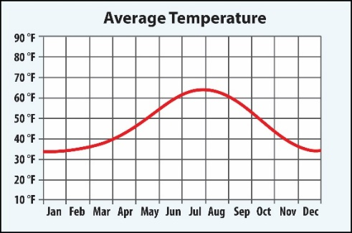
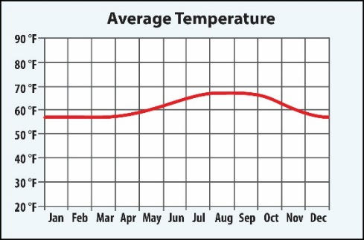
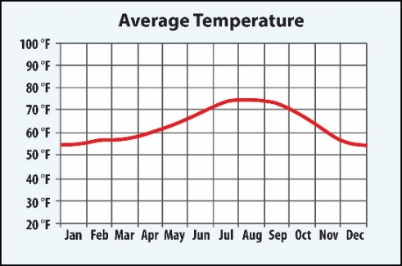
Investigation 5: Team Challenge 1
Challenge 1: Below are three temperature graphs for places within 100 miles of Los Angeles, California, with average high temperatures in July and January each year (in degrees Fahrenheit). Explain why these places, which are located close to one another, have different temperatures throughout the year.
Location: Big Bear Lake, CA
Average January Temperature: 47 ºF
Average July Temperature: 81 ºF
Location: Santa Monica, CA
Average January Temperature: 64 ºF
Average July Temperature: 71 ºF
Location: Pomona, CA
Average January Temperature: 68 ºF
Average July Temperature: 90 ºF
Notes:
1 min
a. Introduce challenge 1 and assign this scenario to one of the teams.

Slide 62
Investigation 5: Team Challenge 2
Challenge 2: How might you explain the temperature pattern in Belém, Brazil?
The city of Belém, Brazil, is located at latitude 1˚ S, which is almost at the equator. Below are Belém’s average monthly temperatures for one year.
Notes:
1 min
a. Introduce challenge 2 and assign this scenario to one of the teams.

Slide 63
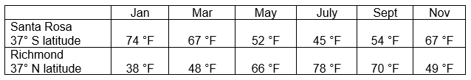
Investigation 5: Team Challenge 3
Challenge 3: Why is it warm in Santa Rosa, Argentina, when it’s cold in Richmond, Virginia? Why is it cold in Santa Rosa, Argentina, when it’s warm in Richmond, Virginia? (Think about the four positions of Earth as it orbits the Sun.)
The city of Santa Rosa, Argentina, is located at latitude 37˚ S. The city of Richmond, Virginia, in the United States is located at latitude 37˚ N. Below are the average monthly temperature in those two cities for one year.
Notes:
1 min
a. Introduce challenge 3 and assign this scenario to one of the teams.

Slide 64
Investigation 5: Team Challenge 4
Challenge 4: Describe your thinking about why it’s warmer in the summer than in the winter?
Four friends were sharing their ideas about why it’s warmer in the summer than in the winter. This is what they said:
Ava: “It’s because the Sun gives off more heat in the summer than in the winter.”
Raul: “It’s because Earth’s tilt changes the angle of sunlight hitting the surface.”
John: “It’s because Earth orbits closer to the Sun in the summer than in the winter.”
Shakira: “It’s because one side of Earth faces the Sun, and the other side faces away from the Sun.”
Which friend do you most agree with and why?
Notes:
7 min
a. Introduce challenge 4 and assign this scenario to one of the teams.
b. “Now let’s begin the team challenge!”
c. Teams: “First, review your assigned scenario on the handout and study the corresponding data. Then discuss your observations and develop a concise explanation to solve the challenge. Record your team’s explanation in your science notebooks. Afterward you’ll have time to prepare for your team presentations.”

Slide 65
The Sun’s Effect on Climate
Lesson 7b
Photo courtesy of NASA
Notes:
Less than 1 min
a. “In this final investigation, you’ll prepare for your team presentations and share your challenge solutions with the group.”

Slide 66
Content Deepening: Focus Question 4
  How can we use what we’ve learned about the Sun’s effect on climate to answer the unit central question, Why are some places on Earth hotter than others at different times of the year?
Notes:
Less than 1 min
a. Review the focus question on the slide.
b. “We’ll continue thinking about this question during our investigation.”
c. Remind participants that this focus question will guide student thinking throughout lesson 7b.

Slide 67
Investigation 6: Team Presentations
Work with your team to create a chart that explains your challenge solution.
Summarize all key ideas and support your ideas and conclusions with evidence.
Illustrate your chart with drawings, data tables, and graphs that support your reasoning.
Present your chart and explanation to the group.
Be creative and have fun!
Notes:
10 min
a. Read the instructions on the slide and inform participants that each team will have 3 minutes to present their chart to the group.
b. Give teams adequate time to create their charts and prepare for their presentations. Before the presentations, have teams hang their charts where everyone will be able to see them.

Slide 68
Investigation 6: Team Presentations
What do you think? What is your evidence?
Challenge 1: Below are three temperature graphs for places within 100 miles of Los Angeles, California, with average high temperatures in July and January each year (in degrees Fahrenheit). Explain why these places, which are located close to one another, have different temperatures throughout the year.
Challenge 2: How might you explain the temperature pattern in Belém, Brazil?
Challenge 3: Why is it warm in Santa Rosa, Argentina, when it’s cold in Richmond, Virginia? Why is it cold in Santa Rosa, Argentina, when it’s warm in Richmond, Virginia? (Think about the four positions of Earth as it orbits the Sun.)
Challenge 4: Describe your thinking about why it’s warmer in the summer than in the winter?
Notes:
20 min
a. Before beginning the presentations, draw participants’ attention to the questions (in red) at the top of the slide and emphasize that keeping these questions in mind will help them stay on track during their presentations.
b. Call on each team one at a time to stand next to their chart, read their challenge scenario aloud, and deliver a concise 3-minute presentation, highlighting the key ideas and evidence on their chart.
c. After each team finishes their presentation, allow 2 minutes for questions or comments from the group.

Slide 69
Unit Central Question
  Why are some places on Earth hotter than others at different times of the year?
Notes:
5 min
a. “Ultimately, the goal of the team challenge is to give you an opportunity to use what you’ve learned so far about the Sun’s effect on climate to answer the unit central question.”
b. Review the question on the slide and give participants a minute to write an answer in their science notebooks.
c. Whole group: Invite a few participants to share their answers in a few concise statements, using evidence from the SEC investigations.
d. As participants share their responses, record key ideas on chart paper. Remind others to listen carefully to the responses and be prepared to agree, disagree, or add ideas from the investigations. Ask probe and challenge questions and elicit differing points of view.

Slide 70
Summarizing Today’s Work
Think about the Science Content Storyline Lens strategies we’ve studied so far:
Think about your science-content-learning work today.
Reflect: What ideas or questions do you want to remember from today and refer back to?
A—Identify one main learning goal.
B—Set the purpose with a focus question or goal statement.
C—Select activities that are matched to the learning goal.
D—Select content representations and models matched to the learning goal and engage students in their use.
I—Summarize key science ideas.
Notes:
6 min
a. Individuals (4 min): Ask participants to think about the first two tasks on the slide and respond to the reflection question in their notebooks.
b. Whole group (2 min): Ask for volunteers to share an idea or question from their responses to the reflection question.

Slide 71
Homework
Read about SCSL strategies F, G, and H in the STeLLA strategies booklet and complete the
Z-fold summary chart for these strategies.
Be ready to share your assigned lesson in the SEC lesson series.
Bring your calendar for the academic year so we can schedule the dates for our school-year study-group meetings!
Notes:
3 min
a. Review the homework assignment and have participants write it in their notebooks.
b. Make sure participants understand the assignment.
c. “We won’t address strategy E about sequencing science ideas and activities until the school year, since you’ll learn a lot about sequencing from teaching the RESPeCT lesson plans.”

Slide 72
Reflections on Today’s Session
What are your reactions to the strategy of selecting content representations and models that are matched to the lesson’s main learning goal?
What is something new you’ve learned about the Sun’s effect on climate? Did your content-representation analyses support this learning in any way?
Provide feedback about today’s session and the PD program so far (likes, dislikes, questions, concerns, and suggestions).
Notes:
6 min
a. Allow at least 5 minutes for participants to think about today’s session and write their reflections and feedback on the Daily Reflections sheet (handout 7.8 in PD program binder).

Slide 73
Norms for Working Together: The Basics
Purpose: Build trust and develop a productive study group for all participants.
The Basics
Arrive prepared and on time; stay for the duration; return from breaks on time.
Remain attentive, thoughtful, and respectful; engage and be present.
Eliminate interruptions (turn off cell phones, email, and other electronic devices; avoid sidebar conversations).
Make room for everyone to participate (monitor your floor time).
Notes:
Hidden slide—available for use as needed.

Slide 74
Norms for Working Together: The Heart
Purpose: Build trust and develop a productive study group for all participants.
The Heart of RESPeCT Lesson Analysis and Content
Deepening
Keep the goal in mind: analysis of teaching to improve student learning.
Share your ideas, uncertainties, confusion, disagreements, questions, and good humor. All points of view are welcome.
Expect and ask questions to deepen everyone’s learning; be constructively challenging.
Listen carefully; seek to understand other participants’ points of view.
Notes:
Hidden slide—available for use as needed.

