Slide 1




RESPeCT PD pROGRAM
Day 5
RESPeCT Summer Institute
Notes:
5 min
a. Take care of any housekeeping issues.

Slide 2
Agenda for Day 5
Day-4 reflections
Focus questions
Review of strategy 6: use and apply
What Is the Science Content Storyline Lens (SCSL)?
Introducing SCSL strategy A
Lesson analysis: SCSL strategy A
Lunch
Content deepening: plants and animals
Summary, homework, and reflections
Notes:
2 min
a. Talk through the agenda for the day.

Slide 3
Trends in Reflections
Lesson Analysis | Science Content Learning
Notes:
5 min
a. Give participants time to review your feedback on their reflections from day 4 and offer reactions, comments, or follow-up questions.

Slide 4
Norms for Working Together: The Basics
Purpose: Build trust and develop a productive study group for all participants.
The Basics
Arrive prepared and on time; stay for the duration; return from breaks on time.
Remain attentive, thoughtful, and respectful; engage and be present.
Eliminate interruptions (turn off cell phones, email, and other electronic devices; avoid sidebar conversations).
Make room for everyone to participate (monitor your floor time).
Notes:
5 min
a. Review the norms as a group.
b. Ask: “Any comments or suggested changes? How are we doing with applying these norms?”

Slide 5
Norms for Working Together: The Heart
Purpose: Build trust and develop a productive study group for all participants.
The Heart of RESPeCT Lesson Analysis and Content
Deepening
Keep the goal in mind: analysis of teaching to improve student learning.
Share your ideas, uncertainties, confusion, disagreements, questions, and good humor. All points of view are welcome.
Expect and ask questions to deepen everyone’s learning; be constructively challenging.
Listen carefully; seek to understand other participants’ points of view.
Notes:
5 min
a. Review these norms as a group.
b. Ask: “Any comments or suggested changes? Which of these norms do you think we could get better at applying individually and as a group?”
c. Remind participants: “These norms will become increasingly important during the Summer Institute and throughout the academic year as we analyze one another’s classroom videos and learn together.”

Slide 6
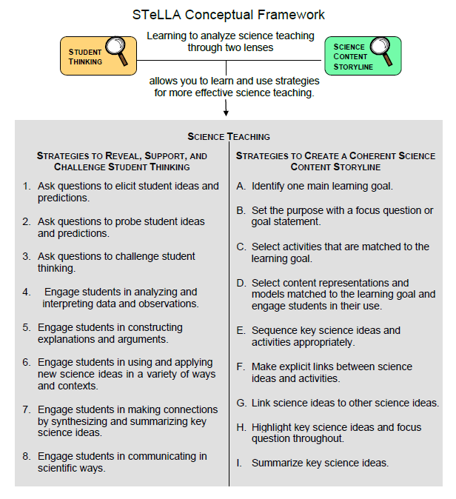
Notes:
2 min
a. Transition: This slide marks the transition from the STL strategies to the Science Content Storyline Lens strategies.
b. “Throughout the PD program, we’ll continue learning about the Student Thinking Lens (STL) strategies, but today we’ll transition to the Science Content Storyline Lens strategies.”
c. Highlight the SCSL strategies on the slide.

Slide 7
Focus for the Week
Content area 2: plants and animals
Science Content Storyline Lens
  Strategies A, B, C, D, F, G, H, and I
  Video-based lesson analysis (SEC lessons)
  Plants and Animals lesson plans review (last day)
  Academic-year schedule (last day)
    Video recording
    Study-group sessions
Notes:
1 min
a. “This week we’ll focus on a new content area: plants and animals. We’ll examine the Science Content Storyline Lens strategies and the Plants and Animals lessons you’ll be teaching in the fall, analyze video clips of those lessons, and deepen your science-content knowledge related to the lesson plans.”
b. “On the last day of the RESPeCT PD program, we’ll review the lesson plans and the schedule for the academic year.”
c. “You may notice that we skip strategy E: Sequence key science ideas and activities appropriately. This strategy will be addressed during the school year as you teach the STeLLA lesson plans and analyze how they’re sequenced within each lesson and across lessons.”

Slide 8
Today’s Focus Questions
What is the Science Content Storyline Lens (SCSL)?
Why is one main learning goal essential for science content storyline coherence?
What is an environment, and how does it compare with an ecosystem?
How can we categorize and describe the contents of our terrarium environment?
Notes:
1 min
a. Introduce the focus questions that will guide today’s work.

Slide 9
Check Your Understanding of Strategy 6
  Jot down your responses to this multiple-choice quiz:
  Use-and-apply tasks are used [before/during/after] new science ideas are introduced.
  For difficult content ideas, students might need to practice applying new ideas in [one/two/many] different contexts.
  [True/false]: Use-and-apply questions or activities are used primarily for student assessment at the end of a unit.
  It’s appropriate for teachers to ask [elicit/probe/challenge] questions during a use-and-apply activity.
  Teachers should [never/judiciously/always] tell students about science ideas they are missing or stating inaccurately.
Notes:
7 min
Note: Display this slide only if it wasn’t used on day 4.
a. “To check your understanding of STL strategy 6, jot down your responses to this multiple-choice quiz in your science notebooks.”
b. Have participants discuss their answers either in pairs or as a group. (If time is short, just read the answers aloud.)
Answer key:
1. After
2. Many
3. False
4. Challenge (and probe)
5. Judiciously (defined as “good or discriminating judgment; wise, sensible, or well advised”)

Slide 10
Use and Apply Your Content Deepening Knowledge
Challenge: Use what you learned about weather and seasons last week to draw a diagram that illustrates key science ideas about factors that influence weather and climate. Examples include latitude, the Sun, Earth’s tilt and orbit, elevation, and the atmosphere.
Notes:
8 min
a. Individuals: Have participants complete the use-and-apply task on the slide. Encourage them to use available resources, including their notes and handouts, as well as the content background document and Common Student Ideas about Weather and Seasons.
b. Whole group: Invite participants to share their diagrams and explain the key science ideas they illustrated.

Slide 11
Planning Science Lessons: Quick Write
What is generally your thinking process when you plan your science lessons?
Be prepared to share your ideas with the group.
Notes:
6 min
Note: This activity is a lead-in for thinking about specific SCSL strategies. When planning science lessons, are participants thinking primarily about (1) SCSL issues, such as learning goals, (2) student misconceptions (an STL issue), which is a great start but doesn’t include SCSL strategies, or (3) activities and/or classroom management and timing issues?
a. Individuals: Direct participants to take 2–3 minutes to write down the key things they think about when planning science lessons.
b. Whole group: Ask participants to share their reflections with the group.
c. Tell participants: “The Science Content Storyline Lens strategies should provide some new or additional ways of thinking about planning your science lessons.”

Slide 12
Lesson Analysis: Focus Question 1
What is the Science Content Storyline Lens (SCSL)?
  What is a science content storyline, and why is it important?
  What is challenging about developing a science content storyline?
Notes:
7 min
a. Small groups: Direct half the group to focus on the first bulleted question on the slide, and the other half to focus on the second. Allow groups 2 minutes to think about their assigned questions as they review “Introduction to the Science Content Storyline Lens” in the STeLLA strategies booklet.
b. Whole group: Have each group share their ideas and responses for these questions.
c. As you listen to participants, make sure that what they’re saying is consistent with the strategies booklet. If you aren’t sure they’re interpreting the text accurately, ask them to identify the specific text they are drawing from.

Slide 13
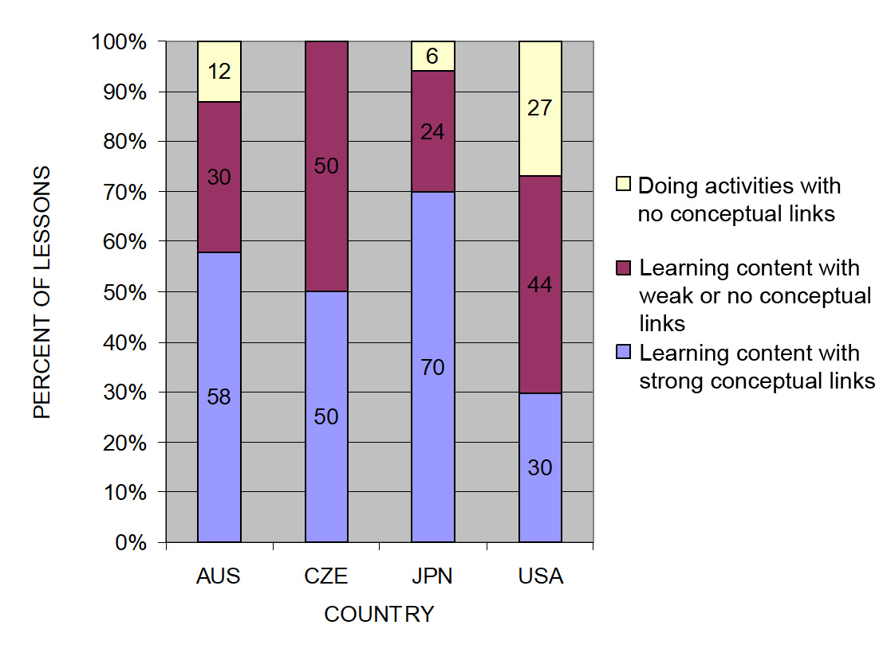
The TIMSS Video Study Findings and the Science Content Storyline Lens
Source: TIMSS study
Notes:
2 min
a. Emphasize the research basis for the Science Content Storyline Lens and its importance. Remind participants that the data on the slide was presented on day 1 of the PD program.
b. Ask: “What does this graph reveal about US science lessons compared with higher-achieving countries?”
Ideal response: According to the study, US science lessons didn’t do as well linking science ideas to lesson activities; in fact, many lessons were activity focused and included significantly fewer science ideas compared to other countries.
c. Summarize: Point to strategies F and G on the STeLLA strategies poster: Make explicit links between science ideas and activities (strategy F) and link science ideas to other science ideas (strategy G). These strategies and the idea of a Science Content Storyline Lens grew out of the TIMSS research findings.
d. “Today we’ll begin our study of the Science Content Storyline Lens, with a focus on strategy A: Identify one main learning goal.”

Slide 14
Lesson Analysis: Focus Question 2
Why is one main learning goal essential for science content storyline coherence?
Notes:
1 min
a. Read the focus question on the slide.

Slide 15
Notes:
1 min
a. “Now let’s dig into SCSL strategy A!”
b. “As you can see, strategy A is the first of nine Science Content Storyline Lens strategies. It appears first because it’s the foundation on which all the other SCSL strategies are built. This will become clearer as we delve into the other strategies and see how important it is that each of them is matched to the lesson’s main learning goal.”

Slide 16
Purpose and Key Features of Strategy A
Review your SCSL Z-fold summary chart and share with a partner the purpose and key features of strategy A: Identify one main learning goal.
Remember to cite passages from the STeLLA strategies booklet.
Be prepared to share with the group.
Notes:
25 min
a. Pairs: “Share with a partner what you wrote on your Science Content Storyline Lens Z-fold summary chart about the purpose and key features of strategy A.”
b. Whole group: Have one or two participant volunteers lead the group in creating a chart that describes the purpose and key features of strategy A.
c. Transition: “Next, we’ll review the difference between a science idea and the main learning goal of a lesson. Then you’ll practice identifying and clarifying this distinction.”

Slide 17
A Main Learning Goal Is …
A big science idea that you want students to learn
A big idea that shows the relationship among science ideas
The focus of the lesson (or series of lessons)
Stated in a complete sentence (for planning purposes)
Stated by the teacher, a student, a text, or a multimedia resource
A support for teacher planning
Notes:
1 min
a. “This slide lists some key ideas about the definition of a main learning goal.”
b. Read through the ideas.
c. Emphasize: “Notice the parenthetical reference to ‘lessons’ in the third bullet point. Each lesson should have only one main learning goal, but you might need two or more lessons to help students accomplish a difficult goal. So it’s often necessary to spend more than one lesson on a specific learning goal.”

Slide 18
A Main Learning Goal Is NOT …
A topic or phrase
An activity
A question
A performance task or objective
A supporting detail, definition, or fact
A student misconception or idea that isn’t scientifically accurate
Notes:
1 min
a. Review what is not considered a main learning goal.

Slide 19
Definitions: One Main Learning Goal and Science Ideas
Read these sections in the STeLLA strategies booklet: (1) STeLLA Strategy A: Identify One Main Learning Goal, and (2) Student Ideas and Science Ideas Defined.
Based on these readings, what are the differences between a main learning goal
and a science idea?
Notes:
10 min
a. Have participants locate these two readings in the strategies booklet: (1) STeLLA Strategy A: Identify One Main Learning Goal, and (2) Student Ideas and Science Ideas Defined.
b. “After you read these sections in the strategies booklet, we’ll discuss the differences between a science idea and a main learning goal.”
c. Individuals (3 min): Give participants time to read the specified sections in the strategies booklet.
d. Whole group (7 min): Discuss the question on the slide.
e. Emphasize: “While you might incorporate several science ideas that support the main learning goal of a lesson, be careful not to plan an ‘all about’ lesson with too many different science ideas that will likely come across to students as a bunch of disconnected facts to be memorized.”

Slide 20
Practice Identifying Student Ideas and Science Ideas
Identify any student ideas and science ideas in this list:
  Energy
  Students engage in a role-play showing how plants make food.
  Plants get their food by taking it in from the soil.
  Animals need food, water, and air.
  Plants don’t need food to grow; they only need water.
  Both plants and animals need air, but only animals need oxygen from the air. Plants use carbon dioxide from the air.
  How do plants get their food?
  Some animals get their food by eating plants.
Notes:
5 min
a. “Next, we’ll practice identifying student ideas and science ideas just to make sure you understand the way we’re defining these terms.”
Note: As needed, refer participants to the section in the strategies booklet where student ideas are defined (Student Ideas and Science Ideas Defined).
b. Individuals: “First, identify examples of science ideas on the slide. If you need help, refer to the document in your lesson plans binders titled Common Student Ideas about Plants and Animals. Then identify examples of student ideas on the slide.”
c. Whole group: Discuss participants’ responses and the correct answers (see answer key).
Answer key:
Science ideas: 4, 8
Student ideas: 3, 5, 6
Neither: 1, 2, 7
Note for idea 6: Even though it’s accurate to say that plants and animals need air, it’s inaccurate to say that only animals need oxygen from the air. Plants need both carbon dioxide and oxygen from the air. They use carbon dioxide to make their food through photosynthesis and oxygen to break down food molecules to release energy in cellular respiration. Although kindergartners won’t learn these ideas in the lesson series, it’s important for you to understand them.

Slide 21
Practice Identifying Student Ideas and Science Ideas in a Class Discussion
Identify one student idea and one science idea in this class discussion:
T: What do plants need?
S: Water.
SN: Someone to take care of them.
T: Do plants need the same things as animals?
SN: Yes. Both plants and animals need water.
SN: But only animals need to get food.
SN: And they both need soil.
T: Tell me more about that.
S: Plants need soil for their food, and some animals eat dirt,
like rabbits and gophers.
Notes:
5 min
a. “It’s a little trickier to recognize student ideas and science ideas in class discussions because students sometimes give only one- or two-word answers to teacher questions. But if you link the teacher’s question with the student’s response, you can sometimes find a science idea or a student idea.”
Note: In the RESPeCT PD program, we encourage students to speak in complete sentences as much as possible.
b. “Let’s practice linking the teacher’s question with student responses in the sample discussion on the slide.”
c. Pairs: “Work with a partner to see if you can identify one student idea and one science idea in this discussion.”
d. Whole-group share-out: Have participants share the ideas they identified in the sample discussion.
e. Emphasize: “Here’s some food for thought: To make student thinking more visible, why not require students to speak in complete sentences during classroom discussions about science ideas?”

Slide 22
Science Ideas That Support the Main Learning Goal
Main learning goal: To stay alive, plants need to take in water from their environment.
Supporting ideas:
  Plants are living things.
  An environment is a place where living things can get what they need to live and grow.
  Most plants take in water from their roots.
  Plants die when they don’t get the water they need.
Notes:
6 min
a. Display only the main learning goal on the slide.
b. Pairs: “Work with a partner to come up with two or three science ideas that might support the development of this main learning goal. Use the content background document and the Common Student Ideas chart as resources.”
c. Whole group: Have pairs share the supporting science ideas they came up with.
d. Next, reveal the list of possible supporting science ideas one by one on the slide and compare them with participants’ ideas.
e. Highlight: “Some of these supporting science ideas could also be a lesson’s main learning goal.”

Slide 23
Practice Identifying Main Learning Goals
Small groups or pairs: Use the criteria in Analysis Guide A (handout 5.1 in binder) to analyze a list of candidate main learning goals related to the Sun’s effect on climate (handout 5.2: Practice Identifying One Main Learning Goal).
Select candidates from the list that you think
are good main learning goals for the focus of the lesson and record the reasons for your choices
on handout 5.2.
Whole group: Discuss and justify your selections.
Notes:
10 min
a. Direct participants to locate handout 5.1 (Analysis Guide A: Identifying One Main Learning Goal) and handout 5.2 (Practice Identifying One Main Learning Goal) in their PD program binders.
b. Small groups/pairs: Have participants form small groups or pairs and use the criteria from Analysis Guide A to analyze the list of possible learning goals on handout 5.2.
c. Direct participants to write yes or no on the handout to indicate whether the statement is or is not a good candidate for a lesson’s main learning goal. Then have them state the reason for each assessment using criteria from the analysis guide.
d. Whole-group share-out: Have participants share and discuss their selections.
e. Be sure to highlight what distinguishes a main learning goal from supporting science ideas, topics, phrases, activities, or questions.
f. Also use this discussion to clarify science content.
Note: For answers, see PD Leader Master: Practice Identifying One Main Learning Goal (Answer Key).

Slide 24
Lesson Analysis: Strategy A
Next, we’ll watch a sequence of three video clips from a single lesson about plants and animals.
Analysis question for all three clips: Does this lesson have one main learning goal?
  Follow-up questions:
  If yes, what is it?
  If no, what do you think is happening in the lesson?
Notes:
1 min
a. Make sure participants understand that they will be viewing a sequence of three video clips from the same lesson on plants and animals.
b. “For all three clips, we’ll answer the analysis question, Does this lesson have one main learning goal?”
c. “If the answer is yes, what is the learning goal? If no, why do you think that’s the case? What do you think is happening in the lesson?”

Slide 25
Lesson Analysis: Review Lesson Context, Video Clip 1
Read the lesson context on the video transcript (handout 5.3 in PD program binder).
As you watch the clip, keep the analysis question in mind: Does this lesson have one main learning goal?
If yes, what is it?
If no, what do you think is happening in the lesson?
Link to video clip 1: 5.1 mspcp_kinder.pa_yoon_L2_c3
Notes:
5 min
a. Have participants read the lesson context at the top of the video transcript (handout 5.3 in PD program binder). (Less than 1 min)
b. Read the information on the slide. (Less than 1 min)
c. Show the video clip. (4 min)

Slide 26
Lesson Analysis: Analyze the Video,
Video Clip 1
Study the video transcript and write down any science ideas the students and/or the teacher put on the table.
Pair up and compare the science ideas you identified. Then discuss the analysis question: Does this lesson have one main learning goal?
If yes, what is it?
If no, what do you think is happening in the lesson?
As a group, discuss what the main learning goal might be. Support your answers using your analysis of the science ideas you identified.
Notes:
25 min
a. Before participants analyze the video transcript, remind them of these key points: (1 min)
A science idea is a full-sentence idea that students could take away as something they learned during the lesson.
Science ideas are sometimes identified by linking the teacher’s question with the student’s response.
b. Individuals (8 min): “Study the video transcript and write in your notebooks any science ideas you identify in the discussion.”
c. Pairs (5 min): “Pair up and compare the science ideas you identified. Then discuss the questions on the slide.”
d. Whole-group share-out (11 min): Have participants share what they think might be the main learning goal of this lesson, using their analyses of the science ideas they identified.
e. List the possible learning goals on chart paper.
f. Let participants know they’ll revisit this list of possible main learning goals for the lesson after they watch the remaining video clips.

Slide 27
Lesson Analysis: Review Lesson Context, Video Clip 2
Read the lesson context on the video transcript (handout 5.4 in PD binder).
As you watch the clip, keep the analysis question in mind: Does this lesson have one main learning goal?
If yes, what is it?
If no, what do you think is happening in the lesson?
Link to video clip 2: 5.2 mspcp_kinder.pa_yoon_L2_c4
Notes:
5 min
a. Have participants read the lesson context at the top of the video transcript (handout 5.4 in PD binder). (Less than 1 min)
b. Review the instructions on the slide. (Less than 1 min)
c. Show the video clip. (4 min)

Slide 28
Lesson Analysis: Analyze the Video,
Video Clip 2
Study the video transcript and write down any student ideas and science ideas you identify.
Pair up and compare the student ideas and science ideas you identified. Then discuss this question: Are these ideas consistent with the possible main learning goal you identified for video clip 1?
As a group, discuss the possible main learning goal for this lesson. Make sure to support your answers using your analysis of the science ideas you identified.
Notes:
25 min
a. Review the definitions of a science idea and a student idea. Remind participants that students can express correct science ideas and inaccurate student ideas at the same time. (1 min)
b. Individuals (8 min): “Study the video transcript and write in your notebooks any student ideas and science ideas you identify.”
c. Pairs (5 min): “Pair up and compare the student ideas and science ideas you identified. Then discuss the question on the slide.”
d. Whole-group share-out (11 min): Have participants share out what they think might be the main learning goal of this lesson, using their analyses of the science ideas they identified to support their suggestions.
e. List the possible learning goals on chart paper.
f. Let participants know they’ll revisit this list of possible main learning goals for the lesson after they watch one more video clip.

Slide 29
Lesson Analysis: Review Lesson Context, Video Clip 3
Read the lesson context on the video transcript (handout 5.5 in PD binder).
As you watch the clip, keep the analysis question in mind: Does this lesson have one main learning goal?
If yes, what is it?
If no, what do you think is happening in the lesson?
Link to video clip 3: 5.3 mspcp_kinder.pa_yoon_L2_c5-7
Notes:
5 min
a. Have participants read the lesson context at the top of the video transcript (handout 5.5 in PD binder). (Less than 1 min)
b. Review the instructions on the slide. (Less than 1 min)
c. Show the video clip. (4 min)

Slide 30
Lesson Analysis: Analyze the Video,
Video Clip 3
Study the video transcript and write down any student ideas and science ideas you identify.
Pair up and compare the student ideas and science ideas you identified. Then discuss this question: Are these ideas consistent with the possible main learning goal you identified for clips 1 and 2?
As a group, discuss the possible main learning goal for this lesson. Make sure to support your answers using your analysis of the science ideas you identified.
Notes:
24 min
a. Individuals (8 min): “Study the video transcript and write in your notebooks any student ideas and science ideas you identify.”
b. Pairs (5 min): “Pair up and compare the student ideas and science ideas you identified on the transcript. Then discuss the question on the slide.”
c. Whole-group share-out (11 min): Have participants share what they think might be the main learning goal of this lesson, using their analyses of the science ideas they identified to support their suggestions.
d. List the science ideas and possible learning goals on chart paper.
e. Ask: “Did the three video clips develop coherence across the lesson or include too many ideas that didn’t support the main learning goal?”

Slide 31
One Main Learning Goal?
Based on your analysis of the three video clips, does this lesson have one main learning goal? What do you think it is?
Use the criteria questions in Analysis Guide A to analyze the main learning goal identified in these clips.
Are there any supporting science ideas that don’t closely match the main learning goal?
Notes:
15 min
a. Whole group: Discuss the first question on the slide and reach a consensus on the main learning goal for the lesson.
b. Pairs: Have participants work in pairs to answer the criteria questions in Analysis Guide A for this agreed-upon main learning goal. Also have them identify any supporting science ideas that don’t closely match the main learning goal.
c. Whole group: Discuss participants’ responses to the questions in Analysis Guide A and the final question on the slide.

Slide 32
Examine Plants and Animals: Lesson 1
Locate the scope and sequence chart for the Plants and Animals lessons (lesson plans binder, pretab section).
Examine the main learning goals for lessons 1a-d. Then read the supporting science ideas in the Science Content Storyline column.
What patterns do students identify in these lessons?
Keep these patterns in mind as the storyline develops in the lesson sequence.
Notes:
5 min
Note: This slide is optional if time is running short. It’s designed to help participants see how the lesson plans are written to highlight the main learning goal and science ideas that support the main learning goal.
a. Have participants examine the main learning goals for lessons 1a–d in the scope and sequence chart of their lesson plans binder. Then have them review the supporting science ideas in the Science Content Storyline column.
b. Ask: “What patterns do students identify in these lessons?”
c. Encourage participants to keep the identified patterns in mind throughout the lesson sequence.

Slide 33

Plants and animals
SCIENCE CONTENT DEEPENING Kindergarten
Notes:
Less than 1 min
“Now let’s deepen our science-content understandings of plants and animals.”
Note: Throughout this content deepening phase, refer as needed to the Plants and Animals Content Background Document and Common Student Ideas about Plants and Animals.

Slide 34
Unit Central Question
Do plants and animals need the same things to live and grow? Explain your thinking.
Notes:
2 min
a. Read the unit central question on the slide.
b. Emphasize that this question will guide student learning throughout the entire Plants and Animals lesson series.
c. Have participants write the unit central question in their science notebooks and draw a double-lined box around it to reinforce the practice they’ll follow with students.
d. If time allows, have students review the overview page of lesson 1a in their lesson plans binders to orient themselves to the lesson plan. You may also want to have them review the focus questions, main learning goals, and science content storylines in the scope and sequence (pretabs section in the lesson plans binder).

Slide 35
Student Learning Goals
Review the student learning goals in the pretab document Plants and Animals: Learning Goals for Students and Teachers. (Note: Skip learning goal number 4.)
Draw a diagram or thinking map that shows how these learning goals answer the unit central question, Do plants and animals need the same things to live and grow?
Notes:
10 min
a. Have participants locate the pretab document Plants and Animals: Learning Goals for Students and Teachers in their lesson plans binders.
b. Individuals (or pairs): “Read the student learning goals on this document. Then draw a diagram or thinking map that shows how these learning goals answer the unit central question, Do plants and animals need the same things to live and grow?”
Note: Tell participants to skip learning goal number 4.
c. Whole group: Invite one or two participants to share their diagrams or thinking maps using a document reader. As participants share, ask probe questions, such as “Can you say that in a complete sentence?” “What do you mean by …?” “Can you say more about that?”
d. Ask participants, “What questions do you have about the science content at this grade level?”
e. Write participants’ questions on chart paper, but don’t answer them at this point. Note that during the content deepening sessions, you’ll dig deeper into the science ideas that will help them answer these questions.

Slide 36
Content Deepening: Focus Question 1
  What is an environment, and how does it compare with an ecosystem?
Notes:
5 min
a. Read the focus question on the slide.
b. Have participants write the question in their science notebooks. Make sure they leave plenty of space to record their initial ideas and then write a response later in the session.
c. Individuals: Ask participants to think about this question and jot down their initial ideas.
d. Whole group: Invite participants to share their ideas with the group. Elicit a variety of ideas and record them on chart paper.
Note: Let participants know that it’s OK if they don’t have much to say about environments or ecosystems. At this point, you only want to hear their initial ideas.

Slide 37
Environment vs. Ecosystem
Read handout 5.6 (Environment vs. Ecosystem) in your PD program binder.
Then discuss these questions with an elbow partner:
Are the words environment and ecosystem synonyms? Use evidence from the handout to support your ideas.
The word environment is used throughout the Plants and Animals lesson series. What are the advantages and disadvantages of that word choice?
Notes:
10 min
a. Individuals (2 min): Have participants locate handout 5.6 (Environments vs. Ecosystems) in their PD program binders and read the definitions and descriptions.
b. Pairs (3 min): Ask participants to pair up with an elbow partner and discuss the questions on the slide.
c. Whole group (5 min): Invite participants to share their responses with the group, using evidence from the reading to support their ideas.
Key ideas:
The words environment and ecosystem are almost synonyms, but not exactly. It’s important to recognize the distinctions.
One advantage of using the word environment in the Plants and Animals lesson series is that students will encounter this word in everyday life, while the term ecosystem is a more scientific. But a disadvantage is environment means different things in everyday life, which could confuse students.

Slide 38
Defining Environment
How might you define the word environment for your students?
Definitions in the Plants and Animals lessons:
  An environment is a place where living things can get what they need to live and grow.
  An environment has both living things and nonliving things.
What are the advantages and disadvantages of using these definitions?
Notes:
10 min
Note: Initially, display only the question at the top of the slide.
a. Read the first question on the slide.
b. Pairs: Have participants work with an elbow partner to come up with a student-friendly definition of environment. Encourage them to refer to handout 5.6 (Environment vs. Ecosystem) as needed for ideas.
c. Whole-group share-out: Invite pairs to share the definitions they developed. Elicit a variety of definitions and record them on chart paper.
After the share-out, display the lesson definitions on the slide and the question that follows.
d. Discuss the lesson definitions and compare them with participants’ definitions listed on chart paper.
e. Individuals: “Now take a moment of think time to consider which definition of environment is best among all of the options we’ve listed. Be prepared to share your choice and why you think it’s the best definition.”
f. Whole group: Invite participants to share their selections and reasons with the group. Elicit a variety of responses and ask probe questions to clarify participants’ reasoning.
e. Work toward a group consensus on the best definition of environment. Participants may also have some good suggestions for strengthening the lesson definitions and improving language for kindergartners.
Ideal response:
Defining environment as a place (or home) suggests that it’s only the physical space that shelters an organism. It also puts the focus on animals, who have visible homes (nests, caves, burrows, trees), rather than on plants.

Slide 39
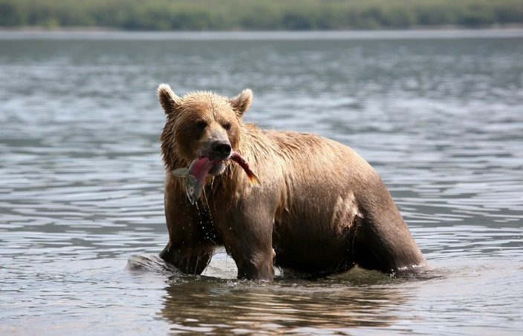
Is This an Environment? Why or Why Not?
Photo courtesy of Pixabay.com
Notes:
3 min
a. “Next, we’ll look at different pictures and decide whether the scenarios they portray fit our definition of an environment.”
b. “What do you think about this picture? Does it show an environment? Why or why not?”
c. Record participants’ ideas on chart paper and work toward a group consensus.
Ideal response:
This scenario fits the definition of an environment because the bear can get the food, water, and air it needs to live and grow. Plants can also get the light, water, and air they need. And the fish in the bear’s mouth was able to get food in the river before the bear caught it.

Slide 40
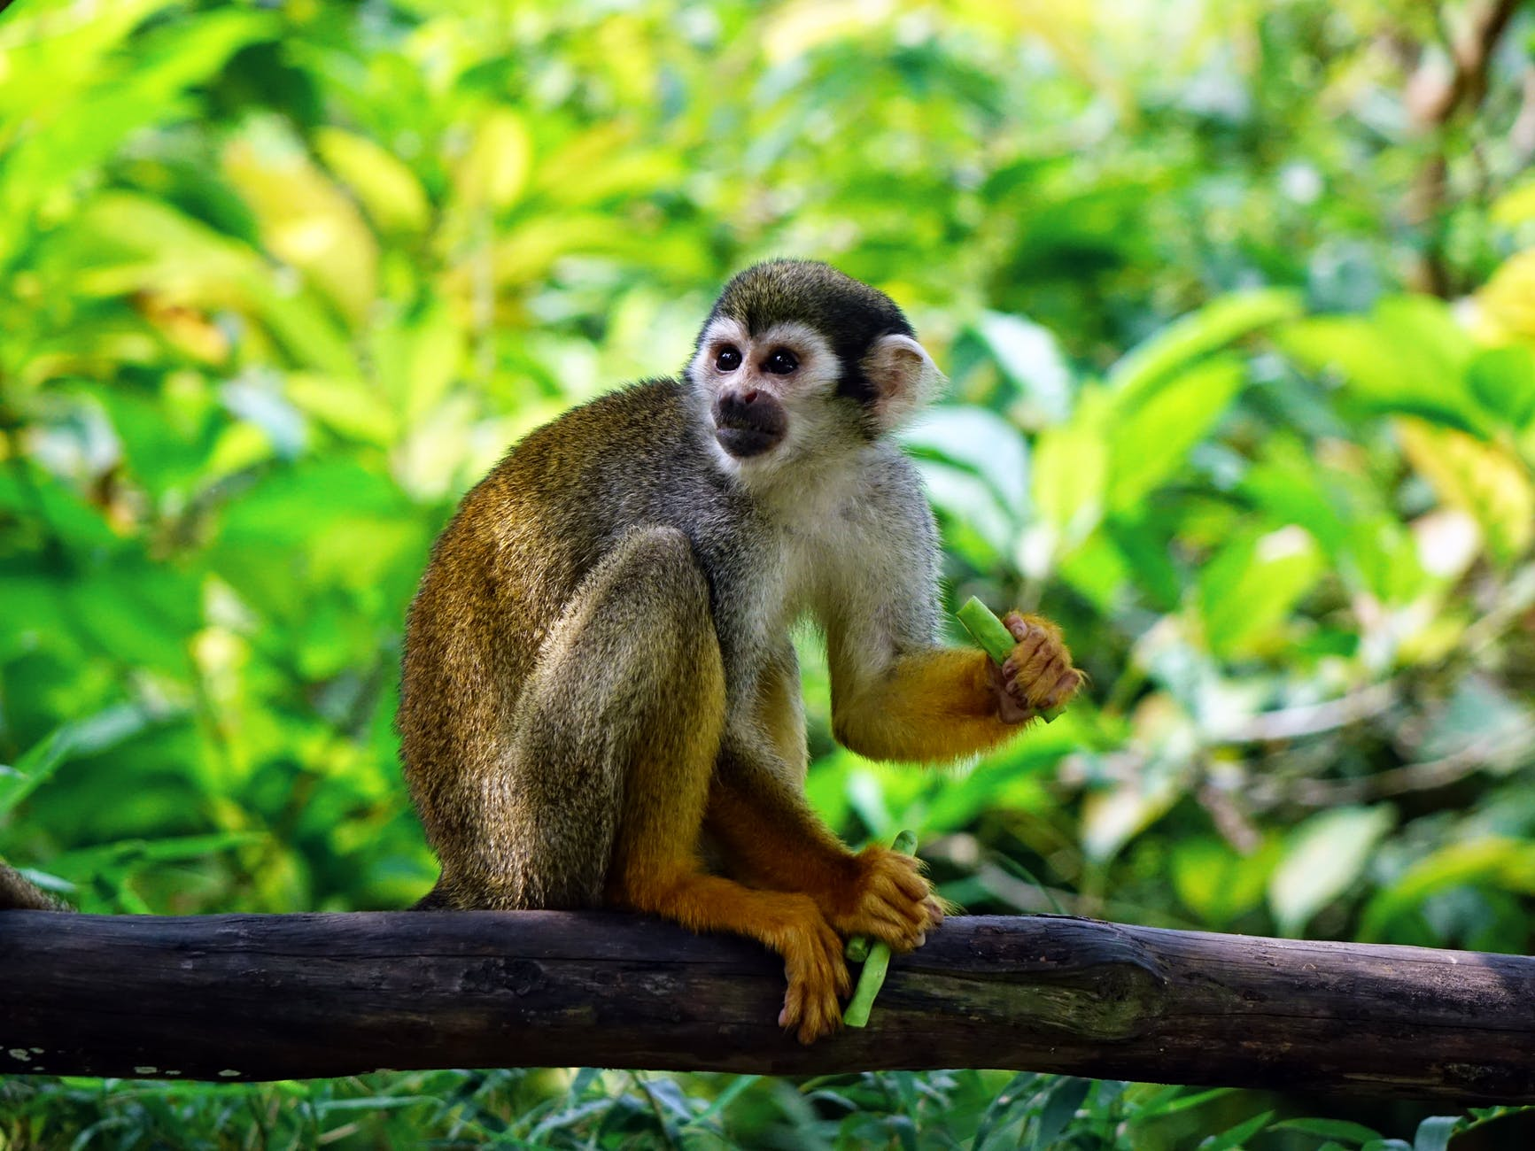
Is This an Environment? Why or Why Not?
Photo courtesy of Pexels.com
Notes:
2 min
a. “Does this picture show an environment? Why or why not?”
b. Record participants’ ideas on chart paper and work toward a group consensus.
Ideal response:
This scenario fits the definition of an environment because the monkey and the plants can get what they need to live and grow. In a rain-forest environment, a monkey can get food, water, and air. Plants can also get air, water, and sunlight to make their own food.

Slide 41
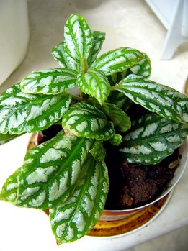
Is This an Environment? Why or Why Not?
Photo courtesy of Phillipe Giabbanelli/Wikimedia Commons
Notes:
3 min
a. “Does this picture show an environment? Why or why not?”
b. Record participants’ ideas on chart paper and work toward a group consensus.
Possible response:
Participants could argue that this is an artificial environment because the plant is dependent on a human to water it on a regular basis so it can stay alive and grow. If the plant isn’t watered regularly, it will die. It could also die if it doesn’t get enough sunlight.

Slide 42
Is a Terrarium an Environment?
Photo courtesy of BSCS
Notes:
4 min
Note: The terrarium you set up in advance should be placed where everyone can see it.
a. “Each classroom will have a terrarium like this one for students to observe throughout the lesson series. The terrarium will get light and water every day, and the organisms in the terrarium will be fed according to a schedule. Notice that the top is vented to allow air to circulate.”
b. “So do you think this terrarium fits our definition of an environment? Why or why not?”
c. Record participants’ ideas on chart paper and work toward a group consensus.
Ideal response:
A terrarium fits the definition of an environment as long as humans ensure that the living things get what they need to live and grow. The praying mantis, worms, and ladybugs need food, water, and air, and the plants need water, air, and light to live and grow.

Slide 43
Reflect: Content Deepening Focus Question 1
  What is an environment, and how does it compare with an ecosystem?
Notes:
6 min
a. Review the focus question on the slide.
b. Individuals: Have participants answer the question in their science notebooks and support their ideas with evidence from the investigations they just completed.
c. Whole group: Invite participants to share their answers and evidence with the group.

Slide 44
Content Deepening: Focus Question 2
How can we categorize and describe the contents of our terrarium environment?
Photo courtesy of BSCS
Notes:
1 min
a. Read the focus question on the slide.
b. Have participants write the question in their science notebooks and leave space for a response.

Slide 45
What’s in Our Terrarium?
Observe the terrarium carefully. List each thing you see in the environment on a sticky note.
Then organize
the cards into
different groups
or categories. Jot
down all of the
categories you
come up with.
Photo courtesy of BSCS
Notes:
10 min
a. “Next, we’ll identify the different things in our terrarium.”
b. Give each participant 10 small sticky notes or index cards.
c. Individuals: “Observe the terrarium carefully. On a sticky note [or index card], list each thing you see in the environment. Then organize the items into different groups or categories and record all of the categories you come up with.”
d. Whole group: Invite participants to share the things they identified in the terrarium and the categories they used to organize them. Make a list of the terrarium contents on chart paper and record the various categories participants come up with to organize the items.
Possible categories:
Living vs. nonliving things
Animals vs. plants
Color
Size
Legs vs. no legs
Wings vs. no wings
e. If time allows, take participants on a virtual BioTrek field trip at https://www.cpp.edu/~biotrek/.

Slide 46
Math Connections
We can use the terrarium activity to connect to math concepts :
  Sorting (animals or plants, living or nonliving things, big things or small things)
  Counting (How many of each thing?)
  Comparing quantities (more than/less than)
Notes:
1 min
a. Walk participants through the math connections on the slide.

Slide 47
Characteristics of Living and Nonliving Things
List the characteristics or features that all living things have in common.
Identify any characteristics on your list that nonliving things also have.
Notes:
7 min
a. Pairs: Have participants pair up with an elbow partner and complete the tasks on the slide.
b. Circulate around the room as pairs work on the tasks. Listen carefully to the ideas participants share and ask probe questions to clarify their thinking (e.g., “Can you say more about …?” “Why do you think that?” “What do you mean by …?”).

Slide 48
Characteristics of Living and Nonliving Things
Read the seven characteristics of living things in section 2 of the content background document (resources section of lesson plans binder).
Does this reading give you any new ideas about characteristics of living things?
Do nonliving things have any of these characteristics?
Notes:
8 min
a. Individuals: “Now turn to the content background document in your lesson plans binders and read the seven characteristics of living things in section 2. Think about the questions on the slide and be prepared to share your ideas with the group.”
b. Whole group: Discuss the questions on the slide. Elicit a variety of ideas from participants and record them on chart paper.

Slide 49
Plants versus Animals
Create a Venn diagram or double bubble map to compare and contrast the characteristics of plants and animals.
Both
Plants
Animals
Notes:
10 min
a. “So how can we distinguish plants from animals? What characteristics are the same, and what characteristics are different?”
b. Individuals: Have participants create a Venn diagram or double bubble map in their science notebooks to compare and contrast the characteristics of plants and animals.
c. As participants work on the task, create a Venn diagram on chart paper.
d. Whole group: Invite participants to share the similarities and differences they listed on their diagrams for plants and animals. Record ideas on the group Venn diagram and discuss the groupings. If participants disagree or have questions about any of the groupings on the chart, place a question mark next to them. Let participants know they can modify the list later to reflect any new understandings.
e. “Now let’s deepen our understandings of plants and animals and see if we learn anything to help us modify this list.”

Slide 50
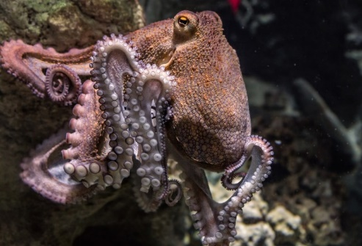
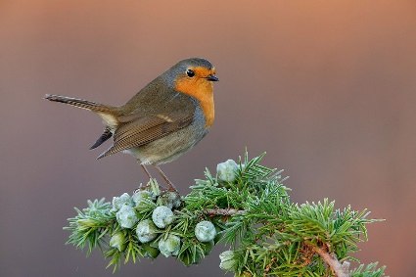
Key Characteristics of Animals
Animals are multicellular,
eukaryotic organisms.
All animals move at some
point in their lives.
Animals must ingest other
organisms (or their
products) as food.
Animals have a nervous
system, with the exception
of sponges.
Octopus
Photos courtesy of Pixabay.com
Bird
Photos courtesy of Pixabay.com
Notes:
2 min
a. “This slide lists the most important characteristics of animals.”
b. Read through the characteristics on the slide. Explain that eukaryotic refers to cells with a membrane-bound nucleus. Then ask participants if they have any comments or questions.
c. “Are there any new ideas on this slide that we can add to our Venn diagram? Do you think we should make any other changes to our diagram?”

Slide 51
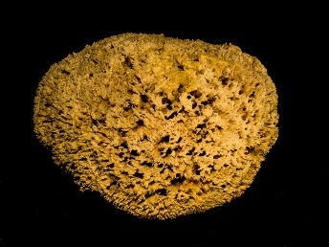
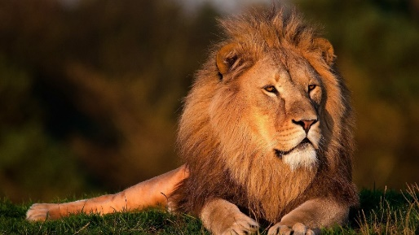
Classifying Animals
Vertebrates
  Mammals, birds, amphibians,
  reptiles, fish
Invertebrates
  Mollusks (clams, oysters,
  octopuses, squid, snails)
  Arthropods (centipedes, insects,
  spiders, scorpions, crabs,
  lobsters, shrimp)
  Annelids (earthworms, leeches)
  Sponges
  Jellyfish
Sponge
Photos courtesy of Pixabay.com
Lion
Photos courtesy of Pixabay.com
Notes:
2 min
a. “Animals can be classified as vertebrates and invertebrates. Vertebrates have a backbone or spinal column and a spinal cord, with an advanced nervous system and a developed brain. Invertebrates have no backbone or cell walls.”
b. Read through the examples of vertebrates and invertebrates on the slide.
c. Ask participants if they want to make any changes to the Venn diagram based on this information.

Slide 52
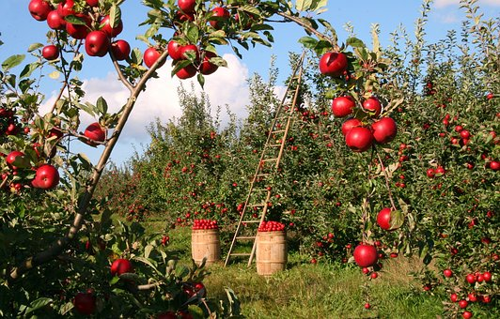
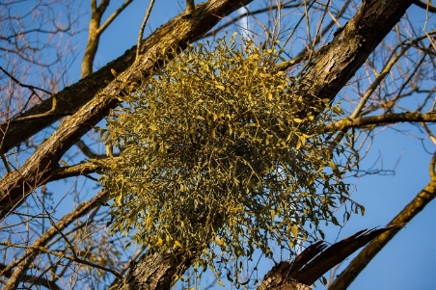
Key Characteristics of Plants
Plants are multicellular living
organisms typically growing in a
permanent site, synthesizing
nutrients in their leaves by
photosynthesis.
Plants reproduce sexually and
asexually. The great majority of
plants are seed plants.
Green plants provide most of the
world’s oxygen and are the basis
of most of Earth’s ecologies.
Apple Tree
Photos courtesy of Pixabay.com
Parasitic Plant
Photos courtesy of Pixabay.com
Notes:
2 min
a. “This slide lists the most important characteristics of plants.”
b. Read through the characteristics on the slide. Then ask participants if they have any comments or questions.
c. “Are there any new ideas on this slide that we can add to our Venn diagram? Do you think we should make any other changes to our diagram?”

Slide 53
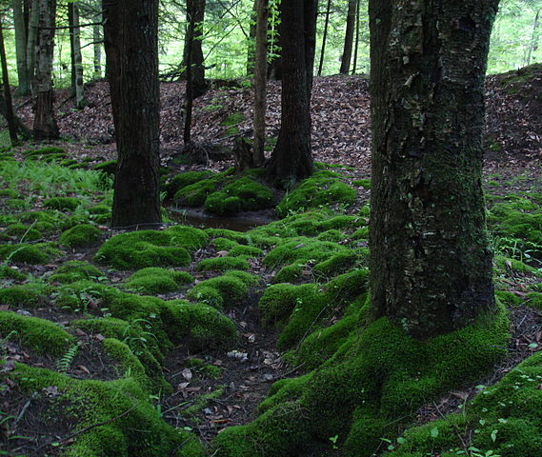
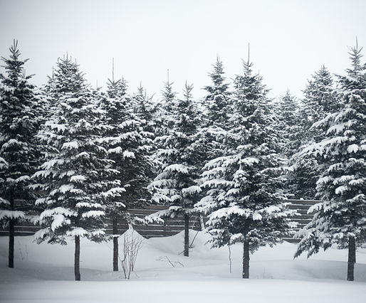
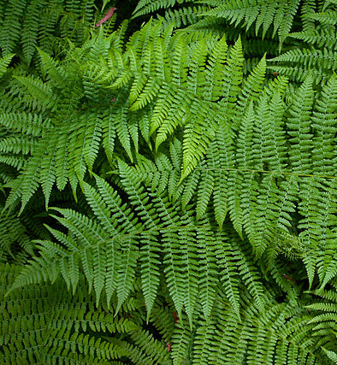
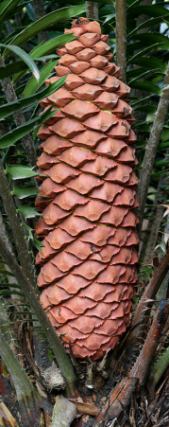
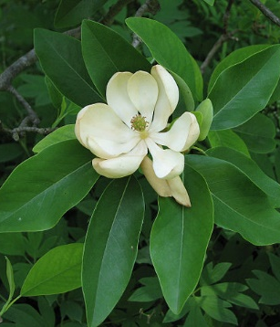
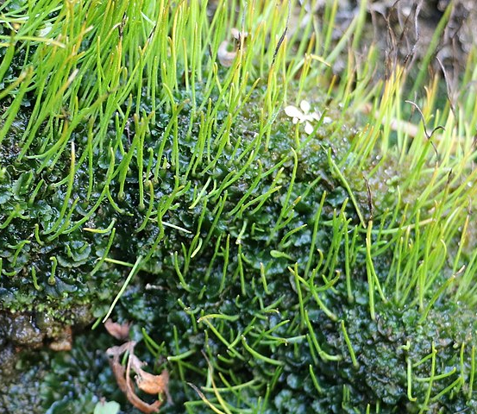
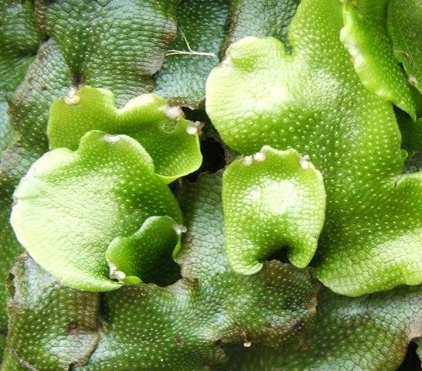
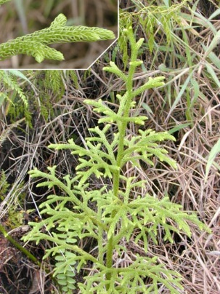
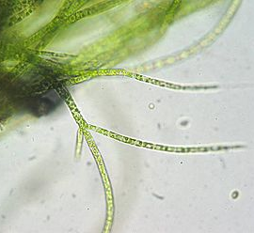
Types of Plants
Plants are multicellular eukaryotes (with a membrane-bound nucleus).
Gymnosperms Seed producing plants
Mosses
Conifers
Ferns
Photo courtesy of IvoShandor/ Wikimedia Commons
Photo courtesy of Wikimedia Commons
Photo courtesy of Sanjay ach/
Wikimedia Commons
Photograph by Muhammad Mahdi Karim / Wikimedia Commons
Flowering
plants
Hornworts
Liverworts
Clubmosses
Green Algae
Photograph by Derek Ramsey/ Wikimedia Commons
Photo courtesy of Peter Woodard/
Wikimedia Commons
Photo courtesy of Lairich Rig/
Wikimedia Commons
Photo courtesy of Eric Guinther/ Wikimedia Commons
Photo courtesy of Kristian Peters/ Wikimedia Commons
Notes:
2 min
a. “This slide shows the major types of plants. Like animals, plants are multicellular eukaryotes with cells that have a membrane-bound nucleus containing DNA.”
b. After listing the different types of plants on the slide, ask participants if they want to make any changes to the Venn diagram based on this information.

Slide 54
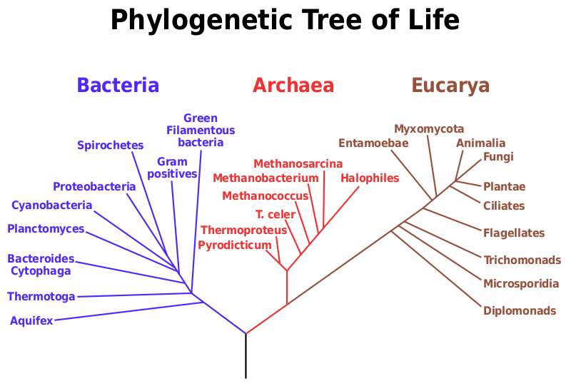
Where Do Plants and Animals Fit?
Courtesy of Eric Gaba/Wikimedia Commons
Notes:
10 min
a. “There are a lot more categories of living things than just plants and animals. But where do plants and animals fit on this phylogenetic tree of life?”
b. Individuals: Have participants turn to section 2 in their content background documents and read the paragraph following the seven characteristics of living things. The paragraph begins with the sentence “Among living things, there is a great deal of diversity.”
c. After participants finish the reading, ask them to study the diagram on the slide and consider where plants and animals fit on the tree of life. Also challenge them to consider what kinds of living things are in their terrarium.
d. Whole group: “So based on the diagram on the slide, where do plants and animals fit on the tree of life. What kinds of living things are in our terrarium?”
Ideal responses:
Although plants and animals are categories of living things that are most apparent to us and to our students, they’re a small part of the much larger tree of life. On the phylogenetic tree of life, animals and plants are classified as Eukarya (or Eucarya). Animals belong to the kingdom Animalia, and plants belong to the kingdom Plantae.
Apart from the visible living organisms in the terrarium, such as plants, the praying mantis, worms, and ladybugs, there are also many microscopic organisms, especially different kinds of bacteria.

Slide 55
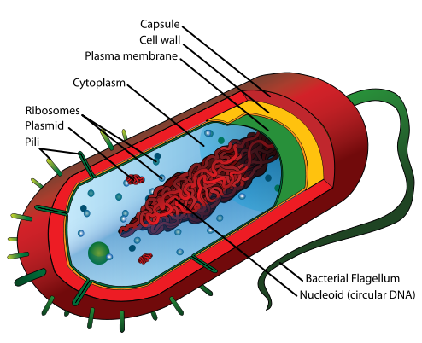
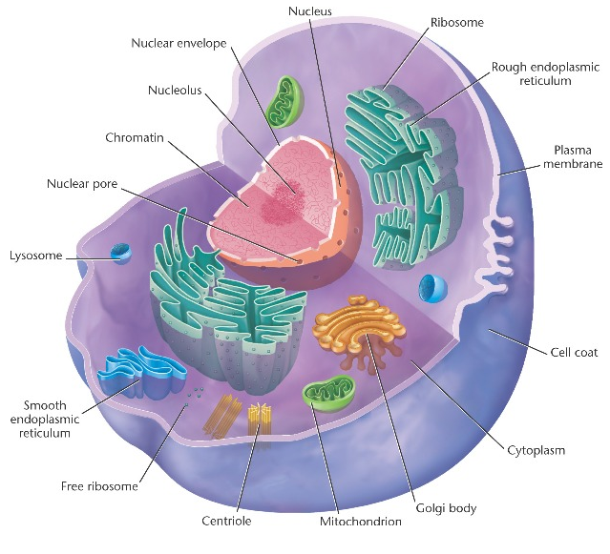
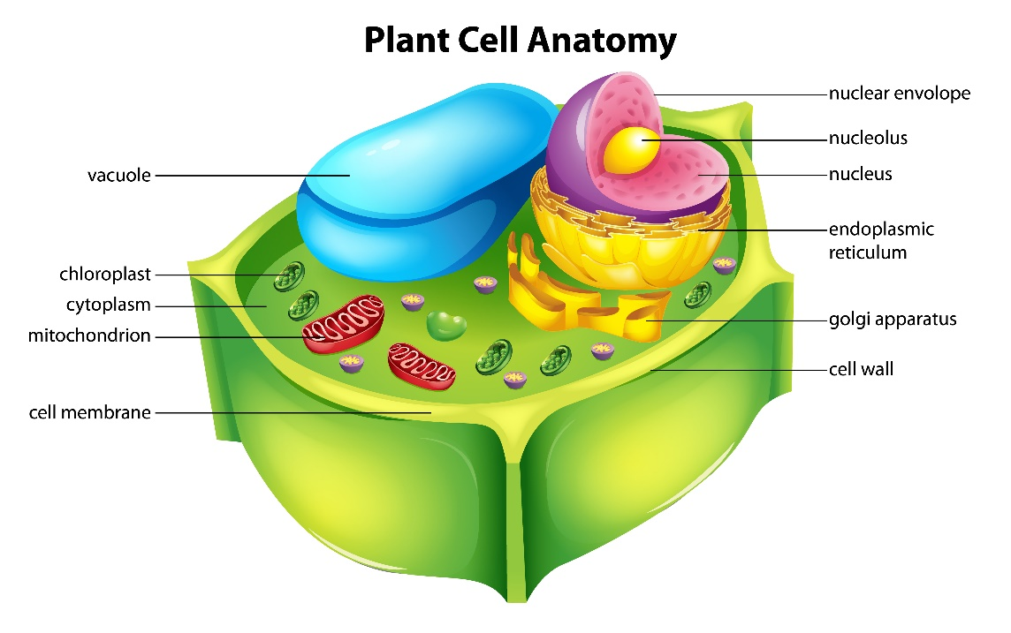
Living Things Are Made Up of Cells
Bacterial
Cell
Animal Cell
Courtesy of Pixabay.com
Plant Cell
Courtesy of Wikia.com
Courtesy of Stock.Adobe.com
Notes:
15 min
a. Pairs: Ask participants to pair up with an elbow partner and study the diagrams on the slide. They can also find the diagrams on handout 5.7 (Living Things Are Made Up of Cells) in their PD program binders.
b. Have pairs create a table or Venn diagram showing similarities and differences among the three types of cells.
c. Whole group: “What key similarities and differences did you find when you compared the three types of cells?”
d. As participants share key similarities and differences among the types of cells, record them on chart paper.
Key ideas:
All living things are made up of cells.
Microorganisms, such as bacteria, are made up of a single cell that’s rather simple compared to animal and plant cells.
Prokaryotes are single-celled organisms that have DNA (deoxyribonucleic acid) inside their cells, but they don’t contain a nucleus or membrane-bound organelles. Bacteria are prokaryotes.
Eukaryotes, such as animal and plant cells, are organisms whose cells have a membrane-bound nucleus that contains DNA. Eukaryotes also have membrane-bound organelles, such as mitochondria (present in animal and plant cells), chloroplasts (present only in plant cells), endoplasmic reticulum, and Golgi bodies or complexes.

Slide 56

Summarize: Animal and Plant Cells
Animal Cell
Nucleus
Plant Cell
Cell Membrane
Chloroplast
Cell Wall
Courtesy of Wikia.com
Mitochondria
Courtesy of Stock.Adobe.com
Notes:
1 min
a. Summarize the differences between animal cells and plant cells.
b. “The red captions on this slide highlight the similarities between animal and plant cells, and the green captions highlight the major differences.”

Slide 57

Characteristics of Animal Cells
Nucleus
Cell Membrane
Mitochondria
Courtesy of Linda Salzman Sagan/Wikimedia Commons
Courtesy of Mediran/Wikimedia Commons
Notes:
Less than 1 min
a. “Let’s look more closely at the characteristics of an animal cell.”
b. “Animals are multicellular organisms that have a membrane-bound nucleus and intracellular, membrane-bound organelles, such as mitochondria, but they don’t have cell walls or chloroplasts.”

Slide 58


Characteristics of Plant Cells
Cell Membrane
Nucleus
Chloroplast
Mitochondria
Cell Wall
Courtesy of Stock.Adobe.com
Photo courtesy of Sanjay ach/Wikimedia Commons
Notes:
Less than 1 min
a. “Now let’s examine the characteristics of a plant cell more closely.”
b. “Like animals, plants are also multicellular organisms that have a membrane-bound nucleus and intracellular, membrane-bound organelles, such as mitochondria, but unlike animals, they have cell walls and chloroplasts that convert light energy into sugars that plant cells can use as food.”

Slide 59
Our Venn Diagram
Do you want to add any similarities or differences to our Venn diagram? Do you think we need to make any other changes?
Both
Plants
Animals
Notes:
3 min
a. Review the group Venn diagram showing the similarities and differences participants identified earlier between plants and animals.
b. Ask participants if they have anything new to add to the diagram or would like to propose any other changes.
c. If participants disagreed earlier about the groupings or had questions, take a moment to revisit them and reach a consensus.

Slide 60
Reflect: Content Deepening Focus Question 2
How can we categorize and describe the contents of our terrarium environment?
Photo courtesy of BSCS
Notes:
5 min
a. “What are the biologically important ways we can categorize and describe the contents of our terrarium environment?”
b. Turn and Talk: Discuss this with an elbow partner. Then write your answers to the focus question in your science notebooks. Be prepared to share your ideas with the group.
c. Whole group: Invite participants to share their ideas for categorizing and describing the contents of the terrarium environment. Record key ideas on chart paper and ask probe questions to clarify participants’ thinking. Make sure participants provide distinguishing characteristics or features for each of the categories they name.
Ideal response:
The biologically important ways we can categorize and describe the contents of the terrarium are as living versus nonliving things and plants versus animals. (Participants should identify the characteristics that distinguish living versus nonliving things and plants versus animals, especially at the cellular level.)

Slide 61
Today’s Focus Questions
What is the Science Content Storyline Lens (SCSL)?
Why is one main learning goal essential for science content storyline coherence?
What is an environment, and how does it compare with an ecosystem?
How can we categorize and describe the contents of our terrarium environment?
Notes:
1 min
a. Review the focus questions addressed during today’s session.

Slide 62
Summary: Today’s Lesson Analysis Work
Reflect on today’s session:
STL strategy 6: use and apply
  The Science Content Storyline Lens (SCSL)
  Science ideas and student ideas
  SCSL strategy A: Identify one main learning goal
Based on our work today, do you have any suggestions for modifying our image of effective science teaching?
Notes:
3 min
a. Individual think time (1 min): Ask participants to reflect on the work they accomplished during today’s lesson analysis and think about the question on the slide.
b. Whole-group share-out (2 min): Invite participants to share their ideas for modifying the image of effective science teaching based on today’s work. Revise the chart as needed.

Slide 63
Summary: Today’s Content Deepening Work
Name one main learning goal for today’s content deepening work.
OR
Name one supporting science idea you learned today about plants and animals.
OR
Name one common student idea (misconception) about plants and animals.
Notes:
3 min
a. Individual think time (1 min): Present the options on the slide and give participants 1 minute to come up with a statement that summarizes today’s content deepening work in one of these areas.
b. Whole-group round-robin (2 min): Go quickly around the room and have each participant share one summarizing statement. Push for complete sentences!

Slide 64
Homework
Read in the STeLLA strategies booklet:
  SCSL strategy B: Set the purpose with a focus question or goal statement
  SCSL strategy C: Select activities that are matched to the learning goal
  SCSL strategy I: Summarize key science ideas
  STL strategy 7: Engage students in making connections by synthesizing and summarizing key science ideas
Fill in the appropriate columns on your SCSL
Z-fold summary charts.
Notes:
3 min
a. Review the homework assignment on the slide and have participants write it in their notebooks.
b. Make sure participants are clear about the reading and writing tasks.

Slide 65
Extended Homework
Locate handout 5.8 (Extended Homework) in your PD program binder.
Between now and Friday, read the scope and sequence for the Plants and Animals lesson plans and your assigned lesson(s) in the lesson plans binder.
Be prepared to share your findings in a study-group conversation on our last day.
Notes:
3 min
a. Go over the information on this slide.
b. Have participants review the Extended Homework assignment sheet (handout 5.8), which provides further details about the assignment.
c. In the Plants and Animals lesson-plan sequence, lessons 1 and 5 have four parts (A–D); lessons 2, 4, and 6 have two parts (A and B); and lesson 3 has three parts (A, B, and C), with two optional parts (D1 and D2). Assign each two-part lesson to one participant and assign two of the four-part lessons to one participant and the other two parts to another participant. Assign lesson 3 (parts A, B, and C) to one participant and have another participant review parts D1 and D2.
d. Ask if there are any questions about the assignment.
e. Emphasize: The group share-out on the last day of the PD program (day 8) should focus on the assignment-sheet questions (section 2). Participants won’t have time to share all the details of each lesson plan.

Slide 66
Reflections on Today’s Session
Reflect on lesson analysis: In what way(s) did our lesson analysis work and/or our study of SCSL strategy A (one main learning goal) stretch your thinking? Give an example to support your response.
Reflect on content deepening: Describe how our content deepening work today helped you clarify a science-content idea.
Feedback: Provide feedback about today’s session and the program so far (likes, dislikes, questions, concerns, suggestions).
Notes:
7 min
a. Allow at least 5 minutes for participants to think about today’s session and write their reflections and feedback on the Daily Reflections sheet (handout 5.9 in PD program binder).

