Slide 1
RESPeCT PD pROGRAM
Day 7
RESPeCT Summer Institute
Notes:
5 min
a. Take care of any housekeeping issues.

Slide 2
Agenda for Day 7
Day-6 reflections
Focus questions
Introducing SCSL strategy D
Sample analysis of content representations
Lesson analysis: SCSL strategy D
Lunch
Content deepening: plants and animals
Summary, homework, and reflections
Notes:
5 min
a. Talk through the agenda for the day.

Slide 3
Trends in Reflections
Lesson Analysis | Science Content Learning
Notes:
5 min
a. Give participants time to review your feedback on their reflections from day 6 and offer reactions, comments, or follow-up questions.

Slide 4
Norms for Working Together: The Basics
Purpose: Build trust and develop a productive study group for all participants.
The Basics
Arrive prepared and on time; stay for the duration; return from breaks on time.
Remain attentive, thoughtful, and respectful; engage and be present.
Eliminate interruptions (turn off cell phones, email, and other electronic devices; avoid sidebar conversations).
Make room for everyone to participate (monitor your floor time).
Notes:
2 min
a. Review the norms and ask participants to think about areas where they could improve individually or as a group.
b. “How do you think we’re doing individually and as a group applying these norms? Do you have any comments or suggestions about areas where we could improve?”

Slide 5
Norms for Working Together: The Heart
Purpose: Build trust and develop a productive study group for all participants.
The Heart of RESPeCT Lesson Analysis and Content Deepening
Keep the goal in mind: analysis of teaching to improve student learning.
Share your ideas, uncertainties, confusion, disagreements, questions, and good humor. All points of view are welcome.
Expect and ask questions to deepen everyone’s learning; be constructively challenging.
Listen carefully; seek to understand other participants’ points of view.
Notes:
5 min
a. Review the norms that are at the heart of the RESPeCT program and ask participants to think about areas where they could improve individually or as a group.
b. Emphasize: “We’re doing quite well with our norms, but as we approach the fall, I hope to see our interactions evolving so that you feel comfortable interacting less through your PD leaders as the ‘teachers’ and direct more of your questions and comments to one another, challenging each other, piggybacking on each other’s ideas, and listening carefully to one another so that everyone is contributing to the kind of productive analysis that will help us figure out ways to strengthen our students’ science learning.”
c. Offer an opportunity for participants to comment on how the group is doing with these norms. Ask, “Are there any areas where we could improve? Any suggested changes?”

Slide 6
Today’s Focus Questions
How do you know when a content representation is appropriate and matched to the main learning goal?
How can we engage students in using content representations and models in meaningful ways?
What happens to the food (glucose) and oxygen that plants make during photosynthesis?
Notes:
1 min
a. Introduce the focus questions on the slide.

Slide 7
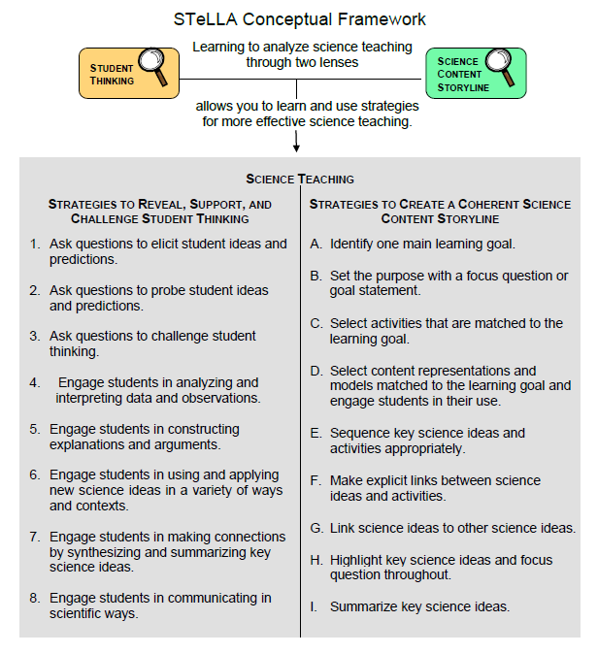
Notes:
2 min
a. “We’ll be focusing on STeLLA strategy D today. Notice that this SCSL strategy has two parts. The first part—select content representations and models matched to the learning goal—sounds similar to strategy C—select activities that are matched to the learning goal. The second part focuses on engaging students in the use of content representations. This ensures that students aren’t just looking at diagrams or models but are actively engaging with them.”

Slide 8
Lesson Analysis: Focus Question 1
How do you know when a content representation is appropriate and matched to the main learning goal?
Notes:
Less than 1 min
a. “Now let’s explore the first part of strategy D and our first focus question.”
b. Read the focus question on the slide.

Slide 9
SCSL Strategy D: Purpose and Key Features
What are the purpose and key features of this strategy?
Cite ideas and examples from the STeLLA strategies booklet and your SCSL Z-fold summary chart.
Notes:
25 min
a. Small groups (13 min): Divide participants into two groups and have each group make a chart identifying the purpose and key features of strategy D described in their SCSL Z-fold summary charts and the STeLLA strategies booklet.
b. Whole group (12 min): Have groups report out. Then ask, “What differences do you notice between the two charts?”
Key ideas:
Content representations can help students envision things that are too big or too small for them to see firsthand in the classroom, or processes that take place too quickly or slowly for them to perceive.
Content representations give students access to different ways of making sense of key science ideas.
If content representations or models are closely matched to the main learning goal, they can be especially useful in helping students see how the science content storyline fits together.
There are many different types of content representations (analogies, metaphors, and visual representations, such as diagrams, charts, graphs, concept maps, models, and role-plays).
Content representations can reveal and challenge student thinking if students are involved in creating, modifying, and analyzing the representations (instead of just listening to the teacher explain them).

Slide 10
Strategy D: Discussion Questions
How is this strategy similar to or different from selecting activities matched to the learning goal (strategy C)?
How might good content representations be especially helpful for English language learners?
Notes:
10 min
a. Whole group: Discuss the questions on the slide.
Key ideas:
Slide question 1: Both strategy C and strategy D emphasize that all activities must be matched to the main learning goal. Strategy D, however, emphasizes a very important kind of activity: content representations. It also emphasizes that teachers should actively engage students in creating, modifying, and using content representations.
Slide question 2: Good content representations can benefit all students, but they especially benefit ELL students because they present science ideas in pictures, images, and other visual formats in addition to words.

Slide 11
Analysis Guide for Strategy D
Read Analysis Guide D (handout 7.1 in your PD program binder).
Keep this question in mind: What do you notice about how this guide is organized?
Notes:
6 min
a. Have participants locate Analysis Guide D in their PD program binders (handout 7.1).
b. Individuals : “As you read the analysis guide, keep in mind the discussion question on the slide.”
c. Whole group: Discuss the question on the slide.
Key ideas:
The analysis guide focuses on the main learning goal by having participants write that down first.
The guide is divided into three parts. Part 1 focuses on how well matched the content representation is to the main learning goal. Part 2 focuses on how well engaged students are in using the content representation.
The guide ends with identifying ways to improve the content representation and its use in a lesson (part 3).

Slide 12
Content Representation 1: Leaf Diagram of Photosynthesis
Read the main learning goal and description of the content representation in Analysis Guide D1 (page 1 of handout 7.1).
Notes:
2 min
a. Set the context: “Now we’re going to analyze a content representation to see how well it’s matched to the stated learning goal.”
b. Have participants read the main learning goal and description of the content representation in Analysis Guide D1 (page 1 of handout 7.1).

Slide 13
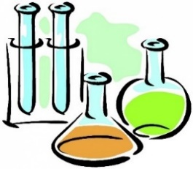
Content Representation 1: Leaf Diagram of Photosynthesis
Sunlight
MAKES
Food (Glucose)
Air
Water
Notes:
8 min
a. Individuals: Have participants work independently on part 1 of Analysis Guide D1.
b. Pairs: “Now pair up and discuss your answers to the analysis questions.”
c. Emphasize that the content representation participants are analyzing is not just the image but the entire activity.

Slide 14
Does Content Representation 1 Match the Main Learning Goal?
How did you answer these questions from part 1 of the analysis guide?
Is the content representation scientifically accurate?
Is it closely matched to the main learning goal?
Does it present science ideas to students in comprehensible ways?
Does it reinforce/introduce any misconceptions?
Does it address common misconceptions?
Does it contain distracting details?
Notes:
10 min
a. Whole group: Discuss participants’ responses to the questions in part 1 of Analysis Guide D1.
b. Ask: “How might this content representation be improved? Would you use it with your students?”
Sample analysis, part 1 of Analysis Guide D1:
Scientifically accurate? The diagram is scientifically accurate. It should be noted, however, that it omits the ideas that energy from the Sun powers the chemical reaction, and oxygen is another product of photosynthesis.
Closely matched to the MLG? The diagram is closely matched to key parts of the learning goal. However, it doesn’t address the idea that the plant uses the food it makes to live and grow. It also surpasses the learning goal by using the words photosynthesis and glucose.
Science ideas comprehensible? The diagram might confuse students because the leaf is detached from the plant. Students also might not understand that the chemical apparatus represents a reaction involving sunlight, water, and carbon dioxide that creates food. Will they understand that the three ingredients on the left side of the diagram are changed into food? Will they understand that this is happening inside the leaf, and not on top of it? Will they understand what the arrow represents?
Reinforces misconceptions? The diagram doesn’t reinforce any key misconceptions.
Addresses misconceptions? The diagram addresses the misconception that water and/or soil are food for the plant.
Contains distracting details? The vocabulary of “photosynthesis” and “glucose” is distracting and not necessary to match the learning goal.
Possible improvements:
To avoid confusion, show a diagram of the entire plant rather than just a leaf.
Remove the words photosynthesis and glucose from the diagram.
Take-home message: Trying to address all six criteria in the analysis guide is a balancing act or trade-off. To make complex science ideas meaningful and comprehensible to students, the content representation needs to be simplified, but simplifications can sometimes be misleading in terms of scientific accuracy. The important thing is for teachers to be aware of such problems so they can be addressed.

Slide 15
Content Representation 2: Photosynthesis Role-Play
Read the main learning goal and description of the content representation in Analysis Guide D2 (page 2 of handout 7.1).
Use your experience with this content representation to complete part 1 of the analysis guide.
Notes:
5 min
a. Set the context for analyzing another content representation.
b. Have participants turn to Analysis Guide D2 (page 2 of handout 7.1) and read the main learning goal and description of the content representation.

Slide 16
Content Representation 2: Photosynthesis Role-Play
Courtesy of wikipedia.org and publicdomainfiles.com
Notes:
7 min
a. Whole group: Have participants stand up. Then lead them through the photosynthesis role-play using the script in the PD Leader Master (Role-Play and Mixing Bowl Analogy of Photosynthesis).
b. Individuals: Following the role-play, have participants work independently on part 1 of Analysis Guide D2.
Note: If time is short, just do partner work.
c. Pairs: “Now pair up and discuss your answers to the analysis questions.”

Slide 17
Does Content Representation 2 Match the Main Learning Goal?
How did you answer these questions from part 1 of the analysis guide?
Is the content representation scientifically accurate?
Is it closely matched to the main learning goal?
Does it present science ideas to students in comprehensible ways?
Does it reinforce/introduce any misconceptions?
Does it address common misconceptions?
Does it contain distracting details?
Notes:
10 min
a. Whole group: Discuss participants’ responses to the questions in part 1 of Analysis Guide D2.
b. Ask: “How might this content representation be improved? Would you use it with your students?”
Sample analysis, part 1 of Analysis Guide D2:
Scientifically accurate? The role-play is scientifically accurate, but it greatly simplifies a very complex process and leaves out several important ideas, such as the conversion of energy from light to chemical food energy, the concept of cells, and the production of oxygen during photosynthesis.
Closely matched to the MLG? The role-play is closely matched to the main learning goal, including the idea that plants use the food they make to live and grow.
Science ideas comprehensible? The role-play simplifies the process of making food and presents it in a way that young students can understand.
Reinforces misconceptions? The human analogy might reinforce or introduce a misconception that plants can think like people do. In addition, students might not catch on that the food being made in the leaves is the plants’ only food source. They might still think that water, air, and sunlight are also food for plants.
Addresses common misconceptions? The role-play doesn’t address the misconceptions that water is food for plants, that anything plants take in is food, or that plants not only make food but also take in food.
Contains distracting details? There are no distracting details in the role-play.
Possible improvements:
The role-play could be modified to clarify and emphasize that plants can’t grow if they don’t make food, and that growth doesn’t happen just because plants take in sunlight, water, and air. Growth only happens when plants turn these three things into food in their leaves.
Take-home message: Trying to address all six criteria in the analysis guide is a balancing act or trade-off. To make complex science ideas meaningful and comprehensible to students, the content representation needs to be simplified, but simplifications can sometimes be misleading in terms of scientific accuracy. The important thing is for teachers to be aware of such problems so they can be addressed.

Slide 18
Content Representation 3: Mixing-Bowl Analogy
Read the main learning goal and description of the content representation in Analysis Guide D3 (page 3 of handout 7.1).
Notes:
5 min
Note: If time is running short, this content representation can be skipped.
a. Have participants turn to Analysis Guide D3 (page 3 of handout 7.1) and read the main learning goal and description of the content representation.

Slide 19
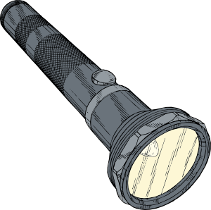
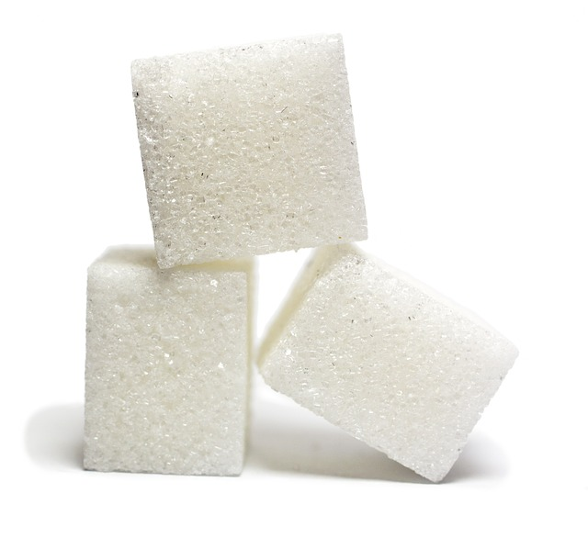
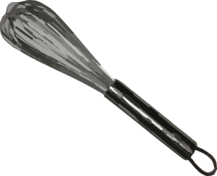
Content Representation 3: Mixing-Bowl Analogy
Notes:
7 min
a. “Our next content representation is the mixing-bowl analogy of photosynthesis that we demonstrated in our last content deepening session.”
b. Whole group: Repeat the demonstration of the mixing-bowl analogy using the script in the PD Leader Master (Role-Play and Mixing-Bowl Analogy of Photosynthesis).
c. Individuals: Have participants work independently on part 1 of Analysis Guide D3.
Note: If time is short, just do partner work.
Pairs: “Now pair up and discuss your answers to the analysis questions.”

Slide 20
Does Content Representation 3 Match the Main Learning Goal?
How did you answer these questions from part 1 of the analysis guide?
Is the content representation scientifically accurate?
Is it closely matched to the main learning goal?
Does it present science ideas to students in comprehensible ways?
Does it reinforce/introduce any misconceptions?
Does it address common misconceptions?
Does it contain distracting details?
Notes:
10 min
a. Whole group: Discuss participants’ responses to the questions in part 1 of Analysis Guide D3.
b. Ask: “How might this content representation be improved? Would you use it with your students?”
Sample analysis, part 1 of Analysis Guide D3:
Scientifically accurate? It isn’t scientifically accurate to say that air, sunlight, and water “mix together” to make food. In scientific terms, when substances are mixed together, they retain their unique properties (like mixing different fruits together to make a fruit salad). Conversely, photosynthesis is a chemical reaction in which water and carbon dioxide, powered by light energy from the Sun, are transformed into a completely new substance: food (glucose). However, the appearance of the sugar cubes at the end of the demonstration suggests that “mixing” sunlight, water, and air produced something completely new, so that helps move the demonstration toward scientific accuracy. Another inaccuracy is the suggestion that sunlight is mixed together with water and air. Sunlight is a form of energy that powers the chemical reaction of photosynthesis. It is not a substance (matter) that can be rearranged and made into a new substance.
Closely matched to the MLG? The mixing-bowl analogy closely matches the part of the learning goal about plants using air, sunlight, and water to make food, but it doesn’t address the part about plants using the food to live and grow.
Science ideas comprehensible? If students make the connection that the bowl is like the inside of a leaf, they might find this idea comprehensible. But will they be able to make the connection?
Reinforces misconceptions? Pouring water into the bowl could reinforce the misconception that water is food for plants. Also, making the sugar cubes suddenly appear at the end of the demonstration while students’ eyes are closed could introduce the misconception that photosynthesis is magic instead of a process that can be explained scientifically.
Addresses common misconceptions? By emphasizing that sunlight, water, and air change into food at the end of the demonstration, the mixing-bowl analogy attempts to address the misconception that water, air, and sunlight by themselves are food for plants.
Contains distracting details? Including carbon dioxide in the analogy is a distracting detail. Kindergartners will have no idea what that is or that air is composed of different gases.
Possible improvements:
Remove the reference to carbon dioxide.
Emphasize that water, air, and sunlight by themselves are not food for plants.
Emphasize that scientists have studied how plants use sunlight to change water and carbon dioxide into food. End with a discussion about how plants use the food they make to live and grow.
Take-home message: Trying to address all six criteria in the analysis guide is a balancing act or trade-off. To make complex science ideas meaningful and comprehensible to students, the content representation needs to be simplified, but simplifications can sometimes be misleading in terms of scientific accuracy. The important thing is for teachers to be aware of such problems so they can be addressed.

Slide 21
Lesson Analysis: Focus Question 2
How can we engage students in using content representations and models in meaningful ways?
Notes:
Less than 1 min
a. Transition slide: “Next we’ll watch two video clips of strategy D in use during P&A lessons. In addition to completing part 1 of Analysis Guide D4, we’ll focus on parts 2 and 3: How well engaged are students in using the content representation? And what suggestions do you have for improving the content representation and its use with students?”
b. “In these video clips, three different teachers engage their students in using a Hula Hoop, a Styrofoam ball, and a lightbulb setup to simulate Earth’s orbit around the Sun. These lessons were taught using slightly different lesson plans, but the science ideas are found in lessons 3 and 4 of our current RESPeCT lesson series.”

Slide 22
Lesson Analysis 1: Strategy D
Read the context for the first video clip at the top of the transcript (handout 7.2).
Read the main learning goal and description of the content representation at the top of Analysis Guide D4.
Watch the video clip, keeping in mind the criteria for strategy D (part 1 of the analysis guide).
Work with a partner to complete part 1 of the analysis guide.
Share your responses with the group.
Link to video clip 1: 7.1_mspcp_kinder.pa_tanguma_L5_c10-12
Notes:
20 min
a. Orient participants to Analysis Guide D4 and the transcript for video clip 1 (handout 7.2 in PD binder).
b. Have participants read the main learning goal and description of the content representation at the top of the analysis guide.
c. Show the video clip.
d. Pairs: Have participants pair up and complete part 1 of the analysis guide.
e. Whole group: Discuss participants’ responses to the questions in part 1 of the guide.
Sample analysis, part 1 of Analysis Guide D4:
Scientifically accurate? The thinking map is scientifically accurate.
Closely matched to the MLG? The map is closely matched to the main learning goals from previous lessons.
Science ideas comprehensible? It’s unclear whether students understand what the circles and lines represent.
Reinforces misconceptions? The map might reinforce the misconception that dirt or soil is food for plants. But students might interpret this to mean that plants need dirt to hold them up.
Addresses common misconceptions? The map addresses the common misconception that only animals need food by showing that plants need food as well.
Contains distracting details? There are no distracting details in the map.

Slide 23
Lesson Analysis 1: Strategy D
Part 2
Are students engaged in modifying or creating the content representation?
Are students engaged in analyzing the meaning of the content representation?
Are students engaged in critiquing the content representation?
Part 3
What did you learn from watching the video clip that might suggest ways to improve the content representation?
Notes:
15 min
a. “Now we’re going to turn our attention to part 2 of strategy D, which engages students in using content representations. We’ll also consider ways the content representation could be improved.”
b. Individuals: “Study the video transcript again and think about parts 2 and 3 of Analysis Guide D4. Be ready to share evidence that supports your conclusions.”
c. Pairs: “Compare your conclusions about student engagement with the content representation.”
d. Whole group: Review participants’ responses to parts 2 and 3 of the analysis guide. Challenge participants to support their answers with evidence from the video transcript.
e. If it didn’t already come up in the discussion, ask participants, “How might the teacher have engaged these students in analyzing or critiquing the representation?”
Sample analysis, part 2 of Analysis Guide D4
Modifying/creating the CR? Students help create the content representation (thinking map) by sharing their ideas about what plants and animals need.
Analyzing the CR? Students don’t analyze the meaning of the content representation, since they aren’t asked to interpret or explain it.
Critiquing the CR? Students don’t critique the content representation.
Possible improvements, part 3 of Analysis Guide D4:
Make sure that the things both plants and animals need (water, food, air, environment) are all nicely lined up between the two circles on the bubble map (“What Animals Need” and “What Plants Need”). This would help emphasize similarities and highlight that only plants need sunlight (and dirt/soil).
To improve their understanding of the representation, students could be asked to explain what each connecting line tells them about the needs of plants and animals. Then they could analyze similarities and differences among these needs.

Slide 24
Lesson Analysis 2: Strategy D
Read the context for the second video clip at the top of the transcript (handout 7.3).
Review the main learning goal and description of the content representation at the top of Analysis Guide D5.
Watch the video clip, keeping in mind the criteria for part 2 of the analysis guide and looking for ways the content representation might be improved (part 3).
Pairs: Complete parts 2 and 3 of the analysis guide.
Link to video clip 2: 7.2_mspcp_kinder.pa_tanguma_L6_c7-8
Notes:
20 min
a. Orient participants to Analysis Guide D5 and the transcript for the second video clip (handout 7.3 in PD binder).
b. Have participants review the main learning goal and description of the content representation at the top of the analysis guide. Emphasize that they’ll focus only on parts 2 and 3 of the guide for this clip.
c. “For this analysis, we’re going to look at a new classroom video and examine how students are (or are not) engaged in using the content representation.”
d. Show the video clip.
e. Pairs: Have participants pair up and complete parts 2 and 3 of the analysis guide.

Slide 25
Lesson Analysis 2: Strategy D
Part 2
Are students engaged in modifying or creating the content representation?
Are students engaged in analyzing the meaning of the content representation?
Are students engaged in critiquing the content representation?
Part 3
What did you learn from watching the video clip that might suggest ways to improve the content representation?
Notes:
10 min
a. Whole group: Discuss participants’ responses to parts 2 and 3 of Analysis Guide D5. Challenge participants to support their answers with evidence from the video transcript.
b. If it didn’t already come up in the discussion, ask participants, “How might the teacher have engaged these students in analyzing or critiquing the representation?”
Sample analysis, part 2 of Analysis Guide D5:
Modifying/creating the CR? Students create the content representations by drawing pictures to compare the needs of plants and animals.
Analyzing the CR? Two students describe and explain their content representations. The teacher asks if others agree or disagree or have anything to add to the drawings, which are all forms of analysis (video segments 00:02–00:09; 01:12; 01:19; 01:23). The teacher also engages students in comparing (analyzing) Astraya’s picture with the class double bubble map about the needs of plants and animals. However, the teacher uses yes-or-no questions (segments 03:35; 03:39; 03:42) instead of challenge questions.
Critiquing the CR? The teacher asks students to critique the CR when she invites them to agree or disagree.
Sample analysis, part 3 of Analysis Guide D5:
Instead of asking for a thumbs-up to indicate agreement (video segment 01:23), the teacher could have asked students to find something in Kiara’s picture that they want to know more about and then follow up by asking if they can add anything.
The teacher could engaged students more in comparing the class double bubble map with the two girls’ drawings. For example, have a student stand up and point to what all plants and animals need on the double bubble map; then have a different student find each of those things in the girls’ pictures. Alternatively, the teacher could ask students to look at their own pictures and analyze whether they showed everything on the double bubble map.
The teacher could have asked both girls why they included sunlight in the list of what animals need.
The teacher could ask more challenge questions (segment 03:42) instead of leading questions (00:42) and yes-or-no questions (01:12; 01:19; 03:31; 03:35; 03:39). For example, the teacher could have asked, “How does Kiara’s picture show how plants and animals are the same?” “How does Astraya’s picture show how plants and animals get their food?”

Slide 26
Strategy D: Synthesize and Summarize
What new ideas do you have about these aspects of today’s lesson analysis work?
How to select content representations
How to engage students in using content representations
Did our content-representation work give you any new insights about plants and animals?
Notes:
10 min
a. Individuals (5 min): Have participants work on the slide questions. Encourage them to use their resources (e.g., the strategies booklet, their Z-fold summary charts, the content background document, notes they’ve taken).
b. Whole group (5 min): Have participants share their new ideas for each question in a round-robin format, if time allows. Otherwise, have a couple of volunteers share their ideas for each question.

Slide 27
Plants and animals
SCIENCE CONTENT DEEPENING Kindergarten
Notes:
Less than 1 min
a. Transition: This slide marks the transition to the content deepening phase of the session.
Note: Throughout this content deepening session, refer as needed to the content background document and Common Student Ideas about Plants and Animals.

Slide 28
Content Deepening Homework
Review sections 4.5 (How Plants Get Their Food), 5.1 (Photosynthesis), and 5.2 (Chemosynthesis) in the content background document.
What new ideas did the reading contribute to your understanding of photosynthesis?
Did it clarify anything we talked about last time?
Did it raise any new questions?
Notes:
7 min
a. “Let’s talk about the content deepening homework from our last session.”
b. Individuals: Have participants review sections 4.5, 5.1, and 5.2 in the content background document and their responses to the questions on the slide.
c. Whole group: Discuss the questions on the slide and invite participants to share any new ideas they gleaned from the reading.
Note: New ideas should include xylem, phloem, the role of chlorophyll in photosynthesis, two phases of photosynthesis, chemosynthesis, and the history of how cells evolved to make complex food molecules.
d. Take time to address any questions or confusion participants have about basic concepts related to photosynthesis.
e. Emphasize: “In today’s content deepening session, we’ll dig into more of the details about photosynthesis.”

Slide 29
Review: What Do Plants Need?
Share your ideas for answering our content deepening focus questions from last time:
What do plants need from their environment to live and grow? Why do they need these things?
Notes:
3 min
Note: Use this slide as an optional review.
a. Give participants an opportunity to share their ideas (writings/drawings) for answering the content deepening focus questions from day 6 if they didn’t have a chance to do so in the previous session.
b. Have participants display their diagrams on a document reader as they explain their ideas. Ask probe and challenge questions to clarify their reasoning and encourage others to agree or disagree, ask questions, or add on. Record key ideas on chart paper.

Slide 30
Where Does Photosynthesis Happen?
Where does photosynthesis occur in plants? Be as specific as possible.
Can photosynthesis happen in the stem/trunk of a plant or in the roots? Why or why not?
Notes:
6 min
a. Read the questions on the slide.
b. Turn and Talk: “Discuss these questions with an elbow partner and be prepared to share your answers and explanations with the group.”
c. Whole group: Discuss participants’ responses to each question and challenge them to explain their reasoning.
Ideal response to the first question: Photosynthesis occurs in the chloroplasts of cells in the plants’ leaves.
d. Emphasize: Only the green parts of plants can photosynthesize. Not all plant cells have chloroplasts that contain chlorophyll, the pigment that captures light energy so that enzymes can convert it to chemical energy during photosynthesis. In addition to leaves, some stems can photosynthesize. For example, cactus plants don’t have leaves, so they make food in the green cells in their “stems.”

Slide 31
Can Seeds Grow in the Dark?
Photo courtesy of Wisconsin Fast Plants Program, College of Agricultural and Life Sciences: University of Wisconsin-Madison, Fastplants.org
Notes:
8 min
a. “In the experiment on the slide, seeds were planted in soil in two different containers. Then the container on the left was placed in the Sun, and the container on the right was placed in the dark.”
b. “What do you observe about the seedlings that were placed in the dark? How do you explain what happened?”
c. Turn and Talk: “Discuss your observations and ideas with an elbow partner, and be prepared to share with the group.”
d. Whole group: Invite participants to share their observations and explanations with the group. Record key ideas on chart paper and ask probe questions to clarify participants’ thinking. Encourage participants to agree or disagree with one another’s ideas, add on, or ask questions.
e. Make sure participants grapple with the idea that the seeds were able to grow in the dark. How could this happen?
f. If it doesn’t come up during the discussion, explain that seeds contain stored food that the parent plant produced during photosynthesis. Young seedlings use this food to live and grow until they sprout leaves and can make their own food.

Slide 32
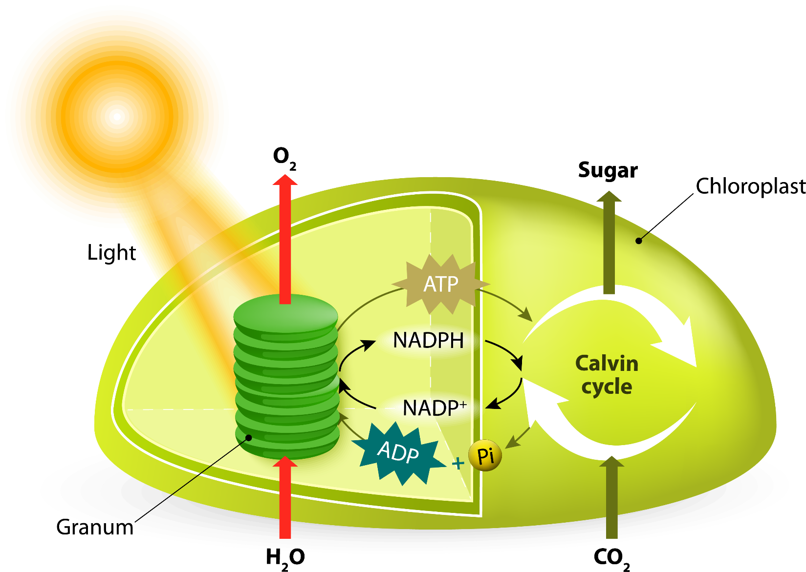
Chemical Reactions in Photosynthesis
Light-Independent Reactions
Light-Dependent Reactions
Courtesy of Stock.Adobe.com
Notes:
10 min
a. “This slide gives us a closer look at photosynthesis. Inside the chloroplast, two different reactions take place: a light-dependent reaction, and a light-independent reaction, or dark reaction.”
b. Pairs: Have participants pair up and explain each of the chemical reactions on the slide, starting with sunlight, water, and carbon dioxide entering the cell.
c. Whole group: Invite participants to share their explanations of the reactions. Ask probe questions to clarify participants’ thinking and correct any misconceptions or errors. Encourage participants to respond to one another’s ideas by agreeing or disagreeing, adding on, or asking questions. Record key ideas on chart paper.
d. Explain that ATP is a molecule that stores and transfers energy in cells. When energy is needed for a task, ATP converts to ADP. NADPH is produced during the first stage of photosynthesis and powers the reactions in the second stage.
Ideal explanation:
Light and water generate ATP and NADPH molecules in a light-dependent reaction.
ATP, NADPH, and CO₂ (from the air) are then involved in a light-independent reaction (also known as the Calvin cycle), and glucose is produced!

Slide 33
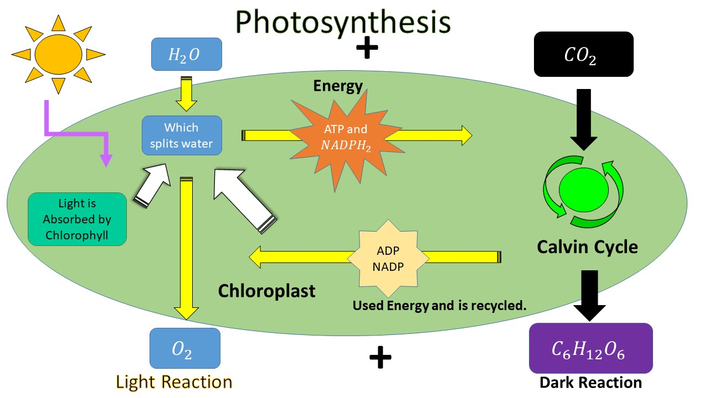
Trace the Hydrogen, Carbon, and Oxygen Atoms
Courtesy of Cal Poly Pomona
Notes:
10 min
a. “This slide shows another content representation of the chemical reactions in photosynthesis.”
b. Pairs: Work with a partner to trace what happens to the hydrogen, oxygen, and carbon atoms in these two reactions.
c. Whole group: Invite participants to share their ideas with the group. Ask probe questions to clarify participants’ thinking.
Key ideas:
The water molecules are split in the light-dependent reaction, releasing hydrogen atoms and oxygen atoms. The oxygen atoms produced in this reaction aren’t involved any further in photosynthesis.
The hydrogen atoms from the light-dependent reaction enter the Calvin cycle (dark reaction), where they “meet up with” carbon-dioxide molecules.
In the light-independent (dark) chemical reaction, the carbon and oxygen atoms from carbon dioxide join together with the hydrogen atoms from the water molecule to form sugar/glucose molecules (C₆H₁₂O₆).
Source: https://image.slidesharecdn.com/photosynthesisppt1-120126155816-phpapp02/95/photosynthesis-ppt-1-1-728.jpg?cb=1327593534

Slide 34
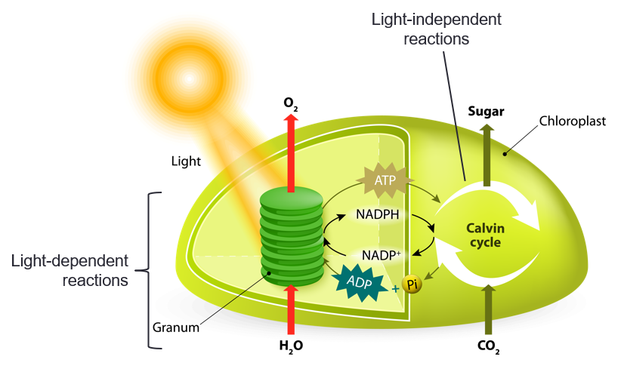
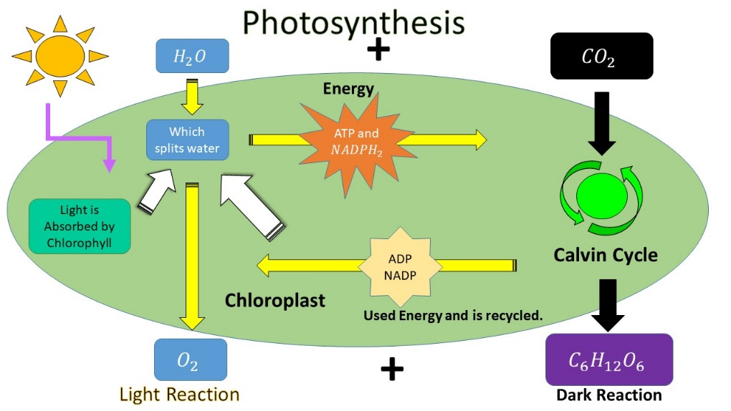
Create Your Own Content Representation!
Courtesy of Stock.Adobe.com
Courtesy of Cal Poly Pomona
Notes:
15 min
a. “Now I’d like you to make visual representations that will help you make sense of these ideas. Your representations don’t have to show all of the details in these slide diagrams, but they should include key aspects of the light and dark reactions.”
b. Individuals: Challenge participants to create their own representations of photosynthesis that include key aspects of the light and dark reactions.
c. Pairs: Have participants share their representations with an elbow partner.
d. Whole group: Invite a few participants to share their representations with the group. Display the diagrams on a document reader as participants share. Encourage participants to ask questions and offer feedback during the share-out.

Slide 35
Content Deepening Focus Question
What happens to the food (glucose) and oxygen that plants make during photosynthesis?
Notes:
5 min
a. “In our previous content deepening session, we investigated what plants need from their environment to live and grow, and why they need these things. What did we discover?”
Ideal response: Plants need sunlight, carbon dioxide, and water from their environment to make their own food during photosynthesis.
b. Read the focus question on the slide.
c. Individuals: Ask participants to write the question in their science notebooks. Then have them jot down their initial ideas for answering this question before advancing to the next slide.

Slide 36
What Do Humans Do with the Food and Oxygen Plants Make?
Blood Vessels
Lungs
Heart
Small Intestine
Stomach
Large Intestine
Courtesy of Stock.Adobe.com
Notes:
8 min
a. “Let’s think about our focus question in terms of what humans do with the products of photosynthesis.”
b. Pairs: Have participants pair up with an elbow partner and share their ideas.
c. Whole group: “What ideas do you have for answering our focus question as it relates to humans? Don’t worry about making sure your ideas are scientifically accurate. At this point, we just want to get our initial ideas down on paper.”
d. “Let’s begin with what happens when we eat a plant. Which parts of the human body are involved?”
e. On chart paper, create a two-column chart with the headings “Food” and “Oxygen.” As participants share their ideas, record them on the chart and ask probe questions to clarify their thinking. Avoid labeling ideas as right or wrong or leading participants to the “correct” answer.
f. “Next, let’s talk about what we do with oxygen. Which parts of the human body are involved?”
g. Record ideas on the chart and ask participants probe questions to clarify their thinking.

Slide 37
What Happens to the Food We Eat?
Blood Vessels
Lungs
Heart
Small Intestine
Stomach
Large Intestine
Courtesy of Stock.Adobe.com
Notes:
7 min
a. Have participants locate Common Student Ideas about Plants and Animals in the resources section of their lesson plans binders.
b. Individuals: Direct participants to read idea 17 and the corresponding scientific explanation.
c. Whole group: “Did the scientific explanation give you any new ideas about what happens to the food we eat?”
Key ideas:
Food must be broken down into smaller pieces before it can be transported to every cell in the body.
Cellular respiration causes a chemical reaction to occur between oxygen and food molecules in the cells so that stored energy in the food molecules is released.

Slide 38
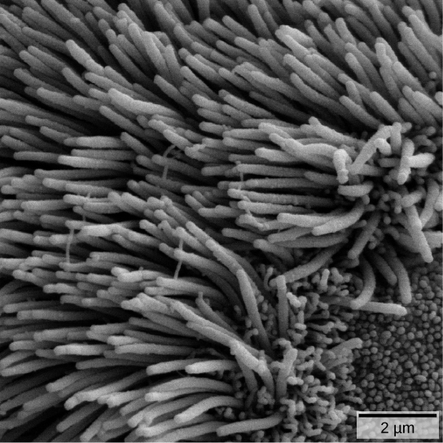
How Does Food Get to Every Cell?
Courtesy of CNX OpenStax/Wikimedia Commons
Courtesy of Cal Poly Pomona
Notes:
3 min
a. “So how does food get to every cell in our bodies? The answer is the circulatory system. Food molecules have to be small enough to diffuse into blood vessels so they can be transported to cells all over the body.”
b. Ask: “Do you have any ideas about what the images on this slide represent?”
c. Explain: “The images on this slide show the lining of the small intestines. The tiny projections in the photo on the left are called villi, which provide ample surface area for tiny food molecules to diffuse through the cell lining of the small intestine (which is just one cell layer thick) and then quickly diffuse into tiny blood vessels called capillaries. Once in the bloodstream, the food molecules can travel to cells all over your body, from your toes to your brain.” what about the circulatory and digestive systems, since food is transported through the gastrointestinal tract? Saying only the circulatory system gives the impression that food makes it to the cells entirely through the circulatory system without any other organ involvement.
Sources:
https://www.google.com/search?q=image+villi+in+small+intestine&tbm=isch&tbo=u&source=univ&sa=X&ved=0ahUKEwjJhdnxns_TAhVMzVQKHU4zD08QsAQIJg&biw=1601&bih=915#imgrc=imT4jycJ2mqOiM:
https://www.google.com/search?q=image+villi+in+small+intestine&tbm=isch&tbo=u&source=univ&sa=X&ved=0ahUKEwjJhdnxns_TAhVMzVQKHU4zD08QsAQIJg&biw=1601&bih=915#imgrc=XDjPjH1CwQou_M:

Slide 39
What Happens to the Oxygen We Breathe?
Blood Vessels
Lungs
Heart
Small Intestine
Stomach
Large Intestine
Courtesy of Stock.Adobe.com
Notes:
7 min
a. Individuals: Direct participants to read idea 18 and the corresponding scientific explanation in the Common Student Ideas resource document.
b. Whole group: “Did the scientific explanation give you any new ideas about what happens to the oxygen we breathe in?”
Key ideas:
Animals breathe in oxygen, which travels to the lungs and is then transported to every cell in the body. In each cell, a chemical reaction (cellular respiration) occurs between oxygen and food molecules to release stored energy the cells need to function.
During cellular respiration, the oxygen and food molecules rearrange to form carbon-dioxide and water molecules that animals exhale.

Slide 40
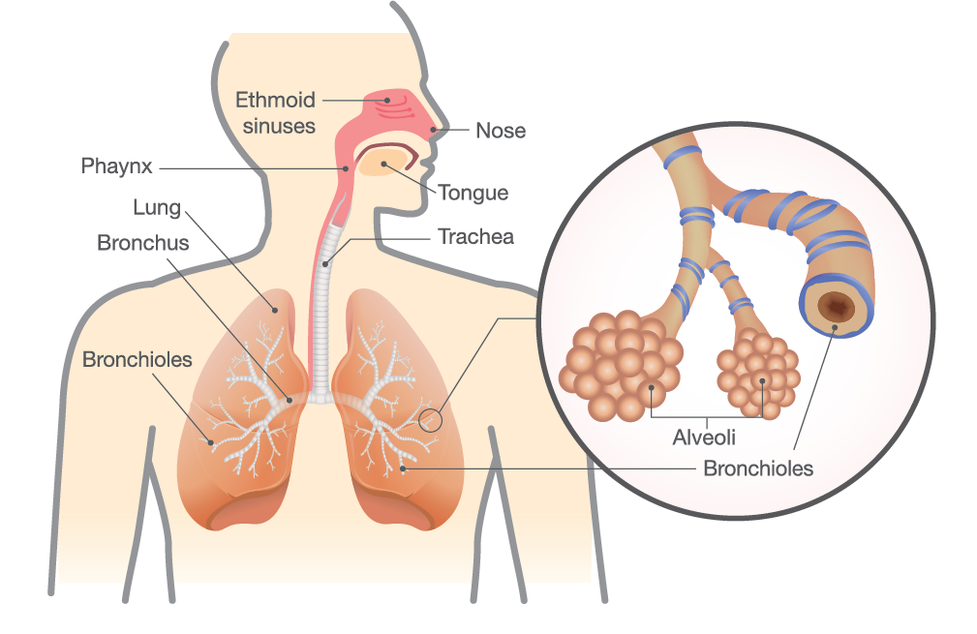
How Does Oxygen Get to Every Cell?
Courtesy of David Gregory & Debbie Marshall
Courtesy of Stock.Adobe.com
Notes:
7 min
a. “So how does oxygen get to every cell in our bodies? The answer is the circulatory system. Oxygen molecules have to be small enough to diffuse into blood vessels so they can be transported to cells all over the body.”
b. Ask: “Do you have any ideas about what the images on this slide show?”
c. Explain: “The images on this slide show how the design of the lungs allows oxygen molecules come into close contact with tiny blood vessels or capillaries and move from the lungs into the circulatory system. Once in the bloodstream, the oxygen molecules are transported to cells all over the body. In the lungs, structures called alveoli allow oxygen molecules to diffuse into the capillaries. This is similar to what happens in the small intestines when villi allow food molecules to diffuse into the capillaries. But the alveoli are more complicated because they also allow carbon-dioxide molecules to diffuse from the circulatory system into the lungs so they can be exhaled.”
Sources:
https://www.google.com/search?q=image+alveoli+in+lungs&tbm=isch&tbo=u&source=univ&sa=X&ved=0ahUKEwjCxZbVpM_TAhULyGMKHbqtCFwQsAQILA&biw=1601&bih=915#imgrc=gQmMpn5WtbvHQM:
https://www.google.com/search?q=image+alveoli+in+lungs&tbm=isch&tbo=u&source=univ&sa=X&ved=0ahUKEwjh84aGpc_TAhVW1GMKHd4XDtIQsAQILA&biw=1601&bih=915#imgrc=YgqiAwunQNmKdM:

Slide 41
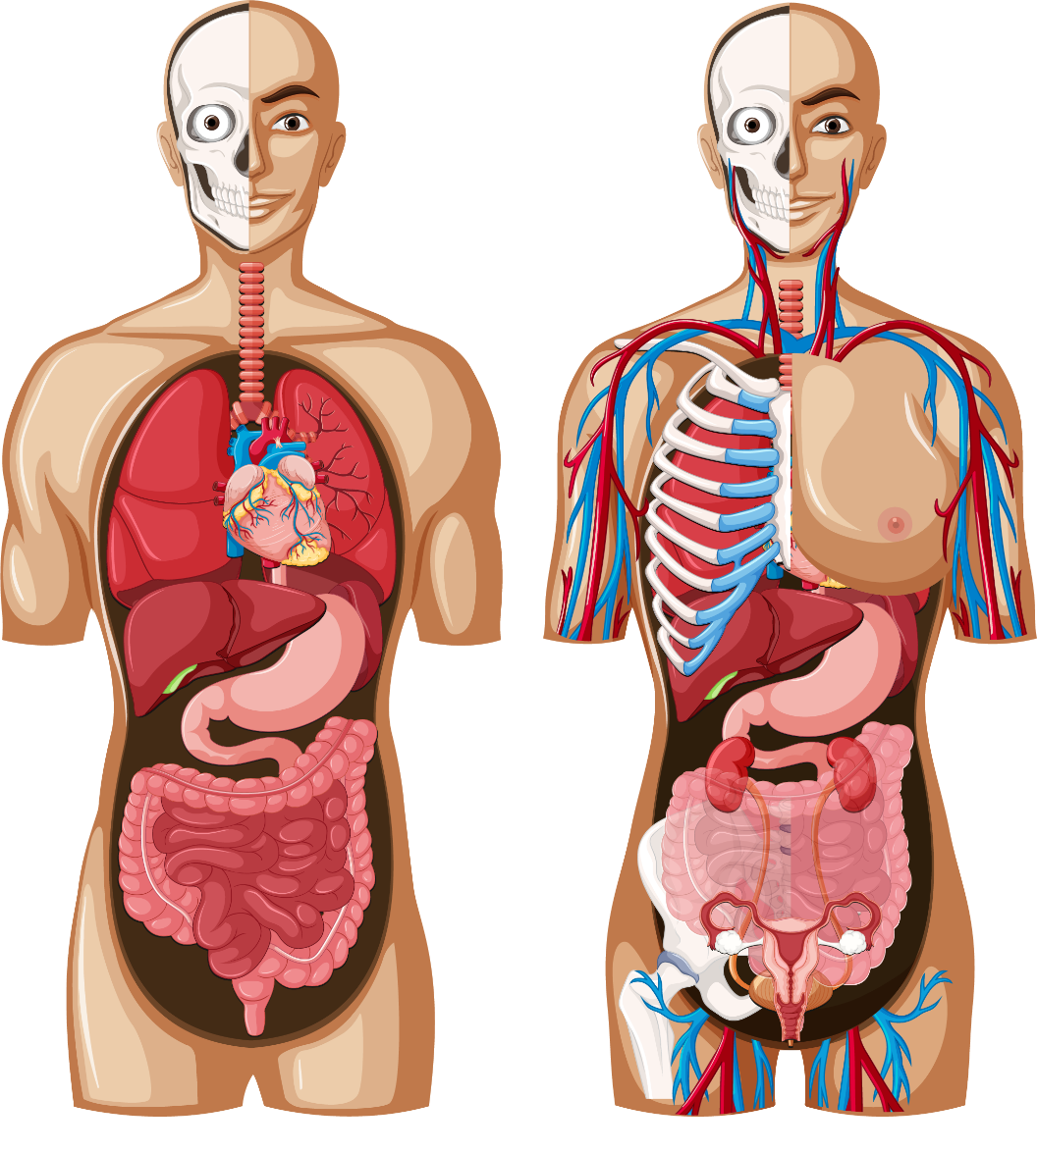
How Do Food and Oxygen Get to Your Thumb Cells?
Blood Vessels
Lungs
Heart
Small Intestine
Stomach
Large Intestine
Courtesy of Stock.Adobe.com
Notes:
8 min
a. Read the question on the slide.
b. Ask participants to locate handout 7.4 (The Human Body) in their PD program binders.
c. Pairs: Direct participants to pair up and use the handout to help them describe how food and oxygen molecules travel to their thumb cells.
d. Whole group: Have participants explain how food and oxygen molecules travel through the body to thumb cells. Record key ideas on chart paper and ask probe questions to clarify participants’ thinking.
Key ideas:
Food: We take food into our mouths and chew it to break it down into smaller pieces. The food then travels through the esophagus to the stomach and into the small intestines, where it’s broken down further into tiny molecules that can diffuse into the bloodstream through a single layer of cells in the villi that line the small intestines. The food molecules then travel through the bloodstream to cells all over the body, including the thumb cells.
Oxygen: We breathe in oxygen through our nostrils or mouths. Then it travels through the trachea to the lungs (through the bronchus and bronchioles), where it diffuses through the alveoli into the bloodstream. Once in the bloodstream, the oxygen molecules travel to cells all over the body, including the thumb cells.

Slide 42
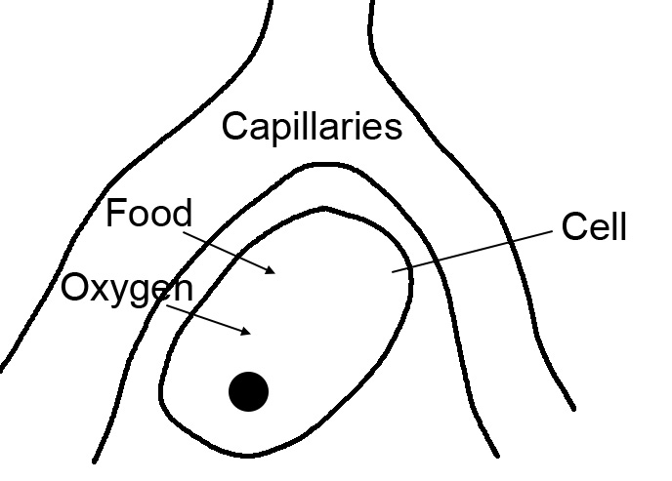
What Happens in the Cells?
Notes:
1 min
a. “What does this diagram show?”
Answer: The diagram shows the bloodstream transporting food and oxygen molecules to a body cell.
b. “After the food and oxygen molecules reach the cells, what happens to them? How are they used? That’s what we’ll explore next.”

Slide 43
Cellular Respiration
Courtesy of pixabay.com
Notes:
2 min
a. “This slide shows a diagram of an organelle in each human cell called a mitochondrion.”
b. Ask: “Based on this diagram, what do you think is happening in the mitochondrion?”
Key ideas:
Glucose and oxygen are undergoing a chemical reaction in which the atoms recombine to form carbon dioxide and water, and the chemical energy stored in the glucose molecules is released so it can be used.

Slide 44
Cellular Respiration
FOOD
GLUCOSE
ANIMAL CELL
GLUCOSE
Inside the Cell
2 ATP
GLYCOLYSIS
2 ATP
CO₂
H₂O
PYRUVATE
PYRUVATE
Acetyl CoA
KREBS
CYCLE
Nucleus
OXYDATIVE
PHOSPHOR
28 ATP
ENERGY
Mitochondria
O₂
Courtesy of Nancy Buckley
Notes:
5 min
a. “Now let’s examine this detailed diagram of cellular respiration in animal cells.”
b. Describe the process illustrated on the slide and respond to participants’ questions.
Diagram notes:
Blue font = inputs to the reactions
Red Font = outputs of the reactions
In cellular respiration, food is broken down into glucose (6 carbon molecule), which is broken down further into pyruvate (3 carbon molecule) through the process of glycolysis.
Pyruvate then enters the mitochondrion and is converted to acetyl coenzyme A (acetyl-CoA).
Then acetyl-CoA reacts with oxygen to release stored energy in the form of ATP, which the organism can use to live and grow.
Byproducts of cellular respiration are CO₂ (carbon dioxide) and H₂O (water).

Slide 45
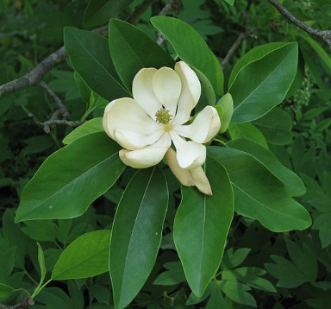
What about Plants?
What do plants do with the food (glucose) and oxygen they make?
Photograph by Derek Ramsey/ Wikimedia Commons
Notes:
8 min
a. “Now we know what humans do with the food and oxygen plants make, but what do plants do with them?”
b. Individuals: Direct participants to read ideas 16 and 19 and the corresponding scientific explanations in the Common Student Ideas resource document.
c. Whole group: “Did these explanations give you any new ideas about how plants use the food and oxygen they make?”
Key ideas:
Just as cellular respiration occurs in all animals, including humans, it also occurs in plant cells. Oxygen needs to reach each and every plant cell so it can react with food (glucose) molecules to release energy the plant can use to function and keep on living. Just as in animals, carbon dioxide and water are given off in this chemical reaction.
Interestingly, most people think that plants only need carbon dioxide. While they do, in fact, need carbon dioxide in specialized leaf cells for photosynthesis to occur, they also need oxygen to reach every cell for cellular respiration to take place.

Slide 46
What Plants Do with the Food They Make
PLANT CELL
Chloroplast
GLUCOSE
Inside the Cell
2 ATP
GLYCOLYSIS
2 ATP
CO₂
H₂O
PYRUVATE
PYRUVATE
Acetyl CoA
KREBS
CYCLE
Nucleus
OXYDATIVE
PHOSPHOR
28 ATP
Mitochondria
O₂
Courtesy of Nancy Buckley
Notes:
5 min
a. “Now let’s look more closely at the diagram on the slide to see what plants do with the food they make.”
b. Have participants locate handout 7.5 (Cellular Respiration in Plants and Animals) in their PD program binders.
c. Explain the following process that takes place in the plant cell:
Glucose is produced through photosynthesis in the chloroplast.
Glucose is then broken down into pyruvate through glycolysis.
Pyruvate is converted to acetyl coenzyme A (acetyl-CoA) in the mitochondria.
Acetyl-CoA and oxygen are used to generate precious energy in the form of ATP.
Carbon dioxide (CO₂) and water (H₂O) are produced as byproducts.
Carbon dioxide and water (both of which are generated as byproducts in the cell and from the environment) can be used in photosynthesis.

Slide 47
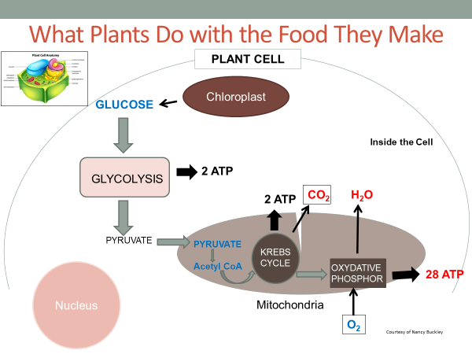
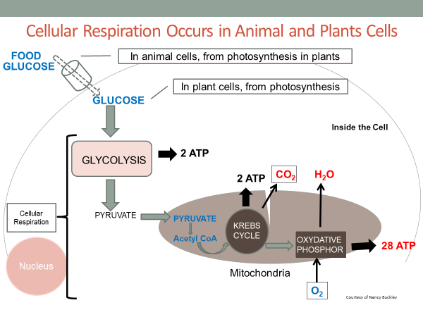
Cellular Respiration in Plants and Animals
Courtesy of Nancy Buckley
Notes:
6 min
a. Individuals or pairs: Have participants compare the diagrams on handout 7.5 (Cellular Respiration in Plants and Animals) and note any similarities and differences.
b. Whole group: Ask participants to share the similarities and differences they identified between the two content representations of cellular respiration.
Key ideas:
The process of cellular respiration is identical in plant and animal cells.
The difference is how plants and animals get the food (glucose) they need for the process.

Slide 48
Reflect: Content Deepening Focus Question
What happens to the food (glucose) and oxygen that plants make during photosynthesis?
Notes:
8 min
a. Review the focus question on the slide.
b. Have participants locate handout 7.6 (Let’s Summarize!) in their PD program binders.
c. Individuals: “Now I’d like you to answer our focus question by finishing the diagram on this handout and adding a title. Include as many details as possible to show what happens to the food and oxygen in the cell. You may use any available resources, such as handouts, your notes, the content background document, and the Common Student Ideas document as you work on your diagrams. Be prepared to share your diagrams with the group.”
d. Whole group: Invite as many participants as possible to share their diagrams with the group. Have them display their diagrams on a document reader as they explain them.
Ideal response:
The diagram should show water and carbon dioxide leaving the cell and diffusing into the capillaries. The release of energy for the cell to use should be represented as well. Participants should also draw a mitochondrion in the cell with an arrow pointing to it to indicate that this is where cellular respiration takes place. Additional details would be nice but aren’t essential.
Possible diagram title: Cellular respiration in Plants and Animals.

Slide 49
Content Deepening Homework
Read sections 4 (The Needs of Living Things) and 5.3 (Cellular Respiration) in the Plants and Animals Content Background Document.
Questions to think about:
What new ideas does the reading contribute to your understanding of the needs of plants and animals and cellular respiration?
Does it clarify anything we talked about today?
Does it raise any new questions?
Notes:
1 min
a. Go over the content deepening homework on the slide and have participants copy it into their science notebooks.
b. “Be prepared to discuss the questions in our next content deepening session.”

Slide 50
Summarizing Today’s Work
Think about the Science Content Storyline Lens strategies we’ve studied so far:
Think about your science-content-learning work today.
Reflect: What ideas or questions do you want to remember from today and refer back to?
A—Identify one main learning goal.
B—Set the purpose with a focus question or goal statement.
C—Select activities that are matched to the learning goal.
D—Select content representations and models matched to the learning goal and engage students in their use.
I—Summarize key science ideas.
Notes:
6 min
a. Individuals (4 min): Ask participants to think about the first two tasks on the slide and respond to the reflection question in their notebooks.
b. Whole group (2 min): Ask for volunteers to share an idea or question from their responses to the reflection question.

Slide 51
Homework
Read about SCSL strategies F, G, and H in the STeLLA strategies booklet and complete the Z-fold summary chart for these strategies.
Be ready to share your assigned lesson in the P&A lesson series.
Bring your calendar for the academic year so we can schedule the dates for our school-year study-group meetings!
Notes:
3 min
a. Review the homework assignment and have participants write it in their notebooks.
b. Make sure participants understand the assignment.
c. “We won’t address strategy E about sequencing science ideas and activities until the school year, since you’ll learn a lot about sequencing from teaching the RESPeCT lesson plans.”

Slide 52
Reflections on Today’s Session
What are your reactions to the strategy of selecting content representations and models that are matched to the lesson’s main learning goal?
What is something new you’ve learned about plants and animals? Did your content-representation analyses support this learning in any way?
Provide feedback about today’s session and the PD program so far (likes, dislikes, questions, concerns, and suggestions).
Notes:
6 min
a. Allow at least 5 minutes for participants to think about today’s session and write their reflections and feedback on the Daily Reflections sheet (handout 7.7 in PD program binder).

Slide 53
Norms for Working Together: The Basics
Purpose: Build trust and develop a productive study group for all participants.
The Basics
Arrive prepared and on time; stay for the duration; return from breaks on time.
Remain attentive, thoughtful, and respectful; engage and be present.
Eliminate interruptions (turn off cell phones, email, and other electronic devices; avoid sidebar conversations).
Make room for everyone to participate (monitor your floor time).
Notes:
Hidden slide—available for use as needed.

Slide 54
Norms for Working Together: The Heart
Purpose: Build trust and develop a productive study group for all participants.
The Heart of RESPeCT Lesson Analysis and Content Deepening
Keep the goal in mind: analysis of teaching to improve student learning.
Share your ideas, uncertainties, confusion, disagreements, questions, and good humor. All points of view are welcome.
Expect and ask questions to deepen everyone’s learning; be constructively challenging.
Listen carefully; seek to understand other participants’ points of view.
Notes:
Hidden slide—available for use as needed.

