Slide 1
RESPeCT PD pROGRAM
Day 8
RESPeCT Summer Institute
Notes:
5 min
a. Take care of any housekeeping issues.

Slide 2
Agenda for Day 8
Day-7 reflections
Focus questions
Introducing SCSL strategies F, G, and H
Lesson analysis: SCSL strategies F, G, and H
Plants and Animals Lesson plan review
Fall overview and study-group scheduling
Lunch
Content deepening: plants and animals
Wrap-up and celebration!
Notes:
2 min
a. Talk through today’s agenda.

Slide 3
Trends in Reflections
Lesson Analysis | Science Content Learning
Notes:
5 min
a. Give participants time to review your feedback on their reflections from day 7 and offer reactions, comments, or follow-up questions.

Slide 4
Today’s Focus Questions
How can science content storyline coherence be enhanced by explicitly implementing STeLLA strategy F (Make explicit links between science ideas and activities), strategy G (Link science ideas to other science ideas), and strategy H (Highlight key science ideas and focus question throughout)?
How will the Student Thinking Lens and Science Content Storyline Lens strategies help you teach the Plants and Animals lessons in the fall?
What are the similarities and differences between plants and animals?
What rich, challenging mathematical tasks can we use in our teaching that are related to sorting?
Notes:
2 min
a. Introduce the focus questions that will guide today’s work.

Slide 5
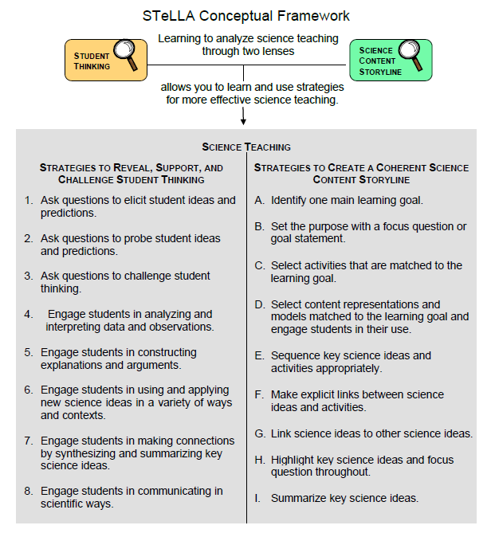
Notes:
1 min
a. “Today we’ll focus on three Science Content Storyline Lens strategies, all of which make explicit links to science ideas:
Strategy F explicitly links science ideas to activities that students are doing.
Strategy G explicitly links science ideas to other science ideas.
Strategy H explicitly highlights key science ideas and links them back to the focus question.”
b. “We won’t address strategy E about sequencing science ideas and activities until the school year, since you’ll learn a lot about sequencing from teaching the RESPeCT lesson plans.”

Slide 6
Lesson Analysis: Focus Question 1
How can science content storyline coherence be enhanced by explicitly implementing STeLLA strategy F (Make explicit links between science ideas and activities), strategy G (Link science ideas to other science ideas), and strategy H (Highlight key science ideas and focus question throughout)?
Notes:
Less than 1 min
a. Read the focus question on the slide.

Slide 7
SCSL Strategies F, G, and H: Purposes and Key Features
Group 1:
What are the purposes and key features of strategy F?
Why is this strategy important for science content storyline coherence?
Group 2:
What are the purposes and key features of strategy G?
Why is this strategy important for science content storyline coherence?
Group 3:
What are the purposes and key features of strategy H?
Why is this strategy important for science content storyline coherence?
Notes:
30 min
a. Small groups: Divide participants into three groups to make charts that capture the purposes and key features of strategies F, G, and H. Direct groups to refer to their Z-fold summary charts and the STeLLA strategies booklet.
b. Whole group: Have small groups share their charts with the entire group.
c. Challenge participants to imagine themselves in their Teacher Leader roles. Ask them, “How would you explain these strategies to the teachers you’re leading?”

Slide 8
SCSL Strategies F, G, and H: Discussion Question
What’s similar and different about these three strategies?
Notes:
10 min
Note: This slide may be skipped if similarities and differences were addressed in the previous discussion.
a. Individuals (3 min): “Look at your three strategy charts, your Z-fold summary charts, and the strategies booklet as you think about the question on the slide.”
b. Whole group: Have participants share their ideas about the three strategies.
Key ideas about strategies F, G, and H:
1. Similarities:
These strategies are all focused on linking complete sentence-length science ideas: Strategy F links science ideas to activities, strategy G links science ideas to other science ideas, and strategy H highlights key science ideas and links them to the focus question throughout the lesson.
All of these strategies emphasize making the links explicit, not just assuming that students will see the intended links.
All of these strategies can and should occur throughout the lesson.
2. Differences:
Strategy F explicitly links science ideas to student activities.
Strategy G explicitly links science ideas to other science ideas.
Strategy H explicitly highlights key science ideas and links them back to the focus question.

Slide 9
Preparing for Video-based Lesson Analysis
Read Analysis Guide F, part 1.
What is the difference between the main learning goal and supporting science ideas?
What is similar about the main learning goal and supporting science ideas?
Notes:
5 min
a. “Next we’re going to watch a series of three classroom video clips from one lesson about plants and animals. The first clip takes place before students start working on the drawing activity. The second clip shows students while they’re working on the activity, and the third clip shows the teacher following up with students after the activity. Our focus for this analysis will be strategy F.”
b. Have participants locate Analysis Guide F (handout 8.1) in their PD program binders.
c. Tell participants that part 1 of the guide provides the context for the video clips.
d. Individuals: “Read part 1 of the analysis guide and be prepared to discuss the two questions on the slide.”
e. Whole group:
Discuss the questions on the slide.
Ask whether participants have any questions about the activity they’ll be observing in the video clips.
Key ideas:
Difference between the main learning goal and supporting science ideas: The main learning goal is the big idea that is the focus of the lesson. Supporting science ideas are smaller, connected ideas that build upon each other to support the main learning goal.
Similarity between the main learning goal and supporting science ideas: The main learning goal and supporting science ideas are all expressed as complete-sentence science ideas (not as topics, phrases, or activities).

Slide 10
Lesson Analysis: Strategy F
For each of the video clips, read the context at the top of the transcript and then watch the clip:
Video clip 1: setup for the activity
Video clip 2: during the activity
Video clip 3: follow-up to the activity
For each clip, use the criteria in part 2 of Analysis Guide F to analyze how well science ideas were linked to the activity.
Links to video clips 1–3: 8.1_mspcp_kinder.pa.tanguma_L6_c9
8.2_mspcp_kinder.pa.tanguma_L6_c10-12
8.3_mspcp_kinder.pa.tanguma_L6_c13
Notes:
60 min—15 min/clip
Note: These video clips are from an earlier version of the lesson plan.
a. Have participants review part 2 of Analysis Guide F. After they watch each video clip, ask them to study the corresponding transcript, answer the questions in part 2 of the analysis guide, and then analyze the links between science ideas and activities that were (or were not) made before, during, or after the activity.
b. Have participants read the context for video clip 1 at the top of the transcript (handout 8.2 in PD program binder).
c. Show video clip 1. Then guide participants through these tasks:
Individuals: “Study the video transcript and then complete part 2, section 1 of the analysis guide, Setup for the Activity.”
Whole group: Ask participants to share their analyses of the video clip.
d. Have participants read the context for video clip 2 at the top of the transcript (handout 8.3 in PD binder).
e. Show video clip 2 and then guide participants through these tasks:
Individuals: “Study the video transcript and then complete part 2, section 2 of the analysis guide, During the Activity.”
Whole group: Ask participants to share their analyses of the video clip.
f. Have participants read the context for video clip 3 at the top of the transcript (handout 8.4 in PD binder).
g. Show video clip 3 and then guide participants through these tasks:
Individuals: “Study the video transcript and complete part 2, section 3 of the analysis guide, Follow-up to the Activity.”
Whole group: Ask participants to share their analyses of the video clip.
Sample analysis for video clip 1:
In this clip (video segment 03:36), the teacher revisits the focus question, Do plants and animals need the same things in order to stay alive and grow? Explain your thinking. At segment 05:00, the teacher explicitly prompts students to think about this question. However, the actual comparison of plant and animal needs begins when she points students to the class double bubble map (02:27).
Explicit links are made in this clip between the science ideas and the activity. The first four minutes of the clip get students thinking about the science ideas they’ve been studying. Then at segment 04:13–04:21, the teacher explicitly points students to the ideas in the double bubble map and tells them to use those ideas in their drawings (the activity).
Students understand that they’re supposed to use what they’ve learned to make their drawings, but it probably isn’t clear to them what they’ll learn from the activity itself.
Sample analysis for video clip 2:
In this clip, students are clearly thinking about the science ideas they’ve learned as they work on their drawings (see segments 00:28 and 00:59).
The teacher repeatedly prompts students to include in their drawings the science ideas they’ve studied (see segments 00:19, 01:37, 01:52, 02:07, 02:55, 03:08, and 03:35).
Sample analysis for video clip 3:
As Logan explains his drawing to the class in this follow-up to the activity, he links ideas about the needs of plants and animals to his picture. He says that animals need water, food, air, and an environment (segment 00:33), and plants need air, sunlight, food, and water (00:14). He also points out that animals get their food by eating other animals, but he doesn’t say how plants get their food.
Logan is very engaged in making the links. The teacher tries to engage other students in making connections by asking questions (00:53 to the end), but these are yes-or-no questions, and the teacher clearly wants a yes response from students. Her questions highlight how plants and animals are the same—they both need water, air, and food—and different—they have different kinds of food.

Slide 11
Lesson Analysis: Strategies F, G, and H
Strategy F:
Find examples in the video transcripts where students are linking science ideas to a lesson activity.
Suggest one specific way to strengthen strategy F in this lesson.
Strategy G:
Find examples where two or more science ideas are being linked together.
Suggest one specific way to strengthen strategy G in this lesson.
Strategy H:
Find an example where the teacher is highlighting key science ideas or referring back to the focus question.
Suggest one specific way to strengthen strategy H in this lesson.
Notes:
20 min
Note: If time is running short, have participants work only on part A of their assigned tasks.
a. Assign participants one of the strategies (F, G, or H) to analyze for this activity and then go over the directions on the slide. Emphasize the importance of using the STeLLA strategies booklet and strategy charts as resources.
b. Individuals: “Study the transcripts for video clips 1–3 and search for examples of your assigned strategy being used during the lesson. Be ready to share your ideas with the group, and make sure to support your answers with evidence.”
c. Whole group: Have participants share their findings. Encourage listeners to agree or disagree, ask clarification questions, and add on.
Examples of Strategy G
Video Clip 8.1:
Video segment 01:17–01:39: The teacher asks questions to get students to make links/comparisons between plants and animals.
Segment 02:52–03:13: The teacher makes a linking statement that compares plants and animals.
Segment 05:00–05:14: The teacher asks questions to help students identify the needs that plants and animals share.
Video Clip 8.2:
Segment 01:32–02:00: The teacher tries to get a student to make links and comparisons between plants and animals.
Video Clip 8.3:
Segment 00:33–01:03: The teacher helps students compare similarities between plants and animals.
Examples of Strategy H
Video Clip 8.1:
Video segment 02:27: The teacher refers students to the double bubble map of key ideas about the needs of plants and animals.
Segment 02:52: The teacher pauses in the lesson flow to summarize key ideas students have been discussing.
Segment 05:00: The teacher highlights a version of the focus question by asking students to tell her what needs of plants and animals are the same.
Video Clip 8.3:
Segment 00:45–01:00: The teacher points again to key ideas on the double bubble map and prompts students to indicate whether plants and animals have the same needs (water, air, and food).

Slide 12
Summary: Strategies F, G, and H
Use linking strategies to make the science ideas explicit to the whole class (strategies F and G).
Engage students in linking science ideas to activities before, during, and after an activity (strategy F).
Engage students in linking science ideas to other science ideas (strategy G).
Highlight key science ideas throughout the lesson (strategy H).
Keep returning to the focus question throughout and at the end of the lesson (strategy H).
Notes:
Less than 1 min
a. Read the summary statements on the slide or give participants time to read them silently.
b. Ask participants whether they have a brief comment or question about the summary.

Slide 13
Lesson Analysis: Focus Question 2
How will the Student Thinking Lens and Science Content Storyline Lens strategies help you teach the Plants and Animals lessons in the fall?
Notes:
Less than 1 min
a. Read the focus question on the slide.

Slide 14
Plants and Animals Lesson Plan Conversation
The science content storyline across lessons
Review the main learning goal for each lesson sequentially.
The science content storyline within lessons (5–7 min for each two-part lesson)
How does this lesson fit into the arc of all the lessons?
What are the main learning goal and focus question?
Describe the main activity (or activities).
How will the activity help students better understand the learning goal for the day?
What STeLLA strategy/strategies are highlighted in this activity?
What concerns or suggestions do you have about this activity?
Practical issues and questions
Notes:
60 min (in conjunction with next two slides)
Note: Create charts like the samples on the next two slides so that participants can view both as they report out.
Timing note: Make sure you limit the time for each lesson conversation so you can get through them all. Aim for 5–7 minutes for each lesson.
a. Give a brief overview of the science content storyline across lessons and then begin the lesson conversation.
b. For step 1 on the slide, review the main learning goal for each lesson sequentially and how it connects to the lesson before and after it. (5 min)
c. For steps 2 and 3, ask each participant to report on her/his two-part lesson, which was assigned on day 5.
Note: Encourage participants to present the big picture using the questions in step 2 on the slide, not to walk through every step in their lesson plans. They should bring up details only when they have some concern, question, or suggestion about a modification.
d. As participants give their reports, fill in the charts you’ve created, checking off the main strategies highlighted in each lesson. (See the chart format on next two slides.)
Note: Encourage participants to pick just one or two Student Thinking Lens strategies and one or two Science Content Storyline Lens strategies that are actually highlighted in the lesson. (Each lesson uses several strategies.)
Ideal pattern to highlight for the Student Thinking Lens strategies:
Early lessons highlight elicit and probe questions (strategies 1 and 2). Middle lessons highlight challenge questions and analyzing and interpreting data (strategies 3 and 4). Strategy 6—communicating in scientific ways—is highlighted in lesson 4 when students analyze data from their plant experiment. The final lessons in the unit highlight using and applying new science ideas (strategy 5) and making connections by synthesizing and summarizing key science ideas (strategy 7).
Ideal pattern to highlight for the Science Content Storyline Lens strategies:
All lessons should include a focus question (strategy B) and some kind of summary (strategies I and 7). Strategy 7 is a main focus in lesson 6a when students draw pictures to show what plants and animals need.
All lessons should include a clear setup and follow-up for the main activity that focus on linking science ideas to the activity (strategy F).
Most lessons after the first one should include highlighting key science ideas (strategy H). Linking ideas to other ideas (strategy G) occurs primarily in the later lessons, when students are comparing plants and animals.

Slide 15
STL Strategies Highlighted in the P&A Lessons
Lesson | 1a | 1b | 1c | 1d | 2a | 2b | 3a | 3b | 3c | 3d | 4a | 4b | 5a | 5b | 5c | 5d | 6a | 6b
1. Elicit
2. Probe
3. Challenge
4. Analyze/ Interpret
5. Explain/ Argue
6. Use/Apply
7. Synthesize/ Summarize
Notes:
a. As participants report out, complete this chart, indicating with check marks the STL strategies highlighted in the lessons.
b. Discuss the reasons certain strategies appear at specific times in the lesson sequence. (See ideal patterns on slide 14 and refer to the summary charts in the STeLLA strategies booklet as needed.)

Slide 16
SCSL Strategies Highlighted in the P&A Lessons
Lesson | 1a | 1b | 1c | 1d | 2a | 2b | 3a | 3b | 3c | 3d | 4a | 4b | 5a | 5b | 5c | 5d | 6a | 6b
A. Identify Main Learning Goal
B. Set Purpose and Focus Question
C. Match Activity to MLG
D. Match Content Reps to MLG
F. Link Activity to Science Ideas
G. Link Science Ideas
H. Highlight Key Science Ideas and Focus Question
I. Summarize Key Science Ideas
Notes:
a. As participants report out, complete this chart, indicating with check marks the SCSL strategies highlighted in the lessons.
b. Discuss the reasons certain strategies appear at specific times in the lesson sequence. (See ideal patterns on slide 14 and refer to the summary charts in the STeLLA strategies booklet as needed.)

Slide 17
Overview of Study-Group Sessions
Purpose: To practice, analyze, and learn from the use of the STeLLA strategies in your science teaching.
Review the focus of each study-group session:
What is the main focus for fall study-group sessions 1–3?
What is the purpose of the 2-hour meeting in December/January?
What is the main focus for spring study-group sessions 4–6?
Notes:
5 min
a. Have participants locate handout 8.5—Overview of School-Year RESPeCT Study Groups—in their PD program binders.
b. Emphasize: “The purpose of the study-group sessions is to practice, analyze, and learn from the use of the STeLLA strategies in your teaching of the Plants and Animals lessons in the fall and the Weather and Seasons lessons in the spring.”
c. Talk participants through Study Groups 1–3 on the handout.
d. Pause for questions and a summary task. Ask participants, “What is the main focus for fall study-group sessions 1–3?”
e. Talk participants through the 2-hour meeting in December/January and Study Groups 4–6 on the handout.
f. Pause for questions and a summary task. Ask participants, “What is the purpose of the 2-hour meeting in December/January?” and “What is the main focus for spring study-group sessions 4–6?”

Slide 18
Teaching the Plants and Animals Lessons
Before teaching lesson 1, give your students the classroom pretest.
Teach all the lessons and have one lesson video recorded.
Give your students the classroom posttest.
Hold on to your students’ pre-post tests! You’ll analyze them in preparation for Study Group 3.
Notes:
10 min
a. Before going over this slide, have participants locate the Plants and Animals classroom pre-post test in their lesson plans binders (pretabs section).
The classroom pre-post test: “This test is in your lesson plans binder. After you administer the test to your students, you’ll need to save all of them, since you’ll be analyzing them as part of our study-group work in the fall.”
b. Review the steps on the slide.
c. Emphasize: “It’s very important to follow these steps in order and save all of your classroom pre-post tests. Don’t return them to students until after Study Group 3.”

Slide 19
Scheduling School-Year Study Groups
Proposed meeting day/time: Wednesdays 2:00–6:00 p.m.
Meeting place: In our classrooms, rotating from school to school
Possible dates for our study-group sessions:
Study Group 1: [insert possible date]
Study Group 2: [insert possible date]
Study Group 3: [insert possible date]
2-hour meeting to review Weather and Seasons lessons: [insert possible date]
Study Group 4: [insert possible date]
Study Group 5: [insert possible date]
Study Group 6: [insert possible date]
Notes:
15 min
Note: Include on this slide some possible dates for six 4-hour study-group meetings and the 2-hour meeting that occurs between Study Groups 3 and 4.
a. Suggest possible dates for the study-group sessions, starting with the Wednesday afternoon slot from 2:00 to 6:00 p.m.
Note: As you schedule the meetings, keep in mind that you’ll need some time between the end of the school day and the beginning of the meeting to get to the location and set up everything.
Study Group 1: Early October. Round-1 teachers should have their classroom video recordings completed at least three weeks before this session. You will need three weeks to watch the classroom video(s), select the ones you’ll use during the study groups, and prepare the video-clip selections and transcripts.
Study Group 2: Mid-November. Round-2 teachers should have their classroom video recordings completed at least three weeks before this session. You will need three weeks to watch the classroom video(s), select the ones you’ll use during the study groups, and prepare the video-clip selections and transcripts.
Study Group 3: Early December. This session can occur anytime after Study Group 2 and before the holiday break.
2-hour meeting: December/January. The purpose of this meeting is to review the Weather and Seasons lesson plans in preparation for teaching them.
Study Group 4: Early February. Round-1 teachers should have their classroom video recordings completed at least three weeks before this session. You will need three weeks to watch the classroom video(s), select the ones you’ll use during the study groups, and prepare the video-clip selections and transcripts.
Study Group 5: March. Round-2 teachers should have their classroom video recordings completed at least three weeks before this session. You will need three weeks to watch the classroom video(s), select the ones you’ll use during the study groups, and prepare the video-clip selections and transcripts.
Study Group 6. April. This session can occur anytime after, but preferably within a month of, Study Group 5.

Slide 20
Plants and Animals
SCIENCE AND MATH CONTENT DEEPENING Kindergarten
Notes:
Less than 1 min
a. “Next, we’ll wrap up our science content deepening investigations of plants and animals for the week and engage in some math content deepening.”
Note: Throughout this content deepening phase, refer as needed to Plants and Animals Content Background Document and Common Student Ideas about Plants and Animals.

Slide 21
Unit Central Question
Do plants and animals need the same things to live and grow? Explain your thinking.
Notes:
Less than 1 min
a. Read the unit central question on the slide.
b. Remind participants that this question will guide student learning throughout the Plants and Animals lessons series.

Slide 22
Content Deepening: Focus Question 1
What are the similarities and differences between animals and plants?
Notes:
Less than 1 min
a. “Our first content deepening focus question is a variation of the unit central question.”
b. Read the question on the slide.
c. “In the first half of today’s content deepening session, we’ll synthesize key ideas about plants and animals that we’ve learned about this week. Then we’ll engage in a drawing and writing activity to summarize our understandings of the similarities and differences between plants and animals.”

Slide 23
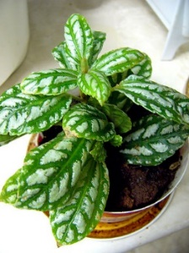
What Do Plants Need?
From their environment, plants need to get …
… to live and grow.
Photograph by Phillipe Giabbanelli/Wikimedia Commons
Notes:
1 min
a. “This bubble map is used in lesson 4b to help students summarize what plants need from their environment to live and grow.”
b. “Students list only three things, but you may come up with more. What would you say are the most important things that plants need from their environment to live and grow?”
c. As participants share their ideas, record them on chart paper.
Ideal student response: sunlight, air, water
Ideal participant response: sunlight, carbon dioxide, oxygen, water

Slide 24
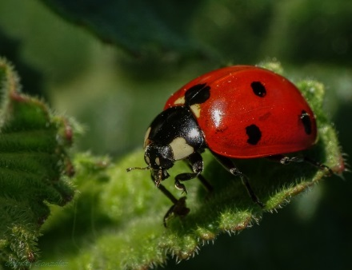
What Do Animals Need?
From their environment, animals need to get …
… to live and grow.
Photograph by Gabriel Gonzalez/Wikimedia Commons
Notes:
1 min
a. “What would you say are the most important things that animals need from their environment? We expect students to list only three things, but you may come up with more.”
c. As participants share their ideas, record them on chart paper.
Ideal student response: sunlight, air, water
Ideal participant response: sunlight, carbon dioxide, oxygen, water

Slide 25
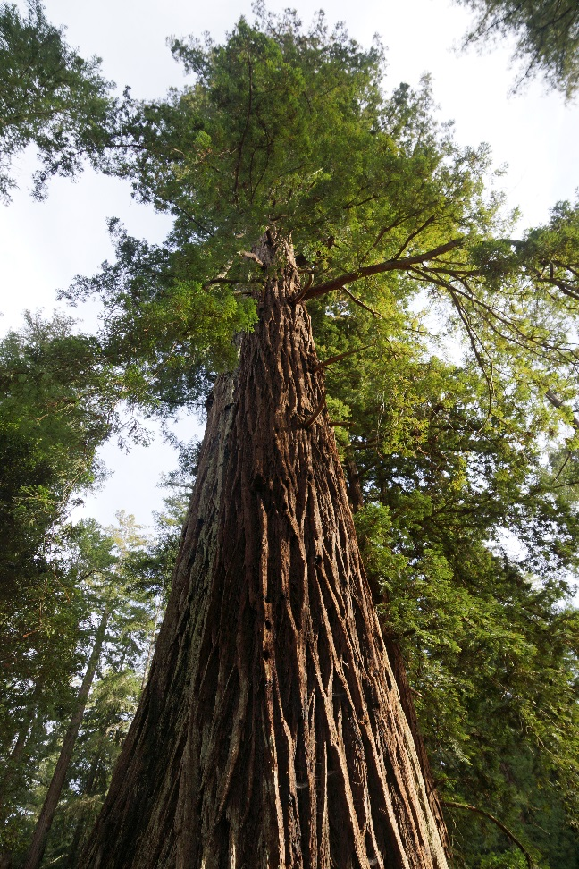
Let’s Compare Plants and Animals!
How do this ladybug and the redwood tree get food from their environment?
Resources: Your notes and section 4 of the content background document.
Photograph by Gabriel Gonzalez/Wikimedia Commons
Photograph by Allie Caulfield/Wikimedia Commons
Notes:
6 min
a. “Now let’s compare the needs of plants and animals. First, we’ll think about food.”
b. “How do this ladybug and the redwood tree get food from their environment?”
c. Pairs: “Discuss this question with an elbow partner and work together to make a comparison. You may use your notes and the content background document as resources to support your ideas. Be prepared to share your comparisons and evidence with the group.”
d. Whole group: Invite pairs to share their comparisons with the group and challenge participants to offer constructive feedback and critiques.
Key ideas:
The redwood tree makes its own food. During photosynthesis, cells in the leaf rearrange carbon-dioxide and water molecules in the presence of light energy to make energy-supplying glucose molecules (food) and oxygen.
Ladybugs can’t make their own food like the redwood tree. They have to get food to eat from their environment, including plants and other insects like aphids.

Slide 26
Let’s Compare Plants and Animals!
Why do ladybugs and redwood trees need air and food? Highlight similarities and differences.
Resources: Your notes and section 4 of the content background document.
Photograph by Gabriel Gonzalez/Wikimedia Commons
Photograph by Allie Caulfield/Wikimedia Commons
Notes:
6 min
a. “Why do ladybugs and redwood trees need air and food?”
b. Pairs: “Discuss this question with an elbow partner and work together to make a comparison that highlights similarities and differences. You may use your notes and the content background document as resources to support your ideas. Be prepared to share your comparisons and evidence with the group.”
c. Whole group: Invite pairs to share their comparisons with the group and challenge participants to offer constructive feedback and critiques.
Key ideas:
The cells of both ladybugs and redwood trees need oxygen and food molecules to carry out cellular respiration. In each cell, the oxygen and food molecules react to release energy that can be used for life functions. This reaction (cellular respiration) is identical in plants and animals.
In addition to oxygen, plants need carbon dioxide from their environment to make food through photosynthesis. This is a key difference between plants and animals.

Slide 27
Ladybugs: A Closer Look
H₂O
CO₂
Air
(Oxygen)
Generate ATP
(ATP-stores energy)
Food
(Glucose)
A ladybug breathes through tiny holes called spiracles on the sides of its abdomen and thorax
Photo courtesy of maxpixel.net
Notes:
Less than 1 min
a. “This slide summarizes what ladybugs do with food molecules and oxygen. The animation also illustrates why ladybugs need these things.”
b. Show the animation several times so that participants understand what happens.
c. Highlight the key idea at the bottom of the slide.

Slide 28
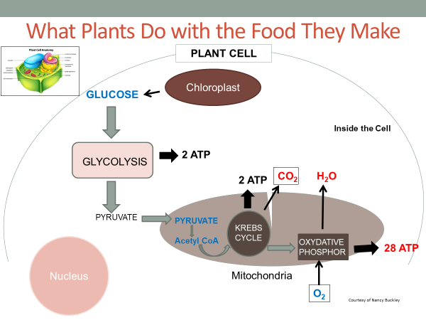
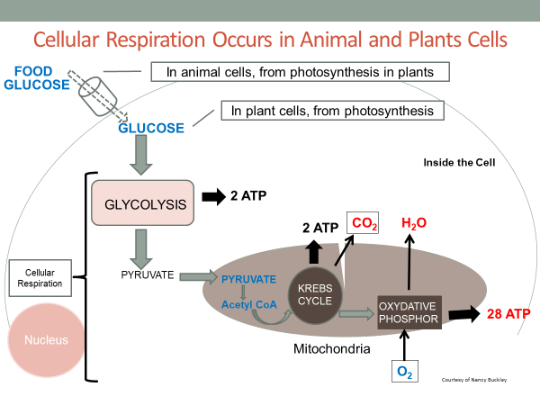
Cellular Respiration in Plants and Animals
Courtesy of Nancy Buckley
Notes:
1 min
a. “Remember these diagrams of cellular respiration in plants and animals from our last session? What similarities and differences did we observe?”
Key ideas:
Cellular respiration is identical in plants and animals.
The key difference is how plants and animals get the food they need for this process. Plants use sunlight, carbon dioxide, and water to make their own food, but animals must get food from their environment. Animals also depend on plants to make the food they need.

Slide 29
Cellular Respiration Occurs in Animal and Plants Cells
FOOD
In animal cells, from photosynthesis in plants
GLUCOSE
In plant cells, from photosynthesis
GLUCOSE
Inside the Cell
2 ATP
GLYCOLYSIS
2 ATP
CO₂
H₂O
Cellular
Respiration
PYRUVATE
PYRUVATE
Acetyl CoA
KREBS
CYCLE
Nucleus
OXYDATIVE
PHOSPHOR
28 ATP
Mitochondria
O₂
Courtesy of Nancy Buckley
Notes:
Less than 1 min
a. “This diagram summarizes the key difference between plants and animals in cellular respiration.”
b. Emphasize that both plant and animal cells carry out cellular respiration, and this process is identical in plants and animals. The only difference is that the food molecules (glucose) in plant cells come from the plant itself as a product of photosynthesis inside the chloroplasts of the plant leaves. The food molecules in animal cells come from the food animals take in from their environment (plants or other animals that have eaten plants). Ultimately, the food molecules in both plant and animal cells come from photosynthesis in plants.
Source:
http://www.ncbi.nlm.nih.gov/books/NBK9903/

Slide 30
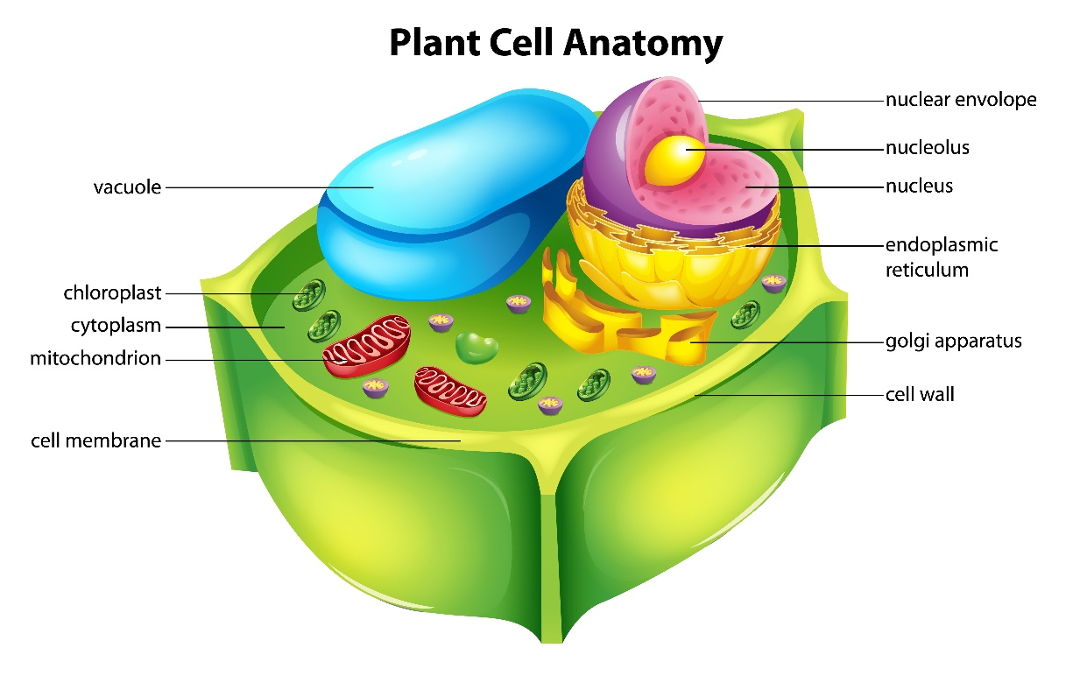
Compare: Animal and Plant Cells
Animal Cell
Nucleus
Plant Cell
Cell Membrane
Chloroplast
Cell Wall
Courtesy of Wikia.com
Mitochondria
Courtesy of Stock.Adobe.com
Notes:
Less than 1 min
a. “What does this diagram highlight?”
Ideal response: The red captions highlight the similarities between animal and plant cells, and the green captions highlight the key differences.

Slide 31
Let’s Compare Plants and Animals!
Why do ladybugs and redwood trees need water? Highlight similarities and differences.
Resources: Your notes and section 4 of the content background document.
Photograph by Gabriel Gonzalez/Wikimedia Commons
Photograph by Allie Caulfield/Wikimedia Commons
Notes:
6 min
a. “Why do ladybugs and redwood trees need water?”
b. Pairs: “Discuss this question with an elbow partner and work together to make a comparison that highlights similarities and differences. You may use your notes and the content background document as resources to support your ideas. Be prepared to share your comparisons and evidence with the group.”
c. Whole group: Invite pairs to share their comparisons with the group and challenge participants to offer constructive feedback and critiques.
Key ideas:
Differences:
Plants need water for photosynthesis.
Water also helps maintain turgor pressure so that plants can stand upright to get sunlight.
Similarities:
Water is a solvent that helps move materials, such as food and minerals, throughout an organism via the blood and transpiration.
Water supports life processes.
Most of the cell substance is water.
Water is used as a cooling mechanism.

Slide 32
Reflect: Content Deepening Focus Question 1
What are the similarities and differences between animals and plants?
Notes:
Less than 1 min
a. Review the focus question on the slide.
b. “To answer this question, you’ll summarize your understandings of the similarities and differences between plants and animals we’ve explored in our content deepening work this week.”

Slide 33
Show What You Know!
Use everything you’ve learned this week about plants and animals to draw a representation illustrating key similarities and differences between plants and animals.
Write a summary statement in complete sentences at the bottom of your diagram.
Be prepared to present and explain your content representation to the group.
Goal: To help solidify our understandings of the P&A science content
Notes:
10 min
a. “Next, we’ll conclude our science content deepening work by summarizing our understandings of the similarities and differences between plants and animals.”
b. “In this activity, use everything you’ve learned this week about plants and animals to draw a representation illustrating key similarities and differences between plants and animals. Then write a summary statement in complete sentences at the bottom of your diagram. Afterward, each of you will present and explain your content representation to the group, and others will have an opportunity to ask questions and offer feedback. Our goal for this summarizing activity is to help one another solidify our understandings of the Plants and Animals science content.”
c. As participants work on their diagrams, circulate around the room and note any confusion, inaccuracies, or misconceptions regarding the science content that need to be addressed during the group discussion.

Slide 34
Show What You Know!
Presenters:
Each of you will have 1–2 minutes to present your content representation to the group.
Make sure your explanation highlights the similarities and differences between plants and animals.
Listeners:
Ask probe and challenge questions to clarify what the presenter thinks and to address possible inaccuracies.
Suggest additions or modifications that might improve the representation.
Comment on what you found helpful.
Notes:
10 min
a. Read through the presentation protocol on the slide.
b. Allow 1–2 minutes for each presentation, followed by 1–2 min for questions, comments, and feedback.
c. Make sure to ask challenge questions to address any content inaccuracies, misconceptions, or confusion. If questions don’t resolve the issues, explicitly correct the errors.
d. The content representations should include these basic ideas:
1. Cells
Plants and animals are multicellular organisms.
Plant cells are different from animal cells because they have cell walls and chloroplasts, where photosynthesis takes place.
2. Food
Both plant and animal cells need food to live and grow.
Food is matter (building materials) that contains stored energy living things can use to live and grow.
Unlike animals, plants use sunlight, water, and air to make their own food inside their leaves through photosynthesis.
Animals can’t make their own food. They must get food from their environment by eating plants and other animals.
All of the food animals consume can ultimately be traced back to plants.
3. Air
Both plant and animal cells need air from their environment to live and grow.
Both plant and animal cells need oxygen for cellular respiration.
Green plant cells also need carbon dioxide to make food during photosynthesis.
4. Water
Both plant and animal cells need water from their environment to live and grow.
Plants and animals use water for a variety of similar purposes, but only plants can use water to make food.
5. Cellular Respiration
All living cells in both plants and animals need oxygen and food molecules. These molecules react during cellular respiration to release the stored energy in food molecules. This is how living things get the energy they need to carry out all of their life functions.
In addition to energy, carbon dioxide and water are also produced during this reaction.

Slide 35
Plants and Animals
MATH CONTENT DEEPENING Kindergarten
Notes:
Less than 1 min
a. “Next we’ll engage in some math content deepening that will challenge us to apply Common Core standards related to counting, comparing, and sorting.”
Note: Throughout the first half of this content deepening section, refer as needed to the content background document, Common Student Ideas about Plants and Animals, and Plants and Animals: Learning Goals for Students and Teachers.
Timing note: At this point, you should have approximately 90–100 minutes left (60–70 minutes for math content deepening and 30 minutes for closing and celebration activities). If you’re running short on time, you’ll need to skip some of the math content deepening slides.
Math Content Writer: Dr. Laurie Riggs
Lriggs@cpp.edu

Slide 36
Content Deepening: Focus Question 2
What are rich, challenging mathematical tasks related to sorting?
Notes:
Less than 1 min
a. Read the question on the slide.
b. “Before we dig into the math content that addresses this question, let’s review some Common Core Mathematics Standards that relate to the Plants and Animals unit.”
Note: If participants are already familiar with the Common Core standards, or if time is running short, you may want to skip this review or run through it quickly.

Slide 37
Common Core Math Standards: Counting and Cardinality
Know number names and the count sequence.
A.1. Count to 100 by ones and by tens.
A.2. Count forward beginning from a given number within the known sequence (instead of having to begin at 1).
A.3. Write numbers from 0 to 20. Represent a number of objects with a written numeral 0–20 (with 0 representing a count of no objects).
Notes:
Less than 1 min
a. Read through the math standards on the slide.
b. Ask participants if they have any questions or comments.

Slide 38
Common Core Math Standards: Counting and Cardinality
Count to tell the number of objects.
B.4. Understand the relationship between numbers and quantities; connect counting to cardinality.
B.4.A. When counting objects, say the number names in the standard order, pairing each object with one and only one number name and each number name with one and only one object.
B.4.B. Understand that the last number name said tells the number of objects counted. The number of objects is the same regardless of their arrangement or the order in which they were counted.
B.4.C. Understand that each successive number name refers to a quantity that is one larger.
Notes:
Less than 1 min
a. Read through the math standards on the slide.
b. Ask participants if they have any questions or comments, especially about which of these standards may be challenging for students.

Slide 39
Common Core Math Standards: Counting and Cardinality
Count to tell the number of objects.
B.5. Count to answer “how many?” questions about as many as 20 things arranged in a line, a rectangular array, or a circle, or as many as 10 things in a scattered configuration; given a number from 1–20, count out that many objects.
Compare numbers.
C.6. Identify whether the number of objects in one group is greater than, less than, or equal to the number of objects in another group, e.g., by using matching and counting strategies.
C.7. Compare two numbers between 1 and 10 presented as written numerals.
Notes:
Less than 1 min
a. Read through the math standards on the slide.
b. Ask participants if they have any questions or comments, especially about which of these standards may be challenging for students.

Slide 40
Common Core Math Standards: Measurement and Data
Describe and compare measurable attributes.
A.1. Describe measurable attributes of objects, such as length or weight. Describe several measurable attributes of a single object.
A.2. Directly compare two objects with a measurable attribute in common, to see which object has “more of”/”less of” the attribute, and describe the difference.
Classify objects and count the number of objects in each category.
B.3. Classify objects into given categories; count the numbers of objects in each category and sort the categories by count.
Notes:
Less than 1 min
a. Read through the math standards on the slide.
b. Ask participants if they have any questions or comments, especially about which of these standards may be challenging for students.

Slide 41
Math and Science Connections
What possible math tasks (such as sorting, classifying, counting, and comparing) could be included in the Plants and Animals unit?
Share some ideas with an elbow partner.
Be prepared to share with the group.
Notes:
4 min
a. Pose the question on the slide.
b. Pairs: Have participants share their ideas with an elbow partner.
c. Whole group: Invite participants to share their ideas with the group. Record key ideas on chart paper.
Example:
Counting and sorting things in the terrarium into categories (e.g., plants and animals; living and nonliving things)

Slide 42
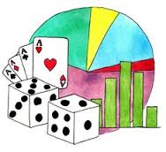
Common Core Standards of Mathematical Practice
Locate handout 8.6 (Common Core Standards of Mathematical Practice) in your PD program binder.
Read the practice standards on the handout.
Think about these questions:
Which standards might relate to the activities in the P&A lessons?
What are the benefits of incorporating rich math tasks into the lessons?
Notes:
4 min
a. Have participants locate handout 8.6 (Common Core Standards of Mathematical Practice) in their PD program binders.
b. Individuals: Have participants read the standards on the handout and consider which standards might relate to the activities in the P&A lessons.
c. Whole group: Invite participants to share their ideas with the group. Record key ideas on chart paper.
d. Emphasize that rich math tasks are a great way to support student thinking and address the Common Core math practices while building science-content knowledge. They’re also an excellent formative assessment tool.

Slide 43
Barriers to Critical Thinking
Think about this excerpt:
If we want students to develop the capacity to think, reason, and problem solve, then we need to start with high-level, cognitively complex tasks. (Instructional tasks and the development of student capacity to think and reason, Stein & Lane, 1996)
We should engage students in critical-thinking tasks early on, but what are the barriers to helping students develop critical-thinking skills?
Notes:
2 min
a. Read the excerpt and question on the slide.
b. Individuals: Give participants a minute of think time to consider the follow-up question.
c. Whole group: Invite participant to share their ideas about the barriers to helping students develop critical-thinking skills.
Possible response: Some students haven’t been challenged to think.

Slide 44
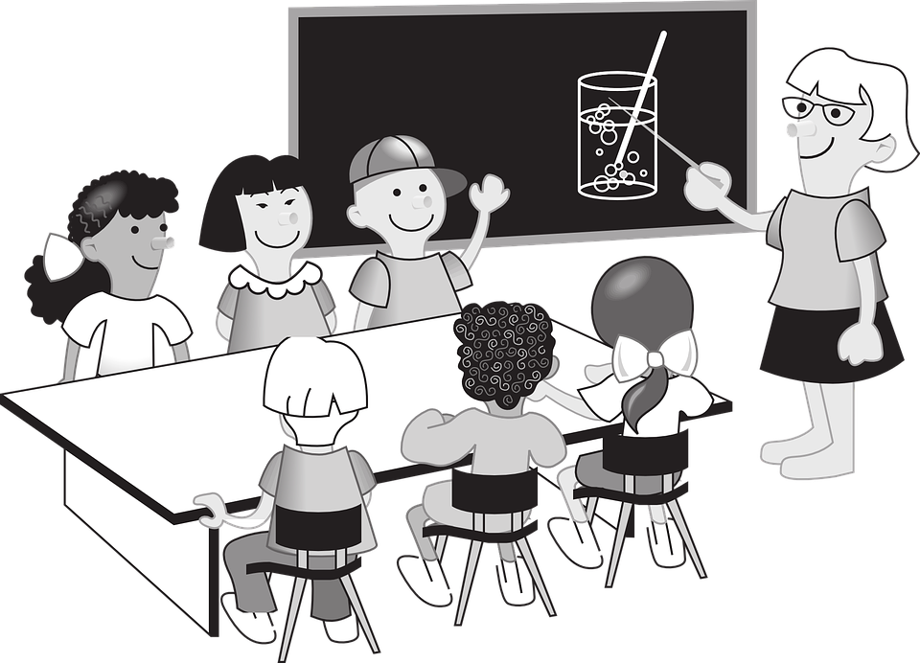
On the Light Side
You should all be free thinking, inventive individuals who will do exactly what I say.
Courtesy of pixabay.com
Notes:
Less than 1 min
a. Inject a little humor into the discussion by sharing the cartoon on the slide.

Slide 45
Classifying and Sorting
Classifying refers to ordering or arranging objects into sets (or classes) based on their relationships.
Sorting tasks can take place after the ordering criteria are determined.
Notes:
Less than 1 min
a. Discuss the distinctions on the slide between classifying and sorting.
b. Emphasize that classifying is more open ended and is based on student ideas and perceptions. Sorting tasks can take place once the ordering criteria are determined.

Slide 46
Rich and Challenging Math Tasks
Are you ready to tackle some rich math tasks that will challenge your thinking … and might just make smoke come out of your ears?
Photo courtesy of Goodfreephotos.com
Notes:
Less than 1 min
a. “Are you ready to tackle some rich math tasks that will challenge your thinking and might just make smoke come out of your ears?”
b. Emphasize that the tasks they’ll be engaging in aren’t intended for use in primary classes, but students in intermediate classes could tackle them.

Slide 47
Classifying Triangles
Notes:
2 min
a. “What are some different ways we could classify these triangles?”
b. Individuals: Give participants a minute of think time to consider different ways the triangles on the slide could be classified.
c. Whole group: Invite participants to share their ideas for classifying the triangles. Record their ideas on chart paper and ask probe questions to clarifying participants’ thinking.
Note: If size (area) doesn’t come up in the conversation, introduce it as a possible way to classify the triangles.

Slide 48
A Sorting and Classifying Challenge
Consider the following:
The area of the small square is 1 square unit.
What is the area of the small triangle?
The side length of the square is 1 unit.
The length of the hypotenuse of the triangle is not 1! (Hint: You can use the Pythagorean theorem to find it: a² + b² = c².)
Notes:
6 min
a. Have participants locate handout 8.7 (Triangle Challenge) in their PD program binders.
b. Introduce the two challenge tasks at the bottom of the handout. Task 1 involves determining the area of each triangle and then sorting the triangles from smallest to largest. Task 2 involves using two different criteria to categorize the triangles.
c. Encourage participants to embed the triangles in rectangles and then subtract areas that can be calculated. You might want to model how to do this with triangle B.
d. Walk participants through the parameters on the slide and note the following:
The area of the small triangle on the slide is 1/2 u².
The length of the hypotenuse of the triangle is the square root of 2 units.
e. The first task is challenging, so participants may not be able to complete both tasks on the handout. If any participants do finish the first task, encourage them to move on to the second task.
f. Let participants struggle with the first tasks for 2 or 3 minutes before moving on to the next two slides.

Slide 49
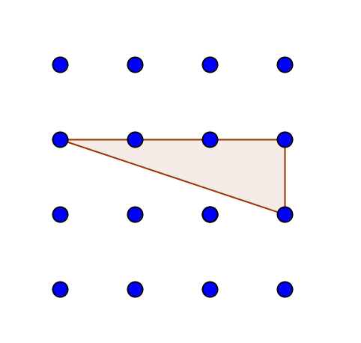
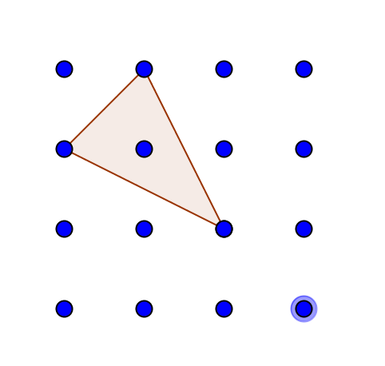
Calculating the Area of Triangles
The formula for calculating the area of a triangle:
Notes:
10 min
a. “Let’s think about some ways we can solve this challenge without using advanced calculations.”
b. Review the formula on the slide for calculating the area of a triangle.
c. Allow participants to wrestle with the task. Don’t rob them of the opportunity to figure this out on their own, but be prepared to offer suggestions and ask leading questions if some participants are struggling.

Slide 50
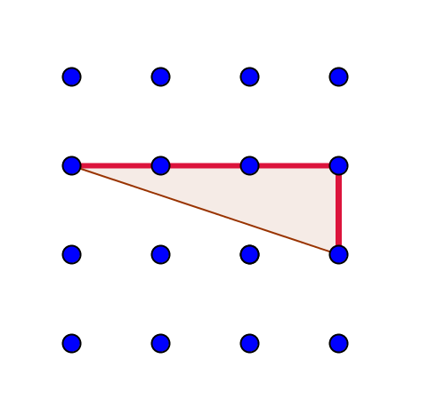
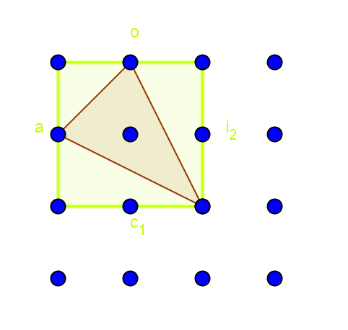
Hints for Calculating Area
The formula for calculating the area of a triangle:
Notes:
5 min
a. Give participants some hints for calculating the area of the triangles if some are still struggling.
b. Allow participants to continue working on the challenge individually or with a partner for another 5 minutes. Then reveal the answers on the next slide.

Slide 51
.5
2
1.5
2
Area (U²) | Triangle
.5 | (A)(J)
1 | (G)
1.5 | (C) (F)
2 | (B)(D)
2.5 | (I) (K)
3 | (E) (H)
3.5
4 | (L)
3
1.5
1
3
Area (U²) | Triangle
.5 | (J)
1 | (A) (G)
1.5 | (C) (F)
2 | (B)(D)
2.5 | (I) (K)
3 | (E) (H)
3.5
4 | (L)
2.5
.5
2.5
4
Notes:
5 min
a. Walk participants through the answer key on the slide that shows the area of each triangle on the handout.
b. Ask participants to sort the triangles from smallest to largest based on area.
c. Invite participants to ask questions or offer comments.

Slide 52
Criteria for Classifying Triangles
Notes:
3 min
a. Review the second task on the handout.
b. Elicit ideas from participants about two ways they could classify the triangles. Record ideas on chart paper.

Slide 53
Classifying Triangles
 | Acute | Right | Obtuse
Equilateral | _
Isosceles | (B) (L) | (A) (I) | (C)
Scalene | (E) (K) | (F) | (D)(G) (H)(J)
Notes:
3 min
a. Discuss the triangle classifications on the slide
Note: Participants may have classified the triangles differently. The two classifications that should be emphasized are the length of sides (equilateral, isosceles, and scalene) and internal angles (right, acute, and oblique).

Slide 54
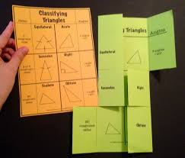
Why Do We Have Students Classify?
To organize objects in order to achieve economy of memory
To learn and describe the structure of and relationships among the objects in a class
To be able to compare and contrast different classes
To generate hypotheses about the objects in the class
Notes:
2 min
Note: Initially show only the question at the top of the slide.
a. “So why do we have students classify things? How does this relate to the Common Core standards?”
b. Elicit ideas from participants and record them on chart paper.
c. Then reveal the reasons on the slide and briefly discuss them.

Slide 55
A Sorting Challenge!
Notes:
6 min
a. “Next, let’s tackle a sorting challenge!”
b. Have participants consider the polygon placement on the slide and determine why some polygons are in the circle and some aren’t.
c. Think-Pair-Share: Give participants a minute to think about this task and then brainstorm with an elbow partner.
d. Whole group: Elicit a few ideas from participants before advancing to the next slide. This is a very challenging task, so participants may only come up with one or two ideas.

Slide 56
A Sorting Challenge!
The polygons inside the circle have at least two acute angles AND no parallel lines, unlike the polygons outside the circle.
Notes:
Less than 1 min
a. Read the solution on the slide.
b. Emphasize that there could be other ways to classify the polygons.

Slide 57
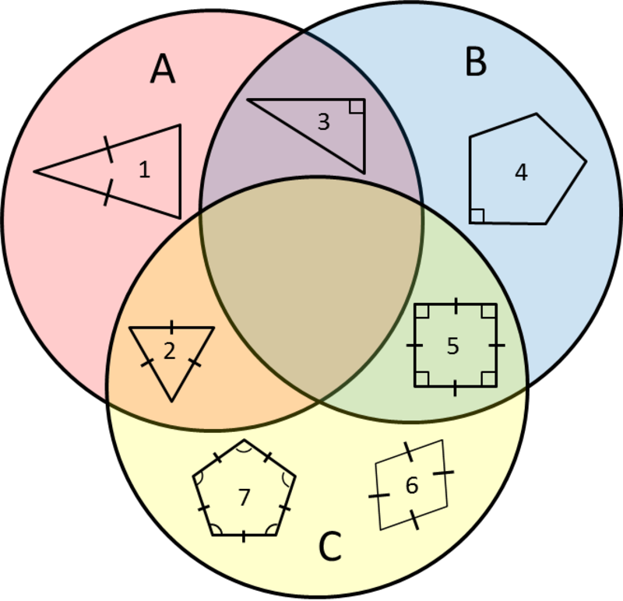
What Is the Classification Rule?
Notes:
2 min
a. Introduce the classification challenge on the slide.
b. Think-Pair-Share: Give participants a minute to consider the rule for each classification of the shapes and then share their ideas with an elbow partner.

Slide 58
What Is the Classification Rule?
A = triangle or three-sided polygon
B = polygon with at least one right angle
C = polygon with all the same side lengths
Notes:
Less than 1 min
a. Discuss the solution on the slide.
b. Ask participants if they have any questions or comments.

Slide 59
Challenge Questions
Where would you place a rectangle that doesn’t have four sides of the same length? Why?
Is there a polygon you would put in the intersection of all three categories?
Notes:
6 min
a. Read the challenge questions on the slide.
b. Pairs: Have participants discuss the questions with an elbow partner and share their ideas and reasoning.
c. Whole group: Invite participants to share their answers and reasoning with the group. Record key ideas on chart paper and ask probe and challenge questions to clarify participants’ thinking.
Key ideas:
Question 1: A rectangle that isn’t a square, or that doesn’t have equal sides, would only be placed in circle B (the light-blue section), not in the overlapping sections for circles A and C.
Question 1: A rectangle that had all of the same side lengths would be a square and would be placed in the overlapping section between circles B and C (the light-green section) that doesn’t include circle A.
Question 2: A polygon that would fit in the intersection of all three categories doesn’t exist, since it would have to be a triangle that has a right angle and all equal sides.

Slide 60
Guess My Rule
Using pattern blocks and sorting circles, can you design a classification rule for your partner to guess?
Think about how this task challenges you in a different way.
Notes:
10 min
a. Introduce the challenge task on the slide.
b. Individuals: This task will challenge participants to think about classification from the design side. Explain that participants will need to use pattern blocks and sorting circles to come up with classification rules.
c. Pairs: After participants finish their designs, have them pair up with an elbow partner and see if their partner can guess the rule.

Slide 61
Sorting Circles
How could we use sorting circles in the Plants and Animals lessons?
Consider when the circles would NOT overlap.
Which of the Common Core Math Standards could be included in the sorting tasks?
Notes:
4 min
a. “How could we use sorting circles in the Plants and Animals lessons? Be sure to consider when the circles wouldn’t overlap. Which of the Common Core Math Standards could be included in the sorting tasks?”
Examples:
Grouping living versus nonliving things in lesson 1b
Lessons 3a/b in relation to the experiments
Lessons 6a/b in relation to what plants and animals need
b. Pairs: “Talk about this with an elbow partner, and see if you can come up with some ideas.”
Note: Have participants refer to their lesson plans binders for this activity.
c. Whole group: Invite participants to share their ideas with the group. Record key ideas on chart paper.

Slide 62
Reflection Questions
What might sorting tasks look like in your class?
How could you use sorting activities to support the Plants and Animals science content and reinforce the Common Core Math Standards?
Notes:
4 min
a. Read the reflection questions on the slide.
b. Individuals: Have participants spend some time thinking about the reflection questions.
c. Whole group: Invite participants to share their answers and ideas with the group. Record key ideas on chart paper.

Slide 63
Today’s Focus Questions
How can science content storyline coherence be enhanced by explicitly implementing STeLLA strategy F (Make explicit links between science ideas and activities), strategy G (Link science ideas to other science ideas), and strategy H (Highlight key science ideas and focus question throughout)?
How will the Student Thinking Lens and Science Content Storyline Lens strategies help you teach the Plants and Animals lessons in the fall?
What are the similarities and differences between plants and animals?
What rich, challenging mathematical tasks can we use in our teaching that are related to sorting?
Notes:
10 min
a. Give participants a couple of minutes to think about today’s focus questions and then answer them in their notebooks.
b. If time allows, have a share-out of ideas.

Slide 64
Summarizing Science Content Storyline Lens Strategies
What does the organization of the summary chart in the STeLLA strategies booklet highlight about the Science Content Storyline Lens strategies?
Do you want to make any revisions or additions to our chart on effective science teaching?
Notes:
10 min
Note: Display one question at a time on the slide.
a. “This week we focused on the Science Content Storyline Lens and strategies. Let’s synthesize and summarize our learning by looking at the summary chart in your strategies booklet—Summary of the STeLLA Science Content Storyline Lens Strategies.”
Note: Participants may also refer to their SCSL Z-fold summary charts for this activity.
b. Individuals: “Look at this summary chart and how it’s organized. What do you think the organization highlights? Write your observations in your notebooks.”
c. Whole group: “What did you notice about the organization of this chart? What does it highlight about the science content storyline strategies?”
d. Reveal the second discussion question on the slide and invite participants to suggest additions or changes to the Effective Science Teaching chart.
Key ideas:
Many of the SCSL strategies must be completed during the lesson planning stage. For example, the main learning goal and activities that match them must be selected ahead of time.
Strategies B, F, G, H, and I are moves the teacher makes while teaching the lesson, but planning and anticipating how these strategies will help develop the lesson is critical to success.
The RESPeCT lesson plans provide examples of how strategies B, F, G, H, and I might be used during the lessons.
Strategies F, G, and H should be applied throughout the lesson. Strategy B is used at the beginning of a lesson, and strategy I is used at the end.
Each strategy has its own distinct purpose(s), but all of them contribute to creating a coherent science content storyline.

Slide 65
Let’s Celebrate!
Design your own end-of-program celebration and insert any comments or instructions here.
Notes:
10 min
a. Decide how you’ll celebrate the end of the RESPeCT PD program, and modify the slide accordingly. Here are a few ideas:
Have refreshments and toast the group’s success with a bubbly, nonalcoholic drink.
Have everyone write on an index card a “golden nugget” that represents something they’re taking away from the Summer Institute experience. Pass around a bowl filled with chocolates wrapped in gold paper, and have participants take a piece of chocolate when they drop their cards in the bowl. After the bowl is passed around, share the golden nuggets with the group.
Take a group photo.

Slide 66
Thank You!
Thank you for participating in the RESPeCT PD program!
Notes:
Less than 1 min
a. Before dismissing participants, thank them for participating in the RESPeCT PD program.

