Slide 1




RESPeCT PD pROGRAM
Day 1
RESPeCT Summer Institute
Notes:
5 min
a. Greet participants as they enter the room.
b. Help them find their notebooks and table tents.

Slide 2
Before We Dig In: Essentials
On-time session starts and endings
Sign-in sheets
Restrooms
Sustenance (lunch and snack breaks)
Questions or special needs?
Notes:
25 min for slides 2–14 presentation (averaging approximately 1 min per slide)
Give everyone a big welcome to the RESPeCT PD program!
Fill participants in on the essential details listed on the slide.

Slide 3
What Is RESPeCT?
Reinvigorating Elementary Science through a Partnership with California Teachers
A partnership built for long-term success!
A professional development program
A leadership development program
A research study
Notes:
Approximately 1 min
a. Emphasize: The RESPeCT project began with three main components:
A professional development program
A leadership development program
A research study
b. The district now sustains RESPeCT as a professional development program.

Slide 4

The RESPeCT Partnership
PUSD
CPP
PUSD:
Pomona Unified School District
CPP:
California State Polytechnic University, Pomona
Photo courtesy of Pixabay.com
BSCS
BSCS:
Biological Sciences Curriculum Study
Notes:
Approximately 1 min
a. The original RESPeCT partners included the following:
Cal Poly: science, science education, and mathematics faculty, as well as the Center for Excellence in Mathematics and Science Teaching (CEMaST)
PUSD: district central administrators, principals, teacher specialists, and teachers
BSCS: an additional partner located in Colorado that provides expertise on science curriculum development, science teacher professional development, and research on science teaching and learning.
Note: Established in 1958, BSCS stands for Biological Sciences Curriculum Study, but the organization now deals with all sciences, not just biology.
Students: Emphasize that students are at the center of this partnership. Their learning is what the project is all about.

Slide 5
The RESPeCT PD Program
  Builds on the successful Science Teachers Learning from Lesson Analysis (STeLLA) program
  Has a significant impact on student learning as demonstrated in two rigorous studies
  Teaches videocase-based lesson analysis
  Facilitates science-content deepening
Notes:
Approximately 1 min
a. Let participants know they’ll be learning more about the RESPeCT PD program and STeLLA teaching strategies as they experience firsthand what it means to perform videocase-based lesson analysis.

Slide 6
The RESPeCT PD Program
Extends the STeLLA approach by
  Addressing grade-level standards in Next Generation Science Standards (NGSS)
  Incorporating Common Core English language arts (ELA) and math standards
  Addressing more explicitly the needs of English language learners (ELLs)
  Addressing all grade levels, K–6
Notes:
Approximately 1 min
a. Read the information on the slide.
b. Emphasize the importance of these additions to the STeLLA approach. By integrating Common Core English language arts (ELA) and math standards into the science curriculum, the RESPeCT PD program enables teachers to invest more time in teaching science. The teaching strategies developed in the RESPeCT PD program are also valuable tools in other subject areas.

Slide 7
Goals of the RESPeCT PD Program
Deepen teachers’ science-content knowledge and knowledge of effective science teaching.
Develop teachers’ analytical skills to improve lesson-plan development and the teaching of science.
Support teachers in the practical use of new knowledge and analytical skills in their classrooms.
Improve students’ science learning.
Achieve sustainability by eventually reaching all
K–6 teachers.
Notes:
Approximately 1 min
a. The bottom line: improving students’ science learning—a goal that has been reached in two previous research studies of this approach.

Slide 8
Summer Institute Study-Group Leaders
Grade [Insert grade level here]
[Insert leader names here]
[Insert leader names here]
Notes:
Approximately 1 min
a. Modify this slide to include the grade level of your study group and the names of the Teacher Leaders who will be facilitating the study-group sessions.
b. Formally introduce yourselves to the group.

Slide 9

The Key
Each of us is key to the success of the
RESPeCT PD program!
Notes:
Approximately 1 min
a. Many people are involved in organizing, planning, and leading this program, but the teacher-participants are the key to its success.

Slide 10
Summer Institute Schedule
Notes:
Note: This is a transition slide.

Slide 11
Summer Institute: A Typical Daily Schedule
8:00 Getting started
8:30 Video-based lesson analysis
10:00 BREAK
10:10 Lesson analysis continued
12:00 LUNCH
12:45 Content deepening
2:00 BREAK
2:10 Content deepening continued
3:00 Wrap-up: homework, summary, reflections
3:30 Adjourn
Notes:
Approximately 1 min
a. A typical daily schedule includes the following:
Time spent on videocase lesson analysis
Time focused on content deepening
Short homework assignments
A morning and an afternoon break, with a 45-minute lunch break

Slide 12
Summer Institute at a Glance
Week 1: Content Area 1 (Weather and Seasons)
  Student Thinking Lens—strategies to make student thinking visible
  Analysis of video teaching in content area 1
  Analysis of lesson plans to be taught second semester
  Content deepening in content area 1
Week 2: Content Area 2 (Plants and Animals)
  Science Content Storyline Lens—strategies to create coherence
  Analysis of video teaching in content area 2
  Analysis of lesson plans to be taught in the fall
  Content deepening in content area 2
Notes:
Approximately 1 min
a. During the Summer Institute, each grade level will focus on two content areas, with one week devoted to each area. Participants will deepen their science-content knowledge, study lesson plans in each content area, and analyze videocases of teachers presenting this content.

Slide 13
School-Year Schedule
Fall [Insert year here]
Teach the first lesson set.
Meet three times as a study group (4 hours each).
Meet an additional time to review the second lesson-set plans (2 hours).
Winter/Spring [Insert year here]
Teach the second lesson set.
Meet three times as a study group (4 hours each).
Note: The study group will determine meeting dates and times.
Notes:
Approximately 1 min
a. “The Summer Institute is just the beginning! During the school year, you’ll continue meeting with your grade-level study group.”

Slide 14
Your RESPeCT PD Program Materials
Your science notebook
STeLLA strategies booklet
RESPeCT PD program binder
RESPeCT lesson plans binder
Materials kit (1 per topic)
Notes:
Approximately 1 min
a. Transition slide: “In a moment we’ll break up into grade-level study groups and dig into the RESPeCT PD program! But first let’s review this list of materials you’ll receive in your designated meeting rooms.”

Slide 15
Transition to Grade-Level Study Groups
Any questions before we break up into our grade-level study groups?
Notes:
5 min
a. “Any questions before we head to our grade-level study groups?”
b. Send-off: “Have a great day and be sure to let us know if there is anything we can do to support you in getting the most out of this experience!”

Slide 16
Notebook Setup
Write your name on the front cover of the notebook.
Leave two or three pages for the table of contents. (You’ll add to the TOC each day throughout the program.)
Number your pages. (Front and back pages should be numbered separately.)
Use sticky tabs to divide your notebook into two main sections: Lesson Analysis and Content Deepening. (Each section will comprise about half the notebook.)
Keep a chronological record of your activity in each section. Add a title for each entry and enter in your TOC to easily locate.
Customize and decorate your notebook any way you wish.
Notes:
8 min
a. Welcome participants to the study group and introduce yourself as they arrive.
b. Help participants find their table tents and materials so they can get settled.
c. Direct them to the instructions for setting up their notebooks (Setting Up Your Summer Institute Notebook in the pretabs section of their PD program binders) and get them started working on this task. Interact informally with them and allow them to chitchat as they work.

Slide 17
Getting Started: Introductions
Quick-write exercise:
  Describe your experience learning science in school.
  What do you hope to learn through RESPeCT in the coming year?
Share your responses with a partner.
Introduce each other to the group.
Notes:
15 min
a. Individuals (3 min): Have participants write their responses to the questions on the slide in their notebooks. Emphasize that this is an independent writing exercise.
b. Pairs (3 min): Have participants pair up and share their responses to the questions. Encourage them to learn other things about their partners as well (e.g., school, years of teaching, favorite subjects to teach, hobbies).
Note: If the group has an odd number of participants, pair up with one of them.
c. Whole group (9 min): Have each participant introduce her or his partner, highlighting what that partner hopes to learn from the RESPeCT PD program. Model the first pair of introductions to demonstrate that they should be brief.
Note: If you weren’t able to pair up with someone, simply introduce yourself.
Monitor the time: Introductions should be longer than a sentence, but not the length of a full essay!

Slide 18
RESPeCT PD Program Goals
Business-as-Usual PD
Not closely linked to day-to-day classroom teaching
Rarely see other teachers practice
Learning about content separate from learning about teaching
RESPeCT PD Program
Learn science content in the context of analyzing teaching and student learning.
Engage with one another
in a collaborative analysis of content-specific videocases
of other teachers.
Learn science content in the context of analyzing teaching and student learning.
Notes:
2 min
a. Talk through this slide, emphasizing how RESPeCT PD is different from many other professional development opportunities.

Slide 19
RESPeCT PD Program Goals: Lesson Analysis PD
Business-as-Usual PD
Focus on what to do tomorrow and “cool” activities
Development not sustained over time
Effectiveness measured in terms of teachers’ enjoyment
RESPeCT Lesson Analysis PD
Learn how to select and carry out science activities based on analysis of science content and student thinking and learning.
Be supported in using new teaching knowledge throughout the year.
Measure effectiveness in terms of teacher and student learning.
Notes:
1 min
a. Highlight the goals of RESPeCT lesson analysis PD and how it differs from other professional development opportunities.

Slide 20
Norms for Working Together: The Basics
Purpose: Build trust and develop a productive study group for all participants.
The Basics
Arrive prepared and on time; stay for the duration; return from breaks on time.
Remain attentive, thoughtful, and respectful; engage and be present.
Eliminate interruptions (turn off cell phones, email, and other electronic devices; avoid sidebar conversations).
Make room for everyone to participate (monitor your floor time).
Notes:
3 min
a. “To do this kind of work together, we need to develop a strong study group where everyone feels safe sharing their ideas, questions, confusion, successes, and stumbles. Having a set of agreed-upon norms will help us build such a learning community.”
b. Read over these basic norms.
c. “What do you think? Are there any changes or additions you’d like to suggest?”

Slide 21
Norms for Working Together: The Heart
Purpose: Build trust and develop a productive study group for all participants.
The Heart of RESPeCT Lesson Analysis and Content
Deepening
Keep the goal in mind: analysis of teaching to improve student learning.
Share your ideas, uncertainties, confusion, disagreements, questions, and good humor. All points of view are welcome.
Expect and ask questions to deepen everyone’s learning; be constructively challenging.
Listen carefully; seek to understand other participants’ points of view.
Notes:
5 min
a. “This set of norms moves beyond the basics and targets the heart of RESPeCT PD program goals.”
b. Read the list.
c. “Is anything unclear? Do you have any changes or additions you’d like to suggest? Do you have any concerns about these norms?”
d. Direct participants to handout 1.1 (Norms for Working Together) and pass out the half-page copy of the norms for them to paste on the inside front cover of their notebooks.
e. Ask participants if they’re willing to live with these norms today; then tell them they’ll have an opportunity to revise them tomorrow.

Slide 22
Agenda for Day 1
Focus questions and ideas about effective science teaching
The case for the Science Content Storyline Lens (SCSL)
The case for the Student Thinking Lens (STL)
Content deepening: weather and seasons
Lunch
Content deepening (continued)
STL strategies: elicit, probe, and challenge questions
Summary, homework, and reflections
Notes:
Less than 1 min
a. Talk through the agenda for the day.

Slide 23
Today’s Focus Questions
Lesson Analysis
Content Deepening
What are the STeLLA lenses and teaching strategies, and what is the evidence that they will make a difference in your science teaching?
What is weather?
How is weather different from climate?
What are weather patterns?
Notes:
1 min
a. “Each day we’re going to have at least one lesson analysis focus question and one content deepening focus question. These are today’s focus questions.”
b. Read the focus questions on the slide.

Slide 24
Ideas about Effective Science Teaching
What is your image of effective science teaching?
  What does it look like in action?
  What are key features of good science teaching?
Notes:
15 min
a. “Before we explore these questions, let’s create a list of ideas about effective science teaching.”
b. Individuals (3 min): “Take a few minutes to think and write about the questions on the slide.”
c. Whole group (10 min): Go around the group (round-robin) asking everyone to contribute an idea. Write the ideas on a chart paper and title the chart “Effective Science Teaching.”
d. “Throughout the sessions, we’ll revisit this list to add new ideas, clarify our thinking, and make other modifications.”

Slide 25

Lesson Analysis Focus Question
What are the STeLLA lenses and teaching strategies, and what is the evidence that they will make a difference in your science teaching?
Student
Thinking Lens
Science
Content
Storyline Lens
Notes:
2 min
a. “This PD program will focus on two lenses as analytical tools to guide our learning: the Student Thinking Lens and the Science Content Storyline Lens.”
b. “Today we’re going to examine why these two lenses were chosen for our focus.”
c. “Let’s begin with the Science Content Storyline Lens.”

Slide 26
TIMSS Video-Study Questions
What does science teaching look like in different countries?
What can we learn from looking at science-teaching practice in higher-achieving countries?
Notes:
2 min
a. “A large video study of science teaching in different countries revealed the importance of the Science Content Storyline Lens.”
b. “The TIMSS video study explored the research questions on this slide.”
Background info:
TIMSS stands for Trends in Mathematics and Science Study.
TIMSS is known for its achievement studies comparing student performance in math and science internationally.

Slide 27
TIMSS Video-Study Comparisons
The study compared science teaching in the United States with science teaching in these higher-achieving countries:
Australia
Czech Republic
Japan
Notes:
2 min
a. “Australia, the Czech Republic, and Japan are higher-achieving countries in science compared to the United States.”
b. “In these countries, 100 eighth-grade lessons were randomly video recorded. The goal was to describe typical science teaching in each country.”

Slide 28
TIMSS Video-Study Results
Although each higher-achieving country had its own approach, they all had strategies for engaging students with core science concepts and ideas.
In US lessons, content played a less central role, and sometimes no role at all. Instead, lessons engaged students in carrying out a variety of activities.
Notes:
2 min
a. “The TIMSS video study showed these results.”

Slide 29
TIMSS Video-Study Results
Although each higher-achieving country had its own approach, they all had strategies for engaging students with core science concepts and ideas.
In US lessons, content played a less central role, and sometimes no role at all. Instead, lessons engaged students in carrying out a variety of activities.
Notes:
2 min
a. Call attention to the text highlighted in red to emphasize the difference between US science lessons and science lessons in higher-achieving countries.

Slide 30
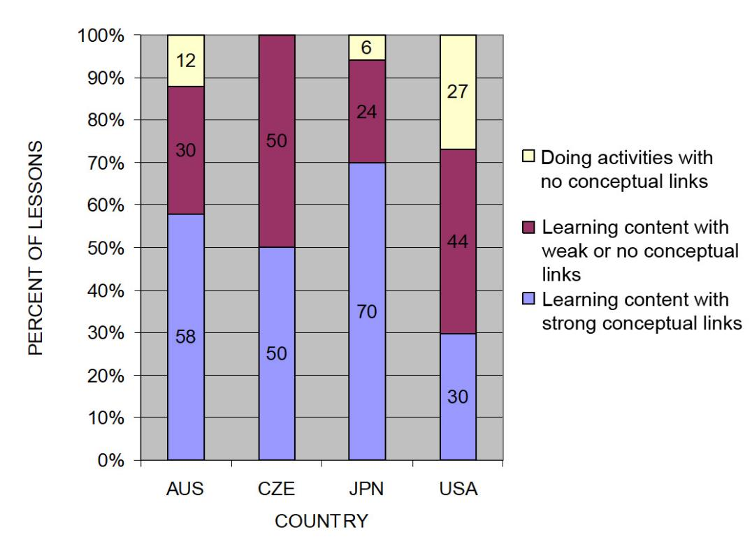
TIMSS: Conceptual Links
Source: TIMSS study
Notes:
3 min
a. Ask: “What do you notice from this graph? What do you make of this data?”
b. Emphasize: “In the US, more than a quarter of the lessons had no science content; whereas in the other countries, the majority of the randomly selected lessons (or typical lessons) had content with strong conceptual links.”
c. Example of a lesson with no science content: “What’s a science lesson with no content? In this research, a lesson with at least one complete statement of a science idea was scored as ‘learning content.’ Lessons with ‘no content’ had only topic-level mentions of science concepts. For example, one teacher started a lesson by telling students to take out their rockets and get to work. They had directions to follow, but the teacher’s only focus in his interactions with students was on how to build the rockets. At the end of the lesson, he told students to clean up and then dismissed them. This is a lesson with no science content!”
Other key ideas to highlight:
Each higher-achieving country engaged students with core science concepts and ideas (more consistently than the US).
All the higher-achieving countries linked ideas and activities (more consistently than the US).
In US lessons, the focus was on performing activities with less attention to content and even less attention to linking activities and science ideas.

Slide 31
What Makes a Difference?
Watch two video clips of 8th-grade science:
  A US classroom
  A Japanese classroom
What did you notice about these two classrooms?
In which classroom are students more likely to learn? Why do you think so?
Link to TIMSS US video clip: 1.1_TIMSS_US_Lesson3_c1
Link to TIMSS Japan video clip: 1.2_TIMSS_Japan_Lesson_c1_1
Notes:
20 min
a. Direct participants to the transcripts for Video Clips 1.1 and 1.2 (handouts 1.2 and 1.3) before showing each clip.
b. Show US classroom video: Ask participants to focus on what is going on with the science content and storyline.
c. Discuss: “What did you notice?”
Key ideas to emphasize and link back to results include the following:
The teacher focuses on the activity and the procedure needed to complete the activity.
The teacher and students place no real focus on important science ideas.
There’s only a topic-level mention of science ideas (“pulleys,” “effort distance,” “resistance force”).
d. Show Japanese classroom video: Ask participants to focus on what is going on with the science content.
e. Discuss: “What did you notice?”
Key ideas to emphasize and link back to results include the following:
Content ideas are made clear to students (focus question, pairs talk) before doing any activity.
Students are asked to talk about science ideas, not just procedures.
The lesson purpose is made clear to students.
f. Ending discussion: “In which classroom are students more likely to learn science concepts? Why?”
Note: Participants may be critical of both classrooms because student thinking isn’t made visible. This is true, but bring their focus back to the science content and storyline. They should see a clear distinction between the science content storylines in the Japanese and US lessons. Students in the Japanese classroom are more likely to learn because science-content ideas are made visible, and students are engaged in thinking about these ideas, not just science activities.

Slide 32
The TIMSS Findings Show …
Each higher-achieving country engaged students with core science concepts and ideas.
All the higher-achieving countries linked ideas and activities.
In US lessons, the focus was on performing activities with less attention to content and even less attention to linking activities and science ideas.
Notes:
1 min
a. Use this slide and the next to summarize key ideas from the TIMSS video study.

Slide 33
What Can We Learn from the Research?
A coherent science content storyline can …
make science ideas more prominent in science lessons,
  strengthen connections among science-content ideas,
  strengthen connections between science-content ideas and activities, and
improve lesson coherence by shaping science lessons as stories that make sense to students.
For more insights, see TIMSS Educational Leadership article, “What Science Teaching Looks Like: An International Perspective” (handout 1.4 in binder).
Notes:
1 min
a. After reading this slide, share with participants that the Science Content Storyline Lens addresses the need uncovered in the TIMSS video study: to strengthen the links between science ideas and lesson activities.
b. Encourage participants to read handout 1.4 (TIMSS Educational Leadership article) for further insight.

Slide 34
Discussion Questions
What new features can we add to our earlier description of effective science teaching?
Are there any ideas we should add to our list, modify, or delete?
Notes:
5 min
a. “What features on our list of ideas about effective science teaching are consistent with the TIMSS video-study findings?”
b. “Are there any ideas you’d like to add to our list, delete, or modify?”
Note: Use a different color to add/delete/modify ideas. Encourage participants to keep an open mind about changing their ideas. Provide opportunities for them to reflect on any changes and the reasons for those changes.
c. Transition: “During week 2 of the Summer Institute, we’ll focus on strategies for creating a strong, coherent science content storyline. This week, we’ll focus on the Student Thinking Lens. Right now, let’s consider the reasons for focusing on the Student Thinking Lens.”

Slide 35
Lesson Analysis Focus Question
What are the STeLLA lenses and teaching strategies, and what is the evidence that they will make a difference in your science teaching?
Student
Thinking
Lens
Science
Content
Storyline
Lens
Notes:
Less than 1 min
a. “At this point, we’ll transition from a focus on the Science Content Storyline Lens (SCSL) to the Student Thinking Lens (STL).”
b. “We’ll be focusing on the Student Thinking Lens the rest of the day and throughout this week.”

Slide 36
Research on How Students Learn
Respond in your notebooks to the following question:
    Imagine that a seed is planted in the ground and grows into a tree. Where does most of the matter come from that makes up the wood and leaves of the tree?
We won’t share our responses with the whole group.
Notes:
3 min
a. Individuals: Have participants answer the question on the slide in their science notebooks.
Background for PD leaders: Participants will likely have the same misconceptions revealed in the video, but they may not yet be comfortable sharing their confusion. At this point, don’t ask them to share their ideas with the group. It will be interesting to see if some of them voluntarily share their “wrong” ideas after they see the video.

Slide 37
Minds of Our Own
Minds of Our Own is a video that visually summarizes a large body of research on student learning in science classrooms.
As you watch, think about the following questions:
How do Harvard graduates answer the question about the mass of a tree? Is their response the same as or different from yours?
Does this give you any new ideas about effective science teaching?
Link to Minds of Our Own video clip.
Notes:
10 min
a. Read the information and instructions on the slide.
b. Watch the Minds of Our Own Lessons From Thin Air video. Total viewing time is approximately 10 minutes. (https://www.learner.org/series/minds-of-our-own/2-lessons-from-thin-air/?jwsource=cl)
MIT/Harvard interview—start at segment 3:30 and end at 5:40.
John preinterview, class, and post interview—start at segment 7:50 and end at 16:45.
Note: If time is short, stop after Phil Sadler. If you have enough time, you can show the entire segment from 3:30 to 16:45.

Slide 38
Discussion Questions
What did you notice in the Minds of Our Own video?
What does research on learning say to us about effective science teaching?
What new features can we add to our description of effective science teaching?
Notes:
15 min
a. There’s a lot to talk about in this video! Here are some additional questions you might pose:
Did John’s ideas about photosynthesis change through instruction?
What did the teacher say about his instruction?
What did the experts say?
How do the Harvard students’ responses compare with your own? What ideas does this give you about your own science learning experiences?
Key idea to emphasize: Research shows that we not only need to engage students in more thinking and sensemaking, but we also need to listen to their ideas—especially when they’re wrong—and use them to guide our instruction.
b. Modify the chart of ideas about effective science teaching as participants share features from the research.

Slide 39
What Can We Learn from the Research?
A Student Thinking Lens can …
reveal, support, and challenge student thinking throughout instruction;
provide opportunities for students to analyze and interpret data, as well as construct arguments and explanations;
engage students in making connections between ideas and activities; and
provide structures to teach students how to communicate in scientific ways.
For more insights, see “Synthesis of Research from How Students Learn: Science in the Classroom” (handout 1.5 in binder).
Notes:
2 min
“This slide nicely summarizes some of the ways we get students thinking and make their thinking visible.”
Note: Encourage participants to read handout 1.5 (“Synthesis of Research from How Students Learn: Science in the Classroom”) for further insight.
b. Transition: “Today we’ll start learning some particular strategies for making student thinking more prominent in science lessons.”
Background for PD leaders: The STeLLA conceptual framework addresses the need uncovered in this and other studies on how people learn and, more specifically, how students learn science:
If students’ initial knowledge is not engaged, they may fail to grasp the new concepts and information that are taught and may distort the new information to make it fit their prior experience.
This idea of learning with understanding has two parts: (1) factual knowledge must be placed in a conceptual framework (a big idea or a set of big ideas) organized in ways that enable students to use and apply that knowledge to make predictions, solve problems, explain new situations, and so forth; and (2) multiple representations that are rich in science ideas and details give concepts meaning.
This idea helps students monitor their developing understandings, engaging them in reflecting on their learning experiences, their changing ideas, and their remaining questions and musings.

Slide 40

WEATHER and Seasons
SCIENCE CONTENT DEEPENING Kindergarten
Notes:
Less than 1 min
a. “Now let’s begin our content deepening work on weather and seasons.”
Note: Throughout this content deepening phase, refer as needed to the Weather and Seasons Content Background Document, Common Student Ideas about Weather and Seasons, and Weather and Seasons: Learning Goals for Students and Teachers.

Slide 41
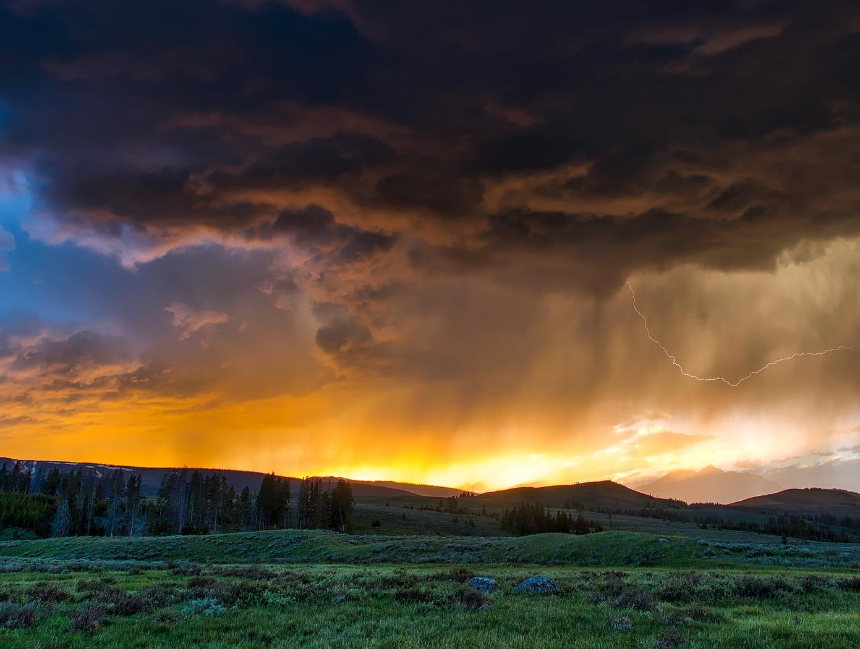
Weather and Seasons
Content Deepening
Day 1
Developed by
Dr. Jeff Marshall
Geological Sciences
Cal Poly Pomona
Used by permission
Photo courtesy of Pixabay.com
Photo courtesy of pixabay.com
Notes:
Less than 1 min
a. “Today’s content deepening work will focus on science ideas from prelessons and lesson 1 of the Weather and Seasons unit.”
b. “We’ll discuss this content at a higher level than we expect from kindergartners to deepen your understandings of the foundational concepts that will be built upon in subsequent grades.”
c. “We’ll also explore science concepts that are related to weather and seasons but aren’t part of this unit.”

Slide 42
Unit Central Questions
Is weather the same everywhere
all of the time? How do you know?
Notes:
4 min
a. Have participants locate prelesson 0a in their lesson plans binders and read the unit central questions and lesson focus question on the overview page (page 1).
b. Ask participants, “What is the difference between a unit central question and a lesson focus question?”
c. Elicit ideas from participants; then emphasize that a unit central question guides student thinking throughout the entire lesson series, while a lesson focus question guides student thinking in one or two lessons.
d. “The science concepts we explore in our content deepening sessions this week will help us answer the unit central questions our students will think about during the Weather and Seasons unit.”
e. To reinforce the practice they’ll follow with students, have participants write the unit central questions in their science notebooks and draw a double-lined box around them.

Slide 43
Weather and Seasons
Lesson 0
Photo courtesy of Pixabay.com
Photo courtesy of pixabay.com
Notes:
Less than 1 min
a. “First, we’ll explore science ideas about weather from the prelessons that students will complete in the fall before the Weather and Seasons unit begins in the spring. Students will begin making outdoor weather observations the first week of school and record their data on a class weather calendar.”

Slide 44
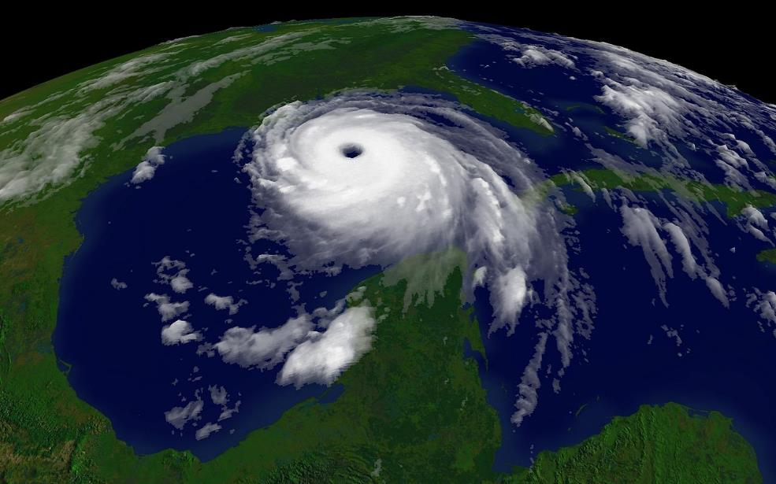
Content Deepening: Focus Question 1
  What is weather?
Courtesy of NOAA/Wikimedia Commons
Notes:
1 min
a. Read the focus question on the slide and emphasize that this question will guide student learning throughout lesson 0a.
b. Have participants write this question in their science notebooks and draw a box around it to reinforce the practice they’ll follow with students in the lessons. Make sure they leave space below the question to write a response later.

Slide 45
What Is Weather?
How would a kindergartner define the word weather?
What are some characteristics we use to describe weather?
Notes:
8 min
a. Read the questions on the slide.
b. Pairs: “Discuss these questions with an elbow partner; then work together to develop concise answers. Be prepared to share your ideas with the group.”
c. Whole group: Call on several pairs to share their responses to the questions. Elicit differing points of view and ask questions to probe and challenge participants’ thinking.
d. As participants share their ideas, record them on chart paper.
Key ideas:
Weather is what it looks like and feels like outside.
Weather includes temperature, sunlight, clouds, wind, and rain or snow.

Slide 46
Content Deepening: Focus Question 2
  How is weather different from climate?
Courtesy of NOAA/Wikimedia Commons
Notes:
1 min
a. Read the focus question on the slide.
b. “This question will launch us into an investigation that isn’t part of the Weather and Seasons lesson series but is designed to deepen our understandings of the key distinctions between weather and climate.”
c. Have participants write this question in their science notebooks and leave space to write a response later.

Slide 47
How Is Weather Different from Climate?
How would you define the words weather and climate?
What are some key differences between weather and climate?
Notes:
5 min
a. Read the questions on the slide.
b. Pairs: “Discuss these questions with an elbow partner; then work together to develop concise answers. Be prepared to share your definitions and ideas with the group.”

Slide 48
How Is Weather Different from Climate?
Similarities and Differences
Weather | Climate
Notes:
5 min
a. Create a two-column table on chart paper like the one on the slide.
b. Invite pairs to share their responses to the questions from the previous slide. Elicit differing points of view and ask questions to probe and challenge participants’ thinking.
c. As participants identify similarities and differences between weather and climate, record them on the table.
d. Ask the following questions during the discussion:
What are the key similarities between weather and climate?
What are the key differences?”
Why is it important for students to understand the differences between weather and climate?

Slide 49

Weather or Climate?
NOAA GOES 12 Satellite Image
Courtesy of NOAA/Wikimedia Commons
Hurricane Katrina—August 28, 2005
Notes:
4 min
a. “Next, we’ll explore the differences between weather and climate.”
b. “This slide shows a satellite image of Hurricane Katrina just before landfall on August 28, 2005.”
c. Ask participants, “Is this an example of weather or climate? Why do you think so?
d. Individuals (1 min): “Look at our table to see how we defined and described weather and climate and think about which definition matches the characteristics of this event.”
e. Whole group (3 min): Invite several participants to share their ideas and reasoning with the group. Encourage participants to respond to one another’s ideas by agreeing or disagreeing, asking questions, or offering alternative ideas.
f. Work toward a consensus regarding whether Hurricane Katrina is an example of weather or climate.

Slide 50
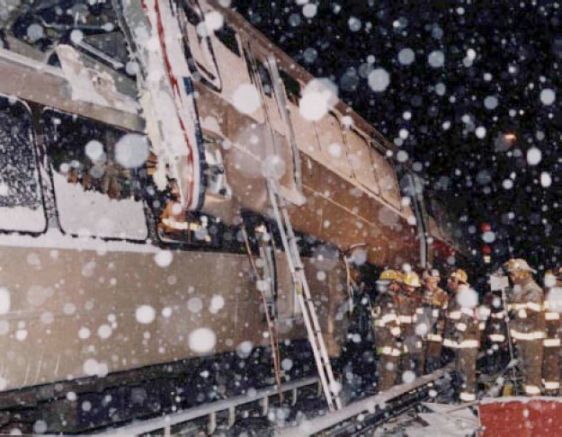
Weather or Climate?
Photo courtesy of NTSB/Wikimedia Commons
Great Blizzard of 1996
Notes:
3 min
a. “This is a photograph of the great blizzard of 1996. Is this an example of weather or climate? Why do you think so?”
b. Individuals (1 min): “Think about which definition on our table matches the characteristics of this event.”
c. Whole group (2 min): Invite several participants to share their ideas and reasoning with the group. Encourage participants to respond to one another’s ideas by agreeing or disagreeing, asking questions, or offering alternative ideas.
d. Work toward a consensus regarding whether a blizzard is an example of weather or climate.

Slide 51
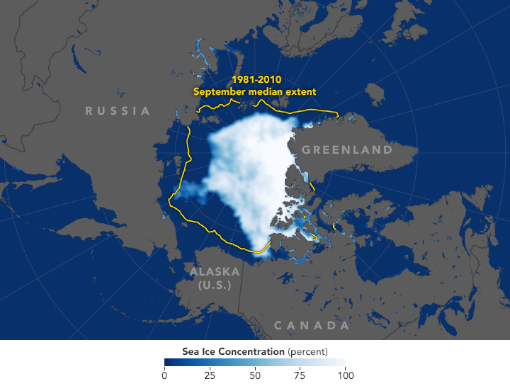
Weather or Climate?
Courtesy of NASA.gov
Decline of Arctic Sea Ice
Notes:
3 min
a. “This NASA image taken on September 19, 2018, shows the decline in arctic sea ice over the past few decades. Is this an example of weather or climate?”
b. Individuals (1 min): “Think about which definition on our table matches the characteristics of this event.”
c. Whole group (2 min): Invite several participants to share their ideas and reasoning with the group. Encourage participants to respond to one another’s ideas by agreeing or disagreeing, asking questions, or offering alternative ideas.
d. Work toward a consensus regarding whether a decline in arctic ice is an example of weather or climate.

Slide 52
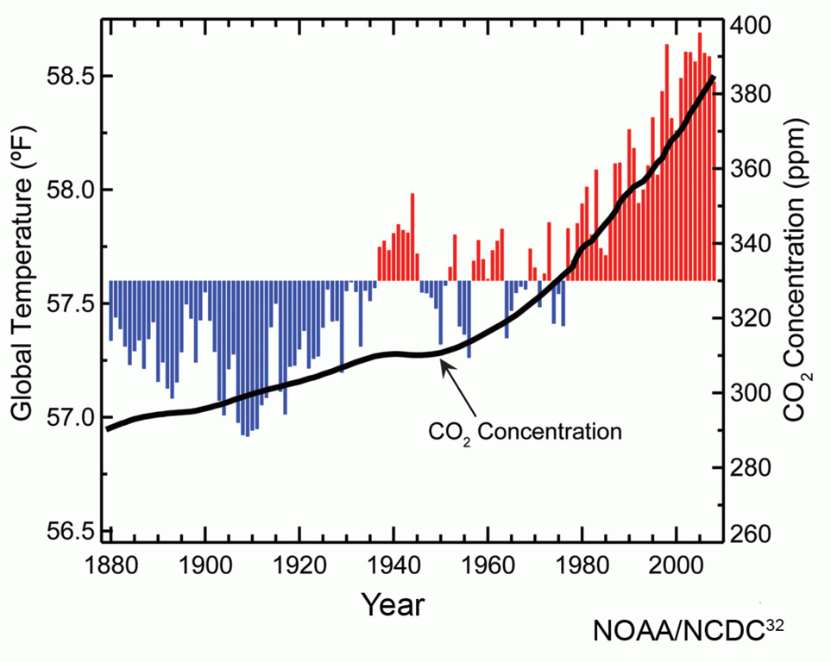
Weather or Climate?
Courtesy of NOAA/NCDC/Wikimedia Commons
Climate Change (Global Warming)
Courtesy of commons.wikimedia.org
Notes:
3 min
a. “This graph shows rising average global temperatures and atmospheric carbon-dioxide concentrations for the past century. Is this an example of weather or climate? Why do you think so?”
b. Individuals (1 min): “Think about which definition on our table matches the characteristics of this event.”
c. Whole group (2 min): Invite several participants to share their ideas and reasoning with the group. Encourage participants to respond to one another’s ideas by agreeing or disagreeing, asking questions, or offering alternative ideas.
d. Work toward a consensus regarding whether climate change or global warming and cooling is an example of weather or climate.

Slide 53
Weather and Climate Video Clips
Climax, Kansas Supercells
https://www.youtube.com/watch?v=Y4EK2r9JJ1k
TV weather forecast
https://www.youtube.com/watch?v=zsdQE275PvA
LA Is on Storm Watch
https://www.youtube.com/watch?v=z_pTv-qvRI0
El Niño Explained
https://www.youtube.com/watch?v=yCsMmajLYG4
Drilling for Ice
https://www.youtube.com/watch?v=fuT8Appwak8
Earth: Climate and Weather https://www.youtube.com/watch?v=zz_CRzcIT-Q
Weather versus Climate Change https://www.youtube.com/watch?v=cBdxDFpDp_k
Notes:
Less than 1 min
a. “Next, we’ll watch a sequence of five short video clips showing different weather-or-climate scenarios. After each clip, you’ll discuss with your elbow partner whether the scenario was an example of weather or climate. Then we’ll discuss the scenario as a group, and I’ll record the consensus on chart paper.”
b. “After the first five clips, we’ll watch two more clips that cover key science ideas related to this activity.”
c. Briefly review the list of seven video clips participants will be watching.
Note: To facilitate preloading the video clips, all seven web links are displayed on this slide. Links are also included on the following slides. Loading these videos into a web browser before starting this segment will make it easier and more efficient to switch back and forth between this PowerPoint presentation and each of the Internet videos. (See overview page for advance preparation instructions.)
Videos credits and total time:
Climax, Kansas Supercells (Stephen Locke, 2:57 min); https://www.youtube.com/watch?v=Y4EK2r9JJ1k
TV weather forecast (Jackie Johnson, CBS2 News, 2:37 min); https://www.youtube.com/watch?v=zsdQE275PvA
LA Is on Storm Watch (Jimmy Kimmel Live, 3:03 min); https://www.youtube.com/watch?v=z_pTv-qvRI0
El Niño Explained (Climatedogs, 1:19 min); https://www.youtube.com/watch?v=yCsMmajLYG4
Drilling for Ice (Horizon, BBC, 3:21 min); https://www.youtube.com/watch?v=fuT8Appwak8
Earth: Climate and Weather (National Geographic, 3:22 min) https://www.youtube.com/watch?v=zz_CRzcIT-Q
Weather versus Climate Change (Neil deGrasse Tyson, National Geographic, Cosmos, A Spacetime Odyssey, 2:09 min) https://www.youtube.com/watch?v=cBdxDFpDp_k

Slide 54
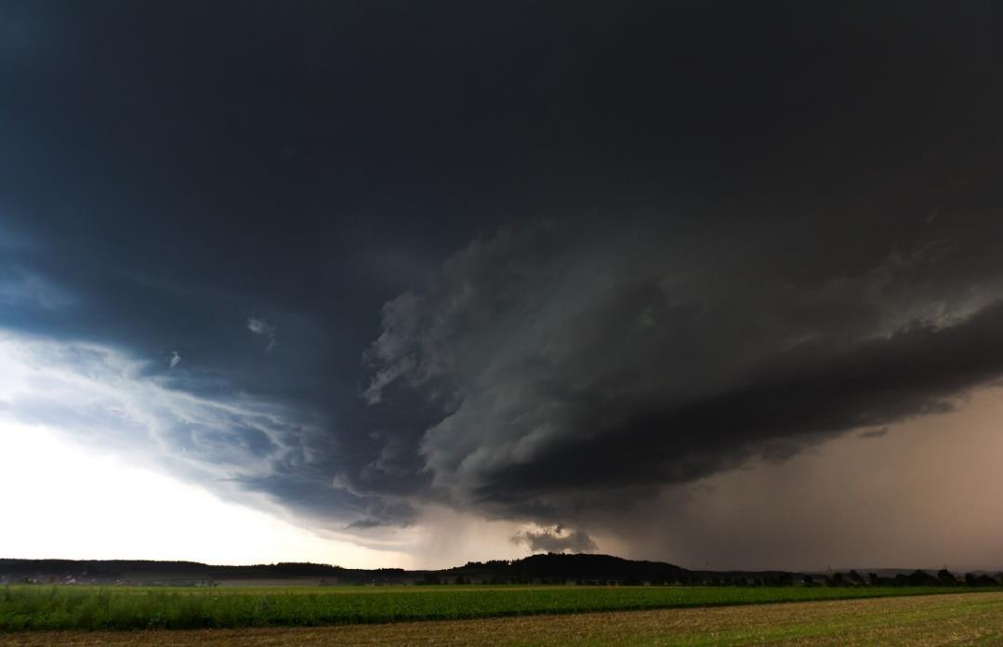
Scenario 1: Midwest Thunderstorm
Photo courtesy of Pixabay.com
Link to video clip: Climax, Kansas Supercells
Notes:
5 min
Note: For slides 54–58, introduce the video scenario and then switch to the web browser to show the video. Afterward, switch back to the PowerPoint slide.
a. Introduce the scenario and show the video clip.
b. Turn and Talk: “Now pair up with an elbow partner and briefly discuss whether the scenario is an example of weather or climate. Which definition on our table matches the characteristics of this event?”
c. Whole group: Invite several participants to share their ideas and reasoning with the group. Encourage participants to respond to one another’s ideas by agreeing or disagreeing, asking questions, or offering alternative ideas.
d. Work toward a consensus regarding whether a thunderstorm is an example of weather or climate. Record the group’s decision on chart paper.

Slide 55

Scenario 2: TV Weather Report
Photo courtesy of Pixabay.com
Link to video clip: Jackie Johnson, CBS2 News
Notes:
5 min
a. Introduce the scenario and show the video clip.
b. Turn and Talk: “Now pair up with an elbow partner and briefly discuss whether the scenario is an example of weather or climate. Which definition on our table matches the characteristics of this event?”
c. Whole group: Invite several participants to share their ideas and reasoning with the group. Encourage participants to respond to one another’s ideas by agreeing or disagreeing, asking questions, or offering alternative ideas.
d. Work toward a consensus regarding whether a thunderstorm is an example of weather or climate. Record the group’s decision on chart paper.

Slide 56
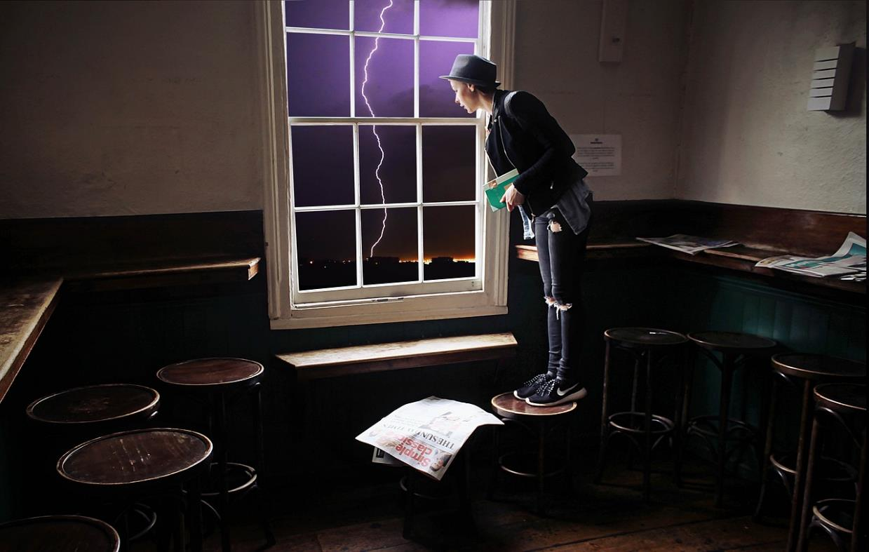
Scenario 3: LA Is on Storm Watch!
Photo courtesy of Pixabay.com
Link to video clip: Jimmy Kimmel Live!
Notes:
5 min
a. Introduce the scenario and show the video clip.
b. Turn and Talk: “Now pair up with an elbow partner and briefly discuss whether the scenario is an example of weather or climate. Which definition on our table matches the characteristics of this event?”
c. Whole group: Invite several participants to share their ideas and reasoning with the group. Encourage participants to respond to one another’s ideas by agreeing or disagreeing, asking questions, or offering alternative ideas.
d. Work toward a consensus regarding whether a thunderstorm is an example of weather or climate. Record the group’s decision on chart paper.

Slide 57
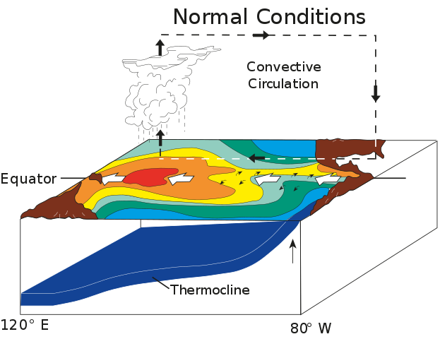
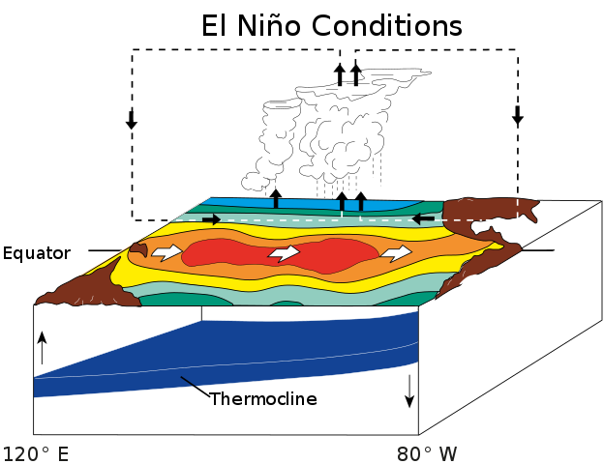
Scenario 4: El Niño Explained
Link to video clip: Climatedogs, El Nino
Courtesy of Fred the Oyster, Wikimedia Commons
Notes:
5 min
a. Introduce the scenario and show the video clip.
b. Turn and Talk: “Now pair up with an elbow partner and briefly discuss whether the scenario is an example of weather or climate. Which definition on our table matches the characteristics of this event?”
c. Whole group: Invite several participants to share their ideas and reasoning with the group. Encourage participants to respond to one another’s ideas by agreeing or disagreeing, asking questions, or offering alternative ideas.
d. Work toward a consensus regarding whether a thunderstorm is an example of weather or climate. Record the group’s decision on chart paper.

Slide 58
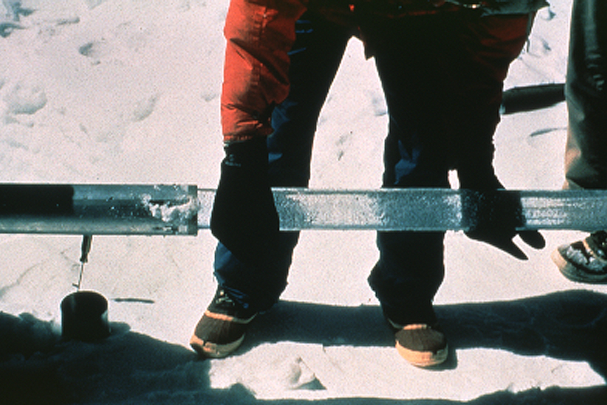
Scenario 5: Ice-Core Research
Courtesy of Lonnie Thompson, Wikimedia Commons
Link to video clip: Drilling for Ice
Notes:
5 min
a. Introduce the scenario and show the video clip.
b. Turn and Talk: “Now pair up with an elbow partner and briefly discuss whether the scenario is an example of weather or climate. Which definition on our table matches the characteristics of this event?”
c. Whole group: Invite several participants to share their ideas and reasoning with the group. Encourage participants to respond to one another’s ideas by agreeing or disagreeing, asking questions, or offering alternative ideas.
d. Work toward a consensus regarding whether a thunderstorm is an example of weather or climate. Record the group’s decision on chart paper.

Slide 59
Summary: Weather and Climate
Weather: Short-term, temporary atmospheric conditions at a particular location.
Climate: Long-term, average atmospheric conditions across a large region or the whole world.
Photo courtesy of Pixabay.com
Notes:
Less than 1 min
a. Read the definitions on the slide and compare them with the group definitions on chart paper.
b. Ask participants, “Does anyone have any lingering questions about these definitions or the differences between weather and climate?”

Slide 60
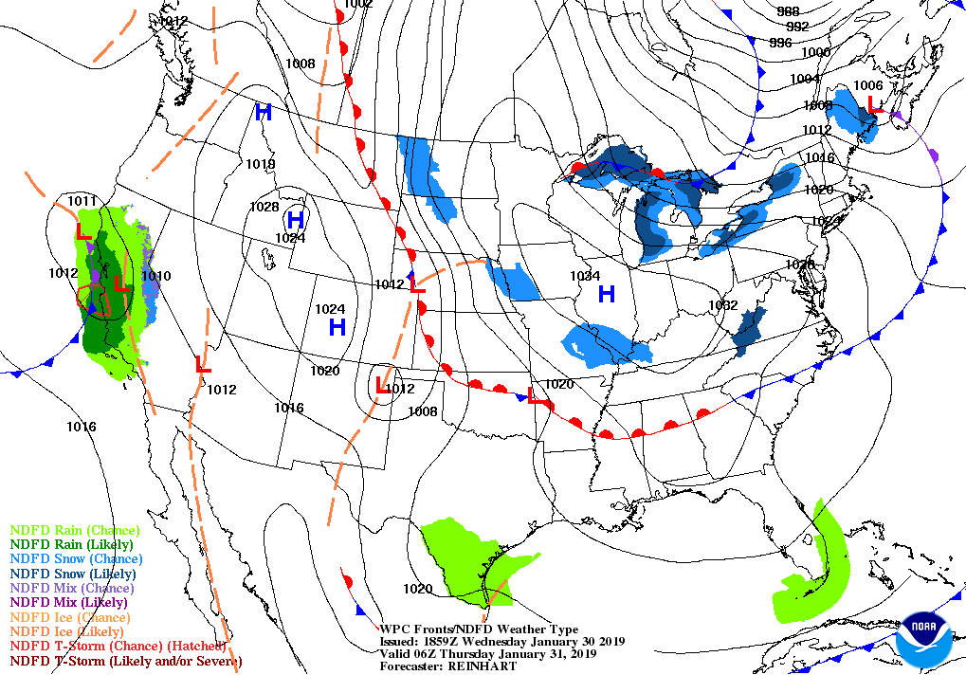
Weather Map of the United States
Courtesy of NOAA/National Weather Service
Notes:
Less than 1 min
a. “This map shows the weather forecast for the United States on January 31, 2019, at a specific time. It’s a weather map because it shows short-term, temporary atmospheric conditions in many locations across the US.”

Slide 61
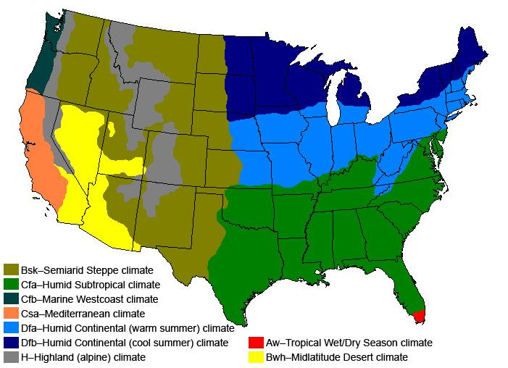
US Climate–Zone Map
Courtesy of Strongbad1982/ Wikimedia Commons
Climate = Regional, long-term, average weather conditions
Notes:
Less than 1 min
a. “This map shows the climate zones of the continental United States. The color key in the bottom left-hand corner classifies the different climate zones based on the Köppen classification system.”
b. “This is a climate map because it shows long-term, average atmospheric conditions across large regions of the United States.”

Slide 62
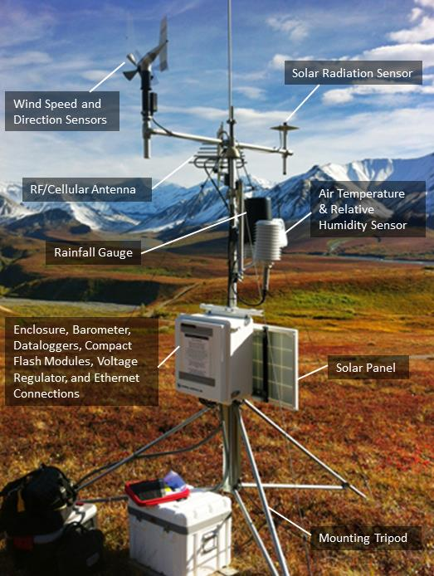
Measuring Weather Data
What types of weather data can
we measure and record?
Photo courtesy of nps.gov
Notes:
3 min
a. “In the prelessons, students go outside each day to collect weather data like weather scientists. First, they observe the weather to determine whether it’s sunny, cloudy, rainy, or windy, and they use a thermometer to measure the temperature to determine whether it’s hot, warm, cool, or cold outside. Then they record their observations and temperature readings on a monthly weather calendar.”
b. “Weather scientists measure and record many types of weather data using weather-station instruments like the ones on this slide.”
c. “What types of weather data can we measure and record?”
d. Highlight the various sensors and gauges on the slide that scientists use to measure wind speed and direction, the amount of solar radiation, air temperature and relative humidity, and the amount of rainfall.

Slide 63
Types of Weather Data
Air temperature
Relative humidity
Precipitation
Wind speed and
direction
Solar radiation
Infrared radiation
Water temperature
Photo courtesy of nps.gov
Notes:
Less than 1 min
a. Summarize the types of weather data that scientists can measure.

Slide 64
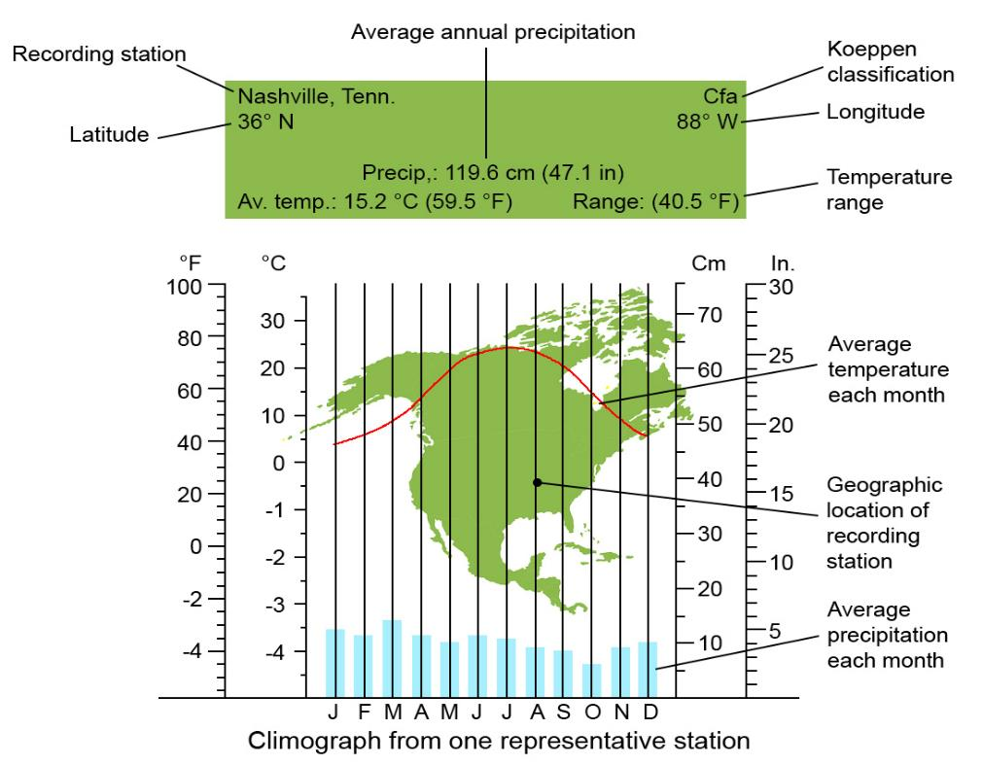
Average Monthly Weather Data
Recreated by Cal Poly Pomona
Nashville, Tennessee, Weather Station
Notes:
Less than 1 min
a. “This slide shows average monthly weather data from a weather station in Nashville, Tennessee. The data include average temperatures and rainfall totals over a 12-month period.”
b. “When short-term, regional weather data are compiled and averaged over longer periods of time, this helps define long-term, regional climate.”
c. Point out the Köppen classification for this weather station at the top right-hand corner of the slide. (Cfa refers to a humid subtropical climate.) The Köppen climate classification is a system that describes different types of regional climates.

Slide 65

Climate and Weather
Photo courtesy of Pixabay.com
Link to video clip: Climate and Weather
Notes:
4 min
a. “Next, we’ll watch two more video clips that cover key science ideas related to our investigation.”
b. Introduce the National Geographic video Climate and Weather: “This National Geographic video presents a nice synopsis of the difference between weather and climate.”
c. Switch to the web browser and show the video clip.
d. After showing the clip, switch back to this PowerPoint slide.
e. Ask participants, “What aspects of this video stood out to you? Do you have any lingering questions about climate and weather?”

Slide 66

Weather versus Climate Change
Photo courtesy of Pixabay.com
Link to video clip: Weather versus Climate Change
Notes:
4 min
a. Introduce the National Geographic video Weather versus Climate Change, hosted by astrophysicist Neil deGrasse Tyson.
b. Explain that this video offers another unique look at the difference between weather and climate.
c. Switch to the web browser and show the video clip.
d. After showing the clip, switch back to this PowerPoint slide.
e. Ask participants, “What aspects of this video stood out to you? Do you have any lingering questions about climate and weather?”

Slide 67

Reflect: Content Deepening Focus Questions 1 and 2
  What is weather?
  How is weather different from climate?
Courtesy of NOAA/Wikimedia Commons
Notes:
5 min
a. Review the focus questions on the slide.
b. Individuals: Have participants answer these questions in concise summary statements in their science notebooks.
c. Whole group: Invite a few participants to share their answers, using ideas and evidence from the previous slides and videos.
d. As participants share their answers, write down key ideas on chart paper.

Slide 68

Key Science Ideas
  Weather involves changes in local atmospheric conditions over short periods of time, such as hours, days, or weeks.
  Atmospheric conditions include temperatures, sunlight, clouds, precipitation, and wind.
  Climate is an average of atmospheric conditions in broader geographic areas over longer periods of time.
Notes:
1 min
a. Review the key science ideas on the slide.
b. Ask participants if they have any comments or questions.

Slide 69
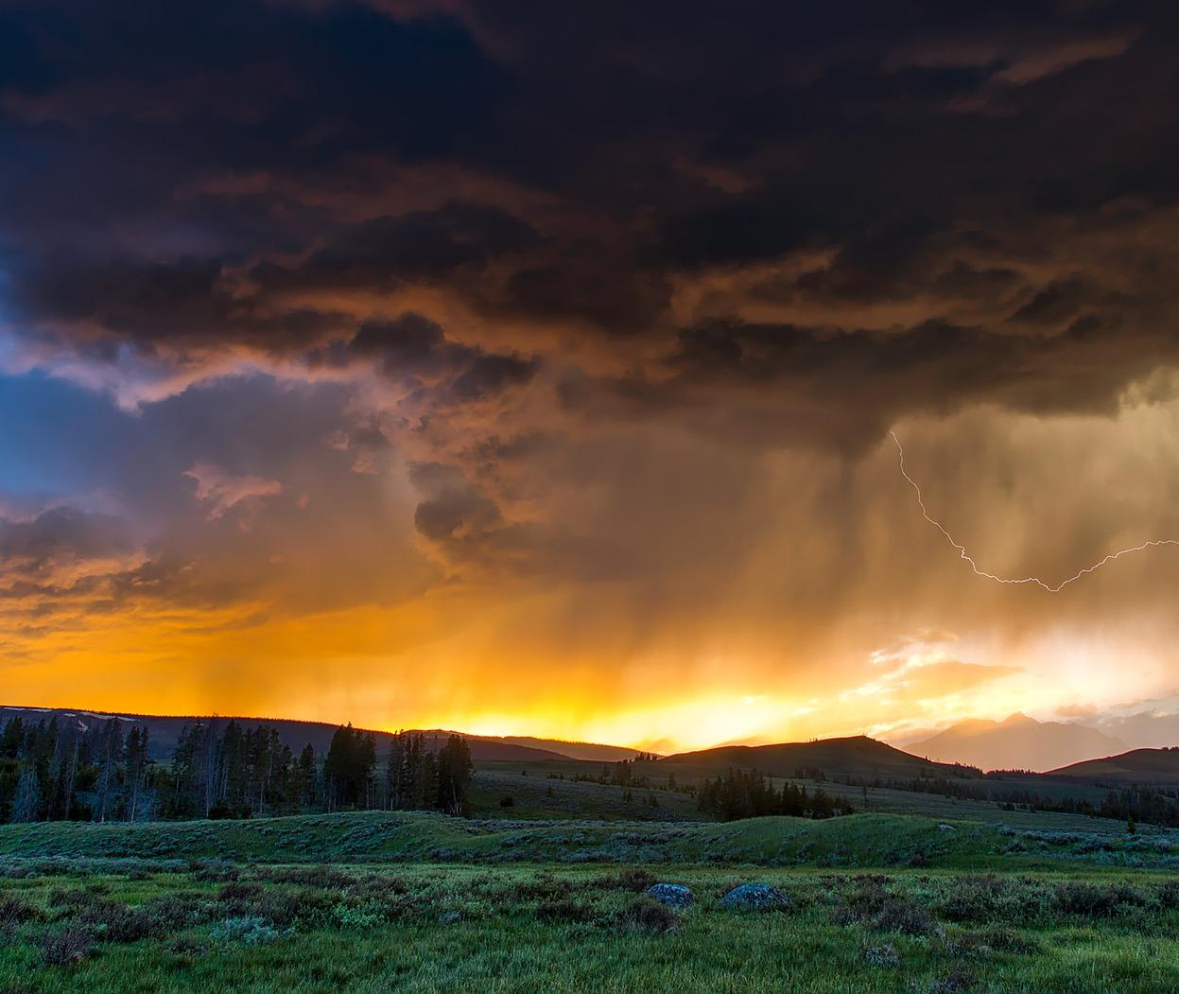
Weather and Seasons
Lesson 1
Photo courtesy of Pixabay.com
Notes:
Less than 1 min
a. “Next, we’ll investigate ideas about weather from lesson 1 of the Weather and Seasons unit.”
b. “We’ll also explore how the Sun affects weather patterns on Earth.”

Slide 70
Content Deepening: Focus Question 3
  What are weather patterns?
Notes:
1 min
a. Read the focus question on the slide.
b. Emphasize that this focus question will guide student learning throughout lesson 1.
c. Have participants write this question in their science notebooks and draw a box around it. Make sure they leave space below the question to write a response later.

Slide 71


What Are Patterns?
What patterns do you notice in the two sets of images below?
Courtesy of Pixabay.com
Notes:
5 min
a. “Can you identify any patterns in the two sets of images on this slide?”
b. As participants share their ideas, record them on chart paper.
c. “The concept of patterns is problematic for kindergartners, since they tend to think that patterns involve repetition or a trend among different objects like the patterns represented on this slide. This becomes even more complicated when they’re asked to identify weather patterns, since repetition isn’t as obvious. For example, we don’t typically see an alternating repetitive pattern of a rainy day and a sunny day followed by a rainy day and a sunny day followed by a rainy day and a sunny day.”
d. “The term weather pattern generally refers to what the weather is like most of the time in a given location.”
e. Write the definition on chart paper and ask participants to write it in their science notebooks.

Slide 72



How Can We Describe the Weather?
What are three ways we can describe weather?
Courtesy of Clipartmag.com
Courtesy of Clipartmag.com
Courtesy of Pixabay.com
Notes:
3 min
a. Read the question on the slide.
b. Ask participants to answer the question using the visual cues on the slide. Elicit a variety of ideas and record them on chart paper.
Answer: We can see weather with our eyes, we can feel weather with our hands (or skin), and we can measure temperatures with a thermometer.
c. “Students will use these three methods to describe the weather they observe and record each day.”

Slide 73
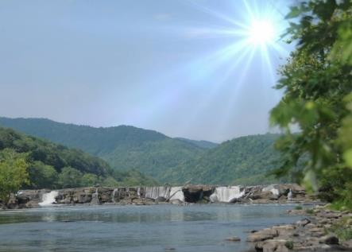
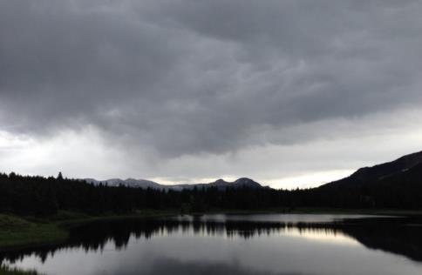
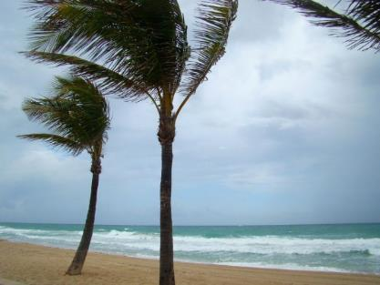



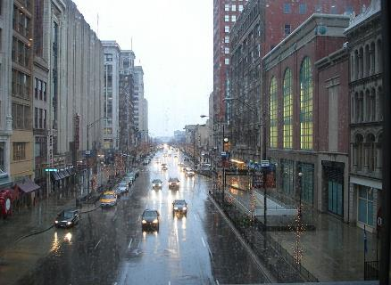
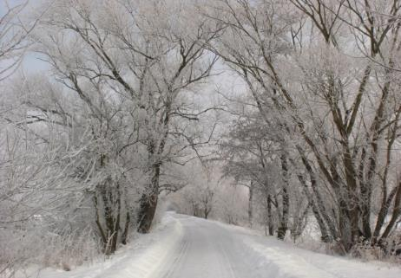
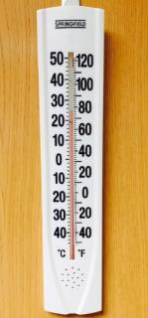


What Is the Weather Like Today?
Photograph by Carey Woods
Photograph by Audrey Mohan
Photo courtesy of Publicdomainpictures.net
Sunny
Cloudy
Windy
Hot
or
Cold?
Photograph by Cyndy Sims Parr/Wikimedia Commons
Photo courtesy of Publicdomainpictures.net
Rainy
Snowy
Photo courtesy of BSCS
Thermometer
Notes:
Less than 1 min
a. “The pictures on this slide are part of the lesson materials kit for this unit on weather. Each picture card shows a different type of weather with a weather word and icon below the picture.
b. “Students will use the picture cards to help them identify and describe the weather conditions they see, feel, and measure outside each day. For example, they may describe the weather as sunny and hot or cloudy and cool.”

Slide 74
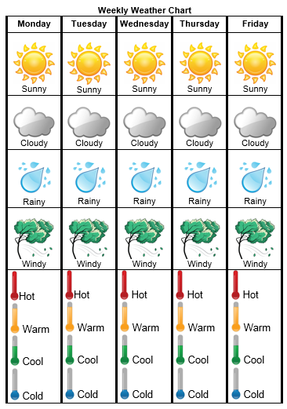
Weekly Weather Chart
Notes:
Less than 1 min
a. “This slide shows a weekly weather chart with weather and temperature icons that students can circle. This is an easy way to describe the weather they observe each day.”
b. “Teachers also record students’ daily weather observations on a class weather calendar, using stickers to represent various weather conditions and temperatures. Data collection begins on the first day of the school year in the fall and continues each school day through January and/or February.”

Slide 75
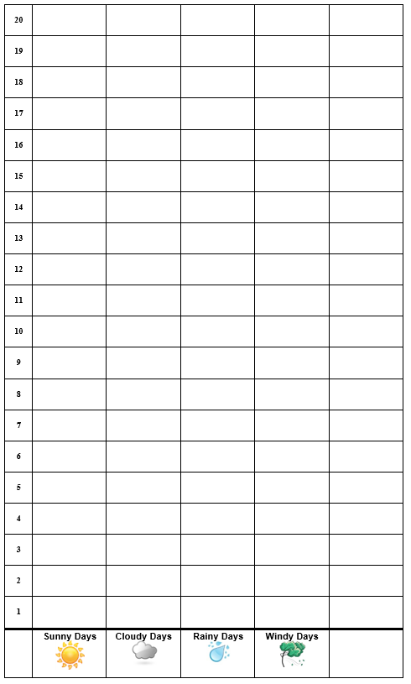




Monthly Weather Data
 | Month 1: _____________ | Month 2: ______________
Sunny Days | _____ days | ____ days
Cloudy Days | _____ days | ____ days
Rainy Days | _____ days | ____ days
Windy Days | _____ days | ____ days
Hot Days | _____ days | ____ days
Notes:
1 min
a. “After weather data has been collected and recorded over a period of several months, students identify weather patterns and compare patterns from month to month.”
b. “Students count the number of sunny, cloudy, rainy, and windy days on their class weather calendar and record them on a monthly observation chart like the chart on the left side of the slide. They also count the number of hot, warm, cool, and cold days on the calendar. Then they use this data to create picture or bar graphs like the sample on the right side of the slide. These graphs make it easier for students identify weather and temperature patterns for each month and compare the patterns for different months.”

Slide 76








Investigation: Weather Patterns
Pomona Weather Calendar for September
Monday | Tuesday | Wednesday | Thursday | Friday
Key: Hot Warm Cool Sunny Cloudy Rainy
Notes:
7 min
a. “The weather calendar on this slide shows hypothetical weather data for Pomona in September.”
b. Highlight the weather-icon key at the bottom of the slide.
c. Pairs: “Pair up with an elbow partner and examine the weather data on the calendar. See if you can identify any weather and temperature patterns in the data. Be ready to share your observations with the group.”
d. Whole group: “What patterns did you identify in the September weather data for Pomona?”
e. During the discussion, encourage participants to agree or disagree, ask questions, and add on. Elicit a variety of responses ask questions to probe and challenge participants’ thinking.
f. Work together to reach a consensus regarding the weather pattern for Pomona in September based on the weather data.

Slide 77
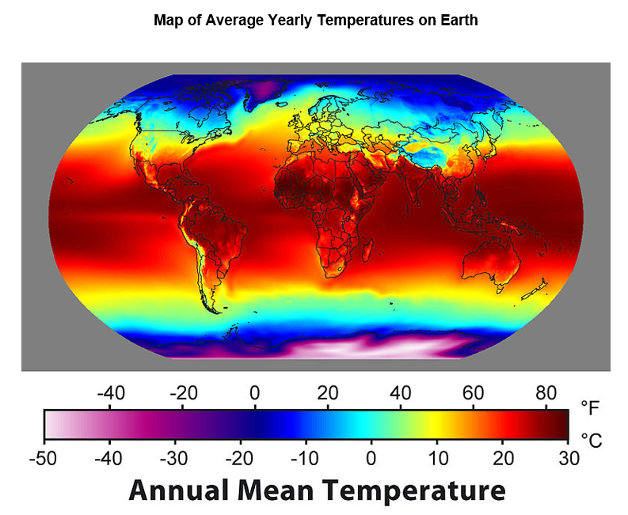
What Patterns Do You Notice?
Courtesy of Robert A. Rohde/ Wikimedia Commons
Notes:
7 min
a. “Next, we’ll deepen our understandings of temperature patterns around the world. These concepts are related to weather and seasons, but they aren’t part of the kindergarten curriculum.”
b. “The map on this slide shows average annual temperatures around the world.”
c. Pairs: “What temperature patterns do you notice? Turn to an elbow partner and share your observations.”
d. Whole group: Invite participants to share their observations with the group. Elicit a variety of ideas and encourage participants to agree, disagree, ask questions, or add on.
e. As participants share the patterns they observe, record them on chart paper. Work toward a group consensus.

Slide 78
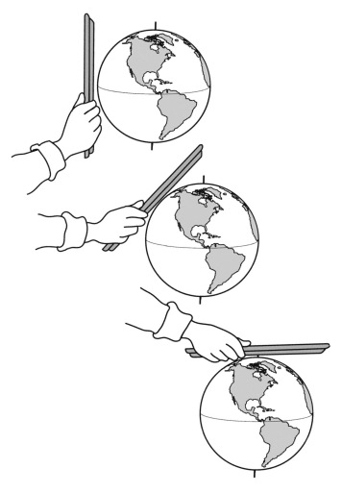

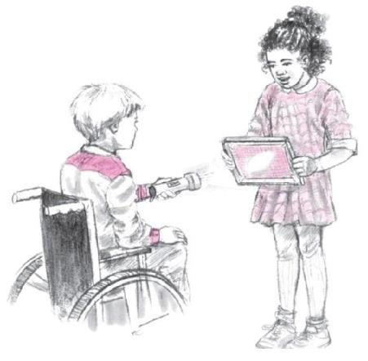
Investigation: Angles of Light Energy
Photo courtesy of BSCS
Notes:
Less than 1 min
a. “How can we explain the temperature patterns we observed on the map?”
b. “For this investigation, we’ll explore what happens when sunlight strikes the surface of Earth at different angles and how this affects temperature patterns in different locations.”

Slide 79
Investigation: Angles of Light Energy
Follow the instructions on handout 1.6 (Angles of Light Energy).
Test two scenarios:
Hold the tray perpendicular to the light beam (straight on).
Hold the tray tilted away from the light beam (at an angle).
Note: In both scenarios, keep the light beam in a horizontal position, parallel to the floor. Maintain the same distance between the flashlight and tray.
On graph paper, trace around the circle/oval of light, enclosing only the area of brightest light.
Notes:
15 min
a. Have participants pair up with an elbow partner and locate handout 1.6 (Angles of Light Energy ) in their PD program binders. Then give each pair a tray, a flashlight, two or three sheets of graph paper, tape, scissors, and two colored pencils or pens.
b. Walk participants through the instructions for part 1 on the handout. Emphasize that the goal of this activity is to investigate differences in the pattern of light striking the tray.
c. Point out that the tray represents the surface of Earth and the flashlight represents sunlight.
d. Note that participants will mark on the graph paper the circles of light hitting the tray at different angles. Then they’ll compare the circles to determine the amount of sunlight striking Earth’s surface at each angle and consider how this affects temperature patterns.
e. As pairs work together on the activity, circulate around the room to provide support as needed.
Note: If time is running short, pairs can skip to the discussion question on the handout.

Slide 80
Investigation: Angles of Light Energy
Complete steps 1 and 2 on handout 1.6 (Angles of Light Energy). Then answer these questions:
Which circle of light was smaller (straight on or at an angle)?
Which circle of light was larger (straight on or at an angle)?
Imagine that the flashlight represents sunlight hitting Earth’s surface. Would you feel warmer standing in the smaller circle or the larger circle? Why? Be prepared to share your answer.
Notes:
10 min
a. Go over the instructions for part 2 on handout 1.6 (Angles of Light Energy).
Note: Skip steps 3 and 4 on the handout.
b. Pairs: Direct pairs to complete steps 1 and 2 on the handout and answer the questions on the slide.
c. Whole group: Invite participants to share their responses with the group. Elicit differing points of view and ask questions to probe and challenge participants’ thinking.

Slide 81
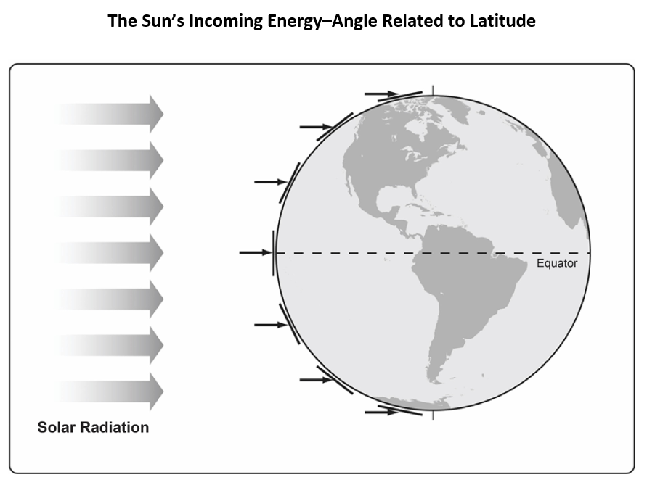
Investigation: Angles of Light Energy
Courtesy of BSCS
Notes:
4 min
a. “The content representation on this slide shows parallel rays of sunlight, or solar energy, striking Earth’s surface. Notice that it doesn’t show Earth tilted at 23.5-degrees on its axis relative to the Sun.”
b. Ask participants how this illustration relates to the flashlight-and-tray activity they just completed.
c. Point out that like the flashlight and the tray, sunlight strikes Earth’s surface at different angles based on latitude. Sunlight hits Earth’s surface straight on at the equator, such as when the tray is perpendicular to the flashlight beam. Sunlight hits the surface of Earth at increasing angles as it moves toward the poles, such as when the tray placed at an angle to the light beam.

Slide 82
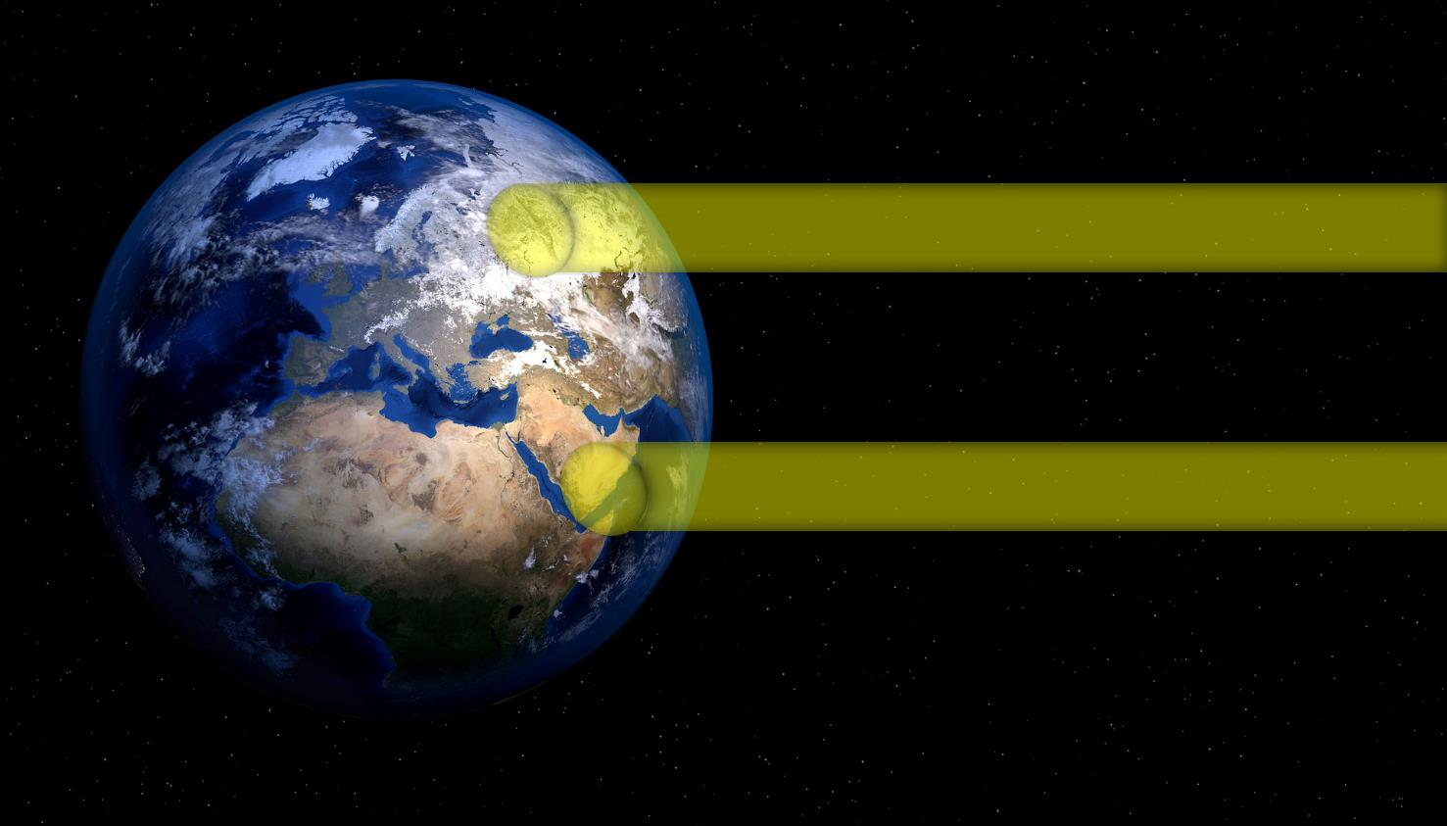
Investigation: Angles of Light Energy
Solar Radiation Concentrated over a Larger Area
Solar Radiation Concentrated over a Smaller Area
Courtesy of Pixabay.com
Notes:
4 min
a. “What do you notice about this image?”
b. “Where will temperatures tend to be warmer and cooler? Why?”
c. Participants should recognize that solar radiation is more concentrated or intense when it covers a smaller area and less concentrated or intense when it covers a larger area. So temperatures are generally warmer near the equator because sunlight strikes the surface more directly (over a smaller area), and temperatures are generally cooler at latitudes north and south of the equator because sunlight strikes the surface at more of an angle (over a larger area).

Slide 83
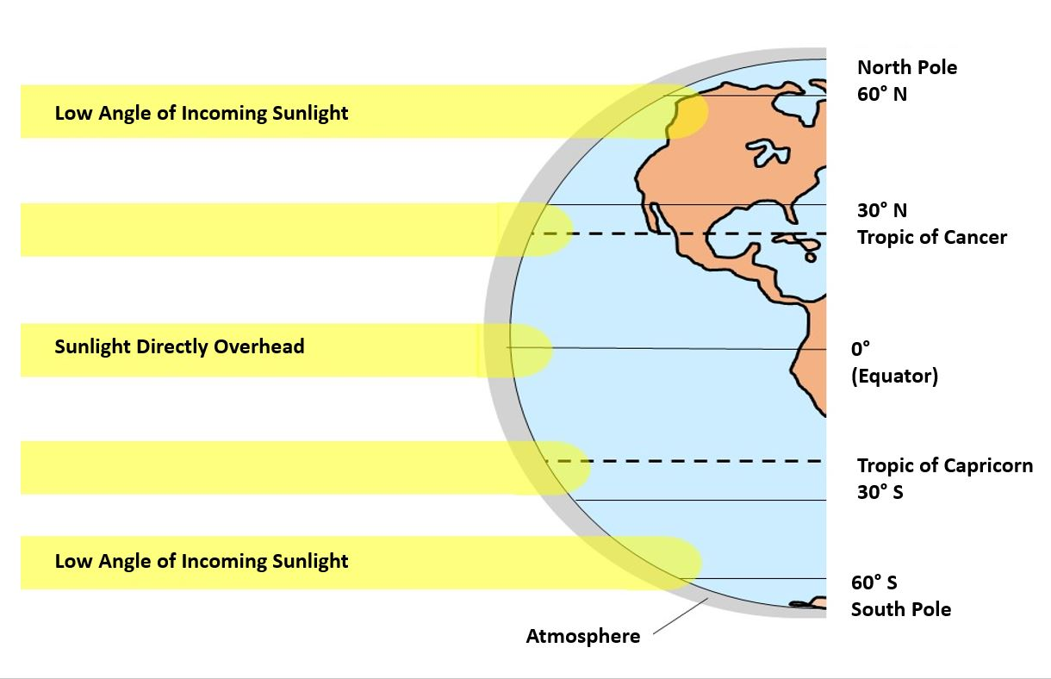
Investigation: Angles of Light Energy
Courtesy of Cal Poly Pomona
Notes:
4 min
a. “Does this representation give you any new insights into temperature patterns around the world?”
b. Participants should observe that this diagram also shows incoming rays of sunlight striking Earth’s surface, but it also includes latitudes on the right. They should also notice that the equator tends to receive the most concentrated light.
c. Emphasize that like the first diagram, this representation doesn’t show Earth tilted on its axis relative to the Sun. With a 23.5-degree tilt, the amount of light striking Earth’s surface at different latitudes changes with the seasons. The Tropic of Cancer receives the most concentrated light during the summer in the Northern Hemisphere, while the Tropic of Capricorn receives the most concentrated light during the summer in the Southern Hemisphere. The tilt of Earth on its axis causes opposite seasons in the Northern and Southern Hemispheres. When the Northern Hemisphere is experiencing summer, the Southern Hemisphere is experiencing winter, and vice versa.

Slide 84
Explaining Temperature Patterns
Courtesy of Robert A. Rohde/ Wikimedia Commons
Notes:
7 min
a. “Now that we understand the relationship between global temperatures and the angle of sunlight striking Earth’s surface, let’s revisit our map of average annual temperatures around the world. How does this new information help us explain the patterns we observed on the map?”
b. Pairs: Have participants pair up again and explain the temperature patterns on the map using ideas about the angle of sunlight striking Earth’s surface.
c. Whole group: Invite participants to share their explanations with the group. Elicit a variety of ideas and encourage participants to agree, disagree, ask questions, or add on.

Slide 85
Reflect: Content Deepening Focus Question 3
  What are weather patterns?
Notes:
5 min
a. Review the focus question on the slide.
b. Individuals: Have participants answer the question in their science notebooks.
c. Whole group: Invite a few participants to share their answers, using ideas and evidence from the investigation they just completed.
d. As participants share their answers, write down key ideas on chart paper.

Slide 86
Key Science Ideas
  Weather patterns describe what the weather in a given location is like most of the time.
  We can identify weather patterns by observing and recording weather in a specific place over time.
  Weather patterns include temperature changes, the number of sunny and cloudy days, and the amount of precipitation.
Notes:
Less than 1 min
a. Review the key science ideas on the slide.
b. Ask participants if they have any comments or questions.

Slide 87
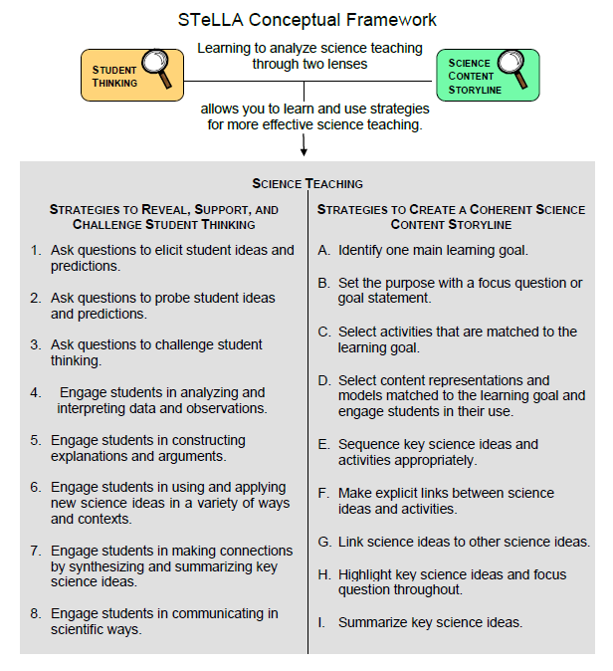
Lesson Analysis Focus Question
What are the STeLLA lenses and teaching strategies, and what is the evidence that they will make a difference in your science teaching?
Notes:
1 min
a. Read the focus question.
b. “This visual on this slide tells us a little about the first part of our focus question: What are the STeLLA lenses and teaching strategies? As you can see, there are eight specific science teaching strategies to support the Student Thinking Lens.”
c. Acknowledge: “I know you have existing frameworks (ideas and language) regarding teaching and learning, and I expect you’ll continuously draw from them during the Summer Institute.”

Slide 88
Lesson Analysis Focus Question
What are the STeLLA lenses and teaching strategies, and what is the evidence that they will make a difference in your science teaching?
Notes:
1 min
a. “Today we’ll begin learning about three of the Student Thinking Lens teaching strategies.”
b. Read the strategies highlighted on the slide.
c. “These three types of questions will help reveal, support, and challenge student thinking.”
d. Emphasize: “Even though we’re studying the strategies this summer, you’ll better understand them as you start trying them out in your teaching next fall.”

Slide 89
Strategies 1, 2, and 3: Questions That Elicit, Probe, and Challenge Student Thinking
Student Thinking Lens: Strategies to reveal, support, and challenge student thinking.
  Strategy 1: Ask questions to elicit student ideas and predictions.
  Strategy 2: Ask questions to probe student ideas and predictions.
  Strategy 3: Ask questions to challenge student thinking.
Read and fill in the purpose and key features of each strategy on your Z-fold summary chart. Then share your charts with a partner.
Notes:
20 min
a. Orient participants to the STeLLA strategies booklet. Forecast that you’ll come back to this resource repeatedly to ensure consistent use of ideas, meaning, and language that match the STeLLA conceptual framework.
b. Individuals: Have participants read about all three strategies and write on their blank STL Z-fold summary charts the purpose(s) and key features of each strategy. State that in the future, they’ll do this kind of reading and writing as homework.
c. Pairs: Have participants pair up and share their Z-fold summary charts. Encourage them to provide evidence from the readings to support their ideas and ask each other questions consistent with the norms for working together, such as “Where did you find that?” or “I interpreted that differently.”

Slide 90
Elicit Questions
What are the purpose and key features of questions that elicit student ideas and predictions?
  Which question from the examples in the strategies booklet do you think would elicit the highest number of different student responses in your classroom? Why do you think so? (Cite ideas from the strategies booklet.)
Notes:
5 min
a. As a group, discuss the purpose and key features of questions that elicit student ideas and predictions. Write these features on chart paper and hang the chart where it can be referenced later.
b. Sample chart:
Key Ideas about Elicit Questions
Purpose: To reveal student’ ideas, predictions, misconceptions, and experiences before they learn about the content.
Key features:
Asked anytime, but often at the beginning of a lesson
Phrased in everyday language that students can understand even before studying the related content
Addressed to multiple students (usually the whole class)
Reveals a variety of student ideas
Useful to teachers in adapting instruction
Useful to students so they see that others have different ideas
Can be a prediction
Can set up a discrepant event

Slide 91
Probe and Challenge Questions
Probe Questions
What are the purpose and key features of questions that probe student ideas and predictions?
Challenge Questions
What are the purpose and key features of questions that challenge student thinking?
  Remember to cite ideas from the strategies booklet!
Notes:
13 min
a. Small groups (5 min): Split participants into two groups—one group for probe questions, and one group for challenge questions. Have each group create a chart of the purpose and key features of the assigned strategy from the STeLLA strategies booklet (not from experience).
b. Whole group (8 min): Share the charts with the entire group. Encourage participants to add to, delete from, and modify them as needed to ensure they’re accurate and match the language in the strategies booklet.

Slide 92
Elicit versus Probe Questions
  What are some key differences between questions that elicit and questions that probe student ideas and predictions?
Notes:
5 min
a. Turn and Talk: “Discuss this question with your elbow partner.”
b. Whole-group share-out. Have participants share their ideas with the group.
Key ideas about elicit questions versus probe questions:
Elicit questions are addressed to the whole class; probe questions are addressed to individual students.
Elicit questions are used before students have studied a concept; probe questions can be asked at any time.
Elicit questions start a discussion; probe questions follow up on something a student has already said.

Slide 93
Elicit/Probe Questions versus Challenge Questions
  What are some key differences between questions that elicit and probe student ideas and predictions and questions that challenge student thinking?
Notes:
5 min
a. Turn and Talk: “Discuss this question with your elbow partner.”
b. Whole-group share-out. Have participants share their ideas with the group.
Key ideas about elicit/probe questions versus challenge questions:
Elicit and probe questions focus on understanding students’ existing ideas rather than trying to change students’ thinking.
In contrast, challenge questions are designed to push students’ thinking toward more-scientific understandings and support them in changing their thinking.

Slide 94
The RESPeCT Lesson Plans Binder
What comes before the lessons?
  Scope and sequence
  Learning goals
  California NGSS
  Student pretest/posttest
  Features analysis chart
  Working with English language learners (ELLs) in science
Overview of lesson format and structure:
  Lesson overview
  Lesson outline
  Detailed lesson plan
Notes:
5 min
a. Foreshadow: “In a moment, we’ll review the details of a homework assignment related to the lesson plans you’ll be teaching in the upcoming school year.”
b. “But before we look at the assignment, let’s review the organization and contents of the lesson plans binder.”
c. Use the slide to guide participants through the binder contents.

Slide 95
Let’s Summarize Today’s Work!
We thought about what constitutes effective science teaching.
We examined the rationale for the Science Content Storyline Lens and analyzed the US and Japanese video clips from the TIMSS video study.
We examined the rationale for the Student Thinking Lens and watched the video of the Harvard and MIT graduates and John and his teacher.
We deepened our understandings of weather and weather patterns.
We read and talked about the purposes and key features of elicit, probe, and challenge questions.
Notes:
5 min
a. Remind participants of the various activities they’ve been involved in today.
b. Foreshadow: Let participants know that you’re going to ask them to reflect on what they’ve learned from these activities.

Slide 96
How Did Today’s Work Help You Think about Our Focus Questions?
What are the STeLLA lenses and teaching strategies, and what is the evidence that they will make a difference in your science teaching?
What is weather?
How is weather different from climate?
What are weather patterns?
Notes:
10 min
Note: If time is running short, you may want to skip the Turn and Talk or the entire slide.
a. Turn and Talk: “Discuss these questions with an elbow partner.”
b. Whole-group share-out: Invite participants to share their ideas with the group.

Slide 97
Extended Homework
Locate handout 1.7 (Extended Homework: RESPeCT Lesson Plan Analysis) in your PD program binder.
Between now and Friday, read the scope and sequence for the set of lessons and your assigned lesson plan in the lesson plans
binder.
Be prepared to share your findings about
your assigned lesson plan in a study-group conversation on Friday.
Notes:
5 min
a. Assign each participant one of the lessons in the Weather and Seasons lesson-plan sequence. That is, Teacher 1 will study lessons 0a, 0b, 0c, and 0d; Teacher 2 will study lessons 1a, 1b, and 1c; and so forth.
Note: The first set of lessons in the Weather and Seasons lesson sequence are prelessons (0a–0d), since they occur in the fall when students collect the weather data they’ll analyze in lessons 1–5 in the spring.
b. If the study group is small, figure out who will be assigned an extra lesson (or when you, as the PD leader, will cover any extra lessons).
c. If the study group is large, assign lessons to more than one teacher later in the sequence.
d. Go over the homework sheet (handout 1.7) with participants. If time allows, have them read the assignment sheet before discussing.

Slide 98
Reflections on Today’s Session
Complete the Daily Reflections sheet.
What were your first reactions to the STeLLA claim that it’s important to plan and analyze science teaching through the Student Thinking Lens and the Science Content Storyline Lens? What was convincing or not so convincing for you and why?
What questions do you have about weather and seasons?
Provide feedback about today’s session and the program so far (likes, dislikes, questions, concerns, suggestions).
Notes:
5 min
a. Review the questions on the Daily Reflections sheet (handout 1.8).
b. Ask participants to think about these questions and write down their reflections.

