Slide 1
RESPeCT PD pROGRAM
Day 3
RESPeCT Summer Institute
Notes:
5 min
a. Take care of any housekeeping issues.

Slide 2
Agenda for Day 3
Day-2 reflections
Focus questions
Purposes and key features of STL strategies 4 and 5
Lesson analysis: STL strategies 4 and 5
Lunch
Content deepening: weather and seasons
Summary, homework, and reflections
Notes:
2 min
a. Talk through the agenda for the day.

Slide 3
Trends in Reflections
Lesson Analysis | Science Content Learning
Notes:
5 min
a. Invite participants to look at your feedback on their reflections from day 2 and offer reactions, comments, or follow-up questions.
b. Optional: Give participants an opportunity to refine the norms for working together.

Slide 4
Today’s Focus Questions
Lesson Analysis
Content Deepening
How can analyzing data and constructing explanations help students move forward toward deeper understandings of science ideas?
How is weather the same or different in different places?
How can we use what we know about weather patterns to decide whether a mystery city is Pomona?
Notes:
2 min
a. Introduce the focus questions that will guide today’s session.
b. “The words move forward are in bold on the slide because that’s our theme for today and the rest of the week. Yesterday we practiced asking elicit and probe questions, which are great for revealing student ideas. But what do we do with those ideas once we’ve elicited them? How do we support students in moving forward toward deeper understandings of science ideas?”

Slide 5
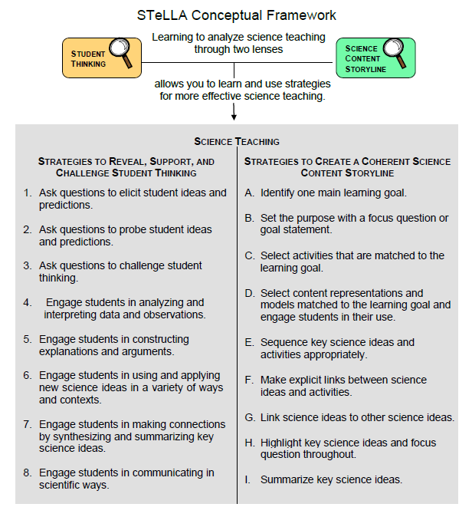
Notes:
1 min
a. Point out the strategies highlighted on the slide.
b. “We’ll continue working on understanding and using the Student Thinking Lens questioning strategies, but today we’ll focus on two closely related activity strategies. Strategy 4 engages students in analyzing and interpreting data and observations, and strategy 5 engages students in constructing explanations and arguments.”

Slide 6
The Student Thinking Lens: Moving Student Thinking Forward
How can we advance students’ science learning without just telling them about science ideas and expecting them to memorize the concepts?
By using STeLLA strategies 4–8 to engage students in making sense of the world around them.
Notes:
10 min
a. Initially, reveal only the question on the slide.
b. Have participants think about the question for a minute; then open up a brief conversation about it.
c. Ask the following questions to stimulate discussion if participants are struggling:
What was your experience as a science student in school or college?
How were you expected to learn science ideas? What learning methods were used?
Did you ever have the opportunity in science classes to make sense of the experiments you performed (instead of just recording the correct answers in a lab report)?
Did science teachers ever support your learning in ways that went beyond merely having you take lecture notes, read from a textbook, or record the correct answers in lab reports?
d. After discussing the questions, reveal the second part of the slide and emphasize the following points:
“Strategies 4 and 5 (as well as 6, 7, and 8) are designed to move student thinking forward by engaging students in sensemaking as they observe data. Rather than just spoon-feeding students science content to read or memorize, these activities lead them toward deeper understandings of science ideas as they construct meaning from evidence.”
“Telling students about science ideas is important, but teachers tend to tell students too much. Instead of doing the hard cognitive work for them, we need to create more opportunities for students to do the thinking and sensemaking themselves so they can truly understand the science concepts. So don’t be in such a hurry to tell students the right answers. Slow down and give them a chance to think!”

Slide 7
The Student Thinking Lens: Moving Student Thinking Forward
Strategies That Reveal Student Thinking | Strategies That Move Student Thinking Forward
1. Elicit questions
2. Probe questions
3. Challenge questions | 3. Challenge questions
4. Analysis and interpretation of data | 4. Analysis and interpretation of data
5. Construction of explanations | 5. Construction of explanations
6. Use and application of new ideas | 6. Use and application of new ideas
7. Synthesis and summarizing | 7. Synthesis and summarizing
8. Scientific communication | 8. Scientific communication
Notes:
5 min
a. Have participants look at the slide representation of the Student Thinking Lens strategies.
b. Ask: “What patterns do you notice?”
Key ideas:
Elicit and probe questions are designed only to reveal student thinking, not to challenge it.
The rest of the strategies reveal and challenge student thinking.

Slide 8
The Student Thinking Lens: From Questions to Activities
Look at the Summary of STeLLA Student Thinking Lens Strategies in the strategies booklet.
What distinguishes strategies 1–3 from the rest of the Student Thinking Lens strategies?
Notes:
5 min
a. Individuals: Have participants briefly examine the summary chart of STL strategies in the STeLLA strategies booklet (Summary of STeLLA Student Thinking Lens Strategies).
Note: Direct participants to the correct page in the strategies booklet or have them consult the table of contents.
b. Whole group: “How are the first three strategies different from the rest?”
Key ideas:
Strategies 1–3 are questions; the rest are activities.
Probe and challenge questions can and should be asked during all types of activities.

Slide 9
STL Strategies 4 and 5: Purposes and Key Features
Strategy 4
What are the purpose and key features?
Strategy 5
What are the purpose and key features?
Notes:
30 min
a. Small groups (12 min): Divide participants into two groups and assign one strategy to each group. Have one group create a chart listing the purpose and key features of strategy 4, and have the other group chart the purpose and key features of strategy 5. Each group should be prepared to answer the discussion question for the assigned strategy.
b. Whole-group share-out (18 min): Have groups report the purpose and key features of each strategy.
Key ideas:
Strategy 4 involves activities that engage students in organizing their data and/or observations and looking for patterns and meaning in them. They aren’t just “doing” activities or describing their observations.
Strategy 5 engages students in learning how to use logical thinking, evidence, and science ideas to construct explanations of scientific data or phenomena they have observed. It also engages them in critiquing various proposed explanations through scientific argumentation.
Remind participants that these strategies are closely related and will overlap in some activities. However, each has a specific purpose and unique attributes.

Slide 10
Relationships between Strategies 4 and 5
Discuss the question assigned to your group and be ready to share your ideas:
Group 1: How is analyzing/interpreting different from describing observations?
Group 2: How are strategy 4 and strategy 5 different? How are they related?
Group 3: How are scientific explanation and scientific argumentation related? How are they different? How are arguments in science different from arguments in everyday situations?
To support your responses, use the STeLLA strategies booklet and Quick Reference Tools for Strategies 4 and 5 (handout 3.1).
Notes:
15 min
a. Small groups (5 min): Divide participants into three small groups or pairs. Assign each group one question to discuss and tell participants to be ready to share their ideas with the entire group.
b. Emphasize: Participants should use the STeLLA strategies booklet and Quick Reference Tools for Strategies 4 and 5 (PD handout 3.1) to support their responses.
c. Whole-group share-out (10 min):
“What did you come up with for the first question?”
Key ideas for question 1: Analysis and interpretation involve moving beyond simply describing observations to doing something with the data, including (but not limited to) making comparisons, identifying relationships, and organizing data in ways that will reveal patterns (such as using charts, diagrams, and graphs).
“What did you come up with for the second question?”
Key ideas for question 2: Strategy 4 lays the groundwork for strategy 5. Before we can build a scientific explanation for a specific phenomenon, we need to make some observations, analyze the data to reveal patterns, and organize the data to gather the necessary evidence to support construction of a scientific explanation. A scientific explanation includes a claim that answers the question being studied, evidence that supports the claim, and reasoning that links the claim to the evidence and to science ideas.
“What did you come up with for the third question?”
Key ideas for question 3: A scientific explanation includes a claim that answers the question being studied, evidence that supports the claim, and reasoning that links the claim to the evidence and to science ideas. Scientific argument involves assessing the strength and quality of the evidence and reasoning in different scientific explanations for the same observations and determining which proposed explanation has the best supporting evidence, science ideas, and reasoning.

Slide 11
Practice Identifying Strategies 4 and 5
Examine student statements made during a science-class activity. Decide whether each statement represents the following:
An observation
An analysis or interpretation of the observations (e.g., describing a pattern) (strategy 4)
An attempt to construct an explanation that has a claim, evidence, and/or reasoning that uses science ideas (strategy 5)
An attempt to construct an argument (strategy 5)
Refer to Practice Identifying Strategies 4 and 5 in Student Work (handout 3.2).
Notes:
15 min
a. “Before we view a classroom video clip to identify and analyze strategies 4 and 5, we’re going to practice identifying observations, analyses, interpretations, explanations, and arguments from a handout of student statements. Learning to distinguish which strategy students are using in these examples will help us when we review the classroom videos, where the strategies aren’t always as clear cut.”
b. Refer participants to handout 3.2 in their PD program binders (Practice Identifying Strategies 4 and 5).
c. Pairs: Have participants work in pairs to analyze student statements in the handout.
d. Whole group: As participants discuss and clarify their analyses of the student statements, encourage them to refer frequently to the STeLLA strategies booklet and the Quick Reference Tools handout (PD handout 3.1).
Note: For examples of ideal participant responses, see PD Leader Master: Practice Identifying Strategies 4 and 5.

Slide 12
Lesson Analysis Focus Question
How can analyzing data and constructing explanations help students move forward toward deeper understandings of science ideas?
Notes:
Less than 1 min
a. Review the focus question that will guide today’s lesson analysis work.

Slide 13
Lesson Analysis: Review Lesson Context
Video Clip 1
Review the lesson context at the top of the transcript for video clip 1 (handout 3.3 in your PD program binder).
Notes:
2 min
a. “Now let’s see if we can recognize students analyzing and interpreting data in a classroom video clip.”
b. Review the lesson context at the top of the transcript for video clip 1 (handout 3.3 in PD binder), making sure participants understand both the content and activity in focus.

Slide 14
Lesson Analysis: Identify Strategy 4
Video Clip 1
Identify instances where the teacher or the students are engaged in analyzing and interpreting data and observations by
clarifying key observations,
identifying a pattern in the observations,
identifying what needs to be explained,
organizing data/observations, and/or
trying to make sense of the observations (analyzing, interpreting).
Discuss: How are these actions implemented in the video?
Link to video clip 1: 3.1_mspcp_kinder_weather_gaines_L2_c1
Notes:
25 min
a. “As we watch the video clip, we’ll identify actions that illustrate strategy 4. Be on the lookout for instances where the teacher or the students do something listed on the slide. That’s what we’ll discuss first.”
b. Show the video clip.
c. Individuals: “Think about the strategy 4 actions listed on the slide.”
d. Whole group: “Discuss the question on the slide. Make sure to support your claims with evidence from the video transcript.”
Examples of strategy 4 in video clip:
Clarifying key observations:
In video segment 00:00:50–01:16, the teacher clarifies that there are more cold days in December by specifying on the calendar which days were blue (cold), green (cool), and yellow (warm).
In segment 00:02:53–02:57, the teacher clarifies differences in weather patterns by pointing out on the calendars there is snow in December but not in September.
Identifying a pattern in the observations and trying to make sense of the observations:
In segment 00:00:19, Alessandra identifies a pattern in December of more cold days than warm or hot days.
In segment 00:02:27–02:44, Elise identifies pattern of snow in December but not in September.
Identifying what needs to be explained by asking questions that move student thinking forward:
Segment 00:00:07: “What’s different about [September and December]?”
Segment 00:00:26: “How do you know that [there are more cold days than warm and hot days]?”
Segment 00:01:19: “Do you notice a couple other things that are different about December?”
Segment 00:01:56: “What about a pattern? Do you … notice anything different about these kind[s] of weather [patterns]?”

Slide 15
Lesson Analysis: Analyze Strategy 4 and Reflect
Video Clip 1
Analyze
What student thinking is revealed in the video clip by engaging students in analysis and interpretation?
Were any opportunities missed for engaging students in analyzing and interpreting data and observations?
Reflect
What did you learn about strategy 4 from analyzing this video clip?
Did the analysis process focus your attention on aspects you might not have noticed before? If yes, what is one example?
Notes:
25 min
a. Individuals: “For the first analysis question on the slide, study the transcript for video clip 1 and come up with a claim, evidence, and reasoning to support your claim. For the second analysis question, consider alternative moves the teacher could have made as you identify missed opportunities.”
b. Whole group: After participants have shared their analyses, ask, “Were there any missed opportunities for engaging students in analyzing and interpreting data?”
c. Reflect: Discuss the reflection questions on the slide, making sure participants share specifically what they learned about strategy 4.
Possible claims, evidence, and reasoning:
Claim 1: Students are using comparison language to describe weather patterns.
Evidence: video segments 00:00:19 (“more cold days than warm and hot”); 00:02:27 (“September doesn’t have the same”); 00:02:38 (“They’re not the same”).
Reasoning: It’s common for kindergartners to describe only what they can visually see (on the calendar in this case). It’s more difficult for them to “see” (analyze/interpret) general patterns, so it’s especially impressive when they’re able to do so, especially since the calendars contain a lot of information. Students in the clip were able to focus on a particular aspect of the weather (cold, snow).
Claim 2: One student isn’t successful in identifying a pattern.
Evidence: segment 00:01:43–01:56 (“There’s a little … windys on the green … and it’s kind of the same as the blue … ’cause it’s still kind of cold.”)
Reasoning: This student is simply pointing out a windy sticker on a green square and a blue square on the December calendar. She isn’t comparing weather patterns in December and September.
Missed opportunities:
Video segment 00:00:19–00:00:26: When Alessandra observes that December has more cold days than warm and hot days (segment 00:00:19), the teacher could have asked a question to clarify whether Alessandra meant that December is colder than September.
Segment 00:00:50–01:16: Instead of doing the cognitive work for students, the teacher could have asked them to point out and/or count the cold and cool days on the December calendar to show that there were more than September.
Segment 00:01:43–01:56: The teacher could have asked a probe or challenge question to see if this student was trying to describe a pattern. Examples: “Can you tell me more about the wind?” (probe question) or “How does this compare with the month of September?” (challenge question).

Slide 16
Strategy 5 Practice: Explanation and Argumentation
Analyze the weather sample transcript in the strategies booklet to find evidence of students engaged in constructing explanations and arguments by
making a claim that answers the investigation question,
making a claim and supporting it with evidence,
making a claim and supporting it with science ideas,
using logical reasoning to explain why the evidence supports a claim, and/or
making an argument.
Notes:
10 min
Note: This is an important activity, but it can be cut if time is short.
a. “Before we watch the video clip again to look for evidence of strategy 5, let’s practice analyzing one of the examples of strategy 5 in the STeLLA strategies booklet. Read the sample transcript in the “About Weather” section and see if you can find any evidence of the teacher engaging students in constructing explanations and arguments. Refer to the action list on the slide for guidance.”
b. Individual work time (5 min).
c. Whole group share-out: Have participants share evidence from the transcript of students engaging in strategy 5, noting the specific action illustrated from the list on the slide.
Sample analysis of strategy 5 in transcript:
Student 1:
Claim: “I think our place is sunnier than Place B.”
Evidence: “Our place has more sunny days than cloudy days.… There were 18 sunny days this month and only five cloudy days.”
Student 2:
Claim: “Our weather is mostly sunny during November.… Place B isn’t sunny at all.”
Evidence: “Because 18 is more than five, so that means it’s sunny.… Almost all [Place B’s] days are cloudy.”
Student 3:
Claim: “The weather isn’t the same everywhere.”
Evidence: “We found out about the weather differences in these two places.… We have more sunny days than Place B.”
Logical reasoning: “There must be some difference between Pomona and Place B.… Maybe Place B is at a higher altitude, because …it’s cooler at higher altitudes. Maybe it’s cooler because it’s cloudy.”
Student 4:
Argument: “I agree with the idea that maybe Place B is at a higher altitude.”
Evidence: “I sometimes see clouds covering up Mount Baldy when it’s sunny down here.”
Student 5:
Argument: “Place B could be cloudy for another reason.”
Logical reasoning: “Maybe it’s more polluted in Place B.”
Student 6:
Argument and evidence: “But it’s really polluted here, and we have lots of sunny days.”
Student 7:
Argument: “I agree with S3 that weather isn’t the same everywhere, and I agree with his evidence. But I have a different reason.”
Evidence: “[In San Francisco], it was … cloudy and foggy every morning.”
Logical reasoning: “I think it was because it was right next to the ocean.”

Slide 17
Lesson Analysis: Review Lesson Context
Video Clip 1
Review the lesson context at the top of the transcript for the same video clip (handout 3.3 in PD program binder).
Notes:
Less than 1 min
a. “Next, we’re going to watch the same video clip, but this time we’ll focus on identifying strategy 5: Engage students in constructing explanations and arguments.”
b. Review the lesson context at the top of the transcript for video clip 1 (handout 3.3 in the PD program binder).

Slide 18
Lesson Analysis: Identify Strategy 5
Video Clip 1
Identify instances in the video clip where students are constructing explanations or arguments by
stating an explanation or claim,
using evidence from observations to support or develop the explanation/claim,
using science ideas to support or develop the explanation/claim,
using logical reasoning to develop the explanation/claim, and/or
engaging in argumentation (agreeing, disagreeing).
Discuss: How are these actions implemented in the video?
Link to video clip 1: 3.1_mspcp_kinder_weather_gaines_L2_c1
Notes:
25 min
a. “As you watch the video clip, identify instances where students are engaged in constructing explanations and arguments (strategy 5). Also notice the kinds of questions the teacher asks (elicit, probe, or challenge).”
b. Before showing the video clip again, read the list of actions on the slide.
c. Individuals: “Think about the strategy 5 actions listed on the slide.”
d. Whole group: “Discuss the question on the slide. Make sure to support your claims with evidence from the video transcript.”
e. Emphasize: “Strategy 5 is designed to help move student thinking forward toward deeper understandings of science ideas, so we should see challenge questions as well as probe questions in the video clip.”
Examples of strategy 5 in video clip:
Video segment 00:00:19: When the teacher asks Alessandra to explain what’s different about September and December, she explains, “There’s more cold days [in December] than warm and hot.”
Segment 00:02:27: Elise explains that September and December aren’t the same because “I see December has snow, and I see [September] has Sun.”
Note: Paisley’s comments at segment 00:01:43–02:15 don’t represent an explanation because they don’t seem to answer the investigation question.

Slide 19
Lesson Analysis: Analyze Strategy 5 and Reflect
Video Clip 1
Analyze
What student thinking is revealed by engaging students in constructing explanations of weather?
Were there any missed opportunities to support students in constructing explanations and arguments?
Reflect
What did you learn about strategy 5 from analyzing this video clip?
Did the analysis process focus your attention on aspects you might not have noticed before? If yes, what is one example?
Notes:
25 min
a. Individuals: “For the first analysis question on the slide, study the video transcript and come up with a claim, evidence, and reasoning to support your claim. For the second analysis question, consider alternative moves the teacher could have made as you identify any missed opportunities.”
b. Whole group: After participants have shared their analyses, ask, “Were there any missed opportunities for engaging students in constructing explanations and arguments?”
c. Reflect: Discuss the reflection questions on the slide, making sure participants share specifically what they learned about strategy 5.
Sample analysis of strategy 5 in video clip:
Video segment 00:00:19–01:16: Alessandra gives a partial explanation of her claim that there are more cold days in December than warm and hot days by pointing to the thermometer on the calendar. But instead of allowing her to finish her explanation, the teacher steps in and gives a complete description of the evidence.
Segment 00:02:27–02:38: Elise explains the difference between December and September by noting on the calendar that “December has snow” and September “has Sun.”

Slide 20
Reflect: Key Ideas about Lesson Analysis
Lesson analysis slows down classroom events so we can focus on specific student thinking.
Making a claim based on evidence challenges us to listen carefully to what students are saying and understanding. When we make quick assessments, we might think they understand things they’re actually still struggling with.
Even though events happen fast in classroom teaching, we can get better at listening to students and making on-the-spot assessments of their understandings and confusion!
Notes:
2 min
a. “Let’s reflect on some key ideas you can take away from your lesson analysis experiences. These ideas may not reflect your personal experiences with lesson analysis so far, but hopefully you’ll see their value in the lesson analysis process over time.”
b. Read the key ideas on the slide.
c. Ask participants for their reactions to these ideas.

Slide 21
Summarizing Strategies 4 and 5
Create a word picture (a concept map, a thinking map, or other visual) to show how analysis and interpretation (strategy 4) are related to explanation and argumentation (strategy 5). Label any connecting arrows. Suggested words to use:
Analyze and interpret
Argument
Data
Evidence
Explanation
Logical thinking
Organize
Observe/observations
Patterns
Reasoning
Science ideas
Notes:
15 min
Note: Skip this activity if time is short.
a. Individuals: To summarize strategies 4 and 5, have participants work independently to create visuals that show how analysis and interpretation, (strategy 4) are related to explanation and argumentation (strategy 5).
b. Pairs: “Share and compare your visuals with a partner.”
c. Whole group: “What questions did this activity raise for you?”

Slide 22
Reflect: Lesson Analysis Focus Question
How can analyzing data and constructing explanations help students move forward toward deeper understandings of science ideas?
Notes:
5 min
a. Review today’s lesson analysis focus question.
b. Think-Pair-Share: “Think for a moment about this focus question and how you might convince parents or colleagues that analyzing data and constructing explanations moves student thinking forward toward deeper understandings of science ideas. Then share your ideas with an elbow partner.”

Slide 23
Weather and Seasons
SCIENCE CONTENT DEEPENING Kindergarten
Notes:
Less than 1 min
a. “Now let’s dig into today’s content deepening work.”
Note: Refer to the content background document and the Common Student Ideas about Weather and Seasons as needed throughout this phase.

Slide 24
Weather and Seasons
Content Deepening
Day 3
Developed by
Dr. Jeff Marshall
Geological Sciences
Cal Poly Pomona
Used by permission
Photo courtesy of Pixabay.com
Photo courtesy of pixabay.com
Notes:
Less than 1 min
a. “Today’s content deepening work will focus on science ideas from lessons 4 and 5 of the Weather and Seasons unit. We’ll also explore ideas about temperature variation that are related to weather but aren’t part of this lesson series.”

Slide 25
Unit Central Questions
Is weather the same everywhere all of the time? How do you know?
Notes:
Less than 1 min
a. Review the unit central questions on the slide.
b. Remind participants that these questions will guide student learning throughout the Weather and Seasons lesson sequence.
c. “Today we’ll continue exploring the key science ideas that will help us answer these questions.”

Slide 26
Weather and Seasons
Lesson 4
Photo courtesy of Pixabay.com
Photo courtesy of pixabay.com
Notes:
Less than 1 min
a. “First, we’ll explore key science ideas about weather from lesson 4.”

Slide 27
Content Deepening: Focus Question 1
How is weather the same or different in different places?
Notes:
Less than 1 min
a. Read the focus question on the slide.
b. Emphasize that this question will guide student learning throughout lessons 4a and 4b.
c. Have participants write this question in their science notebooks and draw a box around it to reinforce the practice they’ll follow with students in the lessons. Make sure they leave space below the question to write a response later.

Slide 28
Weather in Different Places
Discuss these questions with an elbow partner:
How would you compare the weather in Pomona with the weather in San Francisco?
How would you compare the weather in San Francisco with the weather in Colorado Springs, or St. Louis?
What do you think causes any similarities or differences?
Note: It’s OK if you aren’t familiar with the weather in these places. Just share your initial ideas.
Notes:
4 min
a. Think-Pair-Share: “Think for a moment about what the weather is typically like in Pomona compared with San Francisco, Colorado Springs, or St. Louis. Then pair up with an elbow partner and discuss the questions on the slide. Work together to develop concise answers, and be prepared to share your ideas and reasoning with the group.”
b. “Don’t worry if you aren’t familiar with the weather patterns in these locations. The purpose of this activity is to elicit ideas, not factually ‘correct’ answers.”

Slide 29
Weather in Different Places
Similarities and Differences
Pomona | San Francisco
Notes:
4 min
a. “First let’s compare the weather in Pomona with the weather in San Francisco. What are some similarities and differences between the weather in these locations? What do you think causes the similarities and differences?”
b. Create a two-column table on chart paper like the one on the slide.
c. Record similarities and differences on the table, as well as possible causes of any differences. Elicit differing points of view and ask questions to probe and challenge participants’ thinking.

Slide 30
Weather in Different Places
Similarities and Differences
San Francisco | Colorado Springs | St. Louis
Notes:
5 min
a. “Now let’s compare the weather in San Francisco with the weather in Colorado Springs or St. Louis.”
b. Create a three-column table on chart paper like the one on the slide.
c. Record similarities and differences on the table, as well as possible causes of any differences. Elicit differing points of view and ask questions to probe and challenge participants’ thinking.

Slide 31
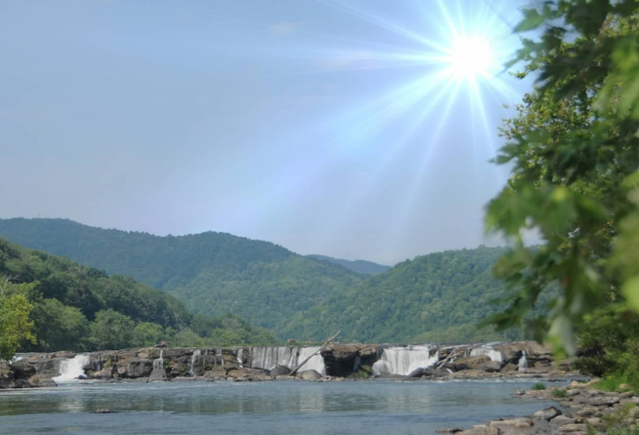
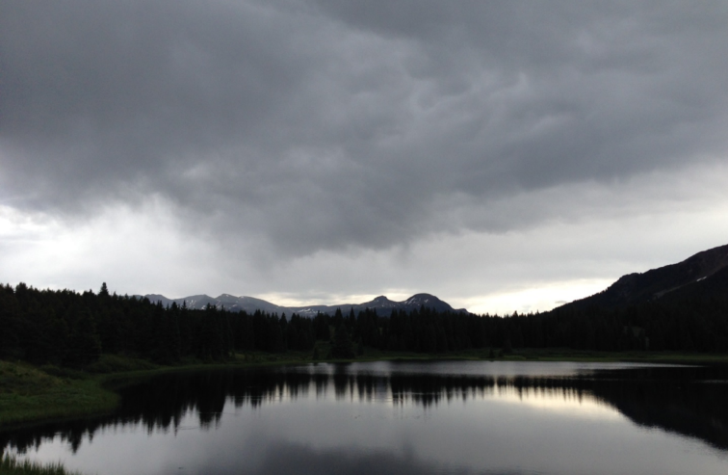
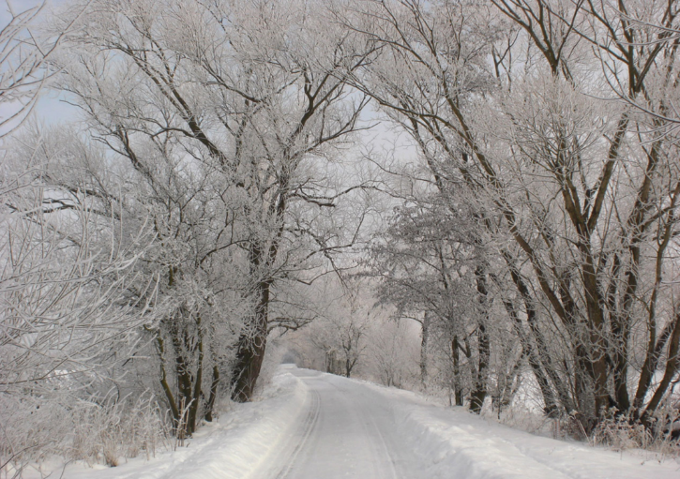
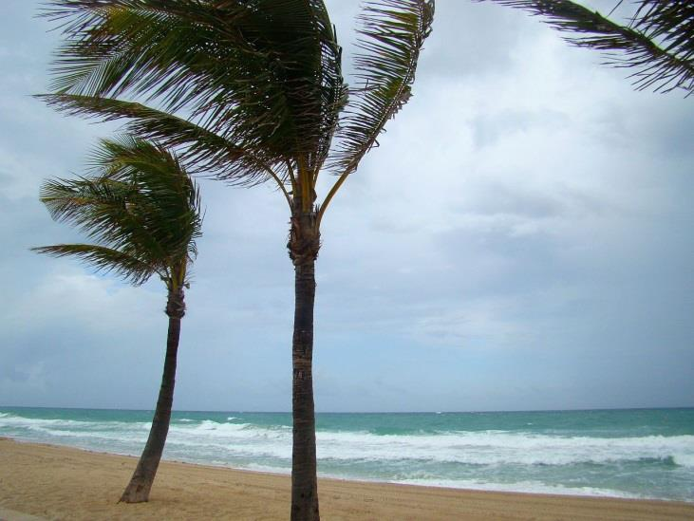
Different weather…
Photograph by Carey Woods
Photograph by Audrey Mohan
… in different places
Photo courtesy of publicdomainpictures.net
Photo courtesy of Publicdomainpictures.net
Notes:
1 min
a. “How would you describe the weather in each of these photos?”

Slide 32
Different Weather in Different Places
Do you think that Detroit and Pomona have the same or different weather in January?
Photo used with permission from BSCS
Notes:
3 min
a. “In lesson 4, students will compare weather data for Pomona and Detroit, Michigan. This slide shows a photograph of Detroit in January.”
b. “Do you think that Detroit and Pomona have the same or different weather in January?”
c. As participants share their ideas, record them on chart paper.
d. Then ask, “How do you think your students will answer this question?”

Slide 33
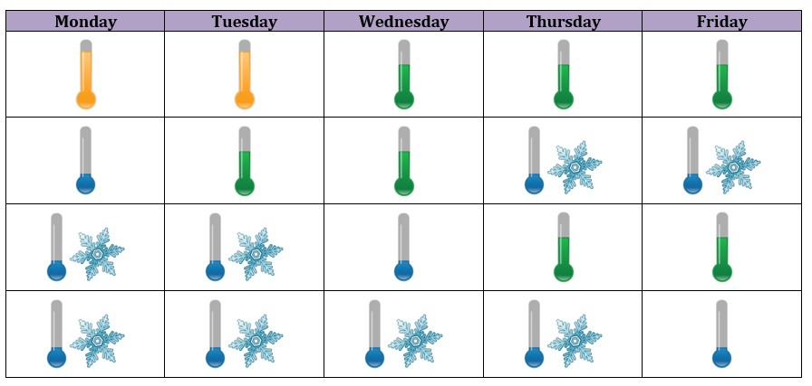
Different Weather in Different Places
January Temperatures for Detroit
20
19
18
17
16
15
14
13
12
11
10
9
8
7
6
5
4
3
2
1
 | Hot/Warm |  | Cool/Cold
January: Detroit Weather Calendar
Notes:
4 min
a. “In lesson 4, students will create bar graphs like the one on the right side of this slide, using January weather data on weather calendars for Detroit, Michigan, and Pomona. On the graphs, they’ll show the number of warm and hot days and the number of cool and cold days in January for each location. Then they’ll compare the two graphs and look for temperature patterns in Pomona and Detroit.”
b. “What challenges do you think your students will encounter with this activity?”

Slide 34
Different Weather in Different Places
Students will also compare the number of snowy days on their January weather calendars for Detroit and Pomona.
Notes:
4 min
a. “Students will also compare the number of snowy days on their January weather calendars for Detroit and Pomona.”
b. “What pattern do you think your students will discover? What challenges might your students encounter when they compare the data?”
c. Point out that the data will likely show that Pomona doesn’t receive any snow at all in January, while the pattern in Detroit is snowy.

Slide 35
Different Weather in Different Places
The January weather pattern in Detroit is _____ and _____.
The January weather pattern in Pomona is _____ and _____.
Word Bank | Picture
Sunny
Snowy
Cool/Cold
Warm
Notes:
4 min
a. “After students compare their January weather calendars and graphs for Detroit and Pomona, they describe the weather patterns they identified for each city using the sentence starters on the slide.”
b. “How would you complete these statements based on what you know about the weather in Pomona and Detroit in January?”

Slide 36
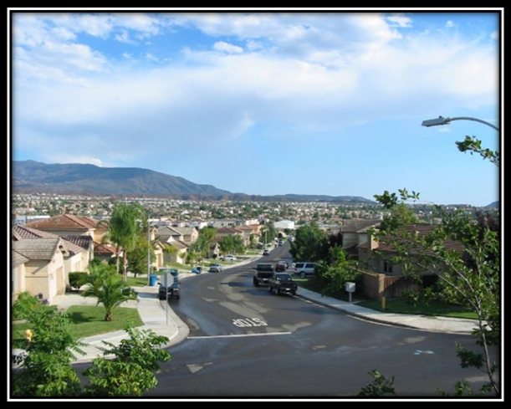
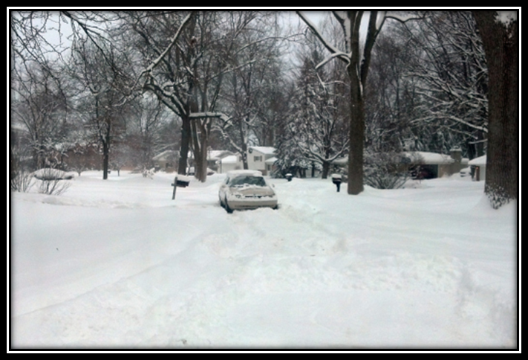
Different Weather in Different Places
I think the weather patterns in Pomona and Detroit are [the same/different].
Photo used with permission from BSCS
Photo used with permission from BSCS
Pomona, CA
Detroit, MI
Notes:
2 min
a. “How would you complete the sentence starter on the slide?”
b. Have participants share their responses in a round-robin and support their conclusions with evidence. Work toward a group consensus that Pomona and Detroit have different weather patterns.

Slide 37
Reflect: Content Deepening Focus Question 1
How is weather the same or different in different places?
Notes:
5 min
a. Review the focus question on the slide.
b. Individuals: Have participants answer the question in their science notebooks.
c. Whole group: Invite a few participants to share their answers, using ideas and evidence from the investigation they just completed.
d. As participants share their answers, write down key ideas on chart paper.

Slide 38
Key Science Ideas
Weather patterns are different in different places.
Some places have sunny, warm weather with very little precipitation, while other places can be cool and cloudy with more precipitation.
Notes:
Less than 1 min
a. Read the key science ideas on the slide.

Slide 39
Weather and Seasons
Lesson 5
Photo courtesy of Pixabay.com
Photo courtesy of pixabay.com
Notes:
Less than 1 min
a. “Next, we’ll explore science ideas from lesson 5.”

Slide 40
Content Deepening: Focus Question 2
How can we use what we know about weather patterns to decide whether a mystery city is Pomona?
Notes:
Less than 1 min
a. Read the focus question on the slide and note that this is also a use-and-apply question.
b. Emphasize that this focus question will guide student learning throughout lesson 5.
c. Have participants copy the question into their science notebooks and leave space to write a response.

Slide 41
Lesson 5: Review of Key Science Ideas
Weather is what it looks like and feels like outside.
Weather changes from month to month.
Notes:
Less than 1 min
a. “In lesson 5, students will review key science ideas from previous lessons, and then they’ll use and apply what they’ve learned about weather to solve a mystery.”
b. Review the key ideas on the slide.

Slide 42
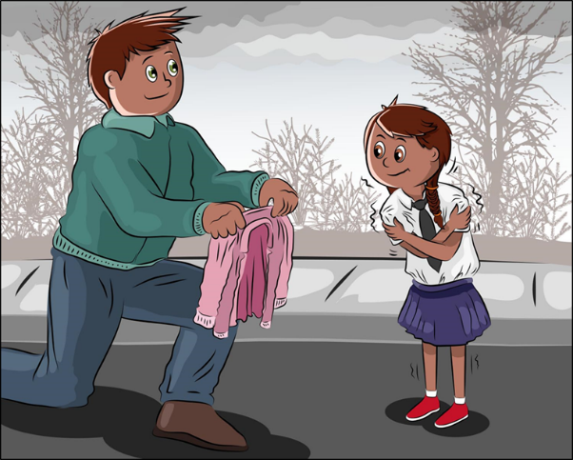
Lesson 5: Review of Key Science Ideas
Weather changes during the day.
Morning
Afternoon
Courtesy of BSCS
Courtesy of BSCS
Notes:
Less than 1 min
a. Review the key idea on the slide.

Slide 43
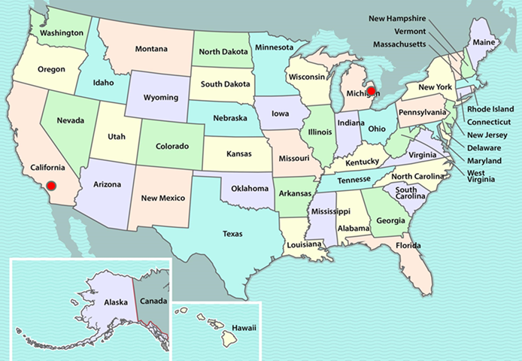
Lesson 5: Review of Key Science Ideas
Weather patterns are different in different places at the same time of year.
Courtesy of BSCS
Notes:
Less than 1 min
a. Review the key idea on the slide.

Slide 44
Lesson 5: Review of Key Science Ideas
We can tell what the weather is like outside by …
observing it,
feeling it, and
measuring it.
Courtesy of Clipartmag.com
Courtesy of Clipartmag.com
Courtesy of Pixabay.com
Notes:
Less than 1 min
a. Review the key ideas on the slide.

Slide 45
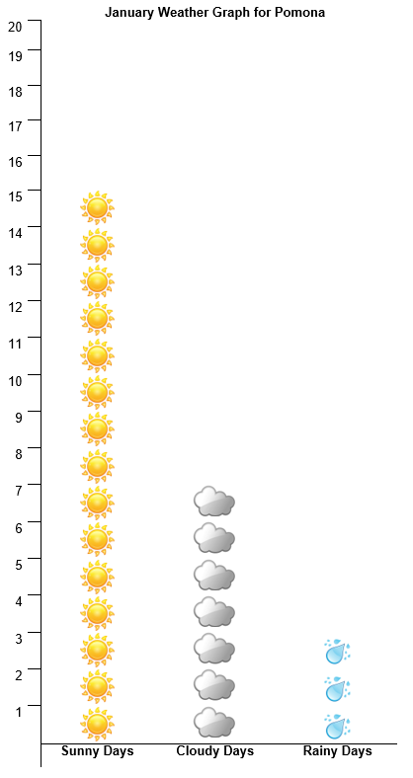
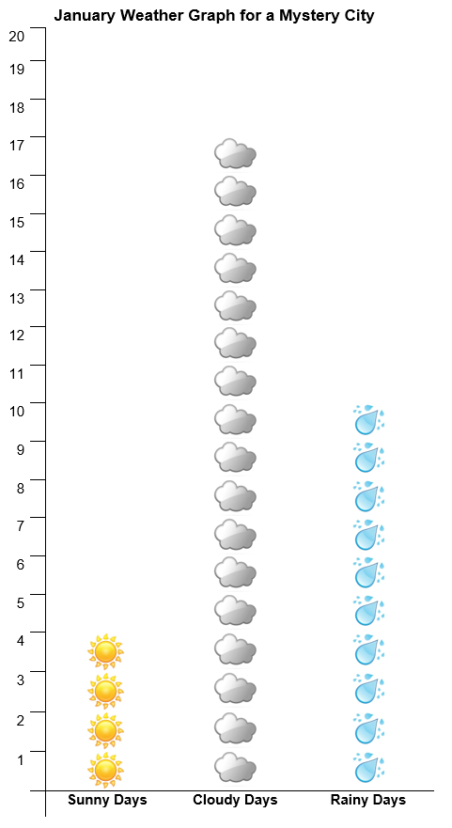
Weather Detectives!
Notes:
4 min
a. “In lesson 5, students become weather detectives and apply their new science knowledge about weather and weather patterns to solve a mystery.”
b. “Using bar graphs like the ones on this slide, students compare January weather data for Pomona and a mystery city to see if they can figure out whether this mystery city is Pomona. First, they count the number of sunny, cloudy, and rainy days for each city, and then they look for similarities and differences in weather patterns.”
c. “What challenges do you think your students might encounter in this use-and-apply activity?”

Slide 46
Weather Detectives!
We claim that the mystery city is Pomona. Our evidence is _______.
OR
We claim that the mystery city is NOT Pomona. Our evidence is _______.
Notes:
4 min
a. “Next, students make claims about the identity of the mystery city and support their claims with evidence from their bar graphs.”
b. “Then students present their claims and evidence to the class, and their classmates engage in scientific communication by agreeing or disagreeing with the claims and explaining their reasoning.”
c. “What challenges do you think your students might encounter with constructing claims and presenting their claims and evidence to the class?”
d. Ask participants where they think the mystery city is located based on the weather pattern. Then reveal that the mystery city is Seattle, Washington, which has a weather pattern in January that’s mostly cloudy and rainy compared to Pomona’s mostly sunny weather.

Slide 47
Reflect: Content Deepening Focus Question 2
How can we use what we know about weather patterns to decide whether a mystery city is Pomona?
Notes:
5 min
a. Review the focus question on the slide.
b. Individuals: Have participants answer the question in their science notebooks.
c. Whole group: Invite a few participants to share their answers, using ideas and evidence from the investigation they just completed.
d. As participants share their answers, write down key ideas on chart paper.

Slide 48
Investigating Temperature Differences
Similarities and Differences
San Francisco | Colorado Springs | St. Louis
Notes:
Less than 1 min
a. “Next, we’ll explore science ideas that aren’t part of the kindergarten lessons on weather but are designed to enhance your knowledge. Our goal for this segment is to investigate why weather is different in different places. What causes variations in weather and temperature patterns from place to place?”
b. “Earlier, we compared the weather in San Francisco with the weather in Colorado Springs and St. Louis and listed some similarities and differences. Now we’ll investigate the possible causes behind these differences.”

Slide 49
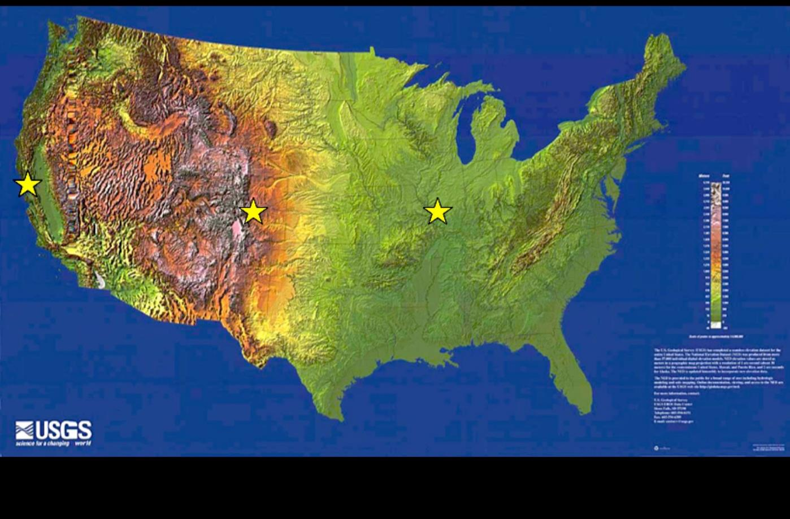
Investigating Temperature Variations
Photo courtesy of USGS
Notes:
1 min
a. Tell participants that the investigation they’ll be conducting comes from the 6th-grade unit on the Sun’s effect on climate.
b. Direct participants to locate handout 3.4 (Map of Three Cities in the United States) in their PD program binders.
c. “The three cities on this map—San Francisco, California; Colorado Springs, Colorado; and St. Louis, Missouri—are located at approximately the same latitude.”

Slide 50
Investigating Temperature Variations
DATA TABLE
Notes:
1 min
a. “The data table on this slide shows the average annual monthly temperatures for the three cities on the map. The names of the cities are listed in the first column, and the second column shows their latitude and elevation above sea level. The third column shows the average monthly temperatures for each city from January through December.”
b. Have participants locate handout 3.5 (Investigating Temperatures at the Same Altitude) in their PD program binders.
c. “For this investigation, you’ll work with an elbow partner to graph the temperature data.”

Slide 51
Investigating Temperature Variations
Work with your partner to investigate temperature patterns in three US cities at about the same latitude: San Francisco, Colorado Springs, and St. Louis.
Examine the data table (handout 3.5) and the map (handout 3.4). Then plot the temperature data for each city on your own line graph.
Note: Choose an appropriate scale to make sure the data for all three cities fits on the graph. (See graph instructions on handout 3.5.)
After completing your graphs, compare the temperature patterns for each city and answer the questions on the handout.
Notes:
20 min
a. Read the instructions on the slide and highlight the note. Emphasize the importance of carefully following the instructions on the handout.
b. Walk participants through the instructions on the handout for making a graph. Then ask if they have any questions before they begin the investigation.
c. Make sure participants have three different-colored pencils to plot the temperature data for the three cities on their graphs.

Slide 52
Investigating Temperature Variations
Work with your partner to develop several working hypotheses that explain the temperature trends for each of the three cities.
Compare the line graphs you created on the handout, look at the locations of the cities on the map, and examine the temperature and elevation data for each city.
Be ready to share your ideas with the group.
Notes:
10 min
a. Read the instructions on the slide.
b. Pairs: Have participants work in pairs to develop hypotheses that explain the temperature trends for the three cities.
c. Whole group: Invite a few pairs to share their hypotheses. Elicit differing points of view and record ideas on chart paper. Ask probe and challenge questions to clarify participants’ thinking.
d. Work together to reach a consensus on the most likely hypothesis that explains the temperature trend for each city. The data should lead the group to conclude that elevation is one factor that causes temperature variations.

Slide 53
Temperature Variations in Soil and Water
Courtesy of Cal Poly Pomona
Notes:
10 min
a. “So elevation is one factor that causes temperature variations in different places. But are there other causes? That’s what we’ll investigate next.”
b. Tell participants that the investigation they’ll be conducting also comes from the 6th-grade unit on the Sun’s effect on climate.
c. “For this investigation, we’ll work together as a group to investigate temperature variations in soil and water samples when they’re heated and then allowed to cool.”
d. Have participants locate handout 3.7 (Uneven Heating) in their PD program binders and direct their attention to the list of supplies they’ll need.
e. Direct participants to check the supplies against the list on the handout. They should have a heat lamp; two plastic cups, one filled two thirds with fresh water, and one filled two thirds with soil; two thermometers; masking tape; a watch with a second hand; and two colored pencils for each participant.
Note: Let participants know that they’ll only be completing the “Collecting Data” and “Graphing Data” sections in part 1 of handout 3.7 for this investigation.

Slide 54
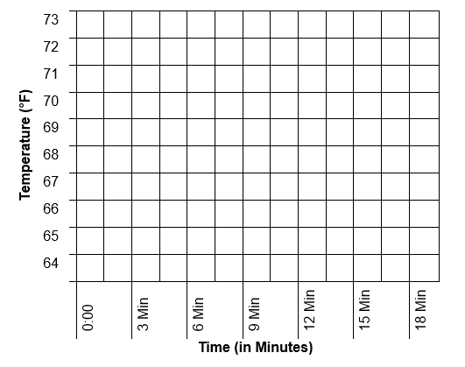
Temperature Variations in Soil and Water
Notes:
Less than 1 min
a. “In this investigation, you’ll measure the temperatures of water and soil samples at 3-minute intervals and record them on a data table like the one on this slide. First, you’ll take a baseline temperature before turning on the heat lamp. Then you’ll take readings every 3 minutes and record the temperatures in the corresponding columns on the data table. At 9 minutes, you’ll measure and record the temperatures and then turn off the heat lamp. As the soil and water samples cool, you’ll continue measuring and recording temperatures every 3 minutes. After the investigation is over, you’ll plot the data on graph paper.”

Slide 55
Temperature Variations in Soil and Water
Purpose: To investigate heating and cooling rates of soil and water
Carefully follow the setup instructions on handout 3.6.
First, record baseline temperatures for each sample on your data tables (handout 3.7). Then turn on the heat lamp and record temperatures every 3 minutes during the heating phase.
After the 9-minute reading, turn off the heat lamp and record temperatures every 3 minutes as the samples cool.
After recording the temperature data, plot the data for each sample on the graph (handout 3.7).
Notes:
30 min
a. Have participants locate handout 3.6 (Lab Instructions for Uneven-Heating Demonstration) in their PD program binders.
b. Read the instructions on the slide and go over the instructions on handout 3.6 for setting up the experiment. Emphasize the importance of following the directions carefully.
Note: Rather than asking volunteers to track the time for this investigation, it may be more efficient to track it yourself (using a wall clock with a second hand, a stopwatch, or the clock on your cell phone). However, you may want to ask for one or more volunteers to take the temperature readings.
c. Before turning on the heat lamp, make sure participants record the baseline temperature of the soil and water samples on their data tables.
d. After turning on the heat lamp, take temperature readings every 3 minutes. After the 9-minute reading, turn off the heat lamp and take three more readings at 12, 15, and 18 minutes.
e. After participants have recorded all the temperature readings on their data tables, have them plot the data on the graph in handout 3.7 (page 2).
f. Emphasize that participants won’t answer the questions on the handout.

Slide 56
Temperature Variations in Soil and Water
What patterns do you observe when you compare the soil and water temperatures during the heating phase? What about during the cooling phase?
Which material (soil or water) heats up and cools down more quickly? Which material changes temperature more gradually?
How does water temperature or soil temperature relate to air temperature?
How do these observations relate to the three-cities investigations you conducted?
Notes:
8 min
a. Read the questions on the slide.
b. Pairs: Have participants pair up to discuss their observations and work together to develop concise answers to the questions.
c. Whole group: Invite a few pairs to share their observations and answers to the questions. Elicit differing points of view and ask probe and challenge questions to clarify participants’ thinking.

Slide 57
Unit Central Questions
Is weather the same everywhere all of the time? How do you know?
Notes:
8 min
a. “How would you answer these questions based on what we’ve learned so far about weather and weather patterns from our content deepening work?”
b. Pairs: “Discuss this with an elbow partner and work together to develop concise answers to the unit central questions. Make sure to include evidence from our investigations. You can use any available resources for this activity, including your science notebooks, handouts, and charts.”
c. Whole group: Invite participants to share their ideas and evidence with the group. Elicit a variety of responses and ask probe and challenge questions to clarify participants’ thinking. Work toward a consensus.

Slide 58
Key Science Ideas
Weather isn’t the same everywhere all of the time.
Certain weather patterns are typical for specific places and times of the year.
We can use weather data to compare the weather in different places and identify weather patterns that are typical for specific locations.
Notes:
Less than 1 min
a. Read the key science ideas on the slide.

Slide 59
Summary: Moving Student Thinking Forward
How can we advance student thinking without simply telling students about science ideas and asking them to memorize the concepts?
Refer to our Effective Science Teaching chart from day 1. Which of these ideas do you want to highlight based on the strategies we’ve explored so far? Anything you want to add or modify?
Notes:
5 min
a. Have participants share ideas about the first question on the slide. Then ask, “What are some things we’ve discussed today that address this question?”
b. Refer participants to the Effective Science Teaching chart from day 1 and discuss the remaining questions on the slide. Modify the chart as participants share their ideas.

Slide 60
Summary: Today’s Focus Questions
Lesson Analysis
Content Deepening
How can analyzing data and constructing explanations help students move forward toward deeper understandings of science ideas?
How is weather the same or different in different places?
How can we use what we know about weather patterns to decide whether a mystery city is Pomona?
Notes:
5 min
a. Review today’s focus questions.
b. Discuss: The STeLLA strategies booklet claims that strategies 4 and 5 are ways of moving student thinking forward. How would you support or challenge that claim? In other words, are you convinced that letting students analyze data and construct explanations will help them move forward toward deeper understandings of science ideas?
c. Ask: “What key ideas do you now have about how to address our content deepening focus question?”

Slide 61
Homework
Review strategy 6 in the STeLLA strategies booklet and complete the STL Z-fold summary chart for this strategy: Engage students in using and applying new science ideas in a variety of ways and contexts.
Be prepared to share your assigned lesson plan review.
Notes:
1 min
a. “Tomorrow we’ll focus on another strategy to help move student thinking forward toward deeper understandings of science ideas.”
b. Review the homework assignment and have participants copy it into their science notebooks.

Slide 62
Reflections on Today’s Session
Complete the Daily Reflections sheet (handout 3.8).
What new idea or insight did you have today related to strategy 4 (analyzing and interpreting data and observations) and strategy 5 (constructing explanations and arguments)?
What ideas do strategies 4 and 5 give you about things to try or change in your science teaching?
Answer one of these questions: (1) What important science idea are you taking away from our content deepening work today? Remember to state the idea in a complete sentence. (2) What question do you have about weather or weather patterns (i.e., something you’re unclear or wonder about)?
Notes:
4 min
a. Have participants reflect on today’s session and answer the questions on the Daily Reflections sheet (handout 3.8 in PD program binder).
Note: To support this task, encourage participants to refer to the STeLLA strategies booklet, the charts they created for STL strategies 4 and 5, the Effective Science Teaching chart, and their STL Z-fold summary charts.

Slide 63
Norms for Working Together: The Basics
Purpose: Build trust and develop a productive study group for all participants.
The Basics
Arrive prepared and on time; stay for the duration; return from breaks on time.
Remain attentive, thoughtful, and respectful; engage and be present.
Eliminate interruptions (turn off cell phones, email, and other electronic devices; avoid sidebar conversations).
Make room for everyone to participate (monitor your floor time).
Notes:
Hidden slide—available for use as needed.

Slide 64
Norms for Working Together: The Heart
Purpose: Build trust and develop a productive study group for all participants.
The Heart of RESPeCT Lesson Analysis and Content Deepening
Keep the goal in mind: analysis of teaching to improve student learning.
Share your ideas, uncertainties, confusion, disagreements, questions, and good humor. All points of view are welcome.
Expect and ask questions to deepen everyone’s learning; be constructively challenging.
Listen carefully; seek to understand other participants’ points of view.
Notes:
Hidden slide—available for use as needed.

