Slide 1
RESPeCT PD pROGRAM
Day 4
RESPeCT Summer Institute
Notes:
5 min
a. Take care of any housekeeping issues.

Slide 2
Agenda for Day 4
Day-3 reflections
Importance of STL strategy 5: constructing explanations
Introducing Student Thinking Lens strategy 6
Lesson analysis: STL strategy 6
Review: STL strategies 1–6
Weather and Seasons lesson plans review
Lunch
Content deepening: weather and seasons
Summary, homework, and reflections
Notes:
3 min
a. Talk through the agenda for the day.

Slide 3
Trends in Reflections
Lesson Analysis | Science Content Learning
Notes:
5 min
a. Invite participants to look at your feedback on their reflections from day 3 and offer reactions, comments, or follow-up questions.

Slide 4
Today’s Focus Questions
Why is it necessary to engage students in using and applying new science ideas in a variety of ways and contexts?
How will the Student Thinking Lens strategies help you teach the lessons on weather and seasons?
Why isn’t weather the same everywhere all of the time?
Why do we use graphs?
Notes:
1 min
a. Introduce the focus questions that will guide today’s work.
b. “Like STeLLA strategies 4 and 5, the goal of strategy 6 is to move student thinking forward toward deeper understandings of science ideas.”

Slide 5
Notes:
1 min
a. Draw participants’ attention to the new strategy highlighted on the slide.
b. “Strategy 6 is the third STL strategy that is a type of activity designed to move student thinking forward.”

Slide 6
The Importance of Engaging Students in Constructing Scientific Explanations
Read handout 4.1 and your group-specific handout. Then complete the assigned task:
Group 1: Analyze a student explanation (handout 4.2).
Group 2: Summarize benefits for students of constructing scientific explanations (handout 4.3).
Group 3: Summarize the benefits for teachers of engaging students in constructing scientific explanations (handout 4.3).
Notes:
25 min
Note: If you need some time to catch up on day-3 activities, you can skip this slide. However, this activity is beneficial for reviewing strategy 5 (constructing explanations) and helping participants understand why explanation building is such important work in science and beyond.
Timing note: For this segment, allot 5 minutes for reading, 10 minutes to prepare for a group share-out, and 10 minutes for the share-out.
a. Divide participants into three groups or pairs. Assign each group a number (1, 2, 3).
b. Direct participants to three handouts:
Importance of Engaging Students in Constructing Scientific Explanations (handout 4.1 in PD program binder) (This handout describes what groups are to do with the following two handouts.)
Student Work from Zembal-Saul Book What’s Your Evidence? (handout 4.2 in PD binder) (Group 1’s task is linked to this handout.)
Benefits of Engaging Students in Constructing Scientific Explanations (handout 4.3 in PD binder) (Tasks for Groups 2 and 3 are linked to this handout.)
c. After participants have read the designated handouts for their groups and completed their assigned tasks, invite them to share out.

Slide 7
The CERA Framework for Constructing Scientific Explanations
Next, we’ll watch video clip of a 3rd-grade teacher instructing students how to construct scientific explanations.
Think about ideas this clip gives you for helping your students learn to construct scientific explanations by making a claim, supporting it with evidence and reasoning, and considering alternative explanations and strategies (CERA).
Link to Introducing the CER video clip.
Notes:
10 min
Note: This activity is optional but powerful.
a. “Let’s watch how one 3rd-grade teacher taught her students to construct scientific explanations. This is the teacher whose student writing Group 1 just read about. The class in this video clip has been studying simple machines (such as pulleys and levers).”
b. “We’re not going to analyze this video clip in terms of STeLLA strategies. Instead, think about ideas this clip gives you as to how you might introduce your students to the CERA framework for constructing scientific explanations, which involves making a claim, supporting it with evidence and reasoning, and considering alternative explanations and strategies.”
c. After watching the clip, discuss participants’ reactions and any ideas it gave them about how they might help their students learn to construct strong scientific explanations.
Note: Make sure participants are aware that in addition to using the CERA framework as a tool for teaching students how to develop scientific explanations and arguments (STeLLA strategy 5) in the classroom, they will be using the same framework for videocase-based lesson analysis of their science teaching in RESPeCT study groups throughout the school year.

Slide 8
Introducing STL Strategy 6
Engage students in using and applying new science ideas in a variety of ways and contexts.
What are the purpose and key features of this strategy?
Why do you think use-and-apply questions or activities are often shortchanged in science teaching?
Notes:
20 min
a. Small groups (10 min): Divide participants into two groups to make charts highlighting the purpose and key features of strategy 6: Engage students in using and applying new science ideas in a variety of ways and contexts. Encourage participants to refer to the STeLLA strategies booklet and STL Z-fold summary chart for this activity.
b. Whole group (10 min): Have groups present their charts in a whole-group share-out and compare them. Ask participants, “What differences and similarities do you notice when you compare your charts with those of other groups?”
Key ideas:
Strategy 6 is a time for “strategic telling” and making sure students are using science ideas accurately.
A use-and-apply question or activity occurs after students have experienced/encountered a new science idea. It provides an opportunity for students to use and apply the idea in a new context or novel way and/or link two or more ideas together.
A common misconception is that use-and-apply questions or activities assess student learning. Teachers often talk about asking these kinds of questions on tests. However, according to research findings published in How People Learn (National Academy of Sciences, 2000), application is part of the learning process, or developing a conceptual framework. If application is treated like assessment, students may encounter a use-and-apply question on a test without ever having had the opportunity to practice this way of thinking as part of their learning.

Slide 9
Lesson Analysis: Focus Question 1
Why is it necessary to engage students in using and applying new science ideas in a variety of ways and contexts?
Notes:
Less than 1 min
a. Highlight the focus question that will guide the lesson analysis work during this phase.

Slide 10
Lesson Analysis: Review Lesson Context
Read the lesson context for this video clip at the top of the transcript (handout 4.4 in your PD program binder).
Notes:
2 min
a. “Read the lesson context at the top of the video transcript (handout 4.4 in your PD program binders).”
b. Make sure participants understand the science content and activity that are the focus of this video clip.
Note: Refer to the content background document as needed throughout the lesson analysis.

Slide 11
Lesson Analysis: Identify Strategy 6
What makes this a use-and-apply task? (Focus on task.)
What do you notice about the types of questions the teacher asks during the clip?
Link to video clip: 4.1_mspcp_kinder_weather_johnson_L5_c1-2
Notes:
25 min
a. “As you watch the video, think about what makes activity in this clip a use-and-apply task. What science ideas should students be using and applying in each scenario? Also notice what kinds of questions the teacher asks.”
b. Show the video clip.
c. Individuals: “Think about the questions on the slide and mark the transcript as you identify the use of strategy 6.”
d. Whole group: Discuss participants’ responses to the questions.

Slide 12
Lesson Analysis: Analyze Strategy 6 and Reflect
Analyze:
What student thinking is revealed by engaging students in using and applying new science ideas? By providing a claim, evidence, and reasoning?
Reflect:
What did you learn about strategy 6 from watching and analyzing this video clip?
Notes:
25 min
a. Individuals: “For the analysis question on the slide, study the video transcript and come up with a claim, evidence, and reasoning to support your claim.”
b. Whole-group share-out: As participants share their claims, evidence, and reasoning, encourage them to challenge one another by asking questions, disagreeing, and suggesting improvements or alternative explanations and arguments. (Refer to the norms at the heart of the RESPeCT program.)
Note: You may also want to ask participants whether they noticed in the transcript any missed opportunities for engaging students in using and applying new science ideas.
c. Reflect (1 min): Give participants time to think about the reflection question on the slide.
d. Whole-group discussion. Discuss the reflection question as a group. Make sure participants note specifically what they learned about strategy 6 from watching and analyzing this video clip.

Slide 13
Check Your Understanding of Strategy 6
Jot down your responses to this multiple-choice quiz:
Use-and-apply tasks are used [before/during/after] new science ideas are introduced.
For difficult content ideas, students might need to practice applying new ideas in [one/two/many] different contexts.
[True/false]: Use-and-apply questions or activities are used primarily for student assessment at the end of a unit.
It’s appropriate for teachers to ask [elicit/probe/challenge] questions during a use-and-apply activity.
Teachers should [never/judiciously/always] tell students about science ideas they are missing or stating inaccurately.
Notes:
5 min
Note: This activity is optional if time is running short.
a. “To check your understanding of STL strategy 6, jot down your responses to this multiple-choice quiz.”
b. Have participants discuss their answers either in pairs or as a group. (If time is short, just read the answers aloud.)
Answer key:
After
Many
False
Challenge (and probe)
Judiciously (defined as “good or discriminating judgment; wise, sensible, or well advised”)

Slide 14
Reflect: Lesson Analysis Focus Question 1
Why is it necessary to engage students in using and applying new science ideas in a variety of ways and contexts?
Notes:
3 min
a. Individuals (1 min): “Think for a moment about how you would answer the focus question on this slide.”
b. Whole-group share-out (2 min): Have a few participants share their ideas.

Slide 15
Lesson Analysis: Focus Question 2
How will the Student Thinking Lens strategies help you teach the lessons on weather and seasons?
Notes:
Less than 1 min
a. Transition: “We’ll now shift our attention to the second lesson analysis focus question and spend some time summarizing what we’ve learned so far about Student Thinking Lens strategies 1–6. Then we’ll review the Weather and Seasons lesson plans and highlight how these strategies are used in the lessons you’ll start teaching in January.”

Slide 16
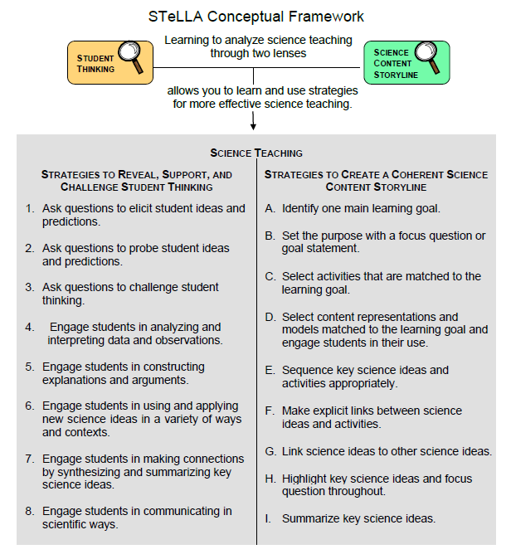
Notes:
Less than 1 min
a. “These are the Student Thinking Lens strategies we’ve explored so far. You’ll get practice using them as you teach the lessons on weather and seasons and plants and animals next year.”

Slide 17
Review: Student Thinking Lens Strategies
Review the STL summary chart in the STeLLA strategies booklet and discuss these questions:
What pattern(s) do you see in this arrangement (organization) of the STL strategies?
How does this arrangement (organization) highlight the differences and similarities among the Student Thinking Lens strategies?
Notes:
3 min
Individuals: Have participants review STL strategies 1–6 on the summary chart in the strategies booklet (Summary of STeLLA Student Thinking Lens Strategies).
Whole group: Discuss the questions on the slide.
Key ideas:
Strategies 1–3 are types of questions, and strategies 4–6 are activities designed to move student thinking forward toward more-scientific understandings.
Some strategies are used at any time during the lesson (e.g., probe questions); others are used at specific times (e.g., elicit questions used before students have been introduced to new science ideas; use-and-apply activities used after students have been introduced to new science ideas).
Each strategy has it’s own specific purpose(s), but the strategies are closely connected to one another. That is, these strategies aren’t used in isolation; they’re complementary.

Slide 18
Lesson Analysis: Review Lesson Context
Read the lesson context for this video clip at the top of the transcript (handout 4.5 in your PD program binder).
Notes:
1 min
a. “Read the lesson context at the top of the video transcript (handout 4.5 in your PD program binders).”
b. Make sure participants understand the science content and activity that are the focus of this video clip.

Slide 19
Lesson Analysis: Identify Student Thinking Lens Strategies
What Student Thinking Lens strategies can you identify in this video clip?
After watching the video, study the transcript (handout 4.5) and fill in handout 4.6 (Identifying Student thinking Lens Strategies).
Be ready to share your findings with the group, including any missed opportunities.
Link to video clip: 4.2_mspcp_kinder_weather_gaines_L2_c3-4
Notes:
30 min
Note: If absolutely necessary, you can skip this video analysis.
a. Orient participants to handout 4.6, Identifying Student Thinking Lens Strategies.
b. Make sure participants understand the context of the video clip (from the transcript).
c. Show the video clip.
d. Individuals: “Study the video transcript and complete handout 4.6, Identifying Student Thinking Lens Strategies.”
e. Whole group: “What STL strategies did you identify in the video transcript? Did you spot any missed opportunities?”

Slide 20
RESPeCT PD Program School-Year Plan
Summer Institute
Content deepening: Weather and Seasons and Plants and Animals |  | Lesson analysis: Introduction to the STeLLA framework and strategies
Fall Study-Group Sessions
Fall Teaching Rounds 1 and 2 | Use the STeLLA strategies while teaching lessons on plants and animals. Analyze student thinking and science content storylines using video from our own classrooms. Deepen content knowledge of plants and animals through lesson video analysis. |  | Plants and Animals
Spring Study-Group Sessions
Spring Teaching Rounds 1 and 2 | Use the STeLLA strategies while teaching lessons on weather and seasons. Analyze student thinking and science content storylines using video from our own classrooms. Deepen content knowledge of weather and seasons through lesson video analysis. |  | Weather and Seasons
Notes:
1 min
a. “Before we share our reports about each of the Weather and Seasons lesson plans and how they support you in practicing these Student Thinking Lens strategies, let’s review the plan for the school year.”
b. “In the fall you’ll teach the Plants and Animals lessons, and we’ll meet in our study group to analyze video clips and student work from these lessons. This analysis will help us deepen our understandings of the STeLLA strategies, the science content, the lesson plans, and our students’ thinking and learning.”
c. “Starting in January, you’ll teach the Weather and Seasons lessons, and we’ll meet in our study group to analyze video clips and student work from these lessons. Do you have any questions?”
d. Important reminder: “Remember that we’re analyzing video clips of our own classroom teaching to help us all learn, not to evaluate and critique one another. Everyone is learning to use both new strategies and new lesson plans, so it’s predictable that our first attempts at teaching these lessons will have rough spots. We need to appreciate and acknowledge the courage each of us is demonstrating in sharing our initial efforts to teach these lessons. Please be assured that our analyses of the videos will focus on the strategies, the science content, and most importantly, how students are making sense of the lessons. We’re not going to focus on rough spots or management problems. We’re here to support one another and to learn and grow as science teachers.”

Slide 21
The RESPeCT Lesson Plans as a Study Tool: Part 1
The RESPeCT lesson plans are study tools designed to support your learning and for our study group to analyze.
This has two implications.
These lessons don’t represent a complete unit. You may need to add lessons to help your students achieve all the learning goals, and …
Notes:
2 min
a. Read through the information on this slide.
b. Elicit and respond to any comments or questions from participants.

Slide 22
The RESPeCT Lesson Plans as a Study Tool: Part 2
As a study tool, the lesson plans are highly scripted to model how they might be implemented.
Study this script in your lesson planning.
Adapt the plans and PowerPoint slides to make them work for you and your students (but don’t add or drop main activities).
You don’t have to be tied to the script as you teach! Using the slides as a guide can help free you from the script.
Notes:
2 min
a. Read through the information on the slide.
b. Elicit and respond to any comments or questions from participants.

Slide 23
Lesson Plan Conversation
The science content storyline across lessons
Review the main learning goal for each lesson sequentially.
The science content storyline within lessons (5–8 min for each two-part lesson)
How does this lesson fit into the arc of all the lessons?
What are the main learning goal and focus question?
What is the main activity (or activities)?
How will the activity help students better understand the learning goal for the day?
What STeLLA strategies are highlighted in the activity?
What concerns or suggestions do you have regarding the activity?
Practical issues and questions
Notes:
60 min in conjunction with next slide
a. For step 1 on the slide, have participants describe the main learning goal for their assigned two-part lesson (parts A and B) and how it connects to lessons that precede and follow it. (5 min)
b. For steps 2 and 3, have participants report on their assigned two-part lesson.
Note: Rather than walking through every step in the lesson plan, participants should present the big picture using the questions in step 2 on the slide. They should bring up details only when they have some concern, question, or suggestion about a modification.
c. As participants give their reports, mark on a chart the Student Thinking Lens strategies that are highlighted in each lesson. (Use the chart on the next slide as a model.)
Note: Encourage participants to pick just one or two Student Thinking Lens strategies that are highlighted in the lesson. (Several strategies may be used in a lesson.)
d. Highlight the following ideal pattern and how STL strategies work together across lessons:
Elicit and probe strategies are very important in lesson 1.
Probe and challenge strategies are used throughout all the lessons.
Strategies 4 and 5 are highlighted in the middle lessons.
Strategy 6 is highlighted toward the end of a lesson, after students encounter new science ideas but before final unit assessments.
Timing note: Make sure you limit the time allotted for each lesson so you can get through them all. If you have 6 two-part lessons, you’ll have approximately 8 minutes for each lesson (4 minutes for part A, and 4 minutes for part B). If your lesson series has more than 6 two-part lessons, or has more than two parts per lesson, you’ll have to decrease the time for each lesson.

Slide 24
STL Strategies Highlighted in Weather and Seasons Lessons
 | 0a | 0b | 0c | 0d | 1a | 1b | 1c | 2a | 2b | 2c | 2d | 3a | 3b | 4a | 4b | 4c | 5
1. Elicit
2. Probe
3. Challenge
4. Analyze/ Interpret
5. Explain/ Argue
6. Use/Apply
Notes:
60 minutes in conjunction with slide 22
a. Use this slide in conjunction with the previous slide.

Slide 25
Weather and seasons
SCIENCE AND MATH CONTENT DEEPENING Kindergarten
Notes:
Less than 1 min
“Let’s dig into our content deepening work for today.”
Note: Refer to the content background document and Common Student Ideas about Weather and Seasons as needed throughout this phase.

Slide 26
Weather and Seasons
Content Deepening
Day 4
Developed by
Dr. Jeff Marshall
Geological Sciences
Cal Poly Pomona
Used by permission
Photo courtesy of Pixabay.com
Photo courtesy of pixabay.com
Notes:
Less than 1 min
a. “Today we’ll synthesize our understandings of why weather isn’t the same everywhere. We’ll also investigate the use of graphs for identifying patterns in data and the importance of presenting data as clearly and accurately as possible.”

Slide 27
Unit Central Questions
Is weather the same everywhere all of the time? How do you know?
Notes:
Less than 1 min
a. Review the unit central questions on the slide.
b. Remind participants that these questions will guide student learning throughout the Weather and Seasons lesson sequence.
c. “Today we’ll continue exploring the key science ideas that will help us answer these questions.”

Slide 28
Content Deepening: Focus Question 1
Why isn’t weather the same everywhere all of the time?
Notes:
1 min
a. “Based on the evidence we’ve gathered in our content deepening sessions, we know that weather isn’t the same everywhere all of the time. But why? What causes differences in weather patterns from place to place?”
b. “Even though we won’t explore this in depth with our kindergartners, it’s important that we understand why weather is different in different places and at various times of the year.”
c. “We already have some ideas about what causes these differences, but let’s spend a few minutes reviewing what we know that can help us answer this focus question.”
d. Have participants copy the focus question into their science notebooks and leave space to write a response.

Slide 29
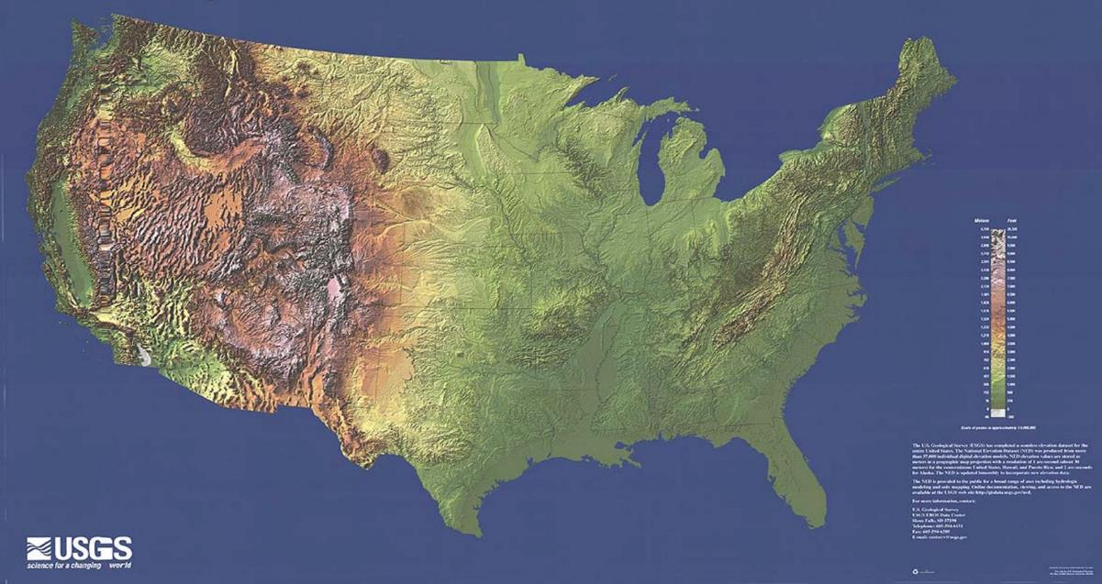
What Causes Temperature Variations?
What causes the different temperature patterns in San Francisco, Colorado Springs, and St. Louis?
Photo courtesy of USGS
Notes:
6 min
a. “In our previous content deepening session, we investigated possible causes of temperature variations among three cities: San Francisco, Colorado Springs, and St. Louis. What did we find out? What causes the different temperature patterns in these cities?”
b. Pairs: Have participants discuss this question with an elbow partner. Allow them to use available resources (notes, handouts, charts) to help them develop a list of causes.
c. Whole group: Invite pairs to share their ideas with the group. List the causes of temperature variations on chart paper and encourage participants to agree, disagree, ask questions, or add on during this discussion. Make sure participants include evidence to support the causes they list.

Slide 30
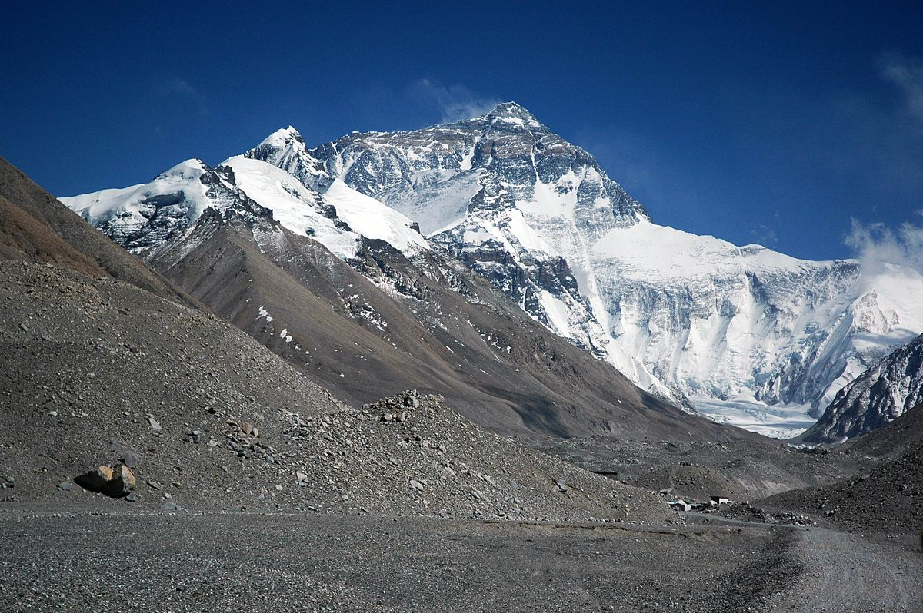
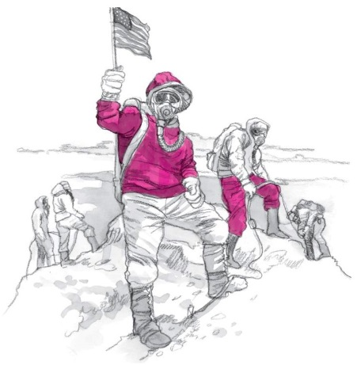
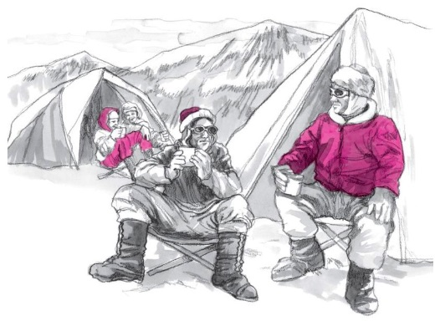
Investigation: Climb to Cold!
Photo courtesy of Wikimedia.org/BSCS
Notes:
Less than 1 min
a. “Next, we’ll engage in one final investigation to help us synthesize our ideas about why weather isn’t the same everywhere. For this investigation, we’ll read a story titled “Climb to Cold” about a hiking expedition to Mount Everest. The inset images on this slide are from the story.”
b. Note that this activity comes from a 6th-grade lesson on the Sun’s effect on climate.

Slide 31
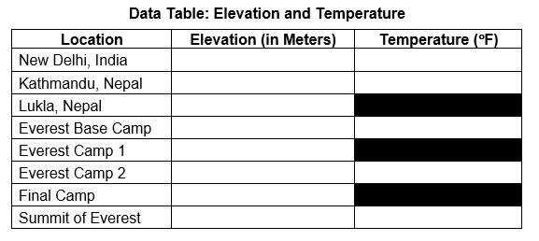
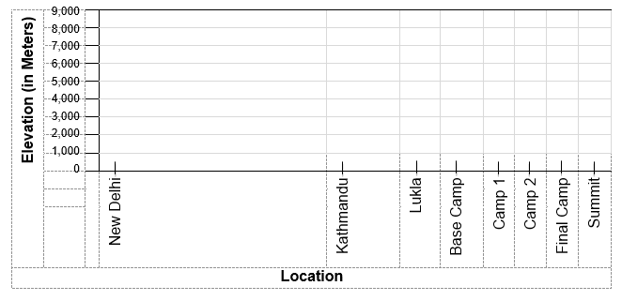
Investigation: Climb to Cold!
Notes:
1 min
a. “Throughout the story, you’ll find elevation and temperature data that you’ll record on a data table like the one at the top of this slide. Then you’ll plot the data on a graph and analyze the results.”
b. Direct participants to pair up with an elbow partner for the investigation. Then have them locate handout 3.7 (Uneven Heating) from the previous session and handout 4.7 (Climb to Cold) in their PD program binders.

Slide 32
Investigation: Climb to Cold
Carefully follow the instructions on part 2 of handout 3.7 (Uneven Heating).
Individuals: Read the story on handout 4.7 (Climb to Cold). Pause whenever you see a stop sign ( ) and record the elevation and temperature data on the data table (page 3 of handout 3.7). Then plot the data on the graph on page 4. (Some locations won’t have temperature data.)
Pairs: Discuss the questions on handout 3.7 (pages 4 and 5).
Think: How does this story relate to the temperature variations we observed for the three cities?
Notes:
15 min
a. Read the instructions and the question on the slide. Then walk participants through the instructions in part 2 of handout 3.7.
b. Ask participants if they have any questions before they begin reading the Climb to Cold story.
c. Emphasize that pairs should develop concise answers to the questions on handout 3.7 and be prepared to share their ideas with the group.
d. Whole group: Following the investigation, invite participants to share their responses to the questions on the handout. Challenge them to use evidence from the data table and graph to support their answers.

Slide 33
What about the Three Cities?
How does the story relate to the temperature variations between San Francisco, Colorado Springs, and St. Louis?
Photo courtesy of USGS
Notes:
5 min
a. “How does the story relate to the temperature variations between San Francisco, Colorado Springs, and St. Louis?”
b. Elicit a variety of ideas and ask probe and challenge questions to clarify participants’ thinking.
c. Review the list of causes you recorded earlier for temperature variations among the three cities and ask participants if they have any causes to add to the list.
d. Emphasize that the story illustrates how elevation affects temperatures in different locations. As elevation increases, temperatures generally decrease. Elevation is one key factor that causes temperature variations between cities like San Francisco, Colorado Springs, and St. Louis, even though these cities are located at approximately the same latitude.

Slide 34
Use and Apply What You’ve Learned
Do you think that weather patterns are similar or different in Pomona, California; Hiroshima, Japan; and Casablanca, Morocco?
Discuss this question with an elbow partner. Consider as many factors as you can.
Develop a claim and support it with evidence. Be prepared to share your claim, evidence, and reasoning with the group.
You may use any available resources, including the Internet, the lesson content background document, and a globe or world map.
Notes:
12 min
a. “Do you think that weather patterns are similar or different in Pomona, California; Hiroshima, Japan; and Casablanca, Morocco?”
b. Pairs: “Discuss this question with an elbow partner. Consider as many factors as possible that might explain similarities or differences between the weather patterns in these cities. Then work together to make a claim that answers the question using what you’ve learned about weather patterns. You can also use any available resources to find evidence that supports your claims. Be prepared to share your claims, evidence, and reasoning with the group.”
c. Some of the resources participants might use are listed on the slide (e.g., the Internet, the content background document in their lesson plans binders, a globe or world map), but allow them to use any other resources at their disposal.
d. Whole-group discussion: Invite participants to share their claims, evidence, and reasoning with the group. Record key ideas on chart paper and ask probe and challenge questions to clarify participants’ reasoning.
Key ideas:
Latitude, the angle of sunlight striking Earth’s curved surface, Earth’s tilt and orbit, elevation, and proximity to water and mountains are all factors that influence weather patterns in different locations at various times of the year.

Slide 35
Reflect: Content Deepening Focus Question 1
Why isn’t weather the same everywhere all of the time?
Notes:
4 min
a. Review the focus question on the slide.
b. Individuals: Have participants answer the question in their science notebooks, using evidence the investigations to support their ideas.
c. Whole group: Invite participants to share their ideas and evidence with the group. Record key ideas on chart paper and ask probe and challenge questions to clarify participants’ thinking.

Slide 36
Unit Central Questions
Is weather the same everywhere all of the time? How do you know?
Notes:
7 min
a. “Let’s revisit our unit central questions.”
b. Read the questions on the slide.
c. Pairs: Have participants pair up with an elbow partner and work together to develop a few concise statements that answer the questions. Remind them to support their answers with evidence from the weather investigations they conducted this week.
d. Whole group: Invite pairs to share their answers and evidence with the group. Record key ideas and evidence on chart paper. Elicit a variety of responses and ask probe and challenge questions to clarify participants’ reasoning.
e. Encourage participants to listen carefully to the ideas others share and be prepared to agree or disagree, ask questions, and add ideas or evidence from the investigations.

Slide 37
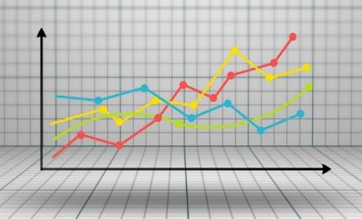
Presenting Data
Courtesy of Pixabay.com
Courtesy of Pixabay.com
Dr. Laurie Riggs
Lriggs@cpp.edu
Courtesy of Cal Poly Pomona
Courtesy of Pixabay.com
Notes:
Less than 1 min
a. “Next, we’ll focus on math content deepening and explore ideas about data presentation.”

Slide 38
Content Deepening: Focus Question 2
Why do we use graphs?
Notes:
1 min
a. Introduce the focus question on the slide.
b. Have participants write the question in their science notebooks.

Slide 39
What Do You Know about Graphs?
What do you already know about graphs and why we use them?
Is it important to know which type of graph to use and how to read and/or interpret it?
Notes:
1 min
a. “First, let’s share what we already know about graphs.”
b. Discuss the questions on the slide and record participants’ ideas on chart paper.
c. Emphasize: “We want our students to be graph literate and comfortable using graphs.”

Slide 40
What Does This Graph Depict?
1989
1999
Claim: Oil consumption in the US doubles.
Notes:
2 min
a. “What does the graph on this slide depict? Is it an accurate representation?”
Ideal answer: The graph falsely depicts that the oil consumption from 1989 to 1999 more than doubled.
b. “What do you think is missing from this graph?”
Ideal answer: It has no legend or units.
c. “In this content deepening session, we’ll consider the importance of presenting data as clearly and accurately as possible. We’ll also look at some deceptive statistics and talk about the implications for clarity.”

Slide 41
What Does Statistics Involve?
The study of statistics involves math and relies on numerical calculations. It also relies on how the numbers are chosen and how the data are presented and interpreted.
Notes:
Less than 1 min
a. “Let’s think for a moment about what statistics involves.”
b. Read the information on the slide.
c. “So if statistics relies on how numbers are chosen and how the data are presented and interpreted, can statistics be misleading or even deceptive? Next, we’ll consider how statistics were presented and interpreted in different scenarios and see if we can identify a major flaw in each scenario.”

Slide 42
Scenario 1: Ice-Cream Sales
A new advertisement for Ben and Jerry's ice cream introduced in late May of last year resulted in a 30% increase in ice-cream sales for the following three months. Thus, the advertisement was effective.
Fact: Ice-cream consumption generally increases in the months of June, July, and August, regardless of advertisements.
The major flaw in this scenario is called a history effect and leads people to interpret outcomes as the result of one variable when another variable (in this case, seasonal timing) is actually responsible.
Notes:
6 min
Note: Initially, display only the scenario at the top of the slide.
a. Introduce the scenario on the slide.
b. “What is the major flaw in how the statistics in this scenario were presented and interpreted?”
c. Think-Pair-Share: Ask participants to think about this question for a moment and then share their ideas with an elbow partner.
d. Whole group: Reveal the rest of the information on the slide and briefly discuss the major flaw in how the statistics were presented and interpreted.

Slide 43
Scenario 2: Churches and Crime
When there are more churches in a city, there is more crime. Thus, churches lead to crime.
Fact: Bigger cities with larger populations have more churches and more crime. Larger populations explain why there are more churches and higher crime rates.
Major flaw: People erroneously believe that there is a causal relationship between two primary variables rather than recognizing that a third variable may be responsible.
Notes:
6 min
Note: This slide may be skipped if time is running short.
a. Display only the scenario at the top of the slide.
b. Ask participants, “What is the major flaw in how the data in this scenario were presented and interpreted?”
c. Think-Pair-Share: Ask participants to think about this question for a moment and then share their ideas with an elbow partner.
d. Whole group: Reveal the rest of the information on the slide and briefly discuss the major flaw in how the statistics were presented and interpreted.

Slide 44
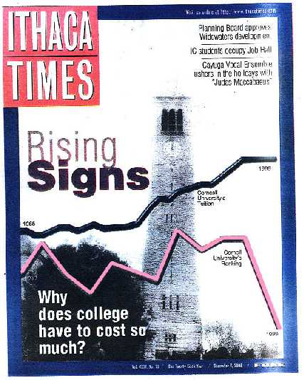
Deceptive Displays
Courtesy of Ithaca Times
Notes:
Less than 1 min
a. “Next, we’ll consider deceptive displays of data.”
b. “This cover of the December 7, 2000, issue of the Ithaca Times shows what may be the most misleading graphs ever published. I have never seen so many graphical sins in a single image!”

Slide 45
Deceptive Displays
Courtesy of Ithaca Times
Notes:
1 min
a. “On the cover of the magazine is the question, ‘Why does college have to cost so much?’ Superimposed on an image of Cornell University are two lines showing the university’s tuition rate and ranking from the 1960s to 1999.”
b. Ask participants, “What message does this graphic convey? How should we interpret it?”

Slide 46
Deceptive Displays
Courtesy of Ithaca Times
Notes:
Less than 1 min
a. “Let’s take a closer look at the graphic on the magazine cover. The top black line shows Cornell’s tuition rising steadily between 1965 and 1999, and the bottom red line shows the university’s ranking rising and falling before plummeting to an all-time low in 1999.”
b. “The clear impression is that students are paying more for a college education at Cornell but are receiving far less in terms of quality.”

Slide 47
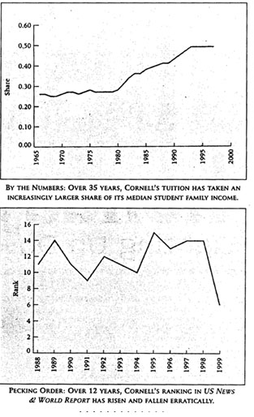
Deceptive Displays
Courtesy of Ithaca Times
Notes:
3 min
a. “Now look at each graph in context.”
b. “What do you notice? What is each graph saying?”

Slide 48
Three Big Problems
The tuition graph covers a 34-year period, and the ranking graph covers an 11-year period, but they’re placed on the same horizontal scale on the cover.
The vertical scales for tuition and ranking couldn’t possibly have common units, but the ranking graph is placed under the tuition graph on the cover, creating the impression that cost exceeds quality.
Here’s the masterstroke: The sharp “drop” in the ranking graph over the past few years actually represents the fact that Cornell's ranking actually improved from 15th to sixth!
Notes:
1 min
a. “Here are three big problems with the tuition and ranking graphs:
“The tuition graph covers a 34-year period, and the ranking graph covers an 11-year period, but they’re placed on the same horizontal scale.
“The vertical scales for tuition and ranking couldn’t possibly have common units, but placing the ranking graph under the tuition graph on the cover creates the impression that cost exceeds quality.
“Here’s the masterstroke: The sharp “drop” in ranking on the graph actually represents the fact that Cornell's ranking improved from 15th to sixth!”
b. “What are the implications of failing to examine data presentations with a critical eye? What are the implications for our students?”

Slide 49
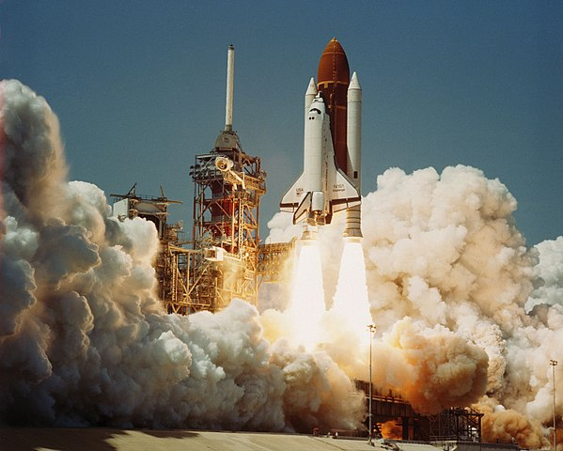
The Challenger Disaster
Courtesy of Cal Poly Pomona
Photo courtesy of Wikipedia.org
Notes:
Less than 1 min
a. “The way data is presented can not only be misleading or deceiving; it can also cost lives! Do you remember the Challenger disaster in 1986?”
b. “In 1997, Edward R. Tufte, one of the world's leading experts in the visual presentation of information, demonstrated how poor data presentation contributed to the explosion of the space shuttle, which led to the deaths of seven astronauts.”

Slide 50
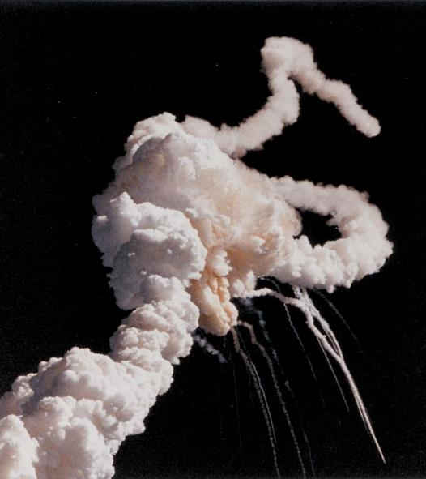
The Challenger Disaster
Tufte’s argument: If the data had been presented more clearly, NASA officials would have understood the extreme risk of O-ring failure in cold temperatures and surely would have postponed the launch!
Photo courtesy of Kennedy Space Center/Wikipedia Commons
Notes:
Less than 1 min
a. “Tufte's argument was compelling: Had the data been presented more clearly, NASA officials would have understood the extreme risk of O-ring failure in cold temperatures and surely would have postponed the launch. The data was available well before the launch, but it was never presented in a way that highlighted the problem or made it apparent.”

Slide 51
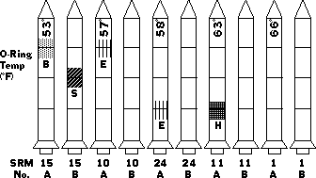
The Challenger Disaster
Source: Tufte, Edward R. (1997). Visual explanations: Images and quantities, evidence and narrative. (pp. 27–54). Cheshire, CT: Graphics Press.
Notes:
2 min
a. “After analyzing the thirteen charts submitted to NASA, Tufte concluded that the chart makers had failed to demonstrate a clear causal link between cold temperature and O-ring damage. They had accurately assessed the problem, but the way they presented the data failed to communicate the severity of the risk to NASA officials.”
b. “Graphics were another major flaw in the presentation. The first chart, like the one shown on this slide, included a legend with symbols of various types of damage to the O-rings, but the legend didn’t appear on subsequent charts that showed serious O-ring damage. Had the legend appeared on every chart, NASA officials would have been able to quickly and accurately assess the damage.”

Slide 52
The Challenger Disaster
Space Shuttle Challenger Historical Launch Data Temperatures and O-ring Condition
Courtesy of Edwardtufte.com
Source: Tufte, Edward R. (1997). Visual explanations: Images and quantities, evidence and narrative. (pp. 27–54). Cheshire, CT: Graphics Press.
Notes:
6 min
a. “Let’s examine a different presentation of the O-ring data.”
b. Distribute handout 4.8 (Space Shuttle Challenger Historical Launch Data: Temperatures and O-ring Condition).
c. “This graph shows historical temperature data and O-ring condition for the Challenger. It also tells us that the forecast temperatures for the Challenger launch were between 26 and 29 degrees Fahrenheit. The O-ring damage is plotted along the vertical axis on the graph, and the temperature data is plotted along the horizontal axis.”
d. “What does the graph tell us? At which temperature did the most damage occur?”
e. “Based on this scatter-plot data for the 24 previous Challenger launches, would you predict a problem for the upcoming launch? Why or why not?”
Key observations:
Over the years, Challenger’s O-rings had persistent problems at cooler temperatures. Every launch below 66 degrees resulted in O-ring damage.
At or above 66 degrees, only three launches experienced some O-ring erosion.
A launch forecast of 29 degrees is 5.7 standard deviations from the average temperature for previous launches!
The graph data clearly shows that there were serious risks of O-ring damage for a launch at 29 degrees.

Slide 53
The Best Way to Display Data
What is the best way to display data?
What are some effective ways you’ve displayed data in your classroom?
Notes:
3 min
a. “What is the best way to display data? What are some effective ways you’ve displayed data in your classrooms?”
b. Elicit ideas from participants and record them on chart paper.
c. Emphasize: “The best way to display data can depend on the type of data you collect and what you need to learn from the data. Different types of graphs tell us different things.”

Slide 54
Types of Graphs
What types of graphs and charts are you familiar with? Can you name a few?
Notes:
2 min
a. “What types of graphs and charts are you familiar with? Can you name a few?”
b. As participant’s share their ideas, record them on chart paper.
Possible responses:
Histogram
Bar graph
Line graph or chart
Scatter-plot or scatter graph
Pie chart
Stem-and-leaf plot or diagram
Box-and-whisker plot or box plot

Slide 55
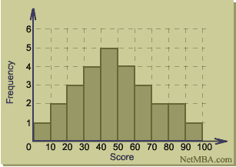
Histograms
Histograms show interval data.
Courtesy of NetMBA.com
Notes:
Less than 1 min
a. “Let’s look at some different types of graphs and charts.”
b. “A histogram is similar to a bar graph, but it’s used for interval data and relates to only one variable. Who can tell me what interval data are?”
Answer: Interval data are a type of data measured along a scale, and each data point is equidistant from another data point.

Slide 56
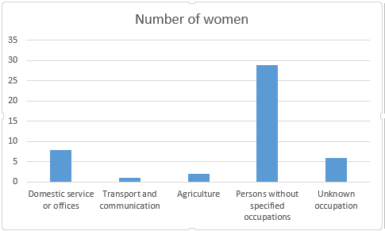
Bar Graphs
How are bar graphs different from histograms?
Courtesy of Mattallen8/ Wikimedia Commons
Notes:
1 min
a. “How are bar graphs different from histograms?”
b. Point out that bar graphs show categorical data and typically have space between the bars. Categorical data are simply data that can be categorized. Color, grade, and size (small, medium, and large) are some examples of categories.

Slide 57
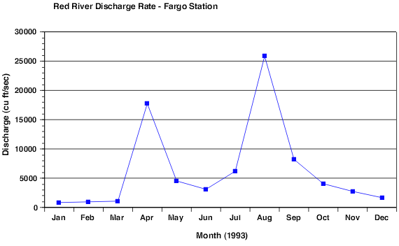
Line Graphs
Courtesy of North Carolina State University
Line graphs help us see more clearly the rate of change (slope) between individual data points. This data could have also been presented as a bar graph.
Notes:
1 min
a. Read the information on the slide.
b. Ask participants, “How are line graphs similar to bar graphs?”

Slide 58
Scatter Plots
Courtesy of North Carolina State University
Notes:
2 min
a. “What does a scatter plot help us see?”
b. Point out that a scatter plot or diagram plots two variables along two axes and shows the pattern of relationships among the data points. The line on the graph is called a trend line or line of best fit and shows the general pattern of the data.

Slide 59
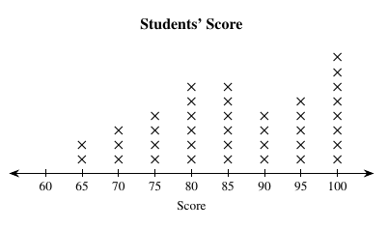
Line Plots
A line plot is a graph that shows data frequency along a number line.
Courtesy of Safwat.alshazly/Wikimedia Commons
Notes:
2 min
a. “A line plot is a graph that shows data frequency along a number line. Students can learn to make this kind of graph at an early age.”
b. “What challenges might students encounter when making a graph like this?”
c. Note that students often don’t pay attention to scale, so graph paper can help.

Slide 60
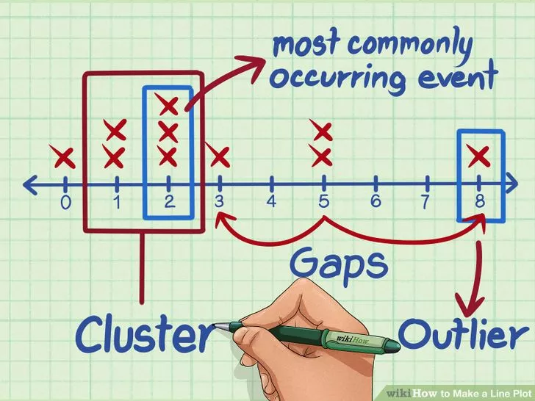
What Do Line Plots Help Us See?
Courtesy of How to Make a Line Plot/WikiHow
Notes:
Less than 1 min
a. “In addition to showing data frequency, line plots also show gaps in data, clusters of data, and outliers.”

Slide 61
Picture Graphs (Pictographs)
Our Class Birthday Chart!
Jan | Feb | Mar | Apr | May | Jun | Jul | Aug | Sept | Oct | Nov | Dec
Notes:
1 min
a. “Kindergarten students most often use picture graphs, or pictographs, to display data, as we saw in the lessons on weather.”
b. “How does this graph relate to other graphs we’ve discussed?”

Slide 62
Stem-and-Leaf Plot
A stem-and-leaf plot or diagram is similar to a dot plot, but the number line is usually vertical, and digits are used instead of dots.
5 | 4 6 7 9
6 | 3 4 6 8 8
7 | 2 2 5 6
8 | 1 4 8
9 |
10 | 6
Examples:
Stem “5” Leaf “4” means 5.4
Stem “6” Leaf “3” means 6.3
Stem “6” Leaf “4” means 6.4
STEM
LEAVES
Notes:
Less than 1 min
a. Read the information on the slide.
b. “This type of graph is also similar to a histogram placed on its side, but it can display more information. You also see the exact data points rather than just the intervals.”

Slide 63
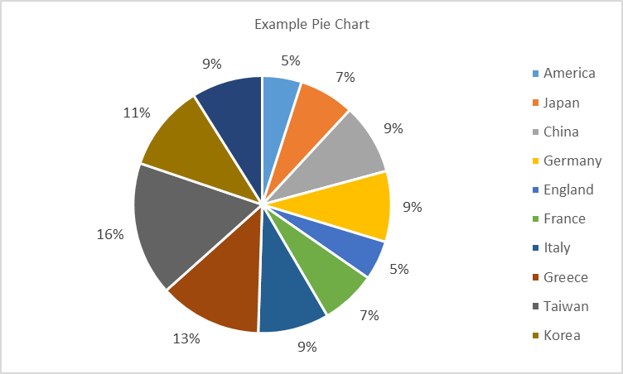
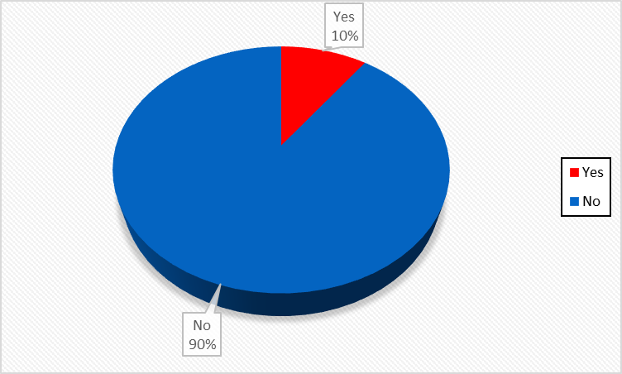
Circle Graphs or Pie Charts
Circle graphs represent categorical data as percentages.
Courtesy of Cal Poly Pomona
Notes:
1 min
a. “Circle graphs or pie charts represent categorical data as percentages. Students can use pie charts to compare data in terms of percentages or fractions of the whole.”
b. “How is a circle graph similar to a bar graph?”
c. Highlight some of the categories and percentages of the circle graph on the slide.

Slide 64
Link to web site: https://nces.ed.gov/nceskids/createagraph/
Notes:
5 min
a. “The National Center for Education Statistics has some very nice resources for students on its website. Let’s look at some of the graphs they can create and the graphing tutorial they can use.”
b. Quickly tour the NCES Kids’ Zone Create a Graph web site and show participants how to use the Create a Graph Tutorial (https://nces.ed.gov/nceskids/help/user_guide/graph/index.asp).

Slide 65
Let’s Learn by Doing!
Is it OK to text on a cell phone while you’re driving?
What if we wanted to see how distraction affects reaction time?
Notes:
Less than 1 min
Note: If time is running short, skip this activity and move on to slide 73 (reflect on the content deepening focus question).
a. “Is it OK to text on a cell phone while you’re driving? What if we wanted to see how distraction affects reaction time?”
b. “Next, we’ll apply what we’ve been learning about graphs and collect some data on reaction time that we can display.”

Slide 66
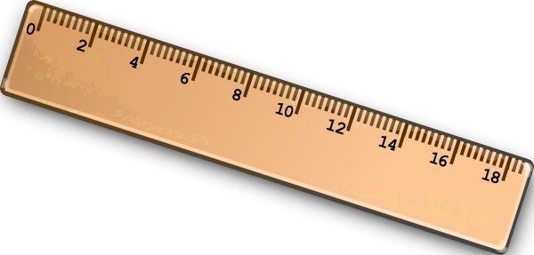
Investigation: Catch a Falling Ruler
In this experiment, you and a partner will test reaction time by catching a falling ruler with and without a distraction.
Courtesy of Pixabay.com
Notes:
2 min
“This experiment is simple. You and a partner will test reaction time for catching a ruler with and without a distraction. One partner will drop a ruler 10 times, and the other partner will try to catch it. You’ll record the measurements you collect and then switch roles. First, you’ll perform the experiment without any distractions, and then you’ll perform it again with a distraction.”
b. Have participants pair up with an elbow partner. Then give each pair a 30-cm ruler.

Slide 67
Investigation: Catch a Falling Ruler
Instructions:
Partner 1: Hold the ruler near the 30-cm mark and let it hang vertically.
Partner 2: Place your thumb and index finger on either side of the 0-cm mark without touching the ruler.
Partner 1: Without warning, let the ruler go. (Hint: To prevent Partner 2 from anticipating when you’ll drop the ruler, vary the timing.)
Partner 2: Try to catch it as quickly as possible when it drops.
Partner 1: Measure just above the first finger where Partner 2 caught the ruler and record the data in your notebook.
Perform the test 10 times with Partner 1 dropping the ruler and Partner 2 catching it. Then calculate and record the mean average of the 10 drops.
Then switch roles. (Partner 2 drops the ruler, and Partner 1 catches it.)
Notes:
15 min
a. Walk participants through the instructions on the slide. Then pair up with a volunteer and model for participants how to drop the ruler and collect the data.
b. Have pairs practice at least one drop per person before they begin the investigation.
c. As pairs practice, circulate around the room and make sure everyone is following the instructions correctly.
Note: If the ruler drops to the ground without being caught, have pairs record a score of 30, since 0 would be perfect score.
d. After pairs have completed all of the trials and recorded their results, have them repeat the same investigation. But this time, direct the partner dropping the ruler to distract the other partner by asking questions that will make him or her think (e.g., “What did you have for dinner last night?” or “What is 12 + 3 − 7?”). Each partner should perform 10 drops and record the measurement for each drop and the mean average of the results.

Slide 68
Discuss the Results
Compare your mean averages for each set of 10 drops with and without distraction.
Discuss your findings with another pair.
Question: What type of graph or chart would you use to display your data?
Notes:
5 min
a. After the investigation, have pairs compare their mean averages for each set of 10 drops with and without distraction.
b. Then have pairs briefly discuss their findings with another pair of participants.
c. Next, discuss as a group what type of graph or chart they would choose to display their data.

Slide 69
Sample Data Display
Courtesy of Cal Poly Pomona
Notes:
1 min
a. “The sample bar graph on this slide is one way we could display our data.”
b. “What does the graph tell us? Is reaction time better with or without a distraction? How do you know?”
Ideal response: The graph shows that in all but one instance (Juan), reaction time is better without a distraction.

Slide 70
Interpreting Data
Notes:
1 min
a. “What does this circle graph or pie chart tell us? What does it help us see?”
Ideal response: The graph helps us see that a larger percentage (83%) of test subjects had better reaction times without distraction than with distraction. So we can conclude that reaction time is better without distraction.

Slide 71
Curiosity Zone
Do reaction times vary …
for people of different ages (children versus adults)?
if you use your dominant hand versus your nondominant hand?
if you’re alert or tired?
for men or women?
depending on your mood?
after an alcoholic drink?
Notes:
2 min
a. Briefly discuss other factors on the slide that might influence reaction time.

Slide 72
Math-Science Relationships
Where do you see opportunities to display data in the Weather and Seasons lessons?
What are some challenges for kindergartners in using and interpreting graphical data?
Notes:
5 min
a. Briefly discuss the questions on the slide.
b. Ask participants to consider how they might teach their students to use and interpret graphical data. What challenges might they encounter with scale when using pictographs?
c. Note that attending to precision (a common core standard of mathematical practice) can be a challenge for students when placing stickers on picture graphs.

Slide 73
Reflect: Content Deepening Focus Question 2
Why do we use graphs?
Notes:
6 min
a. Review the focus question on the slide.
b. Individuals: “Answer this question in your science notebooks and support your ideas with evidence from today’s investigations.”
c. Whole group: Invite a few participants to share their ideas and evidence with the group.

Slide 74
Today’s Focus Questions
Why is it necessary to engage students in using and applying new science ideas in a variety of ways and contexts?
How will the Student Thinking Lens strategies help you teach the lessons on weather and seasons?
Why isn’t weather the same everywhere all of the time?
Why do we use graphs?
Notes:
2 min
a. Review today’s focus questions.
b. Individual think time (1 min): Ask participants to reflect on these questions and think about how they might revise their answers.

Slide 75
Let’s Summarize!
Lesson Analysis Strategy 6
What new understandings did you develop?
What do you still have questions about?
Lesson Plans Review
What new insight(s) did you gain?
What do you still have questions about?
Content Deepening
What did you learn?
What do you still have questions about?
Notes:
5 min
a. Individual think time (1 min): Give participants a minute to think about the questions on the slide and consider questions they still have. Challenge them to formulate a statement summarizing what they learned in each area.
b. Whole-class share-out: Have participants share at least two different statements about each of the areas on the slide. Elicit more if time allows.

Slide 76
Homework
Read in the STeLLA strategies booklet:
Student Ideas and Science Ideas Defined
Introduction to the Science Content Storyline Lens
Science Content Storyline Lens, STeLLA Strategy A: Identify One Main Learning Goal
Complete strategy-A column on the Coherent Science Content Storyline Strategies Z-fold summary chart (front binder pocket).
Notes:
3 min
a. “Next week we’ll focus on the Science Content Storyline Lens strategies and explore a new content area: plants and animals. To prepare, complete the homework tasks on the slide.”
b. Make sure participants copy the assignment into their science notebooks.”

Slide 77
Reflections on Today’s Session
Complete the Daily Reflections sheet (handout 4.9 in PD program binder).
This weekend you bump into a friend who knew you were attending RESPeCT this week. What would you say you’ve learned about the STeLLA Student Thinking Lens strategies and their potential impact on your teaching practice and/or student learning?
What do you understand better about weather and seasons after this week’s session? What helped clarify your understanding?
Notes:
5 min
a. Give participants time to reflect on today’s session and write their responses to the questions on the Daily Reflections sheet (handout 4.9 in PD program binder).

Slide 78
Norms for Working Together: The Basics
Purpose: Build trust and develop a productive study group for all participants.
The Basics
Arrive prepared and on time; stay for the duration; return from breaks on time.
Remain attentive, thoughtful, and respectful; engage and be present.
Eliminate interruptions (turn off cell phones, email, and other electronic devices; avoid sidebar conversations).
Make room for everyone to participate (monitor your floor time).
Notes:
Hidden slide: Available for use at any time as needed.

Slide 79
Norms for Working Together: The Heart
Purpose: Build trust and develop a productive study group for all participants.
The Heart of RESPeCT Lesson Analysis and Content Deepening
Keep the goal in mind: analysis of teaching to improve student learning.
Share your ideas, uncertainties, confusion, disagreements, questions, and good humor. All points of view are welcome.
Expect and ask questions to deepen everyone’s learning; be constructively challenging.
Listen carefully; seek to understand other participants’ points of view.
Notes:
Hidden slide: Available for use at any time as needed.

