Slide 1
Plants and Animals Lesson 1a
What Living Things Are in Our Terrarium?

Slide 2
Unit Central Question
Do plants and animals need the same things to live and grow? Explain your thinking.

Slide 3
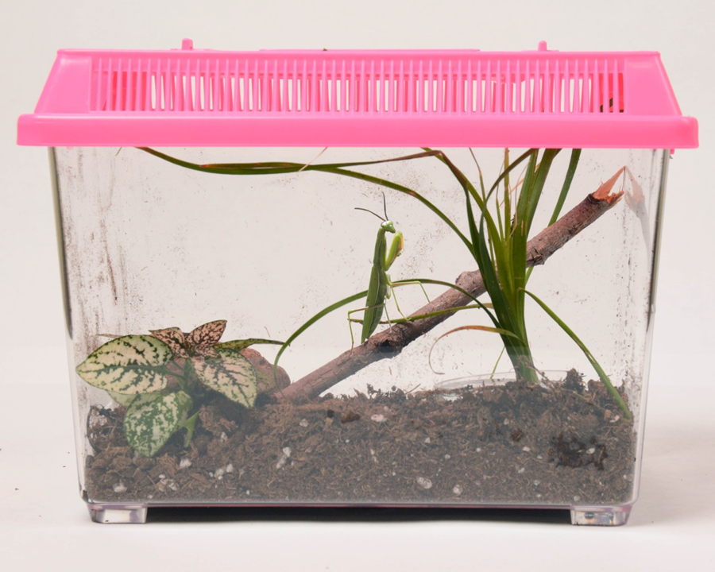
Today’s Focus Question
What living things are in our terrarium?
Photo courtesy of BSCS

Slide 4
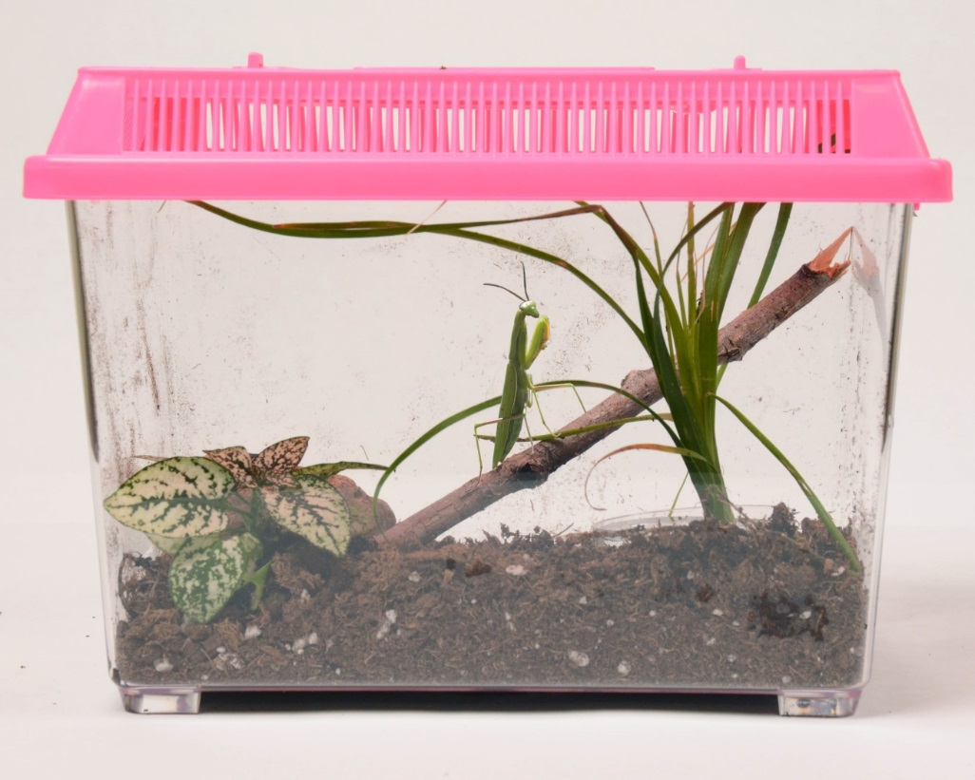
Our Terrarium
What do you see in our terrarium?
Photo courtesy of BSCS

Slide 5
Our Rules
Do not open the terrarium or pick it up.
Do not shake the terrarium.
Do not tap on the terrarium.
Photo courtesy of BSCS

Slide 6
What Can Living Things Do?
Scientists sort things into groups of living things and nonliving things.
How do we know when something is alive?
What can living things do that nonliving things can’t do?
Use this sentence starter to share your ideas: Living things can …

Slide 7
Sort Your Picture Cards
What things in our terrarium are living?
What things in our terrarium are nonliving?
If you think the object is living, put the picture card in the living group.
If you think the object is nonliving, put the picture in the nonliving group.

Slide 8
Our Tree Map
Things in Our Terrarium
Living Things Nonliving Things

Slide 9
Math Connection
How many different kinds of living things did we find in our terrarium?
How many kinds of nonliving things did we find in our terrarium?
Were there more living things or nonliving things in our terrarium? How do you know?

Slide 10
Let’s Summarize!
Our focus question: What living things are in our terrarium?
Turn and Talk: Share your ideas with an elbow partner. Be ready to share your answers with the class.
As you work together, you may look at our circle map and tree map.

Slide 11
Let’s Summarize!
Look at the pictures on our tree map. Each picture has a label telling what the object is.
Each of these objects is a living or nonliving thing we saw in our terrarium.
In your science notebook, write down the name of one living thing and one nonliving thing you saw in our terrarium.

Slide 12
Next Time
How can we group the living things in our terrarium?
Photo courtesy of BSCS

