Slide 1
Plants and Animals Lesson 1b
How Can We Group the Living Things in Our Terrarium?

Slide 2
Unit Central Question
Do plants and animals need the same things to live and grow? Explain your thinking.

Slide 3
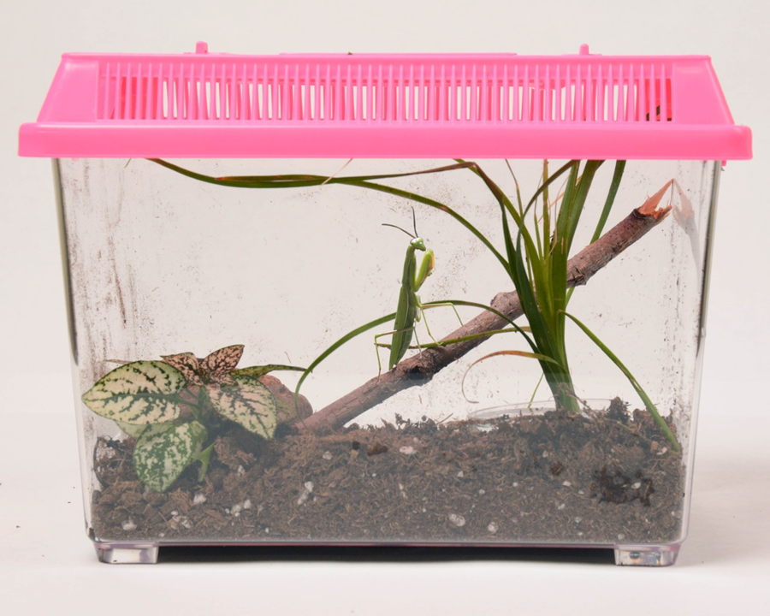
Today’s Focus Question
How can we group the living things in our terrarium?
Photo courtesy of BSCS

Slide 4
Here’s a Challenge for You!
Look at the pictures of living things we listed on our tree map from last time.
Pick two living things from our terrarium that you think are most like each other.
Share your choices and reasons with an elbow partner.
Be prepare to share with the class.

Slide 5
Sort Your Picture Cards
What living things in our terrarium are plants?
What living things in our terrarium are animals?
If you think the living thing is a plant, put the picture card in the plant group.
If you think the living thing is an animal, put the picture card in the animal group.

Slide 6
Our New Tree Map
Living Things in Our Terrarium
Plants Animals

Slide 7
Math Connection
How many kinds of plants did we find in our terrarium?
How many kinds of animals did we find in our terrarium?
Were there more kinds of plants or more kinds of animals in our terrarium? How do you know?

Slide 8
Let’s Summarize!
Our focus question: How can we group the living things in our terrarium?
Turn and Talk: Share your ideas with an elbow partner. Be ready to share your answers with the class.
You may look at our new tree map as you work together.

Slide 9
Let’s Summarize!
Look at the pictures on our tree map. The name of each living this is written below the picture.
In your science notebook, write down the name of one plant and one animal you saw in our terrarium.

Slide 10
Next Time
What do plants and animals need to live and grow? Where can they get these things?
Photo courtesy of BSCS

