Slide 1
Plants and Animals Lesson 1c
Where Do Plants and Animals in Our Terrarium Get What They Need to Live and Grow? Where Do We Get What We Need to Live and Grow?

Slide 2
Unit Central Question
Do plants and animals need the same things to live and grow? Explain your thinking.

Slide 3
Today’s Focus Questions
Where do plants and animals in our terrarium get what they need to live and grow?
Where do we get what we need to live and grow?

Slide 4
Our Circle Map
What Plants and Animals Need

Slide 5
What Scientists Have Discovered
Plants and animals can survive only if they live in a place where they can get what they need to live and grow.
Scientists have a special word to describe this kind of place.
It’s called an environment.

Slide 6
What Is an Environment?
An environment is a place where living things can get what they need to live and grow. There are both living and nonliving things in an environment.

Slide 7
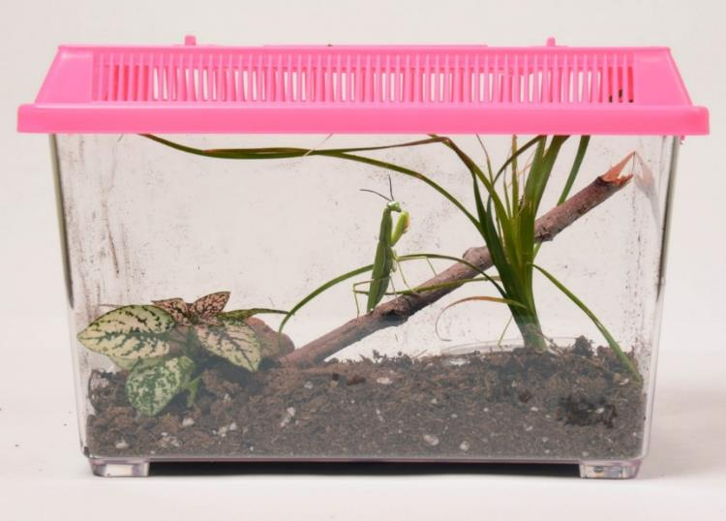
Is This an Environment?
Photo courtesy of BSCS
Is our terrarium a place where living things can get what they need to live and grow? Why or why not?

Slide 8
Is This an Environment?
Photo courtesy of BSCS
Sentence starters:
I think it’s an environment because …
I don’t think it’s an environment because …

Slide 9
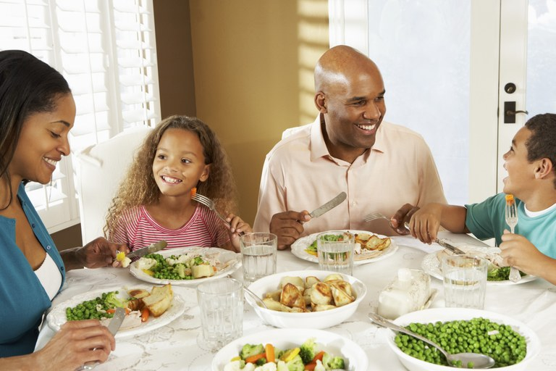
What Is Our Environment?
Photo courtesy of ag.ndsu.edu
Notes:
Photo credit: https://www.ag.ndsu.edu/publications/food-nutrition/family-meal-times-issue-1-family-meals-matter

Slide 10
Plant, Animal, or Environment?
Photo courtesy of ManuelFD/Wikimedia Commons

Slide 11
Plant, Animal, or Environment?
Photograph by Mai Tran
Notes:
Note that this coud be considered a plant, but also an environment for some bugs.
They could get both food and drink from the plant.

Slide 12
Plant, Animal, or Environment?
Photograph by Greg Thompson/U.S. Fish and Wildlife Service

Slide 13
Our Focus Questions
Where do plants and animals in our terrarium get what they need to live and grow? Where do we get what we need to live and grow?

Slide 14
Let’s Summarize!
What is an environment? Why do living things need an environment?
Talk about these questions with an elbow partner.
Be ready to share your ideas and reasons with the class.

Slide 15
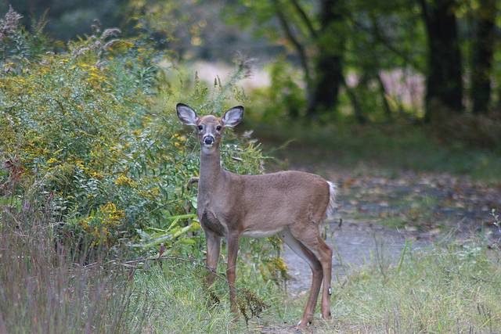
Key Science Idea
Plants and animals need an environment where they can get all of the things they need to live and grow.
Photograph by Greg Thompson/U.S. Fish and Wildlife Service

Slide 16
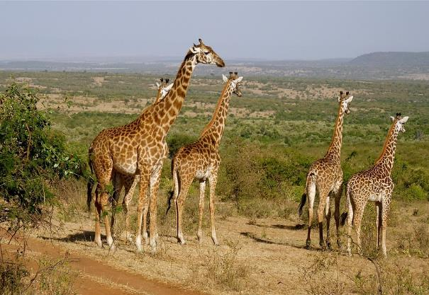
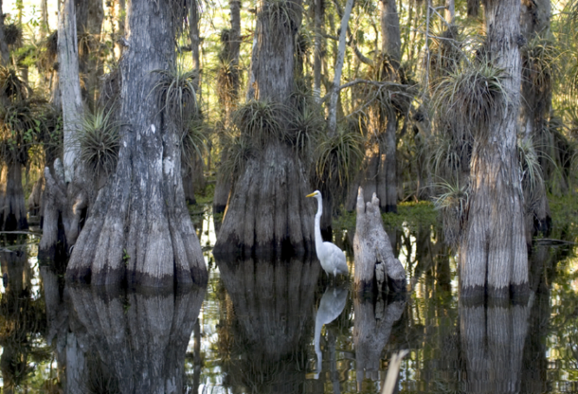
Next Time
In our next lesson, we’ll talk about some other environments and how plants and animals in these places get what they need to live and grow.
Photos courtesy of Pixabay.com

