Slide 1
Plants and Animals Lesson 1d
Where Do Plants and Animals in Other Places around the World Get What They Need to Live and Grow?

Slide 2
Unit Central Question
Do plants and animals need the same things to live and grow? Explain your thinking.

Slide 3
Review: What Is an Environment?
An environment is a place where living things can get what they need to live and grow. There are both living and nonliving things in an environment.

Slide 4
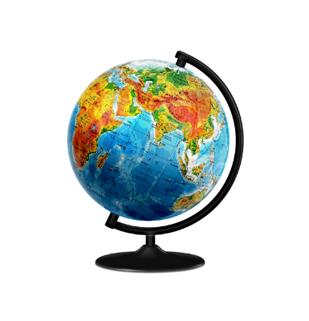
Today’s Focus Question
Where do plants and animals in other places around the world get what they need to live and grow?
Photo courtesy of Pixabay.com
Notes:
https://pixabay.com/nl/wereldbol-wereld-atlas-kaart-214199/

Slide 5
Is This an Environment? Why or Why Not?
Photograph by Greg Thompson/US Fish and Wildlife Service

Slide 6
Directions for the Picture Cards
Look carefully at each picture.
Talk with your partner about whether the picture shows an environment.
Think about the definition of an environment.
Ask yourself these questions:
Is this a place where plants and animals can get what they need to live and grow?
Does it have both living and nonliving things?
Make a decision together.

Slide 7
Is This an Environment? Why or Why Not?
Photo courtesy of Pixabay.com

Slide 8
Is This an Environment? Why or Why Not?
Photograph by Jeffrey Kietzman/National Science Foundation

Slide 9
Is This an Environment? Why or Why Not?
Photo courtesy of Pixabay.com

Slide 10
Is This an Environment? Why or Why Not?
Photo courtesy of NPS.gov

Slide 11
Is This an Environment? Why or Why Not?
Photo courtesy of NPS.gov

Slide 12
Is This an Environment? Why or Why Not?
Photo courtesy of Pixnio.com
Notes:
Notice the turtle in front lower-right corner and plants growing, too.

Slide 13
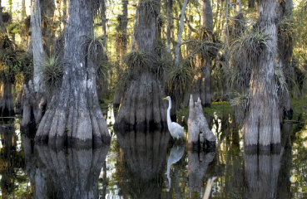
Are All Environments Alike?
Use your picture cards to help you answer these questions:
Do you think all environments are alike?
How do you know?
Photo courtesy of Pixabay.com
Photo courtesy of Pixnio.com
Notes:
Notice the turtle in front lower-right corner and plants growing, too.

Slide 14
Let’s Summarize!
Our focus question: Where do plants and animals in other places around the world get what they need to live and grow?
Photo courtesy of Pixabay.com
Notes:
https://pixabay.com/nl/wereldbol-wereld-atlas-kaart-214199/

Slide 15
Draw an Environment
Draw a picture of an environment that fits our definition:
It should show living and nonliving things.
It should also show how a plant or an animal gets what it needs to live and grow.
You could draw an environment near your home. Or you could draw an environment from a book, a movie, or someplace you visited.
At the top of your drawing, write this title: An Environment.

Slide 16
Checklist
Does your environment show a plant or an animal?
Does your environment show things that the plant or animal needs to live and grow?
Does your environment show both living and nonliving things?

Slide 17
Next Time
Today we learned that there are many different kinds of environments around the world where plants and animals get what they need to live and grow.
Next time, we’ll talk some more about what animals need from their environment to live and grow.

