Slide 1
Plants and Animals Lesson 2a
To Live and Grow, What Do Animals Need to Get from Their Environment?

Slide 2
Review: Environments
What is an environment?
Why do living things need an environment?

Slide 3
Review: Environments
An environment is a place where living things can get what they need to live and grow. There are both living and nonliving things in an environment.

Slide 4
Today’s Focus Question
To live and grow, what do animals need to get from their environment?
Photo courtesy of Aldric de Villartay/Wikimedia Commons

Slide 5
What Do Animals Need?
In another lesson, we shared ideas about what plants and animals need. Then we listed these things on a circle map.
Look at our circle map.
What things on our map do animals need?

Slide 6
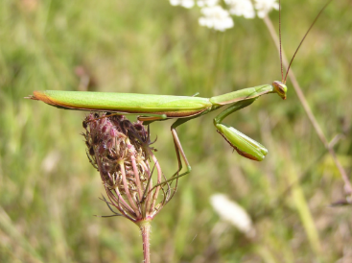
What Does the Praying Mantis Need?
My prediction:
I think the praying mantis needs to get __________ from its environment to live and grow.
Photo courtesy of Aldric de Villartay/Wikimedia Commons

Slide 7
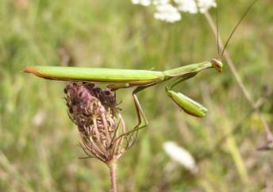
Let’s Be Science Detectives!
Courtesy of clipartpanda.com
Photo courtesy of Aldric de Villartay/Wikimedia Commons
Let’s find out what animals need to get from their environment to live and grow!

Slide 8
What Kind of Animal Is This?
Photo courtesy of Kevin Pluck/Wikimedia Commons

Slide 9
What Do Lions Need?
Photo courtesy of Diamond Glacier Adventure/Wikimedia Commons

Slide 10
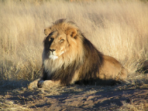
Our Lion Circle Map
Photo courtesy of Kevin Pluck/Wikimedia Commons

Slide 11
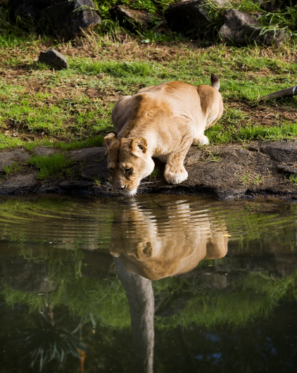
What Do Lions Need?
Photo courtesy of Joyce Royan/Wikimedia Commons

Slide 12
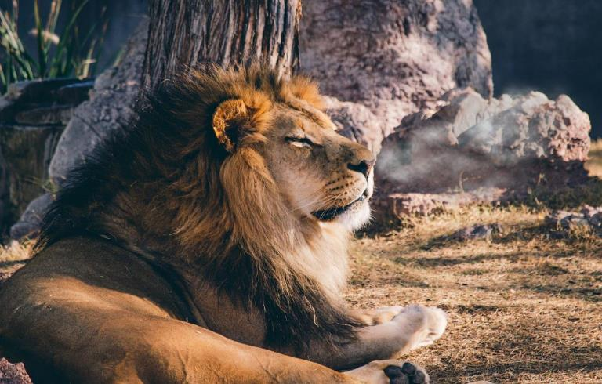
What Do Lions Need?
Photo courtesy of Pixabay.com

Slide 13
Let’s Investigate Praying Mantises!
Courtesy of clipartpanda.com
Photo courtesy of Aldric de Villartay/Wikimedia Commons

Slide 14
Let’s Investigate Praying Mantises!
Look carefully at each picture in your booklet.
Look for clues or evidence of what praying mantises need to get from their environment.
Courtesy of clipartpanda.com
Photo courtesy of Aldric de Villartay/Wikimedia Commons

Slide 15
What Do Praying Mantises Need?
Sentence starter:
The praying mantis needs to get ______ from its environment. Our evidence is ______.
Courtesy of clipartpanda.com
Photo courtesy of Aldric de Villartay/Wikimedia Commons

Slide 16
Let’s Find Out More!
Photo courtesy of Pixabay.com
Courtesy of Video Plasty/Wikimedia Commons

Slide 17
Our Focus Question
To live and grow, what do animals need to get from their environment?
Photo courtesy of Aldric de Villartay/Wikimedia Commons

Slide 18
A Praying Mantis: Looking for Food
Photo courtesy of Gunjan Pandey/Wikimedia Commons
Notes:
A praying mantis uses its big and excellent eyes to look for food. It can easily turn its neck to look all around its environment for smaller insects to eat. Larger praying mantises also look for small lizards, frogs, fish, birds, and snakes.

Slide 19
A Praying Mantis: Catching Food
Photograph by Paul White/Wikimedia Commons
Notes:
The praying mantis sits very still and waits patiently for insects or other animals (prey) to catch and eat. The praying mantis hides itself by looking a lot like a stick. When an insect or other animal comes close enough, the praying mantis strikes with amazing speed to capture its food.
Can you find the praying mantis in this picture?
How does being very still help the praying mantis get the food it needs? [Answer: When the praying mantis is very still, other insects or animals think it’s a stick, so the praying mantis can catch them more easily.]

Slide 20
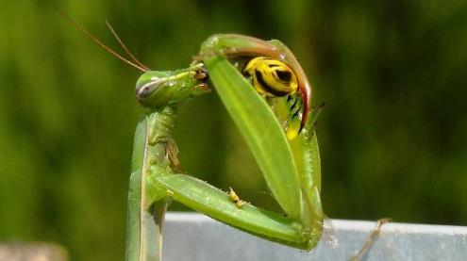
Praying Mantises Eating Their Food
Photo courtesy of Pixabay.com
Photo courtesy of Avenue/Wikimedia Commons
Notes:
Praying mantises use their strong, spiny (or spiky) front legs to capture and hold their food (prey) tightly while they use their mouths to eat it. Their mouths have strong jaws that they use to cut and chew their food.
Video links:
A praying mantis captures and eats a fly. (Note: Show 1 minute of the clip.)
https://www.youtube.com/watch?v=rwPaUma6R_k
OR
A praying mantis eats a cricket. (Note: This clip is five times the normal speed. Show 1 or 2 minutes.)
https://www.youtube.com/watch?v=5Yl1EW9dTP8

Slide 21
What Body Parts Does the Praying Mantis Use to Get Its Food?
Courtesy of Ineuw/Wikimedia Commons
Notes:
What body parts does the praying mantis use to get its food from the environment? [Answer: Eyes to spot the food, legs to pounce quickly, front legs with spikes to hold the food, and a mouth to eat the food.]

Slide 22
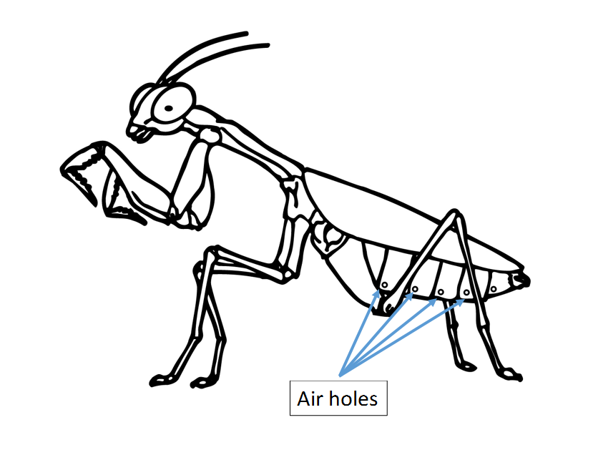
How Does a Praying Mantis Breathe?
Air Holes
Courtesy of Abcteach.com
Notes:
The praying mantis doesn’t breathe like we do, but it does need to take in oxygen from the air. Instead of breathing in the oxygen, the praying mantis has tiny holes along the side of its body. The oxygen in the air flows through these holes. If the praying mantis ends up underwater, it will die because the oxygen can’t enter the air holes.
Can you find the air holes on the praying mantis? [Answer: They’re along the side of its body by the back legs.]
Do you think the praying mantis has a nose? [Answer: No, because it takes in oxygen through the air holes.]

Slide 23
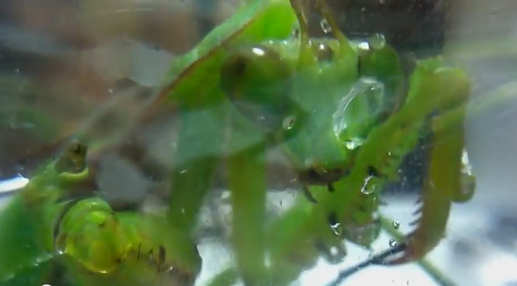
A Praying Mantis Drinking Water
Photo used with permission from BSCS
Notes:
The praying mantis needs water to stay alive. It uses its mouth to drink the water. This is why we need to spray water in our terrarium!
Video link:
A praying mantis drinks water. (Note: Show 1 minute of the clip.)
https://www.youtube.com/watch?v=giyuBCghZZs

Slide 24
Our Praying-Mantis Circle Map
Photo courtesy of Aldric de Villartay/Wikimedia Commons

Slide 25
Our Focus Question
To live and grow, what do animals need to get from their environment?
Photo courtesy of Aldric de Villartay/Wikimedia Commons

Slide 26
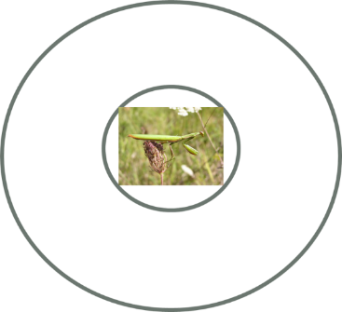
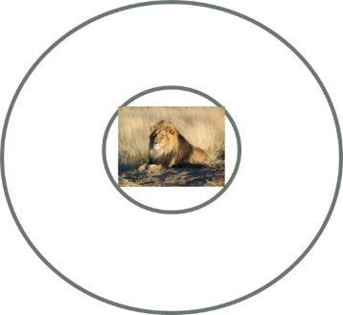
Let’s Compare Our Circle Maps!

Slide 27
What Do Animals Need?
Both the lion and the praying mantis need three things from their environment to live and grow
What are those three things?

Slide 28
Let’s Summarize!
Our focus question: To live and grow, what do animals need to get from their environment?
Answer this question in your science notebook. Use this sentence starter:
To live and grow, animals need to get
________, _______, and _______ from
their environment.
Draw a picture showing the three things animals need to get from their environment.

Slide 29
What Do We Need?
Do we need to get food, water, and air from our environment to live and grow?
How do we get these things?

Slide 30
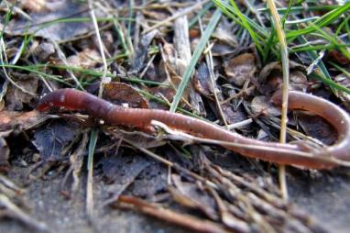
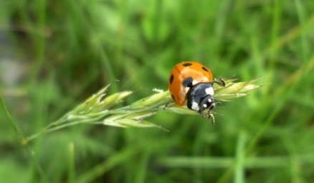
Next Time
What do the earthworms and ladybugs in our terrarium need to get from their environment to live and grow?
Do they need the same things the lion and the praying mantis need?
Photo courtesy of S Shepherd/Wikimedia Commons
Photo courtesy of Gorupka/Wikimedia Commons

