Slide 1
Plants and Animals Lesson 2b
To Live and Grow, What Do All Animals Need to Get from Their Environment?

Slide 2
Review: Environments
An environment is a place where living things can get what they need to live and grow. There are both living and nonliving things in an environment.

Slide 3
Review: What Do Animals Need?
What three things do lions and praying mantises need to get from their environments to live and grow?

Slide 4
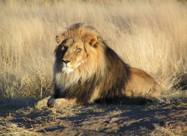
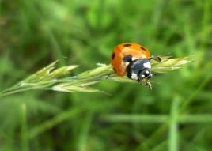
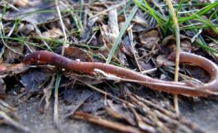
Today’s Focus Question
To live and grow, what do all animals need to get from their environment?
Photo courtesy of Kevin Pluck/Wikimedia Commons
Photo courtesy of Gorupka/Wikimedia Commons
Photo courtesy of Aldric de Villartay/Wikimedia Commons
Photo courtesy of S Shepherd/Wikimedia Commons

Slide 5
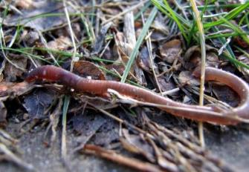
What Do Ladybugs and Earthworms Need?
My prediction:
I think that [ladybugs/earthworms] need to get __________ from their environment to live and grow.
Photo courtesy of Gorupka/Wikimedia Commons
Photo courtesy of S Shepherd/Wikimedia Commons

Slide 6
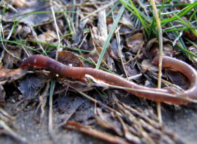
Let’s Be Science Detectives!
Photo courtesy of Gorupka/Wikimedia Commons
Courtesy of clipartpanda.com
Let’s find out what other animals need to get from their environment!
Photo courtesy of S Shepherd/Wikimedia Commons

Slide 7
Let’s Investigate Ladybugs and Earthworms!
Look carefully at each picture in your booklets.
Look for evidence (clues) of what ladybugs and earthworms need to get from their environment.
Photo courtesy of Gorupka/Wikimedia Commons
Courtesy of clipartpanda.com
Photo courtesy of S Shepherd/Wikimedia Commons

Slide 8
What Do Ladybugs Need?
Sentence starter:
Ladybugs need to get ______ from their environment. Our evidence is ______.
Photo courtesy of Gorupka/Wikimedia Commons
Courtesy of clipartpanda.com

Slide 9
What Do Earthworms Need?
Sentence starter:
Earthworms need to get _____ from their environment. Our evidence is ______.
Courtesy of clipartpanda.com
Photo courtesy of S Shepherd/Wikimedia Commons

Slide 10
Let’s Find Out More!
Photo courtesy of Pixabay.com
Courtesy of Video Plasty/ Wikimedia Commons

Slide 11
Our Focus Question
To live and grow, what do all animals need to get from their environment?
Photo courtesy of Kevin Pluck/Wikimedia Commons
Photo courtesy of Gorupka/Wikimedia Commons
Photo courtesy of Aldric de Villartay/Wikimedia Commons
Photo courtesy of S Shepherd/Wikimedia Commons

Slide 12
Ladybugs: Looking for Food
Photo courtesy of Amazonaws.com
Notes:
Ladybugs get their food by catching and eating smaller insects. Most often, they eat tiny insects called aphids.

Slide 13
Ladybugs: Eating Aphids
Photograph by Scott Bauer/U.S. Department of Agriculture
Notes:
Aphids destroy many garden plants by sucking the sap out of them. So gardeners are happy when ladybugs are around to eat up the aphids.

Slide 14
Ladybugs: Sniffing Out Food!
Photograph by C.L. Goforth
Notes:
Ladybugs don’t see very well, so they use their sense of small to find their food. A pair of antennae help a ladybug smell and feel its way around. Like praying mantises, ladybugs use their mouths to grasp, crush, and cut up the food they catch.
Can you find the ladybug’s antennae in this picture?

Slide 15
Ladybug Body Parts
Courtesy of Persian Poet Gal/Wikimedia Commons
Notes:
What body parts does a ladybug use to find and eat its food? [Answer: Eyes and antennae to spot aphids, legs to crawl to their food, and a mouth to eat aphids.]

Slide 16
How Ladybugs Breathe
Photo courtesy of Pexels.com
Notes:
Ladybugs need oxygen from the air to stay alive. But like praying mantises, ladybugs don’t use lungs to breathe. Instead, they take in air through tiny holes on the sides of their bodies. These holes are located underneath their wings. Ladybugs can open (or expand) and close (or contract) these holes.
Can someone point to the area under the ladybug’s wings? [Note: You can’t see the holes in this picture, but they’re located underneath the wings on the sides of the body.]

Slide 17
How Ladybugs Stay Alive in Water
Photo courtesy of Pixabay.com
Notes:
Because ladybugs can close their air holes, they can stay alive underwater for a little while. But they can’t live that way for long. It’s like when we hold our breath underwater. We can only do it for a short while.

Slide 18
Ladybugs: Drinking Water
Photo courtesy of Wallpaperbetter.com
Notes:
Ladybugs need water to stay alive, but too much water will drown a ladybug. Ladybugs use their mouths to drink water. Ladybugs sometimes close their air holes to keep their bodies from losing water.
Video link:
A ladybug drinks from a water droplet. (Note: Show 1 minute of the clip.)
https://www.youtube.com/watch?v=VC9rVp8uur8

Slide 19
Is This a Good Environment?
Photograph by Donald Hobern/Wikimedia Commons
Notes:
Is this a good environment for the ladybug? Why or why not?

Slide 20
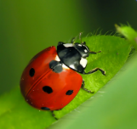
Our Ladybug Circle Map
Photo courtesy of Clipart-library.com

Slide 21
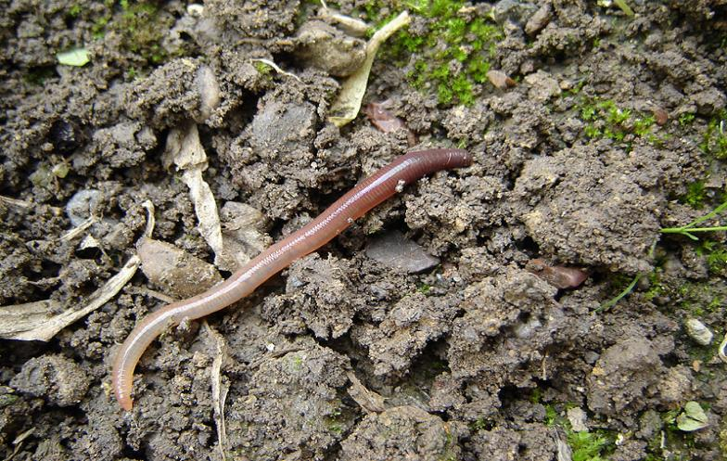
Earthworms: Finding Food
Photograph by Dodo-Bird
Notes:
Earthworms need food to live and grow. Earthworms that live near the top of the ground use their mouths to take in dead leaves and grass. Earthworms eat dead leaves, but they also eat tiny creatures we can’t see that live on these leaves.
Video link:
Earthworms eating dead leaves. (Note: Start at around segment 00:20 and end at 1:00 before the mating segment.)
https://www.youtube.com/watch?v=bFpblBf1dfE

Slide 22
Earthworms: Finding Food
Photo courtesy of USDA NRCS
Notes:
Earthworms that live deep underground find tiny living things in the dirt. The earthworms swallow the dirt and use the tiny living things as their food. People mistakenly think that earthworms eat dirt, but what they’re actually eating are the living things in the dirt.

Slide 23
Earthworms: Finding Food
Photograph by Mikhail Kokhanchikov
Notes:
What kind of food do you think these earthworms are searching for? [Answer: leaves and tiny things that live in the soil]

Slide 24
A Compost Bin
Photo courtesy of Southgippsland.wordpress.com
Notes:
Some people put leftover pieces of food, like fruits and vegetables, in a pile to rot and turn into materials that are good for the soil. These piles are called compost bins.

Slide 25
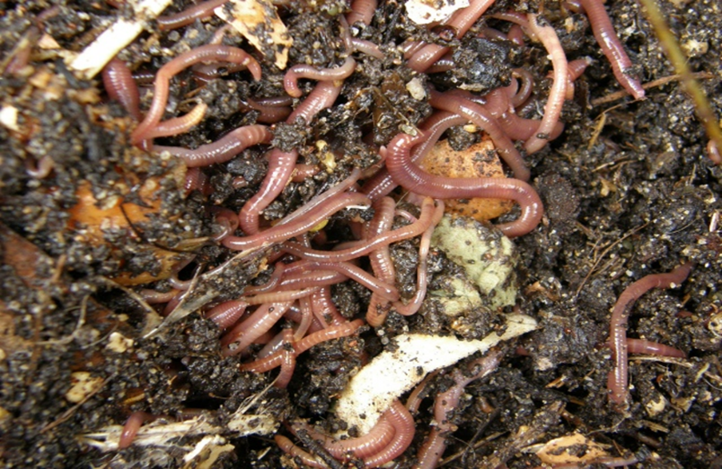
What Do You See in This Photo?
Photograph by Clare Snow
Notes:
People like to put earthworms in compost bins because the worms will eat the old, rotting vegetables and fruits.
Do you see pieces of rotting fruits and vegetables in this picture?

Slide 26
How Earthworms Breathe
Photograph by Ben McLeod
Notes:
Earthworms need air (or oxygen) to survive, but they don’t have noses and lungs to help them breathe. So they take in air through their skin. This means that they breathe all over their bodies!

Slide 27
Earthworms Need Water to Breathe!
Photograph by ll_browneyes_ll
Notes:
For an earthworm to take in air, its skin needs to be wet. So earthworms have to find water in their environment.

Slide 28
Earthworms Need Water and Air
Photograph by Schizoform
Notes:
If an earthworm’s skin dries out, it will die because the air can’t soak through its skin. So earthworms don’t spend a lot of time in the hot sun!
What might happen to this earthworm if it stays in the sun too long? Why do you think that?

Slide 29
Our Earthworm Circle Map
Photograph by Dodo-Bird

Slide 30
Our Focus Question
To live and grow, what do all animals need to get from their environment?
Photo courtesy of Kevin Pluck/Wikimedia Commons
Photo courtesy of Gorupka/Wikimedia Commons
Photo courtesy of Aldric de Villartay/Wikimedia Commons
Photo courtesy of S Shepherd/Wikimedia Commons

Slide 31
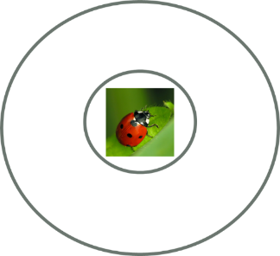
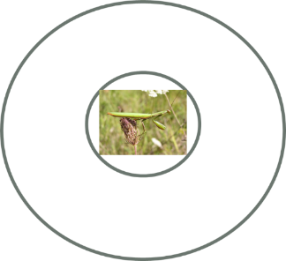
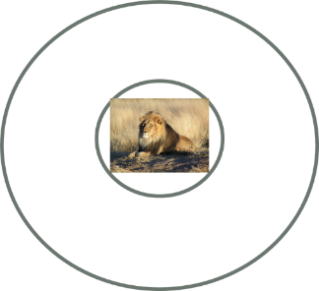
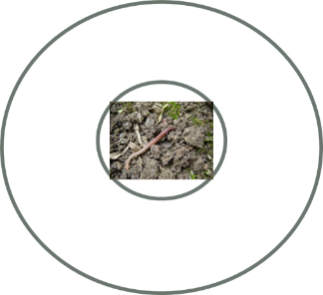
Let’s Compare Our Circle Maps!

Slide 32
Let’s Summarize!
Animals like lions, praying mantises, ladybugs, and earthworms need food, water, and air to live and grow.
Animals need an environment to help them get these things.
They may get these things in different ways, but they all need to get the same things from their environment to live and grow.

Slide 33
Let’s Summarize!
Our focus question: To live and grow, what do all animals need to get from their environment?
Answer this question in your science notebook. Use this sentence starter:
To live and grow, animals need to get
________, _______, and _______ from
their environment.
Draw a picture showing the three things animals need to get from their environment.

Slide 34
Next Time
What do plants need to get from their environment to live and grow?
Do they need the same things as animals?
Photography by Wouter Hagens/Wikimedia Commons

