Slide 1
Plants and Animals Lesson 3a
How Can Experiments Help Us Find Out What Plants Need to Live and Grow?

Slide 2
Review: What Do Animals Need?
What three things do animals need to get from their environment to live and grow?

Slide 3
Unit Central Question
Do plants and animals need the same things to live and grow? Explain your thinking.

Slide 4
Today’s Focus Question
How can experiments help us find out what plants need to live and grow?

Slide 5
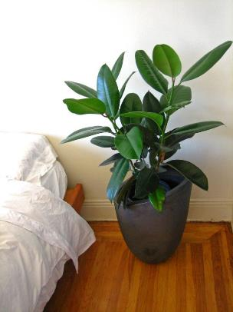
What Do Plants Need to Live and Grow?
Animals need food, water, and air from their environment to live and grow.
What do plants need? Do they need the same things animals need?
Sentence starters:
My idea is …
I think that …
Photograph by Margaretshear
Notes:
Create a circle map showing students’ ideas.

Slide 6
What Is Evidence?
What do you think of when you hear the word evidence?
What symbol on our Communicating in Scientific Ways poster reminds us of what evidence is?
What is evidence? How would you define this word?

Slide 7
What Is Evidence?
Evidence is a clue that helps us answer a question about the world around us.
Evidence helps us figure out whether something works the way we think it does.
Scientists use evidence to help them explain why things happen the way they do.

Slide 8
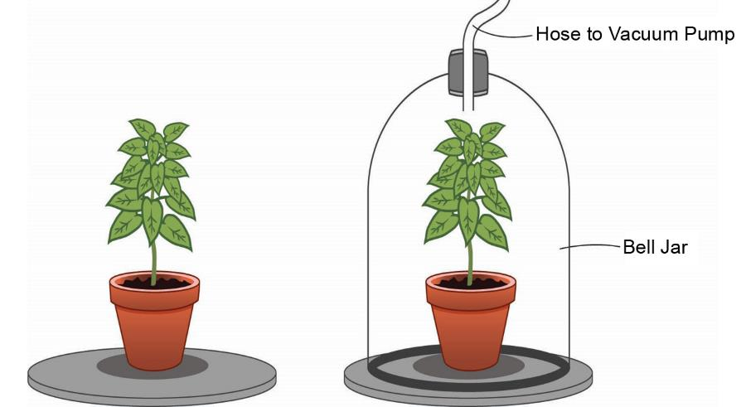
An Experiment: Do Plants Need Air?
Courtesy of BSCS

Slide 9
Our Predictions: What Will Happen?
Courtesy of BSCS

Slide 10
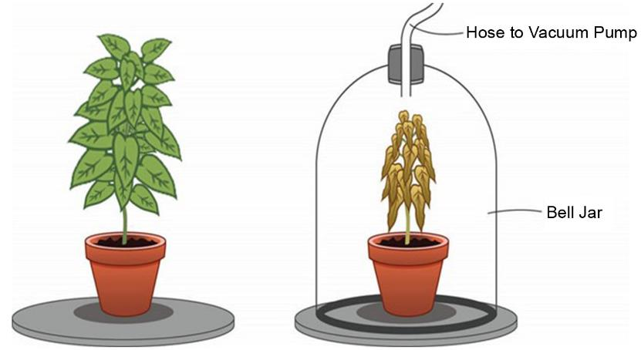
Two Weeks Later
Courtesy of BSCS

Slide 11
Do Plants Need Air?
What does the evidence tell us?
Sentence starters:
I think plants need air. My evidence is _______.
I think plants do NOT need air. My evidence is _______.

Slide 12
Do Plants Need Air?
Our conclusion:
We think plants need air to live and grow because ______________.

Slide 13
Let’s Summarize!
Our focus question: How can experiments help us find out what plants need to live and grow?
How did today’s experiment help us find out what plants need to live and grow?

Slide 14
Let’s Summarize!
How did we act like scientists today? What did we do that scientists do?
What question was the scientist trying to answer?
What experiment did the scientist design to help her answer this question?
What did the results of the experiment show us?

Slide 15
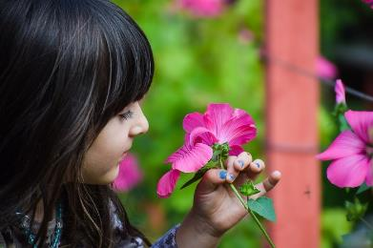
Next Time
Today we learned that plants need air to live and grow just like animals do.
Do you think that plants need light to live and grow?
Next time, we’ll set up our own experiment to help us answer this question.
Photo courtesy of Pixabay.com

