Slide 1
Plants and Animals Lesson 3b
How Can Experiments Help Us Find Out Whether Plants Need Light to Live and Grow?

Slide 2
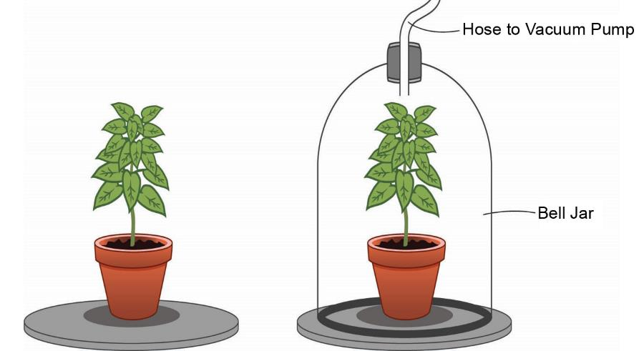
Review: Do Plants Need Air?
Courtesy of BSCS

Slide 3
Unit Central Question
Do plants and animals need the same things to live and grow? Explain your thinking.

Slide 4
Today’s Focus Question
How can experiments help us find out whether plants need light to live and grow?

Slide 5
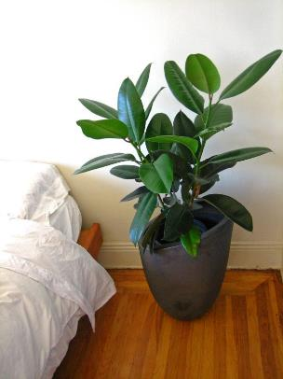
What Do Plants Need to Live and Grow?
Do plants need light to live and grow? Why or why not?
Sentence starters:
My idea is …
I think that …
I agree …
I disagree …
Photograph by Margaretshear

Slide 6
Review: What Is Evidence?
What symbol on our Communicating in Scientific Ways poster reminds us of what evidence is?
What is evidence?

Slide 7
Review: What Is Evidence?
Evidence is a clue that helps us answer a question or explain how something works in the world around us.
Evidence also helps us figure out whether our ideas are right.

Slide 8
Do Plants Need Light?
To help us answer this question, we’ll observe two plants.
Be careful not to knock over the plants.
Don’t pick up the cups or touch the plants.
Just OBSERVE!
Courtesy of BSCS
Notes:
Art is clip art.

Slide 9
Let’s Plan an Experiment!
Turn and Talk: How could we plan an experiment to find out whether plants need light to live and grow?
Be ready to share your ideas with the class!
Courtesy of BSCS
Notes:
Art is clip art.

Slide 10
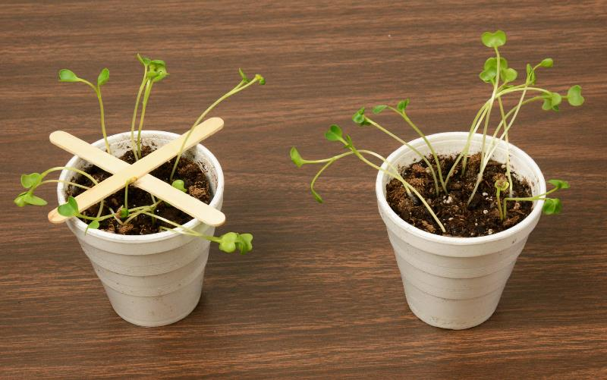
Let’s Set Up Our Experiment!
Photo courtesy of BSCS

Slide 11
Our Predictions: What Will Happen?
Our question: Do plants need light?
Our experiment: One plant will be in light, and one plant will be in no light.
Courtesy of BSCS
What do you think (predict) will happen to the two plants?
Notes:
Art is clip art.

Slide 12
Let’s Be Good Scientists!
Good scientists observe things carefully and write down their observations!
Writing down our observations will help us keep track of our evidence so we can answer our question accurately.

Slide 13
Let’s Summarize!
Our focus question: How can experiments help us find out whether plants need light to live and grow?
Why are we doing this experiment?
What question are we trying to answer?
How will our experiment help us answer this question?

Slide 14
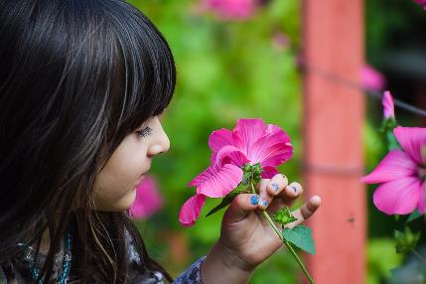
Next Time
In our next lesson, we’ll investigate whether plants need water to live and grow.
How could we set up an experiment to find out?
Photo courtesy of Pixabay.com

