Slide 1
Plants and Animals Lesson 3c
How Can Experiments Help Us Find Out Whether Plants Need Water to Live and Grow?

Slide 2
What Do Plants Need to Live and Grow?
Last time, we set up a new experiment.
What are we doing in this experiment?
What question are we trying to answer?
What is happening with your plants so far?
Photograph by Margaretshear

Slide 3
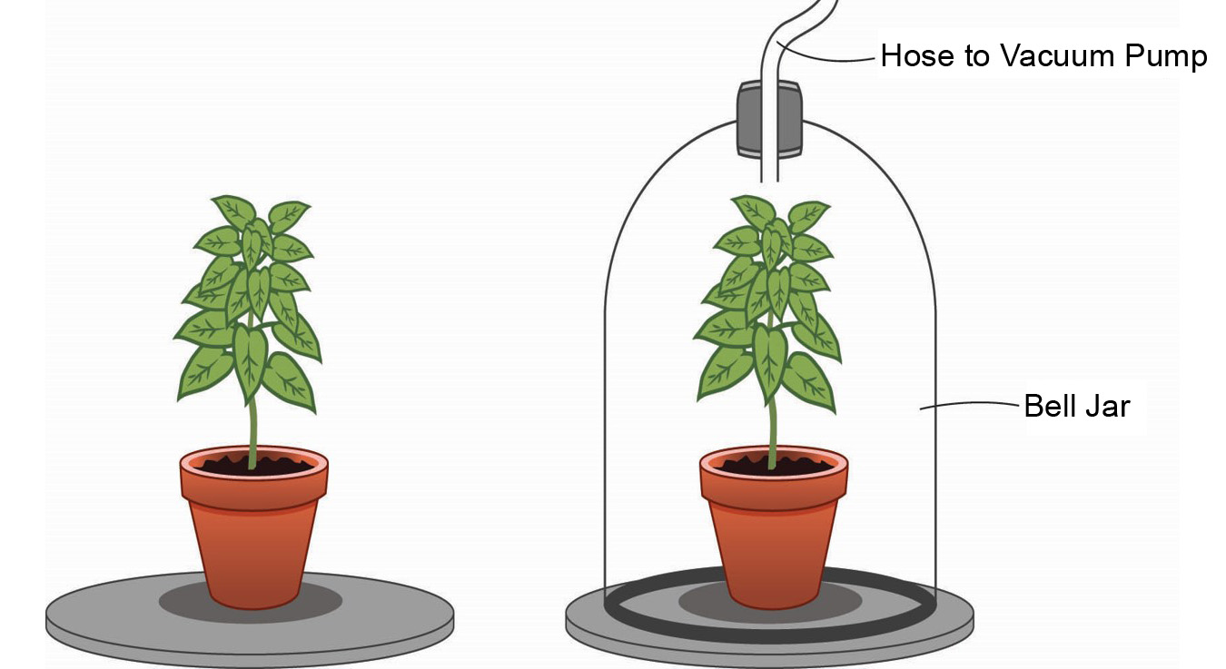
Review: Do Plants Need Air?
Courtesy of BSCS

Slide 4
Today’s Focus Question
How can experiments help us find out whether plants need water to live and grow?

Slide 5
What Do Plants Need to Live and Grow?
Do plants need water to live and grow? Why or why not?
Sentence starters:
My idea is …
I think that …
I agree …
I disagree …
Photograph by Margaretshear

Slide 6
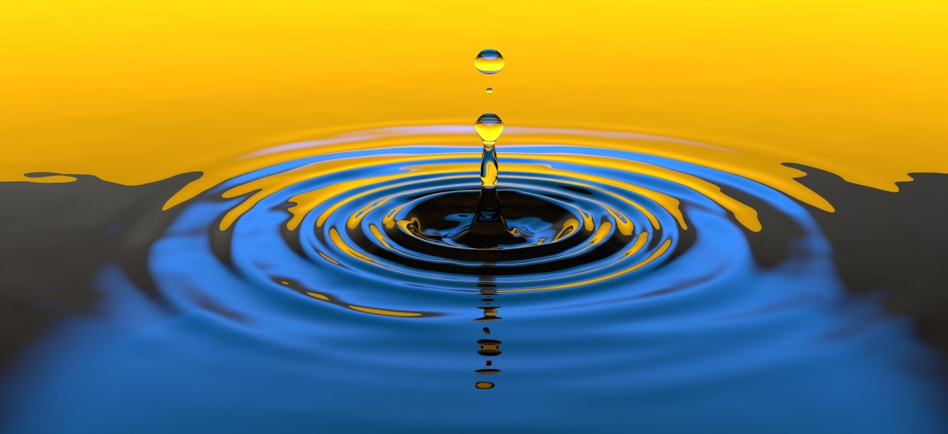
Let’s Plan an Experiment!
Turn and Talk: How could we plan an experiment to find out whether plants need water to live and grow?
Be ready to share your ideas with the class!
Photo courtesy of Pixabay.com

Slide 7
Let’s Set Up Our Experiment!
Photo courtesy of BSCS

Slide 8
Our Predictions: What Will Happen?
Our question: Do plants need water?
Our experiment: One plant will get water, and one plant will get no water.
What do you think (predict) will happen to the two plants?
Photo courtesy of Pixabay.com
Notes:
Art is clip art.

Slide 9
Let’s Be Good Scientists!
Good scientists observe things carefully and write down their observations!
Writing down our observations will help us keep track of our evidence so we can answer our question accurately.

Slide 10
Let’s Summarize!
Our focus question: How can experiments help us find out whether plants need water to live and grow?
Why are we doing this experiment?
What question are we trying to answer?
How will our experiment help us answer this question?

Slide 11
Next Steps
Every few days, you’ll observe your plants and record your observations for both experiments.
In two weeks, we’ll look at all of our evidence and find out whether plants need light and water!
Photo courtesy of BSCS

