Slide 1
Plants and Animals Lesson 3D.1
How Can Experiments Help Us Find Out Whether Plants Need Soil to Live and Grow?

Slide 2
Unit Central Question
Do plants and animals need the same things to live and grow? Explain your thinking.

Slide 3
Our Plant Experiments
What are we trying to find out from the two experiments we set up?

Slide 4
Today’s Focus Question
How can experiments help us find out whether plants need soil to live and grow?

Slide 5
What Do Plants Need to Live and Grow?
Do plants need soil to live and grow? Why or why not?
Sentence starters:
My idea is …
My evidence is …
I agree because …
I disagree because …
Photograph by Margaretshear

Slide 6
How Did We Set Up Other Experiments?
What did we do with the two plants in our light experiment?
What did we do with the two plants in our water experiment?
Photo courtesy of BSCS

Slide 7
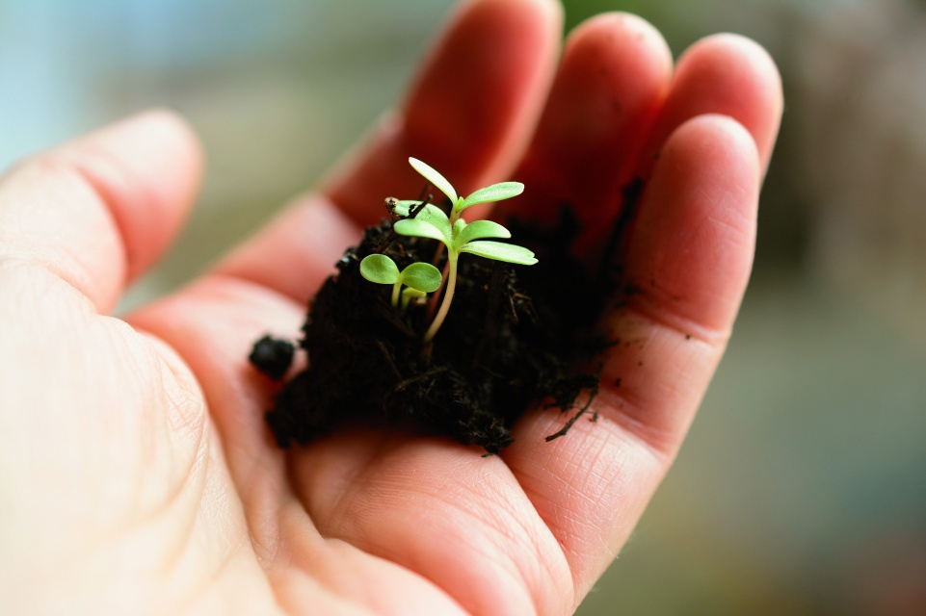
Let’s Plan an Experiment!
Turn and Talk: How could we plan an experiment to find out whether plants need soil to live and grow?
Be ready to share your ideas with the class!
Photo courtesy of congerdesign/Pixabay.com

Slide 8
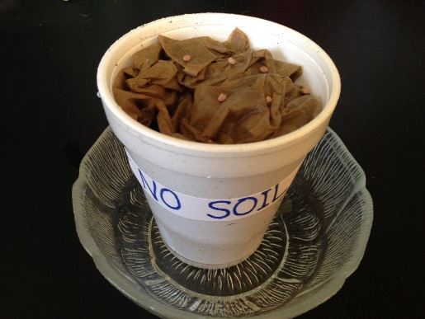
Let’s Set Up Our Experiment!
Photo courtesy of BSCS
Photo courtesy of BSCS

Slide 9
Our Predictions: What Will Happen?
Our question: Do plants need soil?
Our experiment: Some seeds will have soil, and some seeds will have no soil.
What do you think (predict) will happen to the seeds?
Photo courtesy of BSCS
Photo courtesy of BSCS
Notes:
Art is clip art.

Slide 10
What Did You Predict?
What do you think (predict) will happen to the seeds?
Sentence starters:
Our prediction is …
Our evidence is …
I agree because …
I disagree because …

Slide 11
Let’s Summarize!
Our focus question: How can experiments help us find out whether plants need soil to live and grow?
How do you think the experiment we set up today can help us find out whether plants need soil to live and grow?
How is today’s experiment like our experiments with light and water?

Slide 12
Next Time
Will our seeds grow without soil?
Stay tuned to find out!
Photo courtesy of BSCS

