Slide 1
Plants and Animals Lesson 3D.2
Do Plants Need Soil to Live and Grow? What Is Your Evidence?

Slide 2
Our Plant Experiments
What are we trying to find out from each of our plant experiments?
What questions are we trying to answer?

Slide 3
Today’s Focus Question
Do plants need soil to live and grow? What is your evidence?

Slide 4
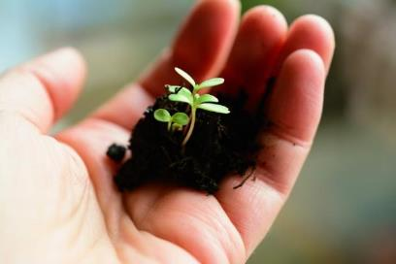
Do Plants Need Soil?
Observe the seeds we planted with and without soil.
What evidence do you see to help you answer our question, “Do plants need soil?” Talk about it with your partner.
Photo courtesy of congerdesign/Pixabay.com

Slide 5
What Do Plants Need Soil?
Do plants need soil to live and grow? Why or why not?
Sentence starters:
Our idea is …
Our evidence is …
I agree because …
I disagree because …
Photograph by Margaretshear

Slide 6
What Do You Observe?
Photo courtesy of Air Plant Design Studio

Slide 7
What Do You Observe?
Photo courtesy of Pixabay.com

Slide 8
Do Plants Need Soil to Live and Grow?
These plants sit on rocks or hang from tree branches.
Some have roots that hold them in place, but their roots don’t soak up water.
Photograph by Mark Marathon/Wikimedia Commons

Slide 9
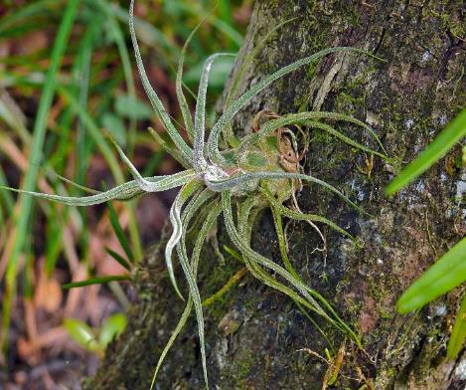
Do Plants Need Soil to Live and Grow?
The spiky leaves on this plant soak up water and take in moist air.
Photograph by Bernard Dupont/Wikimedia Commons

Slide 10
Do Plants Need Soil to Live and Grow?
These plants need a good amount of sunlight and some water.
Photograph by Dennis M/Flickr

Slide 11
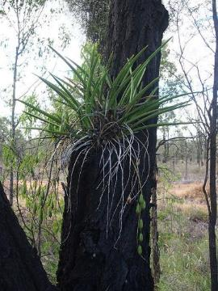
Do Plants Need Soil to Live and Grow?
Do these air plants need soil? What is your evidence?
Photograph by Bernard Dupont/Wikimedia Commons
Photograph by Dennis M/Flickr
Photograph by Mark Marathon/Wikimedia Commons

Slide 12
Do Plants Need Soil to Live and Grow?
Photograph by Emilia Murray, Flickr

Slide 13
Do Plants Need Soil to Live and Grow?
These elodea plants live underwater.
Sometimes they send roots into the soil at the bottom of a lake.
But they often float near the surface of the water, where they can get the sunlight they need.
Photograph by Ernst Schütte/Wikimedia Commons

Slide 14
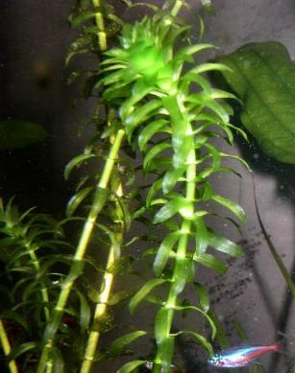
Do Plants Need Soil to Live and Grow?
Do these elodea plants need soil? What is your evidence?
Photograph by Emilia Murray, Flickr
Photograph by Ernst Schütte/Wikimedia Commons

Slide 15
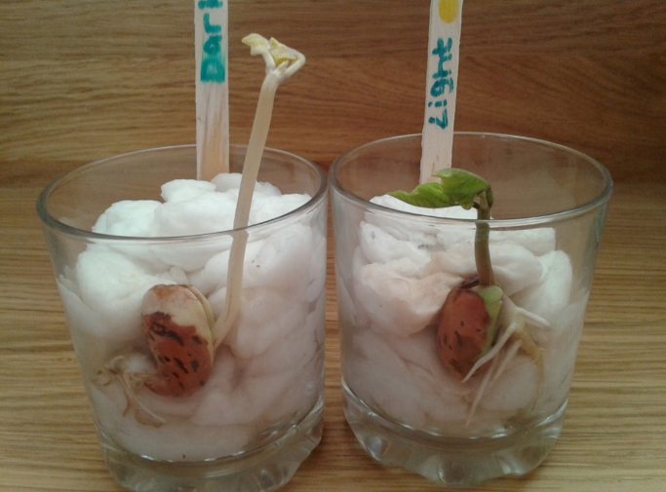
Do Plants Need Soil to Live and Grow?
Photograph by Babbage, Flickr
Photograph by Littlemisskirsty, Amazing Little Minds

Slide 16
Make a Claim!
Do plants need soil to live and grow?
Look at the evidence on our tree map.
Work with your partner to make a claim about whether plants need soil.
Write your claim on your handout.
Add evidence to your handout to support your claim.

Slide 17
Present Your Claim and Evidence
Sentence starters for science presenters:
Our claim is …
Our idea is …
Our evidence is …
Our reason is …
Sentence starters for science listeners:
I agree because …
I disagree because …
What do you mean when you say …?
I want to add on.
Notes:
Art is clip art.

Slide 18
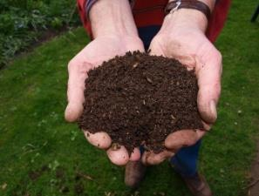
Let’s Summarize!
Our focus question: Do plants need soil to live and grow? What is your evidence?
Do you think plants DO need soil to live and grow? Why? What is your evidence?
Do you think plants DO NOT need soil to live and grow? Why? What is your evidence?
Photo courtesy of Pixabay.com

Slide 19
Next Time
We’ll see what’s happening with the plants from our light experiment!
Do plants need light to live and grow?
Courtesy of BSCS

