Slide 1
Plants and Animals Lesson 4a
Do Plants Need Light to Live and Grow? What Is Your Evidence?

Slide 2
Our Light Experiment
What are we trying to find out with our light experiment?
What question are we trying to answer?
Courtesy of BSCS

Slide 3
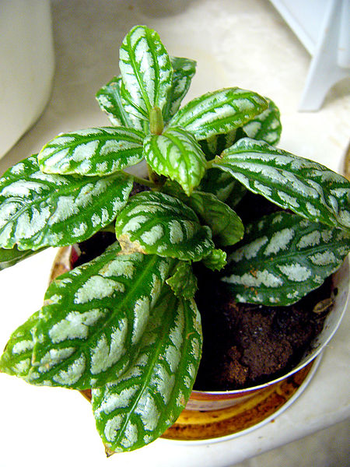
Today’s Focus Questions
Do plants need light to live and grow? What is your evidence?
Courtesy of BSCS
Photograph by Philippe Giabbanelli/Wikimedia Commons

Slide 4
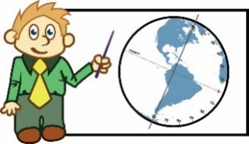
Communicating in Scientific Ways
Symbol | What a Scientist Says
 | Why? How? I wonder …
 | I see …
 | My idea is … My claim is …
 | My evidence is …
 | My reason is …
Notes:
REFER TO COMMUNICATING IN SCIENTIFIC WAYS CHART FOR THIS DISCUSSION

Slide 5
Our Light Experiment
What question are you and your partner trying to answer about plants and light?
Courtesy of BSCS

Slide 6
Review: What Is Evidence?
Evidence is a clue that helps us answer a question or explain something in the world around us.
Evidence also helps us figure out whether our ideas are right or wrong.

Slide 7
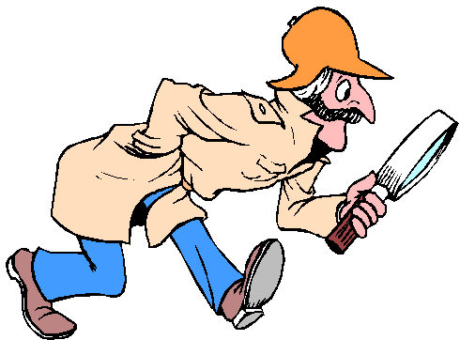
Do Plants Need Light?
Courtesy of BSCS
Courtesy of clipartpanda.com
Photograph by Philippe Giabbanelli/Wikimedia Commons
Notes:
Circle either need or do NOT need.

Slide 8
Let’s Make a Claim!
Observe your plants carefully. Then look at the observations you wrote down during our light experiment.
Talk with your partner and come up with a claim (an idea) to answer our question, “Do plants need light?”
Talk about the evidence and reasons you have to support your claim.
Courtesy of BSCS

Slide 9
Share Your Claim and Evidence
Our claim is:
Plants need light to live and grow.
OR
Plants do NOT need light to live and grow.
Our evidence is _______________.

Slide 10
Think about the Claim and Evidence
LISTEN as your classmates share their claims and evidence!
Do you agree or disagree?
Do you have something to add?

Slide 11
Let’s Summarize!
Our focus question: Do plants need light to live and grow? What is your evidence?
Courtesy of BSCS
Photograph by Philippe Giabbanelli/Wikimedia Commons

Slide 12
Let’s Summarize!
Look at the circle map of our beginning ideas about what plants need.
Which ideas can we circle because we have evidence that plants need these things?

Slide 13
Let’s Summarize!
We know that plants need air and light to live and grow. Our evidence is that plants wither and die without these things.
We also know that not all plants need soil to live and grow. Some plants can grow in air and water.

Slide 14
Let’s Summarize!
Now that we know more about what plants need, have any of your beginning ideas changed?

Slide 15
Next Time
We’ll see what’s happening with the plants from our water experiment!
Do plants need water to live and grow?
Courtesy of Pixabay.com

