Slide 1
Plants and Animals Lesson 4b
Do Plants Need Water to Live and Grow? What Is Your Evidence?

Slide 2
Review: What Do Plants Need?
What have we found out so far about what plants need to live and grow?
What evidence do we have?

Slide 3
Our Water Experiment
What are we trying to find out with our water experiment?
What question are we trying to answer?
Photo courtesy of Pixabay.com

Slide 4
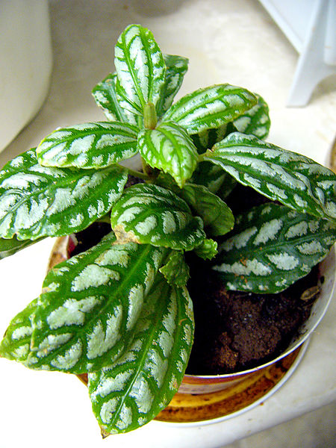
Today’s Focus Questions
Do plants need water to live and grow? What is your evidence?
Photograph by Philippe Giabbanelli/Wikimedia Commons
Photo courtesy of Pixabay.com

Slide 5
Communicating in Scientific Ways
Symbol | What a Scientist Says
 | Why? How? I wonder …
 | I see …
 | My idea is … My claim is …
 | My evidence is …
 | My reason is …
Notes:
REFER TO COMMUNICATING IN SCIENTIFIC WAYS CHART FOR THIS DISCUSSION

Slide 6
Our Water Experiment
What question are you and your partner trying to answer about plants and water?
Photo courtesy of Pixabay.com

Slide 7
Review: What Is Evidence?
Evidence is a clue that helps us answer a question or explain something in the world around us.
Evidence also helps us figure out whether our ideas are right or wrong.

Slide 8
Do Plants Need Water?
Courtesy of clipartpanda.com
Photograph by Philippe Giabbanelli/Wikimedia Commons

Slide 9
Let’s Make a Claim!
Observe your plants carefully. Then look at the observations you wrote down during our water experiment.
Talk with your partner and come up with a claim (an idea) to answer our question, “Do plants need water?”
Talk about the evidence and reasons you have to support your claim.
Photo courtesy of Pixabay.com

Slide 10
Share Your Claim and Evidence
Our claim is:
Plants need water to live and grow.
OR
Plants do NOT need water to live and grow.
Our evidence is _______________.

Slide 11
Think about the Claim and Evidence
LISTEN as your classmates share their claims and evidence!
Do you agree or disagree?
Do you have something to add?

Slide 12
Let’s Summarize!
Our focus question: Do plants need water to live and grow? What is your evidence?
Photograph by Philippe Giabbanelli/Wikimedia Commons
Photo courtesy of Pixabay.com

Slide 13
Let’s Summarize!
Look at the circle map of our beginning ideas about what plants need.
Which ideas did we circle last time?
What other ideas can we circle because we have evidence that plants need these things?

Slide 14
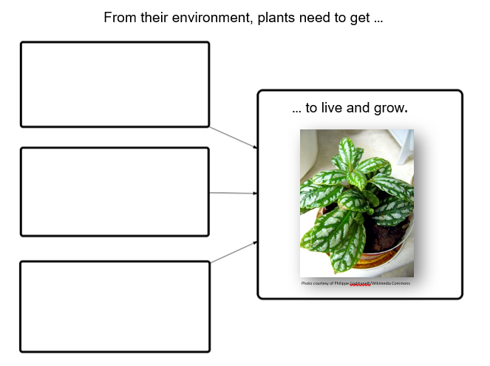
What Do Plants Need to Live and Grow?

Slide 15
Let’s Summarize!
We know that plants need air, light, and water to live and grow. Our evidence is that plants wither and die without these things.
We also know that not all plants need soil to live and grow. Some plants can grow in air and water.

Slide 16
Let’s Summarize!
Now that we know more about what plants need to live and grow, have any of your beginning ideas changed?

Slide 17
Unit Central Question
Do plants and animals need the same things to live and grow? Explain your thinking.

Slide 18
Next Time
What do animals need to live and grow?
What do plants need to live and grow?
Do plants need food just like animals?
We’ll investigate this in our next lesson!

