Slide 1
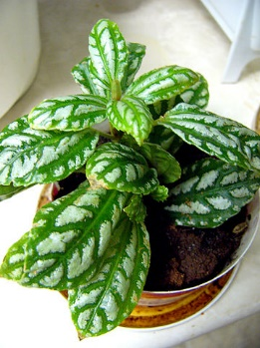
What Do Plants Need to Live and Grow?
Plants Need
Plants live and grow.
Photograph by Philippe Giabbanelli/ Wikimedia Commons

