Slide 1
Plants and Animals Lesson 5a
Do Plants Need Food? What Is Our Evidence?

Slide 2
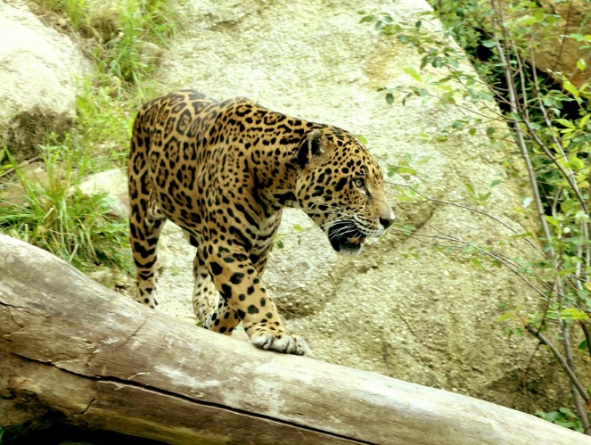
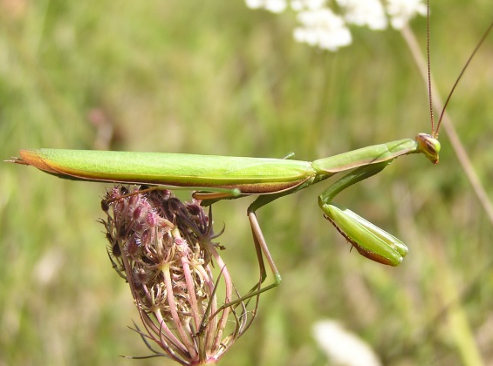
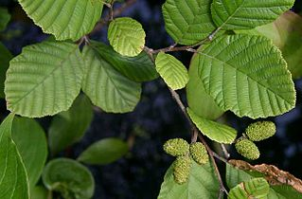
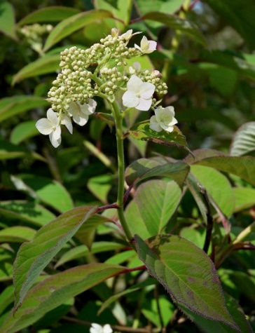
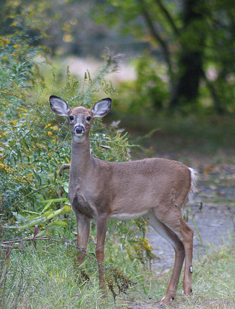
Unit Central Question
Do plants and animals need the same things to live and grow? Explain your thinking.
Photo courtesy of Pixabay.com
Photograph by Aldric de Villartay/ Wikimedia Commons
Photograph by Quadell/ Wikimedia Commons
Photograph by Wouter Hagens
Photograph by Greg Thompson
Notes:
LINK TO PREVIOUS (3 min)

Slide 3
Circle Map: What Do Plants Need?
What Plants
Need from Their Environment
Sentence starter: Plants need ________. My evidence is _______.
Notes:
\

Slide 4
Circle Map: What Do Animals Need?
What Animals
Need from Their Environment
Sentence starter: Animals need ________. My evidence is _______.
Notes:
\

Slide 5
Let’s Compare Our Circle Maps
What’s the same on both circle maps?
What do both plants and animals need from their environment?
What’s different on both circle maps?
What Plants
Need from Their Environment
What Animals
Need from Their Environment

Slide 6
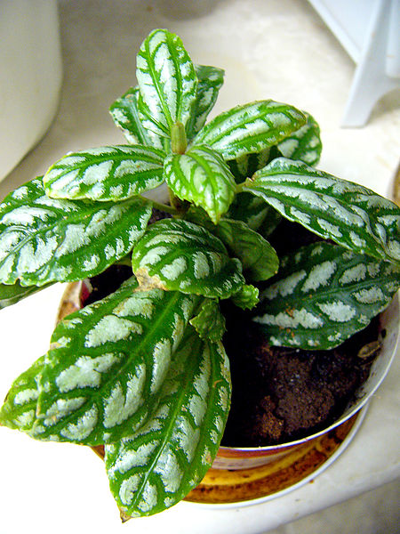
Today’s Focus Questions
Do plants need food? What is our evidence?
Photograph by Philippe Giabbanelli/Wikimedia Commons

Slide 7
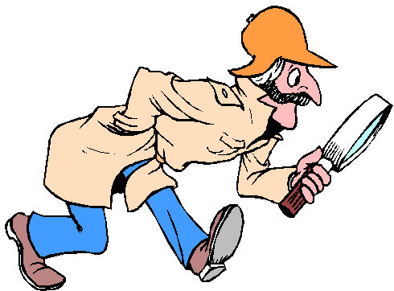
Do Plants Need Food?
Courtesy of clipartpanda.com
Photograph by Philippe Giabbanelli/Wikimedia Commons
Notes:
Circle either need or do NOT need.

Slide 8
Let’s Investigate!
Study the pictures in your book very carefully.
Work with your partner to read as many of the words as you can.
Look for clues in the pictures and words that will help us answer our focus questions: Do plants need food? What is our evidence?
Be ready to share your ideas and evidence with the class.
Courtesy of clipartpanda.com

Slide 9
What Did You Find Out?
Do plants need food? What is our evidence?
Courtesy of clipartpanda.com
Photograph by Philippe Giabbanelli/Wikimedia Commons
Notes:
Circle either need or do NOT need.

Slide 10
Our Focus Questions
Do plants need food? What is our evidence?
Photograph by Philippe Giabbanelli/Wikimedia Commons

Slide 11
How Do Plants Get Their Food?
Photograph by Philippe Giabbanelli/Wikimedia Commons
Sentence starter: Plants get their food by …

Slide 12
Let’s Summarize!
Plants use water, air, and sunlight to make their own food.
They get these things from their environment and turn them into food inside their leaves.
Photograph by Philippe Giabbanelli/Wikimedia Commons

Slide 13
Next Time
We’ll learn more about how plants get their food in our next lesson!
Photograph by Philippe Giabbanelli/Wikimedia Commons

