Slide 1
Plants and Animals Lesson 5b
How Do Plants Get Their Food?

Slide 2
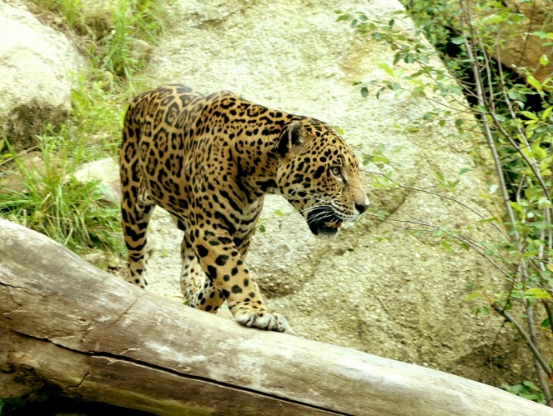
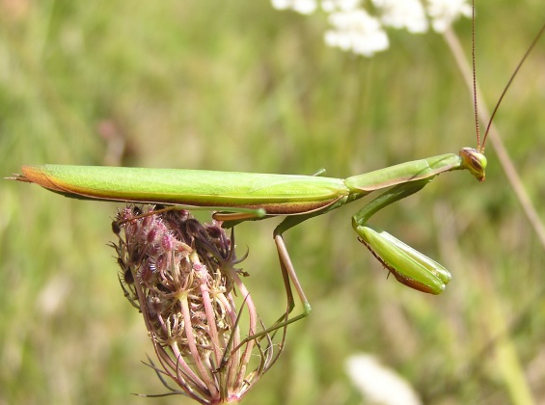
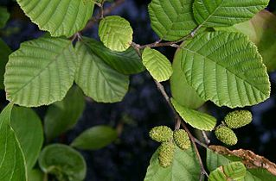
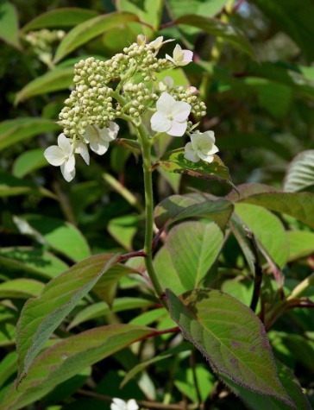
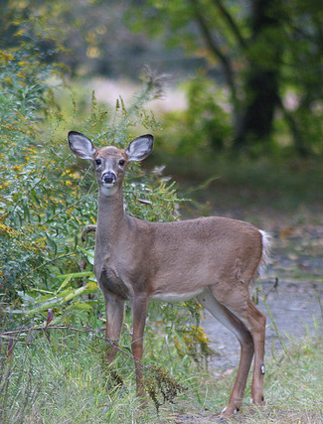
Unit Central Question
Do plants and animals need the same things to live and grow? Explain your thinking.
Photo courtesy of Pixabay.com
Photograph by Aldric de Villartay/ Wikimedia Commons
Photograph by Quadell/ Wikimedia Commons
Photograph by Wouter Hagens
Photograph by Greg Thompson
Notes:
LINK TO PREVIOUS (3 min)

Slide 3
Let’s Review Our Double Bubble Map
What do plants need from their environment to live and grow?
Why do they need these things?
Have any of your ideas changed about whether plants need food?
What Plants
Need from Their Environment
What Animals
Need from Their Environment

Slide 4
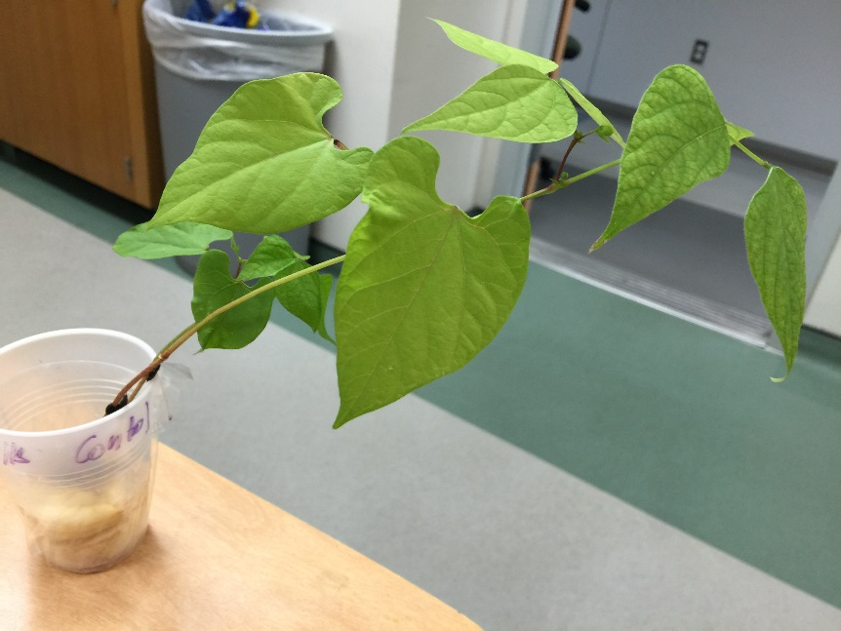
Key Science Ideas
Plants need light, air, and water from their environment to live and grow.
Plants use these three things to make their own food.
Photo courtesy of Cal Poly Pomona

Slide 5
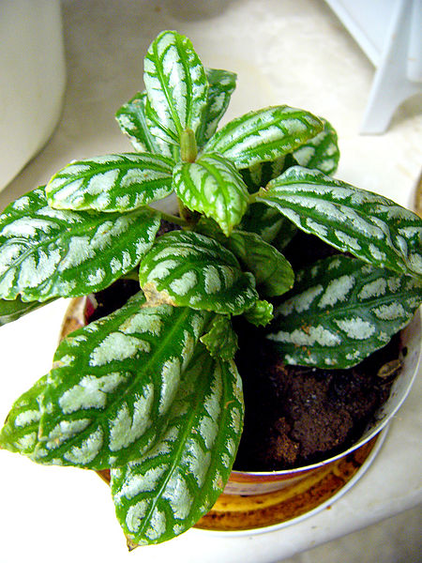
Today’s Focus Question
How do plants get their food?
Photograph by Philippe Giabbanelli/Wikimedia Commons

Slide 6
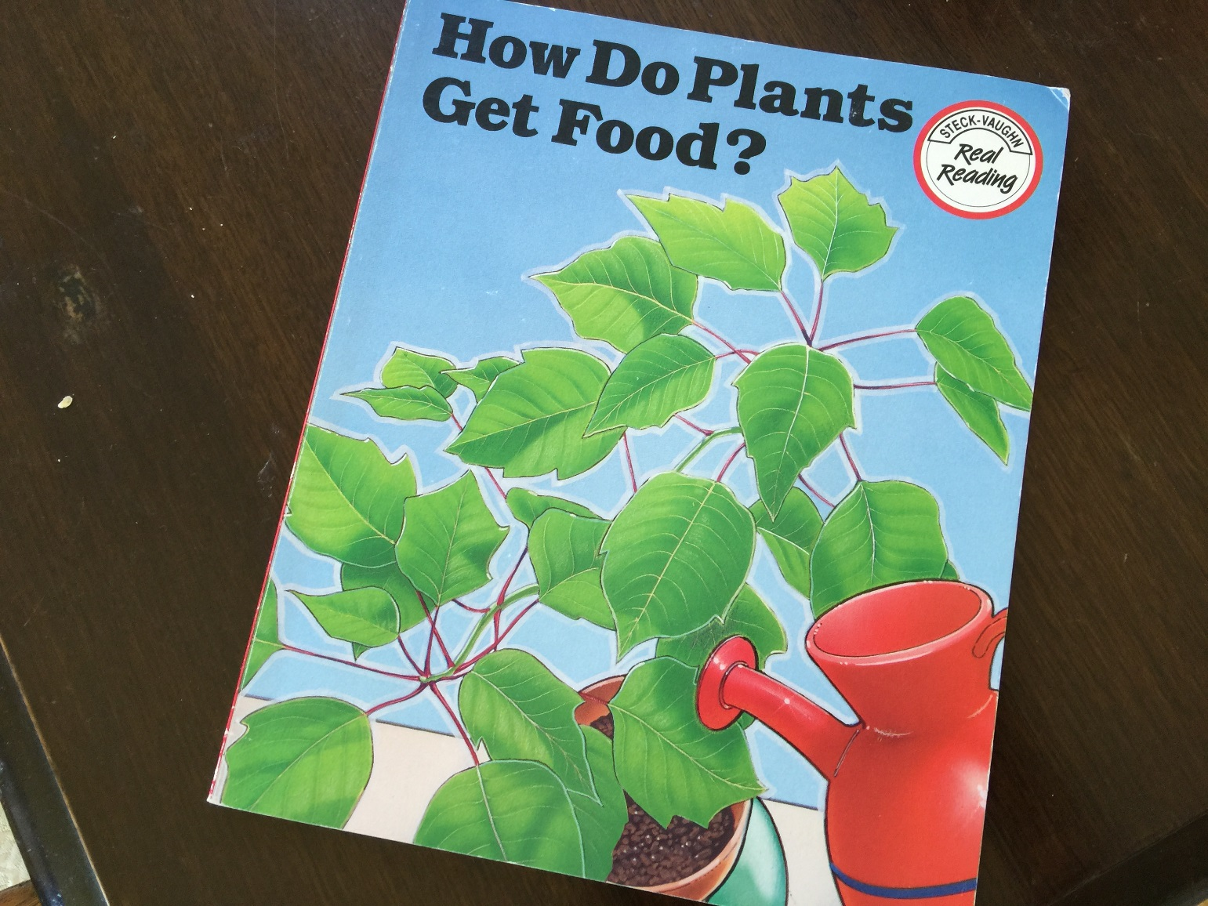
Let’s Find Out More about Plants!
Photo courtesy of BSCS

Slide 7
Today’s Focus Question
How do plants get their food?
Photograph by Philippe Giabbanelli/Wikimedia Commons

Slide 8
Look at Our Double Bubble Map
Do plants and animals get their food in the same way or in different ways?
Sentence starter:
I think plants and animals get their food in the same way because …
OR
I think plants and animals get their food in different ways because …

Slide 9
Key Science Ideas
Both plants and animals need food, but they get their food in different ways.
Plants use light, water, and air to make their own food inside their leaves.
Animals have to find food in their environment that they can catch and eat.
Photo courtesy of Cal Poly Pomona
Photograph by Aldric de Villartay/Wikimedia Commons

Slide 10
Let’s Summarize!
Pairs: Look at the things we listed on our double bubble map.
Which things do both plants and animals need?
Which things do only animals need?
Which things do only plants need?
Photo courtesy of Cal Poly Pomona
Photograph by Aldric de Villartay/Wikimedia Commons

Slide 11
Let’s Summarize!
Photo courtesy of Pixabay.com

Slide 12
Unit Central Question
Do plants and animals need the same things to live and grow? Explain your thinking.
Photo courtesy of Pixabay.com
Photograph by Aldric de Villartay/ Wikimedia Commons
Photograph by Quadell/ Wikimedia Commons
Photograph by Wouter Hagens
Photograph by Greg Thompson

Slide 13
Next Time
How can we use models to help us show how plants make their own food?
Photograph by Philippe Giabbanelli/Wikimedia Commons

