Slide 1
Plants and Animals Lesson 5c
What Are Different Ways We Can Show How Plants Make Their Own Food?

Slide 2
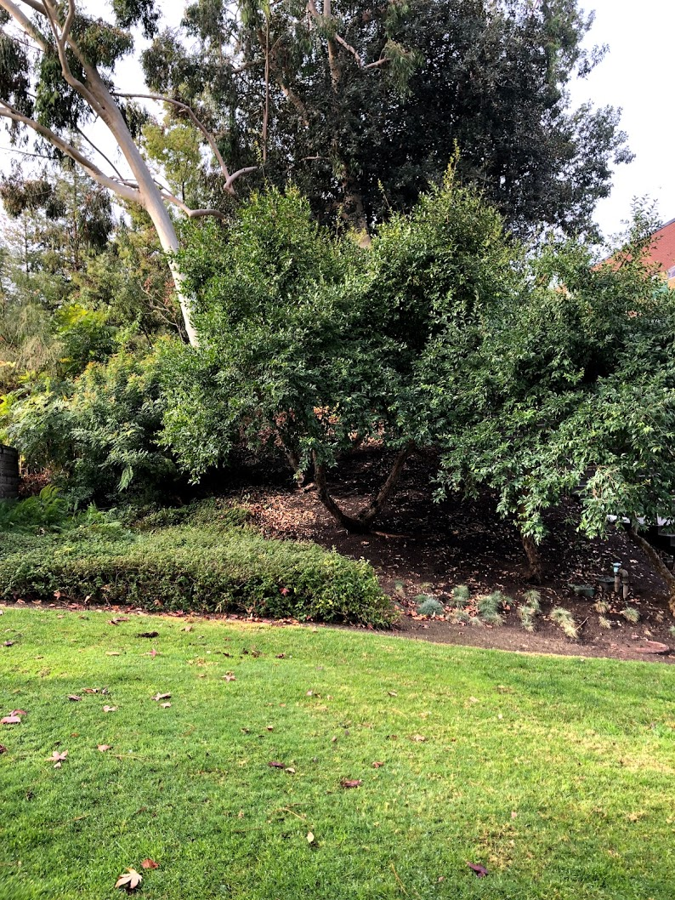
What Kinds of Plants Do You See?
Comstock
Photo courtesy of Cal Poly Pomona

Slide 3
Review: How Do Plants Get Their Food?
Do plants and animals get their food in the same way or in different ways?

Slide 4
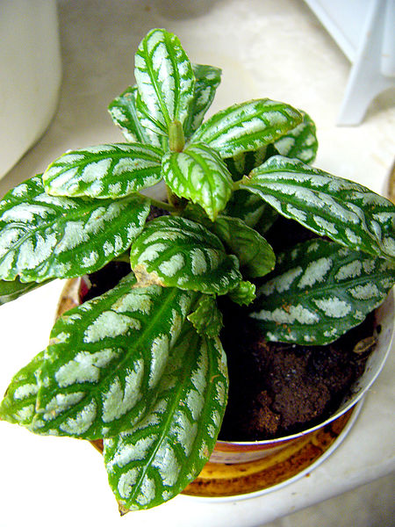
Today’s Focus Question
What are different ways we can show how plants make their own food?
Photograph by Philippe Giabbanelli/Wikimedia Commons

Slide 5
Scientists Use Models
Scientists use models to help them understand and explain how things work in the real world.
What do you think a model is?

Slide 6
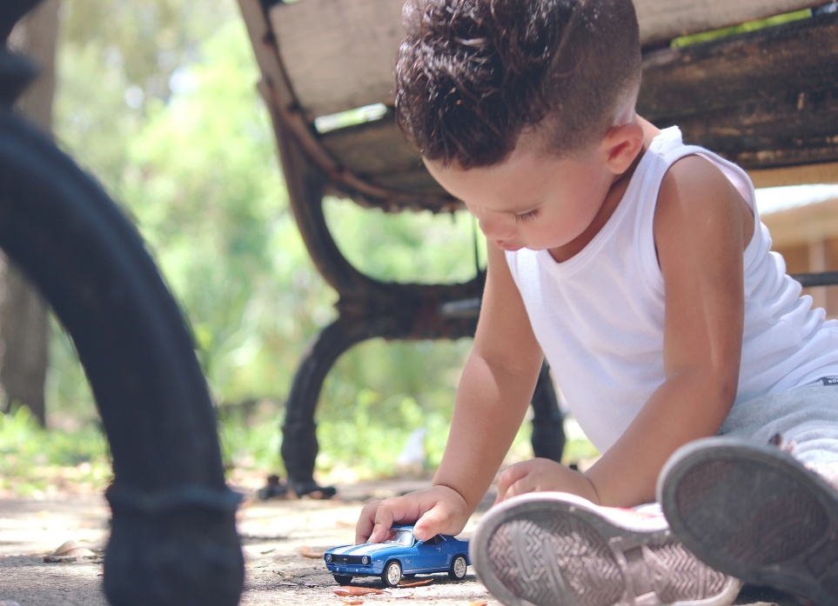
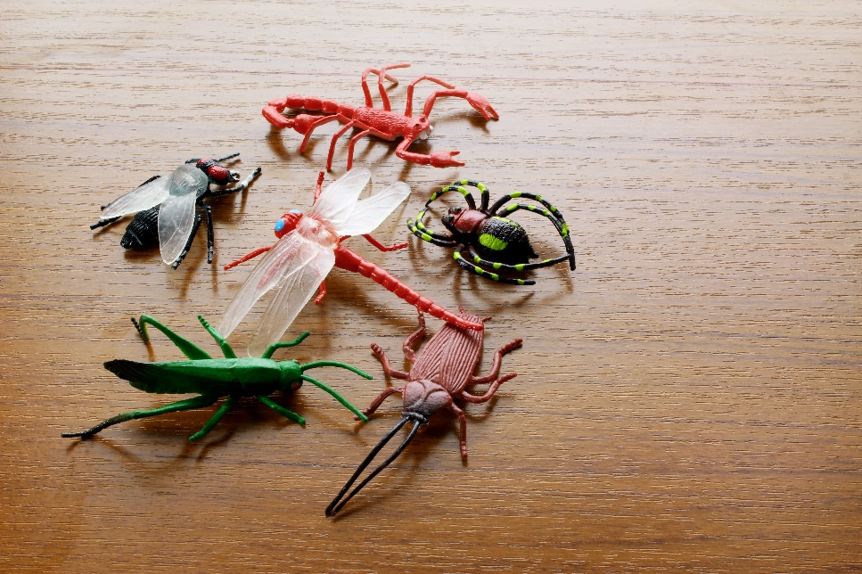
Examples of Models
A Model Car
Model Insects
Photo courtesy of Dayron Villaverde/Pixabay.com
Photo courtesy of Adobe.stock.com

Slide 7
Models Are Not Toys!
Remember: Scientists use models to help them figure out how things work in the real world.
Scientists don’t use models as toys!
Photo courtesy of Dayron Villaverde/Pixabay.com

Slide 8
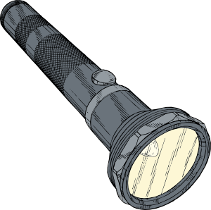
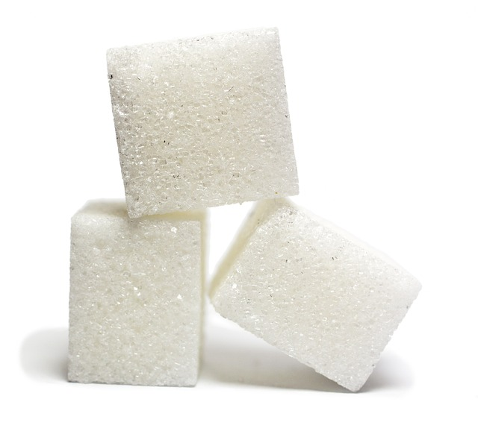
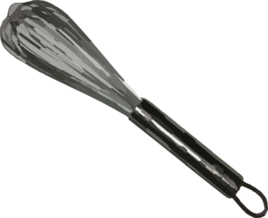
Our First Model: A Mixing Bowl

Slide 9
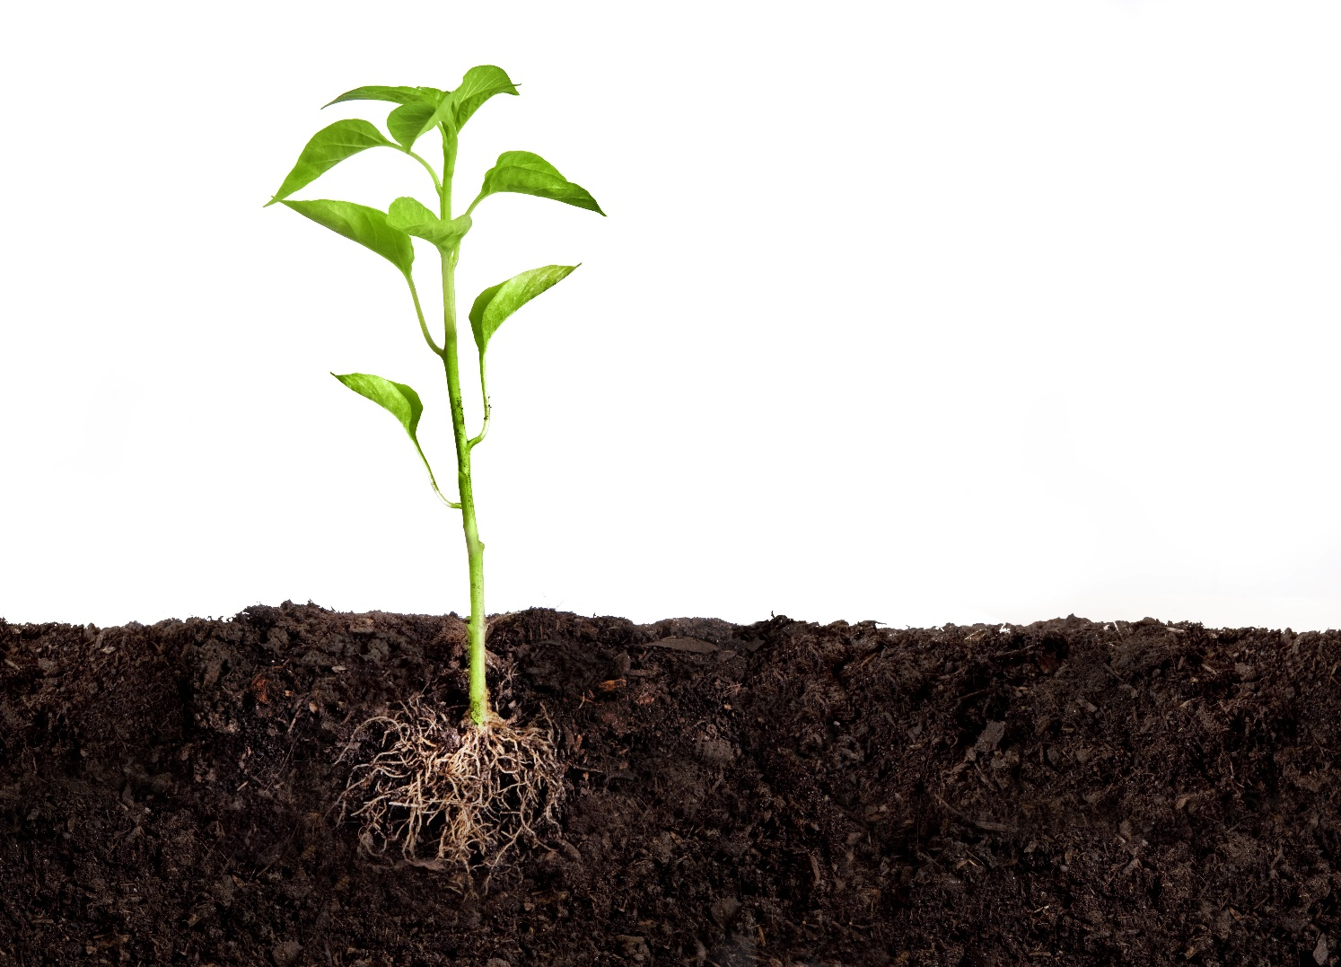
Our Second Model: A Plant Diagram
Image courtesy of BSCS/Photo courtesy of Adobe.stock.com

Slide 10
A Plant Diagram
Light
Makes food!
Air
Water
Image courtesy of BSCS/Photo courtesy of Adobe.stock.com

Slide 11
Our Focus Question
What are different ways we can show how plants make their own food?
Photograph by Philippe Giabbanelli/Wikimedia Commons

Slide 12
What Did Our Models Show about Plants?
Sentence starter: Both models show that …

Slide 13
Let’s Summarize!
Which model made the most sense to you? Why?

Slide 14
Our Two Models
The mixing-bowl model showed how plants mix together water, air, and light inside their leaves to make food.
The plant diagram used arrows and words to show how plants get light, water, and air from their environment and use them to make food inside their leaves.

Slide 15
Next Time
We’re going to be the plant models!
Photograph by Philippe Giabbanelli/Wikimedia Commons

