Slide 1
Plants and Animals Lesson 5D
What Is Another Way We Can Show How Plants Make Their Own Food?

Slide 2
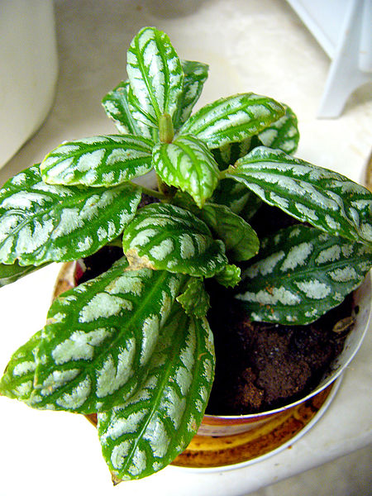
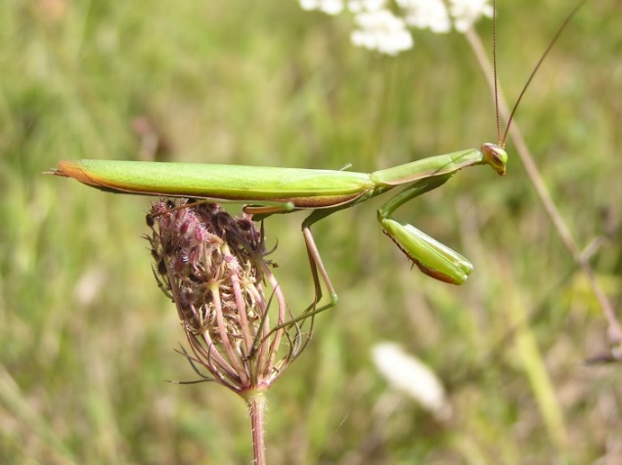
Review: How Do Plants Get Their Food?
Do plants and animals get their food in the same way or in different ways?
Photo courtesy of Aldric de Villartay/Wikimedia Commons
Photograph by Philippe Giabbanelli/Wikimedia Commons

Slide 3
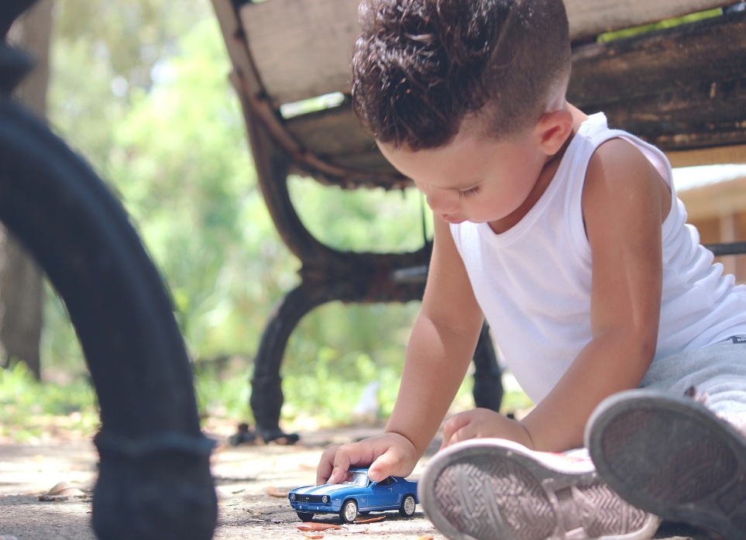
Review: What Is a Model?
Photo courtesy of Dayron Villaverde/Pixabay.com

Slide 4
Review: What Is a Model?
How is a model different from the real thing?
Photo courtesy of Dayron Villaverde/Pixabay.com

Slide 5
Today’s Focus Question
What is another way we can show how plants make their own food?
Photograph by Philippe Giabbanelli/Wikimedia Commons

Slide 6
A Different Kind of Model: A Role-Play
Photo courtesy of Johannes Plenio/Pexels.com

Slide 7
Let’s Pretend We’re Plants!
Your hands are leaves.
Your arms are branches.
Your body is the stem.
Your legs are roots.
Photo courtesy of Gerd Altmann/Pixabay.com

Slide 8
Our Focus Question
What is another way we can show how plants make their own food?
Photograph by Philippe Giabbanelli/Wikimedia Commons

Slide 9
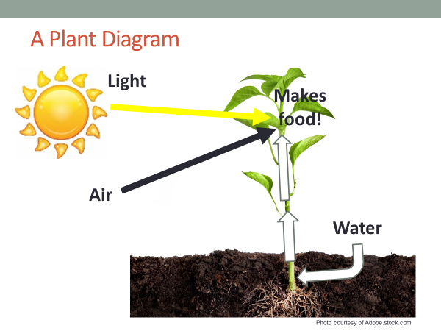
What Did Our Models Show about Plants?
Sentence starter: All three models showed that …
Photo courtesy of Gerd Altmann/Pixabay.com

Slide 10
Let’s Summarize!
Which model made the most sense to you? Why?
Photo courtesy of Gerd Altmann/Pixabay.com

Slide 11
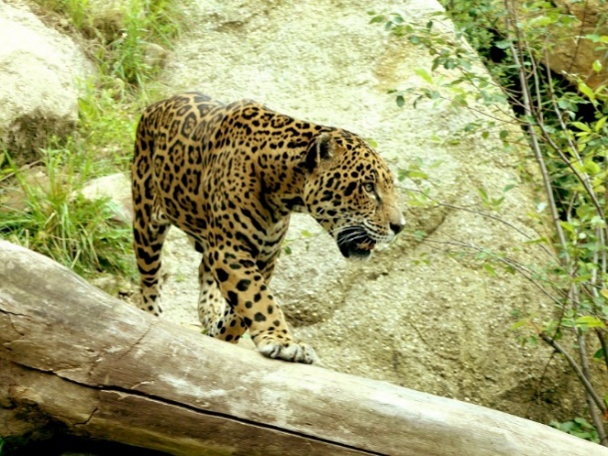
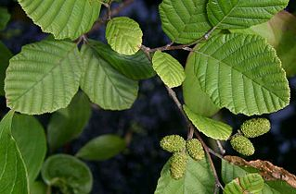
Next Time
Our unit central question: Do plants and animals need the same things to live and grow? Explain your thinking.
What have we learned that can help us answer this question?
Photo courtesy of Pixabay.com
Photograph by Aldric de Villartay/ Wikimedia Commons
Photograph by Quadell/ Wikimedia Commons
Notes:
LINK TO PREVIOUS (3 min)

