Slide 1
Plants and Animals Lesson 6a
Do Plants and Animals Need the Same Things to Live and Grow? Explain Your Thinking.

Slide 2
Review: What Do Plants and Animals Need?
Photo courtesy of BSCS

Slide 3
Review: What Do Plants and Animals Need?
Both plants and animals need food, water, and air to live and grow. Plants also need sunlight.
Plants and animals get their food in different ways.
Plants make their own food, but animals have to get food from their environment.
Photo courtesy of BSCS

Slide 4
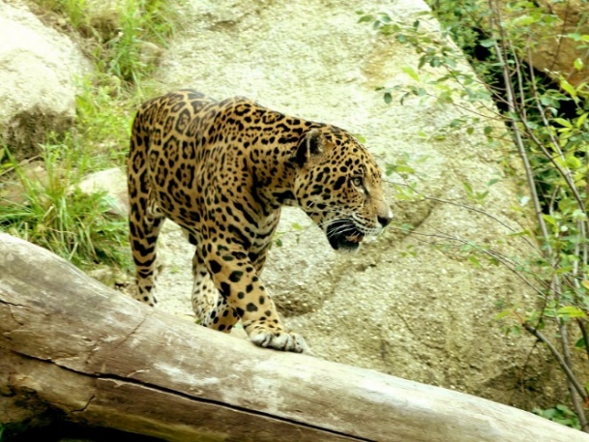
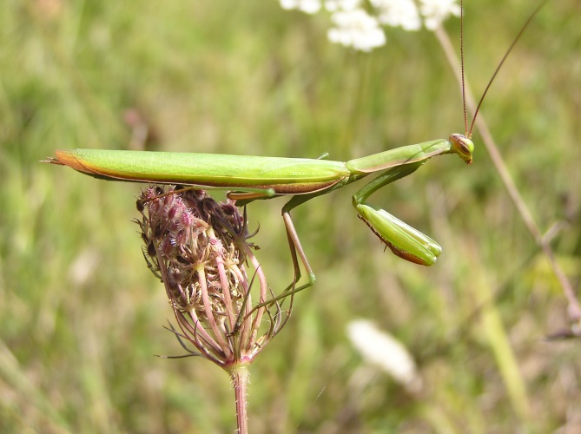
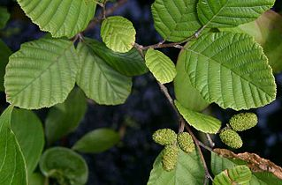
Today’s Focus Question
Do plants and animals need the same things to live and grow? Explain your thinking.
Photo courtesy of Pixabay.com
Photograph by Aldric de Villartay/ Wikimedia Commons
Photograph by Quadell/ Wikimedia Commons
Notes:
LINK TO PREVIOUS (3 min)

Slide 5
Review: What Do Plants and Animals Need?
What do both plants and animals need to from their environment?
What do only plants need?
What do only animals need?
What Plants
Need from Their Environment
What Animals
Need from Their Environment

Slide 6
What Do All Plants and Animals Need?
What Do All Plants and Animals Need to Live and Grow?
What All Plants Need | What All Animals Need

Slide 7
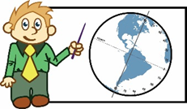
Let’s Talk and Act Like Scientists!
Science Presenters
Our idea is …
Our claim is …
Our evidence is …
Our reason is …
Science Listeners
What do you mean …?
I agree because …
I disagree because …
I want to add on …
I want to piggyback …

Slide 8
Today’s Focus Question
Do plants and animals need the same things to live and grow? Explain your thinking.
Photo courtesy of Pixabay.com
Photograph by Aldric de Villartay/ Wikimedia Commons
Photograph by Quadell/ Wikimedia Commons
Notes:
LINK TO PREVIOUS (3 min)

Slide 9
Next Time
What should students from another class add to their terrarium?
Photo courtesy of BSCS

