Slide 1
Plants and Animals Lesson 6b
Do Plants and Animals Need the Same Things to Live and Grow? Explain Your Thinking.

Slide 2
Review: What Do Plants and Animals Need?
Photo courtesy of BSCS

Slide 3
Review: What Do Plants and Animals Need?
Animals need food, water, and air to live and grow. They get these things from their environment.
Plants need food, water, and air too. But they also need sunlight.
Plants get sunlight, water, and air from their environment. They use these things to make their own food.
Animals have to get food from their environment.

Slide 4
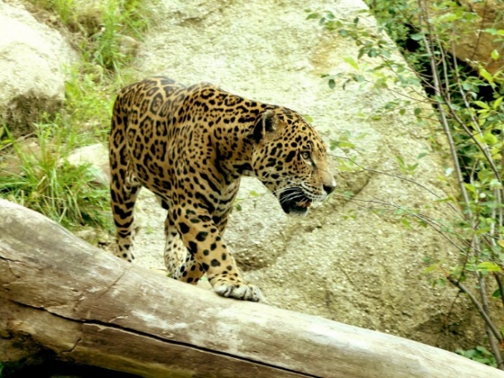
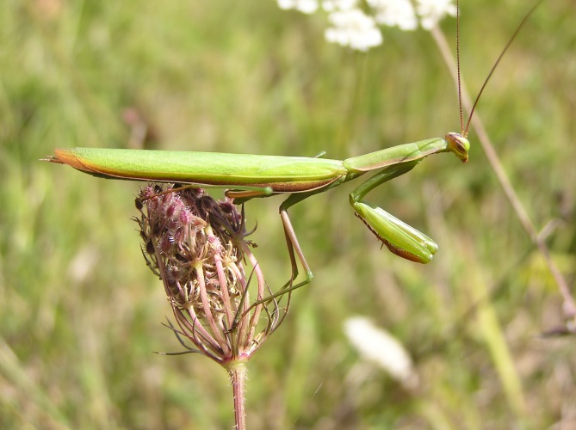
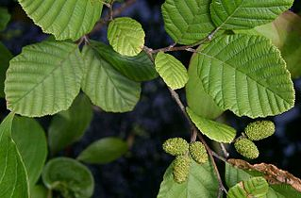
Our Unit Central Question and Focus Question
Do plants and animals need the same things to live and grow? Explain your thinking.
Photo courtesy of Pixabay.com
Photograph by Aldric de Villartay/ Wikimedia Commons
Photograph by Quadell/ Wikimedia Commons
Notes:
LINK TO PREVIOUS (3 min)

Slide 5
Another Class Needs Our Help!
Photo courtesy of BSCS

Slide 6
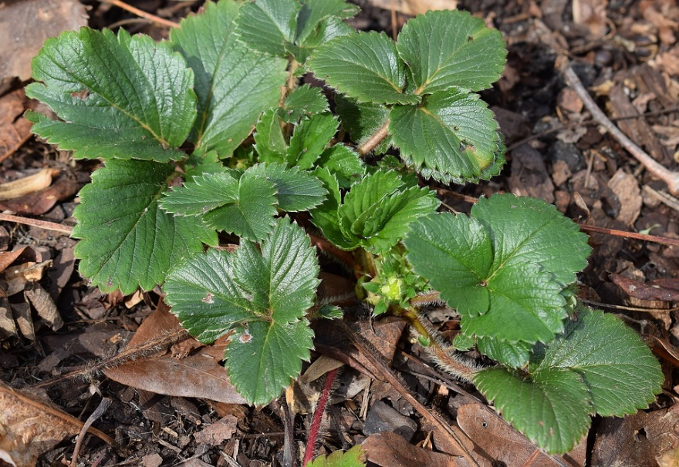
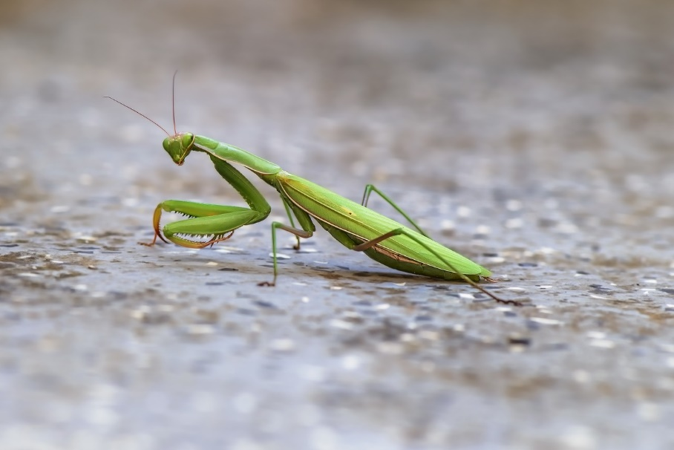
Another Class Needs Our Help!
What do the praying mantis and the plant need to live and grow in their terrarium environment?
Photo courtesy of Pixabay.com
Photo courtesy of Pixabay.com

Slide 7
What Does the Terrarium Need?
Photo courtesy of Unsplash.com

Slide 8
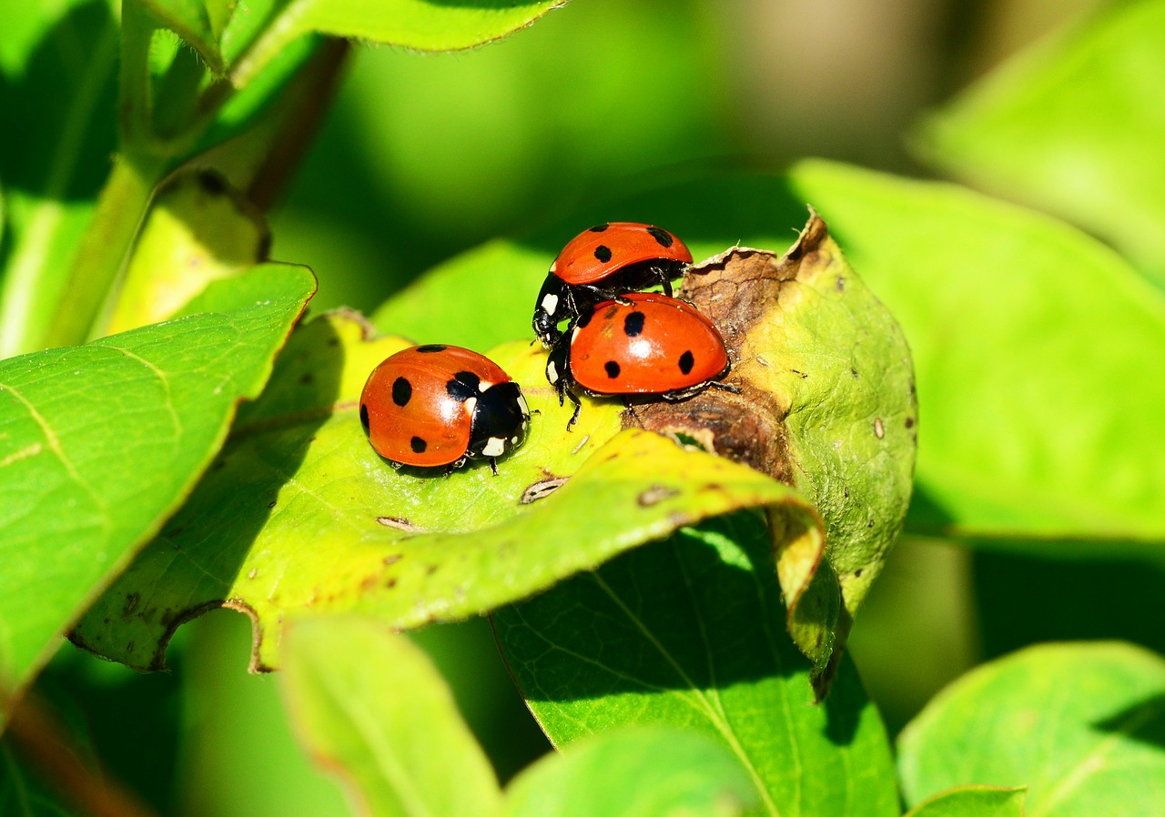
What Does the Terrarium Need?
Photo courtesy of Pixabay.com

Slide 9
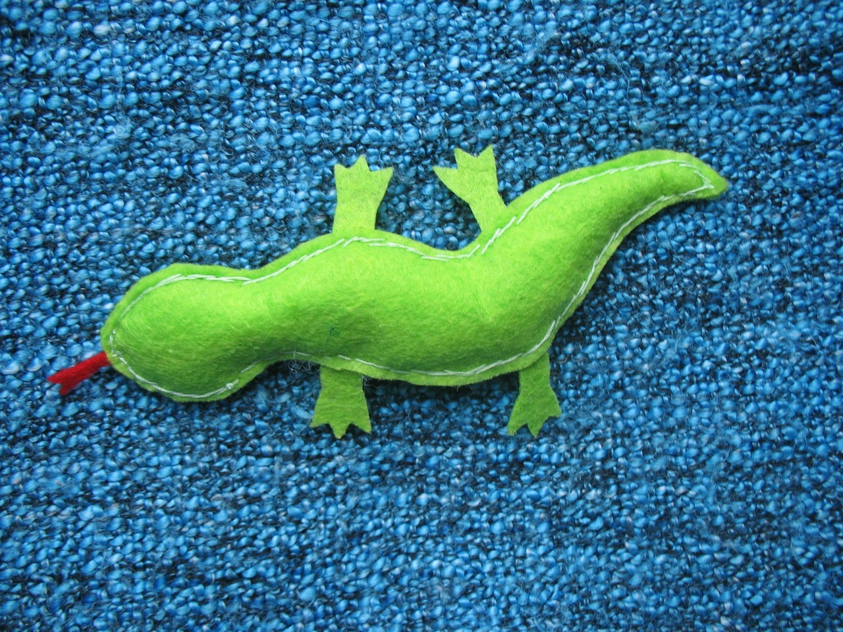
What Does the Terrarium Need?
Photo courtesy of Pxhere.com

Slide 10
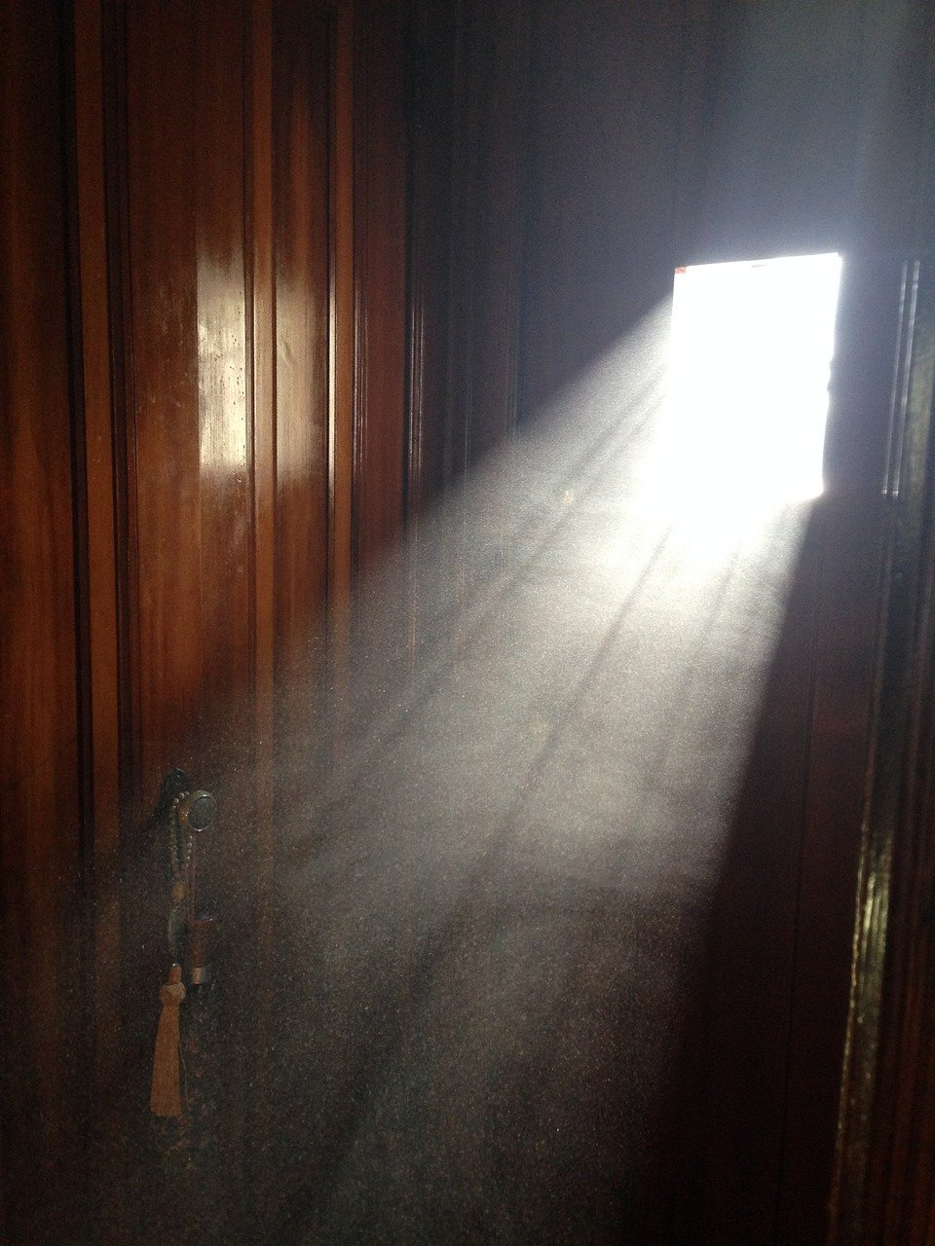
What Does the Terrarium Need?
Photo courtesy of Pixabay.com

Slide 11
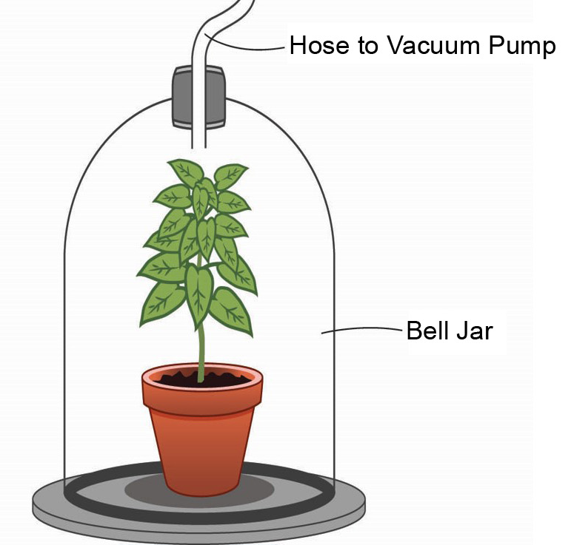
What Does the Terrarium Need?
Courtesy of BSCS

Slide 12
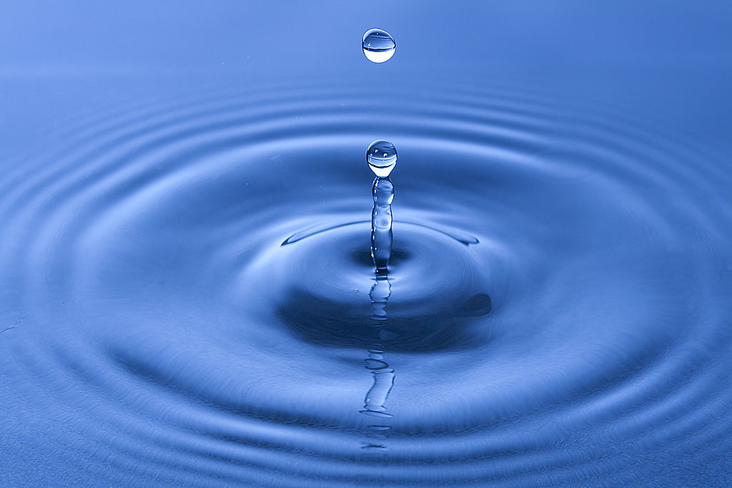
What Does the Terrarium Need?
Photo courtesy of Davide Restivo, Wikimedia Commons

Slide 13
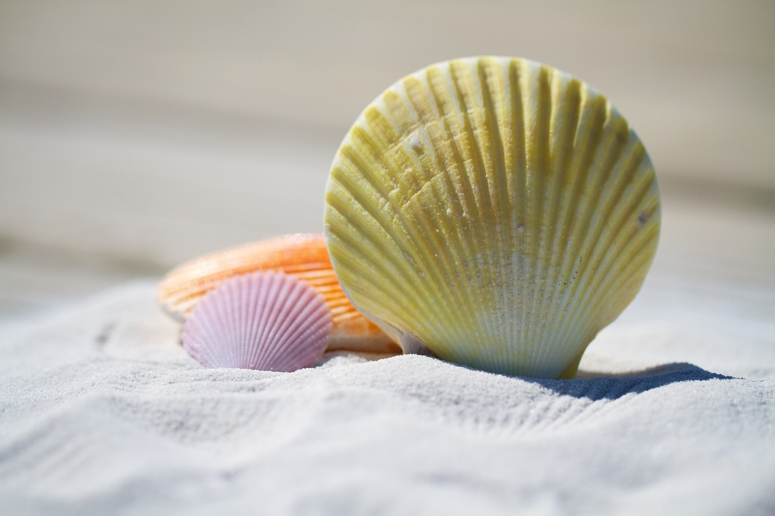
What Does the Terrarium Need?
Photo courtesy of Pixabay.com

Slide 14
What Does the Terrarium Need?
Look at each picture on the handout.
Does the praying mantis need the thing in the picture to live and grow?
Does the plant need the thing in the picture to live and grow?
If YES, put an X in the YES box. If NO, put an X in the NO box.
Give good reasons for your decisions!

Slide 15
Let’s Write a Letter!
What should the other class put in their terrarium? (Look at our checklist.)
What can we tell the other class about these things?
How can we explain why the praying mantis and the plant need these things to live and grow in their environment?

Slide 16
Let’s Summarize!
Animals need food, water, and air to live and grow. They get these things from their environment.
Plants need food, water, and air too. But they also need sunlight.
Plants get sunlight, water, and air from their environment. They use these things to make their own food inside their leaves.
Animals can’t make their own food. They have to get food from their environment by eating plants and other animals.

