Slide 1
Weather and seasons Lesson 0a
What Is Weather?

Slide 2
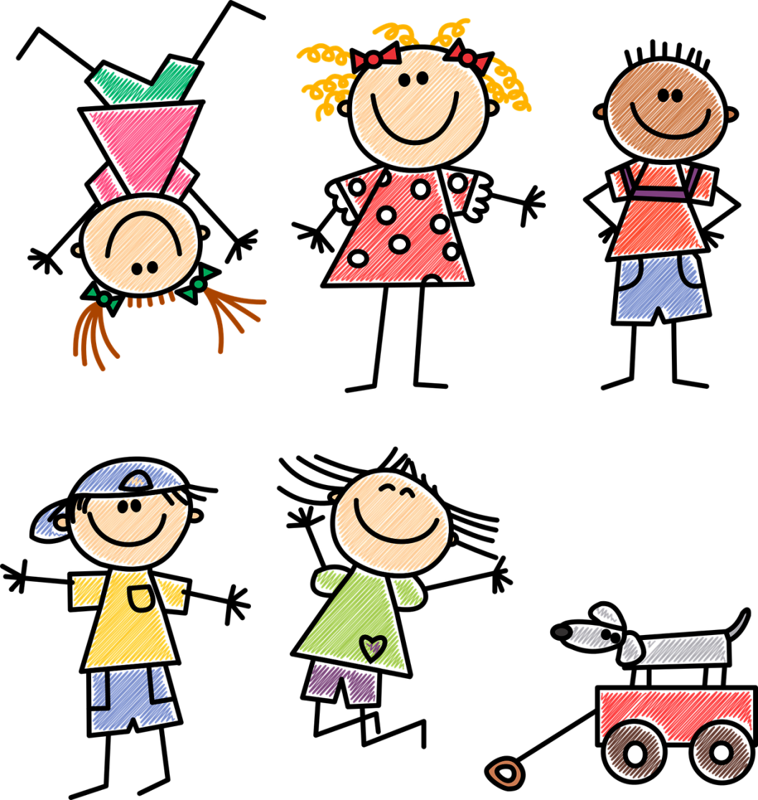
What Did You Wear Today?
How did you decide what to wear to school today?
Did you decide what to wear because of how it feels outside?
Photo courtesy of Gustavo Rezende/Pixabay.com

Slide 3
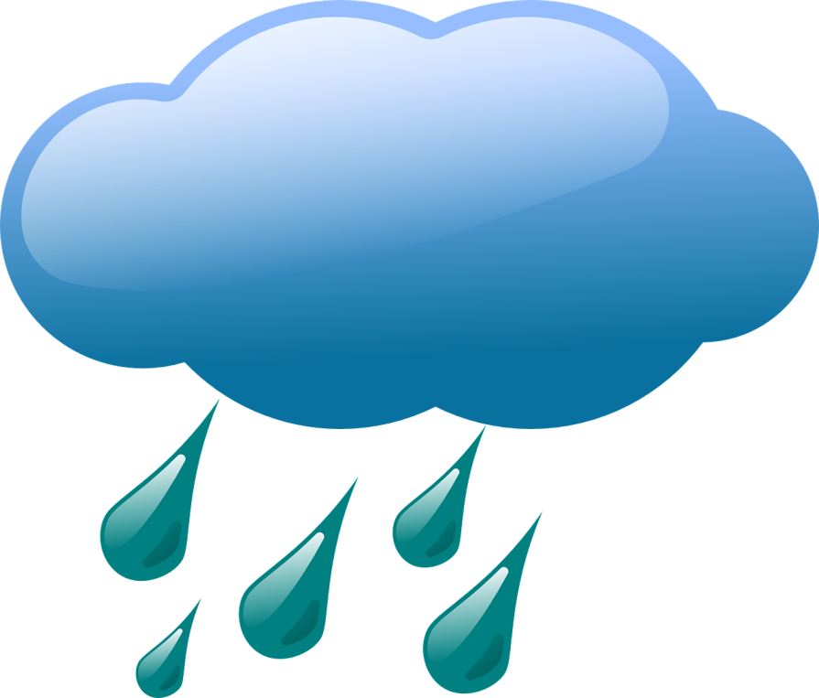
Today’s Focus Question
What is weather?
Courtesy of BSCS
Courtesy of Clker-Free-Vector-Images/Pixabay.com

Slide 4
What Do You Think Weather Is?
Courtesy of Clker-Free-Vector-Images/Pixabay.com
Courtesy of BSCS

Slide 5
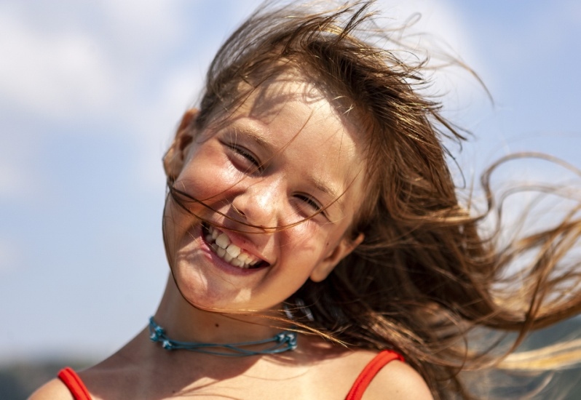
What Is Weather?
Weather is what it looks like and feels like outside.
Courtesy of BSCS
Courtesy of Clker-Free-Vector-Images/Pixabay.com
Photo courtesy of Hulki Okan Tabak/Pixabay.com

Slide 6
Key Science Ideas
We can see and feel different kinds of weather.
When we see things, scientists call this observing.

Slide 7
What Do You Observe?
Look out the window.
What do you observe about the weather?
Raise your hand if you observe something about the weather.
Sentence starter:
I observe ___________.

Slide 8
Let’s Summarize!
Today’s focus question: What is weather?
Courtesy of BSCS
Courtesy of Clker-Free-Vector-Images/Pixabay.com

Slide 9
Let’s Summarize!
Weather is what it looks like and feels like outside.
Weather includes whether it’s …
warm or cold
sunny or cloudy
rainy or not
windy or not
Courtesy of BSCS

Slide 10
Next Time
In our next lesson, we’ll go outside and observe the weather!
We’ll also learn more about how to describe the weather.
Courtesy of Clker-Free-Vector-Images/Pixabay.com

