Slide 1
Weather and seasons Lesson 0b
How Can We Describe Our Weather?

Slide 2
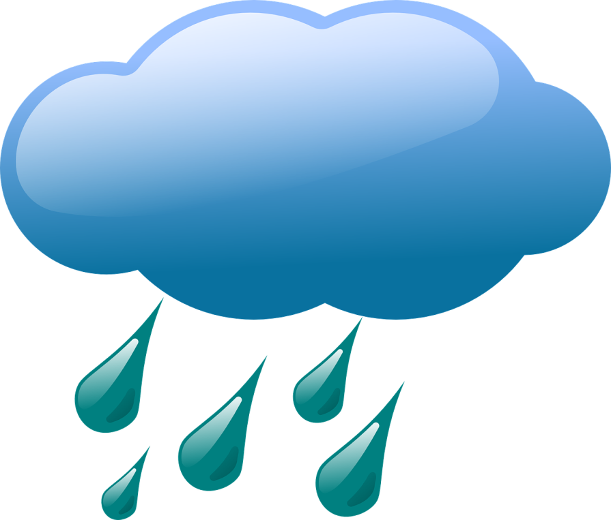
Review: What Did We Learn about Weather?
Courtesy of Clker-Free-Vector-Images/Pixabay.com
Courtesy of BSCS

Slide 3
What Is the Weather Like Outside?
We can see and feel what the weather is like outside.
We can see if it’s sunny or cloudy.
We can see and feel the wind and rain.
Our bodies tell us if it’s hot or cold.
Courtesy of BSCS

Slide 4
Today’s Focus Question
How can we describe our weather?
Courtesy of Clker-Free-Vector-Images/Pixabay.com
Courtesy of BSCS

Slide 5
Let’s Observe Our Weather!
What weather might we observe outside?
Courtesy of Clker-Free-Vector-Images/Pixabay.com
Courtesy of BSCS

Slide 6
What Did You Observe about the Weather?
What did you observe about our weather outside?
Use words from our class chart to describe the weather you saw and felt.
Courtesy of BSCS
Courtesy of Clker-Free-Vector-Images/Pixabay.com

Slide 7
Let’s Summarize!
Our focus question: How can we describe our weather?
Courtesy of Clker-Free-Vector-Images/Pixabay.com
Courtesy of BSCS

Slide 8
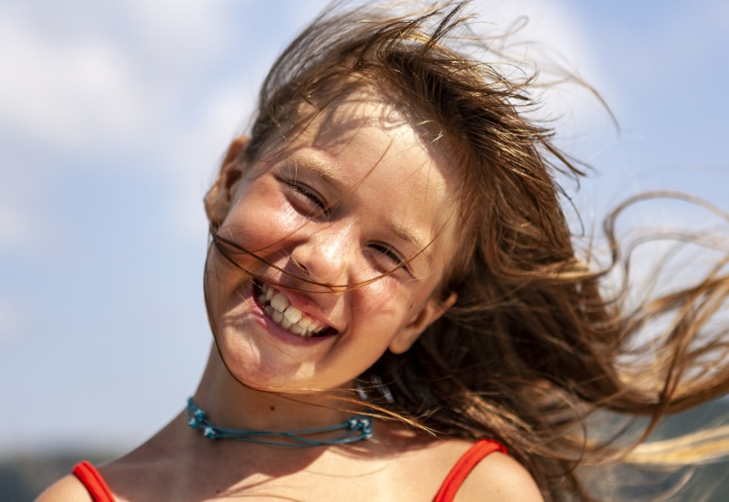
Let’s Summarize!
Weather is what it looks like and feels like outside.
Courtesy of BSCS
Courtesy of Clker-Free-Vector-Images/Pixabay.com
Photo courtesy of Hulki Okan Tabak/Pixabay.com

Slide 9
Let’s Summarize!
Today we went outside to observe our weather. Then we used weather words to describe what we saw and felt.
Our weather report: It’s partly cloudy and warm, with a little wind and no rain.
Courtesy of Marketa Markova/Pixabay.com

Slide 10
Next Time
We can measure temperatures to tell how hot or cold it is outside.
Next time, you’ll learn how to measure temperatures with a thermometer.
You’ll also learn how to record the temperatures you measure.
Courtesy of BSCS

