Slide 1
Weather and seasons Lesson 0c
How Can We Measure the Temperature Outside?

Slide 2
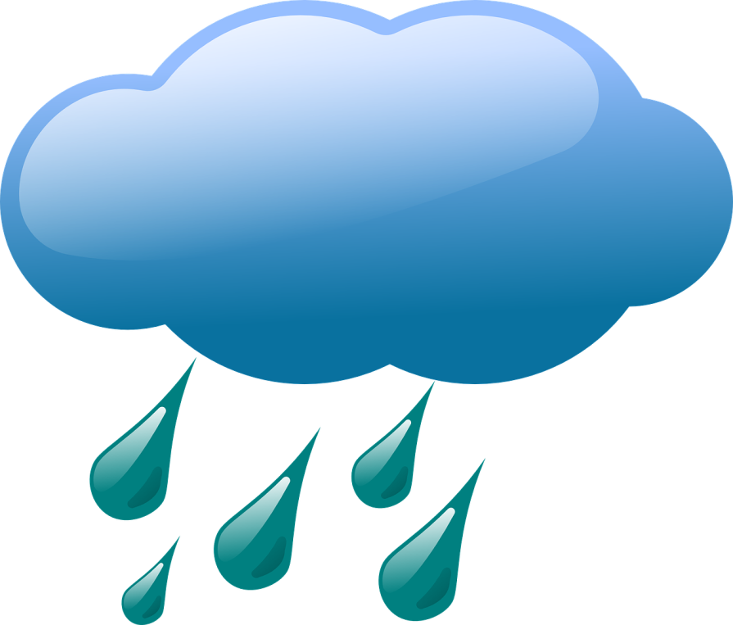
Review: What Is Weather?
Weather is what it looks like and feels like outside.
Courtesy of BSCS
Courtesy of Clker-Free-Vector-Images/Pixabay.com
Photo courtesy of Hulki Okan Tabak/Pixabay.com

Slide 3
What Is the Weather Like Today?
What does the weather look like and feel like outside today?
Use the words on our weather chart to describe the weather.
Courtesy of BSCS

Slide 4
Today’s Focus Question
How can we measure the temperature?
What does it mean to measure something?
What kinds of things can we measure?
What can we use to measure different things?
Courtesy of BSCS

Slide 5
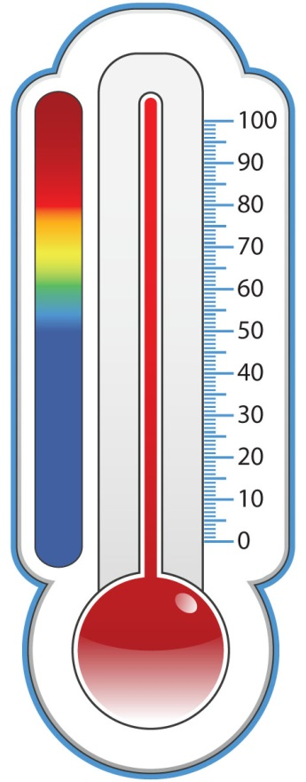
How Can We Measure Temperature?
Using a thermometer is one way to measure temperature.
A thermometer tells us how hot or cold the weather is outside.
Courtesy of BSCS

Slide 6
What Will It Be Like Tomorrow?
What do you think the temperature outside will be like tomorrow?
Courtesy of BSCS

Slide 7
Let’s Summarize!
Our focus question: How can we measure the temperature outside?
How can we tell how hot or cold it is outside?
Courtesy of BSCS

Slide 8
Let’s Summarize!
We can feel with our skin if it’s hot or warm or cool or cold outside.
But we can also use a thermometer to measure the temperature.
Courtesy of BSCS

Slide 9
Next Time
Every day during the week, we’ll go outside and observe the weather.
We’ll use our thermometer to measure the temperature. Then we’ll record the temperature on our class weather calendar.
Each day, one of you will be our lead weather investigator!
Courtesy of BSCS

