Slide 1
Weather and seasons Lesson 0d
How Can We Keep Track of the Weather?

Slide 2
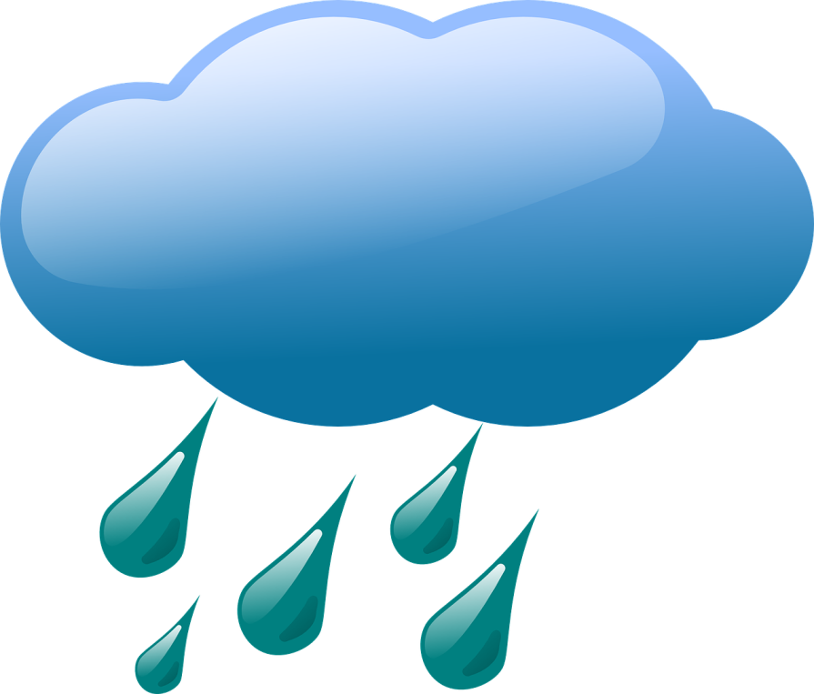
Review: What Did We Observe?
Last time, we went outside to observe the weather.
What did you observe?
Sentence starter:
I observed that …
Courtesy of BSCS
Courtesy of Clker-Free-Vector-Images/Pixabay.com
Photo courtesy of Hulki Okan Tabak/Pixabay.com

Slide 3
Today’s Focus Question
How can we keep track of the weather?
What does it mean to keep track of something?
Courtesy of BSCS

Slide 4
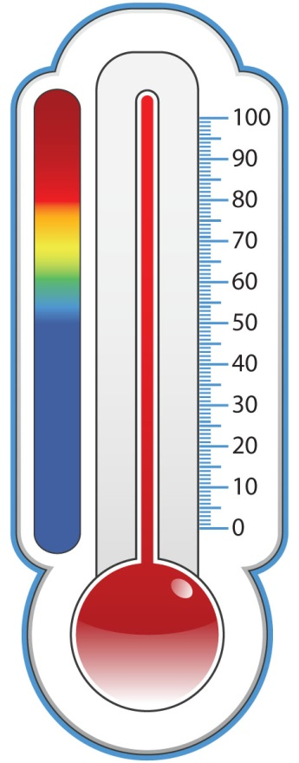
How Can We Keep Track of the Weather?
Keeping track of the weather means finding a way to remember what the weather is like from day to day.
Example: shading in the temperature on our class weather calendar
Today we’ll use temperature and weather stickers to help us remember what the weather is like outside.
Courtesy of BSCS

Slide 5
What Can the Weather Be Like Outside?
Use the words on our class weather chart to describe what the weather can be like outside.
Courtesy of BSCS

Slide 6
How Can We Keep Track of the Weather?
We can measure and record the temperature on our weather calendar.
We can use temperature and weather stickers to record our observations on the weather calendar.
Both of these things can help us remember what the weather was like from day to day.
Courtesy of BSCS
Courtesy of BSCS

Slide 7
What Was the Weather Like Outside?
Describe what the weather was like outside today.
Use the words on our class weather chart.
Courtesy of BSCS

Slide 8
Let’s Summarize!
Our focus question: How can we keep track of the weather?
What are two ways we can keep track of the weather?
Courtesy of BSCS

Slide 9
Let’s Summarize!
Imagine that you’re a weather reporter on TV.
What would you tell people about today’s weather?
Talk about this with an elbow partner.
Use weather words.
Be ready to give a weather report to the class.
Courtesy of BSCS

Slide 10
Next Time
Every day during the week, we’ll observe the weather outside and measure the temperature.
Then we’ll record our weather observations and temperature readings on our class weather calendar and our weekly weather charts.
Each day, one of you will be our lead weather investigator.
Courtesy of BSCS

