Slide 1
Weather and seasons Lesson 1a
What Was Our Weather in Pomona Like in September?

Slide 2
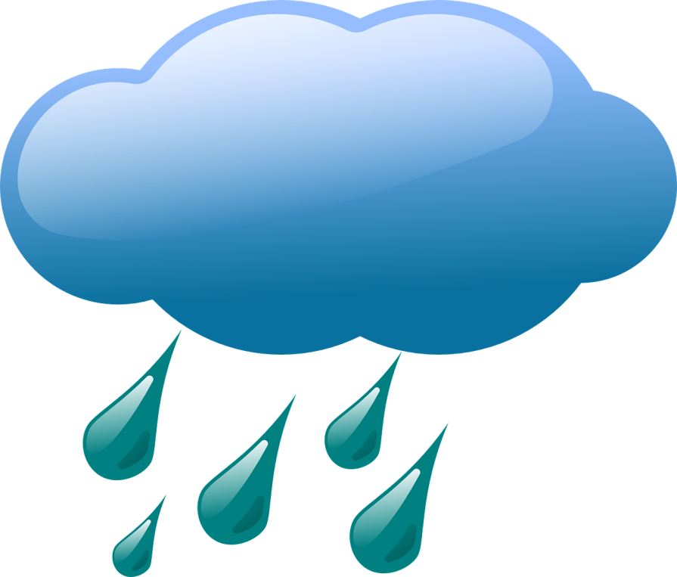
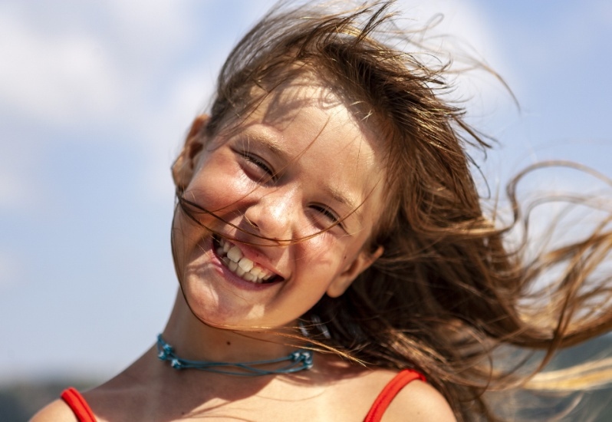
Our Big Weather Questions
Is weather the same everywhere all of the time?
How do you know?
Courtesy of BSCS
Courtesy of Clker-Free-Vector-Images/Pixabay.com
Photo courtesy of Hulki Okan Tabak/Pixabay.com

Slide 3
Our September Weather Calendar
What does our calendar show us about the weather in Pomona during September?
Courtesy of BSCS

Slide 4
Today’s Focus Question
What was our weather in Pomona like in September?
Courtesy of BSCS

Slide 5
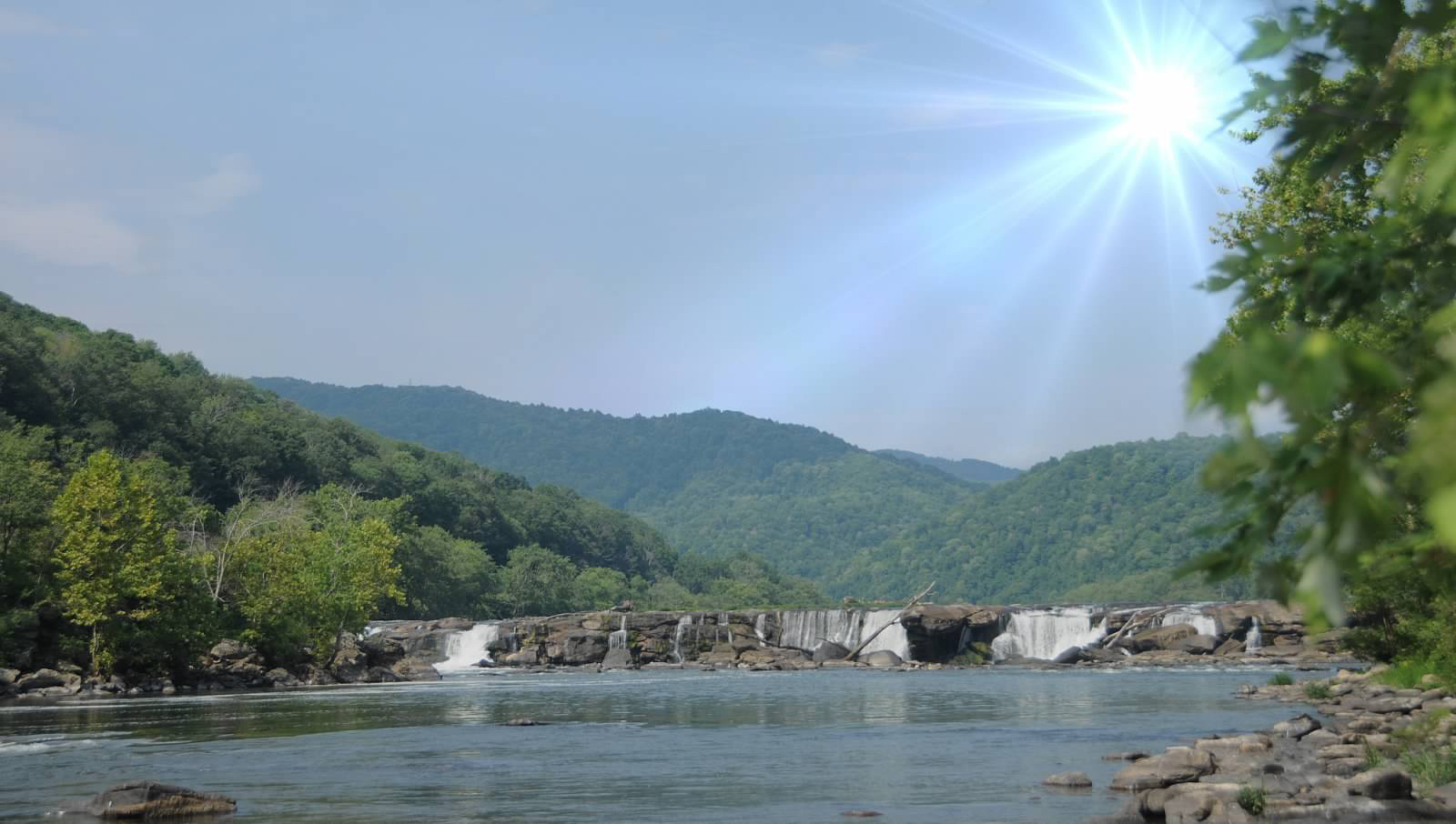
Does Pomona Have This Weather?
Photograph by Carey Woods

Slide 6
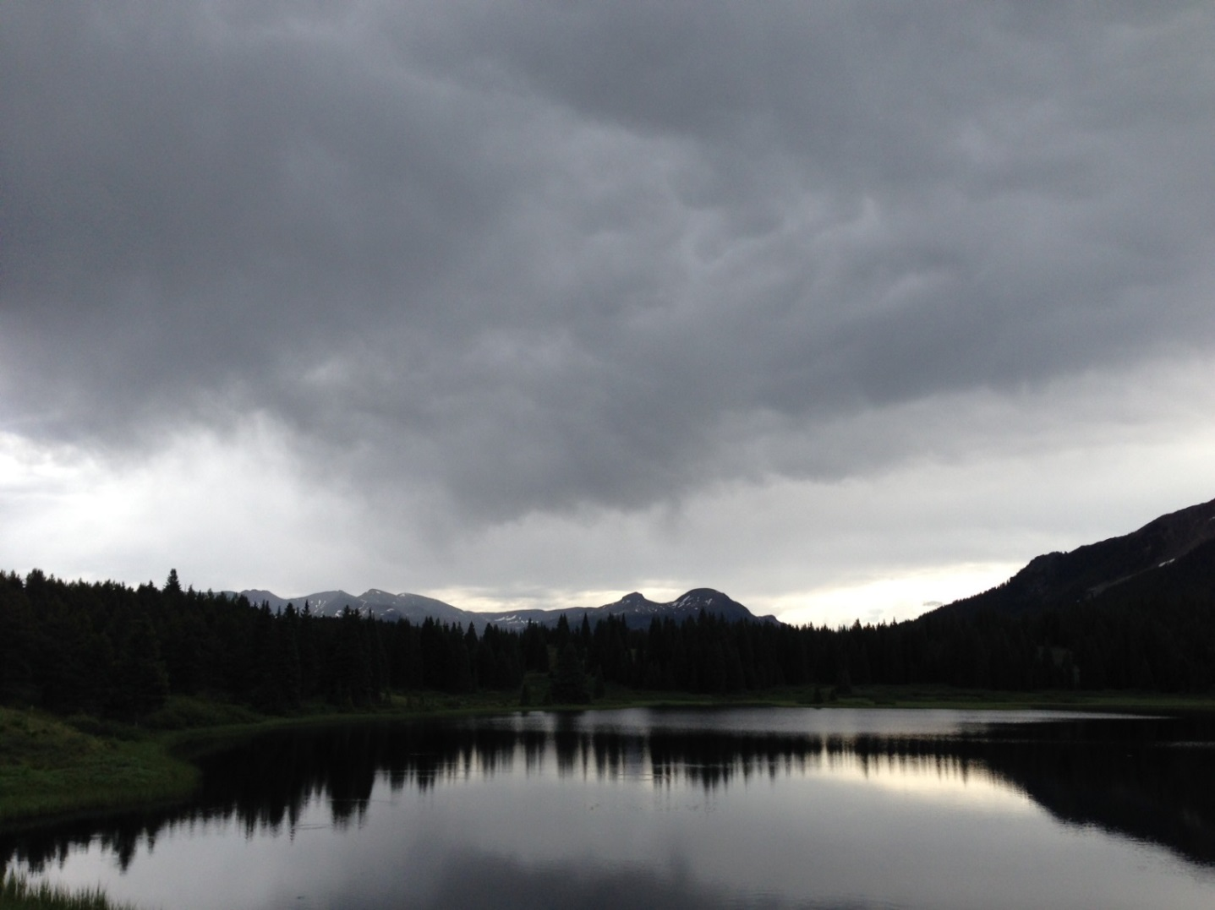
Does Pomona Have This Weather?
Photograph by Audrey Mohan

Slide 7
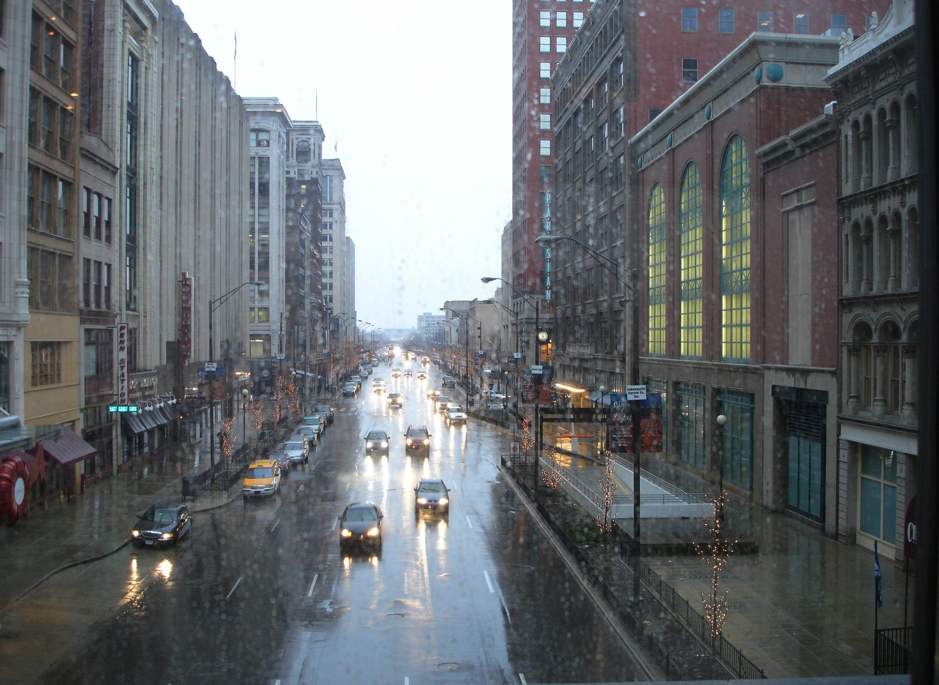
Does Pomona Have This Weather?
Photograph by Cyndy Sims Parr/Wikimedia Commons

Slide 8
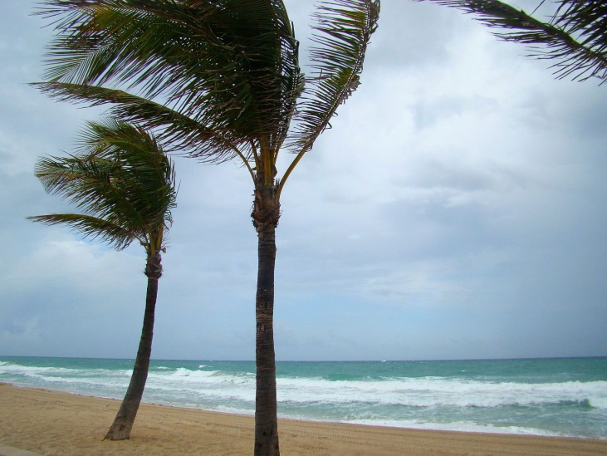
Does Pomona Have This Weather?
Photo courtesy of Publicdomainpictures.net

Slide 9
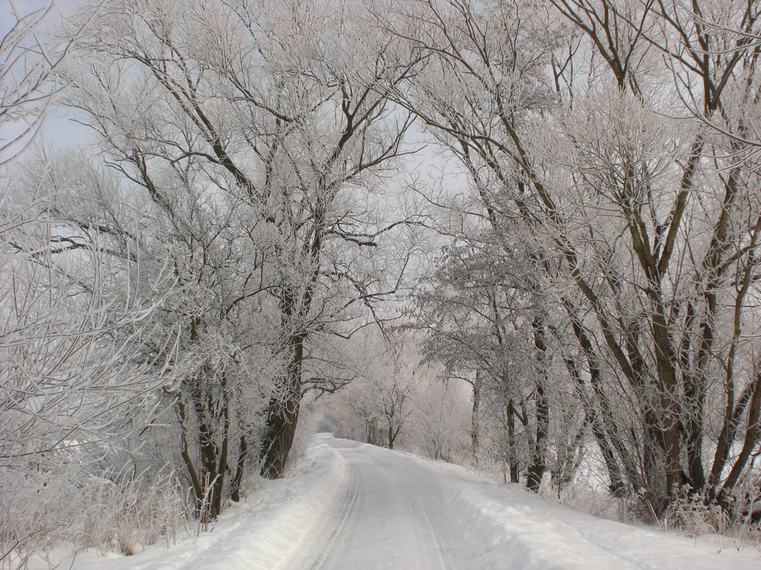
Does Pomona Have This Weather?
Photo courtesy of Publicdomainpictures.net

Slide 10
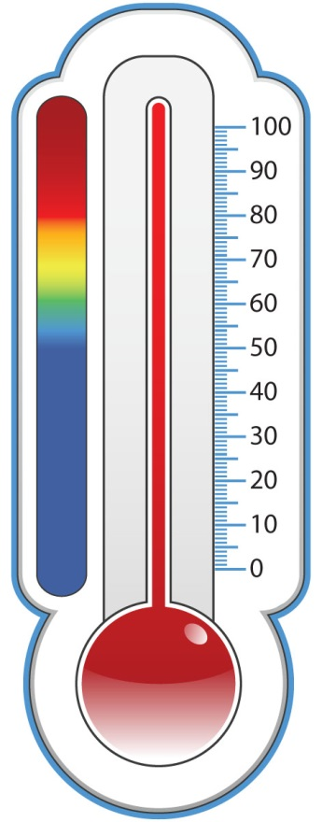
What about Hot or Cold Days?
What is the temperature like in Pomona most of the time?
Hot
Warm
Cool
Cold
Courtesy of BSCS

Slide 11
Key Science Ideas
Weather is what it looks like and feels like outside. The weather can be sunny or cloudy, rainy or dry, windy or calm, hot or cold.
Photograph by Carey Woods
Photo courtesy of Publicdomainpictures.net
Photograph by Cyndy Sims Parr/Wikimedia Commons
Photograph by Audrey Mohan
Photo courtesy of Publicdomainpictures.net

Slide 12
What Is the Weather Like Outside?
We know what the weather is like outside by …
looking at it,
feeling it, and
measuring it.
Courtesy of Clipartmag.com
Courtesy of Clipartmag.com
Courtesy of Pixabay.com

Slide 13
Let’s Study Our Weather Calendar!
A weather pattern is what the weather is mostly like at a certain time of year.
Courtesy of Cal Poly Pomona
Courtesy of Pixabay.com

Slide 14
Let’s Study Our Weather Calendar!
Courtesy of Cal Poly Pomona
Courtesy of Pixabay.com

Slide 15
Let’s Draw Weather Patterns!
What kind of picture would you draw to show the weather patterns in Pomona during the month of September?
Photo courtesy of Getdrawings.com

Slide 16
Let’s Summarize!
Our focus question: What was our weather in Pomona like in September?
Courtesy of Clker-Free-Vector-Images/Pixabay.com
Courtesy of BSCS

Slide 17
Let’s Share Our Pictures!
Tell us about one weather pattern in your drawing.
Sentence starter:
In September, the weather pattern in Pomona was mostly ___________.
Courtesy of Pixabay.com

Slide 18
Let’s Summarize!
Weather is what it looks like and feels like outside.
The weather can be sunny or cloudy, rainy or dry, windy or calm, and hot or cold.
Courtesy of BSCS

Slide 19
Let’s Summarize!
In September, the weather pattern in Pomona is mostly sunny, hot, and dry, with very few clouds and hardly any rain or wind.
HOT!
Courtesy of BSCS

Slide 20
Next Time
In our next lesson, we’ll see how counting can help us find weather patterns on our calendar!

