Slide 1
Weather and seasons Lesson 1b
How Can We Show the Weather Patterns in September in a Different Way?

Slide 2
Review: What Did You Draw?
What did you draw last time to show what the weather was mostly like in September?
Photo courtesy of Pexels.com

Slide 3
Today’s Focus Question
How can we show the weather patterns in September in a different way?
Courtesy of Pixabay.com
Notes:
Add student ideas to this focus question using the board or a Smartboard.

Slide 4
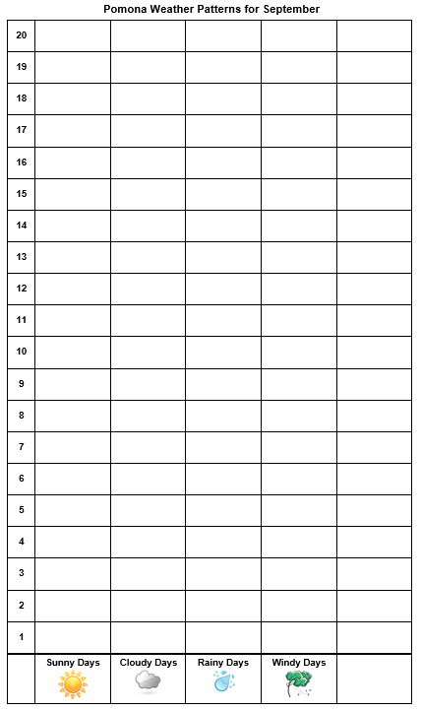
A Picture Graph
Notes:
Use this slide to model counting sunny day and cloudy days. You will have to draw suns and clouds using the Smartboard.

Slide 5
Let’s Make Picture Graphs!
Picture graphs will help us see the weather patterns in Pomona during September.
Remember: A weather pattern is what the weather is like most of the time!

Slide 6
What Is Evidence?
Evidence is a clue that helps us answer a question about the world around us.
Evidence helps us explain why certain things happen.
Evidence can also help us figure out whether our ideas about something are correct.
Courtesy of Pixabay.com

Slide 7
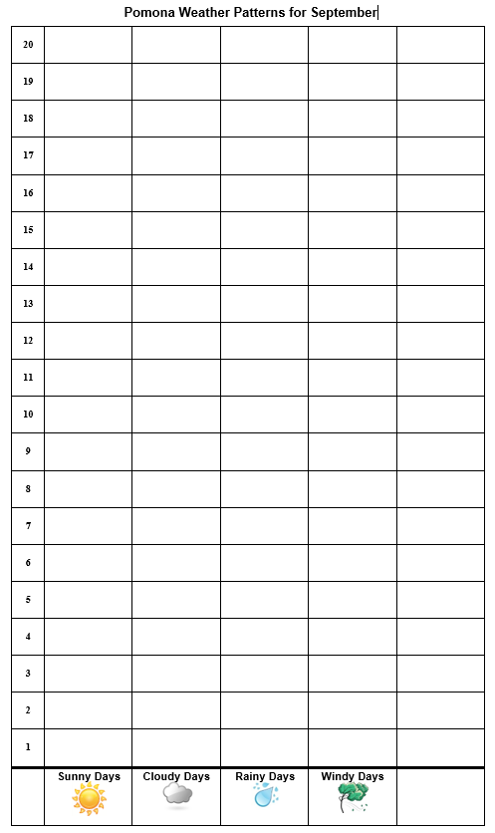
Why Make Picture Graphs?
Why would making a picture graph help us understand the weather?
Notes:
Change this chart to reflect the actual temperature and weather patterns your class observed.

Slide 8
We Found a Weather Pattern!
Our picture graphs show that we had a lot of sunny days in September.
This is evidence of a weather pattern!
This evidence supports our idea that the weather pattern in Pomona during September is mostly sunny.
Courtesy of BSCS

Slide 9
Let’s Summarize!
What is one thing you learned about weather patterns today?
Courtesy of BSCS

Slide 10
Let’s Summarize!
Our focus question: How can we show the weather patterns in September in a different way?
Courtesy of Pixabay.com

Slide 11
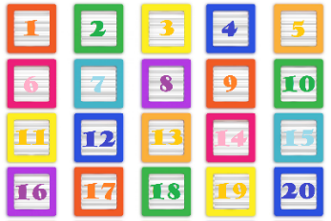
Let’s Summarize!
Scientists count and make graphs to help them find weather patterns.
Our graphs showed that the weather pattern in September in Pomona is mostly sunny.
We can use counting and picture graphs as evidence to support our ideas about weather patterns.
Courtesy of Publicdomainpictures.net

Slide 12
Next Time
We’ll use counting and bar graphs to look for weather patterns in our September temperatures.
Courtesy of Publicdomainpictures.net
Courtesy of Cal Poly Pomona

