Slide 1
Weather and seasons Lesson 1c
What Do Bar Graphs Show Us about Temperature Patterns in September?

Slide 2
Let’s Review!
What is a pattern?
What is a weather pattern?
Courtesy of Cal Poly Pomona
Courtesy of Pixabay.com

Slide 3
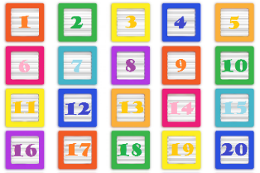
Let’s Review!
Last time, we counted the number of sunny, cloudy, and rainy days on our weather calendar.
Then we recorded the numbers on our observations charts.
Courtesy of Publicdomainpictures.net

Slide 4
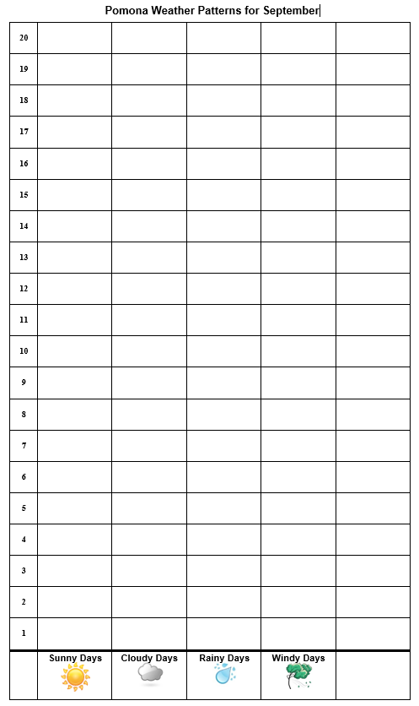
Let’s Review!
We made picture graphs to help us find weather patterns in Pomona during September.
Remember: A weather pattern is what the weather is like most of the time!
Notes:
Change this chart to reflect the actual temperature and weather patterns your class observed.

Slide 5
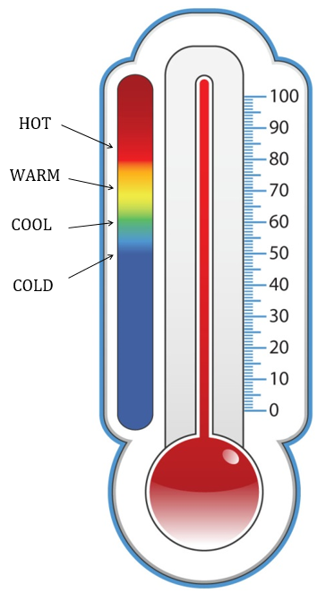
What Should We Count Next?
What did we do every day in September to see how hot or cold it was outside?
Courtesy of BSCS

Slide 6
Today’s Focus Question
What do bar graphs show us about temperature patterns in September?
Courtesy of BSCS

Slide 7
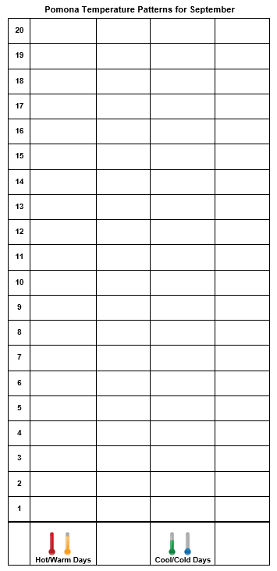
Let’s Make Bar Graphs!
A bar graph is the same as a picture graph.
Bar graphs will help us see temperature patterns in Pomona during September.

Slide 8
Why Make Bar Graphs?
Why would making a bar graph help us understand our temperatures in September?
Notes:
Change this chart to reflect the actual temperature and weather patterns your class observed.

Slide 9
What Patterns Do You See?
Look at your bar graph. Do you see any patterns in the temperatures for September?
Courtesy of Adobe.Stock.com
Courtesy of Adobe.Stock.com
HOT?
COLD?
Courtesy of BSCS

Slide 10
Let’s Summarize!
What is one thing you learned about temperature patterns today?
Courtesy of BSCS

Slide 11
Let’s Summarize!
Our focus question: What do bar graphs show us about temperature patterns in September?
Courtesy of BSCS

Slide 12
Let’s Summarize!
What do both of our graphs show us about weather patterns in Pomona during September?
Courtesy of BSCS

Slide 13
Let’s Summarize!
We know what the weather is like outside by …
looking at it,
feeling it, and
measuring it with a thermometer.
Courtesy of Clipartmag.com
Courtesy of Clipartmag.com
Courtesy of Pixabay.com

Slide 14
Let’s Summarize!
Counting and making graphs can help us see weather and temperature patterns.
Our graphs showed that the weather pattern in September is mostly sunny and warm or hot.
We can use counting and graphs as evidence to support our ideas about weather patterns.
Courtesy of Publicdomainpictures.net

Slide 15
Next Time
We’ll look at our weather calendar for January and create a picture graph to help us find weather patterns.
Courtesy of Cal Poly Pomona
Courtesy of Pixabay.com

