Slide 1
Weather and seasons Lesson 2a
What Was Our Weather Mostly Like in January?

Slide 2
Our Big Questions for This Unit
Is weather the same everywhere all of the time? How do you know?
Courtesy of Cal Poly Pomona

Slide 3
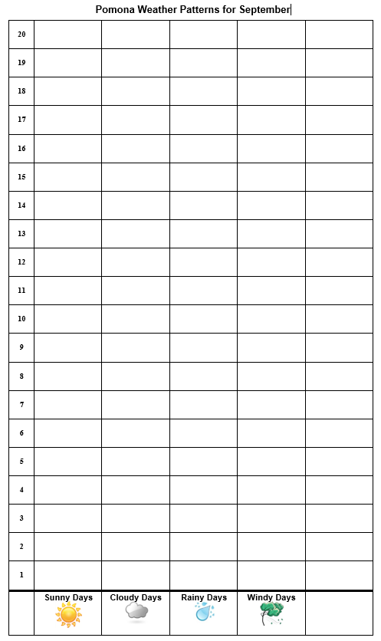
Let’s Review!
We made picture graphs to help us find weather patterns in Pomona during September.
What did we learn from our graphs about the weather in September?
Notes:
Change this chart to reflect the actual temperature and weather patterns your class observed.

Slide 4
Today’s Focus Question
What was our weather mostly like in January?
Courtesy of Cal Poly Pomona
Courtesy of Pixabay.com

Slide 5
What Do You Think?
What do you think our weather was mostly like in January?
Think about this question. Then Share your ideas with an elbow partner.
Use this sentence starter:
I think the weather in January was mostly ________.

Slide 6
Let’s Review!
Evidence is a clue that helps us answer a question about the world around us.
Evidence helps us explain why certain things happen.
Evidence can also help us figure out whether our ideas about something are correct.
Courtesy of Pixabay.com

Slide 7
Our Observation Chart for January
 | Month 2: _____________
Sunny Days | _____ days
Cloudy Days | _____ days
Rainy Days | _____ days
Windy Days | _____ days
Hot Days | _____ days
January

Slide 8
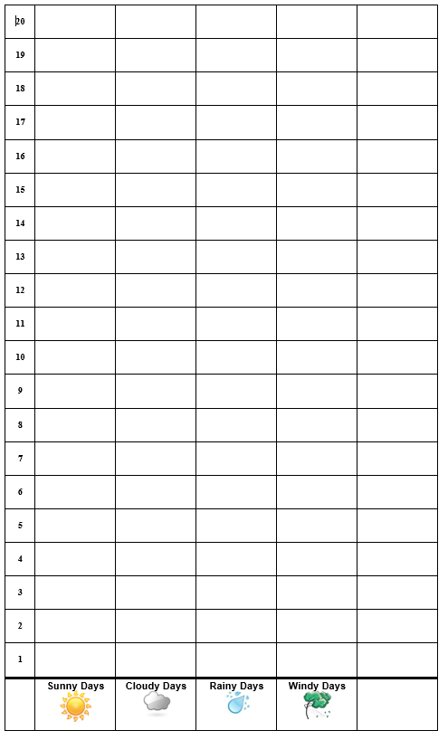
Let’s Make Picture Graphs!
Pomona Weather Patterns for January

Slide 9
What Patterns Do You See?
Pomona Weather Patterns for January
Courtesy of Pixabay.com
Notes:
Change this chart to reflect the actual temperature and weather patterns your class observed.

Slide 10
Let’s Summarize!
Our focus question: What was our weather mostly like in January?
Courtesy of Cal Poly Pomona
Courtesy of Pixabay.com

Slide 11
Let’s Draw Weather Patterns!
What kind of picture would you draw to show the weather patterns in Pomona during the month of January?
Photo courtesy of Getdrawings.com

Slide 12
Let’s Share Our Pictures!
Tell us about one weather pattern in your drawing.
Courtesy of Pixabay.com

Slide 13
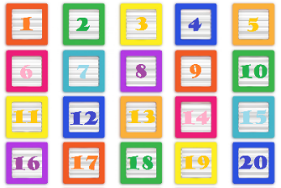
Let’s Summarize!
Today we counted the sunny, cloudy, and rainy days on our weather calendar.
Pomona Weather Patterns for January
Courtesy of Publicdomainpictures.net
Then we made picture graphs to help us see weather patterns.

Slide 14
Let’s Summarize!
What weather pattern did we find for January?
Sentence starter:
In January, the weather pattern in Pomona was mostly ___________.
Remember: Weather patterns are what the weather is like most of the time.

Slide 15
Next Time
Do weather patterns change from one month to the next?
That’s what we’ll explore next time!
 | Month 1: _____________
Sunny Days | _____ days
Cloudy Days | _____ days
Rainy Days | _____ days
Windy Days | _____ days
Hot Days | _____ days
 | Month 2: _____________
Sunny Days | _____ days
Cloudy Days | _____ days
Rainy Days | _____ days
Windy Days | _____ days
Hot Days | _____ days
September
January

