Slide 1
Weather and seasons Lesson 2b
What Did Our Weather Change from September to January?

Slide 2
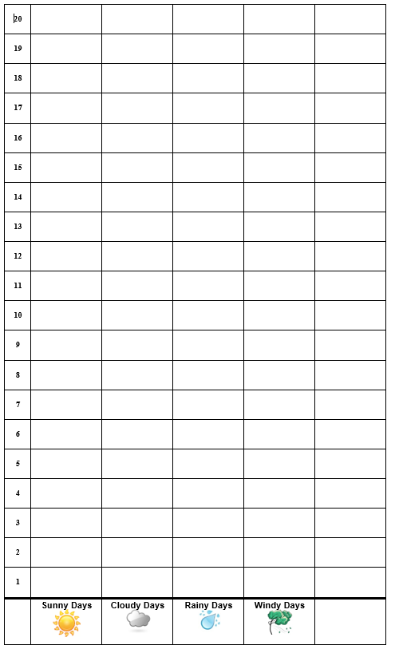
Our Picture Graph for January
Pomona Weather Patterns for January
Courtesy of Pixabay.com

Slide 3
Today’s Focus Question
How did our weather change from September to January?
 | Month 1: _____________
Sunny Days | _____ days
Cloudy Days | _____ days
Rainy Days | _____ days
Windy Days | _____ days
Hot Days | _____ days
 | Month 2: _____________
Sunny Days | _____ days
Cloudy Days | _____ days
Rainy Days | _____ days
Windy Days | _____ days
Hot Days | _____ days
September
January

Slide 4
What Do You Think?
Do you think our weather patterns in September and January are the same or different?
Think about this question. Then Share your ideas with an elbow partner.
Sentence starter:
I think the weather patterns in September and January are [the same/different] because ________.

Slide 5
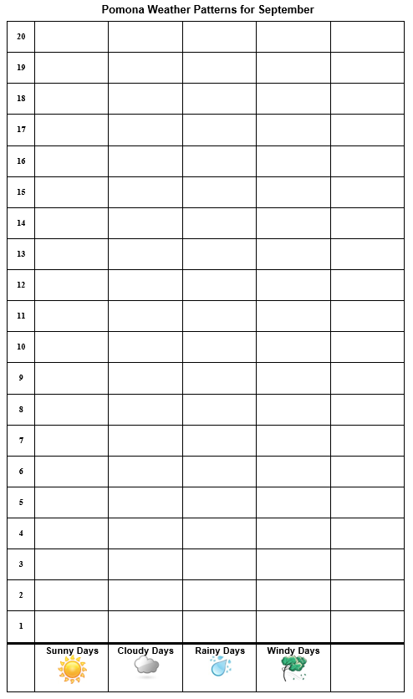
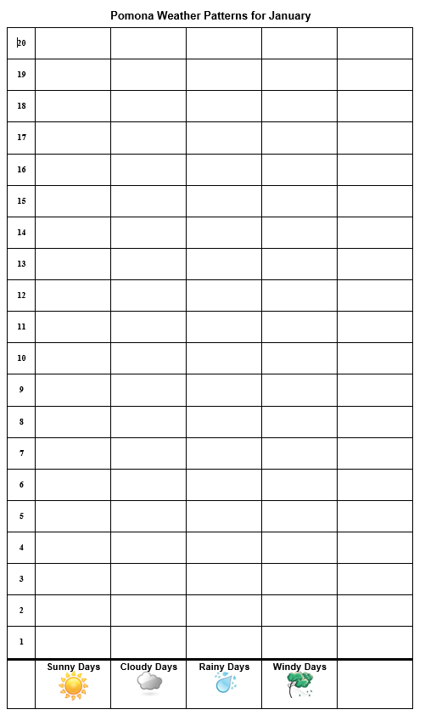
Let’s Compare Our Graphs!
Notes:
Change this chart to reflect the actual temperature and weather patterns your class observed.

Slide 6
Now Let’s Compare Our Charts!
 | Month 1: _____________ | Month 2: ______________
Sunny Days | _____ days | ____ days
Cloudy Days | _____ days | ____ days
Rainy Days | _____ days | ____ days
Windy Days | _____ days | ____ days
Hot Days | _____ days | ____ days
September
January
Notes:
Change this chart to reflect the actual temperature and weather patterns your class observed.

Slide 7
Let’s Summarize!
Our focus question: How did our weather change from September to January?
 | Month 1: _____________
Sunny Days | _____ days
Cloudy Days | _____ days
Rainy Days | _____ days
Windy Days | _____ days
Hot Days | _____ days
 | Month 2: _____________
Sunny Days | _____ days
Cloudy Days | _____ days
Rainy Days | _____ days
Windy Days | _____ days
Hot Days | _____ days
September
January

Slide 8
Let’s Summarize!
Think: Are the weather patterns for September and January the same or different?
Share your ideas and evidence with your elbow partner.
Complete the handout. For each sentence, write the word on the blank line and circle the picture that shows the weather pattern you found.
Write or draw your evidence in the box at the bottom of the handout.

Slide 9
What Patterns Did You Find?
A pattern we found:
September had more ____________ days. | Sunny | Rainy | Cloudy
January had more ____________ days. | Sunny | Rainy | Cloudy
Our evidence is:

Slide 10
Let’s Summarize!
Our focus question: How did our weather change from September to January?
 | Month 1: _____________
Sunny Days | _____ days
Cloudy Days | _____ days
Rainy Days | _____ days
Windy Days | _____ days
Hot Days | _____ days
 | Month 2: _____________
Sunny Days | _____ days
Cloudy Days | _____ days
Rainy Days | _____ days
Windy Days | _____ days
Hot Days | _____ days
September
January

Slide 11
Let’s Summarize!
Weather patterns can change from month to month!
September
January
Courtesy of BSCS
Courtesy of BSCS

Slide 12
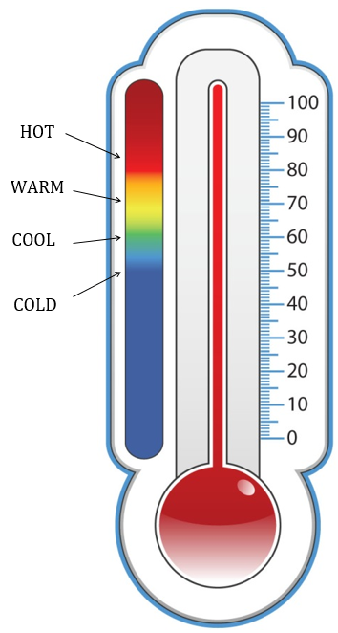
Next Time
What was our temperature pattern in January?
Courtesy of BSCS

