Slide 1
Weather and seasons Lesson 2c
What Was the Temperature Pattern in Pomona in January?

Slide 2
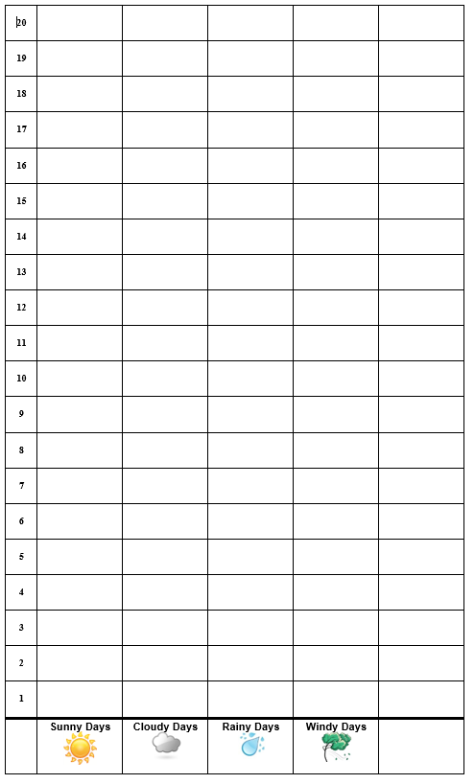
Our Picture Graph for January
Pomona Weather Patterns for January
Courtesy of Pixabay.com

Slide 3
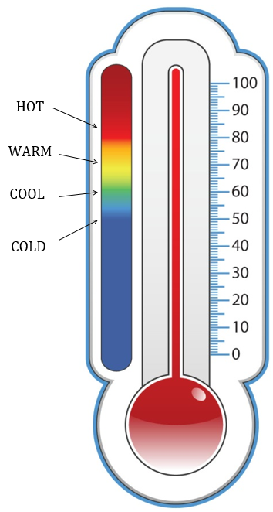
Today’s Focus Question
What was the temperature pattern in Pomona in January?
Courtesy of BSCS

Slide 4
What Do You Think?
What do you think the temperature pattern was like in January?
Think about this question. Then Share your ideas with an elbow partner.
Use this sentence starter:
I think the temperature pattern in January was mostly ________.

Slide 5
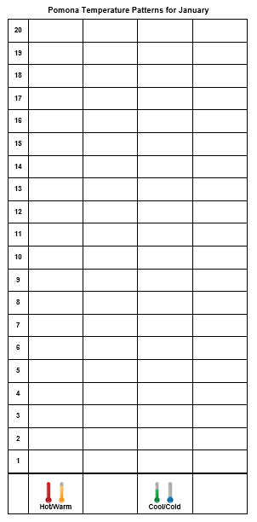
Let’s Make Bar Graphs!

Slide 6
What Patterns Do You See?
Do you see any temperature patterns on your bar graph for January?
Sentence starters:
The temperature pattern is _________.
OR
The bar graph shows ______.
Courtesy of BSCS

Slide 7
Let’s Summarize!
Our focus question: What was the temperature pattern in Pomona in January?
Courtesy of BSCS

Slide 8
Let’s Summarize!
What temperature pattern did you find? What is your evidence?
Sentence starter:
The temperature pattern in January is ______.
Courtesy of BSCS

Slide 9
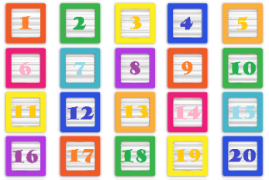
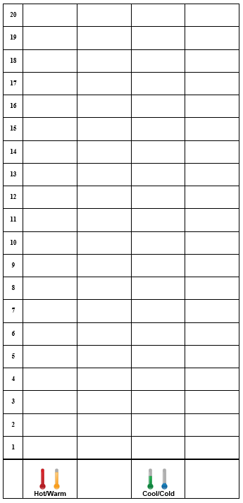
Let’s Summarize!
Counting and making graphs can help us see temperature patterns.
Our graphs showed that the temperature pattern in January is mostly cool.
We can use counting and graphs as evidence to support our ideas about temperature patterns.
Courtesy of Publicdomainpictures.net

Slide 10
Next Time
We’ll compare our temperature graphs for September and January?
What patterns do you think we’ll see?
Temperatures Patterns for September
Temperatures Patterns for January
January

