Slide 1
Weather and seasons Lesson 2d
How Did Our Temperature Pattern Change from September to January? What Is Our Evidence?

Slide 2
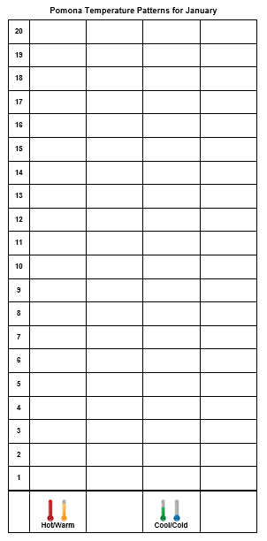
What Temperature Patterns Did We Find?
Courtesy of Pixabay.com
Notes:
Change this chart to reflect the actual temperature and weather patterns your class observed.

Slide 3
Today’s Focus Questions
How did our temperature pattern change from September to January? What is our evidence?
Courtesy of BSCS

Slide 4
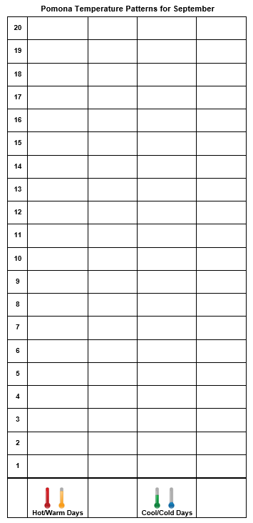
Our Temperatures in September
Notes:
Change this chart to reflect the actual temperature and weather patterns your class observed.

Slide 5
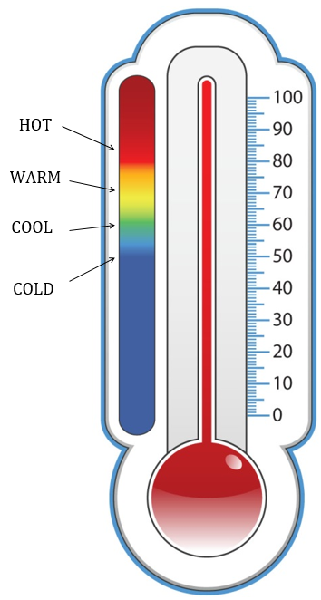
What Do You Think?
Do you think the temperature patterns in September and January are the same or different?
Sentence starter: I think the temperature patterns in September and January are [the same/different] because …
Courtesy of BSCS

Slide 6
Let’s Compare Our Bar Graphs!
What temperature patterns do you see that are the same or different?
Notes:
Change this chart to reflect the actual temperature and weather patterns your class observed.

Slide 7
Let’s Compare Our Graphs!
What patterns do you see when you compare the graphs for September and January?
Use one of these sentence starters:
A temperature pattern I see is …
OR
One pattern I notice is …

Slide 8
Our Focus Questions
How did our temperature pattern change from September to January? What is our evidence?
Courtesy of BSCS

Slide 9
Pomona Temperature Patterns
A pattern we found :
September had more ________ days. | Hot/Warm | Cool/Cold
January had more ________ days. | Hot/Warm | Cool/Cold
Our evidence is:
Courtesy of BSCS

Slide 10
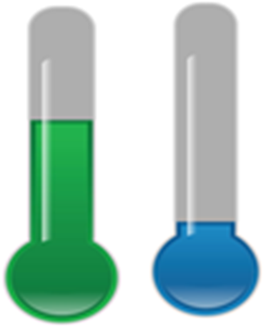
Temperature Patterns in Pomona
Courtesy of BSCS
Courtesy of BSCS
Hot/Warm Cool/Cold
September January

Slide 11
Let’s Review Our Weather Charts!
 | Month 1: _____________ | Month 2: ______________
Sunny Days | _____ days | ____ days
Cloudy Days | _____ days | ____ days
Rainy Days | _____ days | ____ days
Windy Days | _____ days | ____ days
Hot Days | _____ days | ____ days
September
January
Notes:
Change this chart to reflect the actual temperature and weather patterns your class observed.

Slide 12
Let’s Summarize!
What helps us see weather patterns?
Courtesy of Cal Poly Pomona
Courtesy of Pixabay.com

Slide 13
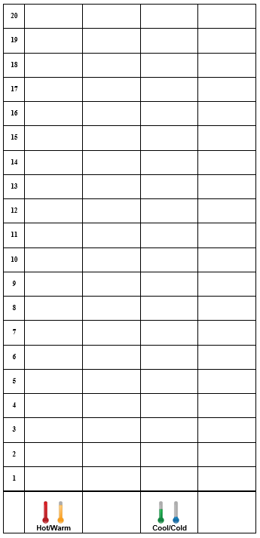
Let’s Summarize!
Graphs help us see weather patterns more easily.
Our bar graphs helped us see temperature patterns.

Slide 14
Let’s Summarize!
What weather patterns can change from month to month?
Courtesy of Cal Poly Pomona
Courtesy of Pixabay.com

Slide 15
Let’s Summarize!
Weather patterns can change from month to month.
Sunny Sunny and cloudy September January
Courtesy of BSCS
Courtesy of BSCS

Slide 16
Next Time
How does weather change during the day?
Courtesy of BSCS
Courtesy of BSCS

