Slide 1
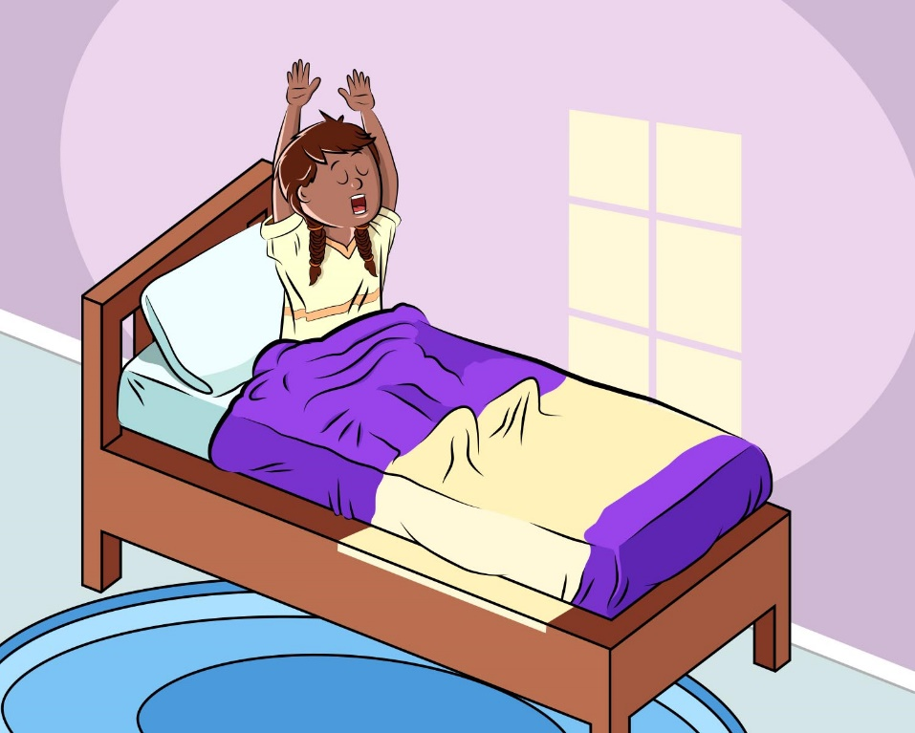
Alisa’s Trip to the Zoo
Alisa woke up one morning ready for school. The Sun was shining brightly outside, and there wasn’t a cloud in the sky. She couldn’t wait to get out of bed!
Alisa put on her favorite T-shirt and skirt. Her class was going on a field trip today to the zoo, and she was so excited.
Courtesy of BSCS
What was the weather like when Alisa got up?

Slide 2
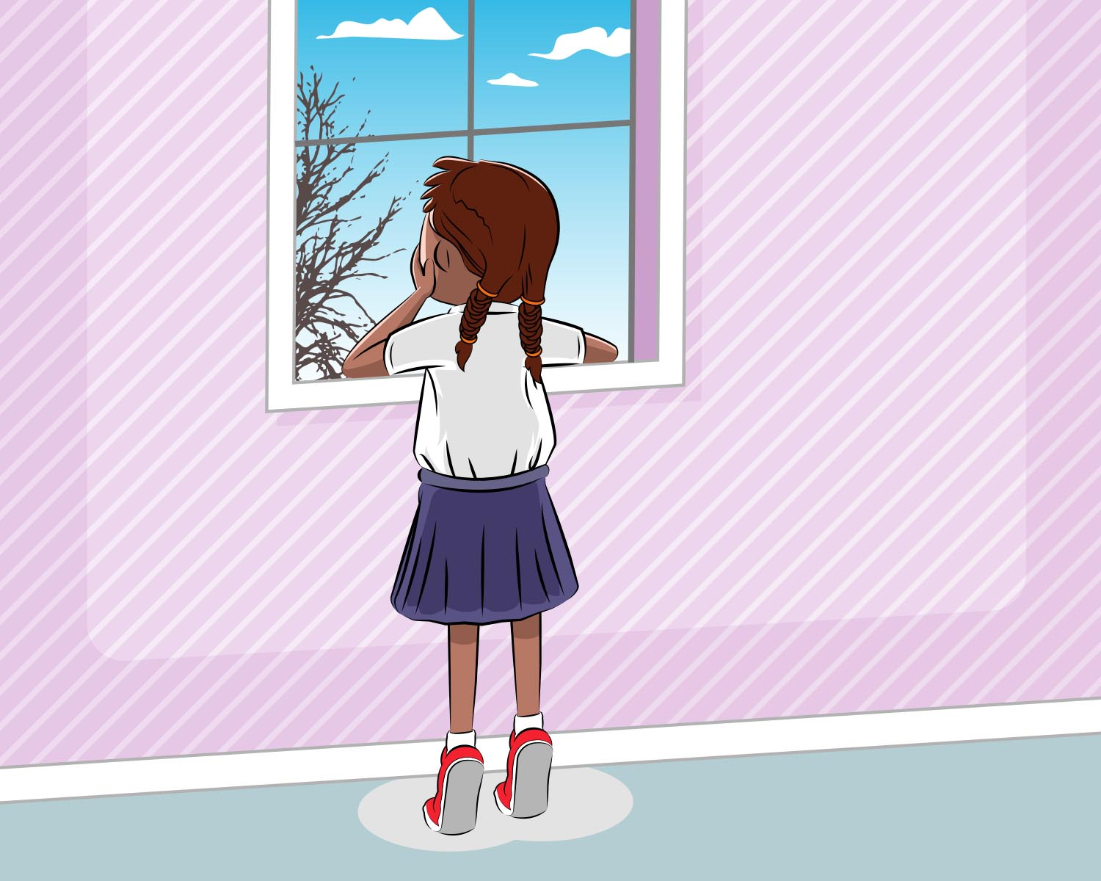
When Alisa arrived at school, she noticed some clouds in the distance. But the Sun was still shining brightly.
Alisa went to Ms. Hernandez’s classroom to get ready for the field trip. Other students were there too.
In a little while, Alisa and her classmates went outside to board the bus. All of a sudden, Alisa felt a gust of wind, and goose bumps popped out on her arms and legs. She rushed to get on the bus!
Has the weather changed since Alisa got to school? How so? Do you think the temperature was warm, hot, cool or cold when Alisa got on the bus? What makes you think that?
Courtesy of BSCS

Slide 3
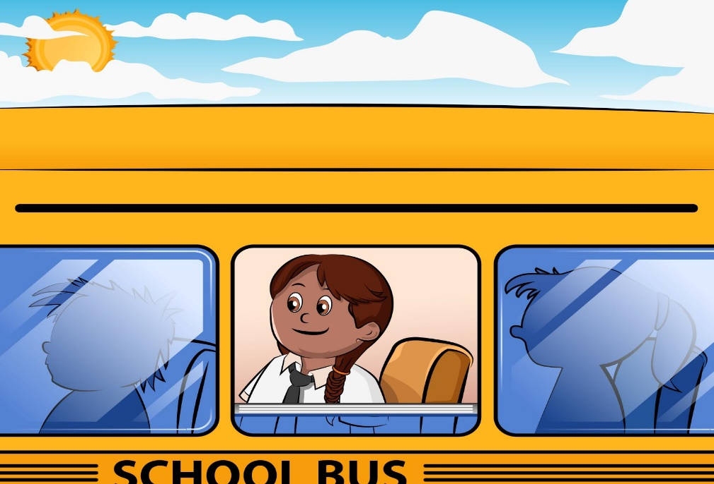
The trip to the zoo was going to be so exciting. Alisa couldn’t wait to see the giraffes and lions.
When the students got off the bus, Alisa noticed that it was cloudy outside. It was also cooler. She wished she had brought her jacket!
Alisa walked very fast with her classmates to the giraffe exhibit. But there weren’t any giraffes around. The zookeeper told Alisa that the giraffes had been moved inside the giraffe house because a storm was coming.
How has the weather changed? Do you think the temperature has changed? Do you think Alisa is wearing the best clothes for the weather on her field trip?
Courtesy of BSCS

Slide 4
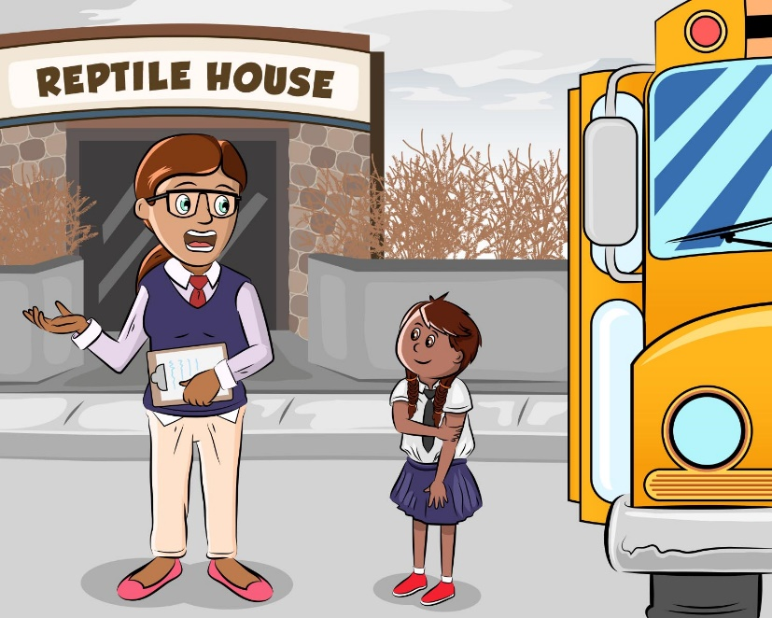
It’s getting colder, thought Alisa. The teacher suggested that Alisa and her friends visit the reptile house, where it would be warm. At least inside the reptile house, Alisa could look at the animals and not shiver!
Alisa and her friends walked around the reptile house to see the frogs and snakes. But then they had to go back to the main entrance and get ready to return to school.
When Alisa walked outside, it was cloudy and cold! Brrr! She nearly ran to get on the bus because she was so cold.
Courtesy of BSCS
What is happening to the weather now? Do you think it’s warm, hot, cool, or cold? What kind of clothes do you think Alisa needs to put on now?

Slide 5
On the bus ride back to school, it started to rain. The bus driver turned on the windshield wipers. Alisa wished she had a jacket and a big umbrella.
How would you describe the weather now? What does Alisa see in the sky while she’s looking out the bus window? What do you think is happening to the temperature?

Slide 6
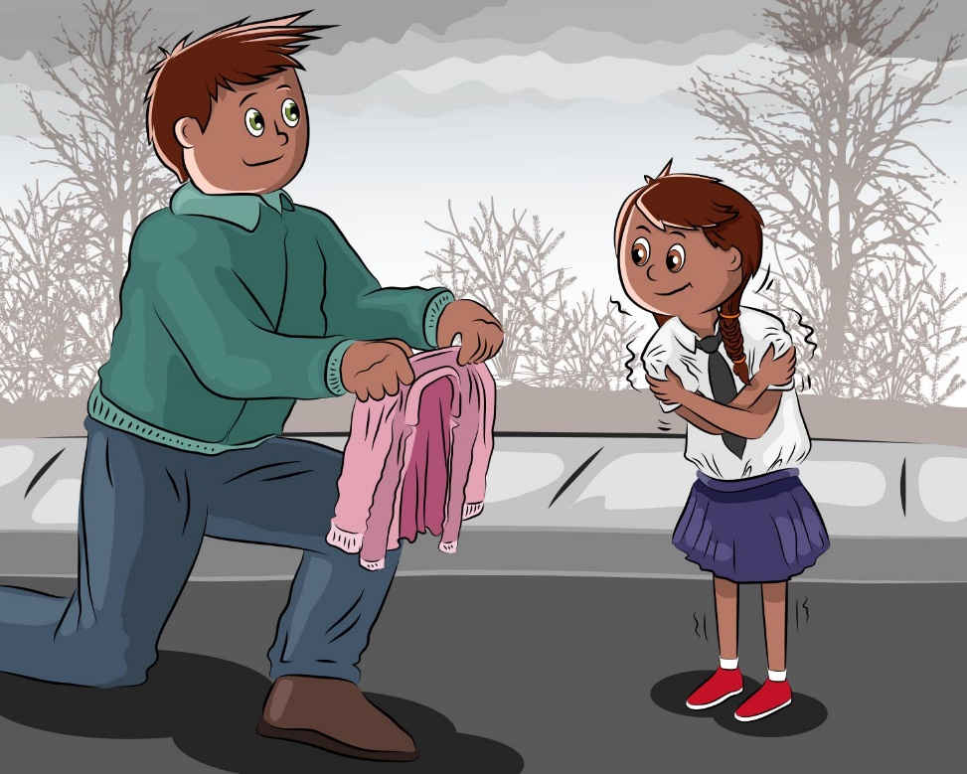
When it was time to leave school at the end of the day, the rain had turned to snow! Oh goodness, it was cold! Alisa wished she had looked at the weather forecast on TV. She was so thankful her dad brought her a jacket when he picked her up from school.
What do you think happened to the temperature?
What does Alisa see in the sky now? Why do you think that?
Courtesy of BSCS

Slide 7
When Alisa got home, she ran straight to her bed and snuggled under the covers.
What a terrible day to go to the zoo! Alisa thought.
Luckily, Alisa’s mom fixed hot soup for dinner! Alisa needed something hot to warm her up. She even got a cup of hot cocoa with marshmallows.
So maybe Alisa’s day wasn’t that bad after all!
How did the weather change during the day from the time Alisa left for school to the time she arrived home?
Courtesy of BSCS

