Slide 1
Weather and seasons Lesson 3a
How Can Weather Change during the Day?

Slide 2
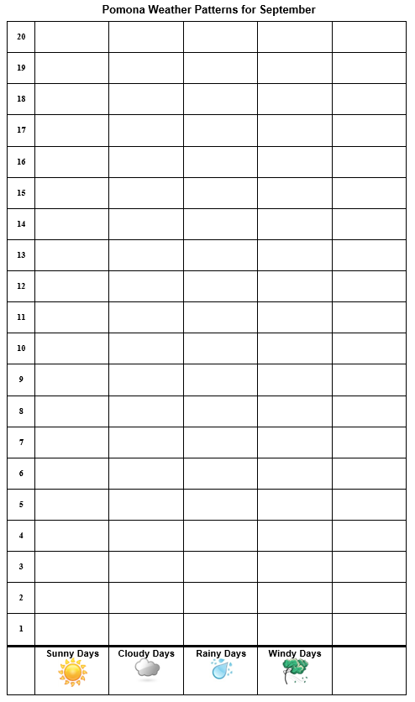
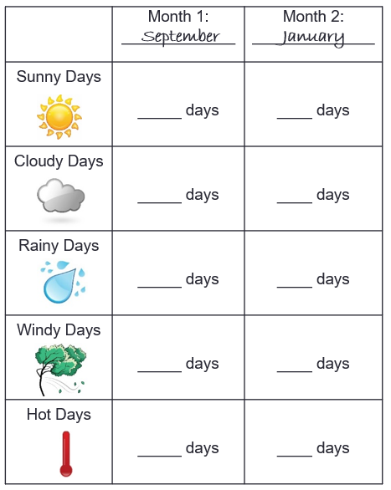
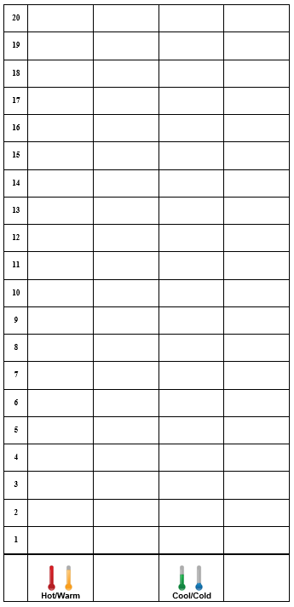
Review: What Patterns Did We Find?
Courtesy of Pixabay.com

Slide 3
Now Think about This!
Do you think weather can change during the day?
Courtesy of BSCS
Courtesy of BSCS
Morning
Afternoon

Slide 4
Today’s Focus Question
How can weather change during the day?
Courtesy of BSCS
Courtesy of BSCS
Morning
Afternoon

Slide 5
Our Big Questions
Is weather the same everywhere all of the time? How do you know?
Courtesy of Cal Poly Pomona

Slide 6
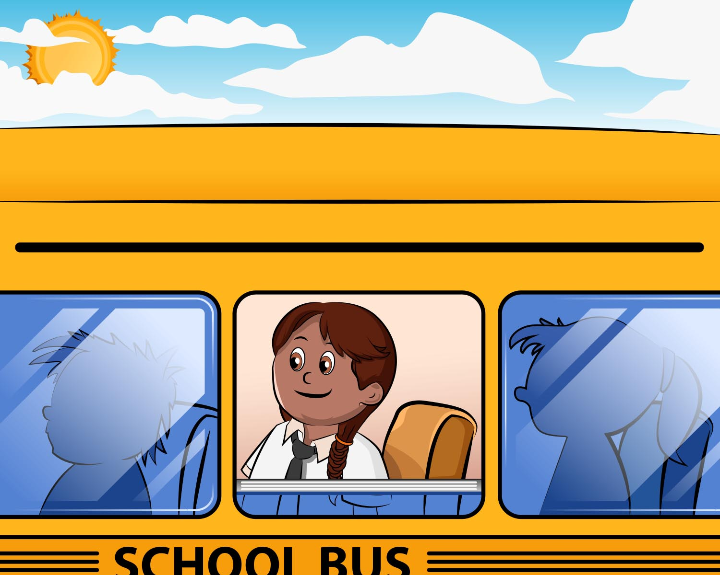
Alisa’s Trip to the Zoo
Courtesy of BSCS

Slide 7
How Did the Weather Change?
What was the weather like when Alisa got up in the morning?
What was the weather like when Alisa boarded the bus for the zoo?
What was the weather like at the zoo?
What was the weather like on the bus ride back to school?
What was the weather like at the end of the day?
Courtesy of BSCS
Courtesy of BSCS

Slide 8
Let’s Summarize!
Our focus question: How can weather change during the day?
Think about a story you could tell about how weather can change from the morning to the afternoon.
Share your story ideas with an elbow partner.
Be ready to share your story with the class.

Slide 9
What about Weather in Pomona?
Could our weather in Pomona change as quickly during the day as the weather in our story?
Courtesy of BSCS
Courtesy of BSCS
Morning
Afternoon

Slide 10
Next Time
We’ll investigate how the weather in Pomona can change during the day.
Courtesy of Cal Poly Pomona
Courtesy of Pixabay.com

