Slide 1
Weather and seasons Lesson 3b
How Does Our Weather in Pomona Change from Morning to Afternoon?

Slide 2
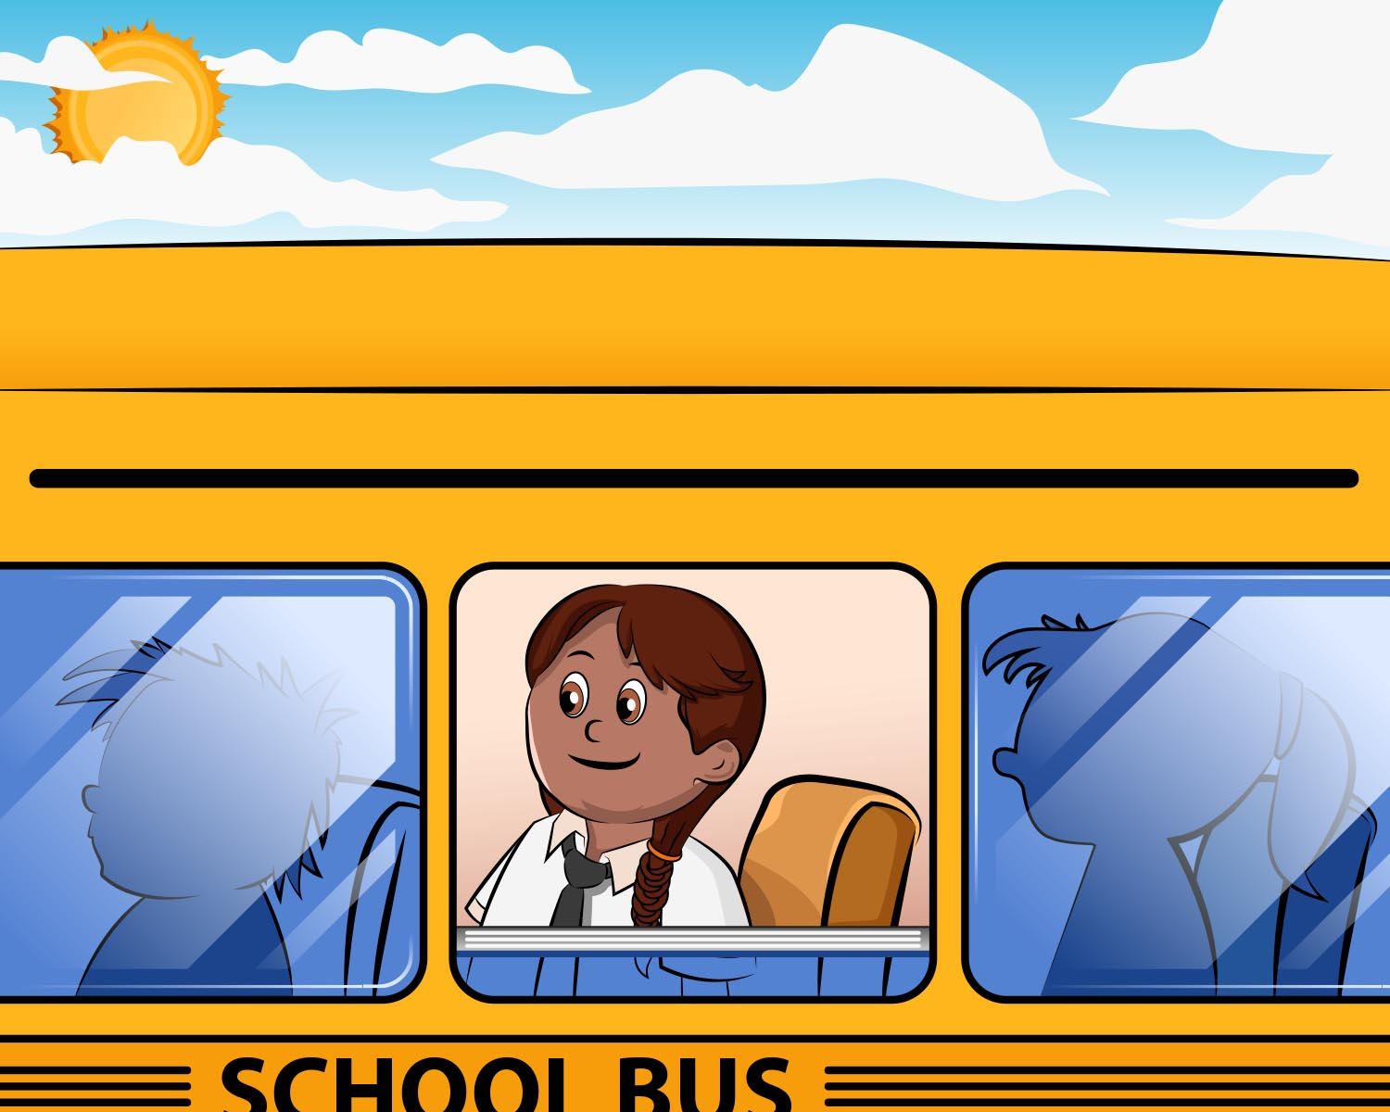
Review: Alisa’s Trip to the Zoo
Courtesy of BSCS

Slide 3
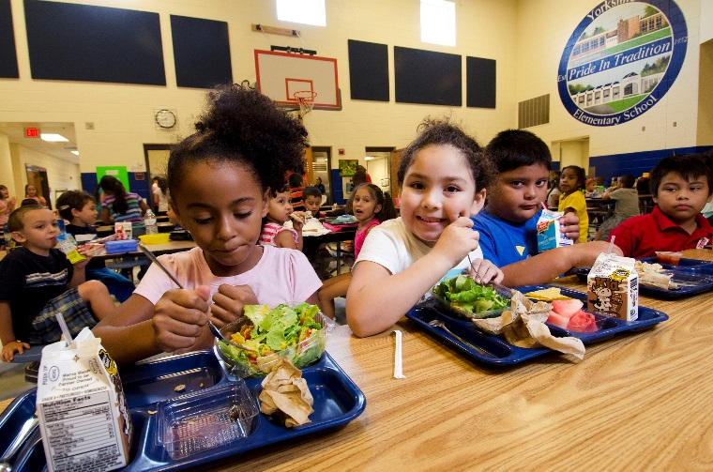
Today’s Focus Question
How does our weather in Pomona change from morning to afternoon?
Morning
(Before Lunch)
Afternoon
(After Lunch)
Photograph by Lance Cheung

Slide 4
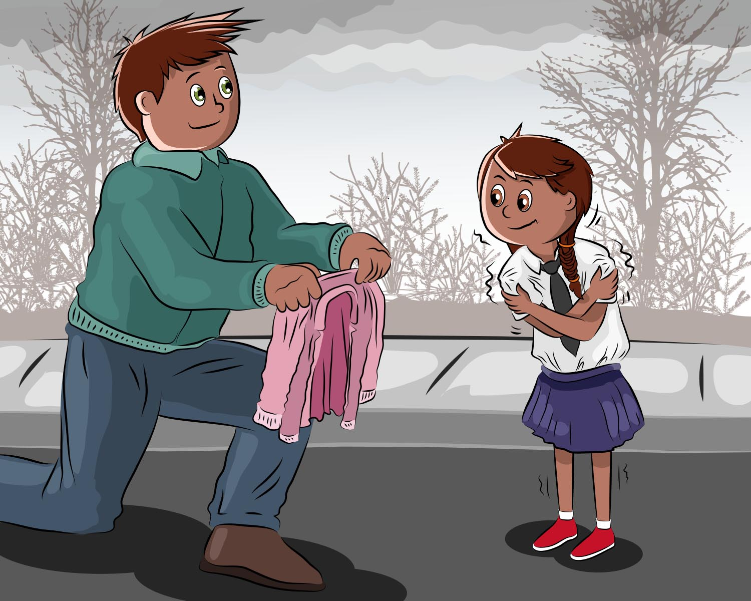
Let’s Talk about Weather Changes!
Do you think our weather in Pomona could change like the weather did in Alisa’s story?
Courtesy of BSCS

Slide 5
Our Daily Temperature Chart
Hot
Warm
Cool
Cold
 | Monday | Tuesday | Wednesday | Thursday | Friday
Morning Temperatures
Afternoon Temperatures
What Changed? (Temperature got warmer, cooler, or stayed the same)

Slide 6
Our Daily Temperature Chart
 | Monday | Tuesday | Wednesday | Thursday | Friday
Morning Temperatures
What temperature patterns do you notice in the mornings?
What weather patterns do you notice in the mornings?

Slide 7
What Do You Predict?
What do you think (predict) most of our afternoon temperatures will be like?
 | Monday | Tuesday | Wednesday | Thursday | Friday
Afternoon Temperatures
Sentence starter:
I predict that our afternoon temperatures will be ___________.

Slide 8
Our Daily Temperature Chart
 | Monday | Tuesday | Wednesday | Thursday | Friday
Afternoon Temperatures
What temperature patterns do you notice in the afternoons?
What weather patterns do you notice in the afternoons?

Slide 9
What Patterns Did We Notice?
What temperature pattern did we notice in the morning?
What temperature pattern did we notice in the afternoon?
 | Monday | Tuesday | Wednesday | Thursday | Friday
Morning Temperatures
Afternoon Temperatures
Notes:
Add afternoon temperature colors and patterns in afternoon temperatures. Then patterns between morning and afternoon.

Slide 10
Our Daily Temperature Chart
How did our temperatures change from morning to afternoon each day?
Temperature went UP
Temperature went DOWN
Temperature stayed the same.
 | Monday | Tuesday | Wednesday | Thursday | Friday
Morning Temperatures
Afternoon Temperatures
What Changed?

Slide 11
Let’s Summarize!
Our focus question: How does our weather in Pomona change from morning to afternoon?
Morning
(Before Lunch)
Afternoon
(After Lunch)
Photograph by Lance Cheung

Slide 12
How Our Weather Changes
Morning | Afternoon
Word bank: sunny cloudy rainy snowy windy hot warm cool cold temperature

Slide 13
Let’s Summarize!
Our focus question: How does our weather in Pomona change from morning to afternoon?
Morning
(Before Lunch)
Afternoon
(After Lunch)
Photograph by Lance Cheung

Slide 14
Let’s Summarize!
Our weather in Pomona changes from morning to afternoon.
In the morning, the weather pattern is usually cooler and cloudy.
In the afternoon, the weather pattern is usually warmer and sunny.
Courtesy of BSCS
Notes:
Point to Daily Weather Chart.

Slide 15
Next Time
What is the weather like in other places far away from Pomona?
That’s what we’ll explore next!
Courtesy of Pixabay.com

Slide 16
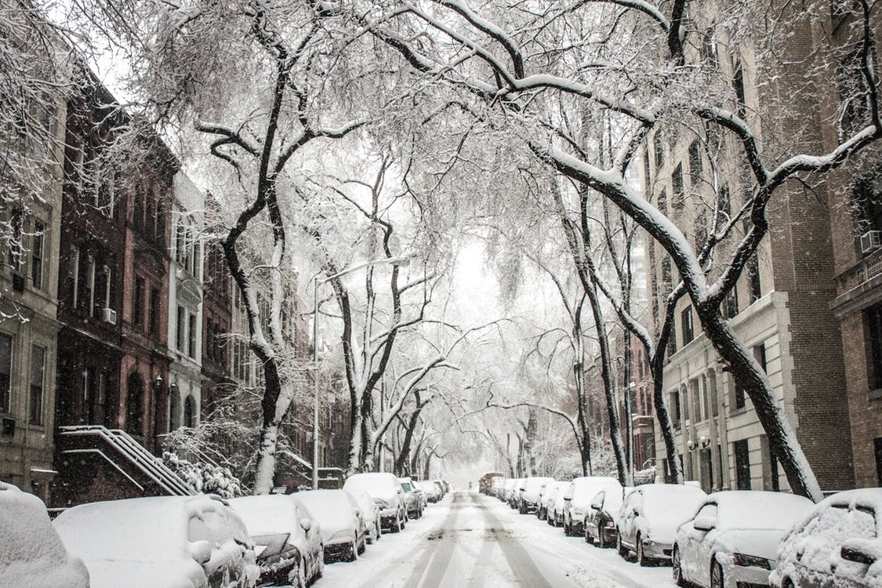
Is This Place Different from Pomona?
Photo courtesy of Pixabay.com

