Slide 1
Weather and seasons Lesson 4a
How Is Weather the Same or Different in Different Places? What Is the Weather Like in January in a Faraway City Called Detroit?

Slide 2
Review: Weather Patterns
What have we learned so far about weather patterns?
Courtesy of Cal Poly Pomona
Courtesy of Pixabay.com

Slide 3
Our Big Questions
Is weather the same everywhere all of the time? How do you know?
Courtesy of Cal Poly Pomona

Slide 4
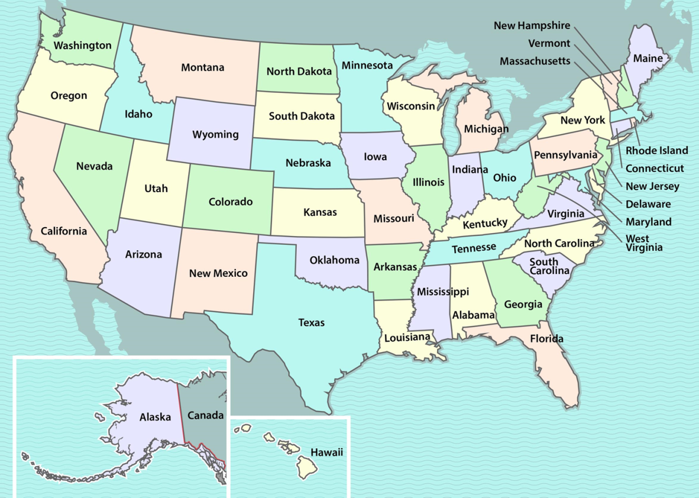
Today’s Focus Questions
How is weather the same or different in different places? What is the weather like in January in a faraway city called Detroit?
Detroit
Pomona
Courtesy of BSCS

Slide 5
Where Is Michigan on this Map?
Courtesy of BSCS

Slide 6
It’s a Long Way from Pomona to Detroit!
Courtesy of BSCS

Slide 7
What Do You Predict?
Will the weather pattern in Detroit be the same as the weather pattern in Pomona? Or will it be different? Why do you think so?
Courtesy of Cal Poly Pomona
Courtesy of Pixabay.com

Slide 8
January Weather Calendar for Detroit
Monday | Tuesday | Wednesday | Thursday | Friday

Slide 9
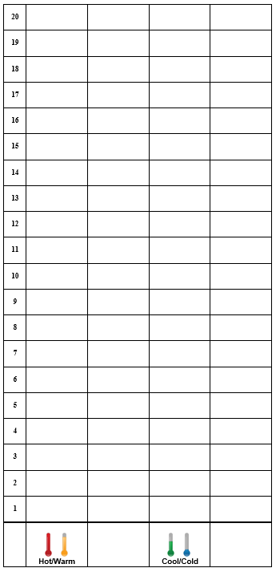
Detroit Temperature Patterns in January

Slide 10
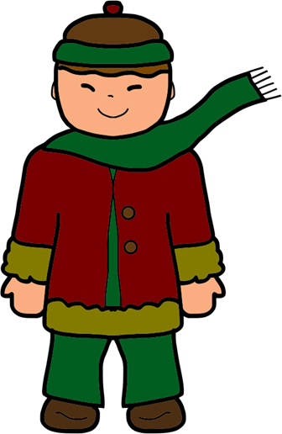
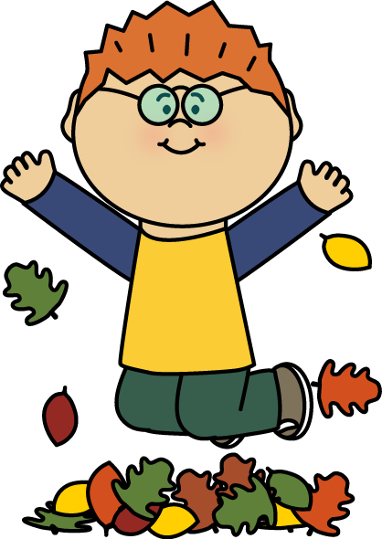
Let’s Look for Weather Patterns!
Do you see any patterns on our weather calendar for snowy days?
Do you see any patterns on your temperature graph?
Courtesy of Pixabay.com
Courtesy of Mycutegraphics.com

Slide 11
What Is the Weather Pattern?
How would you describe the weather pattern for Detroit in January?
Courtesy of Pixabay.com
Sentence starter: The weather pattern in January is …
Courtesy of Mycutegraphics.com

Slide 12
Today’s Focus Questions
How is weather the same or different in different places? What is the weather like in January in a faraway city called Detroit?
Detroit
Pomona
Courtesy of BSCS

Slide 13
Let’s Revisit Our Predictions
Will the weather pattern in Detroit be the same as the weather pattern in Pomona? Or will it be different? Why do you think so?
Courtesy of Cal Poly Pomona
Courtesy of Pixabay.com

Slide 14
Weather in Different Places
Is weather the same or different in different places? Why do you think so?
Courtesy of BSCS

Slide 15
Next Time
We’ll see if the weather patterns in Detroit and Pomona in January are the same or different.
?

