Slide 1
Weather and seasons Lesson 4b
How Is Weather the Same or Different in Different Places? How Are the January Weather Patterns for Detroit and Pomona the Same or Different?

Slide 2
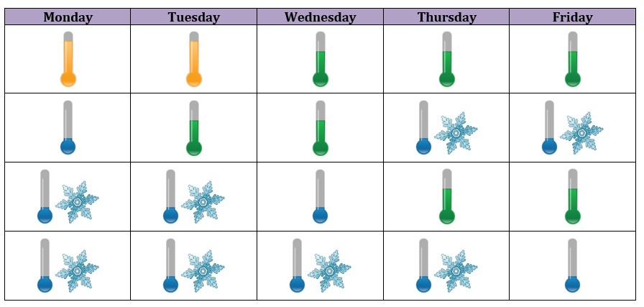
Detroit Weather Calendar for January
Courtesy of BSCS

Slide 3
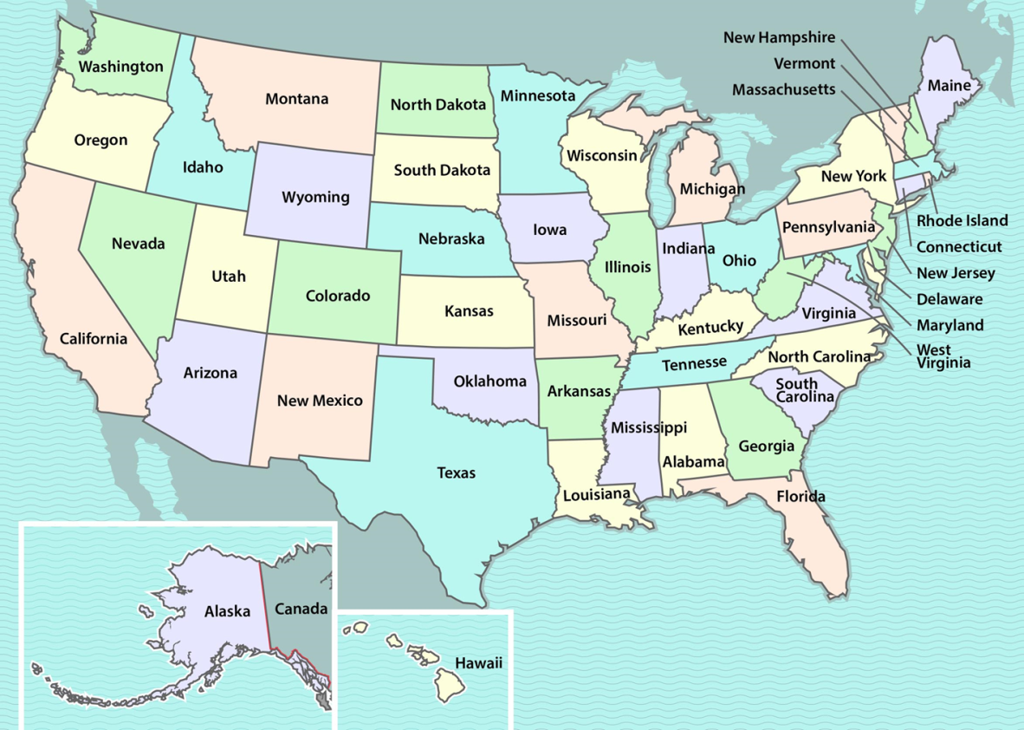
Today’s Focus Questions
How is weather the same or different in different places? How are the January weather patterns for Detroit and Pomona the same or different?
Detroit
Pomona
Courtesy of BSCS

Slide 4
Review: What Are the Red Dots?
Courtesy of BSCS

Slide 5
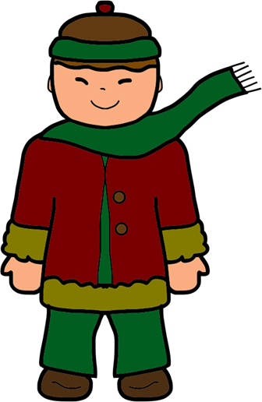
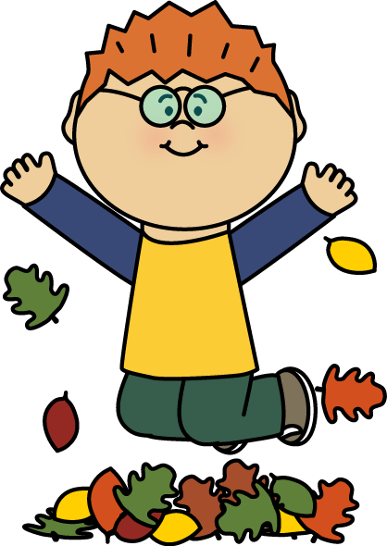
What Do Kids in Detroit Wear in January?
Courtesy of Publicdomainpictures.net
Courtesy of Pixabay.com
Courtesy of Mycutegraphics.com

Slide 6
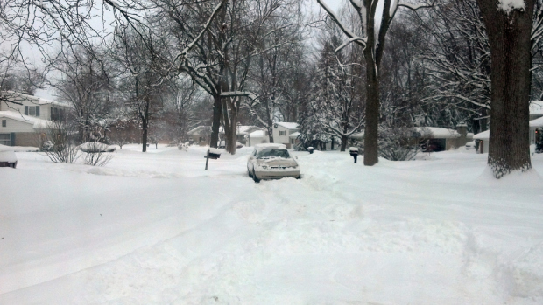
Detroit in January
Photo used with permission from BSCS
Think: Do Pomona and Detroit have the same or different weather in January?

Slide 7
Detroit Weather Calendar for January
Courtesy of BSCS
What do you predict? Will our Pomona weather calendar for January look the same as the Detroit weather calendar, or will it look different?

Slide 8
Let’s Compare Our Weather Calendars!
Did Pomona have any snowy days like Detroit in January?
Courtesy of BSCS

Slide 9
Let’s Compare Our Weather Calendars!
What do our temperature graphs for January show us about cool and cold days in Detroit and Pomona?
Compare the two graphs.
Think about the question.
Share your ideas and reasons with an elbow partner.
COOL COLD
DAYS DAYS

Slide 10
Let’s Compare Our Weather Calendars!
What do our temperature graphs for January show us about hot and warm days in Detroit and Pomona?
Compare the two graphs.
Think about the question.
Share your ideas and reasons with an elbow partner.
HOT WARM
DAYS DAYS

Slide 11
What Weather Patterns Did We Find?
Do Detroit and Pomona have the same or different weather patterns in January? What is your evidence?
Courtesy of Wikimedia.org
Use evidence from our weather calendars and temperature graphs to support your ideas.

Slide 12
The Same or Different?
Do Detroit and Pomona have the same or different weather patterns in January? What is your evidence?
Use one of these sentence starters:
We think that Pomona and Detroit have the same weather pattern. Our evidence is …
We think that Pomona and Detroit have different weather patterns. Our evidence is …

Slide 13
Let’s Summarize!
Our focus questions: How is weather the same or different in different places? How are the January weather patterns for Detroit and Pomona the same or different?
Detroit
Pomona
Courtesy of BSCS

Slide 14
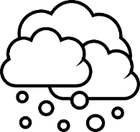
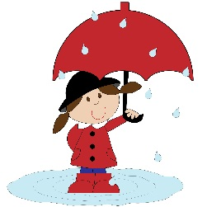
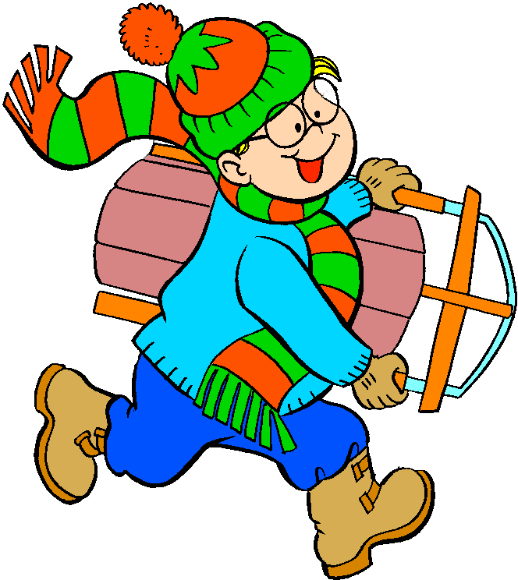
Let’s Summarize!
Draw pictures to show what the weather patterns are like in January for Detroit and Pomona.
Draw yourself outside in the clothes you’d wear. Show the temperature on a thermometer.
Detroit
Pomona
Courtesy of Publicdomainpictures.net, Cliparts.co, and Pixabay.com

Slide 15
Let’s Summarize!
The January weather pattern in Detroit is _____ and _____.
The January weather pattern in Pomona is _____ and _____.
Word Bank | Picture
Sunny
Snowy
Cool/Cold
Warm

Slide 16
Weather in Different Places
Today we learned that weather can be different in different places at the same time of year.
Courtesy of Cal Poly Pomona
Courtesy of Pixabay.com

Slide 17
Next Time
As weather detectives, we’ll predict weather patterns for a mystery city.
Courtesy of Cal Poly Pomona
Courtesy of Pixabay.com

